Slide 1
The W350 Project: A Precursor to Tokyo's Timber Future
Introduce the W350 Project as a foundational case study for advanced timber skyscraper construction.
Architecture concept
A striking architectural rendering of the W350 Project, showcasing its scale and timber construction. Include a small inset map of Japan highlighting Tokyo.
The W350 Project in Tokyo represents a pivotal step towards realizing the potential of mass timber construction for high-rise buildings. This ambitious initiative serves as a critical precursor, demonstrating the viability of constructing tall wooden structures that not only minimize environmental impact but also actively contribute to carbon sequestration.
The W350 Project is a proposed 350-meter, 70-story timber skyscraper in Tokyo.
It aims to utilize 185,000 cubic meters of wood, storing significant amounts of carbon.
This project is a key demonstration for Japan's engineering and sustainability goals in construction.
It sets a precedent for future large-scale timber constructions in urban environments.
Speaker note
Emphasize W350's role as a testbed for advanced timber technologies. Highlight its scale and carbon storage potential.
Slide 1 | Evidence: ORB-ee829ef2, ORB-75068dbf

Slide 2
Kumiki Reimagined: Traditional Joinery for Modern Resilience
Explain how traditional Kumiki joinery is adapted for structural integrity and seismic resilience in high-rise timber buildings.
Process concept
A split visual: one side showing historical examples of Kumiki joinery (e.g., in temples or traditional homes), the other showing a modern, digitally rendered application of Kumiki in a large-scale structural element of a skyscraper.
Traditional Japanese Kumiki joinery, a centuries-old technique of interlocking wooden pieces without nails or glue, is being revitalized for modern high-rise construction. This intricate system offers exceptional structural strength and flexibility, making it ideally suited for seismic resilience in earthquake-prone regions like Tokyo. Its adaptability allows for precise fabrication and potential disassembly, aligning with sustainable building principles.
Kumiki joinery uses precisely cut wooden components that interlock without fasteners.
This technique provides inherent structural strength and flexibility, crucial for seismic resistance.
Modern digital fabrication methods are enhancing the precision and scalability of Kumiki joints.
The absence of nails and glue simplifies disassembly and material reuse.
Speaker note
Highlight the ingenuity of Kumiki in providing strength and seismic resistance. Connect ancient craft with cutting-edge digital design.
Slide 2 | Evidence: ORB-09f74340, ORB-742b05bb

Slide 3
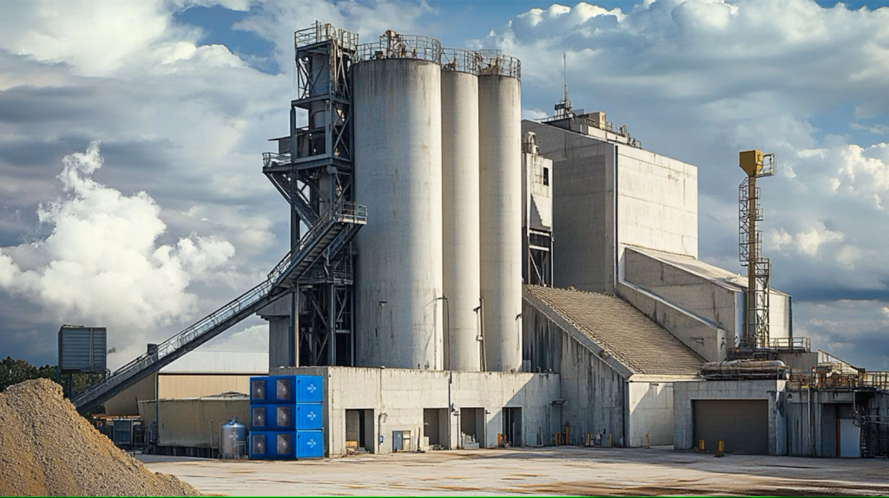
Carbon Capture: Turning Buildings into Carbon Sinks
Detail the integration of carbon-capture technologies to achieve carbon-negative construction.
Beyond timber's natural carbon sequestration, advanced carbon-capture technologies are being integrated to create truly carbon-negative building materials. By infusing captured CO₂ into materials like cement and steel, or enhancing timber's carbon storage, construction can shift from an emissions source to an environmental solution. This approach transforms CO₂ from a liability into a valuable resource for sustainable infrastructure.
Construction is a major contributor to global CO₂ emissions, with cement and steel being key culprits.
Integrating captured CO₂ into materials like cement and steel makes them carbon-negative.
Timber naturally sequesters carbon, and this can be further enhanced through material science.
This technology aims to transform buildings into active carbon sinks, mitigating climate change.
An infographic illustrating the process of carbon capture and its integration into building materials. Show CO₂ being ca
Speaker note
Explain that this goes beyond simply reducing emissions; it's about actively removing CO₂ from the atmosphere. Emphasize the dual benefit of material enhancement and carbon negativity.
Slide 3 | Evidence: ORB-673250da, ORB-2756d5a7

Slide 4
Material Synergy: Wood, Carbon Capture, and Structural Integrity
Analyze the synergistic benefits of combining Kumiki, mass timber, and carbon-capture technologies.
Architecture concept
A cross-section visualization of a timber skyscraper, highlighting the mass timber structure, the Kumiki joinery at key connection points, and callouts indicating where carbon-capture enhanced materials (e.g., concrete foundations, steel connectors) are used.
The true innovation lies in the synergy between traditional craftsmanship, advanced materials, and cutting-edge carbon technologies. Mass timber provides the structural volume for carbon storage, Kumiki ensures its robust assembly, and carbon capture technologies further enhance its environmental credentials, potentially even in supplementary materials like concrete or steel used in hybrid structures. This integrated approach maximizes both structural performance and carbon-negative potential.
Mass timber provides the primary carbon sequestration capacity in these structures.
Kumiki joinery ensures the structural integrity and seismic performance of the timber frame.
Carbon capture technologies can be applied to timber and other building components for enhanced carbon negativity.
Hybrid approaches may combine timber with carbon-negative concrete or steel for optimal performance.
Speaker note
This slide is about the holistic integration. Show how each element supports the others to achieve the overall goal.
Slide 4 | Evidence: ORB-ee829ef2, ORB-75068dbf, ORB-673250da

Slide 5
Tradeoffs and Technical Considerations
Examine the critical tradeoffs and technical challenges in implementing advanced timber skyscrapers.
Comparison concept
A comparison table or matrix outlining key tradeoffs. Columns could include: Material Sourcing, Fire Safety, Durability, Cost, Carbon Footprint. Rows would detail the pros and cons for timber skyscrapers vs. traditional concrete/steel.
While the potential is immense, the widespread adoption of W350-inspired timber skyscrapers necessitates a careful evaluation of tradeoffs. Key considerations include the sustainable sourcing of large volumes of timber, ensuring robust fire safety systems, and addressing the long-term durability and maintenance of timber structures in diverse climates and seismic conditions. Each of these factors requires rigorous engineering and material science solutions.
Sustainable and scalable sourcing of mass timber is crucial to avoid ecological impact.
Advanced fire-retardant treatments and compartmentation strategies are essential for safety.
Long-term durability studies are needed to ensure performance over the building's lifespan.
Maintenance protocols must be developed for large-scale timber structures.
Speaker note
Acknowledge the challenges openly. Frame them as engineering problems to be solved, not insurmountable barriers.
Slide 5 | Evidence: ORB-75068dbf, ORB-2756d5a7

Slide 6

Integration Risks and Regulatory Pathways
Identify potential integration risks and discuss the necessary regulatory frameworks.
Successfully integrating these advanced construction methods involves navigating significant risks, from supply chain complexities to evolving regulatory landscapes. Ensuring a consistent supply of high-quality mass timber, developing standardized prefabrication processes, and adapting building codes to accommodate tall timber structures are critical. Collaboration between industry, researchers, and governing bodies is vital to streamline these processes and foster innovation.
Supply chain reliability for mass timber and specialized components is a key risk.
Standardization of prefabricated elements is needed for efficient construction.
Building codes and regulations must be updated to support tall timber structures.
Gaining regulatory approval requires robust data on safety and performance.
Skilled labor availability for specialized joinery and construction is a consideration.
A flowchart illustrating the integration process, highlighting potential bottlenecks and decision points related to supp
Speaker note
Focus on the proactive steps needed to mitigate these risks. Emphasize the importance of collaboration and adaptive policy.
Slide 6 | Evidence: ORB-7e258466

Slide 7
Feasibility and Future Potential
Assess the overall feasibility and future potential of W350-inspired timber skyscrapers.
Timeline concept
A timeline graphic showing key milestones: W350 Project initiation, development of Kumiki adaptations, integration of carbon capture tech, regulatory approvals, and projected completion of early W350-inspired towers by 2026.
The W350 Project and its successors represent a highly feasible and increasingly attractive paradigm for future urban development. By harmonizing traditional craftsmanship with modern technology and a deep commitment to sustainability, Tokyo can lead the way in constructing carbon-negative high-rises. This approach not only addresses environmental imperatives but also offers aesthetic and functional benefits, paving the path for greener, healthier cities.
The technical and environmental case for W350-inspired skyscrapers is strong and growing.
Successful implementation in Tokyo can serve as a global model for sustainable urbanism.
Continued research and development will further enhance material performance and cost-effectiveness.
This construction method offers significant potential for reducing the built environment's carbon footprint.
Speaker note
Conclude with a strong, forward-looking statement about the transformative potential. Reiterate the key benefits: sustainability, resilience, and innovation.
Slide 7 | Evidence: ORB-ee829ef2, ORB-75068dbf, ORB-09f74340

Slide 8
Conclusion: Building a Carbon-Negative Tomorrow
Summarize the key takeaways and call to action for advancing timber skyscraper construction.
Closing concept
A powerful, aspirational image of a futuristic timber skyscraper integrated into a vibrant cityscape, perhaps with subtle visual cues of greenery and clean energy. Include contact information or a QR code for further engagement.
The convergence of traditional Japanese woodworking, advanced mass timber engineering, and innovative carbon-capture technologies presents a compelling vision for the future of urban construction. Tokyo's W350-inspired skyscrapers are not just buildings; they are carbon sinks, resilient structures, and testaments to sustainable innovation. Embracing this paradigm shift is essential for creating cities that are both environmentally responsible and architecturally inspiring.
W350-inspired timber skyscrapers offer a viable path to carbon-negative construction.
The integration of Kumiki joinery ensures structural integrity and seismic resilience.
Carbon capture technologies are key to maximizing environmental benefits.
This approach represents a significant step towards sustainable urban development globally.
Speaker note
Reiterate the core message: we can build taller, stronger, and more sustainably. Encourage collaboration and investment in this transformative approach.
Slide 8 | Evidence: reasoned synthesis

