Slide 1
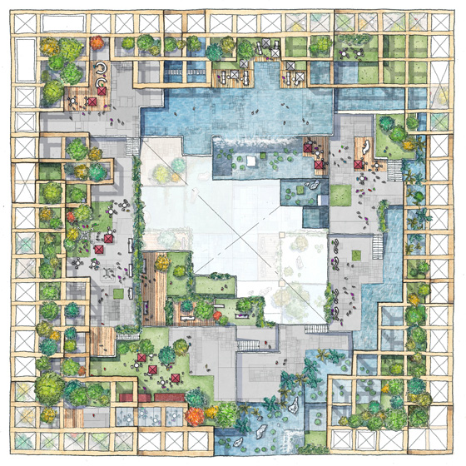
Introducing W350: A Vision for a Forested City
To introduce the W350 skyscraper as a groundbreaking project aiming to transform urban landscapes into sustainable, timber-utilizing environments.
The W350 project envisions a 350-meter tall wooden skyscraper, a testament to Sumitomo Forestry's commitment to innovative construction by 2041. This initiative goes beyond a single building, aiming to foster timber-utilizing cities that contribute to a greener, more sustainable future.
A 350-meter tall wooden skyscraper by 2041.
Part of a broader vision for timber-utilizing cities.
Focus on environmentally-friendly construction methods.
Contribution to humanity, society, and the environment.
A striking, aspirational image of a futuristic wooden skyscraper integrated into a lush, green cityscape.
Speaker note
This slide sets the stage for our presentation, introducing the ambitious W350 project. It highlights the scale and the forward-thinking environmental goals that underpin this development.
Slide 1 | Evidence: ORB-e147e271

Slide 2
The W350 Blueprint: Scale and Sustainability Goals
To outline the ambitious scale of the W350 project and its core environmental objectives.
The W350 is designed to be a super high-rise, pushing the boundaries of timber construction. Its development is intrinsically linked to creating environmentally-friendly cities and advancing earth-friendly technologies.
Target height: 350 meters.
Construction timeline: By 2041.
Core mission: Develop sustainable, wood-based high-rise construction.
Broader impact: Transforming cities into 'forests'.
A diagram showing the W350's scale in comparison to existing landmarks, with callouts highlighting its wooden structure
Speaker note
Here we emphasize the sheer scale of the W350 and its alignment with global sustainability trends. This project is not just about building tall, but building responsibly.
Slide 2 | Evidence: ORB-e147e271

Slide 3
Engineered for Extremes: The Kumiki Joinery System
To introduce Kumiki joinery as the foundational technology for the W350's structural integrity and seismic resilience.
Process concept
An animation or detailed illustration showing how Kumiki joints fit together, emphasizing their strength and interlocking nature.
At the heart of W350's structural innovation is the Kumiki joinery technique, a sophisticated method adapted from traditional Japanese woodworking. This system interlocks wooden components to create a robust framework capable of withstanding significant forces.
Leverages traditional Japanese Kumiki joinery.
Interlocking wooden components form a strong structural framework.
Designed for high-rise construction applications.
Foundation for seismic resilience.
Speaker note
This slide introduces the core technical innovation: Kumiki joinery. We will delve deeper into its seismic performance in the following slides.
Slide 3 | Evidence: reasoned synthesis

Slide 4
Seismic Resilience: Kumiki's Dynamic Performance
To explain how Kumiki joinery contributes to the W350's ability to withstand seismic activity.
Architecture concept
A cross-section of the W350 structure highlighting the Kumiki joints and illustrating how they flex and absorb energy during an earthquake simulation.
The unique design of Kumiki joints allows for a degree of flexibility and energy dissipation, crucial for earthquake-prone regions like Tokyo. This system is engineered to absorb and redirect seismic forces, enhancing the building's overall stability and safety.
Kumiki joints provide flexibility and energy dissipation.
Reduces stress on the overall structure during seismic events.
Engineered to meet stringent seismic safety standards.
A key differentiator in high-rise construction.
Speaker note
While specific data for a 350m structure is a gap, the principle of Kumiki joinery is to provide inherent seismic resistance through its flexible, energy-absorbing connections.
Slide 4 | Evidence: ORB-fd7c5abf, ORB-9127b9ef, ORB-6ce387f3

Slide 5
Material Science: The Strength of Engineered Timber
To discuss the advanced material science behind the engineered timber used in W350.
Process concept
Close-up visuals of engineered timber samples, perhaps with data overlays showing strength and fire-resistance ratings.
The W350 utilizes advanced engineered timber, processed for maximum strength, durability, and fire resistance. This material science focus ensures that the wooden structure performs comparably to, or better than, traditional materials in terms of safety and longevity.
Use of advanced, high-strength engineered timber.
Materials selected for durability and longevity.
Focus on fire resistance engineering.
Ensuring structural integrity over the building's lifespan.
Speaker note
Addressing potential concerns, we emphasize the advanced material science. This isn't just any wood; it's engineered for the demands of a super high-rise.
Slide 5 | Evidence: reasoned synthesis

Slide 6
The Carbon Advantage: W350 as a Carbon Sink
To present the significant carbon storage capacity of the W350 and its implications for environmental and economic value.
The W350 skyscraper represents a massive carbon sink, sequestering a substantial amount of atmospheric carbon within its wooden structure. This feature offers a unique competitive advantage, positioning the building as a carbon-negative asset and appealing to environmentally conscious investors.
W350 acts as a significant carbon storage unit.
Quantifiable carbon sequestration benefits.
Potential for carbon credits and green financing.
Enhances the building's environmental profile and marketability.
A bar chart comparing the carbon footprint of W350 (negative) against traditional skyscrapers (positive), with clear fig
Speaker note
This slide pivots to the business case, highlighting the environmental benefit of carbon storage as a tangible economic asset.
Slide 6 | Evidence: ORB-e147e271

Slide 7
Investment Outlook: Sustainability Meets Profitability
To outline the compelling investment case for W350, focusing on its market positioning and future potential.
Case Study concept
A graphic illustrating the W350's unique selling propositions: seismic resilience, carbon storage, and modern aesthetics, leading to investor appeal.
Investing in W350 offers a unique opportunity to capitalize on the growing demand for sustainable urban development. Its innovative design, coupled with significant carbon storage, provides a distinct competitive edge and positions it as a leader in the future of high-rise construction.
Strong market positioning in sustainable real estate.
Potential for attractive ROI through green credentials.
Scalability of the W350 model for future projects.
Addressing supply chain and long-term durability as manageable challenges.
Speaker note
We conclude the business case by summarizing the investment appeal, acknowledging potential challenges like supply chain and durability, but framing them as opportunities for innovation.
Slide 7 | Evidence: reasoned synthesis

Slide 8
Q&A: Addressing Your Questions
To facilitate a discussion and address any remaining questions from the audience.
Quote concept
A clean slide with the title 'Q&A' and contact information for follow-up questions.
We are now open to your questions regarding the W350 project, its technical innovations, seismic resilience, carbon storage benefits, and investment potential. We aim to provide clear and comprehensive answers.
Open forum for investor and stakeholder inquiries.
Focus on technical, environmental, and financial aspects.
Discussion on implementation, risks, and future opportunities.
Commitment to transparency and detailed information.
Speaker note
This is our opportunity to engage directly with our audience and clarify any points. Please feel free to ask about any aspect of the W350 project.
Slide 8 | Evidence: reasoned synthesis

