Slide 1

UR5 Robotic Arm
Presented by: Mahdi Chalaki

Slide 2
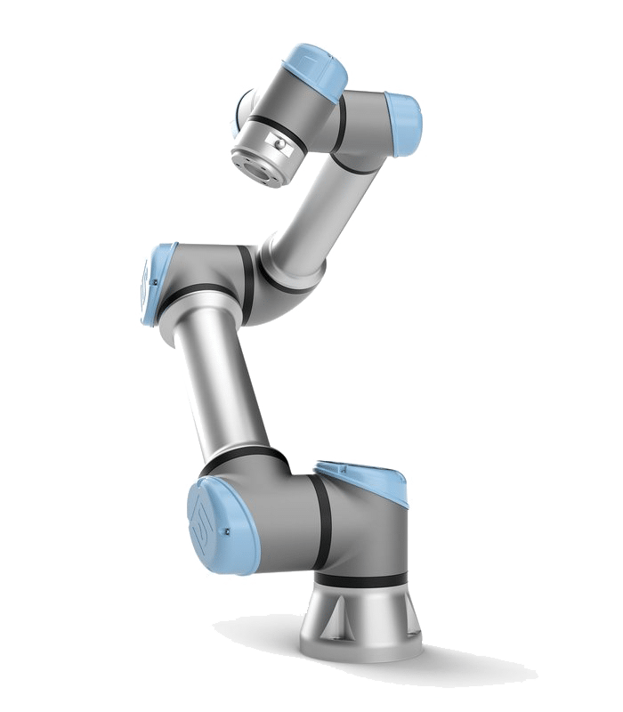
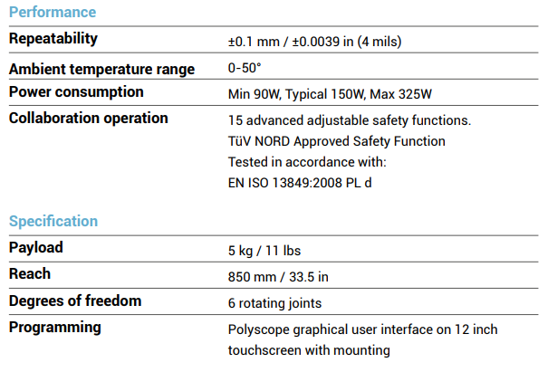
Introduction
Weight 20.6kg / 45.4 lbs

Slide 3
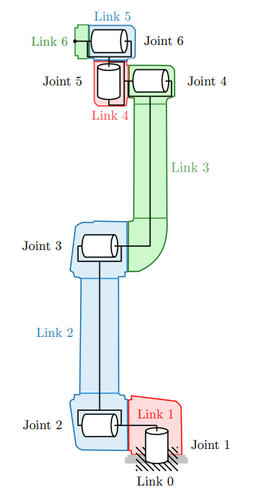
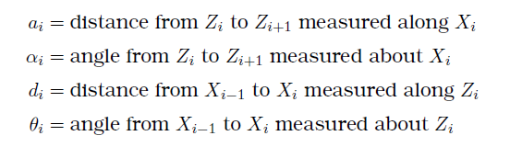
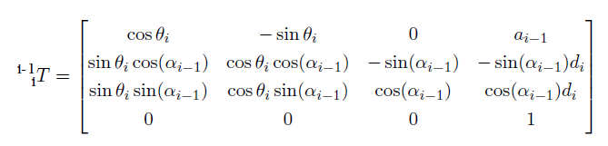
Forward Kinematics
Source: K. Kufieta, ”Force Estimation in Robotic Manipulators: UR5 as a case study”

Slide 4
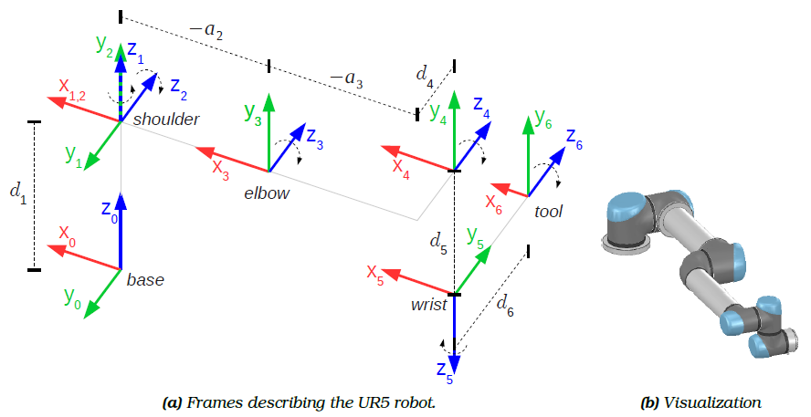
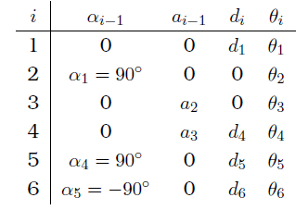
DH parameters

Slide 5
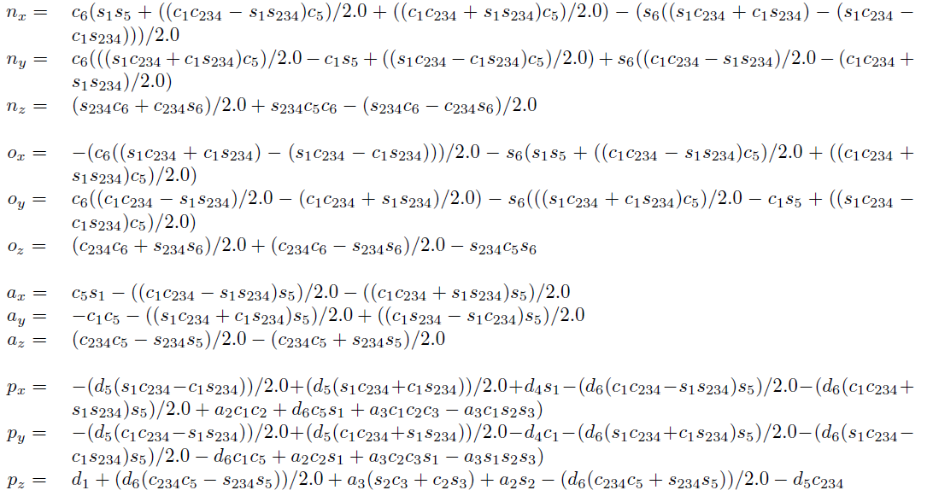
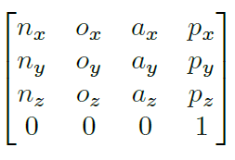
Forward Kinematics
1
6
T =

Slide 6
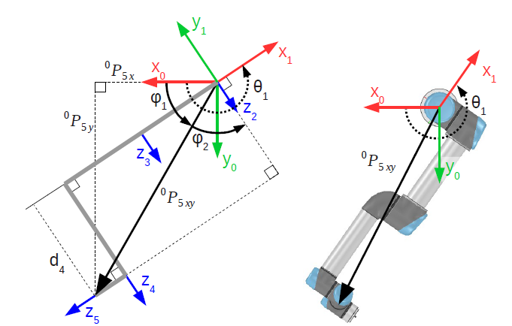


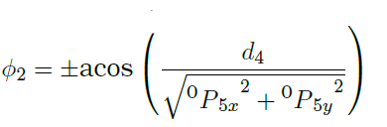
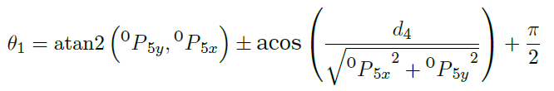
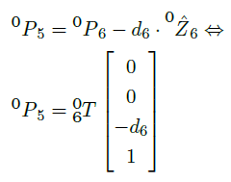
Inverse Kinematics
Finding $θ_{1}$
we first determine the location of frame 5 (the wrist frame) in relation to the base frame.
The two solutions correspond to the shoulder being “left” or “right”.

Slide 7
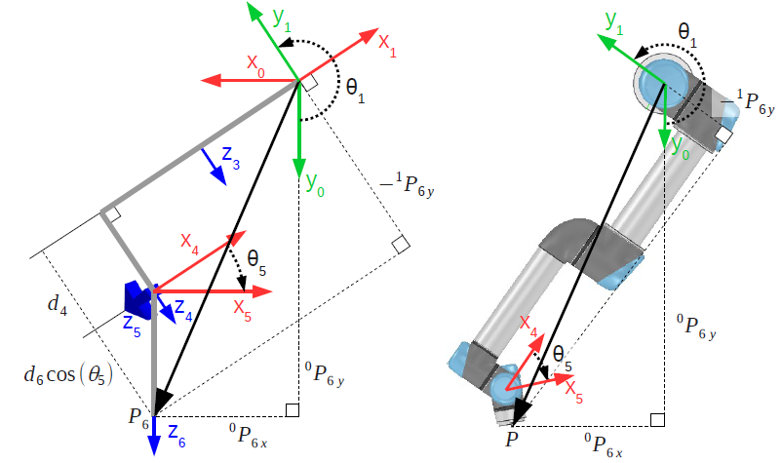


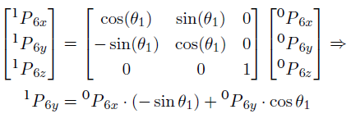
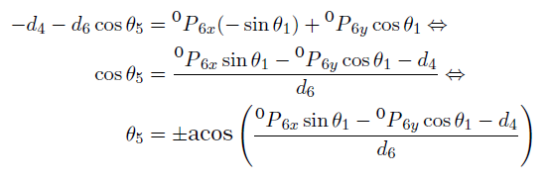

Inverse Kinematics
Finding $θ_{5}$
1
6
the y-component of only depends on $θ_{5}$
P
These correspond to the wrist being “up” or “down”

Slide 8
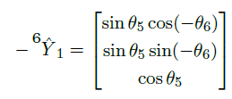
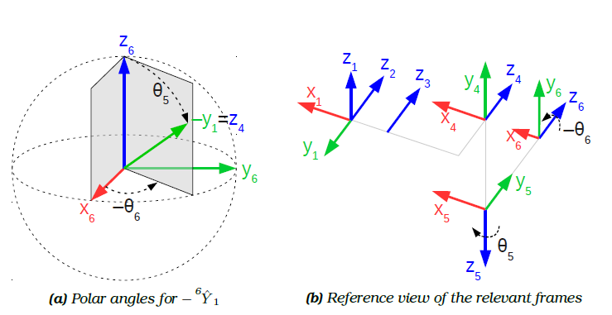




Inverse Kinematics
Finding $θ_{6}$
${}_{6}^{1}{\hat{Y}}$ will only depend on $θ_{5}$ and $θ_{6}$
${}_{6}^{1}{\hat{Y}}$s given as a rotation of $θ_{6}$in the x-y plane of frame O

Slide 9
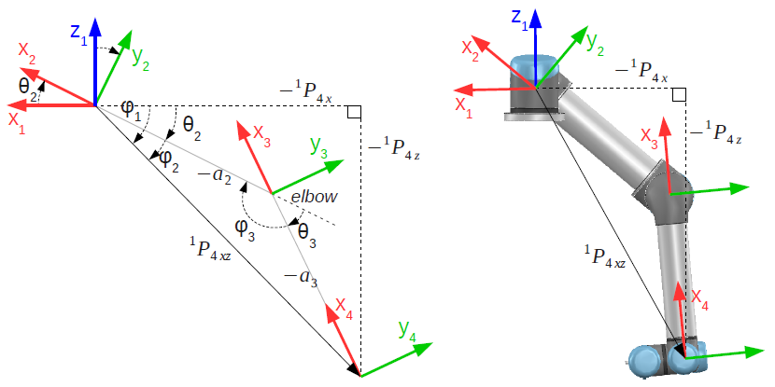


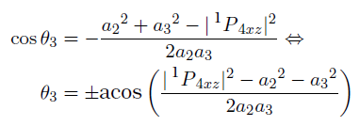

Inverse Kinematics
Finding $θ_{3}$
Three remaining joints form a planar 3R-manipulator

Slide 10




Inverse Kinematics
Finding $θ_{2}$

Slide 11



Inverse Kinematics
Finding $θ_{4}$
$θ_{4}$is defined as the angle from X3 to X4 measured about Z4, and can easily be derived from the last remaining transformation matrix,
To sum up, a total of 8 solutions exist in general for the general inverse kinematic problem of the UR5:

Slide 12
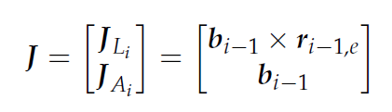
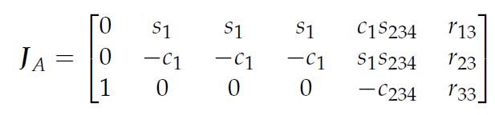
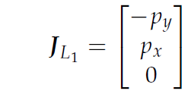
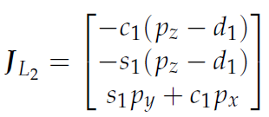
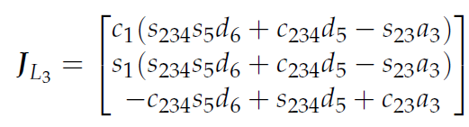
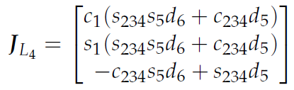
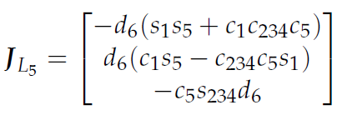
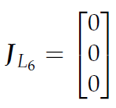

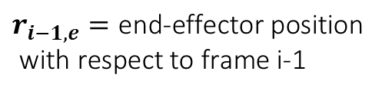
Jacobian
$$b_{i−1}={}_{i−1}^{0}{\hat{z}}$$
$$r_{i−1,e}=\text{end}\text{−}\text{effector} \text{position}$$
$\text{with} \text{respect} \text{to} \text{frame}$ i-1

Slide 13
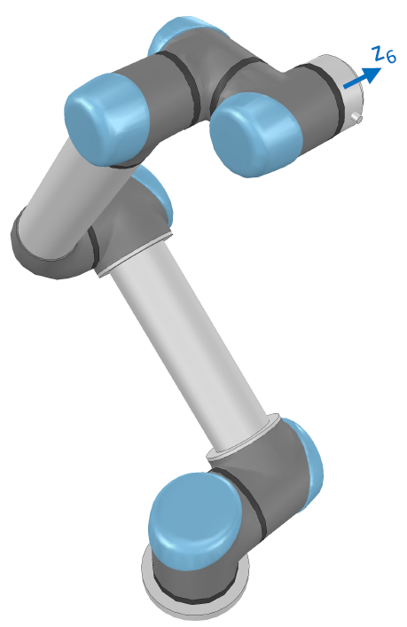



Jacobian
Shoulder singularity:
$$c_{2}a_{2}+c_{23}a_{3}+s_{234}d_{5}=0$$
Wrist singularity:
$$s_{5}=0$$
Elbow singularity
$$s_{3}=0$$
Example of shoulder singularity

Slide 14
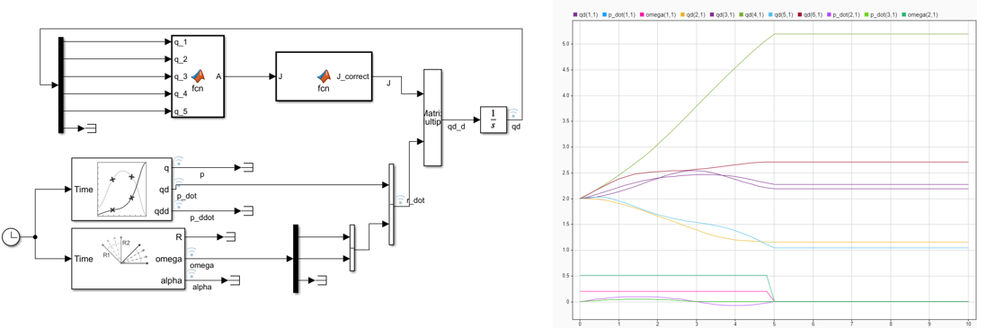


Trajectory in Cartesian space
$$\dot{q}=J_{DLS}\dot{r}$$
$$J_{DLS}=J^{T}{\left(JJ^{T}+μ^{2}I\right)}^{−1}$$

Slide 15
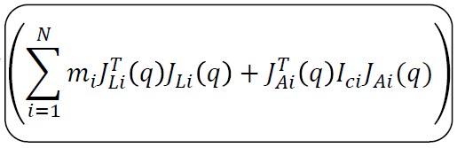
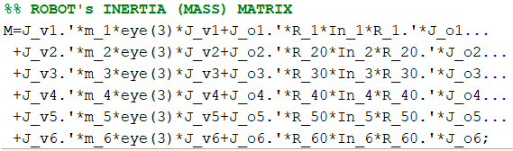
Dynamics
Mass Matrix ($M$)

Slide 16
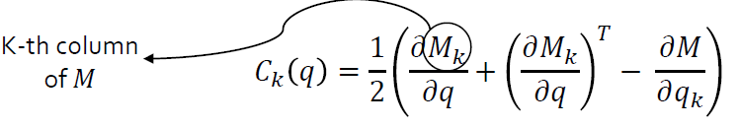
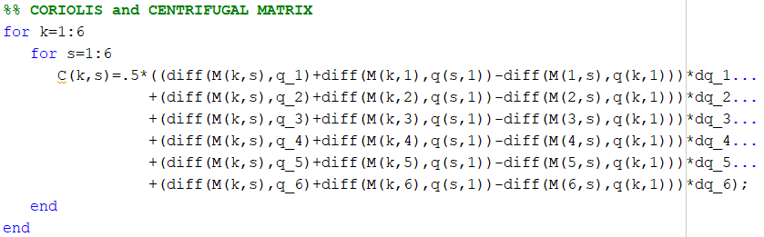
Dynamics
Coriolis and Centrifugal Matrix ($C$)

Slide 17
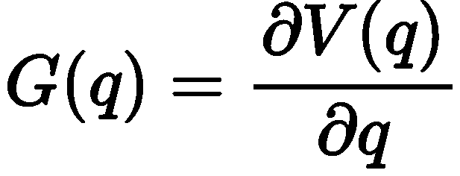
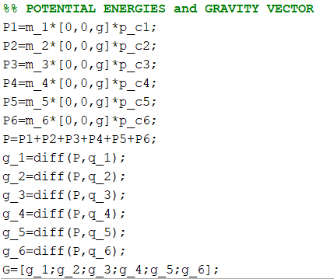
Dynamics
Gravity Vector ($G$)

Slide 18

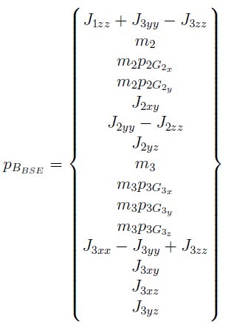
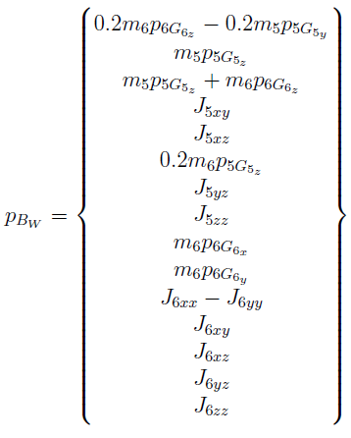
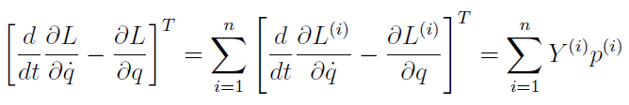
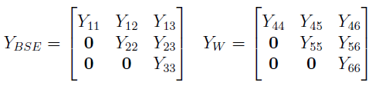
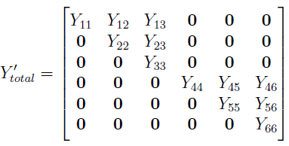
Dynamics
Linear Parametrization (Based on a work done by Gabriele Porcelli)
For computational limit, the robot links are divided into two groups: Base, Shoulder, Elbow (BSE) and the Wrist group (W)

Slide 19
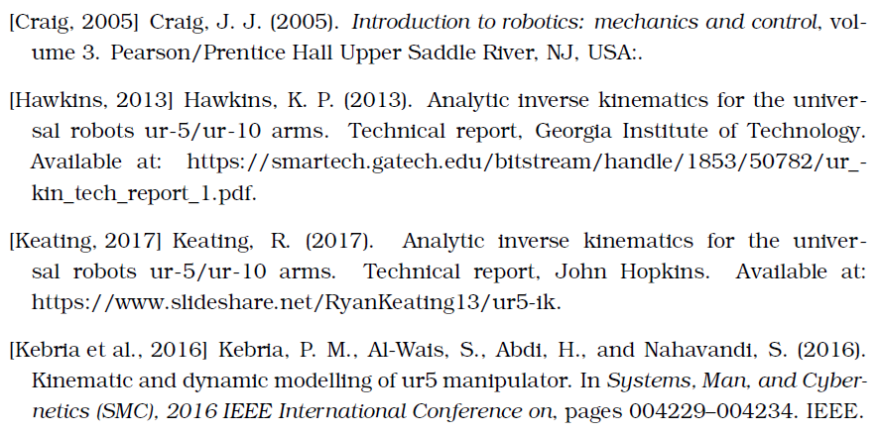
References

Slide 20
Thanks for your attention

Slide 21
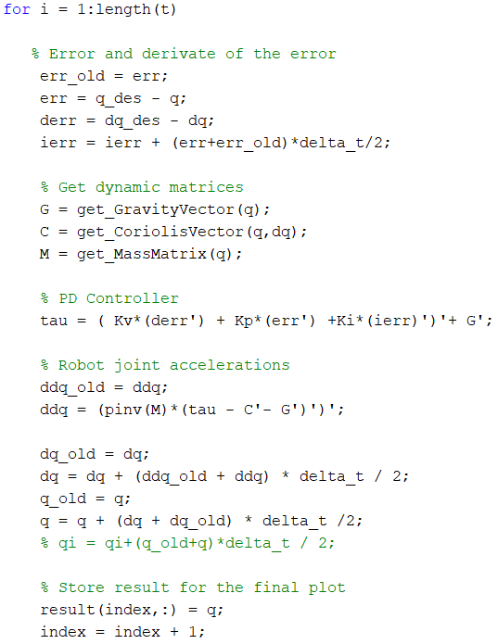
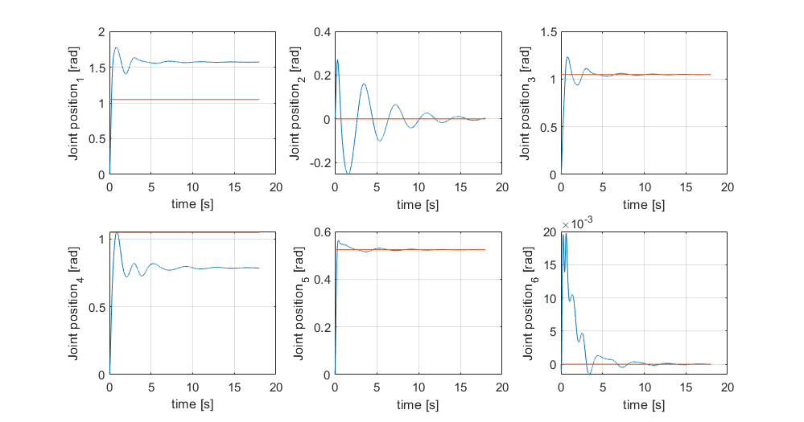
Regulation
PID controller

