Slide 1
A survey on intelligence-endogenous network: Architecture and technologies for future 6G
Supervisor: dr. eslami
Mohammad mahdi karimi
2024

Slide 2
Abstract:
With the maturity of 5G technology and global commercialization, scholars in institutions and industrial circles began to research 6G technology. An important innovation of 6G technology is to integrate artificial intelligence (AI) technology and communication technology to build a highly endogenous intelligent communication network. This paper investigates the process of AI technology introduced into the field of communication and reviews the use cases of the simulation and application of AI algorithms being discussed in 3GPP meetings in industry circles. In this research report, we first investigate the progress of AI technology in 5G network architecture and then discuss the requirements of endogenous intelligent 6G networks, which leads to the possible network architecture. This work aims to provide enlightening guidance for subsequent research of intelligence-endogenous 6G network.

Slide 3
Key words:
5G; 6G; intelligence-endogenous; artificial intelligence; objective; network

Slide 4
Introduction
intelligence. 6G will further expand from serving people and things to supporting the efficient interconnection of agents, and become a link between the real physical world and the virtual digital world, which will eventually help human society realize the beautiful vision of intelligent connection of all things. To realize this vision, it is needed to consider how to integrate AI technology at the beginning of designing 6G architecture, to realize the deep integration of AI and wireless networks and build a complete intelligent system. In recent years, how to build an AI wireless communication network has become a hot topic in academia and industry. Machine learning and neural network are the key technologies to realize AI based on a large amount of data, generalized models, and enhanced computing power. Deep learning and reinforcement learning (RL) have rich model parameters. The performance of the model obtained through massive data training can surpass that of the model by the traditional design method. Using high-quality data in actual scenes to establish the data-driven model can avoid the deviation of manual model. Model training and reasoning need the support of great computing power[1–3] . With the indepth application of AI, how to realize AI-enabled new wireless network architecture is also a research hotspot.
Since the birth of artificial intelligence (AI), its theory and technology have become increasingly mature, and it has been applied in more fields. It has achieved great success in pattern recognition, automatic engineering, knowledge engineering, and other fields, and will empower all fields of social life in the future. 6G will realize the transition from the interconnection of all things to the intelligent connection of all things based on 5G. To realize this transition, 6G network needs to provide ubiquitous intelligent connections between devices at any time and anywhere, build an intelligent interconnected world, and provide AI capabilities and services required for various applications. On the other hand, by endowing 6G network with AI capability, we can build a highly intelligent wireless network and promote the self-evolution ability of the network through 6G omnipresent sensing capability. Facing 2030 and the future, human society will enter the era of

Slide 5
The existing wireless network architecture cannot support AI nativity and lacks the operating environment and basic plug-ins of native AI algorithms. In addition, with the blowout of new vertical industry applications, wireless network resource utilization is low, service matching is poor, and differentiated real-time service requirements cause a sharp increase in the complexity of resource management and control. In the future, AI technology will enable mobile communication systems to build a new intelligent network architecture by combining wireless architecture, wireless data, wireless algorithms, and wireless applications. AI native 6G network not only takes AI technology as an optimization tool, but also realizes AI native new wireless network architecture and air interface technology. AI native 6G network realizes the intelligent management and deployment of access network and core network elements through enabling network architecture and supports intelligent crossdomain management of multi-type resources.
The AI native new air interface technology can support the intelligent scheduling of wireless resources by calling AI algorithm, realizing the real-time service demand matching, and considering the AI demand in the design of interface protocol stack[6] . At the beginning of the design of 6G network communication protocol, the characteristics of different AI nodes in the process of realizing various applications are considered, to realize the resource allocation suitable for AI applications. Further, integrating AI capabilities into 6G network can fully connect the data and computing power scattered at all edge nodes, realize the most effective sensing, allocation of communication, and computing resources, build a super huge neural network between the physical world and the digital world, and provide intelligent capabilities anytime, anywhere, and everywhere for the development of human society in the future. By investigating the research progress of AI algorithms and 6G network architecture, this paper summarizes the commonly used AI algorithms in beyond 5G (B5G) network, analyzes the 6G network architecture requirements and logical architecture proposed to realize AI algorithms.

Slide 6
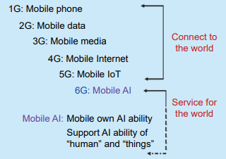
Communication network and artificial intelligence
The development from 1G to 5G has experienced great technological changes, as shown in Fig. 1. The first generation communication technology is analog communication technology, which can make simple voice calls. The second generation mobile communication system 2G has improved the digital voice transmission technology, and began to introduce data services (short message services). The third generation mobile communication system 3G has introduced CDMA technology, which can better realize wireless roaming around the world, and process images, music, video streaming, and other media forms, achieving seamless coverage. 4G communication technology enables users to access the Internet to the theoretical 100 Mbit/s, cancels the circuit domain of the communication network, and adopts an all-IP network architecture with only packet domain.
The performance improvement of 5G communication is limited to multiple aspects, including limited spectrum resources, the emergence of new services, and communication security. To solve these problems, 6G communication technology has proposed new technologies, including enhanced wireless air interface technology, terahertz, and visible light communication technology, integration of key communication technologies crossing domains, and new network with endogenous intelligence

Slide 7
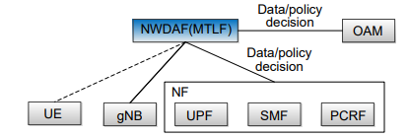
5G network architecture for AI
With the gradual maturity of artificial intelligence theory, it has gradually penetrated the field of communication. For example, 3GPP standard organization proposed to introduce AI function into network data analytics function (NWDAF), which is the core network element of the control plane, as shown in Fig. 2. It mainly helps to realize the automated network operation and maintenance by introducing AI at the network control level, to improve the performance of existing communication systems and users’ service experience quality by using AI’s ability to intelligently control network parameters. The main functions of NWDAF include data collection, model training, and reasoning (data analysis).
5G technology and other basic technologies such as artificial intelligence, edge computing, computer vision, and sensing are organically and efficiently integrated to provide practical means for the digital transformation of vertical industries. In addition to the newly added AI network elements in the 5G communication basic network, 5G network designs different network architectures for different industry applications, and there are also many industry application solutions related to AI. Song et al. proposed the architecture of centralized AI enabled IoT networks.

Slide 8
Artificial intelligence algorithm applied to 5G network
In the three technical application scenarios of eMBB, URLLC, and MMTC for 5G network defined by ITU, twelve key technologies are involved, including largescale antenna array, new network architecture, new multiple access technology, ultra-dense networking technologies, device-to-device (D2D) communication technology, etc. The scale of 5G network is much larger than legacy network, and its network architecture is more complex. The traditional methods of manual configuration of network parameters and formulation of network optimazation strategies based on expert experience cannot meet of dynamic service needs. The combination of communication technologis and AI can effectively improve the intellectualization of 5G network, making it possible for the network to automatic generate network intelligent configuration parameters and formulate intelligent management strategies.
At the communication network side, AI technology can be applied to optimize intelligent base station coverage, heterogeneous network access control, network slice resource management, network operation and maintenance, network security protection, etc. Multiple AI algorithms are used, including supervised machine learning, unsupervised machine learning, strong chemical learning, and other AI algorithms. The above algorithms are summarized in Table 1. At the communication terminal, AI technologies can be used in multiple-input multiple-output (MIMO) signal detection, channel coding, channel equalization, channel estimation and other aspects. The algorithms used include AMP algorithm, deep neural network (DNN), etc.

Slide 9
Architecture of intelligence endogenous 6G network
Facing the evolution of future mobile networks, network management needs to move forward from the local intelligent operation of cost reduction and efficiency increase to high-level autonomous end-toend network. However, the research and development of AI use cases based on the B5G network architecture described in Section 2.2.2 generally adopts the methods of patching, plug-in, chimney and so on, which lacks a unified framework. AI model application effect lacks effective verification and quality assurance means. AI model training and analysis reasoning are decoupled, and the effect verification can only be carried out after the event, which has a great impact on the existing network and cannot achieve a high level of network autonomy, pre-verification of AI effect, online evaluation, and automatic closed-loop rapid optimization.

Slide 10
In addition, to implement the AI algorithm described in Section 2.2.2 in the above architecture, AI model training requires a large amount of sample data, and it is difficult to collect data centrally, resulting in large network transmission overhead, long iteration and update cycle of AI model, large training overhead, slow convergence, poor generalization of AI model, etc. One of the important driving forces of endogenous intelligence is to support the digital intelligence transformation of thousands of industries, explore new intelligent service models, and provide 6G new scenarios and capabilities for users in various vertical industries. On the premise of protecting the data privacy of vertical industries and keeping the data from leaving the park, the 6G new system needs to be able to provide distributed and regional computing power, platforms, and services, and realize the flexible supply of “anytime, anywhere” intelligent capabilities on demand. Compared with traditional cloud AI service providers, it can provide higher real-time and better intelligent capabilities and services. In addition, endogenous intelligence can also provide inter-industry federal intelligence, and realize cross-domain and cross-industry intelligence integration and digital intelligence sharing.

Slide 11
Logical architecture and characteristics of endogenous intelligent network
An intelligent endogenous network has the following architectural characteristics: (1) Endogenous selfconstruction, which realizes the endogenous selfconstruction of capabilities and services through the closed-loop process of “perception, training, verification, reasoning, execution”; (2) Intelligent ability, including relevant data ability and computing ability, while the data ability and computing ability mentioned separately may not be strongly related to intelligent ability; (3) Embedded intelligence, which can provide intelligent services for the system itself, and the system can obtain services without capacity opening; (4) Collaborative control and scheduling management, which emphasize real-time collaborative control and non-real-time/semi real-time scheduling management, respectively. Collaborative control can be QoS-oriented and task-centric to respond quickly to internal and external requirements; (5) Endogenous security, which runs through the endogenous security foundation of the whole network, and provides endogenous security perception, defense, and prevention functions for various functions and resources of the system. These features can be described.

Slide 12
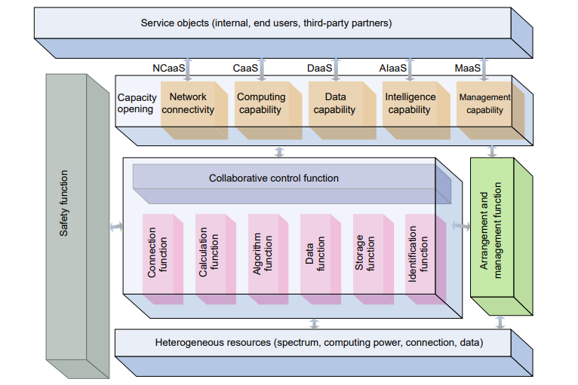
AI enabled 6G mobile network
The endogenous AI network architecture enables the integration of advanced artificial intelligence capabilities with the upcoming 6G mobile network. From this perspective, 6G radio network can be regarded a mobile AI network mainly considering the following aspects: the incredibly high data transfer speeds of 6G enables real-time processing of vast amounts of data;the near-zero latency of 6G allows AI applications to deliver instant responses and real-time interactions; the near-zero latency of 6G allows AI applications to deliver instant responses and real-time interactions; 6G network enable not only to connect billions of devices but also enable AI-driven communication between them; AI can bolster 6G network security by identifying and mitigating potential threats in real-time; AI algorithms within the 6G network can automate tasks, optimize network performance, and enhance user experiences; AI algorithms can analyze user behavior and preferences to offer personalized services and content in real-time.
In wireless communication, many problems cannot be solved by establishing intuitive mathematical models or easily finding the optimal solution. However, data-driven AI algorithms utilize a large amount of data and can solve communication problems that cannot be modeled through AI model training. Model-driven AI algorithms can assist in building mathematical models and ultimately find the optimal solution. The AI algorithm with powerful feature extraction and fast search for optimization solutions can be applied to the optimization design of multiple 6G core technologies. This includes AI-assisted communication physical layer optimization and AIassisted communication high-level optimization.

Slide 13
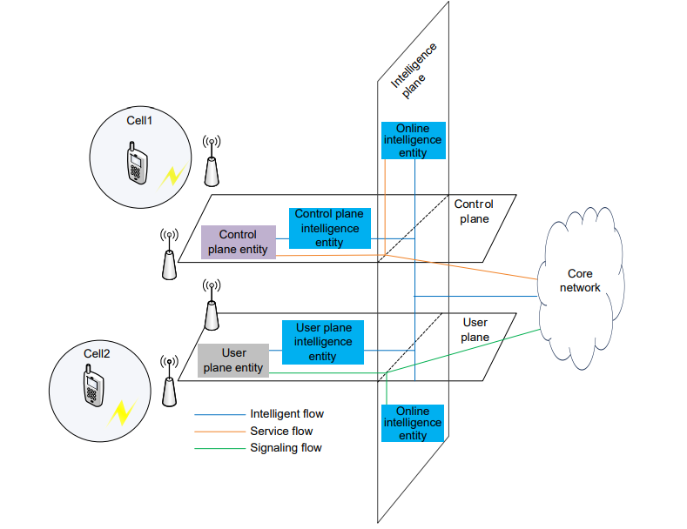
Use case based on endogenous intelligent network
The above introduces the endogenous intelligent network architecture diagram of a 6G network, based on which The network can execute artificial intelligence algorithms to achieve a certain function. This section provides an example of wireless channel prediction using GAN-LSTM as shown in Fig. 9[73] . The predictive channel model can eliminate the abnormal data of the channel impulse response (CIR) in the delay, thereby obtaining data that is more similar to the channel distribution in the real scenario.
Due to the influence of some environmental factors, human factors, and channel sounder systems error during the measurement campaigns, CIR is affected by noise in certain delay periods, where CIR is far from the true channel distribution characteristics.

Slide 14
Conclusion
This paper introduces the background of 6G network with endogenous intelligence. This article first reviews the evolution of communication technology from 1G to 6G, and then summarizes the problems that can be resolved through AI models in 5G networks and the network architecture solutions by which introduce AI functions into 5G networks. It analyzes the drawbacks of existing 5G+AI network architecture by using external and patched network solutions, and the necessity of intelligence-endogenous 6G network architecture. Then, the functional structure and logical architecture diagram of the intelligence-endogenous 6G network in the industry were presented, as well as some physical network architecture proposed for in industry circles. Finally, an example of channel prediction in the 6G network is provided to illustrate the application of AI in the intelligence-endogenous 6G network. This survey may serve as an enlightening guideline for future research works in intelligent 6G communications.

Slide 15
References
K. David and H. Berndt, 6G vision and requirements: Is there any need for beyond 5G, IEEE Veh. Technol. Mag., vol. 13, no. 3, pp. 72–80, 2018.
D. Wang, W. Guan, H. Zhang, and K. Long, 6G network technology based on artificial intelligence, Radio Commun. Technol., vol. 47, no. 6, pp. 724–731, 2021.
A. F. M. S. Shah, A. N. Qasim, M. Ali Karabulut, H. Ilhan, and M. B. Islam, Survey and performance evaluation of multiple access schemes for next-generation wireless communication systems, IEEE Access, vol. 9, pp. 113428–113442, 2021.
T. Alladi, V. Kohli, V. Chamola, F. R. Yu, and M. Guizani, Artificial intelligence (AI)-empowered intrusion detection architecture for the Internet of vehicles, IEEE Wirel. Commun., vol. 28, no. 3, pp. 144–149, 2021.
S. C. Gupta, P. Gandotra, B. Lall, H. Saran, and K. Sabnani, Layered architecture and virtualization for 5G slicing, in Proc. IEEE 4th 5G World
China Mobile, 6G wireless endogenous AI architecture and technology white paper, http://cmri.chinamobile.com/ insight/technology/7325.html, 2022
3GPP, Study on enhancement for data collection for NR and EN-DC, 3GPP TS37.817, 2022.
L. Li, Y. Yi, C. Zhang, X. You, and Y. Huang, Interactive methods, devices, equipment, and storage media for wireless networks, CN112383927A, April 25, 2023.
P. Jaraut, G. C. Tripathi, M. Rawat, and P. Roblin, Independent component analysis for multi-carrier transmission for 4G/5G power amplifiers, in Proc. 89th ARFTG Microwave Measurement Conf. (ARFTG), Honololu, HI, USA, 2017, pp. 1–4.

