Slide 1

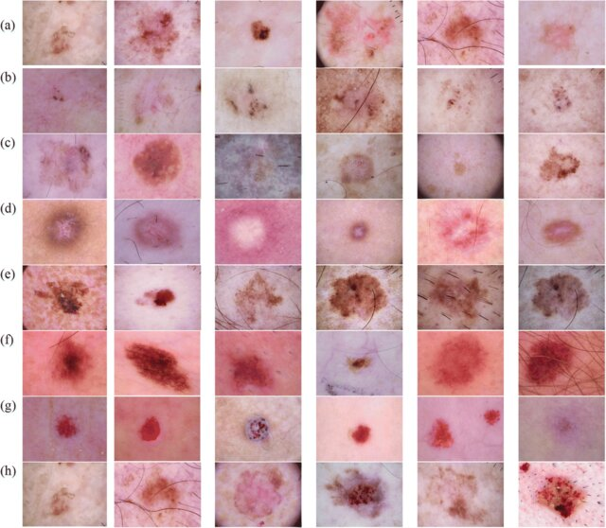


Cad Project
Binary and Multi-class Classification of Skin Lesion using Deep Learning
Prepared By:
Mahdi Islam
Musarrat Tabassum

Slide 2
Skin Lesion Dataset
Binary Dataset
Lesion | Images
 | Train | Validation
Nevus | 7725 | 1931
Others | 7470 | 1865
Total | 15195 | 3796
Balanced Dataset
1

Slide 3

Skin Lesion Dataset
Multi-class Dataset
Lesion | Images
 | Train | Validation
BCC | 1993 | 498
Melanoma | 2713 | 678
SCC | 376 | 94
Total | 5082 | 1270
Imbalanced Dataset
2

Slide 4
Flowchart
Training Set
Data Augmentation
Model Training and Validation
Final Prediction
Validation Set
Image Preprocessing
Test Set
Figure 1: Flowchart
3

Slide 5
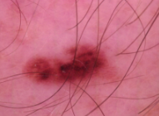
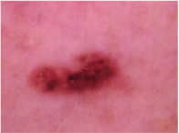
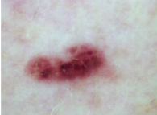
Image Preprocessing
Hair Removal
Blackhat Filter using multiple oriented structural element + Threshold
Hair Removal
Color Normalization
Achieve consistent color balance across images to minimize lighting and color variation effects.
Color Normalization
4

Slide 6
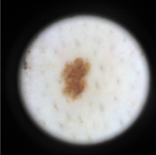
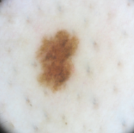
Image Preprocessing
Region of Interest (ROI)
search for the first and the last position in the diagonal of the image where the mean value of the pixels is higher than the threshold.
ROI
Normalization
the per-channel mean and standard deviation of each dataset by preprocessing each image, iteratively computing the mean and squared mean values to derive the dataset's normalization parameters and for giving normalized input to neural network.
5

Slide 7
Data Augmentation
Data Augmentation
Resize
Horizontal Flip
Color Jittering
Rotation
6

Slide 8
Model Implementation
Single Models Implemented
EfficientNetB0
EfficientNetB3
EfficientNetB4
Swin Tiny
Swin Large
Ensemble of the models
7

Slide 9
Training Configuration
Configurations | Binary Class | Multi-Class
Framework | PyTorch | PyTorch
Optimizer | Adam | Adam
Batch Size | 16 | 16
Transfer Learning | ImageNet | ImageNet
Learning Rate | 1e-4 | 1e-4
Loss Function | Binary Cross Entropy | Weighted Cross Entropy
Early Stopping Criteria | Patience =12 | Patience =12
8

Slide 10

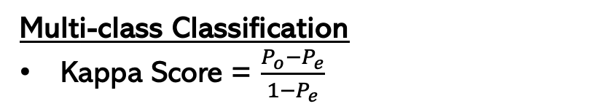
Evaluation Metric
Binary Classification
Accuracy = $\frac{TP+TN}{TP+FP+TN+FN}$
Multi-class Classification
Kappa Score = $\frac{P_{o}{−P}_{e}}{{1−P}_{e}}$
True Labels
True Labels
 | TN | FP | TN
 | FN | TP | FN
 | TN | FP | TN
 | TP | FP
 | FN | TN
mel
bcc
scc
nevus
others
scc
Nevus
nevus
Predicted Labels
Predicted Labels
bcc
Others
others
mel
1
9

Slide 11
Training: Class Imbalance
Weighted Cross Entropy
-Computed class weights are fed to the model to address class imbalance of multi-class challenge.
mel = 0.6244
bcc = 0.85
scc = 4.5053
Weighted Random Sampler -Assigns higher sampling weights to minority class, ensuring balanced class distribution in each training batch.
1
10

Slide 12
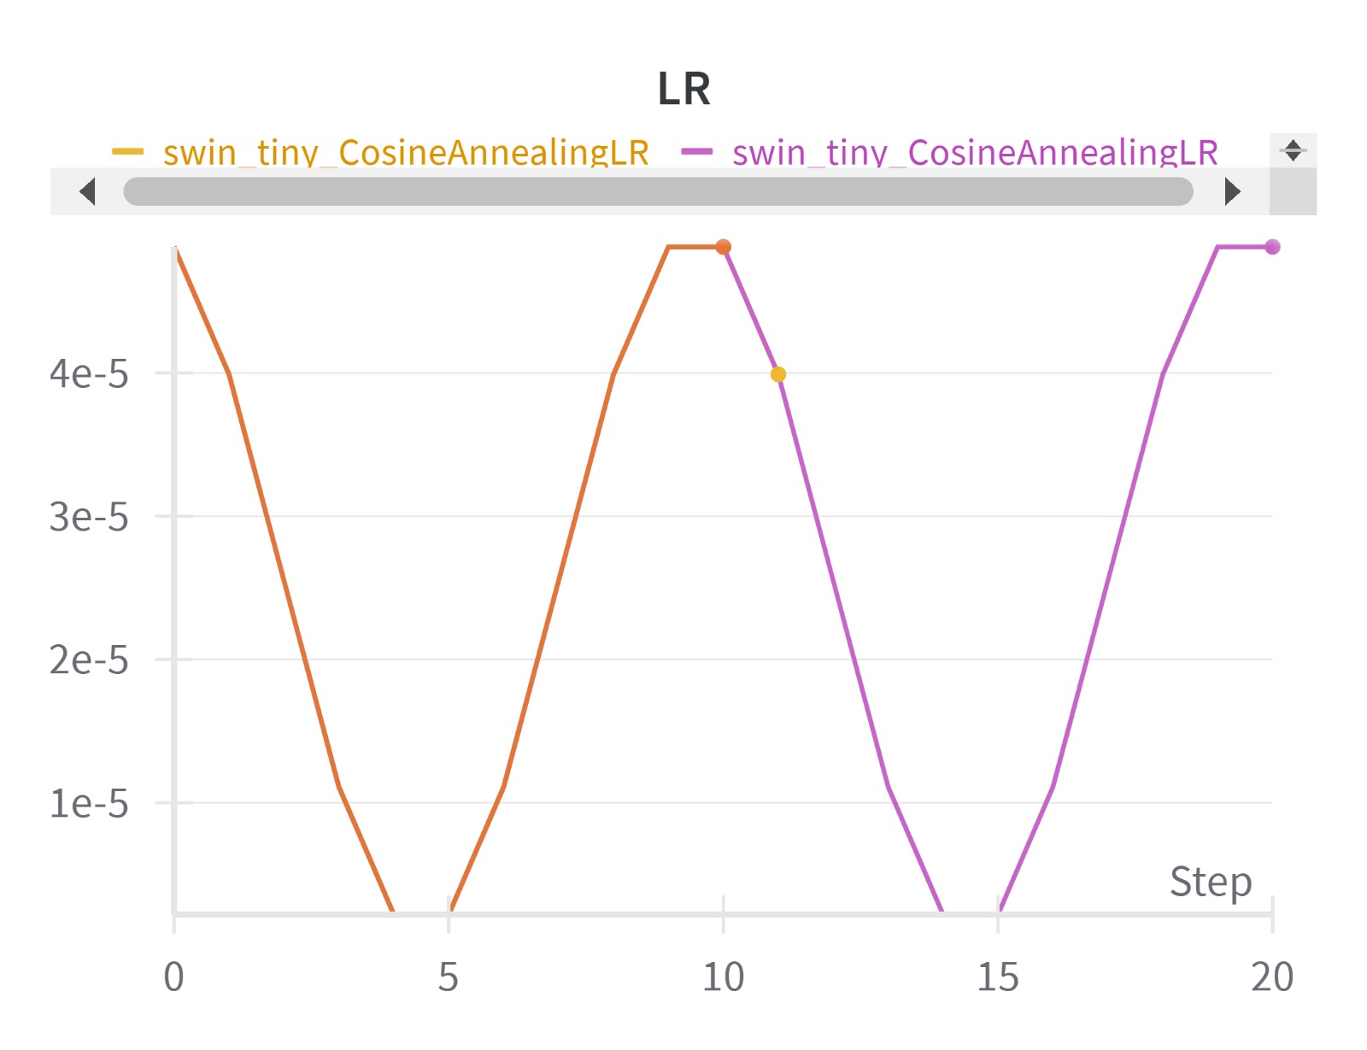
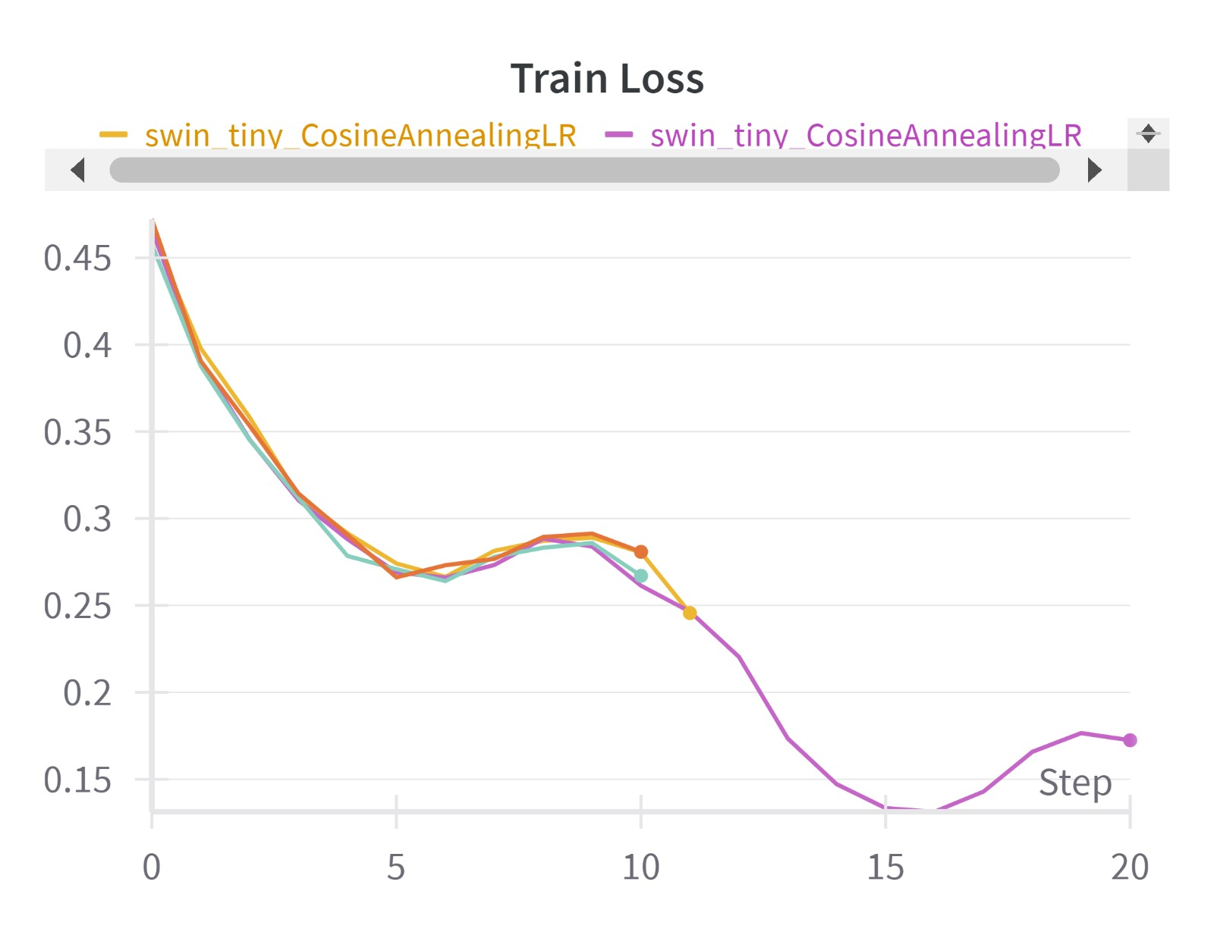
Training Result Analysis
Training Loss increases with the increase of learning rate
1
11

Slide 13
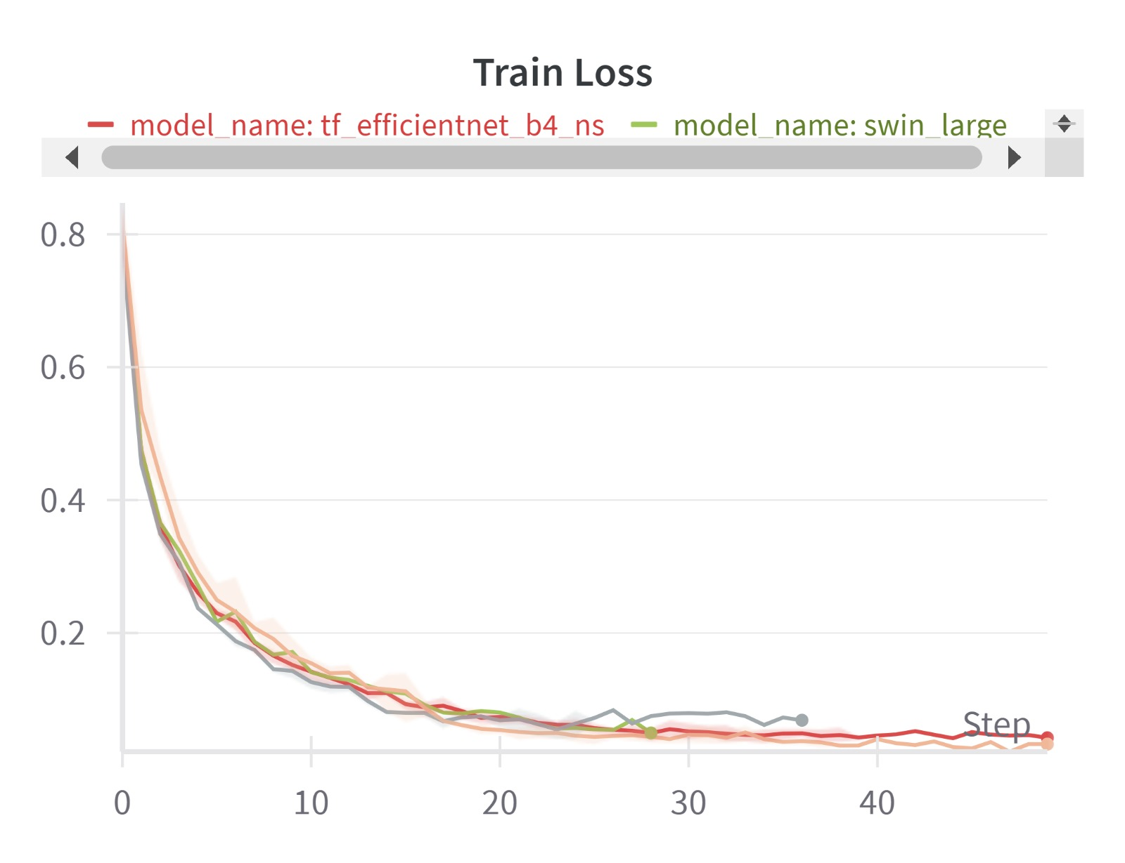
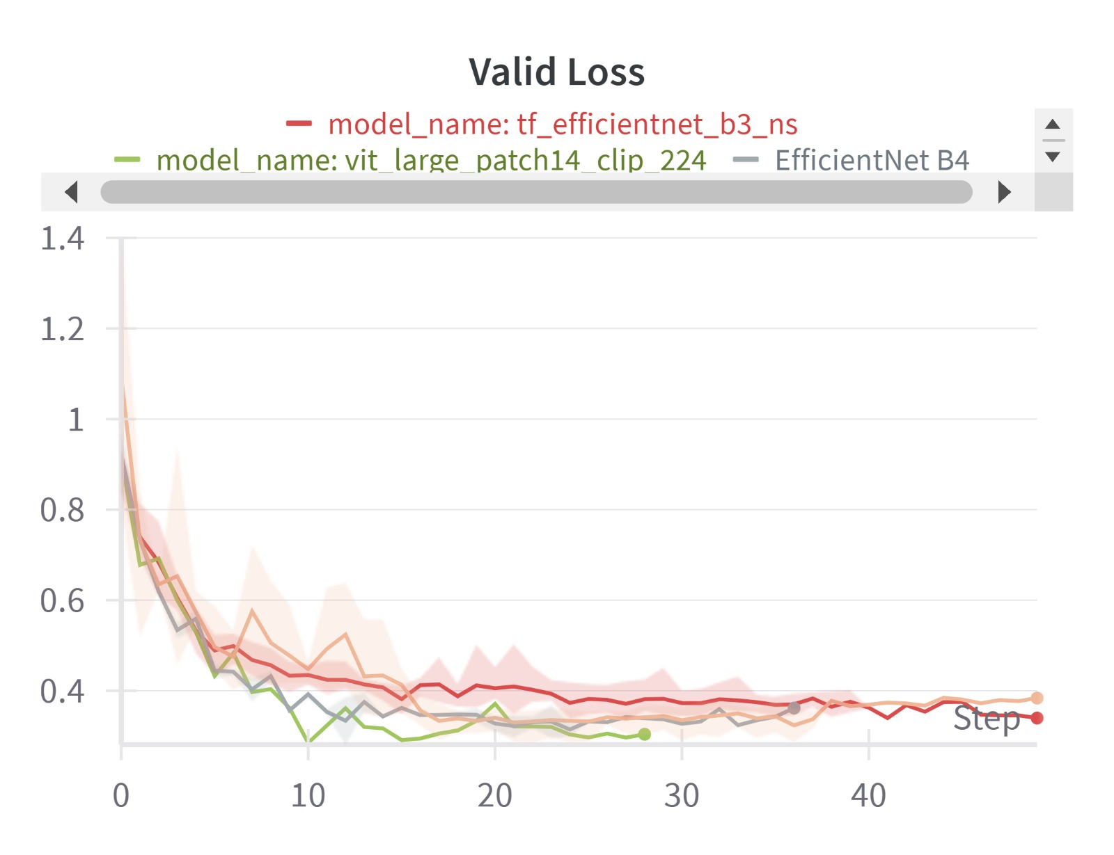
Training Result Analysis
1
12

Slide 14
Validation Result Analysis: Binary Challenge
Model Name | Accuracy | Precision | Recall | AUROC
EfficientNetB0 | 0.8777 | 0.9176 | 0.9327 | 0.8793
EfficientNetB3 | 0.9092 | 0.9191 | 0.9418 | 0.884
EfficientNetB4 | 0.9120 | 0.9281 | 0.9515 | 0.8868
Swin Tiny | 0.903 | 0.9462 | 0.961 | 0.9086
Swin Large | 0.9130 | 0.9537 | 0.965 | 0.9003
Ensemble | 0.85 | 0.85 | 0.85 | 0.85
13

Slide 15
Validation Result Analysis: Multiclass Challenge
Model Name | Kappa Score | Precision | Recall
EfficientNetB0 | .0.8191 | 0.8441 | 0.8406
EfficientNetB3 | 0.858 | 0.8659 | 0.868
EfficientNetB4 | 0.865 | 0.9074 | 0.8735
Swin Tiny | 0.87 | 0.8892 | 0.9072
Swin Large | 0.872 | 0.8912 | 0.9120
1
14

Slide 16
Result Analysis: Comparison ML vs DL
Table shows comparison of the performance of Machine Learning (ML) and Deep Learning (DL) for binary and multiclasss challenge
Binary Class (Accuracy) |  | Multi-Class (Kappa)
ML | DL | ML | DL
0.8184 | 0.8777 | 0.6598 | .0.8191
0.8263 | 0.9092 | 0.707 | 0.858
0.8244 | 0.9120 | 0.7079 | 0.865
0.8276 | 0.903 | 0.6873 | 0.87
0.8363 | 0.9130 | 0.7128 | 0.872
1
15

Slide 17
Conclusion
Key Findings
Dynamic control learning rate helps navigating to global minima.
Performance stagnated after reaching .9 accuracy for binary classification.
Deep learning model adapts significantly better to class imbalance than traditional. approaches.
Future Scope
Segmentation of the lesion using deep learning and extract shape features.
Extracting radiomic features and concatenate them during training.
1
16

Slide 18
Reference
Liu, Z., Lin, Y., Cao, Y., Hu, H., Wei, Y., Zhang, Z., Lin, S., & Guo, B. (2021). Swin Transformer: Hierarchical Vision Transformer using Shifted Windows. Proceedings of the IEEE/CVF International Conference on Computer Vision (ICCV), 10012-10022.
Perez, F., & Wang, J. (2017). The Effectiveness of Data Augmentation in Image Classification using Deep Learning. arXiv preprint arXiv:1712.04621. Paper Link: https://arxiv.org/abs/1712.04621
Ha, Qishen & Liu, Bo & Liu, Fuxu. (2020). Identifying Melanoma Images using EfficientNet Ensemble: Winning Solution to the SIIM-ISIC Melanoma Classification Challenge.
Perez, C. Vasconcelos, S. Avila, and E. Valle, “Data augmentation for skin lesion analysis”, in Or 2.0 context-aware operating theaters, computer assisted robotic endoscopy, clinical image-based procedures, and skin image analysis (Springer, 2018), pp. 303–311.
1
17

Slide 19
ThAnk You

