Slide 1
BigiCoin
Software to see the current price of digital currencies
Powered by Sama

Slide 2

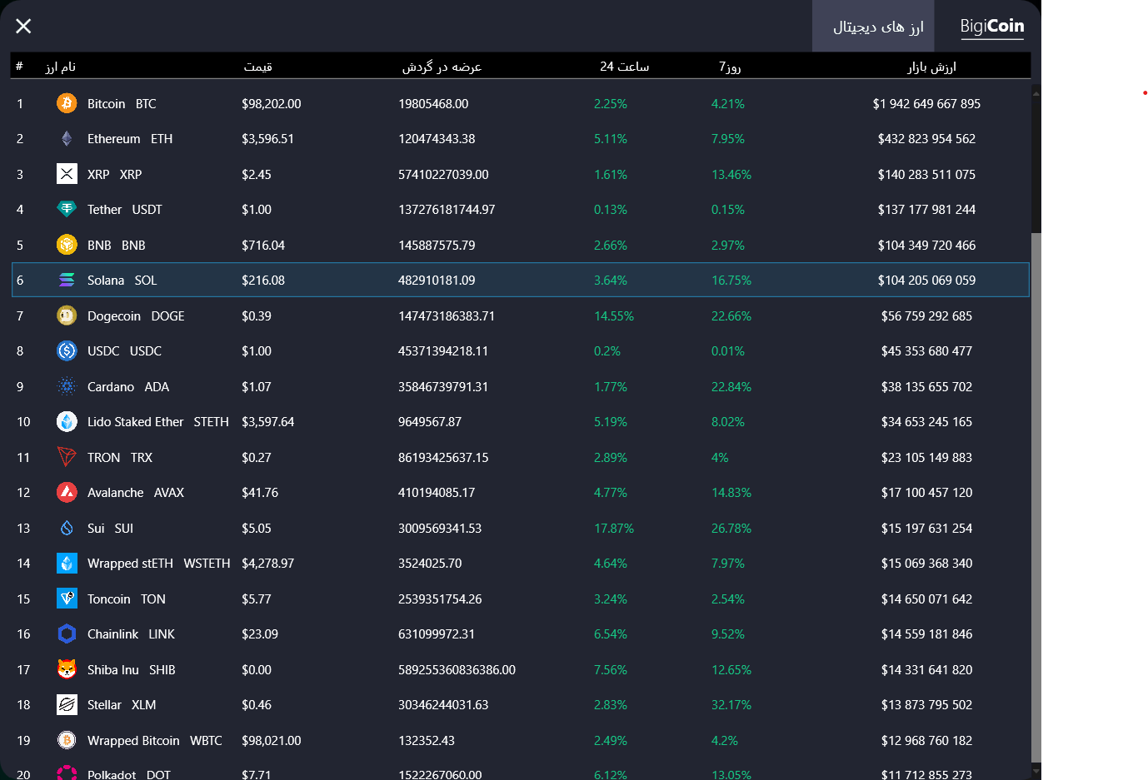
BigiCoin
At Bigi coin we have welcome pages and you can log in to the cryptocurrency page
to see the cryptocurrencies.

Slide 3
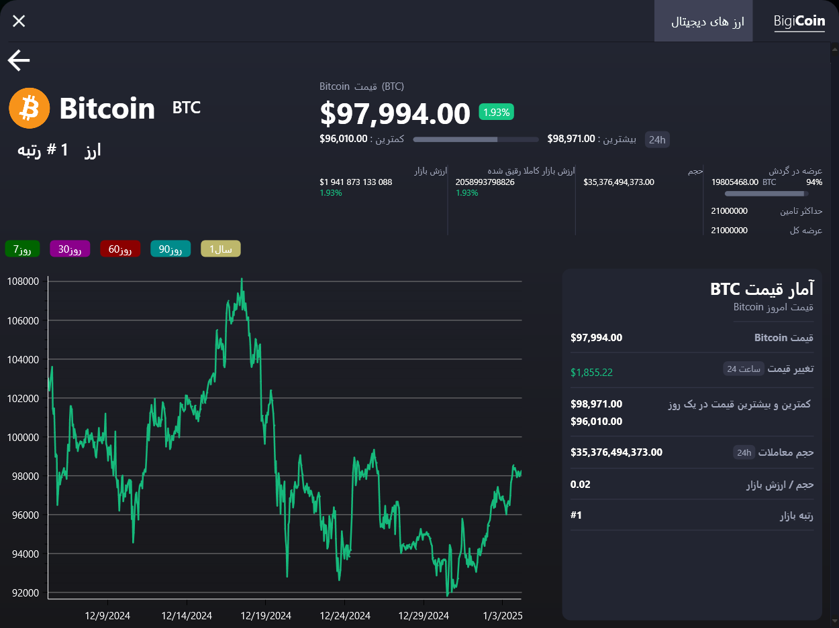
BigiCoin
You can view the price chart and get more information about a currency and check its full price chart.

Slide 4

Technology and packages used:
CoinGecko :
Started in 2014, CoinGecko is the world's largest independent crypto data aggregator that is integrated with more than 1,000 crypto exchanges and lists more than 15,000 coins. CoinGecko API offers the most comprehensive and reliable crypto market data through RESTful JSON endpoints.
MaterialDesignColors & Themes For XAML Files
Newtonsoft For a JSON Files
MetroChart.WPF For Make Charts themes
Oxyplot For make Charts
Git & GitHub

Slide 5
WPF
WPF, or Windows Presentation Foundation, is a UI framework for building visually rich Windows desktop applications. Developed by Microsoft, it is part of the .NET framework and provides developers with a powerful toolkit for creating sophisticated and customizable user interfaces.
Declarative Programming with XAML: WPF uses XAML (eXtensible Application Markup Language) to define and link UI elements. This separation of design and logic allows developers and designers to work more efficiently.
Data Binding: WPF's data binding capabilities are robust, allowing for seamless integration of UI elements with data sources. This makes it easy to create dynamic applications that reflect changes in data instantly.

Slide 6
NuGet
NuGet is a package manager for .NET that allows developers to create, share, and consume packages of code. It's an essential tool for .NET development, providing a central repository for hosting and distributing packages.
Package Creation: Developers can bundle their code (DLLs, other files) into a single ZIP file with a .nupkg extension, which is a NuGet package.
Package Hosting: Packages can be hosted on public repositories like nuget.orgor private hosts such as Azure DevOps.
Package Consumption: Developers can search for and download packages from these repositories, adding them to their projects and using the functionality provided by the packages.
Dependency Management: NuGet handles dependencies, ensuring that all required packages are included and compatible with the project.

Slide 7
XAML
XAML, or eXtensible Application Markup Language, is a declarative XML-based language primarily used for designing user interfaces in Microsoft technologies. It's particularly popular in WPF (Windows Presentation Foundation) and UWP (Universal Windows Platform) applications. Here's a rundown of its key features and uses:
Declarative Syntax: XAML allows you to define the user interface layout and structure in a clear and readable way using tags. This makes it easy to understand and maintain the UI code.
Data Binding: XAML supports powerful data binding features, allowing you to bind UI elements to data sources in a flexible and efficient manner. This makes it easier to keep the UI in sync with the underlying data.
Styles and Templates: XAML enables you to define styles and templates, promoting a consistent look and feel across your application. You can reuse styles and templates, reducing the amount of redundant code.

Slide 8
JSON
JSON files use a text format that is completely language-independent but uses conventions familiar to programmers of the C-family of languages, including C, C++, Java, JavaScript, Perl, Python, and many others.
Configuration Files: Storing configuration settings.
Data Interchange: Transmitting data between a server and a client (e.g., in web APIs).
Storage: Storing structured data in databases (e.g., NoSQL databases like MongoDB).
Advantages:
Human-Readable: Easy to read and write for humans.
Lightweight: Compact format that reduces the amount of data transmitted.
Language-Independent: Can be used with almost any programming language.

Slide 9
We Designed BigiCoin With Themes And Shared Project in GitHub Release 1

Slide 10
Sama Team
Abolfazl Sohrabi : Designer & Programmer
Amir Mahdi Zahmatkesh : Programmer
Ali Khalilzade : Programmer
Seyed Mahdi Mirbagheri : Head & Programmer

Slide 11
Thanks

