Slide 1
AI-Powered Route Recommendations Web Application based on Extreme Weather Conditions and Green Gas Emissions
Mahdi Mohammadizadeh, Hadi Aghazadeh
Geomatics Engineering, Schulich School of Engineering
April-21-2023

Slide 2
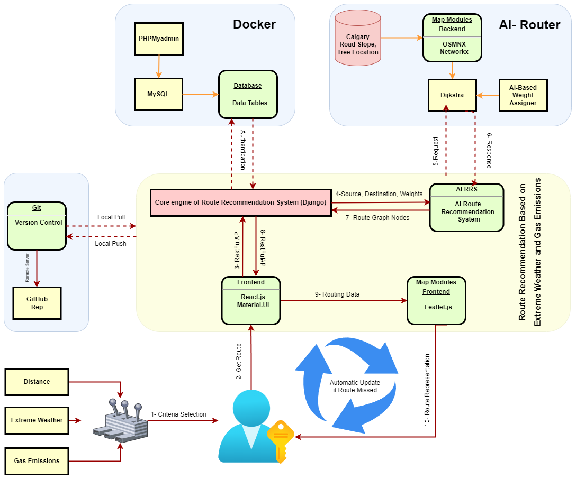
Web App Modules

Slide 3
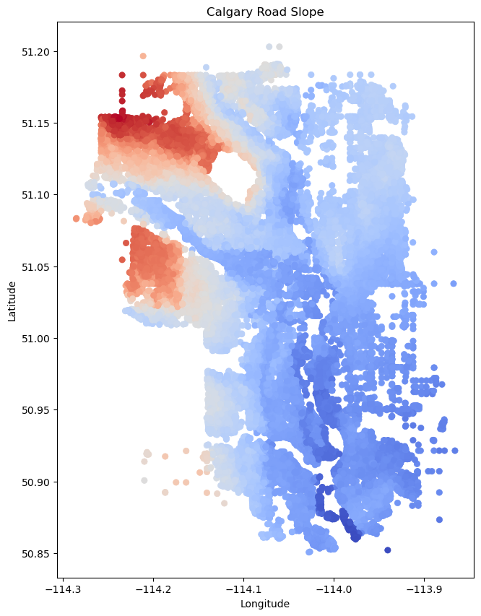
Criteria representations- Extreme Weather
For extreme weather road slopes are chosen as a gentle representation of leakiness on roads

Slide 4
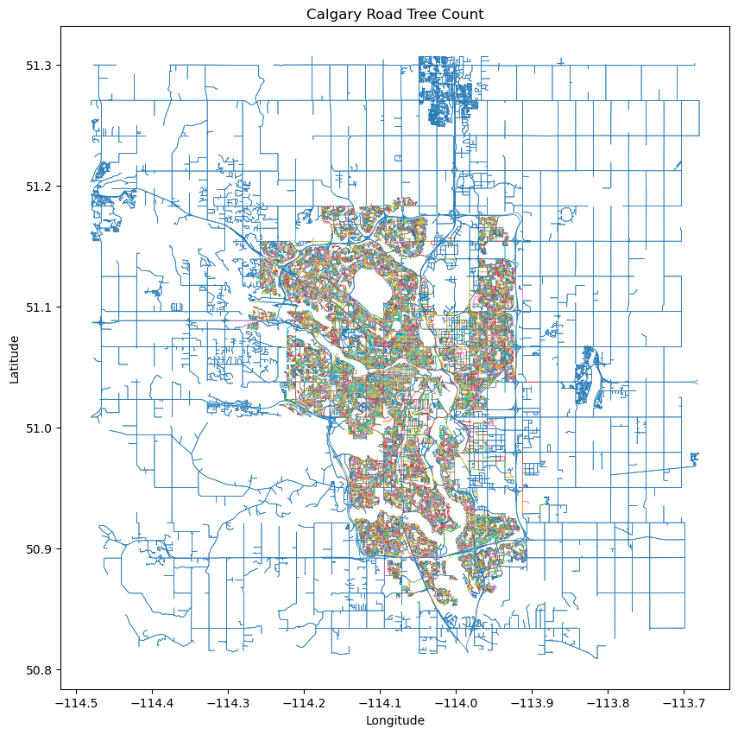
Criteria Representations- Gas Emissions
For Gas emissions, Calgary’s tree data has been used.

