Slide 1
Task Details for TResNet Algorithm develop and optimize

Slide 2
Link list
https://arxiv.org/abs/2003.13630
https://github.com/Alibaba-MIIL/TResNet
https://github.com/rwightman/pytorch-image-models
https://paperswithcode.com/paper/cspnet-a-new-backbone-that-can-enhance
https://arxiv.org/abs/1803.01534
https://arxiv.org/abs/2004.10934
https://www.sciencedirect.com/science/article/abs/pii/S1383762119302656
https://arxiv.org/pdf/1812.01187.pdf

Slide 3
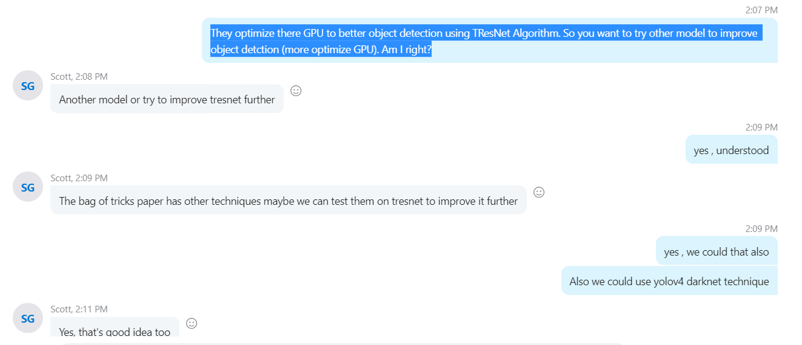
Task Details

