Slide 1

Task Details for TResNet Algorithm develop and optimize

Slide 2
Link list
https://arxiv.org/abs/2004.10934
https://arxiv.org/abs/1803.01534
https://arxiv.org/abs/2003.13630
https://github.com/Alibaba-MIIL/TResNet
https://github.com/rwightman/pytorch-image-models
https://arxiv.org/pdf/1812.01187.pdf
https://arxiv.org/abs/2003.13630
https://towardsdatascience.com/python-performance-and-gpus-1be860ffd58d

Slide 3
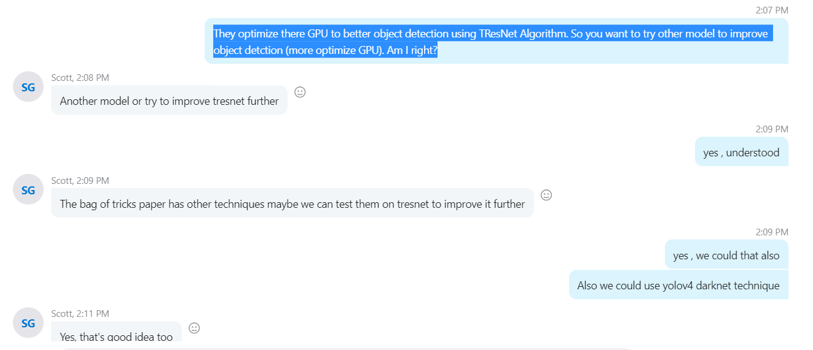
Task List

