Slide 1
Progress update- Ab engineering project

Slide 2
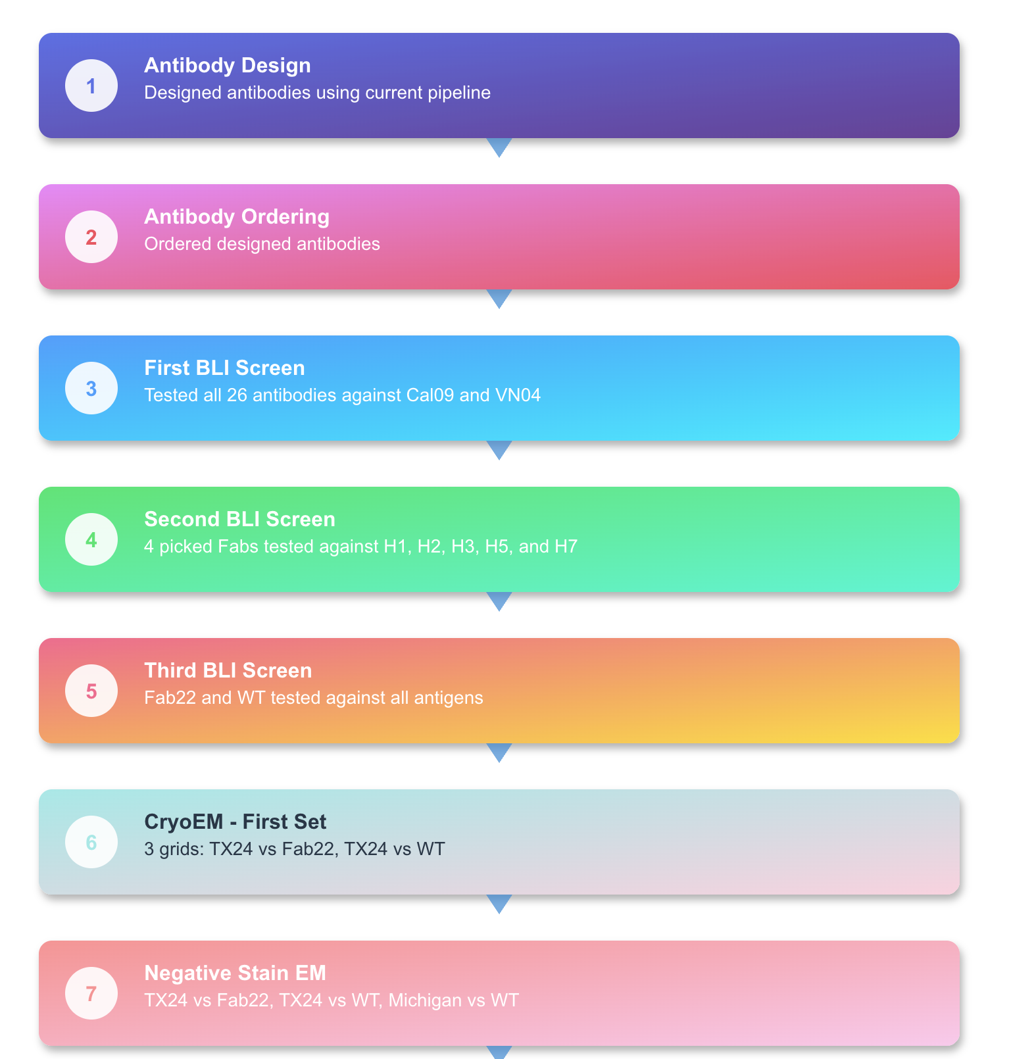
Outline

Slide 3
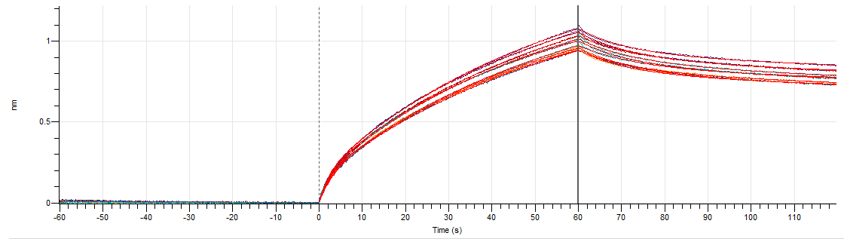
From first BLI we found 4 Fabs are doing better than others
Fab 22
Fab 06
Fab 10
Fab 11
Notes: At this stage we don’t have KDs yet = so we needed to have serial dilutions just for a few of fabs to find KDs

Slide 4
Second BLI: 4 top picks fabs against all
We tested Fab 22, Fab 06, Fab 10 and Fab 11against:
A/Texas/37/2024 (H5N1)
A/Vietnam/1203/2004 (H5N1)
A/Singapore/1/1957 (H2N2)
A/Anhui/1/2013 (H7N9)
A/Michigan/45/2015 (H1N1)pdm09
A/Hong Kong/1/1968 (H3N2)

Slide 5
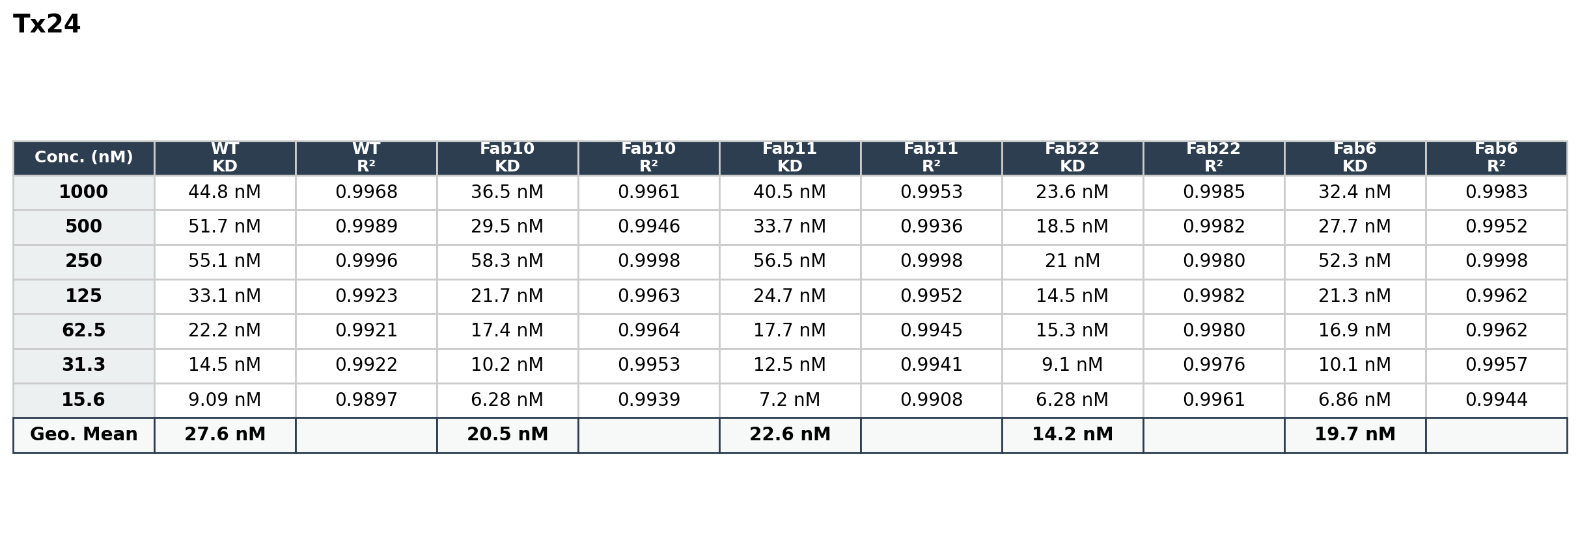
BLI results : round 2
R-square threshold : %95

Slide 6
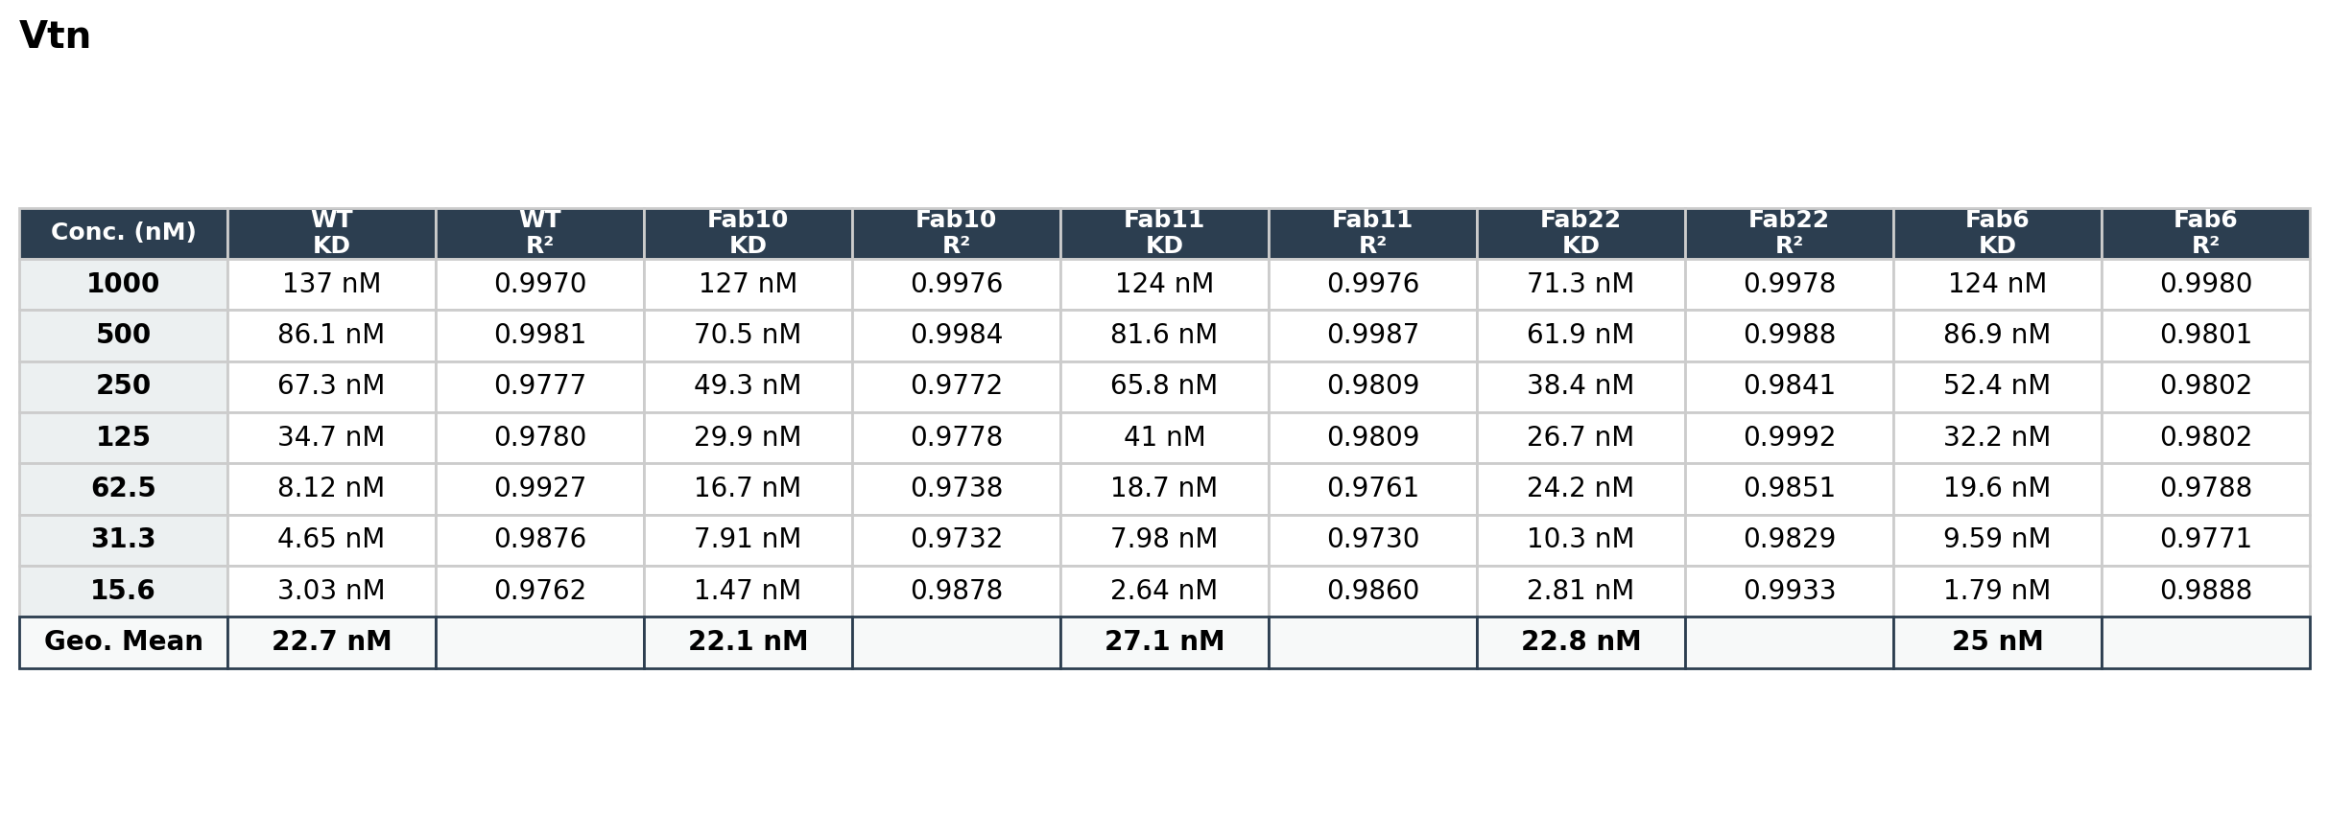
BLI results : round 2
R-square threshold : %95

Slide 7
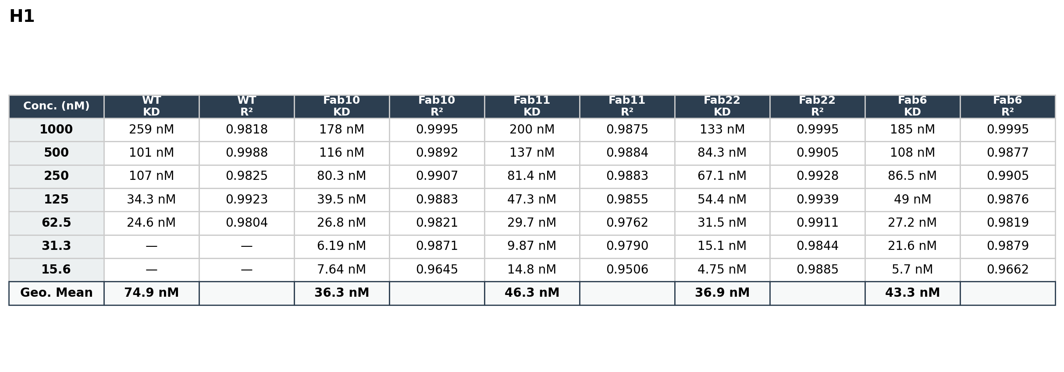
BLI results : round 2

Slide 8
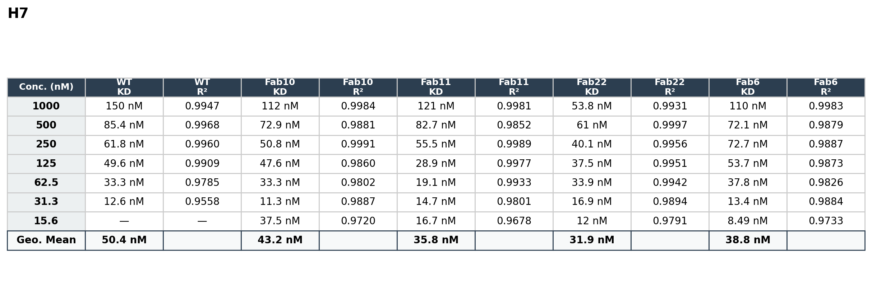
BLI results : round 2

Slide 9
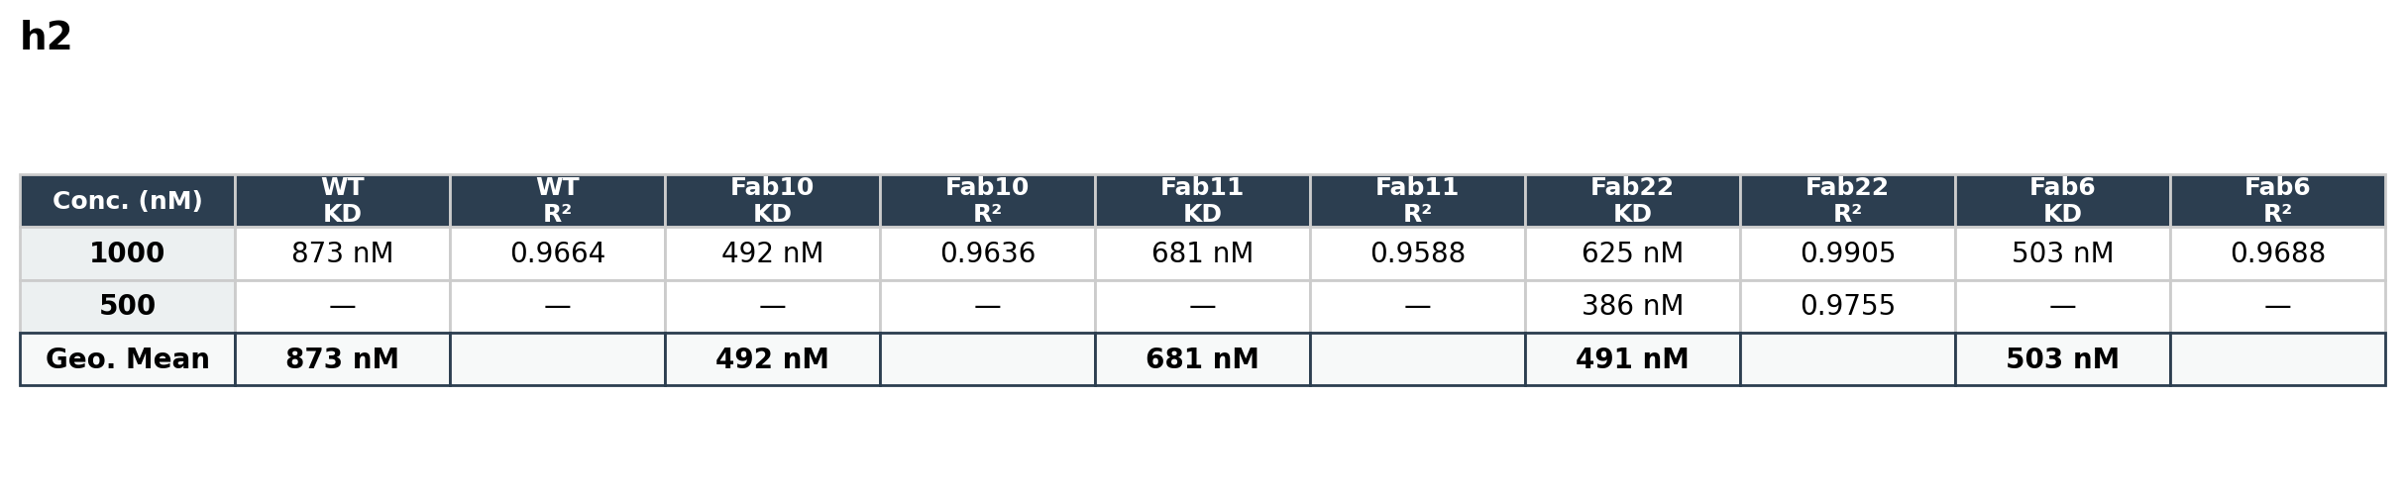
BLI results : round 2

Slide 10
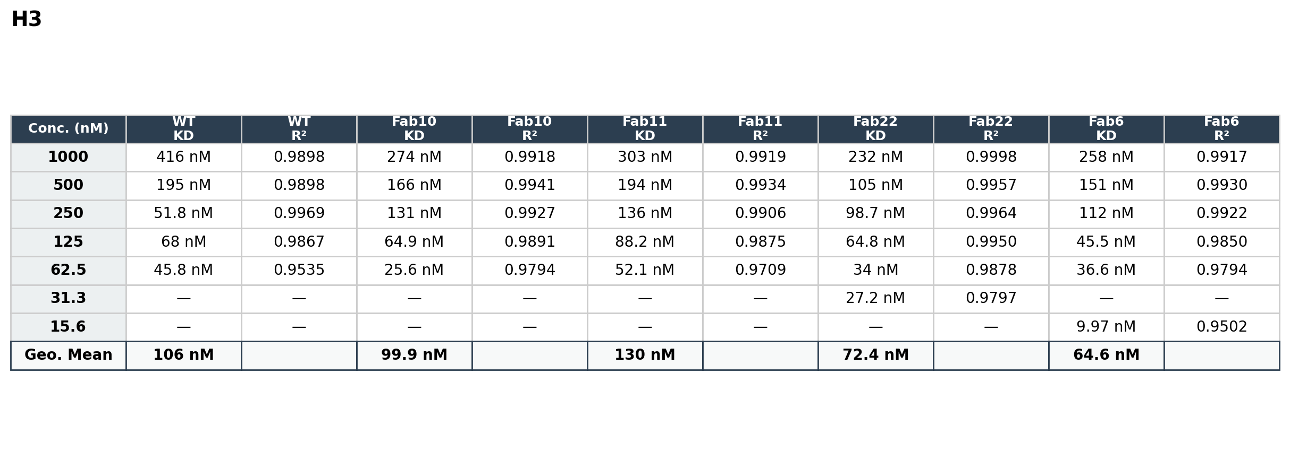
BLI results : round 2

Slide 11
NanoDSF results
Sample ID | Onset #1 for Ratio | Inflection Point #1 for Ratio
Fab 22 | 68.2°C | 74.2°C
Fab 22 | 68.1°C | 74.3°C
Fab 22 | 67.3°C | 74.2°C
Fab 06 | 69.4°C | 75.9°C
Fab 06 | 68.4°C | 75.7°C
Fab 06 | 69.0°C | 75.9°C
Fab 10 | 62.7°C | 70.0°C
Fab 10 | 62.5°C | 69.9°C
Fab 10 | 59.9°C | 69.9°C
Fab 11 | 68.1°C | 74.6°C
Fab 11 | 67.1°C | 74.6°C
Fab 11 | 66.5°C | 74.6°C
WT | 68.0°C | 74.8°C
WT | 68.9°C | 74.9°C
WT | 68.7°C | 75.0°C

Slide 12
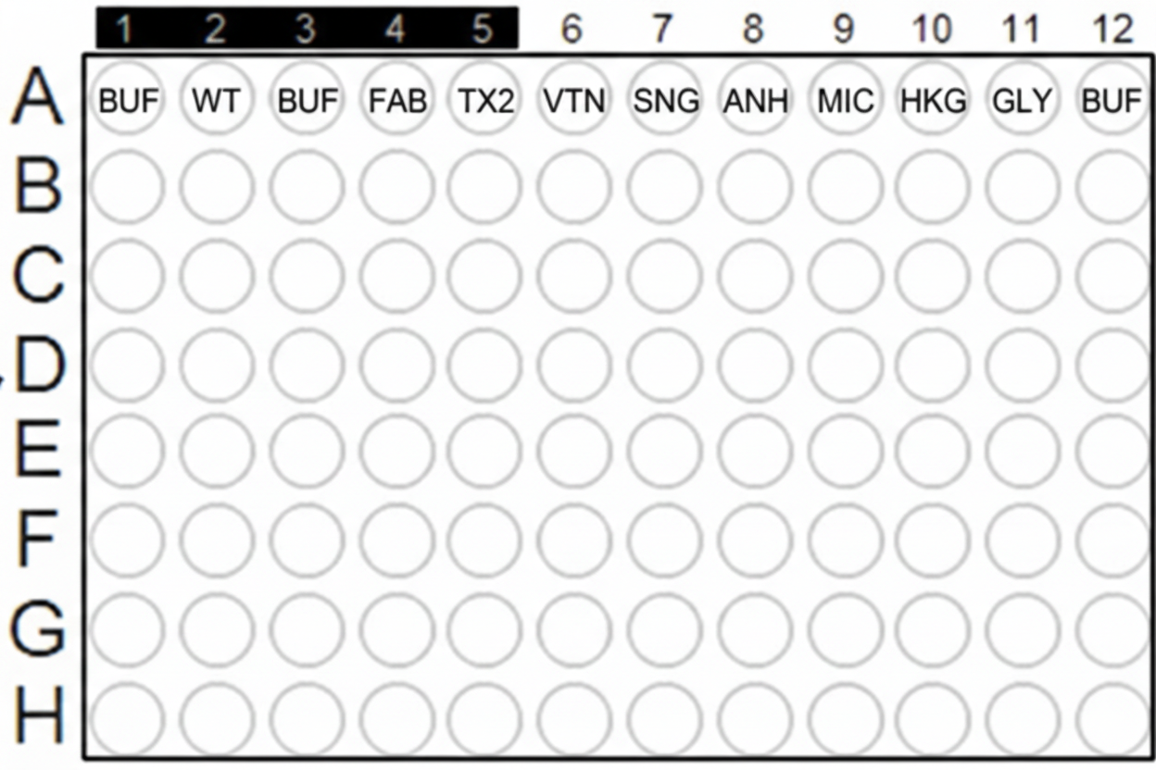
Third round of BLI: full plate comparison of Fab22 and WT against all antigens
Fab 22 and WT against :
A/Texas/37/2024 (H5N1)
A/Vietnam/1203/2004 (H5N1)
A/Singapore/1/1957 (H2N2)
A/Anhui/1/2013 (H7N9)
A/Michigan/45/2015 (H1N1)pdm09
A/Hong Kong/1/1968 (H3N2)

Slide 13
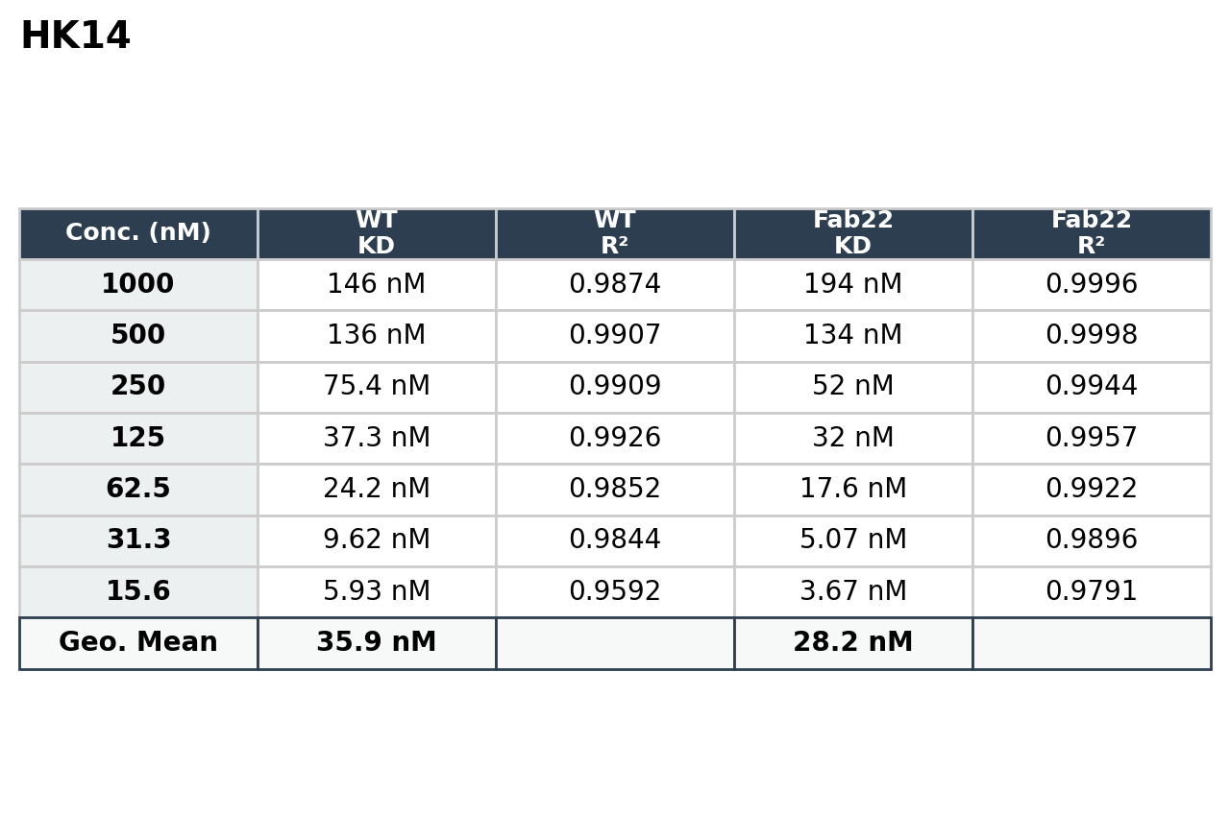
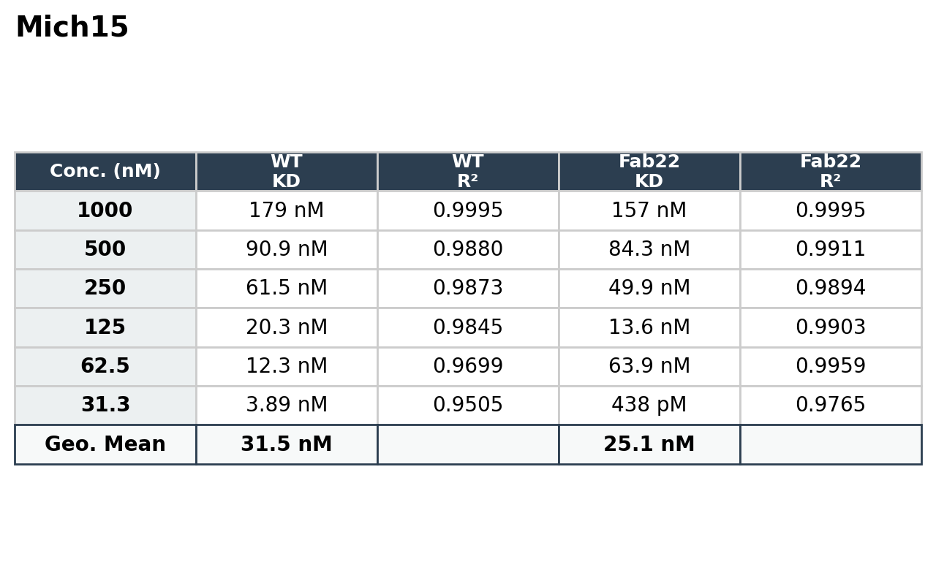
BLI results : round 3

Slide 14
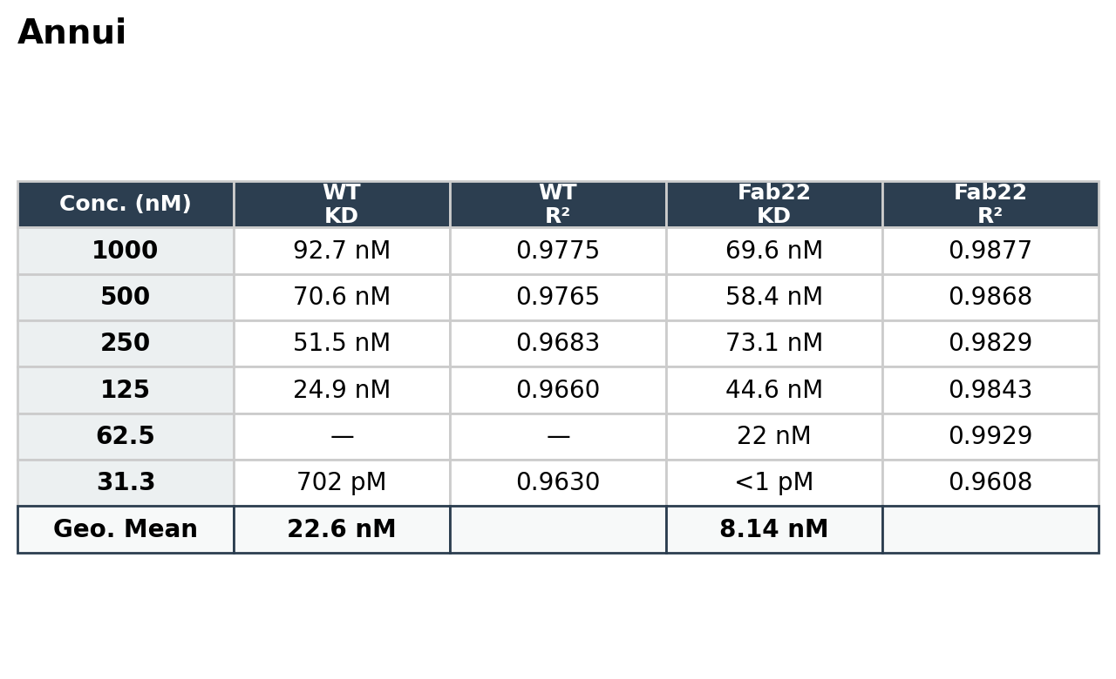
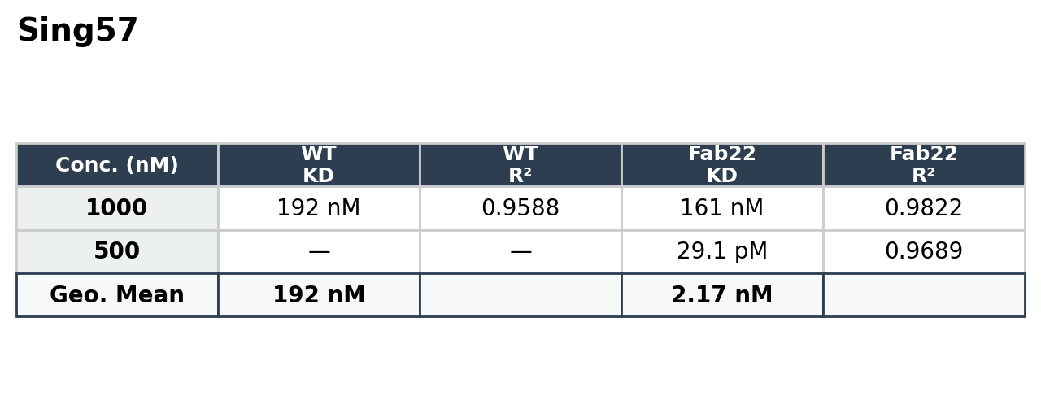
BLI results : round 3

Slide 15
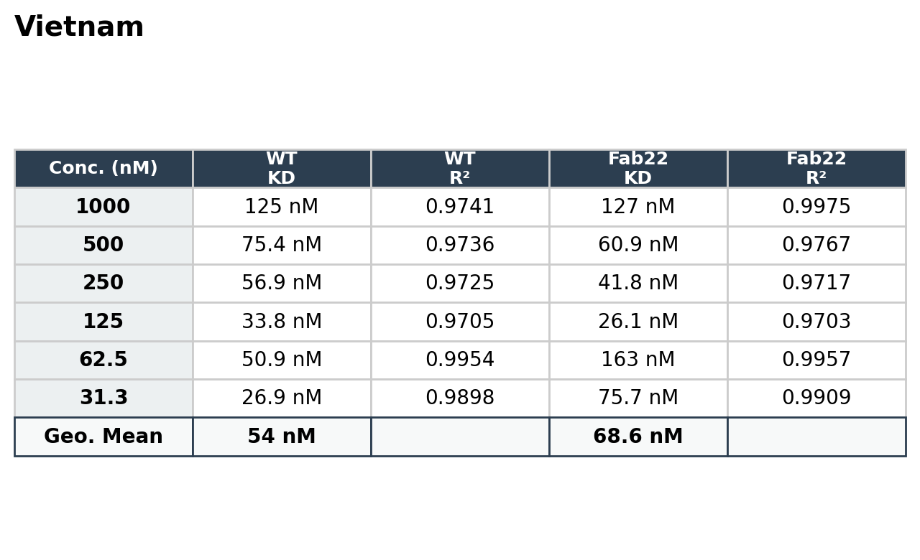
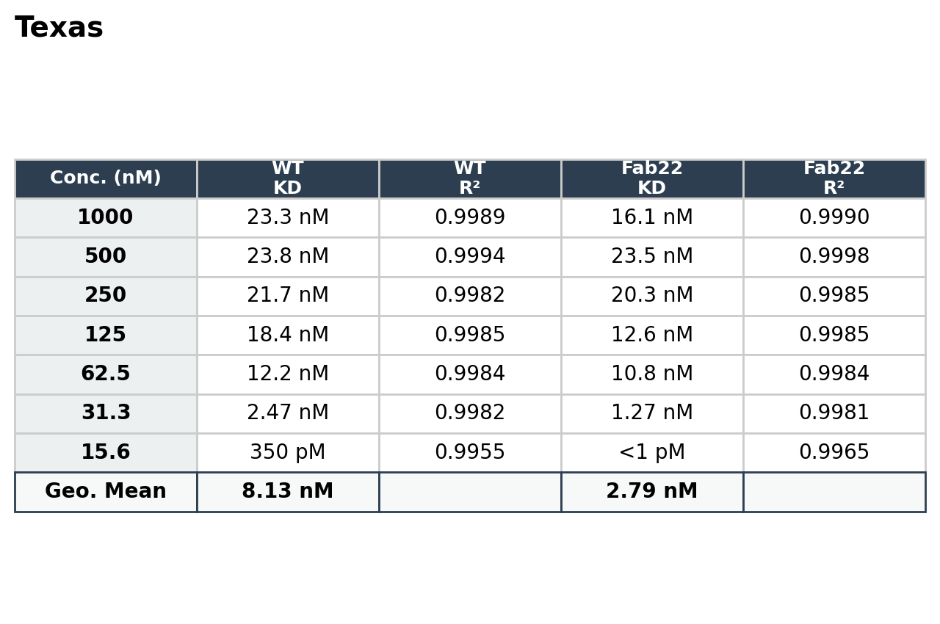
BLI results : round 3

Slide 16
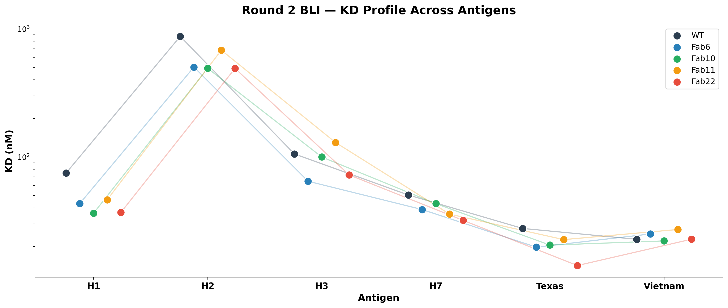
KD comparison plots – round 2

Slide 17
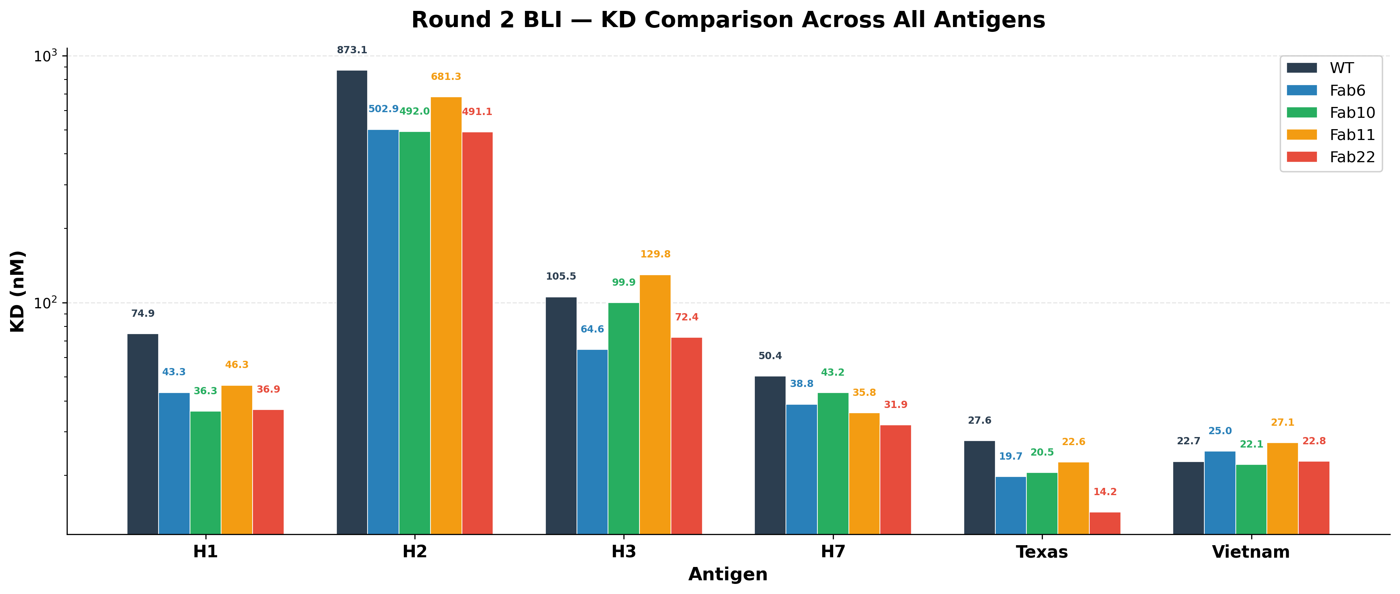
KD comparison plots – round 2

Slide 18

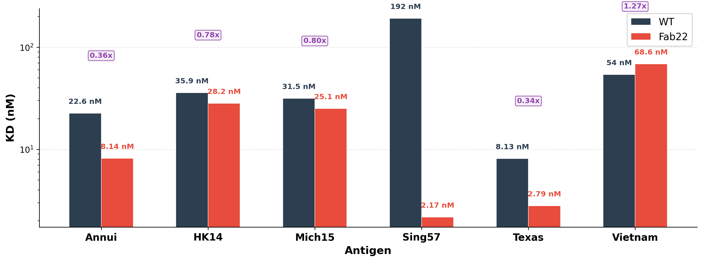
KD comparison plots – round 3

Slide 19
Next step: to see if the binding scite are correct and if the binding is happeing in microscope
CryoEM – First Set 3 grids: TX24 vs Fab22, TX24 vs WT
Issue: We couldn’t see free HA
Solution: let’s see how Negative stain shows them

Slide 20
Negative stain showed a lot of rosets and aggragation!
Negative Stain EM : 3 grids
TX24 vs Fab22
TX24 vs WT
Michigan vs WT
Solution: wait! Can we see the binding between VN04 and WT actually? Prooving somehting that mention in the paper!
OR genscript fabs have problem maybe?

Slide 21
Next step: cryoEM to see if actually WT and VN04 are bnding togereh
Monica mentiond we could see binding in control ‘
Nest step: SPR?

