Slide 1
«تمرین بیست و یکم»
«مهدیس صفری
9531051»
«1398»

Slide 2
web design methodologies
There are a number of different software design methodologies ,ones appropriate for web design including:
Systems Development Life Cycle (SDLC)
Rapid Application Development (RAD)
Participatory Design (PD)
Feature-driven Development (FDD)
Component Based Development (CBD)

Slide 3
Feature-driven Development (FDD)
The steps in FDD are :
Develop overall model
Build feature list
Plan by feature
Design by feature
Build by feature
WHAT IT DOESN'T COVER
Requirements gathering
Interface design
Testing
Deployment

Slide 4
FDD advantages
No technology constraints:
There are no hard and fast rules that prohibit FDD from being used with any other technology. It can be successfully applied to many web-oriented technologies as well, like ASP, PHP, JSP and the likes. It is also freer from ambiguity, if the technology used is Object Oriented, as it proves to be slightly easier to apply FDD in such cases.
Easily adaptable:
Any new process involves a few confusions and hardships when tried to adapt in the beginning. However, the structure of FDD is easily adaptable and uses a common sense-using approach, with respect to web development, and you would find it quite comfortable to understand and involve the whole process into your web developmental activities.

Slide 5
FDD advantages
Efficient planning and reporting functionalities
Clear-cut and conditioned
Reduction of risks:
FDD helps in reducing risks using shorter iterations of designing, understanding of the requirements and the system where the website is to be developed – in a clear and distinct way, thereby leading to a state where there are no ambiguities, as the needs and expectations are already understood very well.
helps to move larger size projects and obtain repeatable success.
The simple five processes help to bring work done in a short time and easiest manner.
support multiple teams working in parallel.

Slide 6
FDD disadvantages
Not an ideal methodology for smaller projects so, it is not good for an individual software developer. High dependency on the main developer means the person should be fully equipped for an act as coordinator, lead designer, and mentor. No written documentation provided to clients in this methodology so, they are not able to get a proof for their own software. Promotes individual code ownership as opposed to shared team ownership.
Iteration are not well defined by the process as other agile methodologies. • The model-centric aspect can have hug impacts when working with an old system that
does not have a system model.

Slide 7
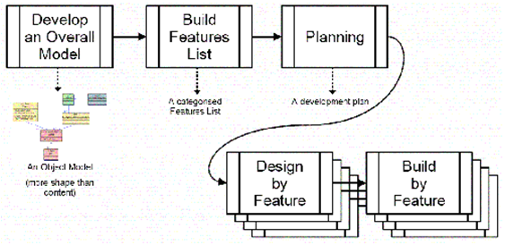
Feature-driven Development (FDD)
https://www.coursehero.com/file/p4bkmi4/Advantages-of-Feature-driven-development-Feature-Driven-Development-helps-to/
https://www.macronimous.com/resources/articles/using-feature-driven-development-fdd-web-development
http://www.featuredrivendevelopment.com/node/550
https://webdev-il.blogspot.com/2014/04/web-design-methodologies.html

Slide 8
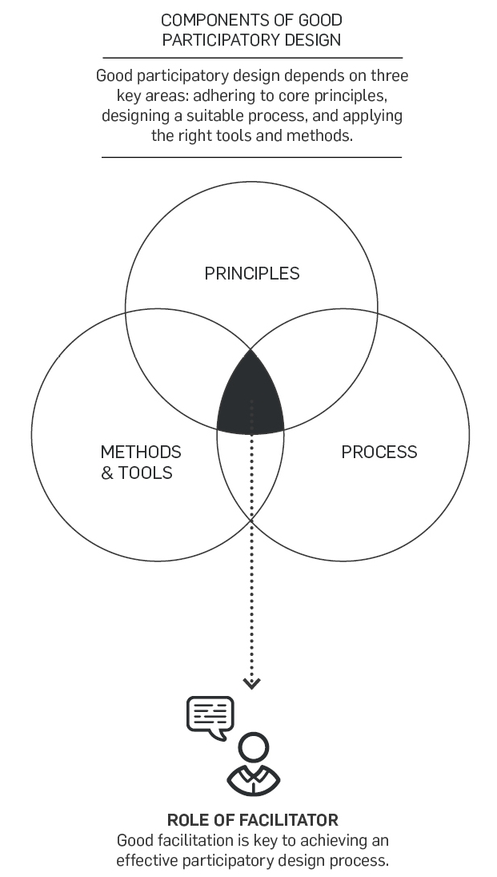
Participatory Design (PD)
Participatory Design is a method to co-create, co-operate, and co-design.
Participatory design is an approach where all the stakeholders i.e. employees, customers, end-users, partners, designers, and researchers are actively involved in the design process.
https://webdev-il.blogspot.com/2014/04/web-design-methodologies.html
http://participateindesign.org/approach/tools
https://www.coursehero.com/file/p5scsut/Advantages-and-disadvantages-of-the-participatory-approach-to-budgeting/
http://participateindesign.org/approach/why
https://medium.theuxblog.com/participatory-design-tools-and-methods-741543b1ff5b
http://www.publicsphereproject.org/node/235

Slide 9
Participatory Design (PD) > 11 PRINCIPLES
Build relationships
Leverage existing networks
Go to where the people are
Make information accessible
Facilitate, not prescribe
Enlist neutral facilitators
Test and refine
Talk less, do more
Do not present a perfect solution
See people for what they are good at
Build capability over time

Slide 10
Advantages and Disadvantages
Advantages
it foster stronger bonds, and in turn greater community involvement
it reduce risk of failure and consequently cost
it build ownership of the outcome
it boost confidence and self-reliance
it enable realistic expectations tp form and lower resistance to change
Participatory design reduce the risk of failure for your end-product.
can certainly be time-consuming
Disadvantages
It is challenging to determine the subordinates to participate in the budget process.
The subordinates might try to manipulate the budgets in their own benefits.
higher quality of the end product cannot be guaranteed

Slide 11
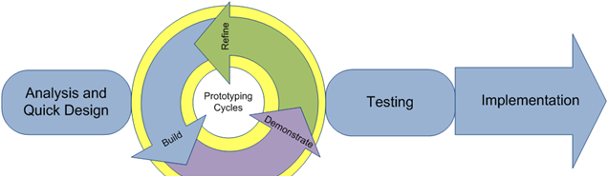
Rapid Application Development (RAD)
RAD uses meetings and prototyping to define requirements and radically decrease the time needed to design and implement information systems.
There is a delay producing the overall design until after all the user requirements have been identified (through prototyping and testing).
This design methodology requires a circular process of building, demonstrating and refining he prototype until it has all the user requirements.
It requires frequent contact and participation from clients and users to refine the site.

Slide 12
RAD advantages
adaptable and flexible to changes
With less people, productivity can be increased in short time
Better quality
RAD increases quality through the involvement of the user in the analysis and design stages.
It is useful when you have to reduce the overall project risk
More projects completed on time and within budget
Due to prototyping in nature, there is a possibility of lesser defects
Each phase in RAD delivers highest priority functionality to client

Slide 13
RAD disadvantages
Lack of scalability
RAD typically focuses on small to medium-sized project teams. The other issues cited above (less design and control) present special challenges when using a RAD approach for very large scale systems
reduced features
Reduced features due to time boxing, where features are pushed to a later version to finish a release in short period
If developers are not committed to delivering software on time, RAD projects can fail
When technical risk is high, it is not suitable
Not all application is compatible with RAD
Progress and problems accustomed are hard to track as such there is no documentation to demonstrate what has been done
https://webdev-il.blogspot.com/2014/04/web-design-methodologies.html
https://en.wikipedia.org/wiki/Rapid_application_development
https://www.guru99.com/what-is-rad-rapid-software-development-model-advantages-disadvantages.html

Slide 14
Comparison
 | FDD | PD | RAD
project size | Efficiency on bigger projects | Large-Scale Public Projects | Focused scope where the business objectives are well defined and narrow
adaptable | adaptable | adaptable | adaptable
ready at deadline | delivered on-time | Guaranteed | 70 to 80 percent Guaranteed
scalability | quite scalable | Scalability is defined with reference to both the number of people and the space for active participation | Lack of scalability

Slide 15
Comparison
 | FDD | PD | RAD
risk control | reduce risk | reduce risk | When technical risk is high, it is not suitable
cost(within budget) | well guaranteed(reduces the cost of fixing the errors) | Well guaranteed | Fairly good guaranteed
ownership | low | high | high
project team size | large numbers of people. | vary in size from two people to large numbers of people. | small to medium-sized project team

