Slide 1
A Survey of higher education learning evolution
Prepared by: Brahimi, Mahdi. Tahar
1) Foundations of Digital Communication and Early Online Learning (1861–2000)
2) Expansion of the Platforms of the Online Learning
(2000–2020)
3) AI Integration and Lifelong Learning
(2020–2025)

Slide 2
The first period (1861–2000) saw long-distance communication and network foundations emerge with the telegraph, the Advanced Research Projects Agency Network (ARPANET), and the expansion of electronic mail. The second period (2000–2020) witnessed online courses and platforms scale through the internet, driven by learning management systems such as the Modular Object-Oriented Dynamic Learning Environment (Moodle) and the rise of Massive Open Online Courses (MOOCs). Finally, following the COVID-19 pandemic in 2020, the scientific and educational communities accelerated a shift to hybrid instruction, widespread integration of artificial intelligence tutors and tools, and the adoption of lifelong-learning platforms with global digital credentials from 2020 To 2025.
1861: Telegraph invented – long- distance communication begin
1969: ARPANET launched – precursor to the internet
1971: Email invented – asynchronous messaging emerges
1981: First fully online course via computer conferencing
1989: Internet launched – global connectivity begins
1996: First large-scale online education field trials
2000: Moodle released – rise of Learning Management Systems (LMS)
2008: First MOOC (Massive Open Online Course) introduced
2012: Coursera, edX, Udacity launch – MOOCs go mainstream
2020: COVID-19 triggers global shift to remote learning
2021–2023: Hybrid models, AI tutors, and microlearning expand
2024–2025: AI-integrated classrooms, global digital credentials, and lifelong learning platforms dominate
The future will be dominated by AI-enhanced lifelong learning, universal hybrid classrooms, and globally recognized digital diplomats, qualifications and professional certificates.

Slide 3
From 1861 to 2000
[1861] Telegraph is invented
[1876] Telephone is invented
[1969] ARPANET begins
[1971] Email is invented
[1978] Bulletin Board System (BBS) is invented
[Mid-1970s] First computer-based education programs
[1981]
- WBSI Executive Education (IES)
- First totally online course (used computer conferencing)
[1982] ICLN: Research Project in four locations
[1983] RAPI: Canada, USA, England, France
[1984] MEIR: Michigan Electronic Resource Initiative
[1985] National Geographic Society Kids Network
[1986] EIES: NJIT
[1987] WIER: Western Interstate Commission (WICHE)
[1988] SPTP in British Columbia, Canada
[1989] NREN: National Research and Education Network
[1990] First online undergraduate courses
[1991] Connected Education (New School of Social Research)
[1992] CALCampus (first totally online school)
[1993] EBC: Electronic Business Courses
[1994] First online high school
[1995] First online graduate program
[1996]
- First online degree program
- Virtual High School initiatives:
• Concord Consortium
• Hudson Public Schools
• Concord Area Schools, TERC
• Illinois Math and Science Academy
• University of Nebraska
• University of California
• University of Michigan
• University of Illinois
[1998]
- Internet is launched
- First online university
- World Wide Web is invented
First online course is offered
[1999]
- TUI-NCE (Canada)
- CL-Net (Europe)
- Virtual-U project is launched
From 2000 to 2020
[2000]
- Moodle (Modular Object-Oriented Dynamic Learning Environment) is released
- Rise of Learning Management Systems (LMS) begins
[2002]
- Cambridge School Online founded – pioneering British online education for ages 7–19
Blackboard and WebCT gain global traction in universities
[2004]
Facebook launches – social media begins influencing educational communities
[2006]
- Khan Academy founded – free video-based learning revolution begins
YouTube becomes a major platform for educational content
[2008]
First Massive Open Online Course (MOOC) launched by Stephen Downes and George Siemens (Connectivism and Connective Knowledge)
[2012]
- Coursera, edX, and Udacity launch – MOOC platforms go mainstream
Harvard and MIT collaborate on edX
[2014]
- Google Classroom introduced – integrates with G Suite for Education
Rise of mobile learning and app-based platforms
[2015]
- Blended learning models widely adopted in K–12 and higher education
- Virtual labs and simulations gain popularity in STEM education
[2016]
- Artificial Intelligence begins to be integrated into adaptive learning platforms
Rise of competency-based education and micro-credentials
[2018]
- Global e-learning market surpasses $200 billion
- Blockchain explored for credential verification and academic records
[2019]
- Online learning becomes standard in corporate training and professional development
- UNESCO and OECD promote digital inclusion and educational equity
From 2020 to 2025
[2020]
- COVID-19 pandemic triggers global shift to remote learning
- Zoom, Microsoft Teams, and Google Meet become primary classroom tools
- UNESCO reports over 1.6 billion learners affected by school closures
- Emergency Remote Teaching (ERT) replaces traditional instruction worldwide
[2021]
- Hybrid learning models emerge: blending in-person and online formats
- UNESCO and OECD promote digital equity and infrastructure investment
- Rise of asynchronous video-based learning and flipped classrooms
- AI-powered tutoring and adaptive learning systems gain traction
[2022]
- Global EdTech investment exceeds $20 billion
- Microlearning and mobile-first platforms dominate adult education
- Blockchain used for secure credentialing and academic records
- Gamification and immersive learning (AR/VR) expand in K–12 and STEM
[2023]
- Personalized learning algorithms widely adopted in LMS platforms
- Online universities and virtual campuses expand globally
- Digital credentials and skill-based certifications replace traditional degrees in some sectors
- UNESCO launches global digital literacy initiative
[2024]
- AI-driven course design and assessment tools become mainstream
- Integration of ChatGPT-like AI assistants into classrooms and LMS
- EdTech platforms offer multilingual, inclusive learning environments
- Governments begin regulating online education standards and data privacy
[2025]
- Over 30% to 80% of academic content delivered online across institutions
- Online education market projected to reach $203.81 billion globally
- Over 1.1 billion users expected in online education platforms by 2029
- Online university education projected to reach $136.8 billion in revenue
- Focus shifts to lifelong learning, upskilling, and global accessibility

Slide 4
Foundations of Digital Communication and Early Online Learning 1861–2000
From the telegraph’s invention in 1861 through late-20th-century advances, this era established the technical and conceptual infrastructure for modern digital education: long-distance signalling and packet-switched networking created reliable channels for transmitting information; ARPANET and subsequent network expansion proved that remote computers could exchange data and support collaborative research; the rise of electronic mail and early conferencing tools introduced asynchronous, text-based interaction appropriate for teaching and discussion; and the first learning management systems, exemplified by modular, object‑oriented designs, translated these communication primitives into organized course delivery, assessment, and resource-sharing frameworks—laying the groundwork for scalable online instruction and later mass-market platforms.
Expansion of Online Learning platforms from 2000 to 2020
This period saw the internet mature into a global delivery backbone and online learning move from pilots to widespread institutional adoption: universities and corporations deployed robust learning management systems that supported structured courses, assessment, and student analytics; broadband, mobile devices, and open standards enabled richer multimedia, synchronous webinars, and scalable blended models; the arrival of Massive Open Online Courses (MOOCs) popularized free and low-cost access to elite content at scale while prompting new business models and credentialing experiments; data-driven personalization, learning analytics, and interoperable content standards improved retention and measurement; and the ecosystem diversified into niche platforms, corporate learning, and informal microlearning—collectively transforming how curricula are designed, delivered, and certified worldwide
AI Integration and Lifelong Learning from 2020 to 2025
This period accelerated the blending of physical and digital education: the COVID-19 pandemic triggered rapid adoption of hybrid classrooms and robust remote teaching practices; artificial intelligence became embedded across instruction and assessment through adaptive tutors, automated feedback, and content-generation tools; credentialing shifted toward microcredentials and globally verifiable digital certificates that support continuous, career‑long learning; analytics, interoperability, and privacy-aware data practices matured to enable personalization at scale; and education ecosystems moved toward modular, competency‑based pathways that connect formal degrees, employer-recognized certifications, and informal learning into lifelong learning trajectories.

Slide 5
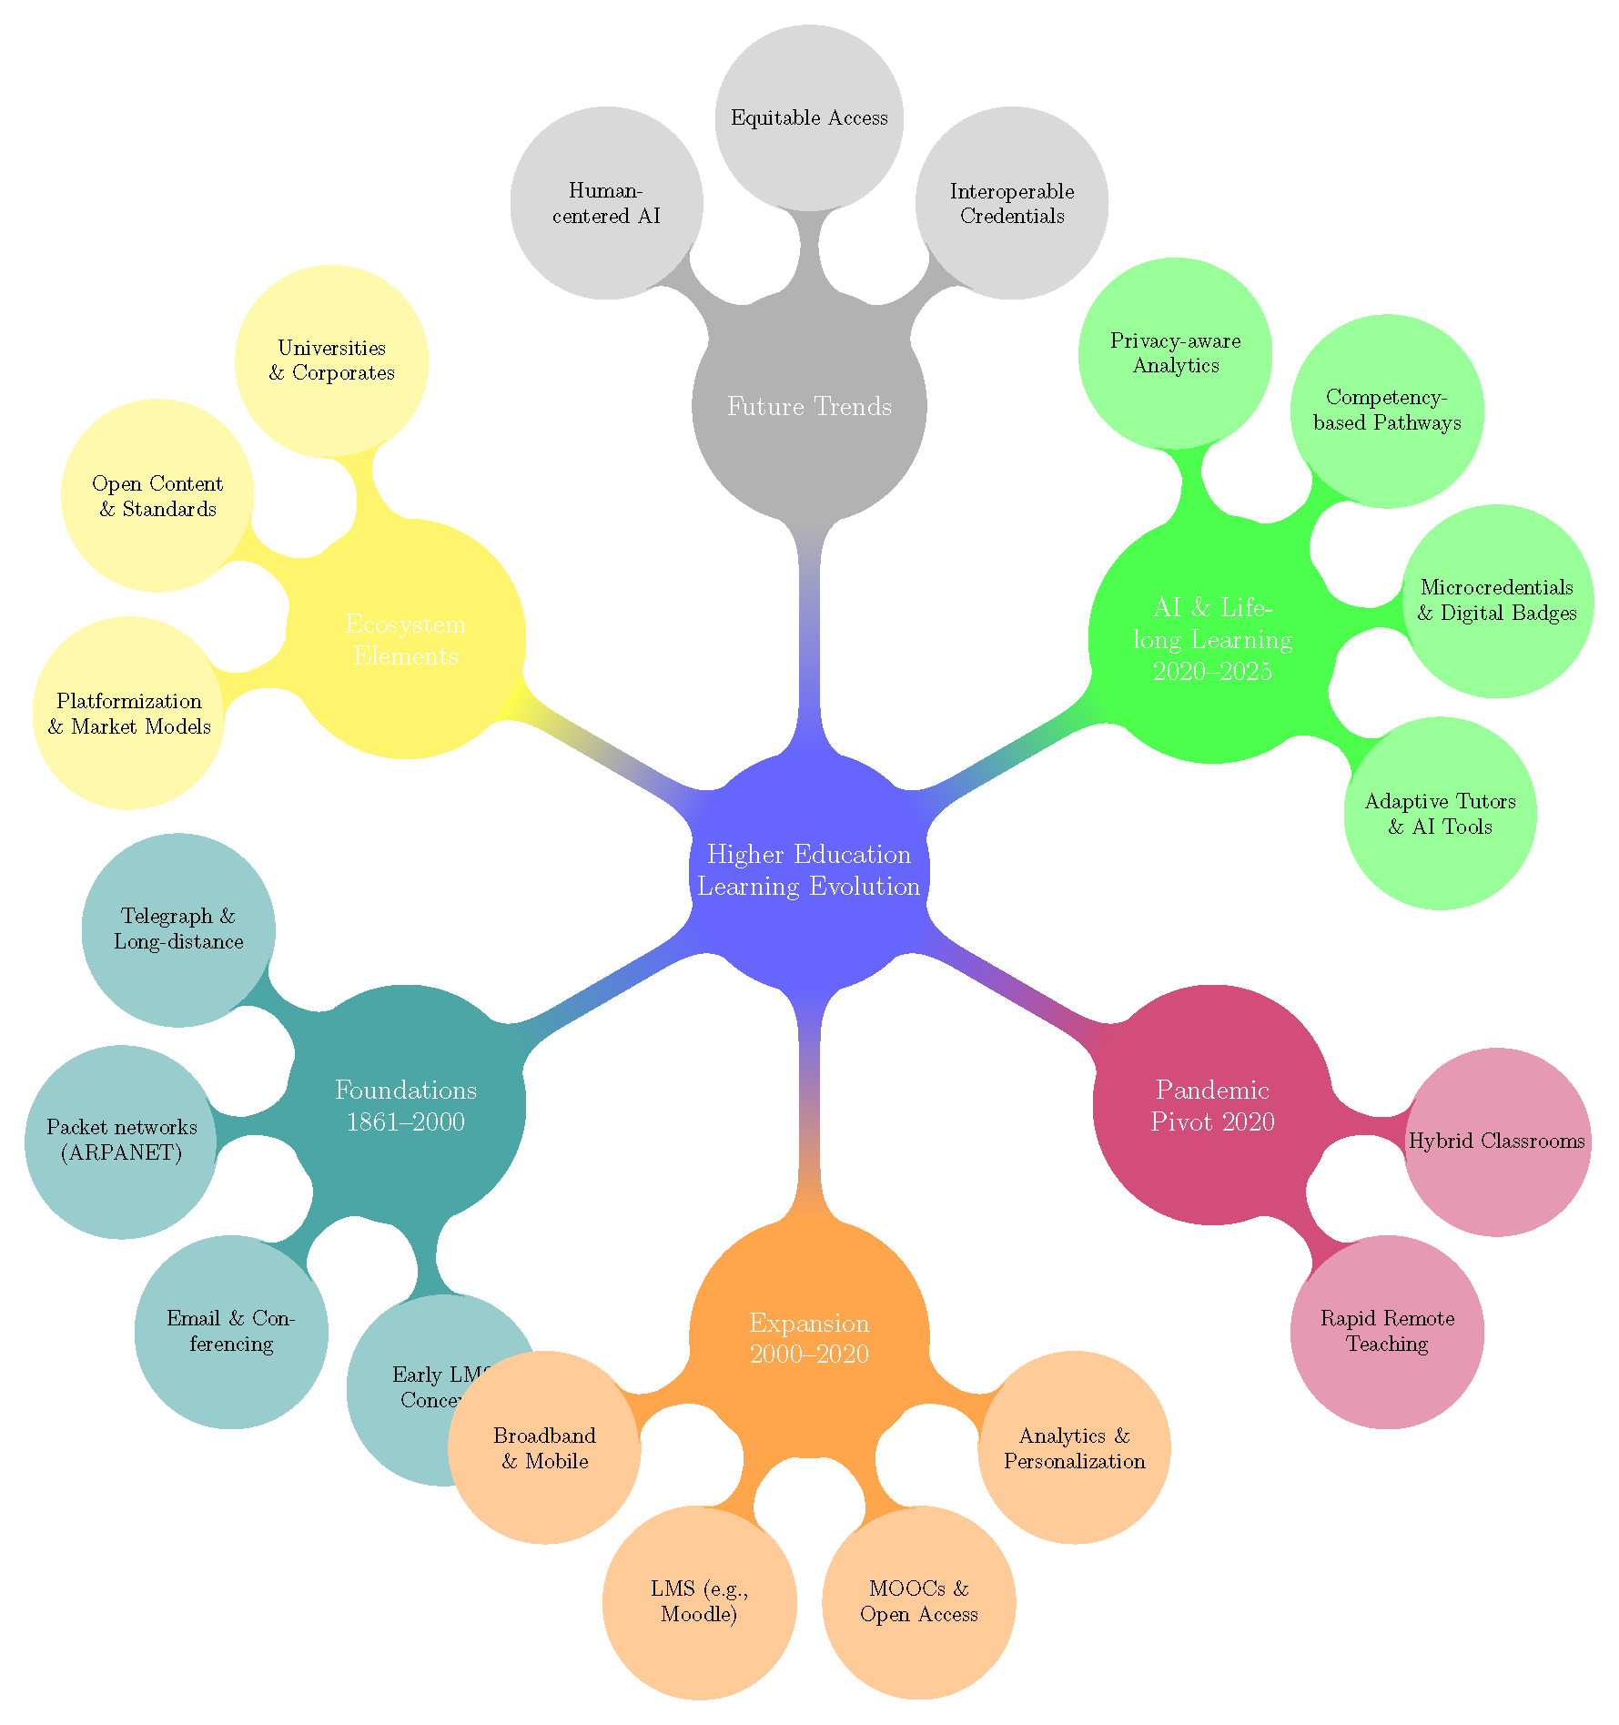
Conclusion
Higher education has moved from early telegraph and network experiments to online courses and big learning platforms, and now to classrooms that mix in-person teaching with online tools and AI. Learning is becoming more flexible, with short, job-focused certificates and digital proofs of skills. The future will focus on fair access, clear proof of skills, and AI that helps teachers and students learn better..
Thanks for listening

