Slide 1

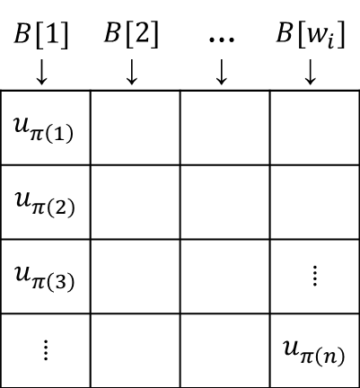

$$B[1]$$ ↓ | $$B[2]$$ ↓ | $$\text{…}$$ ↓ | $$B[w_{i}]$$ ↓
$$u_{π\left(1\right)}^{}$$
$$u_{π\left(2\right)}^{}$$
$$u_{π\left(3\right)}^{}$$ |  |  | ⁞
⁞ |  |  | $$u_{π\left(n\right)}^{}$$
$$\frac{n}{w_{i}}$$
$$w_{i}$$

