Slide 1



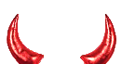
Honest users
Each wants a set of
bridges to connect to Tor
Distributor
Knows the bridges and runs
the bridge distribution algorithm
Corrupt users
Want to block the bridges

