Slide 1
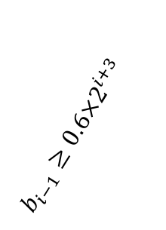
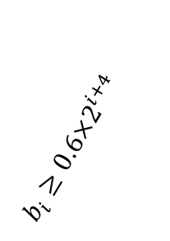
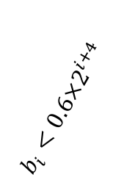
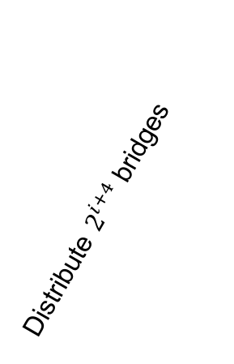



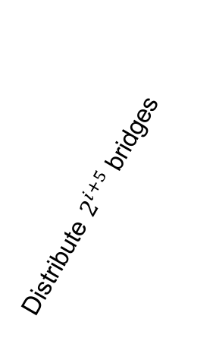
Distribute $2^{i+4}$ bridges
Distribute $2^{i+5}$ bridges
$$b_{i−1}≥{0.6×2}^{i+3}$$
$$b_{i}≥0.6×2^{i+4}$$
$$b_{i}<{0.6×2}^{i+4}$$
…
…
Iterations →
… | S | U | S | S | S | U | S | S | S | S | S | U | S | S | U | S | …
Round $i−1$
Round $i$
Round $i+1$

