Slide 2
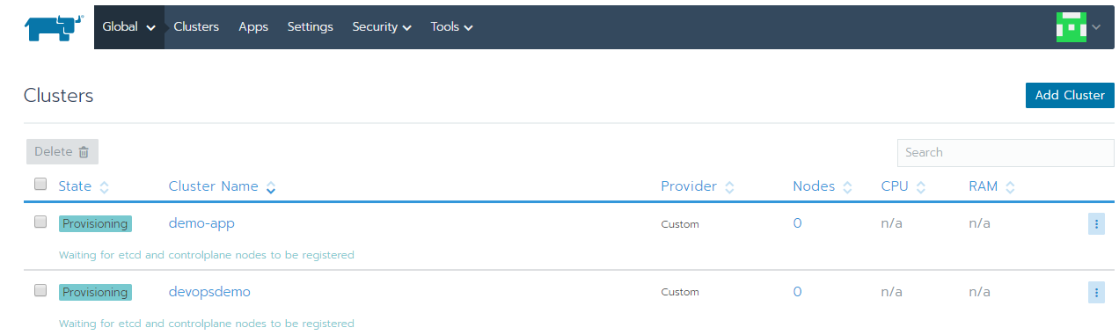
What Is Rancher?
Container Management Tool
Support to deploy Container Orchestration Tool itself like Kubernetes
Make “Container Orchestration itself” abstract and Provide rich UI
UI allow you to deploy your container workload easier than native console
UI allow you to use well-tested catalogue

Slide 3
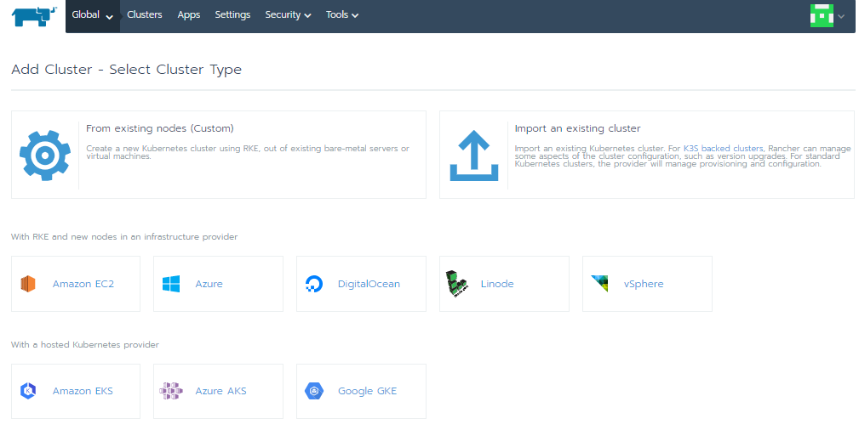
Rancher’s major features
Cross-host networking
Container load balancing
Persistent Storage Services
Service discovery
Service upgrades
Resource management
Multi-tenancy & user management
Multi Orchestration Engines

Slide 4
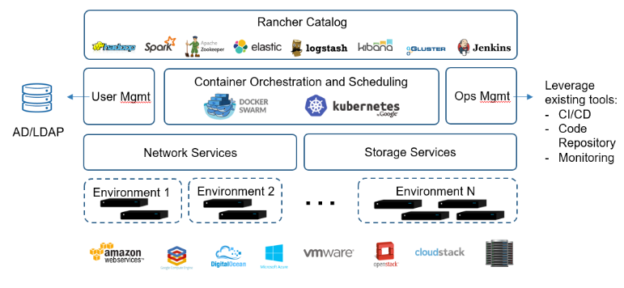
Rancher’s major features(Diagram)

Slide 5
What is Kubernetes?
Kubernetes or K8s was a project spun out of Google as a open source next-gen container scheduler designed with the lessons learned from developing and managing Borg and Omega.
Kubernetes was designed from the ground-up as a loosely coupled collection of components centred around deploying, maintaining, and scaling applications.

Slide 6
Components of a Kubernetes cluster
A working Kubernetes deployment is called a cluster. You can visualize a Kubernetes cluster as two parts: the control plane, which consists of the master node or nodes, and the compute machines, or worker nodes. Worker nodes run pods, which are made up of containers. Each node is its own Linux environment, and could be either a physical or virtual machine

Slide 7
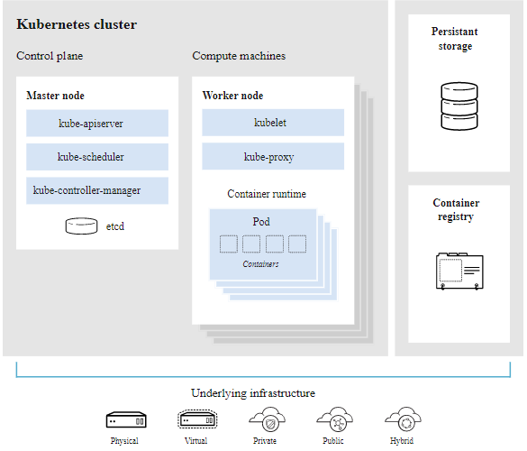
Components of a Kubernetes cluster (Diagram)

Slide 8
What happens in the Kubernetes control plane?
Control plane
Let’s begin in the nerve centre of our Kubernetes cluster: The control plane. Here we find the master node, which includes the Kubernetes components that control the cluster, along with data about the cluster’s state and configuration. The control plane is in constant contact with our worker nodes.
Master node
Inside the master node, core Kubernetes components handle the important work of making sure your containers are running in sufficient numbers and with the necessary resources.

Slide 9
What happens in the Kubernetes control plane? (Cont..)
kube-apiserver
Need to interact with your Kubernetes cluster? Talk to the API. The Kubernetes API is the front end of the Kubernetes control plane, handling internal and external requests. The API server determines if a request is valid and, if it is, processes it. You can access the API through REST calls, through the kubectl command-line interface, or through other command-line tools such as kubeadm.
kube-scheduler
Is the cluster healthy? If new containers are needed, where will they fit? These are the concerns of the Kubernetes scheduler.
The scheduler considers the resource needs of a pod, such as CPU or memory, along with the health of the cluster. Then it schedules the pod to an appropriate worker node.

Slide 10
What happens in the Kubernetes control plane? (Cont..)
kube-controller-manager
Controllers take care of actually running the cluster, and the Kubernetes controller-manager contains several controller functions in one. One controller consults the scheduler and makes sure the correct number of pods is running. If a pod goes down, another controller notices and responds. A controller connects services to pods, so requests go to the right endpoints. And there are controllers for creating accounts and API access tokens.
etcd
Configuration data and information about the state of the cluster lives in etcd, a key-value store database. Fault-tolerant and distributed, etcd is designed to be the ultimate source of truth about your cluster.

Slide 11
What happens in the Kubernetes Worker Node
Worker nodes
A Kubernetes cluster needs at least one worker node, but will normally have many. Pods are scheduled and orchestrated to run on worker nodes. Need to scale up the capacity of your cluster? Add more worker nodes.
Pods
A pod is the smallest and simplest unit in the Kubernetes object model. It represents a single instance of an application. Each pod is made up of a container or a series of tightly coupled containers, along with options that govern how the containers are run. Pods can be connected to persistent storage in order to run stateful applications.

Slide 12
What happens in the Kubernetes Worker Node (Cont..)
Container runtime engine
To run the containers, each worker has a container runtime engine. Docker is one example, but Kubernetes supports other Open Container Initiative-compliant runtimes as well, such as rkt and CRI-O.
kubelet
Each worker node contains a kubelet, a tiny application that communicates with the master node. The kubelet makes sure containers are running in a pod. When the master node needs something to happen in a worker node, the kubelet executes the action.

Slide 13
What happens in the Kubernetes Worker Node (Cont..)
kube-proxy
Each worker node also contains kube-proxy, a network proxy for facilitating Kubernetes networking services. The kube-proxy handles network communications inside or outside of your cluster—relying either on your operating system’s packet filtering layer, or forwarding the traffic itself.

Slide 14
What else does a Kubernetes cluster need?
Persistent storage
Beyond just managing the containers that run an application, Kubernetes can also manage the application data attached to a cluster. Kubernetes allows users to request storage resources without having to know the details of the underlying storage infrastructure. Persistent volumes are specific to a cluster, rather than a pod, and thus can outlive the life of a pod.
Container registry
The container images that Kubernetes relies on are stored in a container registry. This can be a registry you configure, or a third party registry.
Underlying infrastructure
Where you run Kubernetes is up to you. This can be bare metal servers, virtual machines, public cloud providers, private clouds, and hybrid cloud environments. One of Kubernetes’s key advantages is it works on many different kinds of infrastructure.

Slide 15
Kubernetes Pods
A Pod is the basic execution unit of a Kubernetes application–the smallest and simplest unit in the Kubernetes object model that you create or deploy. A Pod represents processes running on the cluster
A Pod encapsulates an application’s container (or, in some cases, multiple containers), storage resources, a unique network identity (IP address), as well as options that govern how the container(s) should run. A Pod represents a unit of deployment: a single instance of an application in Kubernetes, which might consist of either a single container or a small number of containers that are tightly coupled and that share resources.
Docker is the most common container runtime used in a Kubernetes Pod, but Pods support other container runtimes as well.

Slide 16
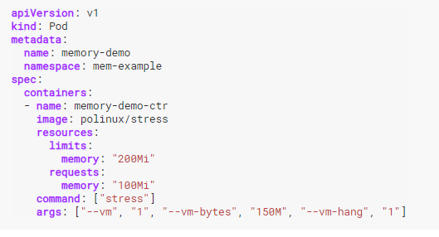
A Sample Kubernetes Pods

Slide 17
Kubernetes ReplicaSet
A ReplicaSet’s purpose is to maintain a stable set of replica Pods running at any given time. As such, it is often used to guarantee the availability of a specified number of identical Pods.
A ReplicaSet is defined with fields, including a selector that specifies how to identify Pods it can acquire, a number of replicas indicating how many Pods it should be maintaining, and a pod template specifying the data of new Pods it should create to meet the number of replicas criteria
A ReplicaSet is linked to its Pods via the Pods’ metadata.ownerReferences field, which specifies what resource the current object is owned by. All Pods acquired by a ReplicaSet have their owning ReplicaSet’s identifying information within their ownerReferences field. It’s through this link that the ReplicaSet knows of the state of the Pods it is maintaining and plans accordingly.

Slide 18
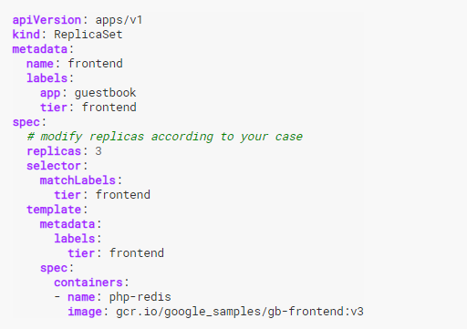
A Sample Kubernetes ReplicaSet

Slide 19
Kubernetes Deployments
A Deployment provides declarative updates for Pods and ReplicaSets.
We describe a desired state in a Deployment, and the Deployment Controller changes the actual state to the desired state at a controlled rate. You can define Deployments to create new ReplicaSets, or to remove existing Deployments and adopt all their resources with new Deployments.

Slide 20
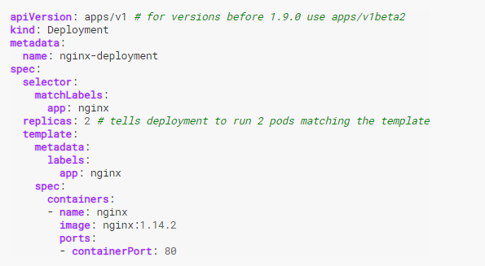
A Sample Kubernetes Deployments

Slide 21
Kubernetes Security
Security is central to modern application and infrastructure design. Kubernetes is a rapidly evolving platform and as such security can become an after-thought in the on-going race to catch up with new releases.
Kubernetes, containerisation and the micro-services trend introduce new security challenges. The fact that Kubernetes pods can be easily spun up across all infrastructure classes leads by default to a lot more internal traffic between pods. This also means that the attack surface for Kubernetes is usually larger. Additionally, the highly dynamic and ephemeral environment of Kubernetes does not lend itself well to legacy security tools.

Slide 22
Kubernetes Security (Attack Surface)
Network Attackers typically enter through a network connection and expand the attack via the network. The network offers the first opportunity to an attack, subsequent opportunities to detect lateral movement, and the last opportunity to catch data stealing activity.
Container Compromised containers can attempt to connect with other running pods on the same or other hosts to probe or launch an attack. Although Layer 3 network controls whitelisting pod IP addresses can offer some protection, attacks over trusted IP addresses can only be detected with Layer 7 network filtering.
Host Here is where traditional host (endpoint) security can be useful to detect exploits against the kernel or system resources. However, host security tools must also be Kubernetes and container aware to ensure adequate coverage.

Slide 23
Kubernetes Security (Attack Surface)
Network Attackers typically enter through a network connection and expand the attack via the network. The network offers the first opportunity to an attack, subsequent opportunities to detect lateral movement, and the last opportunity to catch data stealing activity.
Container Compromised containers can attempt to connect with other running pods on the same or other hosts to probe or launch an attack. Although Layer 3 network controls whitelisting pod IP addresses can offer some protection, attacks over trusted IP addresses can only be detected with Layer 7 network filtering.
Host Here is where traditional host (endpoint) security can be useful to detect exploits against the kernel or system resources. However, host security tools must also be Kubernetes and container aware to ensure adequate coverage.

Slide 24
Reducing Attack Surface
Host Attack Surface
Enable SELinux
AppArmor
Seccomp
Container Attack Surface
Use secure base image when building containers.
Check for vulnerabilities periodically for container Image.
Run container as non root
Limit host mounts.
Kubernetes Cluster Attack Surface
TLS
Audit Logs
Network Policies
Pod Security Policies
Secrets

