Slide 1
Electromagnetic modelling of superconducting cables
Prof. Fabio Freschi
Email: fabio.freschi@polito.it
Telegram: @DualFab

Slide 2
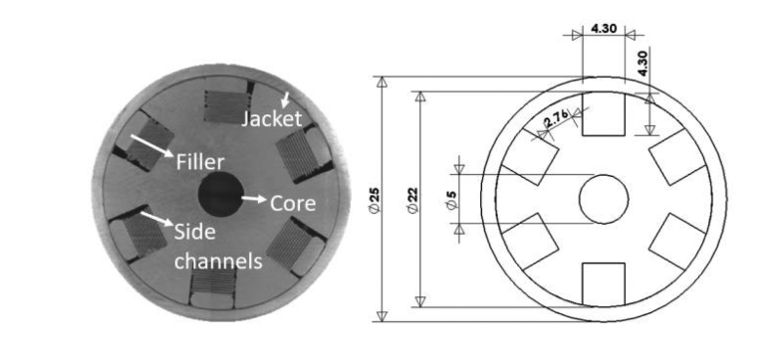
Aim of this lecture
ENEA HTS CICC
aluminum core
six twisted slots with 0.5 m twist pitch
each slot is equipped with 20 nonsoldered REBCO tapes having a width of 4 mm
tapes are held in position using an aluminum filler,
The cable is then inserted in an aluminum pipe (1.5-mm thick).
A. Zappatore et al., "Modeling Quench Propagation in the ENEA HTS Cable-In-Conduit Conductor," in IEEE Transactions on Applied Superconductivity, vol. 30, no. 8, pp. 1-7, Dec. 2020, Art no. 4603307, doi: 10.1109/TASC.2020.3001035.

Slide 3






From circuit theory…
$$line$$
$$R$$
$$L$$
$$e(t)$$
+
$$load$$
$$e(t)$$
+
$$load$$
-
-

Slide 4





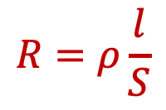
Cable resistance
$$line$$
$$R$$
$$e(t)$$
+
$$load$$
$$e(t)$$
+
$$load$$
-
-
$$R$$
$$R=ρ\frac{l}{S}$$

Slide 5

Nonlinear resistivity
$\vec{J}=σ\vec{E}⟹$ $\vec{E}=ρ\vec{J}$
Macroscopic modelling: power law $E(J)$
$$E=E_{0}{\left(\frac{J}{J_{c}}\right)}^{n}⟹ρ=\frac{E}{J}=\frac{E_{0}}{J_{c}}{\left(\frac{J}{J_{c}}\right)}^{n−1}$$

Slide 6
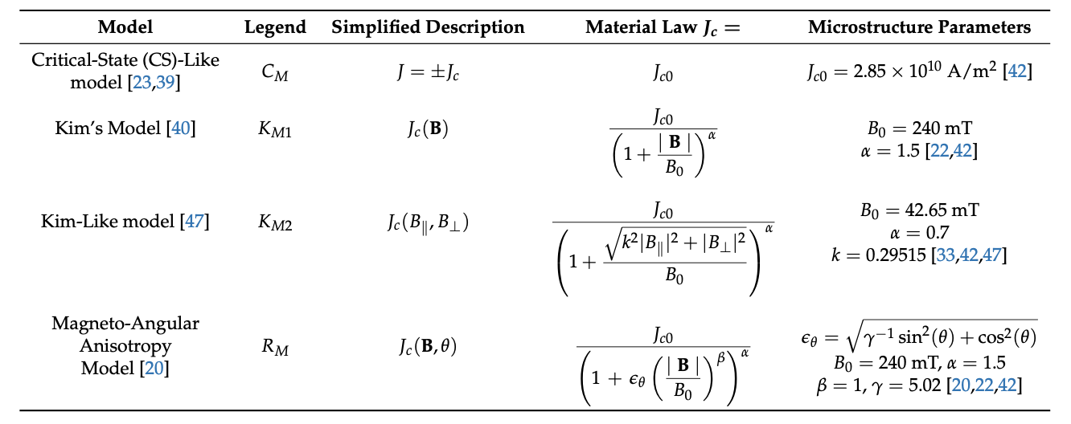


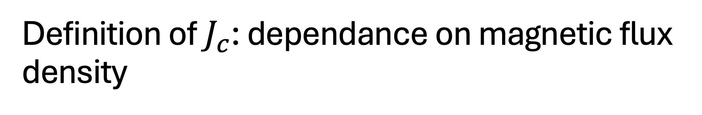




Definition of $J_{c}$: dependance on magnetic flux density
$$B_{⊥}$$
$$\vec{B}$$
$$θ$$
$$i$$
$$B_{∥}$$
$$−90°≤θ≤90°$$
Robert, B. C., Fareed, M. U., & Ruiz, H. S. (2019). How to Choose the Superconducting Material Law for the Modelling of 2G-HTS Coils. Materials, 12(17), 2679. https://doi.org/10.3390/ma12172679

Slide 7
Comparison

Slide 8
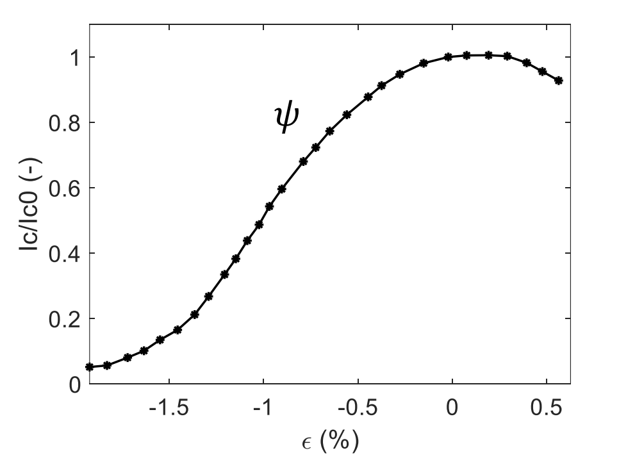


Definition of $J_{c}$: dependance on temperature and strain
Scaling of $J_{c}$ with temperature
$$J_{c}=J_{c0}{\left(1−\frac{T}{T_{c}}\right)}^{s}$$
$$with 1.9≤s≤2.6$$
Strain dependance
Q. Wang et al., "Temperature dependence of transport critical current density for REBCO superconducting tapes deposited by MOCVD," in Superconductor Science and Technology, Volume 37, Number 1, pp. 1-12, 2024, Art no. 015006, doi: 10.1088/1361-6668/ad0db5.
D.C. van der Laan et al., "Status of CORC® cables and wires for use in high-field magnets and power systems a decade after their introduction," in Superconductor Science and Technology, Volume 32, Number 3, pp. 1-12, 2019, Art no. 033001, doi: 10.1088/1361-6668/aafc82.

Slide 9

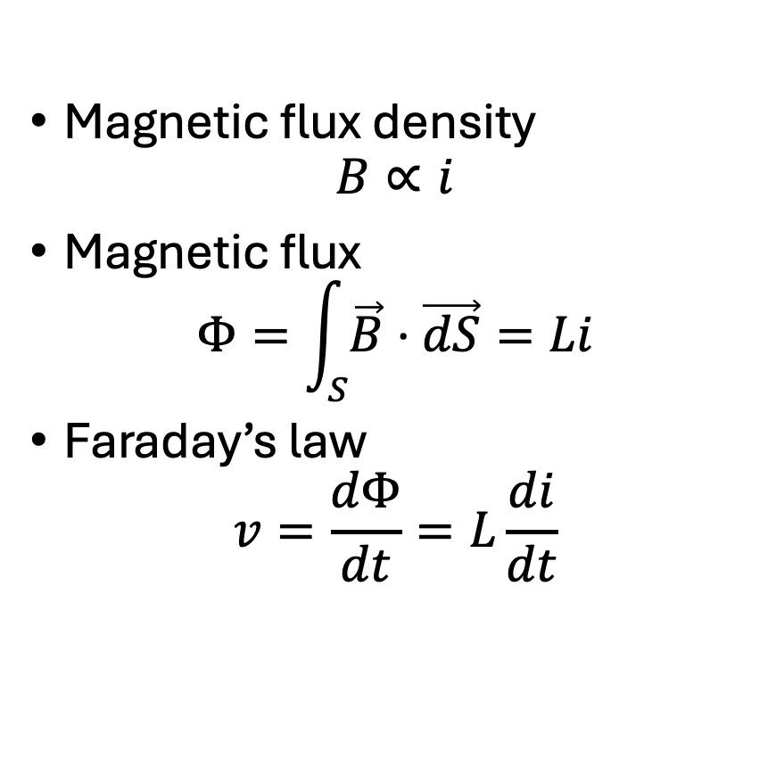



Self inductance
Magnetic flux density
$$B∝i$$
Magnetic flux
$$Φ=\int_{S}{\vec{B}⋅\vec{dS}=Li}$$
Faraday’s law
$$v=\frac{dΦ}{dt}=L\frac{di}{dt}$$
$$S$$
$$i$$
$$v$$
$$\vec{B}$$

Slide 10

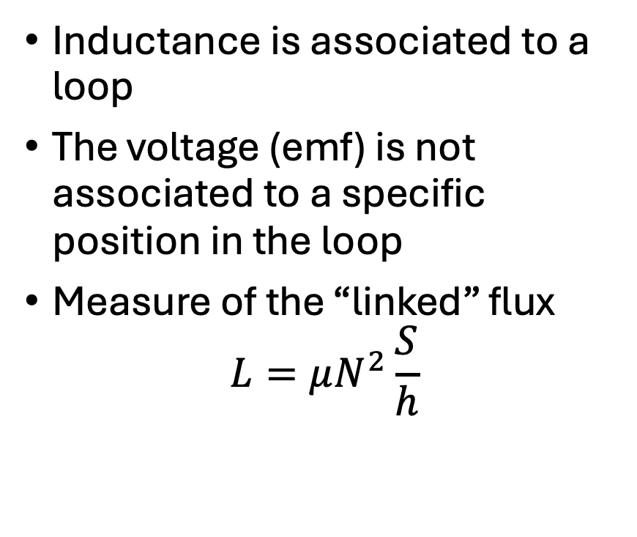



Self inductance
Inductance is associated to a loop
The voltage (emf) is not associated to a specific position in the loop
Measure of the “linked” flux
$$L=μN^{2}\frac{S}{h}$$
$$N turns$$
$$i$$
$$h$$
$$S$$
$$v$$

Slide 11

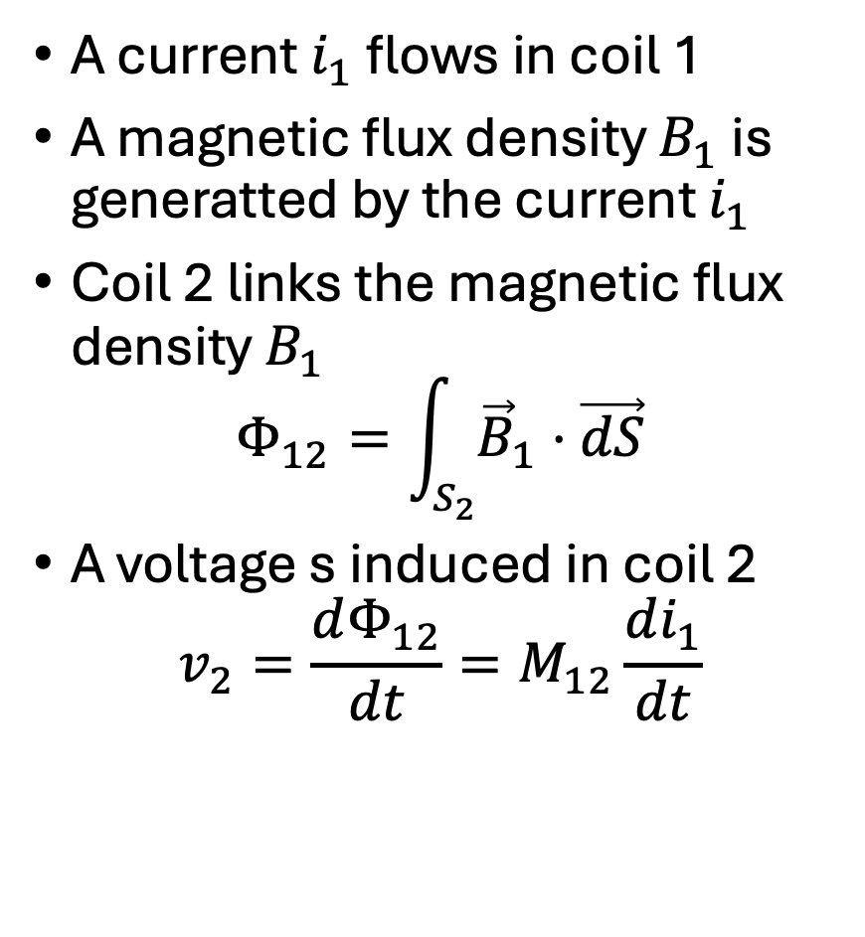



Mutual inductance
A current $i_{1}$ flows in coil 1
A magnetic flux density $B_{1}$ is generatted by the current $i_{1}$
Coil 2 links the magnetic flux density $B_{1}$
$$Φ_{12}=\int_{S_{2}}{{\vec{B}}_{1}}⋅\vec{dS}$$
A voltage s induced in coil 2
$$v_{2}=\frac{dΦ_{12}}{dt}=M_{12}\frac{di_{1}}{dt}$$
$$i$$
$$S_{2}$$
$${\vec{B}}_{1}$$
$$v_{2}$$

Slide 12
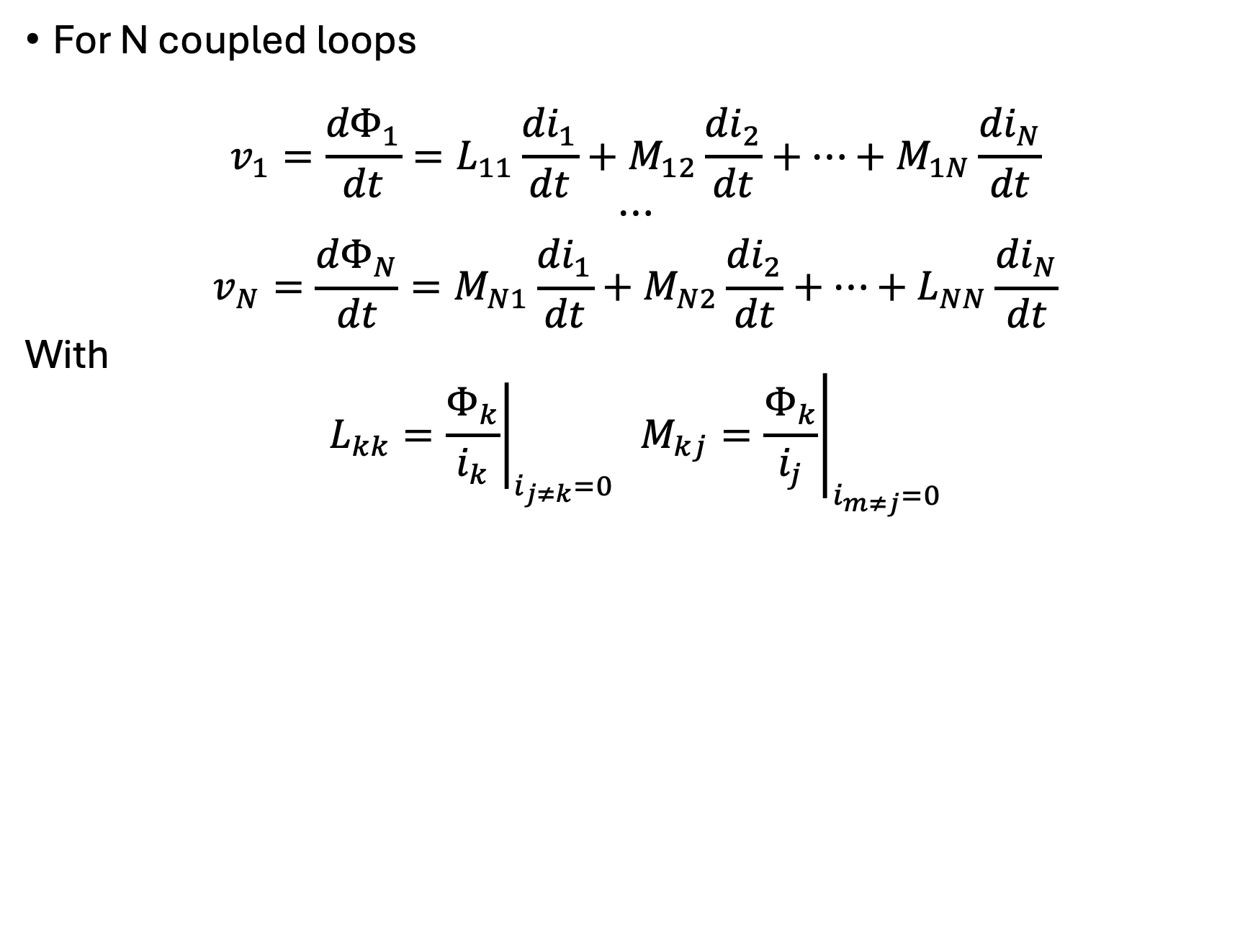
Mutual inductance
For N coupled loops
$$\begin{matrix}v_{1}=\frac{{dΦ}_{1}}{dt}=L_{11}\frac{{di}_{1}}{dt}+M_{12}\frac{{di}_{2}}{dt}+⋯+M_{1N}\frac{{di}_{N}}{dt} \\ ⋯ \\ v_{N}=\frac{{dΦ}_{N}}{dt}=M_{N1}\frac{{di}_{1}}{dt}+M_{N2}\frac{{di}_{2}}{dt}+⋯+L_{NN}\frac{{di}_{N}}{dt}\end{matrix}$$
With
$$L_{kk}={\left.\frac{Φ_{k}}{i_{k}}\right|}_{i_{j≠k}=0} M_{kj}={\left.\frac{Φ_{k}}{i_{j}}\right|}_{i_{m≠j}=0}$$

Slide 13
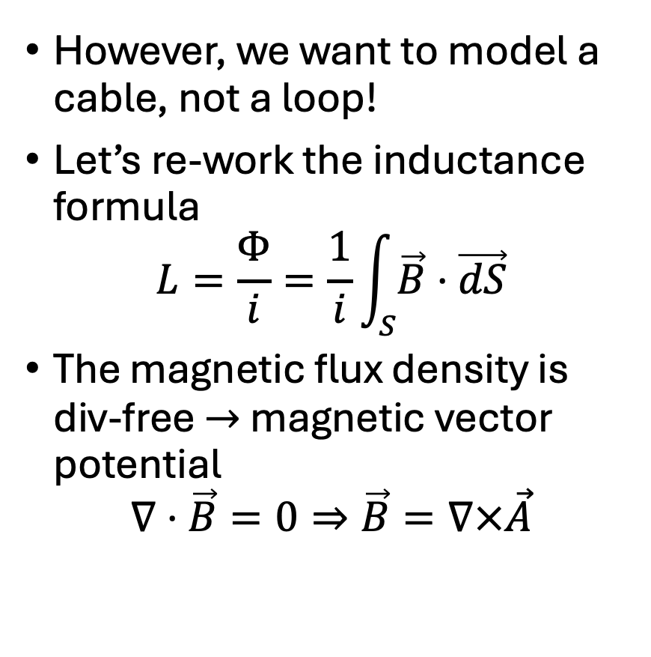



Partial inductance
However, we want to model a cable, not a loop!
Let’s re-work the inductance formula
$$L=\frac{Φ}{i}=\frac{1}{i}\int_{S}{\vec{B}⋅\vec{dS}}$$
The magnetic flux density is div-free $→$ magnetic vector potential
$$∇⋅\vec{B}=0⇒\vec{B}=∇×\vec{A}$$
$$R$$
$$L$$
$$e(t)$$
+
$$load$$
-

Slide 14

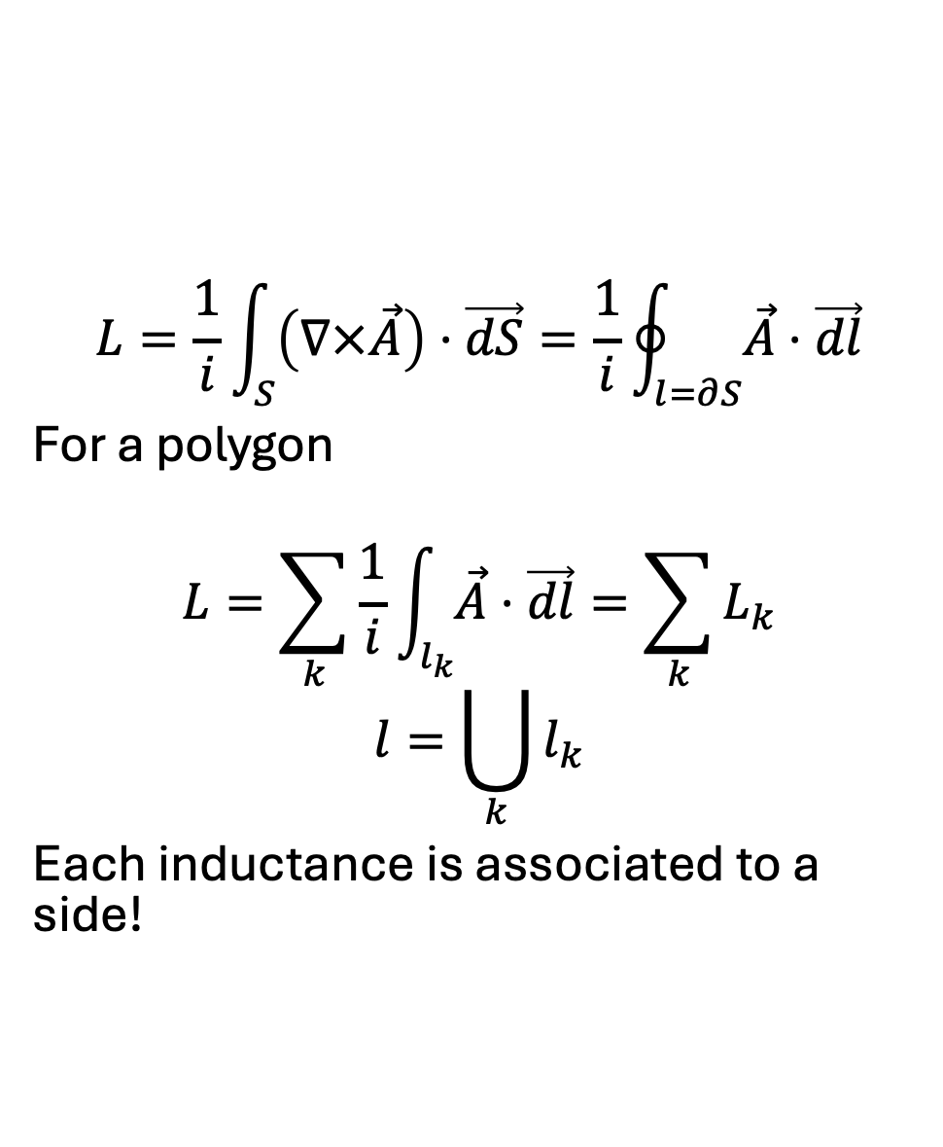

Partial inductance
$$L=\frac{1}{i}\int_{S}{\left(∇×\vec{A}\right)⋅\vec{dS}=\frac{1}{i}\oint_{l=∂S}{\vec{A}⋅\vec{dl}}}$$
For a polygon
$$L=\sum_{k}{\frac{1}{i}\int_{l_{k}}{\vec{A}⋅\vec{dl}}=\sum_{k}{L_{k}}}$$
$$l=\bigcup_{k}{l_{k}}$$
Each inductance is associated to a side!
$$\vec{B}$$
$$\vec{A}$$

Slide 15
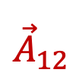


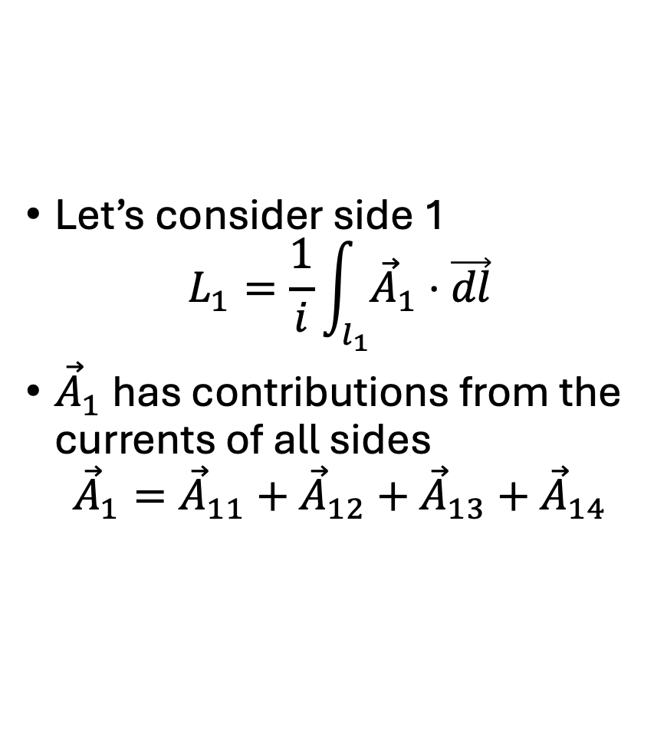


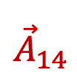

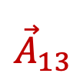
Partial inductance
Let’s consider side 1
$$L_{1}=\frac{1}{i}\int_{l_{1}}{{\vec{A}}_{1}⋅\vec{dl}}$$
${\vec{A}}_{1}$ has contributions from the currents of all sides
$${\vec{A}}_{1}={\vec{A}}_{11}+{\vec{A}}_{12}+{\vec{A}}_{13}+{\vec{A}}_{14}$$
$${\vec{A}}_{11}$$
$$i_{1}$$
$${\vec{A}}_{12}$$
$$i_{4}$$
$$i_{2}$$
$${\vec{A}}_{14}$$
$${\vec{A}}_{13}$$
$$i_{3}$$

Slide 16
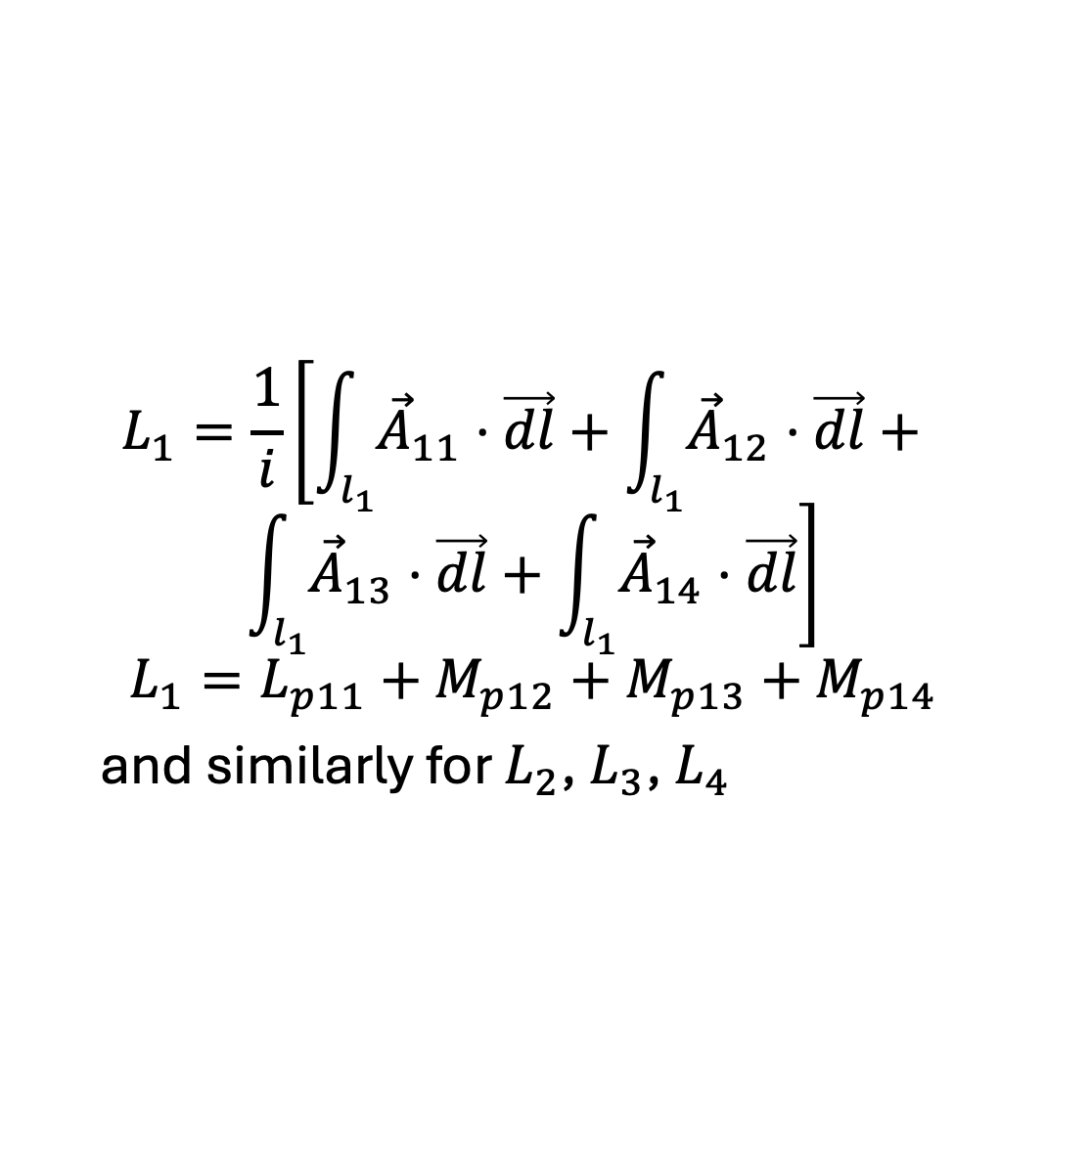
Partial inductance
$$L_{1}=\frac{1}{i}\left[\int_{l_{1}}{{\vec{A}}_{11}⋅\vec{dl}}+\int_{l_{1}}{{\vec{A}}_{12}⋅\vec{dl}}+ \right.$$
$$\left.\int_{l_{1}}{{\vec{A}}_{13}⋅\vec{dl}}+\int_{l_{1}}{{\vec{A}}_{14}⋅\vec{dl}}\right]$$
$$L_{1}=L_{p11}+M_{p12}+M_{p13}+M_{p14}$$
and similarly for $L_{2}$, $L_{3}$, $L_{4}$
$${\vec{A}}_{11}$$
$$i_{1}$$
$${\vec{A}}_{12}$$
$$i_{4}$$
$$i_{2}$$
$${\vec{A}}_{14}$$
$${\vec{A}}_{13}$$
$$i_{3}$$

Slide 17
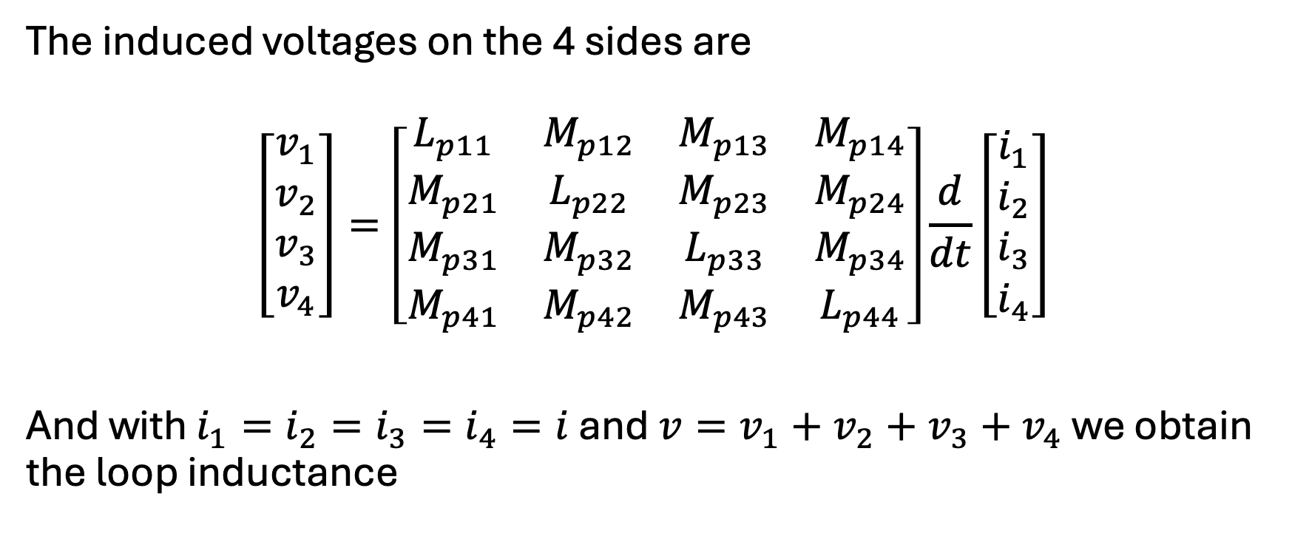
Partial inductance
The induced voltages on the 4 sides are
$$\left[\begin{matrix}v_{1} \\ v_{2} \\ v_{3} \\ v_{4}\end{matrix}\right]=\left[\begin{matrix}L_{p11} & M_{p12} & M_{p13} & M_{p14} \\ M_{p21} & L_{p22} & M_{p23} & M_{p24} \\ M_{p31} & M_{p32} & L_{p33} & M_{p34} \\ M_{p41} & M_{p42} & M_{p43} & L_{p44}\end{matrix}\right]\frac{d}{dt}\left[\begin{matrix}i_{1} \\ i_{2} \\ i_{3} \\ i_{4}\end{matrix}\right]$$
And with $i_{1}=i_{2}=i_{3}=i_{4}=i$ and $v=v_{1}+v_{2}+v_{3}+v_{4}$ we obtain the loop inductance

Slide 18

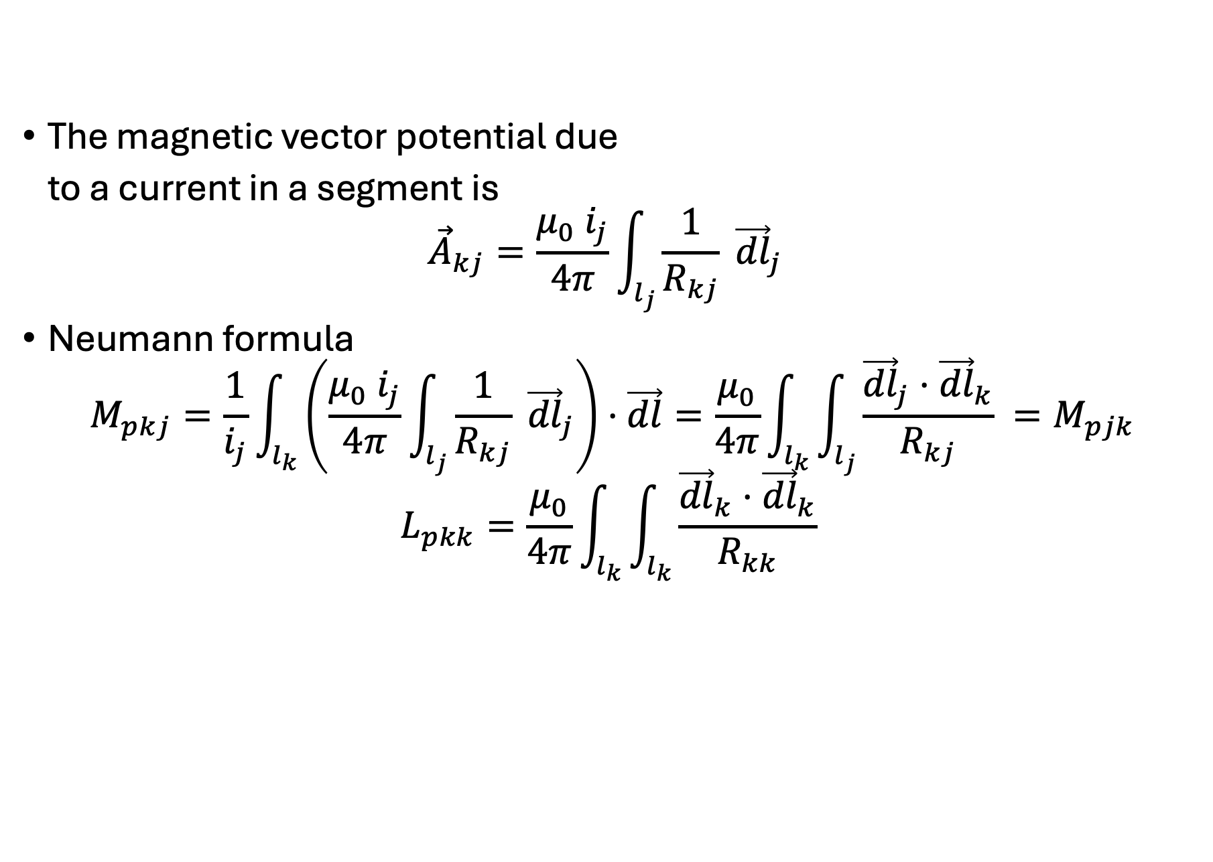



Partial inductances: calculation
$$k$$
The magnetic vector potential due
to a current in a segment is
$${\vec{A}}_{kj}=\frac{μ_{0}{ i}_{j}}{4π}\int_{l_{j}}{\frac{1}{R_{kj}} {\vec{dl}}_{j}}$$
Neumann formula
$$M_{pkj}=\frac{1}{i_{j}}\int_{l_{k}}{\left(\frac{μ_{0}{ i}_{j}}{4π}\int_{l_{j}}{\frac{1}{R_{kj}} {\vec{dl}}_{j}}\right)⋅\vec{dl}}=\frac{μ_{0}}{4π}\int_{l_{k}}{\int_{l_{j}}{\frac{{\vec{dl}}_{j}⋅{\vec{dl}}_{k}}{R_{kj}} }}=M_{pjk}$$
$$L_{pkk}=\frac{μ_{0}}{4π}\int_{l_{k}}{\int_{l_{k}}{\frac{{\vec{dl}}_{k}⋅{\vec{dl}}_{k}}{R_{kk}} }}$$
$$R_{kj}$$
$$i_{j}$$
$${\vec{dl}}_{j}$$
Singular!

Slide 19
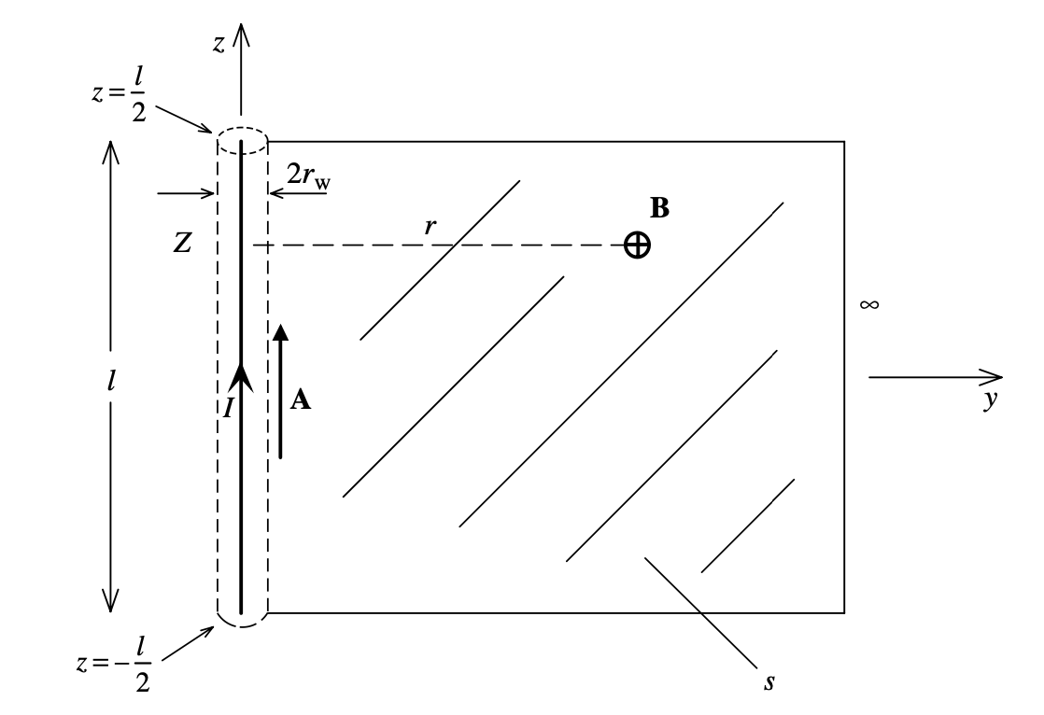
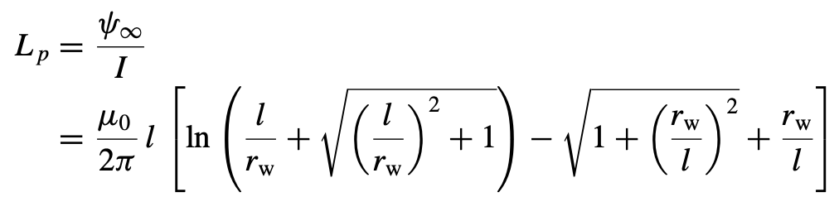
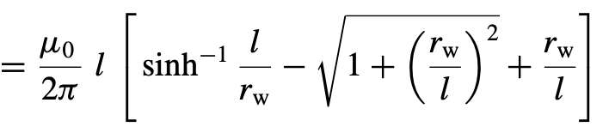
Partial inductances: calculation
C. Paul, Inductance - Loop and Partial, Wiley 2010

Slide 20
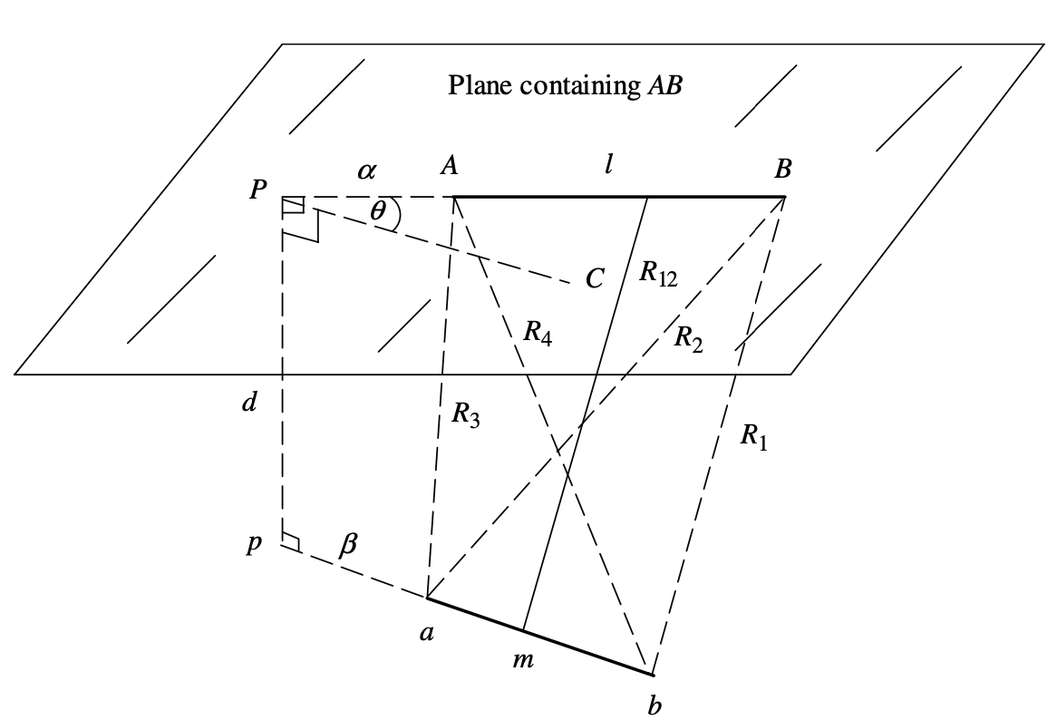
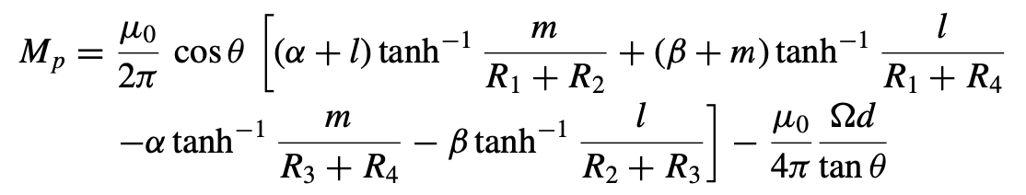
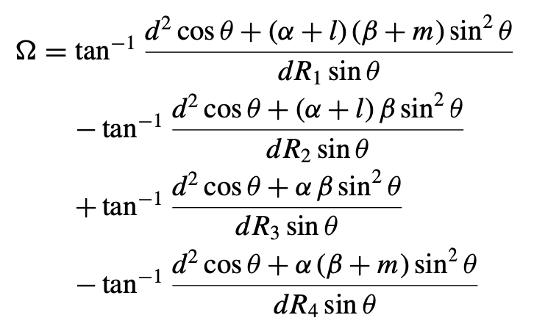
Partial inductances: calculation
C. Paul, Inductance - Loop and Partial, Wiley 2010

Slide 21
Partial inductances: calculation
Different analytic formulas for
Parallel wires
Parallel wires that are offset
Aligned with offset wires
Aligned touching
Wires at an Angle to each other join at a common point
Wires at an Angle to each other not touching
Wires skewed and displaced
Or: numerical evaluation of the Neumann formula

Slide 22



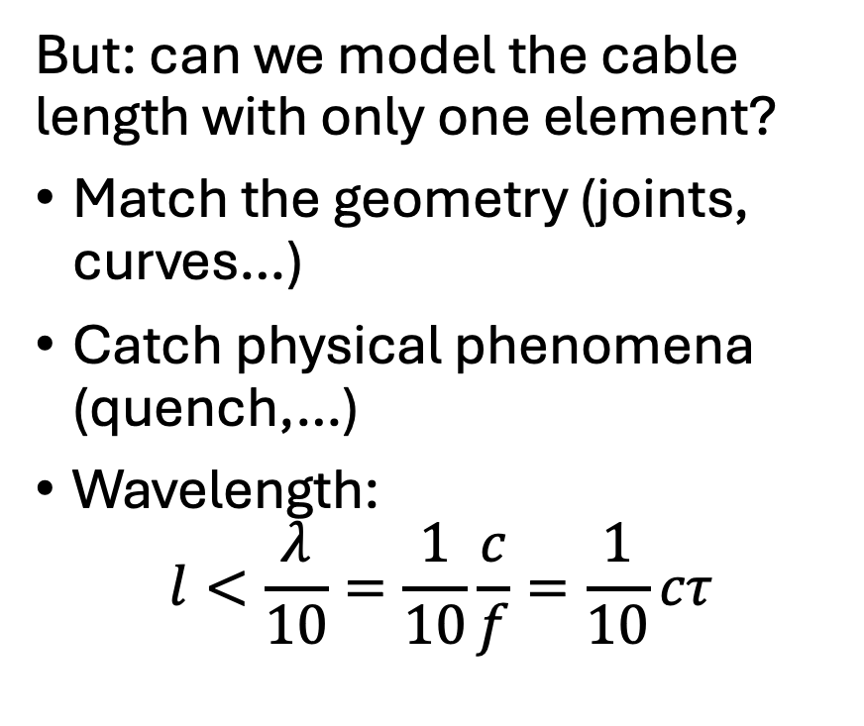



Cable modelling
But: can we model the cable length with only one element?
Match the geometry (joints, curves…)
Catch physical phenomena (quench,…)
Wavelength:
$$l<\frac{λ}{10}=\frac{1}{10}\frac{c}{f}=\frac{1}{10}cτ$$
$$R$$
$$L_{p11}$$
$$e(t)$$
+
$$M_{p12}$$
$$load$$
-
$$R$$
$$L_{p22}$$

Slide 23

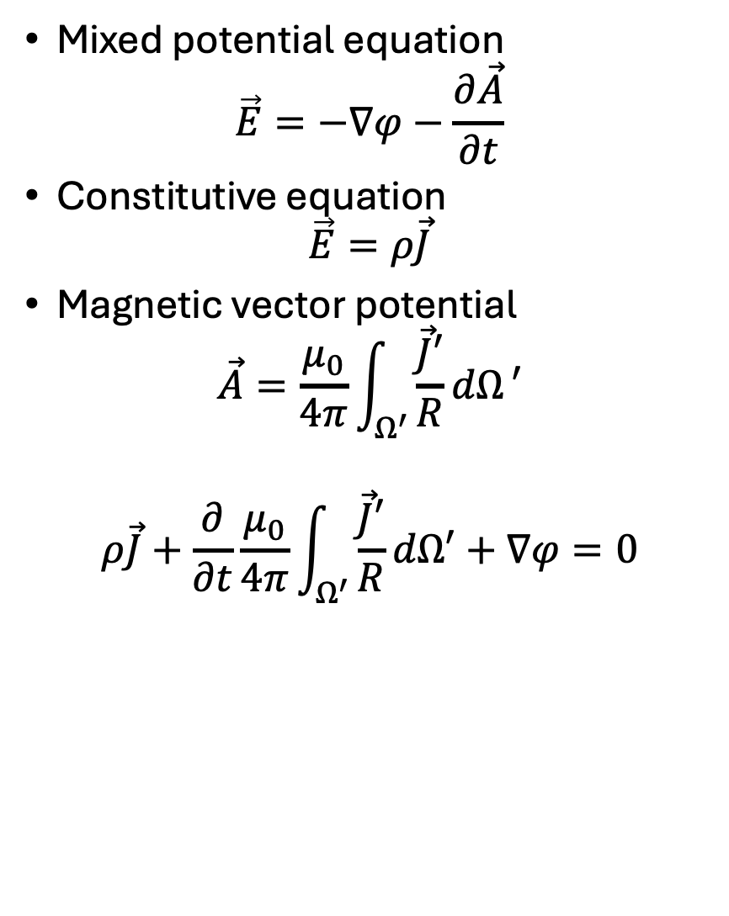
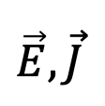


Formulation from Maxwell Equations
$$\vec{E},\vec{J}$$
Mixed potential equation
$$\vec{E}=−∇φ−\frac{∂\vec{A}}{∂t}$$
Constitutive equation
$$\vec{E}=ρ\vec{J}$$
Magnetic vector potential
$$\vec{A}=\frac{μ_{0}}{4π}\int_{Ω^{′}}{\frac{\vec{J}′}{R}dΩ}′$$
$$ρ\vec{J}+\frac{∂}{∂t}\frac{μ_{0}}{4π}\int_{Ω^{′}}{\frac{\vec{J}′}{R}dΩ′}+∇φ=0$$
$$R$$
$$Ω′$$
$$\vec{J}′$$

Slide 24




Formulation from Maxwell Equations
$$i_{j}$$
$$ρ\vec{J}+\frac{∂}{∂t}\frac{μ_{0}}{4π}\int_{Ω^{′}}{\frac{\vec{J′}}{R}dΩ′}+∇φ=0$$
Hp: polygonal wire conductors
$\vec{J}$ uniform in $S→\vec{J}=\frac{i}{S}{\vec{u}}_{l}$
$\vec{J}$ parallel to $\vec{dl}′$
$$\vec{A}=\sum_{k}{\frac{μ_{0}}{4π}\int_{l_{k}^{′}}{\frac{i_{k}^{′}}{R_{k}}{\vec{dl}}_{k}^{′}}}$$
$$R_{k}$$
$$Ω′$$
$$i_{k}^{′}$$

Slide 25
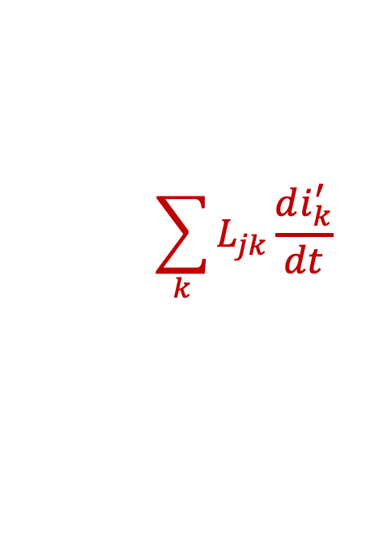

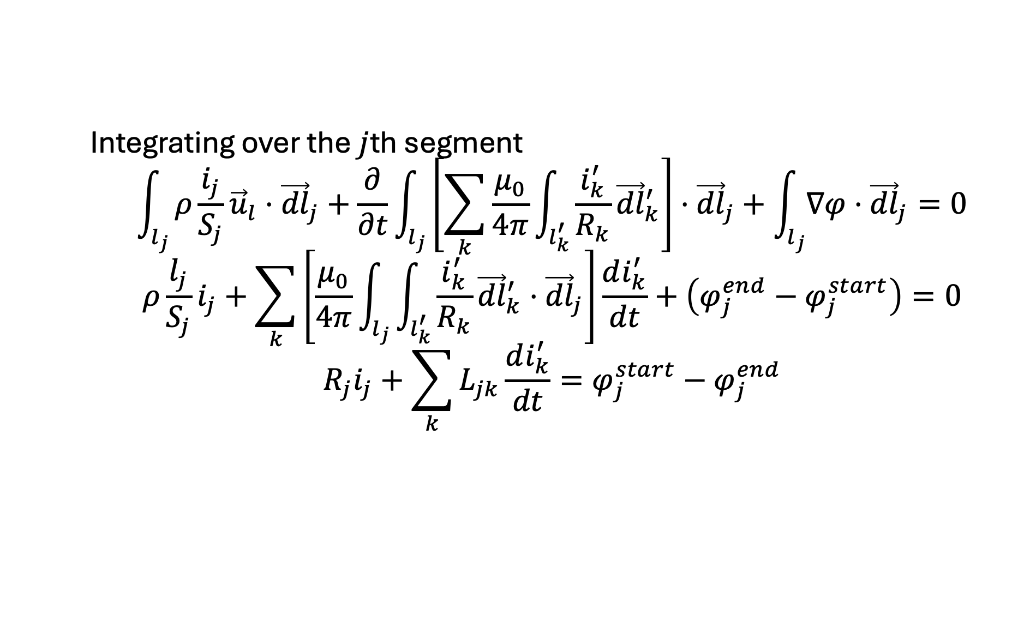



Formulation from Maxwell Equations
Integrating over the $j$th segment
$$\int_{l_{j}}{ρ\frac{i_{j}}{S_{j}}}{\vec{u}}_{l}⋅{\vec{dl}}_{j}+\frac{∂}{∂t}\int_{l_{j}}{\left[\sum_{k}{\frac{μ_{0}}{4π}\int_{l_{k}^{′}}{\frac{i_{k}^{′}}{R_{k}}{\vec{dl}}_{k}^{′}}}\right]⋅{\vec{dl}}_{j}}+\int_{l_{j}}{∇φ}⋅{\vec{dl}}_{j}=0$$
$$ρ\frac{l_{j}}{S_{j}}i_{j}+\sum_{k}{\left[\frac{μ_{0}}{4π}\int_{l_{j}}{\int_{l_{k}^{′}}{\frac{i_{k}^{′}}{R_{k}}{\vec{dl}}_{k}^{′}}⋅{\vec{dl}}_{j}}\right]}\frac{di_{k}^{′}}{dt}+\left(φ_{j}^{end}−φ_{j}^{start}\right)=0$$
$$R_{j}i_{j}+\sum_{k}{L_{jk}}\frac{di_{k}^{′}}{dt}=φ_{j}^{start}−φ_{j}^{end}$$
$$φ_{j}^{start}$$
$$i_{j}$$
$$φ_{j}^{end}$$
$$R_{j}$$
$$\sum_{k}{L_{jk}}\frac{di_{k}^{′}}{dt}$$

Slide 26
Electromagnetic modelling of SC cable

Slide 27

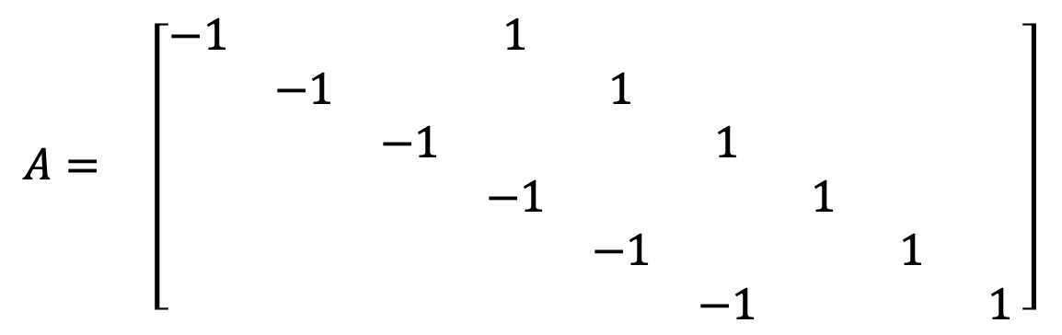


Incidence matrix
1
4
7
$$N_{N}=9$$
1
4
2
5
8
$$N_{E}=6$$
2
5
3
6
9
3
6
1
2
3
4
5
6
7
8
9
$$A= \left[\begin{matrix}−1 & & & 1 & & & & & \\ & −1 & & & 1 & & & & \\ & & −1 & & & 1 & & & \\ & & & −1 & & & 1 & & \\ & & & & −1 & & & 1 & \\ & & & & & −1 & & & 1\end{matrix}\right]$$
1
2
Edge-to-node incidence matrix
3
4
5
$$−Aφ=v$$
6

Slide 28
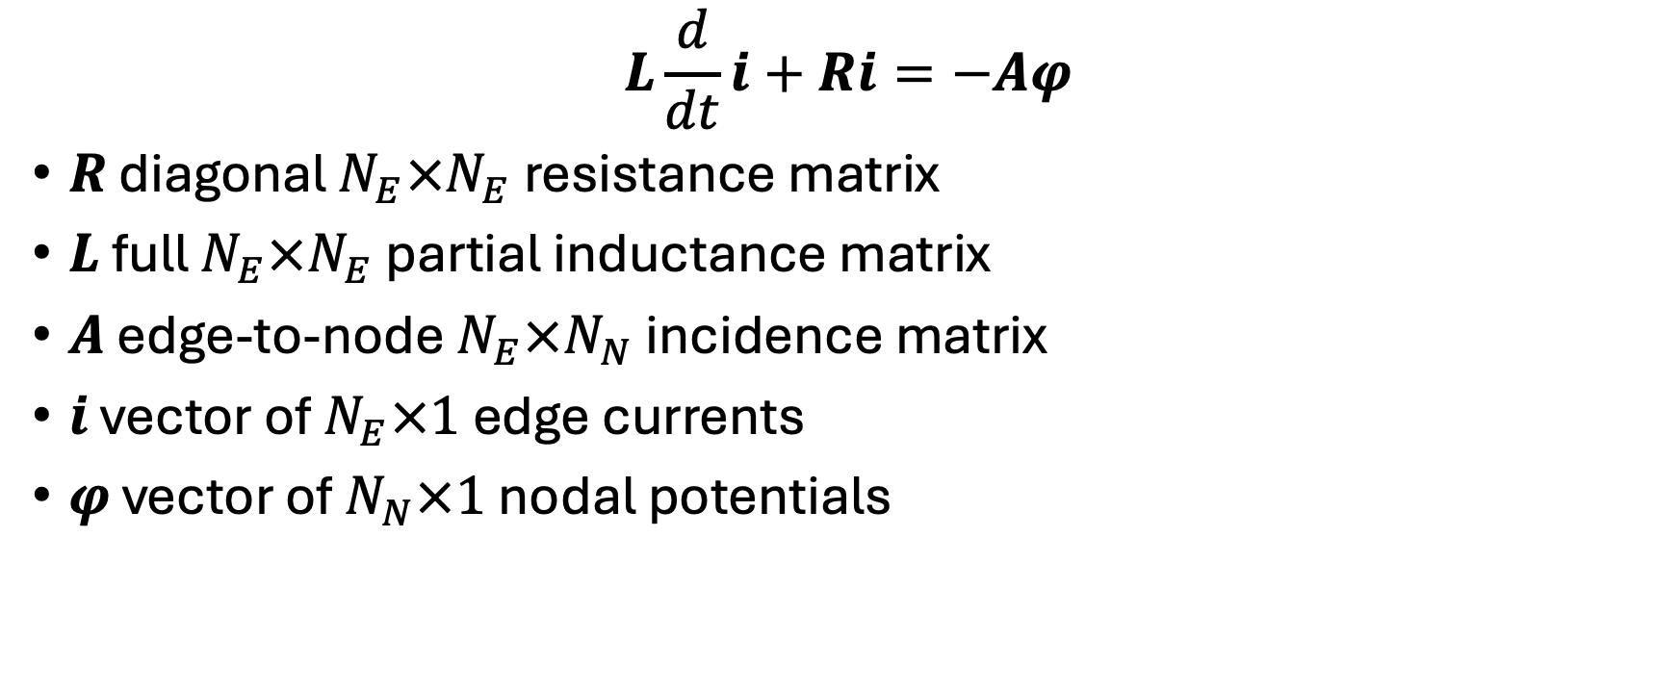
Equations in matrix form
$$L\frac{d}{dt}i+Ri=−Aφ$$
$R$ diagonal $N_{E}×N_{E}$ resistance matrix
$L$ full $N_{E}×N_{E}$ partial inductance matrix
$A$ edge-to-node $N_{E}×N_{N}$ incidence matrix
$i$ vector of $N_{E}×1$ edge currents
$φ$ vector of $N_{N}×1$ nodal potentials

Slide 29









Electromagnetic modelling of SC cable
$$i_{s}$$
1
4
7
$$N_{N}=9$$
$$i_{1}$$
$$i_{4}$$
2
5
8
$$N_{E}=6$$
$$i_{2}$$
$$i_{5}$$
$$i_{s}$$
3
6
9
$$i_{3}$$
$$i_{6}$$
1
2
3
4
5
6
7
8
9
$$A= \left[\begin{matrix}−1 & & & 1 & & & & & \\ & −1 & & & 1 & & & & \\ & & −1 & & & 1 & & & \\ & & & −1 & & & 1 & & \\ & & & & −1 & & & 1 & \\ & & & & & −1 & & & 1\end{matrix}\right]$$
1
KCL
2
3
$$A^{T}i=i_{s}$$
4
5
6

Slide 30
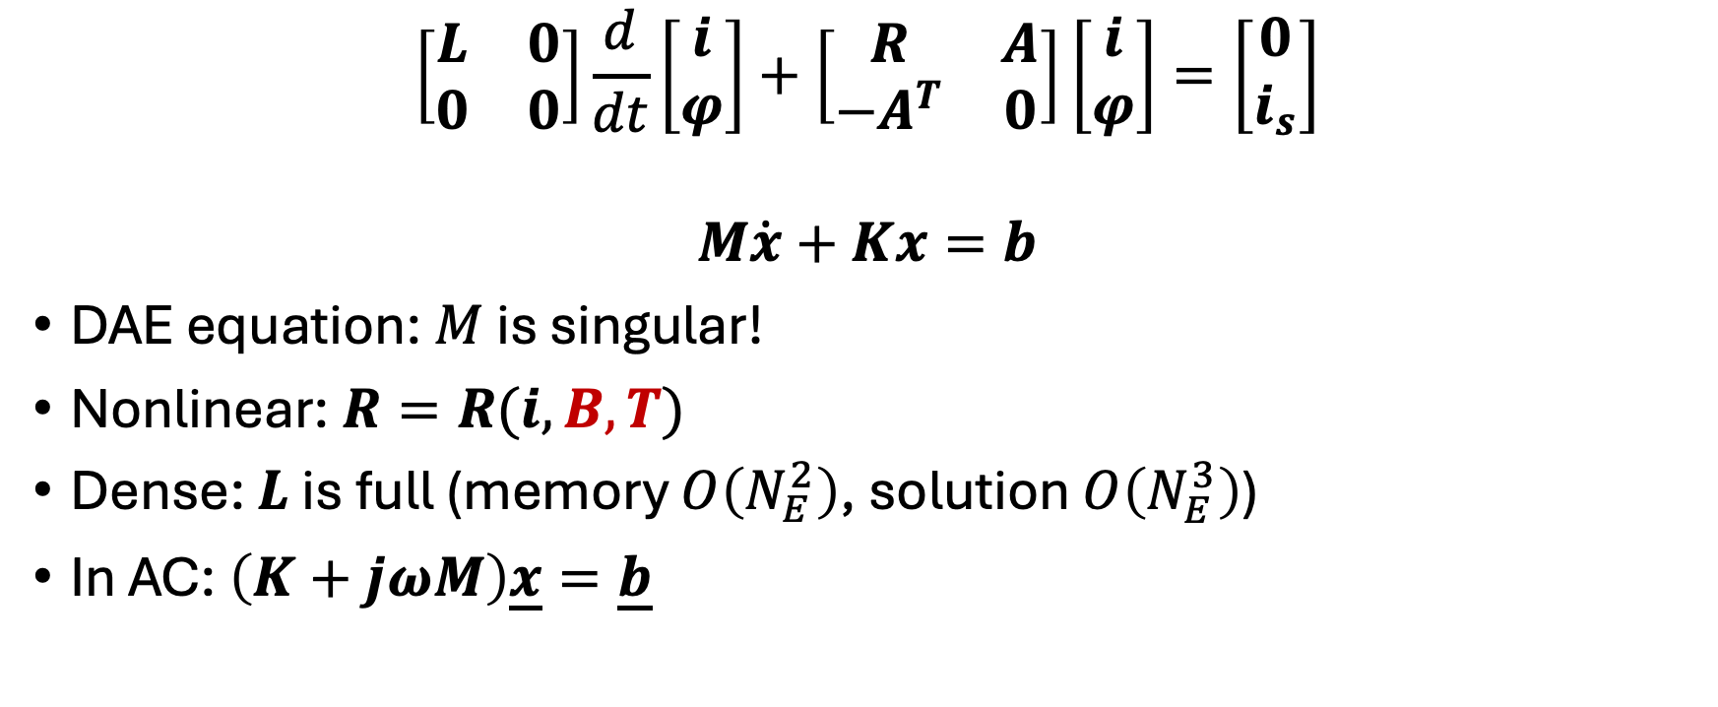
(Quasi) final equations
$$\left[\begin{matrix}L & 0 \\ 0 & 0\end{matrix}\right]\frac{d}{dt}\left[\begin{matrix}i \\ φ\end{matrix}\right]+\left[\begin{matrix}R & A \\ −A^{T} & 0\end{matrix}\right]\left[\begin{matrix}i \\ φ\end{matrix}\right]=\left[\begin{matrix}0 \\ i_{s}\end{matrix}\right]$$
$$M\dot{x}+Kx=b$$
DAE equation: $M$ is singular!
Nonlinear: $R=R(i,B,T)$
Dense: $L$ is full (memory $O\left(N_{E}^{2}\right)$, solution $O\left(N_{E}^{3}\right)$)
In AC: $\left(K+jωM\right)\underline{x}=\underline{b}$

Slide 31


Transverse conductances
$$G_{rb}$$
$$G_{rb}$$

Slide 32



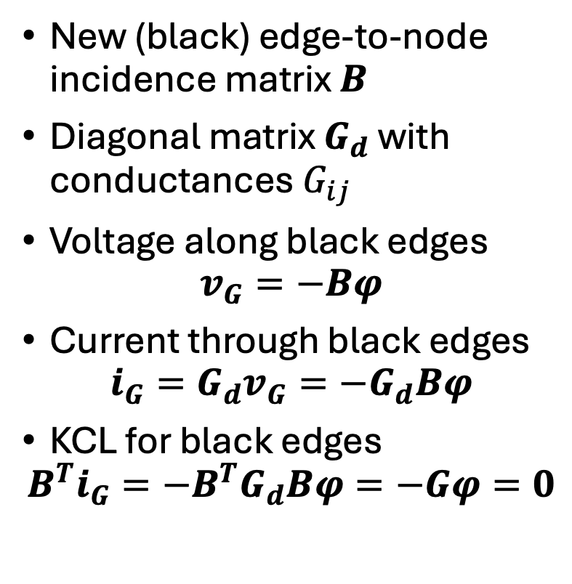



Transverse conductances
New (black) edge-to-node incidence matrix $B$
Diagonal matrix $G_{d}$ with conductances $G_{ij}$
Voltage along black edges
$$v_{G}=−Bφ$$
Current through black edges
$$i_{G}=G_{d}v_{G}={−G}_{d}Bφ$$
KCL for black edges
$$B^{T}i_{G}={−B}^{T}G_{d}Bφ=−Gφ=0$$
1
4
7
$$G_{12}$$
$$G_{45}$$
$$G_{78}$$
2
5
8
$$G_{23}$$
$$G_{56}$$
$$G_{89}$$
3
6
9

Slide 33

Final equations
KCL including all edge currents
$$Gφ−A^{T}i=i_{s}$$
Hence
$$\left[\begin{matrix}L & 0 \\ 0 & 0\end{matrix}\right]\frac{d}{dt}\left[\begin{matrix}i \\ φ\end{matrix}\right]+\left[\begin{matrix}R & A \\ −A^{T} & G\end{matrix}\right]\left[\begin{matrix}i \\ φ\end{matrix}\right]=\left[\begin{matrix}0 \\ i_{s}\end{matrix}\right]$$

Slide 34




Boundary conditions
The electric potential is defined up to an additive constant
The current is injected in the first layer and taken in the last
1
4
7
2
5
8
$$i_{s}$$
$$i_{s}$$
3
6
9
$$φ_{1}=φ_{2}=φ_{3}$$
$$φ_{7}=φ_{8}=φ_{9}$$

Slide 35

Boundary conditions
One face can be set to zero potential
$$φ_{1}=φ_{2}=φ_{3}=0$$
The other face potential are identical but to an unknown value
$$φ_{7}=φ_{8}=φ_{9}=φ^{∗}$$

Slide 36
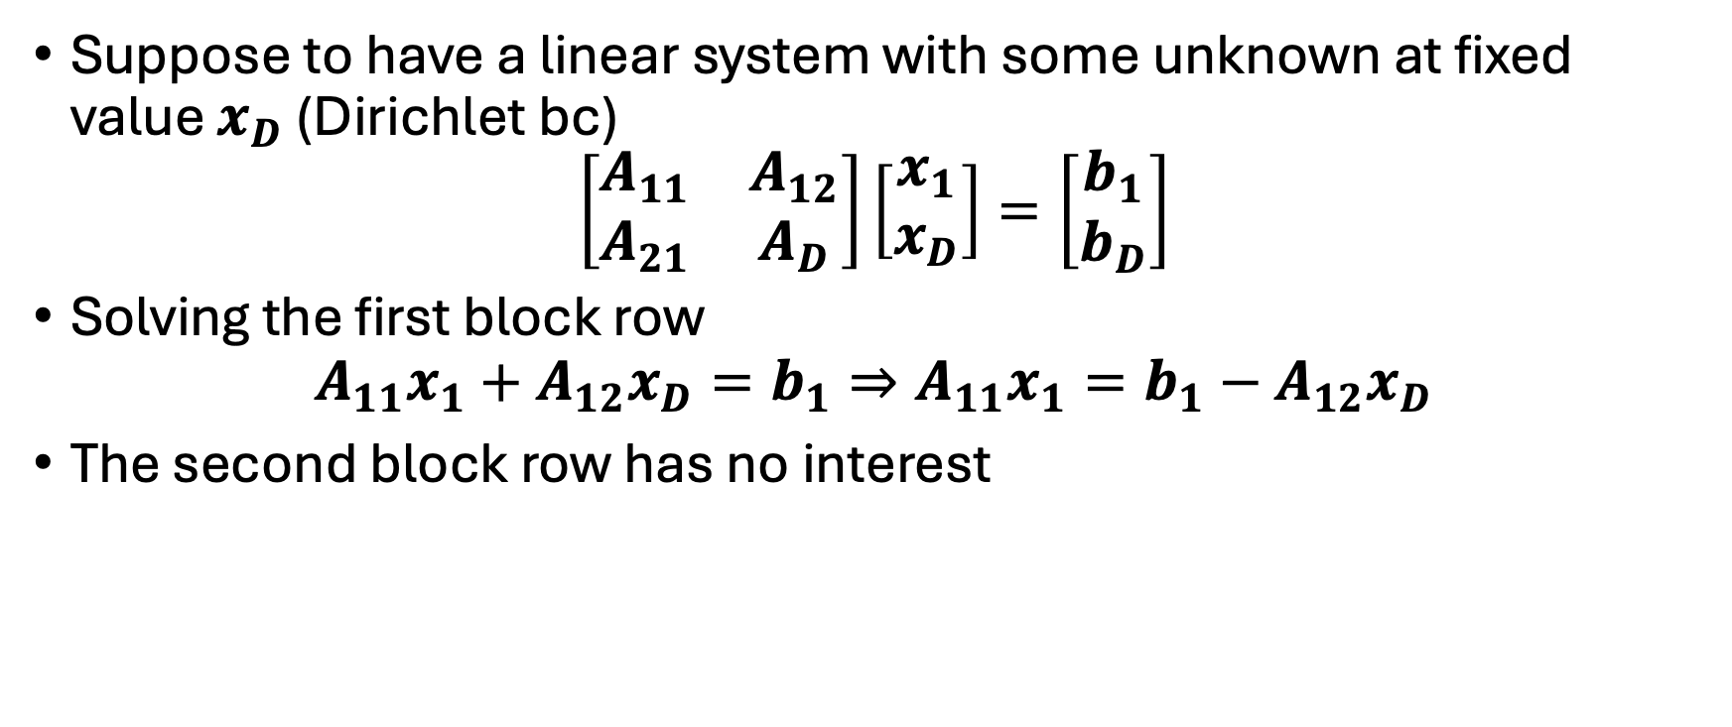
Fixed potential (Dirichlet)
Suppose to have a linear system with some unknown at fixed value $x_{D}$ (Dirichlet bc)
$$\left[\begin{matrix}A_{11} & A_{12} \\ A_{21} & A_{D}\end{matrix}\right]\left[\begin{matrix}x_{1} \\ x_{D}\end{matrix}\right]=\left[\begin{matrix}b_{1} \\ b_{D}\end{matrix}\right]$$
Solving the first block row
$$A_{11}x_{1}+A_{12}x_{D}=b_{1}⇒A_{11}x_{1}=b_{1}−A_{12}x_{D}$$
The second block row has no interest

Slide 37
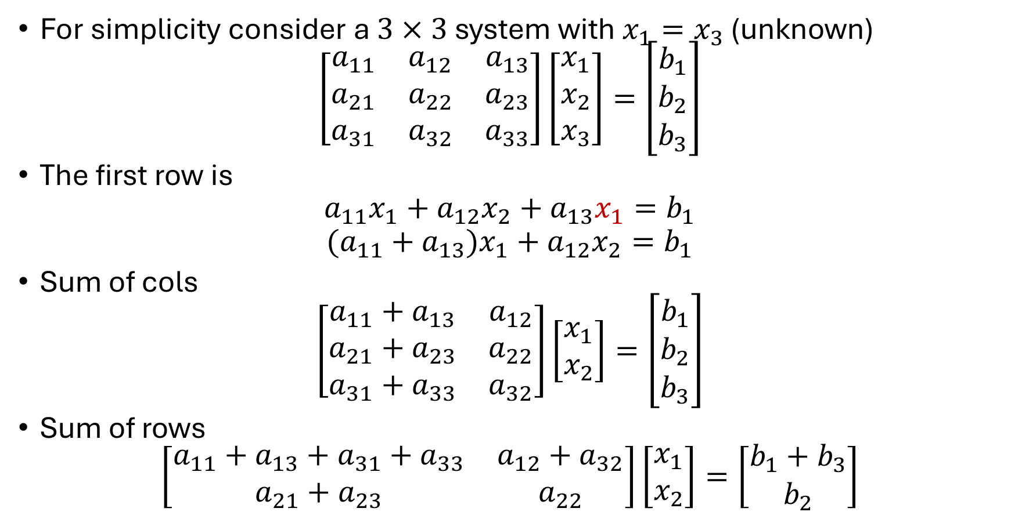
Floating potential
For simplicity consider a $3×3$ system with $x_{1}=x_{3}$ (unknown)
$$\left[\begin{matrix}a_{11} & a_{12} & a_{13} \\ a_{21} & a_{22} & a_{23} \\ a_{31} & a_{32} & a_{33}\end{matrix}\right]\left[\begin{matrix}x_{1} \\ x_{2} \\ x_{3}\end{matrix}\right]=\left[\begin{matrix}b_{1} \\ b_{2} \\ b_{3}\end{matrix}\right]$$
The first row is
$$a_{11}x_{1}+a_{12}x_{2}+a_{13}x_{1}=b_{1}$$
$$(a_{11}+a_{13})x_{1}+a_{12}x_{2}=b_{1}$$
Sum of cols
$$\left[\begin{matrix}a_{11}+a_{13} & a_{12} \\ a_{21}+a_{23} & a_{22} \\ a_{31}+a_{33} & a_{32}\end{matrix}\right]\left[\begin{matrix}x_{1} \\ x_{2}\end{matrix}\right]=\left[\begin{matrix}b_{1} \\ b_{2} \\ b_{3}\end{matrix}\right]$$
Sum of rows
$$\left[\begin{matrix}a_{11}+a_{13}+a_{31}+a_{33} & a_{12}+a_{32} \\ a_{21}+a_{23} & a_{22}\end{matrix}\right]\left[\begin{matrix}x_{1} \\ x_{2}\end{matrix}\right]=\left[\begin{matrix}b_{1}+b_{3} \\ b_{2}\end{matrix}\right]$$

