Slide 1
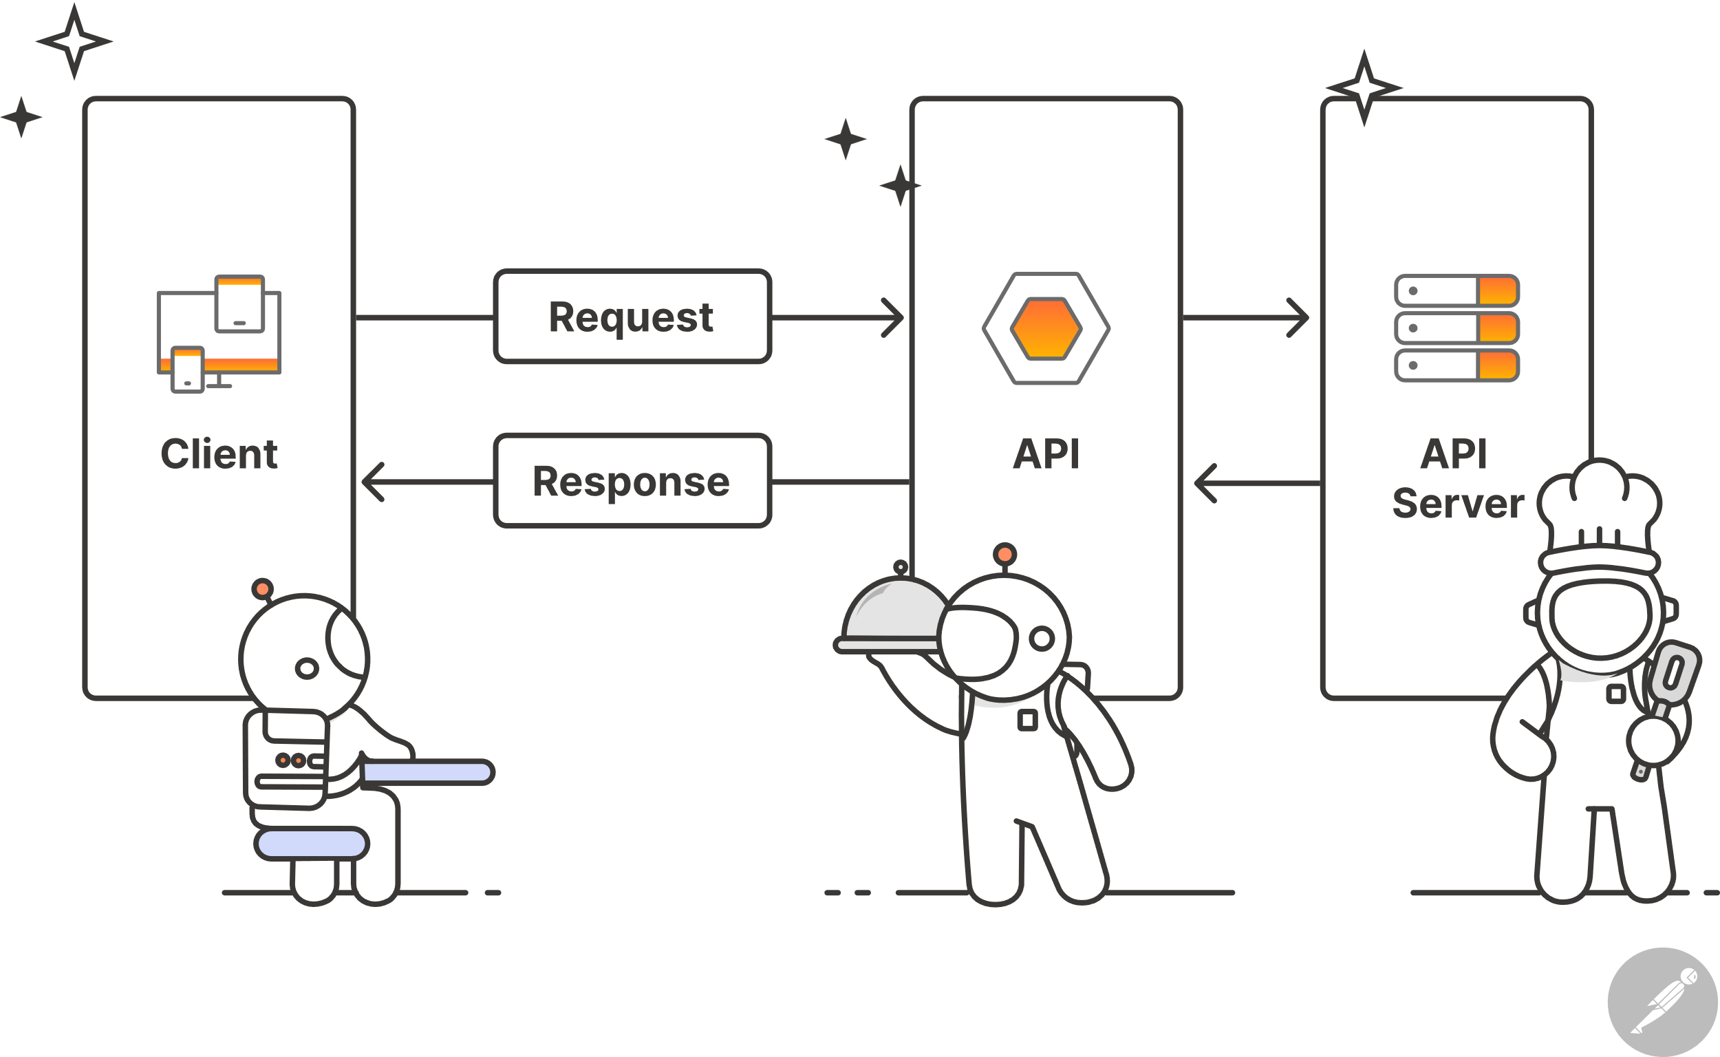
Application Programming Interface
By Maheedharreddy

Slide 2
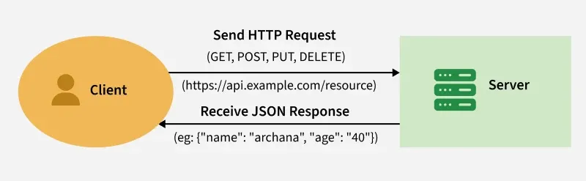
What is REST API?
REST API stands for Representational State Transfer API
REST APIs use HTTP methods (such as GET, POST, PUT, DELETE) to define actions that can be performed on resources. These methods align with CRUD (Create, Read, Update, Delete) operations, which are used to manipulate resources over the web

Slide 3
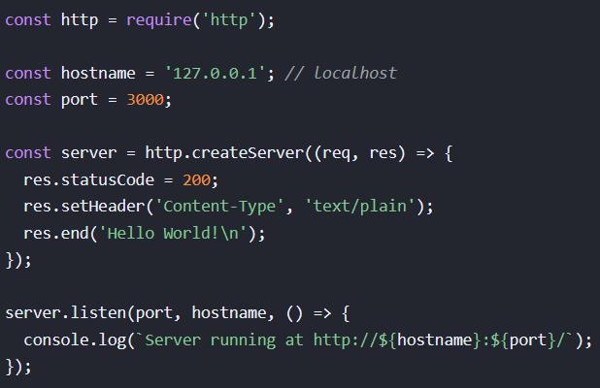
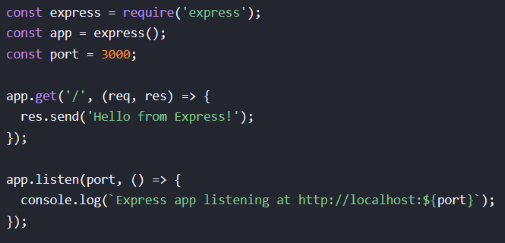
Using Express.Js
Using Node.js

Slide 4
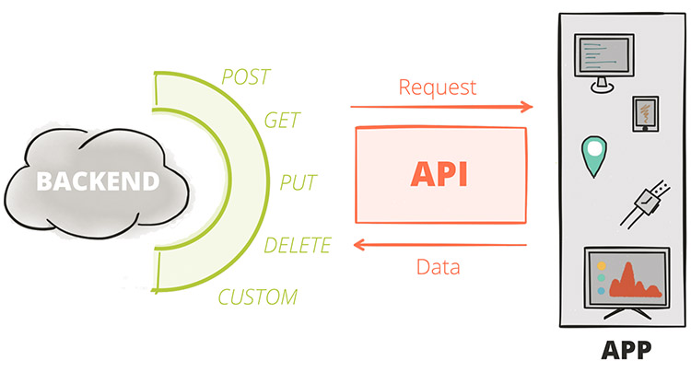

Slide 5

Writing the first API
app.get('/', (req, res) => {
res.send('Hello World!’);
});
This is a GET API endpoint that:
URL: http://localhost:3000/
Method: GET
Response: Returns "Hello World!"
Status Code: 200 (OK) by default

Slide 6

How to read data from a JSON file?
app.get("/data",
(req,res)=>{
res.json(data);
})
Step 1: Create a project
Step 2: Install Express
Step 3: Create a JSON file
Step 4: API to fetch the Data
from JSON using the get method

Slide 7
Post the data into file
app.post('/api/data', (req, res) =>
{
const data = readData();
const newItem = { id: Date.now(),
...req.body };
data.push(newItem);
writeData(data);
res.status(201).json(newItem);
});

Slide 8
Put the data into file
app.put('/api/data/:id', (req,
res) => {
const data = readData();
const id = parseInt(req.params.id);
const index =
data.findIndex(item => item.id === id);
if (index === -1) return
res.status(404).send('Not found');
data[index] = { ...data[index], ...req.body };
writeData(data);
res.json(data[index]);
});

Slide 9
Delete the data into file
app.delete('/api/data/:id', (req, res) => {
const data = readData();
const id = parseInt(req.params.id);
const newData = data.filter(item => item.id!== id);
if (newData.length === data.length) return
res.status(404).send('Not found’);
writeData(newData);
res.sendStatus(204);
});

