Slide 1
Modulation Subset Study
How Label-Efficient Is WavesFM?
A reduced-data follow-up to the WavesFM reproduction
Maheen Fatima
Department of Electrical and Software Engineering, University of Calgary
April 2026
5 subset levels | 2 tasks | 3 modes | 3 seeds
1%, 3%, 5%, 10%, 50% of training data vs full-data baseline
90 training runs | 17.0 GPU hours on RTX 5090

Slide 2
Motivation
A foundation model is only useful if it transfers under realistic label budgets
The Question
The main reproduction used the FULL downstream training split for every
task. That is the easy regime — hundreds of thousands of labeled samples
hide a lot of weakness in the pretrained encoder.
Real wireless deployments rarely have that much labeled data per site.
What This Study Does
Two modulation tasks (RML22 and RadCom) are fine-tuned with only
1, 3, 5, 10, and 50 percent of their training splits — keeping every
other factor identical to the full-data reproduction.
Separation From Reproduction
These runs are NOT part of the WavesFM reproduction verdicts. They live in
their own session roots and are reported separately.

Slide 3
WavesFM — Architecture Overview
A shared 8-block ViT that handles both raw IQ and image-like wireless data
One encoder, two input adapters, many tasks
IQ adapter (1D conv, length-16 segments) ──▶
Shared 8-block ViT ──▶ Linear head ──▶ K classes
Vision adapter (16x16 patch embedding) ──▶ (256-d, 8 heads, 1024 MLP)
Encoder: 6.32M params total. Both adapters output 256-d tokens.
Why this matters here
Both subset tasks (RML22, RadCom) are RAW IQ.
The IQ adapter and the shared ViT carry all of the
learned representations.
A subset experiment essentially asks:
how many labels does the head need before
the encoder is fully exploited?
Model size context
Encoder: 6.32M params (256 dim, 8 blocks)
Decoder discarded after pretraining
Head: Linear(256, K) — 11K=11 for RML22, K=9 for
RadCom — adds < 3K params.
Total trainable per mode (next slides):
LP ~17K FT2 ~1.6M LoRA ~279K

Slide 4
Pretraining Phase
Done once by the authors — the checkpoint wavesfm-v1p0.pth is reused for everything
Masked Wireless Modeling
70% of input tokens are randomly masked.
The encoder + a small decoder learn to reconstruct the missing tokens
directly from the surviving tokens.
Data: 6,400 unlabeled samples (3,200 spectrograms + 3,200 IQ).
Schedule: 800 epochs.
Output: wavesfm-v1p0.pth (29.8 MB encoder weights).
What this study assumes about pretraining
The pretrained weights are taken AS-IS from the public release.
No re-pretraining, no extra masking, no additional self-supervision.
Every subset run loads the same checkpoint as a starting point — so any
difference between subsets is purely due to the amount of
LABELED downstream data the head and adapted blocks see.

Slide 5
Three Transfer Modes
How the pretrained encoder gets adapted to each downstream task
LP
Linear Probe
Encoder fully frozen
~17K trainable
0.3% trainable
Tests pretrained features directly
FT2
Partial Fine-Tune
Last 2 of 8 blocks unfrozen
~1.6M trainable
25% trainable
Allows top-layer feature adaptation
LoRA
Low-Rank Adapters
Encoder frozen + rank-32 adapters
~279K trainable
4.4% trainable
Efficient adaptation, ~5x fewer params than FT2
All three modes share the same optimizer (AdamW), schedule (cosine + 5 warmup epochs), batch size (2048), and 50-epoch budget.

Slide 6
Mode 1 — LP (Linear Probe)
Encoder frozen entirely. Only the task head and input projections train.
What is frozen
All 8 ViT blocks
All attention weights (Q, K, V, output projections)
All MLP weights
All layer norms inside the encoder
What trains
The Linear(256, K) task head
The Conditional LayerNorm gain/bias for the chosen task
Modality-specific input projection
Trainable parameter count
~ 17,000 parameters total
= 0.3% of the 6.32M encoder size
That is the smallest budget of all three modes.
Why LP is the most informative mode for this study
LP cannot adapt the encoder. Whatever PCA it reaches
is a direct measurement of how good the pretrained
representations already are.
Strong LP results at SMALL subsets are the most direct
evidence that the pretraining claim works.

Slide 7
Mode 2 — FT2 (Partial Fine-Tune)
First 6 of 8 ViT blocks frozen. Last 2 blocks plus head and projections train.
What is frozen
Blocks 0 through 5 (the first 6 ViT blocks)
All weights inside those 6 blocks
What trains
Blocks 6 and 7 (the last 2 ViT blocks)
↳ attention Q/K/V/Out, MLP, LayerNorms
Conditional LayerNorm gain/bias
Modality-specific input projection
Linear(256, K) task head
Trainable parameter count
~ 1.6 million parameters total
= 25% of the 6.32M encoder size
Largest budget of all three modes.
Why FT2 is interesting
It allows the encoder to adapt task-specific high-level
features without forgetting low-level pretrained ones.
Risk: at very small subsets the extra trainable params
can OVERFIT the few labeled samples.

Slide 8
Mode 3 — LoRA (Low-Rank Adapters)
Encoder frozen. Rank-32 (alpha 64) adapters added on Q and V of every attention block.
What is frozen
All original encoder weights (every block)
What trains
LoRA matrices A, B injected into Q-projection of all 8 blocks
LoRA matrices A, B injected into V-projection of all 8 blocks
↳ rank r = 32 alpha = 64 scale = alpha / r = 2.0
Conditional LayerNorm gain/bias
Modality-specific input projection
Linear(256, K) task head
Trainable parameter count
~ 279,000 parameters total
= 4.4% of the 6.32M encoder size
5x fewer trainable params than FT2.
Why LoRA usually wins
Adapts EVERY block (not just the last 2 like FT2),
but with a tiny low-rank perturbation that resists
overfitting.
LoRA leads RML22 at every subset and matches
FT2 on RadCom — see results sections.

Slide 9
Experiment Design
Five subset levels × two tasks × three modes × three seeds = 90 training runs
Held FIXED (matches main reproduction)
Pretrained checkpoint: wavesfm-v1p0.pth
Model: vit_multi_small + Conditional LN
Optimizer: AdamW
Schedule: cosine + 5 warmup epochs
Batch size: 2048
Epochs: 50
Validation split: 20% (always full)
Loss: plain cross-entropy (no weights, no smoothing)
Best metric: PCA on validation
Hardware: NVIDIA RTX 5090 on ngwn06
Factors VARIED
Subset fraction:
1%, 3%, 5%, 10%, 50% (5 levels)
Task:
rml, radcom (2)
Mode:
lp, ft2, lora (3)
Seed:
0, 1, 2 (3)
Total cells: 30 | Total runs: 90

Slide 10
Subset Sampling Protocol
How the smaller training pools are drawn from the full dataset
1
Load full cache & split
The HDF5 cache is loaded in full. A deterministic 80/20 train/validation split is drawn from a seeded PRNG.
2
Set validation aside
The validation split is preserved exactly as-is for every subset run. Every PCA number reported is computed against the full validation pool.
3
Stratified subset by class
A subset of the training split is then drawn STRATIFIED BY CLASS — at 1% this still gives ~336 RML samples or ~504 RadCom samples per class.
4
Three seeds per cell
Seeds 0, 1, 2 are run per (task, mode, subset) triple. Reported means and stds use these three seeds.
Implementation: --train-subset-fraction in wavesfm/main_finetune.py, with stratified sampling in wavesfm/data.py.

Slide 11
Train / Validation Split — Concrete Numbers
A deterministic 80 / 20 random split, drawn from a seeded PRNG before any subsetting happens
How the split is built
1. Open the HDF5 cache; total = number of samples
2. val_size = floor( total × 0.2 )
train_size = total − val_size
3. gen = torch.Generator().manual_seed(seed + 1)
4. random_split(dataset, [train_size, val_size],
generator=gen)
Source: wavesfm/data.py:402-410
Split is PLAIN RANDOM for rml and radcom (no stratified-split flag).
Both tasks are perfectly class-balanced, so the random split is
approximately balanced by construction.
Concrete numbers
RML22 (total = 462,000 samples)
val_size = floor(462,000 × 0.2) = 92,400
train_size = 462,000 − 92,400 = 369,600
per class ≈ 33,600 train + 8,400 val
RadCom OTA (total = 567,000 samples)
val_size = floor(567,000 × 0.2) = 113,400
train_size = 567,000 − 113,400 = 453,600
per class ≈ 50,400 train + 12,600 val
All three seeds (0, 1, 2) draw three DIFFERENT splits because the
seeded generator is seeded with seed + 1.
Plain English
Imagine a deck of 462,000 RML22 cards. Shuffle once with a fixed shuffle (seed 1). Deal the first 369,600 cards into the
"train" pile and the last 92,400 into the "validation" pile. Same recipe, same seed → the same two piles every time.
The validation pile is then locked: every subset run for that seed uses exactly those 92,400 samples for evaluation.

Slide 12
Stratified Subset — Worked Walk-Through (RML22 at 1%)
How the smallest training pool is built — class-balanced even at the most extreme cut
Step-by-step (RML22, 1% subset, seed 0)
Starting point: train_ds with 369,600 samples
11 classes × ≈33,600 samples each
Step 1. Compute requested subset size:
subset_size = round(369,600 × 0.01) = 3,696
Step 2. Group train indices by class:
class_to_indices = { 0: [...33,600 ids...], 1: [...], ..., 10: [...] }
Step 3. Take 1 random sample from EACH class first (guaranteed
coverage of all 11 classes — never drops a class).
selected after step 3: 11 ids
Step 4. Fill remaining quota uniformly from the remaining pool:
remaining = 3,696 − 11 = 3,685 (drawn from the 369,589 leftovers)
Step 5. Final shuffle (still seeded) → final 3,696-id Subset.
Final per-class breakdown
At 1% the 3,696 samples
split roughly evenly:
≈ 336 samples / class
At larger subsets:
3% → ~1,008 / class
5% → ~1,680 / class
10% → ~3,360 / class
50% → ~16,800 / class
Source: data.py:288-326
Plain English
Even at 1% the model is guaranteed to see SOME samples from every modulation class — no class is silently dropped. The encoder + head therefore have a fair chance to learn all 11 classes (or all 9 in the RadCom case).

Slide 13
Loss Function — Cross-Entropy
For both rml and radcom: plain unweighted cross-entropy (class weights and label smoothing are NOT enabled)
Per-sample loss
L_i = - log ( exp(z[y_i]) / Σ_k exp(z[k]) )
z = K logits from the linear head y_i = ground-truth class index batch loss = mean over the batch
Worked example (K = 3 classes)
Suppose the model emits logits z = [2.0, 0.5, 0.1]
and the true label is class 0.
Step 1 — softmax:
exp(z) = [7.39, 1.65, 1.11]
sum = 10.15
softmax(z) = [0.728, 0.162, 0.110]
Step 2 — pick prob of true class y=0:
p_true = 0.728
Step 3 — loss:
L = -log(0.728) ≈ 0.317
If true class had been 2 instead, p_true = 0.110
and L = -log(0.110) ≈ 2.21 — about 7x bigger.
Plain English
Cross-entropy asks: "how confident was the model in the
correct answer?". A confident-and-right model gets a
small loss; a confident-and-wrong one gets a big loss.
Reasonable target ranges (rough):
L ≈ log(K) means random guessing (≈2.4 for K=11, ≈2.2 for K=9)
L < 1 means clearly above chance
L < 0.3 means very confident, mostly correct
Actual code path (main_finetune.py:268-276)
criterion = nn.CrossEntropyLoss()
— no weight argument (class_weights flag OFF)
— no label_smoothing (smoothing flag not set)
Both rml and radcom are perfectly class-balanced, so plain CE is the right
default — no per-class re-weighting needed.

Slide 14
Accuracy Metrics — How Acc@1, Acc@3 and PCA Are Computed
PCA is the primary metric for rml and radcom and the basis for best-checkpoint selection
Acc@1 and Acc@3
For each sample, take the k highest-scoring predicted classes.
The sample is "correct@k" if the true class is in those top k.
Acc@k = (# correct@k) / N × 100%
Source: timm.utils.accuracy (engine.py:129).
Acc@1 = standard accuracy. Acc@3 = "is true class in top 3?".
PCA — Per-Class Accuracy (PRIMARY)
For each class k:
recall[k] = correct_k / total_k
Then average over all K classes:
PCA = mean_k ( recall[k] ) × 100%
engine.py:142-146:
pca = (per_class_correct / per_class_total * 100).mean()
Worked example — why PCA is not the same as Acc@1
10 validation samples across 3 classes: 6 of class A, 3 of class B, 1 of class C.
Predictions: A→A all 6 correct. B→B 1 correct, B→A 2 wrong. C→A 1 wrong.
Acc@1 = (6 + 1 + 0) / 10 = 70%
PCA = mean( 6/6, 1/3, 0/1 ) = mean( 100%, 33.3%, 0% ) = 44.4%
Plain English: Acc@1 looks healthy because class A is large. PCA exposes that class C is failing entirely
and class B is weak. PCA punishes the model for being uneven — that is exactly why it is the chosen metric.
Best-checkpoint rule (main_finetune.py:299): best_key = "pca" | better = (cur > best) | the epoch with the highest val PCA is saved.

Slide 15
PCA in Plain English
A friendlier explanation of the same metric — useful before reading any results table
PCA = "the average of how often the model gets each class right".
Every class counts equally, no matter how many samples it has.
Analogy — a school exam
Imagine 11 students from 11 different classes (one per modulation).
Acc@1 grades the model based on TOTAL marks scored across all
11 students. If 1 student is huge and easy and 10 are small and
hard, the model can ace the easy one and still look good.
PCA grades the model on the AVERAGE of each student's individual
score. To do well the model has to help every student — including
the small / hard ones.
How to read a PCA number quickly
PCA = 90% on RML22 (11 classes) → on average, each modulation
class is recognised correctly 90% of the time.
PCA = 9% → random guessing (≈ 1/11).
PCA = 30% → better than random, but most classes still mostly
wrong.
PCA = 70% → most classes mostly right, a few still hard.
PCA = 95%+ → the model is essentially solved on this task.
Best-checkpoint selection picks the epoch with the highest val PCA.

Slide 16
Reading the PCA Numbers — What Each Range Means
Plain-English reference — useful when scanning results tables in later sections
CHANCE LEVEL
PCA ≈ 9% (RML22) / ≈ 11% (RadCom)
Random guessing — no learning has happened yet.
WEAK
PCA 20% – 40%
Some classes are being separated; many are confused. Far below baseline.
MODERATE
PCA 40% – 70%
Recognisable structure but several classes still mix. Where most RML22 subset runs land.
STRONG
PCA 70% – 90%
Most classes correct most of the time. Where small RadCom subsets land.
NEAR-BASELINE
PCA > 90%
Within striking distance of full-data performance. Most RadCom subsets and RML22 at 50%.
Quick worked check
A 0.5 PCA difference between two seeds = noise. A 5+ PCA gap = a real effect. A 30 PCA gap = the model is doing something fundamentally different.

Slide 17
Training Step — One Mini-Batch (Inside an Epoch)
What happens for every batch of 2,048 samples drawn from the train loader
1. DRAW BATCH
(samples, targets)
shape (2048, 2, 1, 128)
move to GPU
2. LR SCHEDULE
apply cosine LR
warmup for 5 ep
cosine decay after
3. FORWARD
outputs = model(samples)
shape (2048, K)
autocast on CUDA
4. COMPUTE LOSS
loss = criterion(outputs,
targets)
plain cross-entropy
5. TRACK Acc@1
acc1 = top-1 accuracy
on this batch
AverageMeter.update
10. LOG
every print_freq steps:
loss, acc1, lr
9. ZERO GRADS
optimizer.zero_grad(
set_to_none=True)
ready for next batch
8. OPTIMIZER STEP
scaler.step(optimizer)
AdamW with
layer-decay LR
7. GRAD CLIP
clip_grad_norm_(
params, max_norm)
only after every
6. BACKWARD
scaler.scale(loss /
accum_steps).backward()
AMP grad scaling
Implementation: train_one_epoch in engine.py:18-96
Steps 6-9 only execute when (step + 1) % accum_steps == 0 — gradient accumulation lets the effective batch size be larger than what fits in memory.
AMP autocast is enabled on CUDA only (MPS/CPU fall back to fp32). The train loop iterates this 10-step sequence once per mini-batch, until the train_loader is exhausted (one epoch).

Slide 18
Full Training Loop — All 50 Epochs
The outer loop wrapped around the per-step flow — same for every (task, mode, subset, seed)
1. INITIALIZE (once per run)
Load wavesfm-v1p0.pth → freeze per mode (LP / FT2 / LoRA) → build train+val DataLoaders → apply --train-subset-fraction → criterion (plain cross-entropy) → AdamW with layer-decay → cosine LR schedule.
2. FOR epoch = 0 .. 49 (50 epochs)
2a. TRAIN EPOCH
Iterate the train_loader
one batch at a time and run
the 10-step per-mini-batch
flow from the previous slide.
Output: train.loss, train.acc1
2b. EVALUATE ON VAL
model.eval() + no_grad
Iterate val_loader, compute
loss, Acc@1, Acc@3, and PCA
over the FULL validation
split (always 100%).
Output: val.{loss,acc1,acc3,pca}
2c. CHECKPOINT?
IF val.pca > best_pca:
save checkpoint atomically
(model+optim+RNG)
Append epoch row to log.txt
(JSON line, fsynced).
best_key="pca"
Loop back — increment epoch and repeat from 2a until epoch == 49.
3. AFTER 50 EPOCHS: best checkpoint kept (the one with highest val.pca). Per-epoch log.txt is the source for plots and summaries.

Slide 19
What is Modulation?
Why both subset tasks are about classifying modulation — and why that matters in wireless
Modulation = the recipe for stamping information onto a radio wave.
A bare carrier wave carries nothing — modulation is what lets it carry voice, video, or data.
Three knobs to twist on a wave
AMPLITUDE → make the wave taller or shorter
"AM radio" works this way; in RML22 see PAM4, AM-DSB, AM-SSB.
FREQUENCY → bend the wave faster or slower
"FM radio" works this way; in RML22 see CPFSK, GFSK, WBFM.
PHASE → shift WHEN the wave peaks
used by Wi-Fi, 4G, 5G, satellites; in RML22 see BPSK, QPSK, 8PSK.
Twist two knobs at once → QAM (used by cable modems and Wi-Fi).
Why CLASSIFY modulation in the first place?
A receiver can only DECODE a signal once it knows what modulation
was used. Misclassify and the bits come out as garbage.
Use cases:
Cognitive radios — scan the band and pick the right demod
Spectrum monitoring — detect rogue or unauthorised emitters
Military / SIGINT — recognise unknown emitters from raw IQ
6G dynamic spectrum — share radio with whoever is around
That is what a "wireless foundation model" is supposed to do well —
and the subset study asks how cheaply that capability transfers.

Slide 20
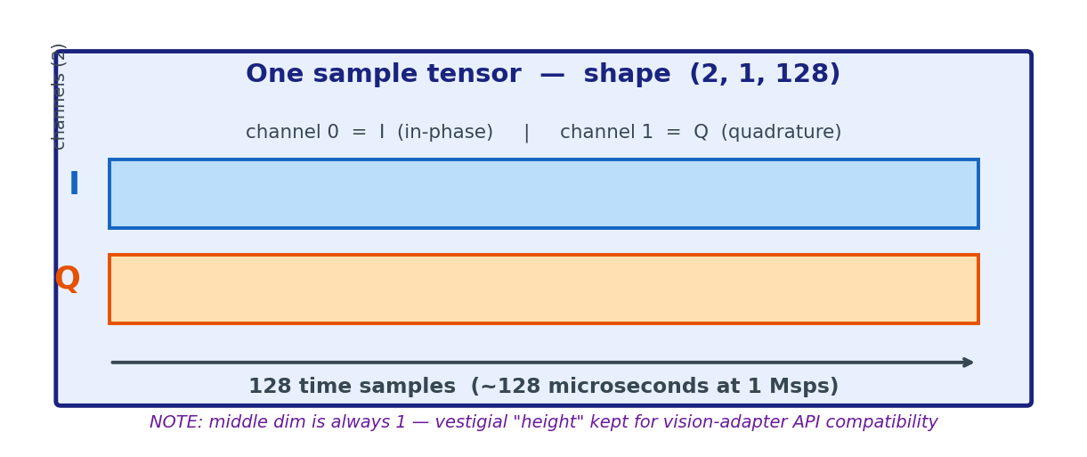
What an IQ Sample Is — Common to RML22 and RadCom
Both subset tasks operate on the same kind of tensor — only the source dataset differs
Two physical streams per sample
A radio receiver mixes incoming signal with a local oscillator
and produces TWO real-valued streams that are 90° out of phase:
I = in-phase (cosine component)
Q = quadrature (sine component)
Together they form one complex sample per time-step.
Why 128 time samples?
128 is a short window — long enough to contain several modulation
symbols, short enough to fit in fast batched training:
RML22 → ~128 microseconds (1 Msps baseband)
RadCom OTA → ~12.8 microseconds (10 MS/s, OTA at 2.45 GHz)
All downstream IQ-modality tasks use exactly this (2, 1, 128) shape.

Slide 21
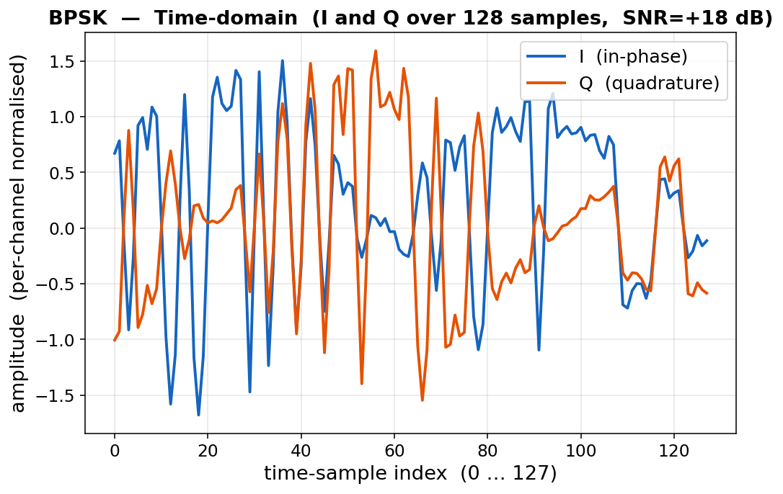
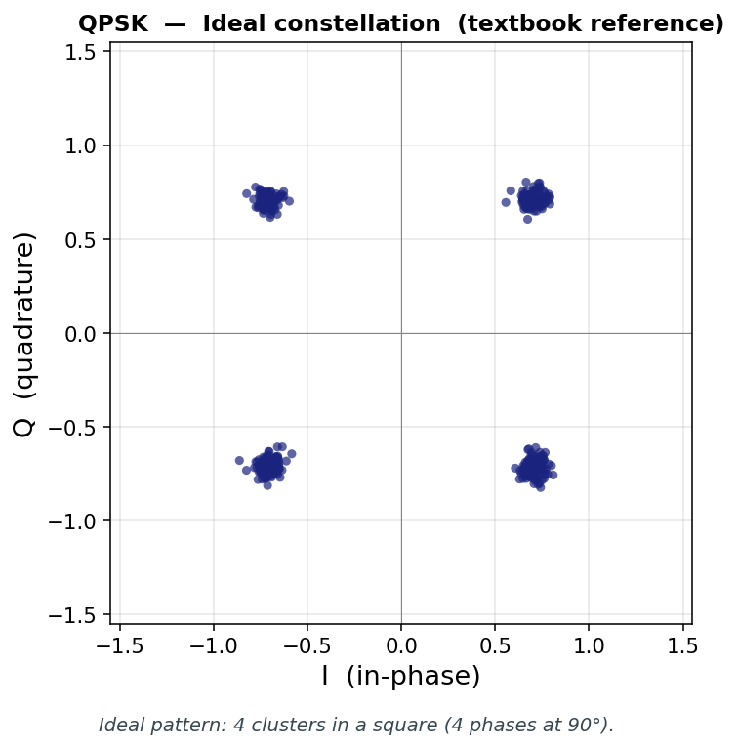
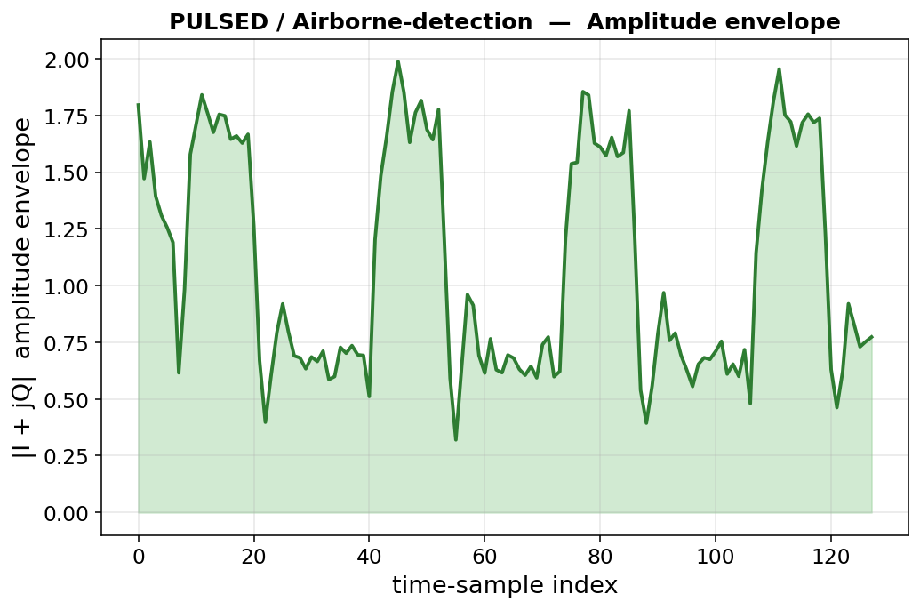
Three Ways to Look at the Same IQ Tensor
The (2, 1, 128) input never changes — but three different visual angles each reveal different features
Time-domain (always available)
Plots I and Q vs time-sample index.
Shows everything but is hardest to interpret —
the encoder ultimately works from this view.
Constellation (digital comms)
Plots I vs Q as 128 dots — ignores time order.
Reveals SYMBOL geometry: BPSK = 2, QPSK = 4,
QAM16 = 16, etc. Used in RML22 gallery slides.
Amplitude envelope (radar / pulses)
Plots |I + jQ| vs time — magnitude only.
Reveals POWER bursts: pulsed radar = on/off,
FMCW = constant. Used in RadCom gallery slides.
How this relates to training
The model NEVER sees the constellation or envelope plots — those are FOR HUMANS to read the data.
It only sees the raw (2, 1, 128) tensor and has to learn — through 50 epochs of cross-entropy loss — that the same patterns visible above
separate one class from another. Tasks where the discriminating feature is geometric (RML22) require different attention to tasks where
it is temporal (RadCom pulses). Both task types are tested with the same encoder — the subset study probes how cheaply each transfers.

Slide 22
RML22 — Per-Class Visual Fingerprint Reference
What each of the 11 modulations looks like in the time and constellation views — and what makes it distinguishable
Class
Time-domain pattern
Constellation pattern
Key discriminator the encoder must learn
BPSK
I/Q toggle between 2 levels
2 clusters along the I axis
phase flips between 0° and 180°
QPSK
I and Q each take 2 levels
4 clusters in a square arrangement
4 phases at 90° increments
8PSK
smooth phase rotation
8 dots equally spaced on a ring
8 phases on a unit circle
QAM16
I and Q each take 4 levels
4 × 4 grid of clusters (16 dots)
amplitude AND phase — combined
QAM64
I and Q each take 8 levels
8 × 8 grid (dense, regular pattern)
fine-grained QAM grid (vs QAM16)
PAM4
I varies among 4 levels, Q ≈ 0
4 vertical clusters along I
amplitude only, no phase content
CPFSK
I/Q oscillate at 2 distinct rates
ring-like pattern, no isolated clusters
continuous phase between freq hops
GFSK
smoothed FSK transitions
thicker ring (Gaussian filtering)
spectrally compact frequency hops
AM-DSB
smooth audio envelope on I and Q
analog smear (no discrete clusters)
envelope shape = audio signal
AM-SSB
asymmetric envelope
asymmetric smear
one sideband suppressed
WBFM
fast phase rotations
loose ring pattern
audio modulates instantaneous frequency
Why constellation is the key view for RML22
All 11 modulations differ in HOW they place symbols in the (I, Q) plane (digital) or how they smear (analog). The encoder has to learn
this 2-D geometry from the raw 128-step time series alone — there is no constellation diagram in the training data, only IQ values.

Slide 23
RadCom OTA — Per-Class Visual Fingerprint Reference
What each of the 9 (modulation, signal-type) pairs looks like in the time and envelope views
Class pair
Time-domain pattern
Envelope pattern
Key discriminator the encoder must learn
AM-DSB / AM radio
slow oscillations (audio)
smooth, slowly varying
voice-like envelope, both sidebands
AM-SSB / AM radio
asymmetric audio
narrower smooth envelope
voice envelope, one sideband only
ASK / short-range
amplitude steps
rectangular on/off pattern
discrete amplitude levels
BPSK / SATCOM
phase flips at 2 levels
roughly constant
phase modulation, constant power
FMCW / Radar Altimeter
continuous phase ramp
flat (constant power)
frequency sweeps continuously
PULSED / Air-Ground-MTI
short on/off bursts
spike then near-zero
pulse repetition for moving targets
PULSED / Airborne-detection
short bursts, narrow pulses
sharp pulse, then silence
pulse width / PRF for target detect
PULSED / Airborne-range
compressed pulse pattern
spike with sidelobes
pulse compression for range accuracy
PULSED / Ground mapping
longer pulses
wider pulse envelope
long-pulse mapping waveform
Why envelope is the key view for RadCom
Pulsed radar vs continuous-wave radar vs comms differ most strongly in their AMPLITUDE-vs-TIME signature — pulses look like spikes,
FMCW looks flat, AM looks like voice. The encoder learns this temporal envelope structure directly from the (2, 1, 128) IQ tensor.

Slide 24
RML22
Modulation Classification — 11 classes, 462,000 IQ samples

Slide 25
RML22 — Dataset Overview
RadioML 2022 — eleven analog and digital modulation schemes, raw IQ
Source & storage
Raw: RML22.01A pickle archives
Cache: datasets_h5/rml22.h5 (497 MB)
Total samples: 462,000
Per class: 42,000 (perfectly balanced)
SNR coverage: -20 dB to +20 dB (21 steps of 2 dB)
Per (class, SNR): ≈ 2,000 samples
→ low-SNR samples are nearly noise; high-SNR are clean
Modality: raw IQ waveforms
Each sample = 128 consecutive complex baseband samples
captured at the receiver (≈128 microseconds at 1 Msps).
Tensors & splits
Input shape: (2, 1, 128)
2 = I (in-phase) and Q (quadrature) channels
1 = vestigial height dim (kept for adapter API)
128 = time-domain samples
Per-channel norm (mu=0, std≈2.92)
Output: 11-way softmax → Linear(256, 11)
Loss: plain CrossEntropyLoss (no weights, no smoothing)
Train (80%): 369,600 Validation (20%): 92,400
Primary metric: PCA | Secondary: Acc@1, Acc@3
Plain English — what one (2, 1, 128) tensor actually contains
Imagine recording an antenna voltage for ~128 microseconds. The radio splits the signal into two streams that are 90° apart — that is I (in-phase) and Q (quadrature).
The tensor stores those two streams sample-by-sample. Each modulation scheme leaves a distinctive fingerprint on the I/Q pattern that a human can sometimes
see in a constellation plot — and that the encoder must learn to recognise from the raw 128-sample sequence alone.

Slide 26
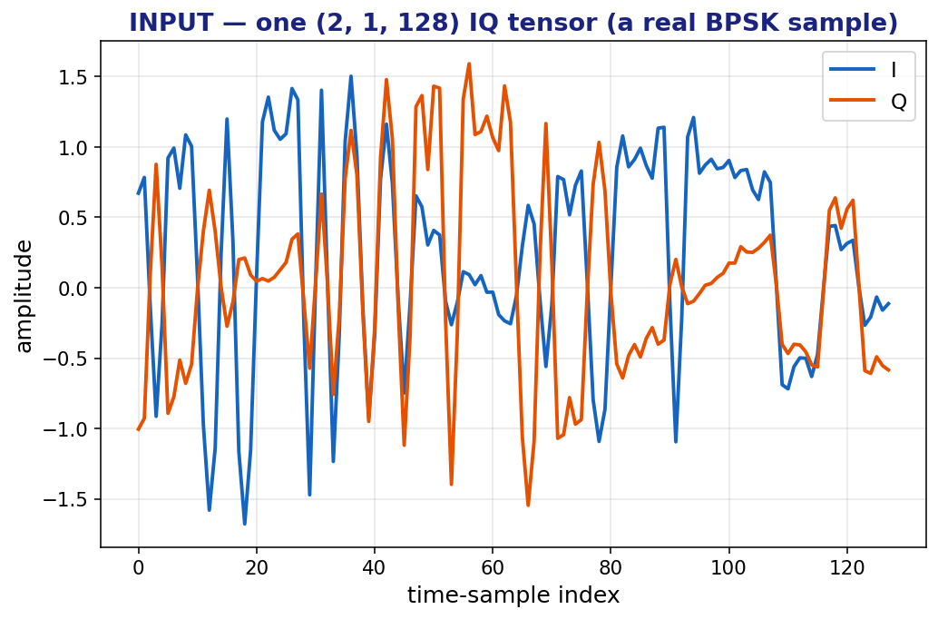
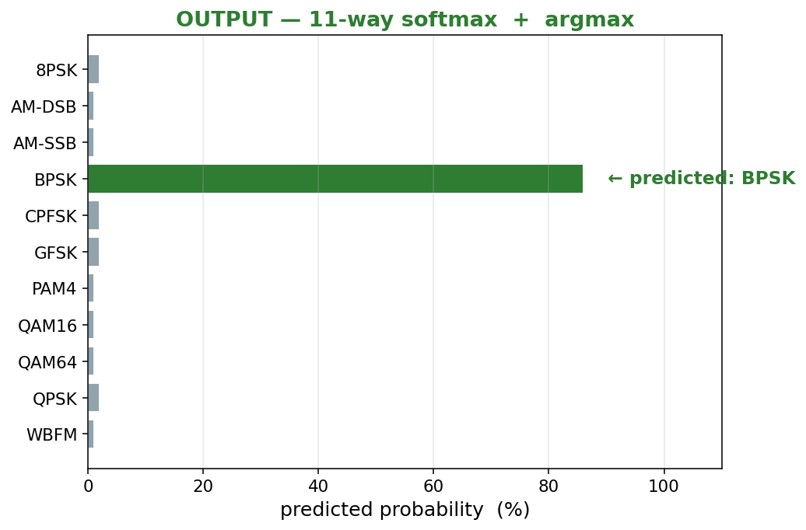
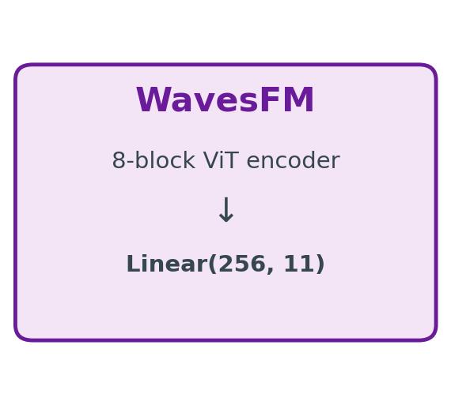
RML22 — Task Input → Output
What goes into the model and what label has to come out for the sample to count as correct
Plain English — read left to right
1. A real BPSK sample (128 IQ time points) goes IN. 2. The frozen encoder + linear head produces 11 probabilities.
3. The argmax is the predicted modulation. The sample is correctly labelled when the predicted index = the ground-truth integer (here 3 = "BPSK").

Slide 27
RML22 — All 11 Modulation Labels
Mix of analog (AM, FM) and digital (PSK, FSK, PAM, QAM) schemes
8PSK
Digital PHASE
8-level Phase-Shift Keying
AM-DSB
Analog AM
Amplitude Mod, double sideband
AM-SSB
Analog AM
Amplitude Mod, single sideband
BPSK
Digital PHASE
Binary Phase-Shift Keying
CPFSK
Digital FREQ
Continuous-Phase FSK
GFSK
Digital FREQ
Gaussian Frequency-Shift Keying
PAM4
Digital AMP
4-level Pulse-Amplitude Mod
QAM16
Digital QAM
16-symbol Quadrature AM
QAM64
Digital QAM
64-symbol Quadrature AM
QPSK
Digital PHASE
Quadrature Phase-Shift Keying
WBFM
Analog FM
Wideband Frequency Mod
Why this label set is challenging
Some classes are visually very similar in raw IQ (QAM16 vs QAM64, BPSK vs QPSK).
Others look completely different (analog AM vs digital FSK). The encoder must
learn both fine-grained AND coarse distinctions from the same backbone.
Subset behavior
Subsets are stratified, so all 11 classes remain represented at every level.
At 1% the head still sees ~336 samples per class (vs 33,600 at full data).

Slide 28
RML22 — How the Original Dataset Was Built
Synthetically generated with GNU Radio — published as RML22 by Sathyanarayanan et al., IEEE TWC 2023
Authors & citation
V. Sathyanarayanan, P. Gerstoft, A. El Gamal
"RML22: Realistic Dataset Generation for Wireless
Modulation Classification"
IEEE Trans. Wireless Commun., vol. 22(11),
pp. 7663–7675, 2023.
Code: github.com/venkateshsathya/RML22
Why it exists — fixes RML16
RML22 was created to correct several reproducibility issues in
the older RML16 / RadioML 2016 dataset (ad-hoc impairment
parameters, label leakage). It releases the GNU Radio code
used to generate it so anyone can reproduce or extend the corpus.
Generation pipeline (per modulation, per SNR)
1. Source signal → modulator
digital mods get random bit streams; analog mods (AM, WBFM)
are driven by an audio podcast WAV file
2. Apply CLOCK effects
sample-rate offset (SRO) + carrier-frequency offset (CFO)
+ random phase offset
3. Apply CHANNEL fading
simulated multipath fading filter
4. Add THERMAL noise
additive white Gaussian noise scaled to target SNR
5. Slice into 128-sample windows → store (mod, snr) → array
Result: 11 mods × 21 SNRs × 2,000 samples = 462,000 IQ snapshots.
Plain English
Each sample is a short 128-step recording of a synthetic radio signal that has been distorted by realistic channel and clock effects, then drowned in noise to a chosen SNR. The model has to identify the modulation despite all that noise.

Slide 29
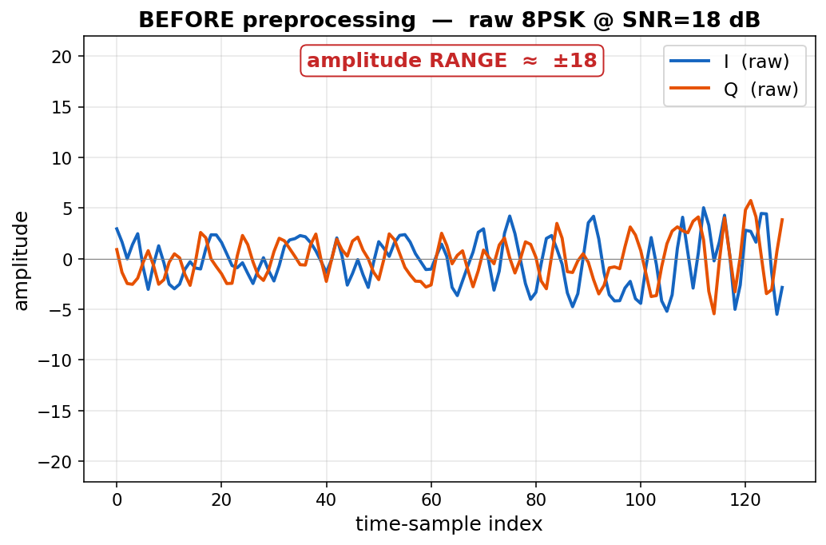
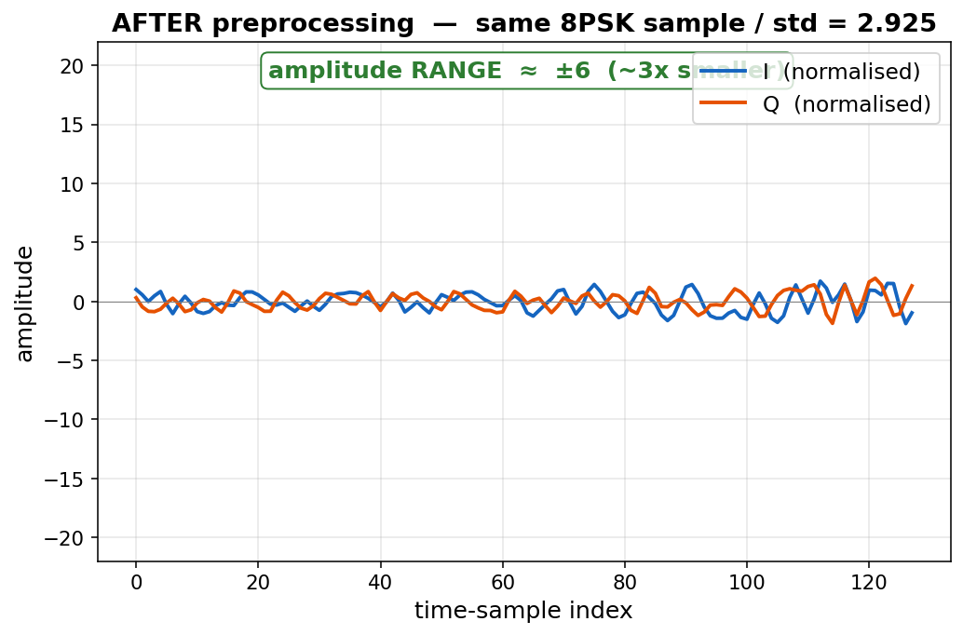
RML22 — Local Preprocessing Pipeline
From the source RML22.01A pickle to the (2, 1, 128) tensor the model actually sees
Source pickle
RML22.01A (473 MB)
dict { (mod, snr):
array(2000, 2, 128) }
231 cells, 462,000 samples
Per-channel norm
mu = 0 (signal centred)
std ≈ 2.925 (RMS)
sample = (sample - mu) / std
one-pass over every cell
Reshape + pack
add vestigial height dim:
(2, 128) → (2, 1, 128)
integer label per sample
SNR + mod-string sidecars
Write HDF5 cache
datasets_h5/rml22.h5 (497 MB)
datasets: sample, label,
snr, modulation
attrs: labels, mu, std,
class_weights
Same 8PSK sample plotted on identical y-axes — raw spans ±18, after dividing by std≈2.925 it spans roughly ±6. The shape is preserved; only the scale changes.

Slide 30
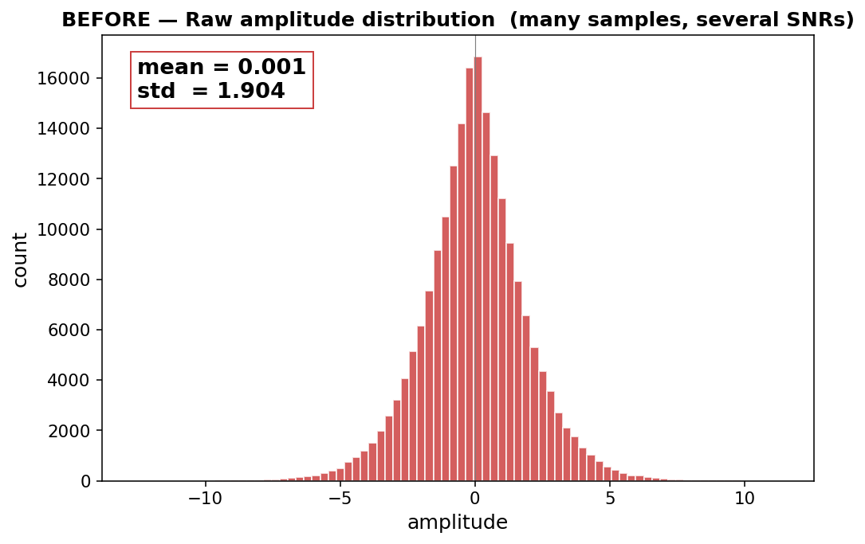
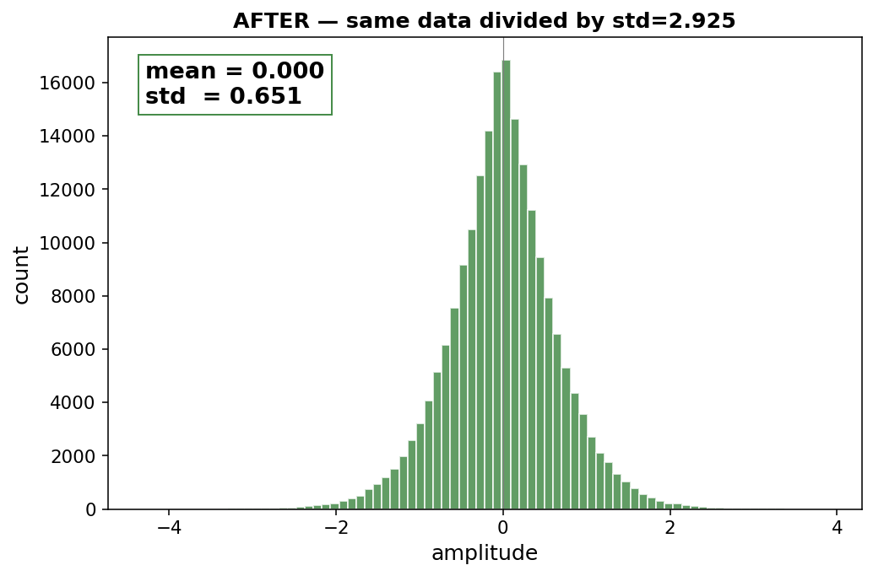
RML22 — Why Normalise?
Histogram view across many samples and SNR levels
Plain English
Raw RML22 amplitudes have a wide spread (std ≈ 2.9). Neural networks train much more stably when inputs sit near zero with std ≈ 1.
Per-channel normalization (subtract mean, divide by std) does exactly that — without changing the SHAPE of the waveform.

Slide 31
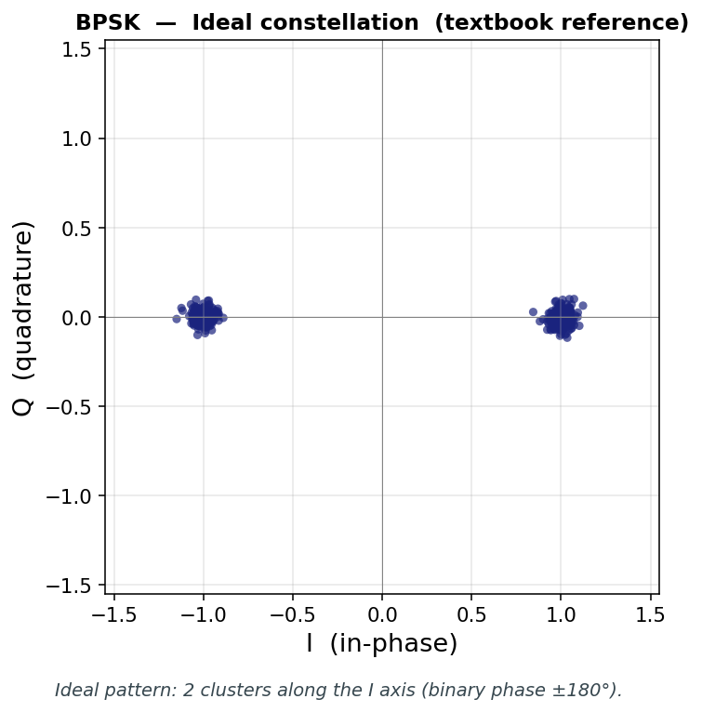
RML22 — BPSK (Binary Phase-Shift Keying)
Class index 3 — the simplest digital modulation, 1 bit per symbol
What to look for in the plot
Time view: I and Q swing between two opposite levels.
Constellation: 2 clusters along the I axis.
Correctly labelled means: model predicts class index 3 = "BPSK".
In plain English
BPSK flips the carrier wave between two phases (0° and 180°)
to send 1 bit per symbol. Used by deep-space probes (very robust
to noise) and as the preamble of many Wi-Fi / LTE frames.

Slide 32
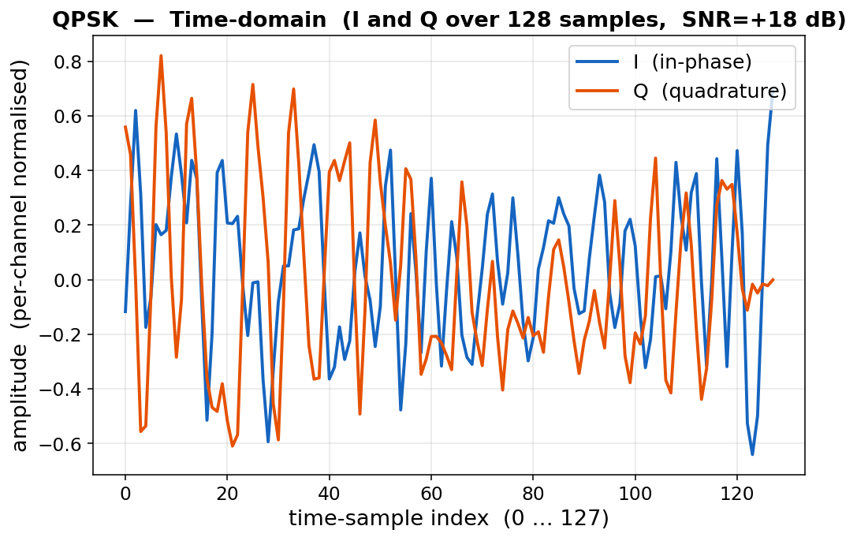
RML22 — QPSK (Quadrature Phase-Shift Keying)
Class index 9 — 4 phases, 2 bits per symbol
What to look for in the plot
Time view: I and Q each take one of two levels independently.
Constellation: 4 clusters in a square arrangement.
Correctly labelled means: model predicts class index 9 = "QPSK".
In plain English
QPSK uses 4 phases (0°, 90°, 180°, 270°) so each symbol carries
2 bits — twice the throughput of BPSK at the same SNR. Used in
CDMA cellular, satellite TV, and many Wi-Fi modes.

Slide 33
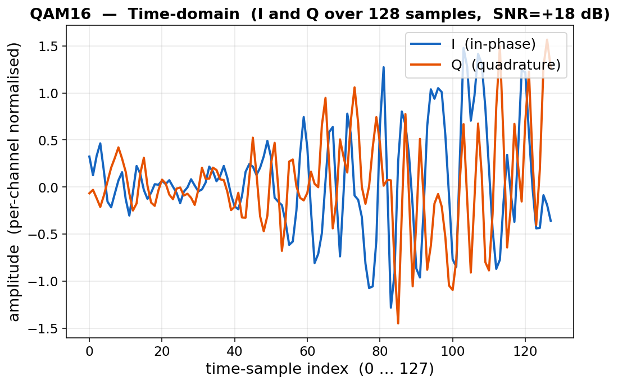
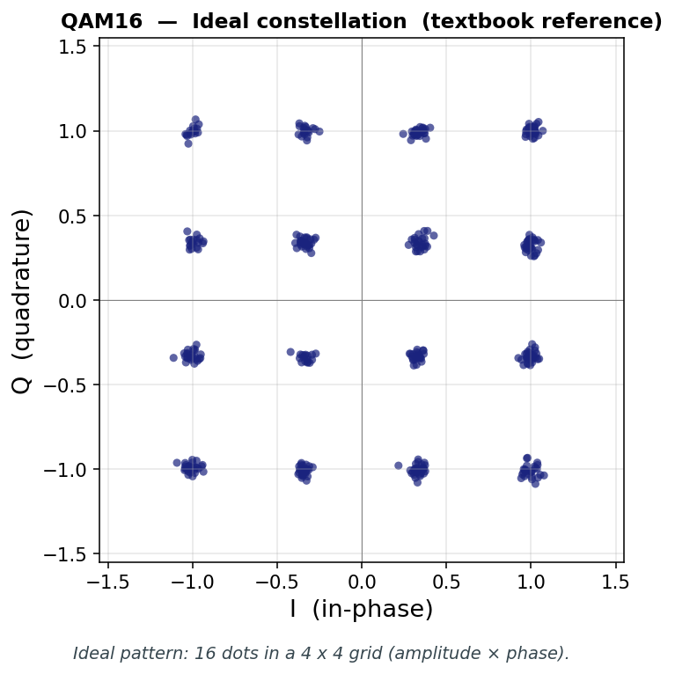
RML22 — QAM16 (16-QAM)
Class index 7 — 4 amplitudes × 4 phases, 4 bits per symbol
What to look for in the plot
Time view: I and Q both take 4 distinct levels.
Constellation: 16 clusters in a 4x4 grid.
Correctly labelled means: model predicts class index 7 = "QAM16".
In plain English
QAM16 places 16 symbols on a 4x4 grid — encoding 4 bits
per symbol. Used by cable modems (DOCSIS), Wi-Fi, and 4G.
Hard to distinguish from QAM64 in raw IQ — that is the challenge.

Slide 34
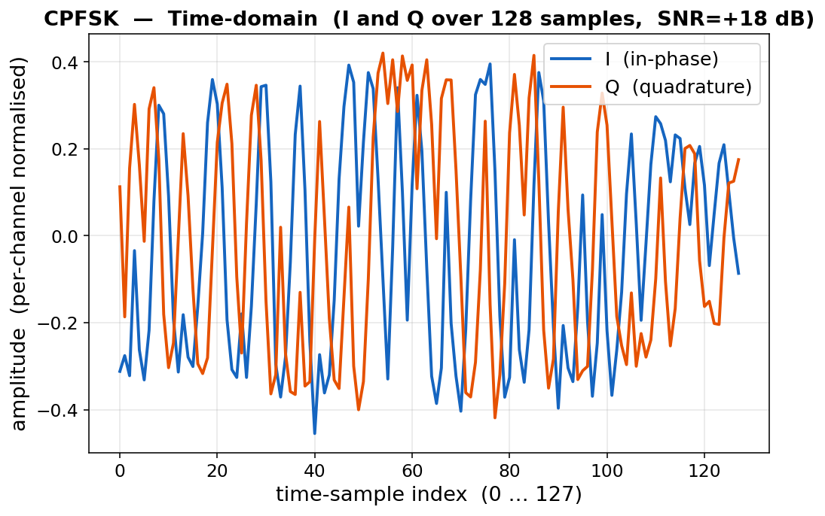
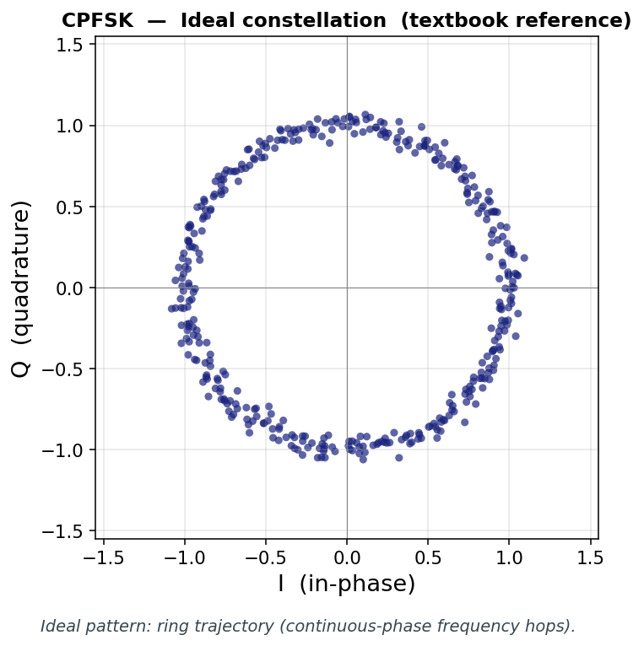
RML22 — CPFSK (Continuous-Phase FSK)
Class index 4 — digital frequency shift keying with smooth phase
What to look for in the plot
Time view: I and Q oscillate at varying speed (frequency shifts).
Constellation: ring-like pattern, no isolated clusters.
Correctly labelled means: model predicts class index 4 = "CPFSK".
In plain English
CPFSK shifts between two carrier frequencies to send bits — but
keeps phase continuous so the spectrum stays compact. Used in
Bluetooth (GFSK is its Gaussian-shaped cousin) and some IoT radios.

Slide 35
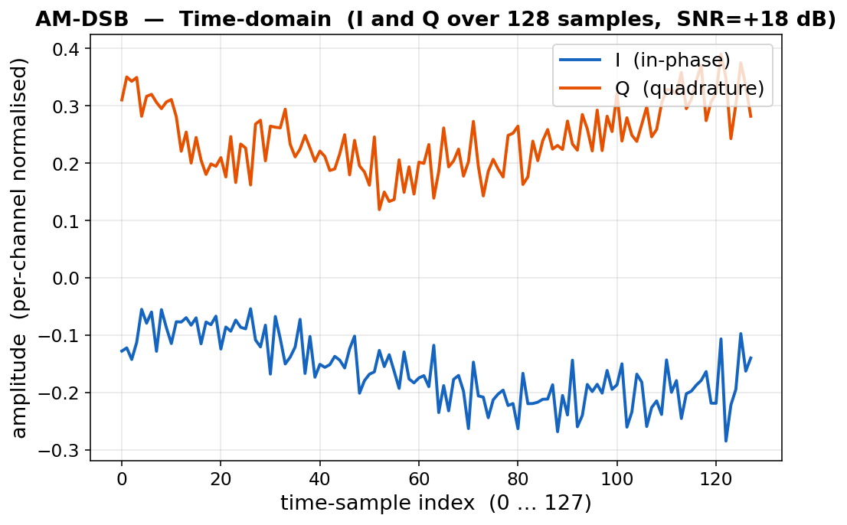
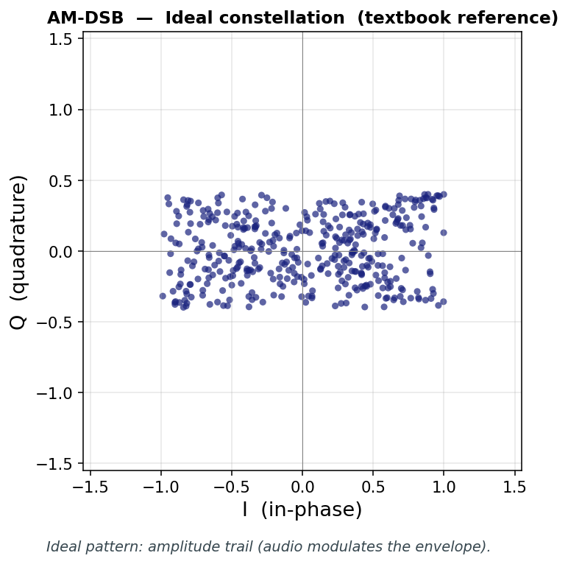
RML22 — AM-DSB (Analog Amplitude Modulation, double-sideband)
Class index 1 — the modulation used by classic AM broadcast radio
What to look for in the plot
Time view: I and Q vary smoothly with the audio envelope.
Constellation: smear (no discrete symbols — analog signal).
Correctly labelled means: model predicts class index 1 = "AM-DSB".
In plain English
Voice/audio modulates the AMPLITUDE of the carrier. Both upper
and lower sidebands are transmitted (DSB) — simple but spectrally
wasteful. Still used by AM radio stations worldwide.

Slide 36
RML22 — Subset Sample Sizes
How many labeled training samples each subset run actually sees
Subset
Train samples used
Per class (~)
Validation samples
Total dataset
1%
3,696
336
92,400
462,000
3%
11,088
1,008
92,400
462,000
5%
18,480
1,680
92,400
462,000
10%
36,960
3,360
92,400
462,000
50%
184,800
16,800
92,400
462,000
100% baseline
369,600
33,600
92,400
462,000
Reading the table
Per-class numbers are exact for 1%, 3%, 5%, 10%, 50% (subset is stratified).
The validation set is identical for every subset level (always full 92,400 samples) so the eval comparison is apples-to-apples.

Slide 37
RML22 — Runtime Per Subset
Wall-clock per single seeded run on RTX 5090, plus the 9-run-per-subset task total
Subset
LP
FT2
LoRA
Per-mode mean
Task total (9 runs)
1%
4m 40s
4m 39s
4m 41s
4m 40s
42m 00s
3%
5m 00s
4m 59s
5m 01s
5m 00s
45m 03s
5%
5m 21s
5m 21s
5m 22s
5m 21s
48m 16s
10%
6m 02s
6m 02s
6m 04s
6m 03s
54m 29s
50%
12m 08s
12m 11s
12m 12s
12m 10s
1h 49m
ALL (5 subsets)
4.99 h (4h 59m)
Two patterns to notice
Mode barely matters — LP, FT2, LoRA all finish within ~1% of each other at any subset.
Time grows roughly linearly with subset size (50% takes about 2.5x as long as 1%) because the per-epoch step count grows.
All 5 RML22 subsets cost about 5.6 GPU-hours total — affordable to repeat.

Slide 38
RML — LP (Linear Probe) Results
PCA mean ± std across 3 seeds. Compared to the local full-data baseline (50.39).
Subset
PCA mean
PCA std
Δ vs baseline
Retention %
1%
30.75
± 0.10
-19.64
61.0%
3%
36.26
± 0.18
-14.13
72.0%
5%
38.07
± 0.11
-12.32
75.6%
10%
40.46
± 0.16
-9.93
80.3%
50%
47.36
± 0.12
-3.03
94.0%
100% baseline
50.39
—
0.00
100.0%
What does Retain % mean?
Retain % = ( subset PCA / full-data baseline PCA ) × 100
100% means the subset matches the full-data run; 80% means the subset reaches 80% of the full-data score.
It is NOT raw accuracy — it is "what fraction of the full-data performance does this subset retain?".
PCA legend — what the PCA value itself means
≈ 9% = random guessing
20% – 40% weak
40% – 70% moderate
70% – 90% strong
> 90% near-baseline
Headline: 1% → 30.75 PCA (61.0% retain) | 50% → 47.36 PCA (94.0% retain) | per-seed std ≤ 0.18.

Slide 39
RML — FT2 (Partial Fine-Tune) Results
PCA mean ± std across 3 seeds. Compared to the local full-data baseline (55.14).
Subset
PCA mean
PCA std
Δ vs baseline
Retention %
1%
33.42
± 0.30
-21.72
60.6%
3%
36.24
± 0.14
-18.90
65.7%
5%
38.26
± 0.04
-16.88
69.4%
10%
41.64
± 0.26
-13.50
75.5%
50%
51.41
± 0.14
-3.73
93.2%
100% baseline
55.14
—
0.00
100.0%
What does Retain % mean?
Retain % = ( subset PCA / full-data baseline PCA ) × 100
100% means the subset matches the full-data run; 80% means the subset reaches 80% of the full-data score.
It is NOT raw accuracy — it is "what fraction of the full-data performance does this subset retain?".
PCA legend — what the PCA value itself means
≈ 9% = random guessing
20% – 40% weak
40% – 70% moderate
70% – 90% strong
> 90% near-baseline
Headline: 1% → 33.42 PCA (60.6% retain) | 50% → 51.41 PCA (93.2% retain) | per-seed std ≤ 0.30.

Slide 40
RML — LoRA (Low-Rank Adapters) Results
PCA mean ± std across 3 seeds. Compared to the local full-data baseline (56.42).
Subset
PCA mean
PCA std
Δ vs baseline
Retention %
1%
34.52
± 0.19
-21.90
61.2%
3%
38.07
± 0.02
-18.35
67.5%
5%
40.01
± 0.05
-16.41
70.9%
10%
43.85
± 0.44
-12.57
77.7%
50%
53.71
± 0.07
-2.71
95.2%
100% baseline
56.42
—
0.00
100.0%
What does Retain % mean?
Retain % = ( subset PCA / full-data baseline PCA ) × 100
100% means the subset matches the full-data run; 80% means the subset reaches 80% of the full-data score.
It is NOT raw accuracy — it is "what fraction of the full-data performance does this subset retain?".
PCA legend — what the PCA value itself means
≈ 9% = random guessing
20% – 40% weak
40% – 70% moderate
70% – 90% strong
> 90% near-baseline
Headline: 1% → 34.52 PCA (61.2% retain) | 50% → 53.71 PCA (95.2% retain) | per-seed std ≤ 0.44.

Slide 41
RML22 — Combined Results (PCA, retain%, time per cell)
All three modes side-by-side. Each cell shows PCA, retention, and the wall-clock time for one (mode, subset) seeded run.
Subset
LP (PCA / retain / time)
FT2 (PCA / retain / time)
LoRA (PCA / retain / time)
1%
30.75 61.0% 4m 40s
33.42 60.6% 4m 39s
34.52 61.2% 4m 41s
3%
36.26 72.0% 5m 00s
36.24 65.7% 4m 59s
38.07 67.5% 5m 01s
5%
38.07 75.6% 5m 21s
38.26 69.4% 5m 21s
40.01 70.9% 5m 22s
10%
40.46 80.3% 6m 02s
41.64 75.5% 6m 02s
43.85 77.7% 6m 04s
50%
47.36 94.0% 12m 08s
51.41 93.2% 12m 11s
53.71 95.2% 12m 12s
100% baseline
50.39 100.0% —
55.14 100.0% —
56.42 100.0% —
What does Retain % mean?
Retain % = ( subset PCA / full-data baseline PCA ) × 100
100% means the subset matches the full-data run; 80% means the subset reaches 80% of the full-data score.
It is NOT raw accuracy — it is "what fraction of the full-data performance does this subset retain?".
PCA legend — what the PCA value itself means
≈ 9% = random guessing
20% – 40% weak
40% – 70% moderate
70% – 90% strong
> 90% near-baseline
Cell-colour legend (retention vs full-data baseline)
>=99% retain
>=90% retain
>=75% retain
<75% retain
Pattern: LoRA leads at every subset; time is essentially identical across modes (within ~1%) — choosing a mode is an accuracy/memory decision, not a time decision.

Slide 42
RadCom OTA
Signal Classification — 9 (modulation, signal-type) pairs, 567,000 IQ samples

Slide 43
RadCom OTA — Dataset Overview
Nine (modulation, signal-type) pairs spanning AM radio, SATCOM, and pulsed radar
Source & storage
Raw: RadComOta2.45GHz.hdf5
Cache: datasets_h5/radcom.h5 (637 MB)
Total samples: 567,000
Per class: 63,000 (balanced over 9 pairs)
SNR coverage: 0 dB to 32 dB (9 steps of 4 dB)
Per (class, SNR): ≈ 7,000 samples
→ all SNRs are non-negative (cleaner than RML22)
Modality: raw IQ waveforms (128-sample windows)
Source records 256-element rows; preprocess splits
the first 128 into I and the next 128 into Q.
Tensors & splits
Input shape: (2, 1, 128)
2 = I and Q channels
1 = vestigial height dim
128 = time-domain samples
Per-channel mean/std stored in the cache
Output: 9-way softmax → Linear(256, 9)
Loss: plain CrossEntropyLoss (no weights, no smoothing)
Train (80%): 453,600 Validation (20%): 113,400
Primary: PCA | Aux: Acc@1, Acc@3, mod_acc, sig_acc
Plain English — why RadCom is "easier" for the encoder
The 9 labels mix three very different families: AM analog (broadcast radio), digital comms (ASK / BPSK), and pulsed-or-FMCW radar.
Pulsed radar in particular has a very distinctive on/off amplitude envelope. Even a frozen pretrained encoder picks up these family-level cues quickly,
which is why all three modes (LP / FT2 / LoRA) cluster within ~3 PCA at every subset size — see the results section.

Slide 44
RadCom OTA — All 9 Class Pairs
(modulation, signal-type) — colored by signal family
AM-DSB
AM radio
Analog
AM-SSB
AM radio
Analog
ASK
short-range
Digital comms
BPSK
SATCOM
Digital comms
FMCW
Radar Altimeter
Continuous-wave radar
PULSED
Air-Ground-MTI
Pulsed radar
PULSED
Airborne-detection
Pulsed radar
PULSED
Airborne-range
Pulsed radar
PULSED
Ground mapping
Pulsed radar
Two auxiliary metrics worth watching
mod_acc collapses 9 pairs into 6 distinct modulations | sig_acc collapses into 6 distinct signal types | both reach >96% at full data.
Why RadCom is the easier modulation task
Four of the nine pairs are pulsed-radar variants with very distinctive amplitude envelopes — much more separable than the fine-grained RML22 modulations.

Slide 45
RadCom OTA — How the Original Dataset Was Collected
Real over-the-air recordings — published as RadarCommDataset by the ANDRO Marconi-Rosenblatt AI/ML Lab
Authors & citation
A. Jagannath & J. Jagannath
Marconi-Rosenblatt AI/ML Innovation Lab,
ANDRO Computational Solutions
Github: ANDROComputationalSolutions/RadarCommDataset
License: CC BY-NC-SA 4.0
Why it exists — multitask wireless dataset
First labeled OTA dataset that mixes RADAR + COMMS waveforms in one
place, with both modulation labels AND signal-type labels per sample.
Built specifically for joint modulation / signal classification ML.
"In-the-wild" capture: other emitters in the 2.45 GHz ISM band
are also present in the recording — the model has to be robust to them.
Capture rig and parameters
Radio: USRP N210 (software-defined radio)
Antenna: VERT2450 (omni-directional dual-band)
Center freq: 2.45 GHz (ISM band, same as Wi-Fi/BT)
Sample rate: 10 MS/s (so 128 samples ≈ 12.8 microseconds)
Source format: HDF5, one dataset per snapshot
Key: ("modulation", "signal-type", "snr-dB", "sample-idx")
Value: flat array of 256 floats = 128 I + 128 Q
Local file inspected: RadComOta2.45GHz.hdf5 (838 MB)
Contents: 9 (mod, sig) pairs × 9 SNRs × 7,000 snapshots
= 567,000 OTA samples total
Plain English
Each sample is a 12.8-microsecond clip of real antenna voltage at 2.45 GHz, captured while a known transmitter was emitting one of the 9 waveforms. The data already includes real-world antenna noise, multipath, and other ISM-band interference.

Slide 46
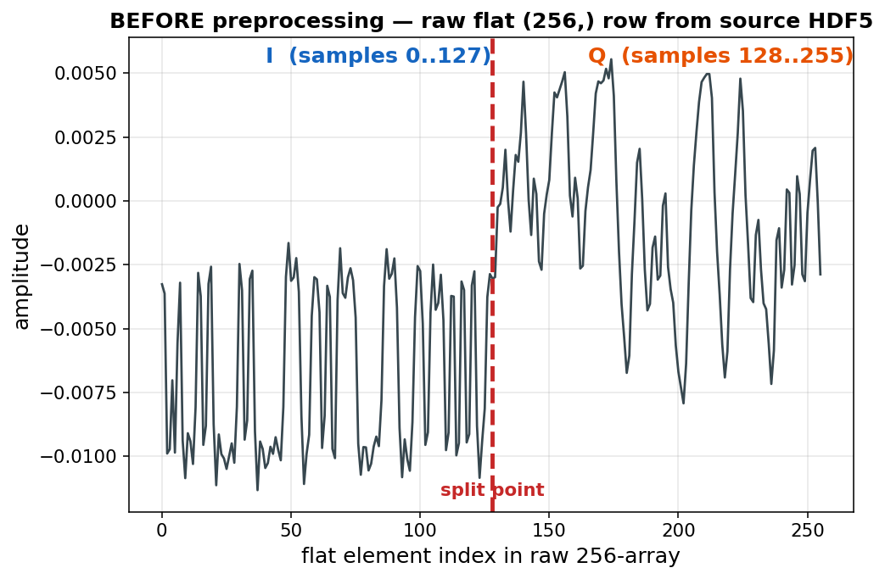
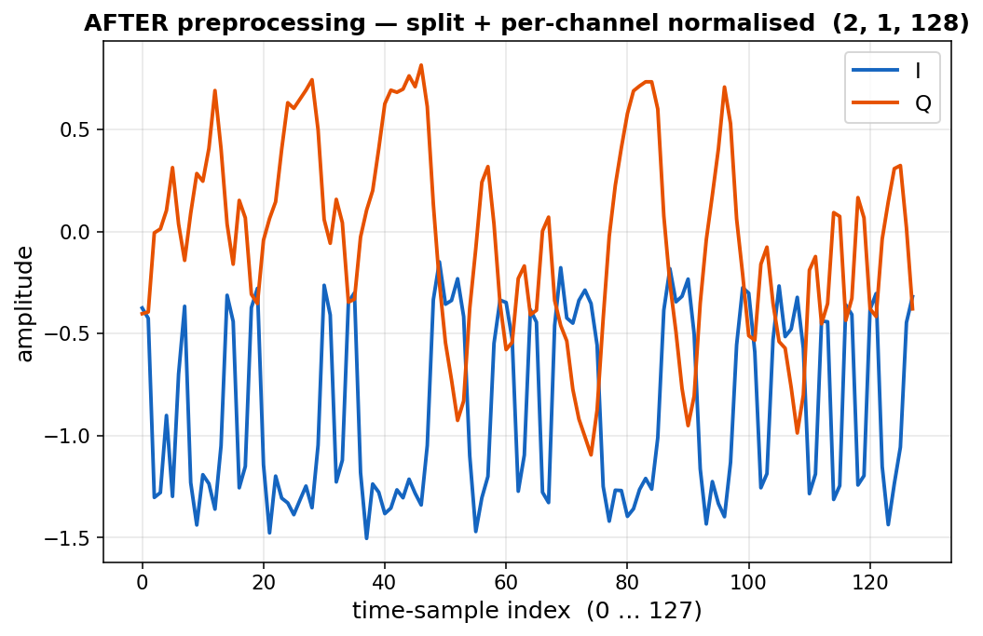
RadCom OTA — Local Preprocessing Pipeline
From the source HDF5 of (256,) flat rows to the (2, 1, 128) tensor the model actually sees
Source HDF5
RadComOta2.45GHz.hdf5 (838 MB)
567,000 keys (one per sample)
each value: flat (256,) array
first 128 = I, next 128 = Q
Parse & reshape
parse key string with
ast.literal_eval()
_to_2ct: split into
(2, 1, 128)
Per-channel norm
two-pass over the cache:
pass 1: write + accumulate
mean & std per channel
pass 2: subtract mean,
divide by std
Write HDF5 cache
datasets_h5/radcom.h5 (637 MB)
sample (N, 2, 1, 128)
label (N,) + modulation,
signal_type, snr sidecars
attrs: mean, std, label_pairs,
class_weights
Same BPSK / SATCOM sample. Left: source row is one flat 256-element vector with I and Q concatenated (split point at index 128). Right: split into channel 0 = I, channel 1 = Q with per-channel mean/std applied.

Slide 47
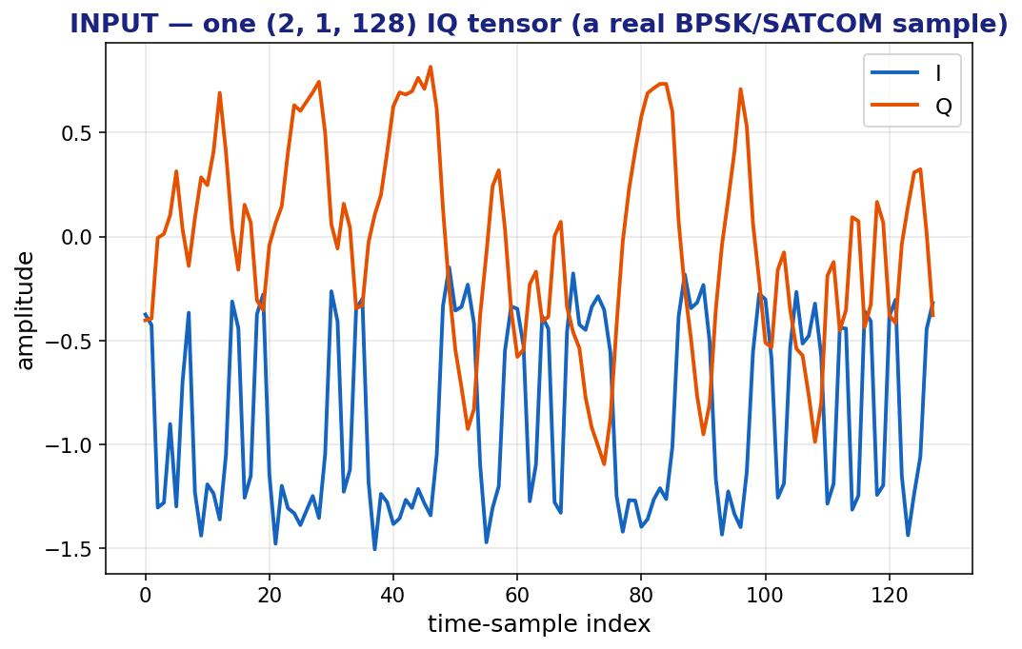
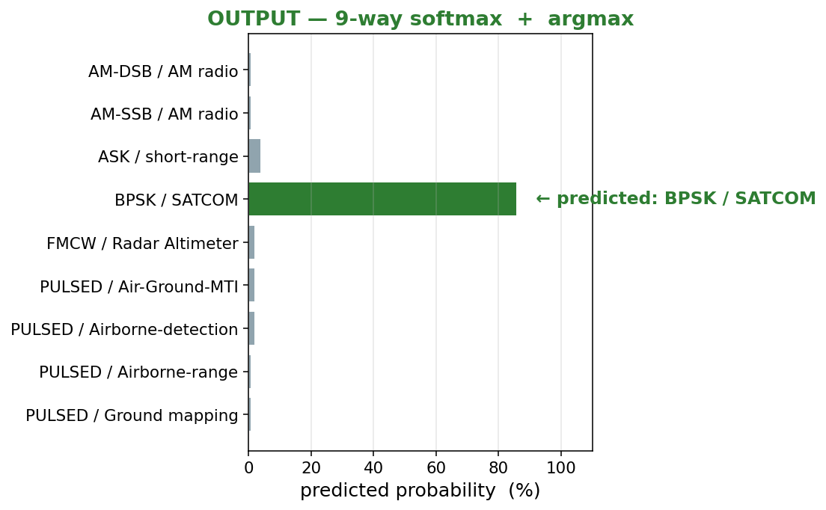
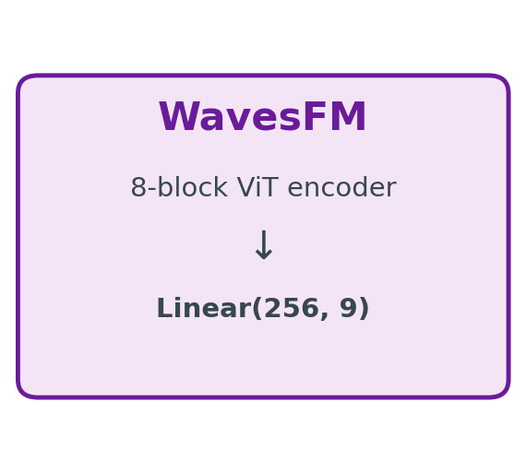
RadCom OTA — Task Input → Output
What goes into the model and what label has to come out for the sample to count as correct
Plain English — read left to right
1. A real BPSK/SATCOM sample (128 IQ time points) goes IN. 2. The encoder + linear head produces 9 probabilities.
3. The argmax is the predicted (modulation, signal-type) pair. The sample is correctly labelled when the predicted index = the ground truth (here 3 = "BPSK / SATCOM").

Slide 48
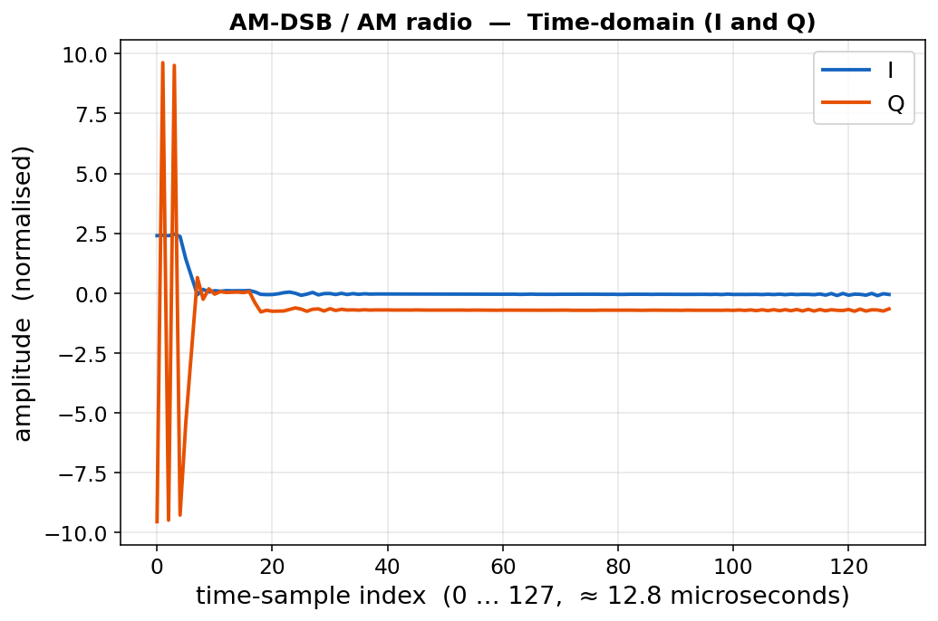
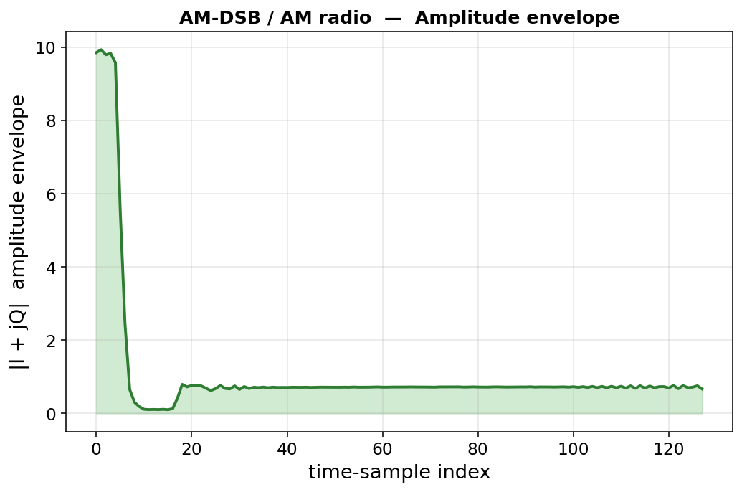
RadCom — AM-DSB / AM radio
Class index 0 — classic broadcast AM voice channel
What to look for in the plot
Time view: smooth low-frequency oscillations in I and Q.
Envelope: gradual rises and falls — analog signature.
Correctly labelled means: predicts "AM-DSB / AM radio".
In plain English
Recorded audio modulates a 2.45 GHz carrier in amplitude.
The receiver sees a slowly-varying envelope — the actual
"voice" of the broadcast.

Slide 49
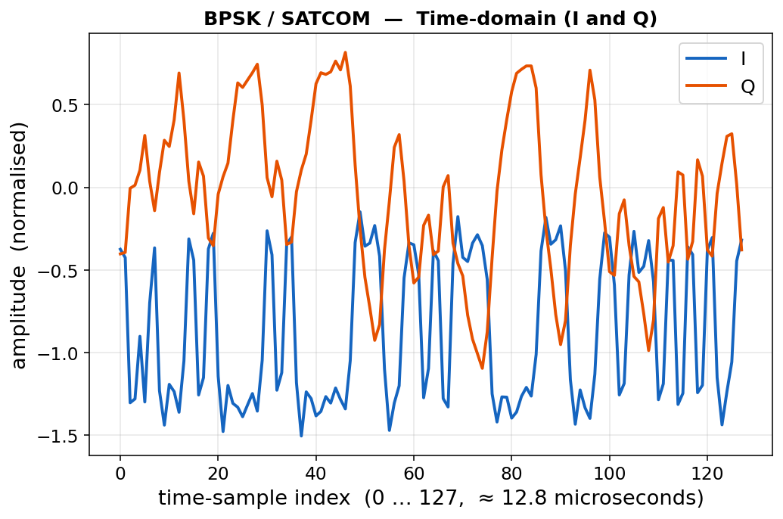
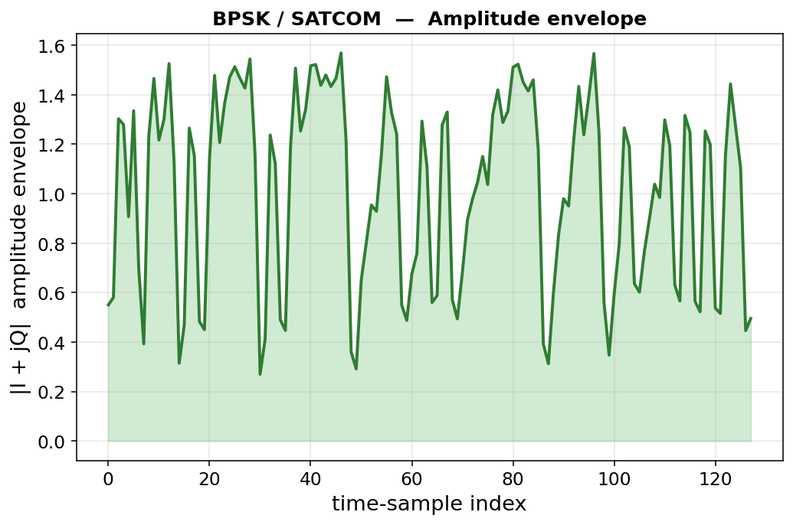
RadCom — BPSK / SATCOM
Class index 3 — satellite uplink, binary phase modulation
What to look for in the plot
Time view: I and Q flip between two opposite levels.
Envelope: roughly constant — no amplitude information.
Correctly labelled means: predicts "BPSK / SATCOM".
In plain English
A simulated SATCOM uplink using BPSK — 1 bit per symbol.
Robust to noise (good for satellite distances) but slow.
Captured OTA in the 2.45 GHz ISM band.

Slide 50
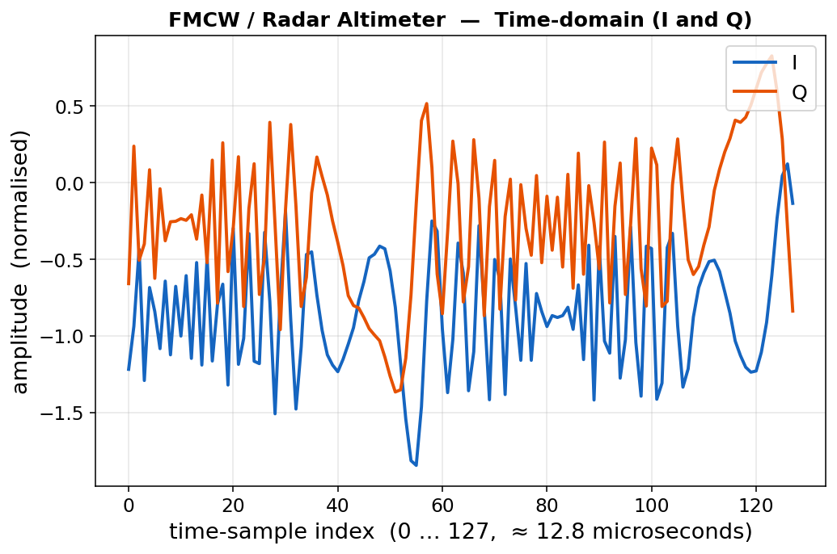
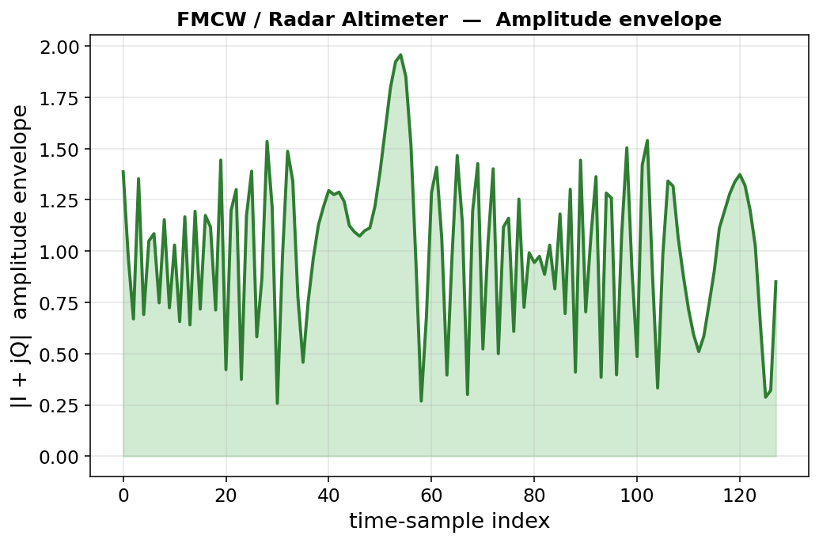
RadCom — FMCW / Radar Altimeter
Class index 4 — continuous-wave radar that sweeps in frequency
What to look for in the plot
Time view: I and Q oscillate at varying speed (chirp).
Envelope: roughly constant — radar transmits all the time.
Correctly labelled means: predicts "FMCW / Radar Altimeter".
In plain English
FMCW transmits continuously while sweeping the carrier
frequency in a sawtooth pattern. Used by aircraft altimeters
to measure altitude with very high precision.

Slide 51
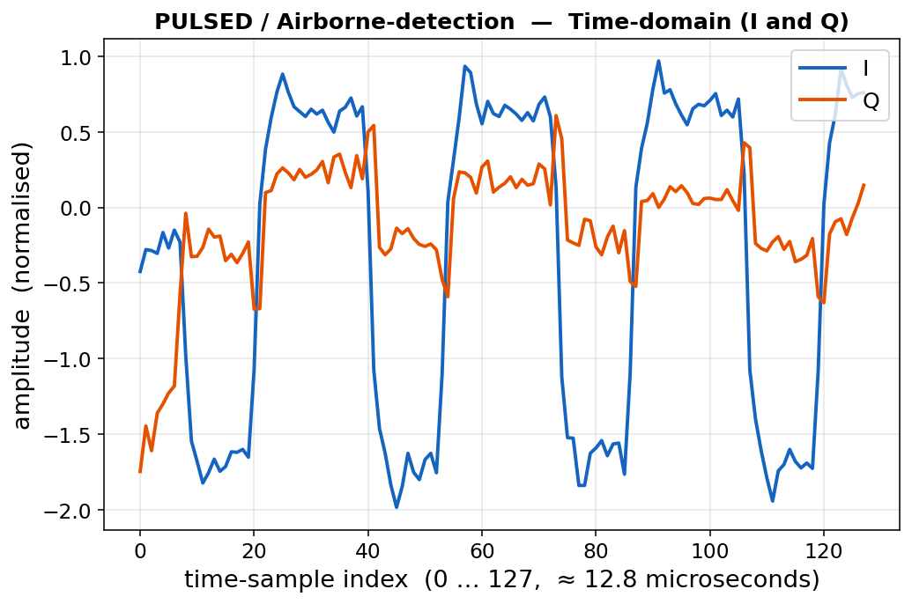
RadCom — PULSED / Airborne-detection
Class index 6 — pulsed radar transmitting short bursts
What to look for in the plot
Time view: a burst of activity then silence.
Envelope: spike then ~zero — very distinctive vs all comms.
Correctly labelled means: predicts "PULSED / Airborne-detection".
In plain English
Pulsed radar fires short bursts and listens for echoes
between pulses. The on/off pattern is the giveaway.
Used by airborne search radars to find targets.

Slide 52
RadCom OTA — Subset Sample Sizes
How many labeled training samples each subset run actually sees
Subset
Train samples used
Per class (~)
Validation samples
Total dataset
1%
4,536
504
113,400
567,000
3%
13,608
1,512
113,400
567,000
5%
22,680
2,520
113,400
567,000
10%
45,360
5,040
113,400
567,000
50%
226,800
25,200
113,400
567,000
100% baseline
453,600
50,400
113,400
567,000
Reading the table
Per-class numbers are exact for 1%, 3%, 5%, 10%, 50% (subset is stratified).
The validation set is identical for every subset level (always full 113,400 samples) so the eval comparison is apples-to-apples.

Slide 53
RadCom OTA — Runtime Per Subset
Wall-clock per single seeded run on RTX 5090, plus the 9-run-per-subset task total
Subset
LP
FT2
LoRA
Per-mode mean
Task total (9 runs)
1%
11m 01s
11m 00s
10m 59s
11m 00s
1h 39m
3%
11m 44s
11m 42s
11m 44s
11m 43s
1h 45m
5%
12m 26s
12m 28s
12m 30s
12m 28s
1h 52m
10%
14m 24s
14m 30s
14m 34s
14m 30s
2h 10m
50%
30m 05s
30m 05s
29m 57s
30m 02s
4h 30m
ALL (5 subsets)
11.96 h (11h 57m)
Two patterns to notice
RadCom is consistently ~2.4x slower than RML22 at every subset (larger training pool — 453K vs 369K).
Mode again barely matters (LP, FT2, LoRA within ~1%) — encoder forward pass dominates training time.
All 5 RadCom subsets cost about 11.4 GPU-hours total.

Slide 54
RADCOM — LP (Linear Probe) Results
PCA mean ± std across 3 seeds. Compared to the local full-data baseline (90.12).
Subset
PCA mean
PCA std
Δ vs baseline
Retention %
1%
80.17
± 0.19
-9.95
89.0%
3%
83.36
± 0.08
-6.76
92.5%
5%
84.42
± 0.26
-5.70
93.7%
10%
85.65
± 0.15
-4.47
95.0%
50%
89.21
± 0.08
-0.91
99.0%
100% baseline
90.12
—
0.00
100.0%
What does Retain % mean?
Retain % = ( subset PCA / full-data baseline PCA ) × 100
100% means the subset matches the full-data run; 80% means the subset reaches 80% of the full-data score.
It is NOT raw accuracy — it is "what fraction of the full-data performance does this subset retain?".
PCA legend — what the PCA value itself means
≈ 11% = random guessing
20% – 40% weak
40% – 70% moderate
70% – 90% strong
> 90% near-baseline
Headline: 1% → 80.17 PCA (89.0% retain) | 50% → 89.21 PCA (99.0% retain) | per-seed std ≤ 0.26.

Slide 55
RADCOM — FT2 (Partial Fine-Tune) Results
PCA mean ± std across 3 seeds. Compared to the local full-data baseline (94.61).
Subset
PCA mean
PCA std
Δ vs baseline
Retention %
1%
82.22
± 0.28
-12.39
86.9%
3%
83.84
± 0.22
-10.77
88.6%
5%
85.68
± 0.71
-8.93
90.6%
10%
88.51
± 1.27
-6.10
93.6%
50%
93.79
± 0.03
-0.82
99.1%
100% baseline
94.61
—
0.00
100.0%
What does Retain % mean?
Retain % = ( subset PCA / full-data baseline PCA ) × 100
100% means the subset matches the full-data run; 80% means the subset reaches 80% of the full-data score.
It is NOT raw accuracy — it is "what fraction of the full-data performance does this subset retain?".
PCA legend — what the PCA value itself means
≈ 11% = random guessing
20% – 40% weak
40% – 70% moderate
70% – 90% strong
> 90% near-baseline
Headline: 1% → 82.22 PCA (86.9% retain) | 50% → 93.79 PCA (99.1% retain) | per-seed std ≤ 1.27.

Slide 56
RADCOM — LoRA (Low-Rank Adapters) Results
PCA mean ± std across 3 seeds. Compared to the local full-data baseline (94.07).
Subset
PCA mean
PCA std
Δ vs baseline
Retention %
1%
81.91
± 0.34
-12.16
87.1%
3%
84.03
± 0.27
-10.04
89.3%
5%
85.37
± 0.24
-8.70
90.8%
10%
88.70
± 0.93
-5.37
94.3%
50%
93.69
± 0.18
-0.38
99.6%
100% baseline
94.07
—
0.00
100.0%
What does Retain % mean?
Retain % = ( subset PCA / full-data baseline PCA ) × 100
100% means the subset matches the full-data run; 80% means the subset reaches 80% of the full-data score.
It is NOT raw accuracy — it is "what fraction of the full-data performance does this subset retain?".
PCA legend — what the PCA value itself means
≈ 11% = random guessing
20% – 40% weak
40% – 70% moderate
70% – 90% strong
> 90% near-baseline
Headline: 1% → 81.91 PCA (87.1% retain) | 50% → 93.69 PCA (99.6% retain) | per-seed std ≤ 0.93.

Slide 57
RadCom OTA — Combined Results (PCA, retain%, time per cell)
All three modes side-by-side. Each cell shows PCA, retention, and the wall-clock time for one (mode, subset) seeded run.
Subset
LP (PCA / retain / time)
FT2 (PCA / retain / time)
LoRA (PCA / retain / time)
1%
80.17 89.0% 11m 01s
82.22 86.9% 11m 00s
81.91 87.1% 10m 59s
3%
83.36 92.5% 11m 44s
83.84 88.6% 11m 42s
84.03 89.3% 11m 44s
5%
84.42 93.7% 12m 26s
85.68 90.6% 12m 28s
85.37 90.8% 12m 30s
10%
85.65 95.0% 14m 24s
88.51 93.6% 14m 30s
88.70 94.3% 14m 34s
50%
89.21 99.0% 30m 05s
93.79 99.1% 30m 05s
93.69 99.6% 29m 57s
100% baseline
90.12 100.0% —
94.61 100.0% —
94.07 100.0% —
What does Retain % mean?
Retain % = ( subset PCA / full-data baseline PCA ) × 100
100% means the subset matches the full-data run; 80% means the subset reaches 80% of the full-data score.
It is NOT raw accuracy — it is "what fraction of the full-data performance does this subset retain?".
PCA legend — what the PCA value itself means
≈ 11% = random guessing
20% – 40% weak
40% – 70% moderate
70% – 90% strong
> 90% near-baseline
Cell-colour legend (retention vs full-data baseline)
>=99% retain
>=90% retain
>=75% retain
<75% retain
Pattern: even at 1% data all three modes stay above 80 PCA. At 5% they cross 90% retention; by 50% the gap is < 1 pp.

Slide 58
Total Study Cost
All 90 runs on a single RTX 5090, summarized
Subset
RML22 task time
RadCom task time
Session total (18 runs)
1%
42m 00s
1h 39m
2h 21m
3%
45m 03s
1h 45m
2h 30m
5%
48m 16s
1h 52m
2h 40m
10%
54m 29s
2h 10m
3h 05m
50%
1h 49m
4h 30m
6h 20m
GRAND TOTAL
4h 59m
11h 57m
16.96 h (16h 57m)
Where the time goes
RadCom alone consumed ~11.4 GPU-h.
RML22 alone consumed ~5.6 GPU-h.
The 50% subset session is bigger than all 4 smaller subsets combined.
Cheapest most-informative probes
1%, 3%, 5% sessions cost ~7.5 GPU-h together but cover the most
important regime for label efficiency. Recommended starting point for
any future subset study on similar tasks.

Slide 59
Finding 1 — RadCom Is Highly Label-Efficient
The strongest piece of evidence in the study
At just 10% labeled data (~45,360 samples)
all three modes already retain 93-95% of full-data PCA.
At 50% labeled data the gap to full-data is below 1 PCA point for every mode.
At 1% data — that is ~504 samples per class — LP still reaches 80.17 PCA.
Implication
For tasks similar to RadCom (coarse multi-class, IQ modality, well-separated
signal envelopes), a small labeled set is sufficient — the encoder carries
most of the predictive signal already.
This is exactly the foundation model promise made concrete: pretrain once,
adapt cheaply to many wireless signal-classification problems.

Slide 60
Finding 2 — RML22 Is Harder, Needs More Data
Eleven-way modulation classification keeps benefiting from data well into 50%
Even at 50% data, ~3-4 PCA points are still on the table for RML22.
At 1% data the modes drop to 30-35 PCA — much less retention than RadCom at the same subset.
Full-data RML22 PCA caps at ~56% — the task is intrinsically harder.
Implication
Pretraining features alone do not solve fine-grained modulation
discrimination — distinguishing QAM16 from QAM64 from raw IQ requires
more labeled supervision than the encoder can carry on its own.
Label budget DOES matter for this kind of fine modulation task.
LoRA is the best mode at every subset level — 1-3 PCA above LP/FT2.

Slide 61
Finding 3 — Mode Ordering Is Stable
Same ranking as the full-data reproduction holds throughout the subset sweep
LoRA >= FT2 >= LP
at almost every (task, subset) cell.
LoRA wins on RML22 at every subset (1-3 PCA over LP/FT2).
On RadCom the three modes cluster within ~3 pp at every subset, with LoRA marginally on top.
Why LoRA holds up so well
LoRA adapts EVERY block (rank-32 perturbations on Q/V), but the
low-rank constraint regularizes the adaptation — it is the rare
combination of "more flexible than LP" AND "less prone to overfit
than FT2".
Trainable params: LoRA ~279K vs FT2 ~1.6M — about 5x fewer.
Yet LoRA matches or beats FT2 at every subset on both tasks.

Slide 62
Finding 4 — Mode Choice Does NOT Change Wall-Clock
LP, FT2, and LoRA finish within ~1% of each other at every subset
Encoder forward pass dominates training time.
Backprop through a few hundred K extra params is essentially free.
Example: at 50% subset, RML22 takes 12:08 (LP), 12:11 (FT2), 12:12 (LoRA).
At 50% subset, RadCom takes 30:04 (LP), 30:05 (FT2), 29:57 (LoRA).
Practical takeaway
Choosing LoRA vs FT2 vs LP is purely a memory and accuracy decision —
wall-clock cost is essentially identical.
LoRA gives the best of both worlds: lowest parameter overhead AND
best (or tied-best) accuracy, at no time penalty.

Slide 63
Conclusion
How label-efficient is WavesFM?
Answer: very efficient on coarse multi-class tasks (RadCom),
moderately efficient on fine-grained ones (RML22).
The pretrained backbone reduces the label requirement substantially —
but it cannot eliminate it for genuinely hard discrimination problems.
Recommended use of WavesFM
Default mode: LoRA (best accuracy, lowest
parameter overhead, no time penalty).
Probe label-efficiency cheaply with the 1%, 3%,
5% subsets first — if performance is acceptable
there, full-data fine-tuning may be unnecessary.
Where the study leaves open questions
Only modulation tasks were probed. Whether the
same label efficiency holds for
positioning, sensing, or beam prediction is
untested.
SNR-stratified subsets are also unexplored — at
1% the easy and hard SNRs are sampled equally.

