Slide 1
Smart Inventory Tracking
Arab Open University – Bahrain
Faculty of Computer Studies
Inventory Management for Satellite Store at AlBa
Student ID: 6220354
Name: Maheen Muhammad Zafeer
Supervisor: Dr. Mohammad Riyaz Belgaum
Smart Inventory Tracking
Satellite Store
AlBa

Slide 2
~ Introduction ~
Maintenance stores manage large numbers of tools.
Many stores still use Excel or handwritten inventory records
Manual tracking leads to errors and inefficiency
No real-time visibility of inventory levels
Poor visibility causes stock shortages and overstocking
Time consuming and difficult to manage large inventories
Missing data and duplicated entries
Can cause delays in maintenance operations

Slide 3
~ Project Aims ~
Develop a smart, digital system to replace manual inventory tracking for a single store in AlBa
Monitor material movement and stock levels
Improve accuracy, efficiency and visibility of store inventory
Support better planning and cost reduction

Slide 4
~ Research Findings ~
Many small stores still rely on spreadsheets – lack automation, alerts and dashboards
Many smart inventory tracking systems share core features
Real-time Updates
Barcode Scanning
Low-Stock Alerts
Dashboards
Centralised Logs

Slide 5
~ Research Findings ~
Existing systems focus on large-scale or retail environments
ERP systems (e.g., Odoo) are complex and costly for single stores
Fully integrated with accounting, sales and manufacturing modules.
Includes complex stock valuation methods and advanced warehouse routing.
Large-scale architecture, advanced workflow management, higher technical setup requirements.
Need for a simple, low-cost system for single maintenance stores

Slide 6
~ Suggested Solution ~
Smart Inventory Tracking System with barcode scanning
Central SQL database for accurate transaction logging
Real-time stock updates for withdrawals and restocking
Automated alerts for low or overstock situations
Dashboard with usage trends
Simple, user-friendly interface with minimal IT dependency

Slide 7
~ Target Users ~
Storekeepers & Maintenance Staff
~ Faster and easier stock recording
~ Reduced manual work and errors
Inventory Managers
~ Clear stock visibility and usage trends
~ Better planning and decision-making
Company
~ Reduced material waste and shortages
~ Improved operational efficiency

Slide 8
~ Requirement Elicitation ~
Meeting & emails with AlBa supervisor
Observation of current Excel-based system
Review of similar inventory systems

Slide 9
~ Functional Requirements ~
Barcode-based stock withdrawal and restocking
Real-time update of inventory levels
Central SQL database for all records
Low-stock and overstock alerts
Search by item name or category
Transaction history and usage trends
Track items sent for repair
Allow stock reservation for planned maintenance jobs
Add, edit and manage item categories

Slide 10
~ Non Functional Requirements ~
Usability: Easy to use for non-technical staff
Performance: Fast, real-time data updates
Maintainability: Simple to update and fix
Scalability: Grows with more stores and inventory
Reliability: Accurate stock tracking
Security: Safe and secure data storage
Auditability: All actions fully traceable
Offline Capability: Scan offline, sync later

Slide 11
~ Software Development Model ~
Agile development methodology – Advantages
Incremental Delivery – System developed in small iterative modules
Feedback Based Development – Continuous feedback from store staff
Flexibility – Allows changes during development (requirements evolve)
Early detection of issues – Continuous testing
Risk reduction – Reduces risk of errors and improves usability

Slide 12
~ Analysis & Design Diagrams ~

Slide 13
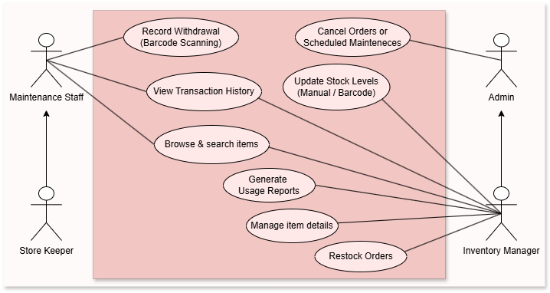
~ Use Case Diagram ~

Slide 14
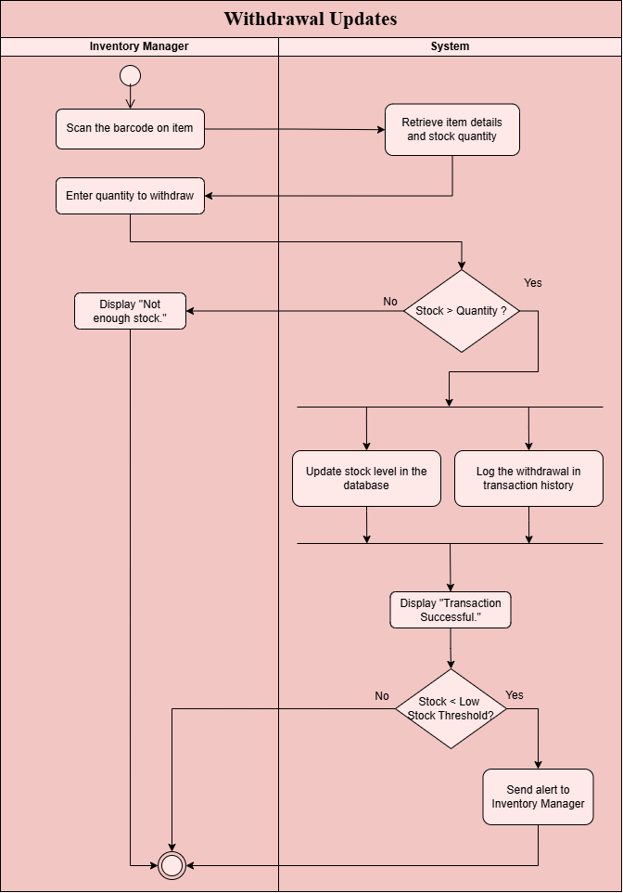
~ Activity Diagram – Withdrawal Updates ~

Slide 15
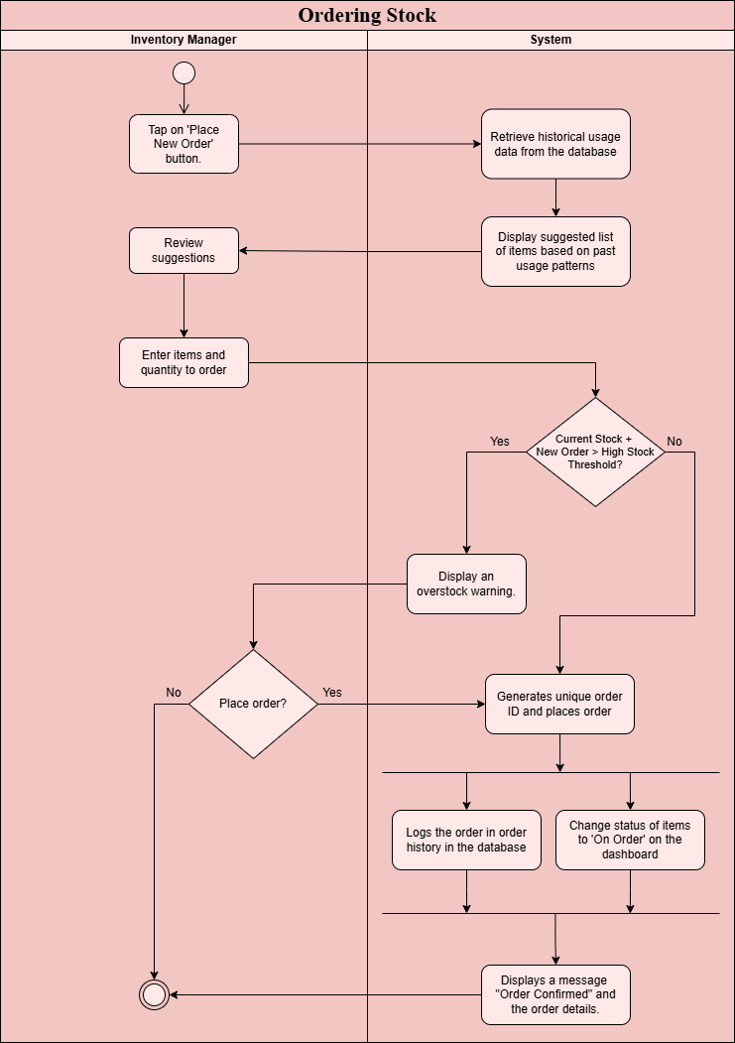
~ Activity Diagram – Ordering Stocks ~

Slide 16
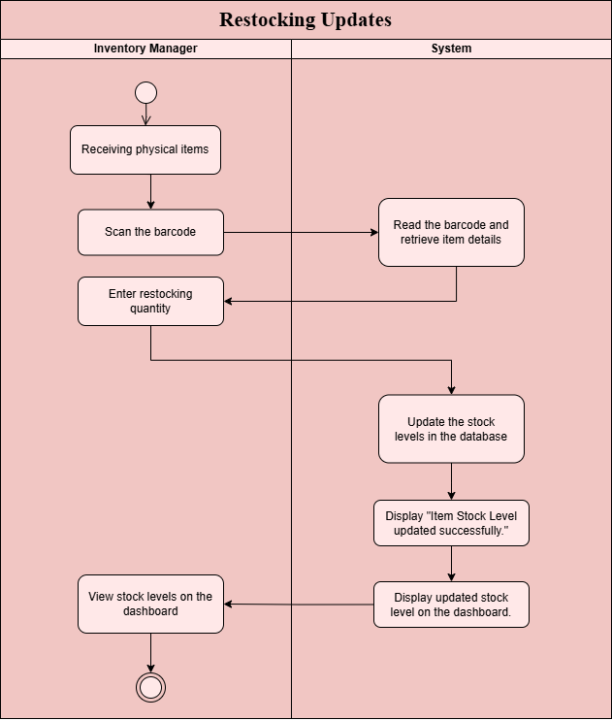
~ Activity Diagram – Restocking Updates ~

Slide 17
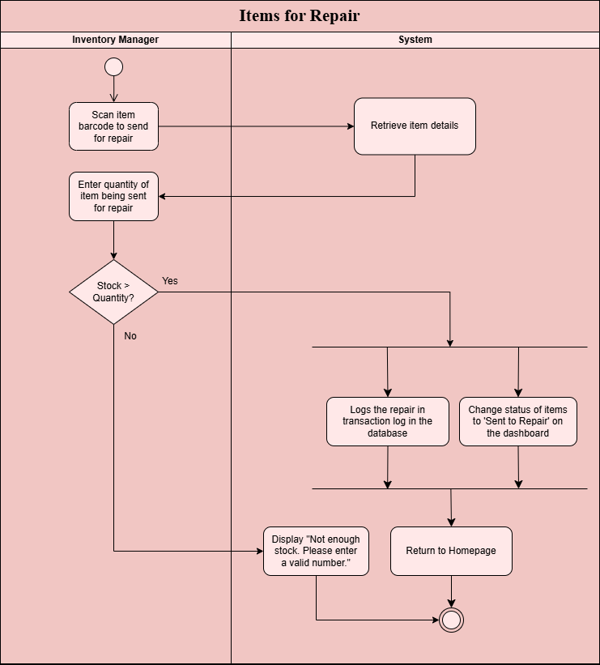
~ Activity Diagram – Items Repair Workflow ~

Slide 18
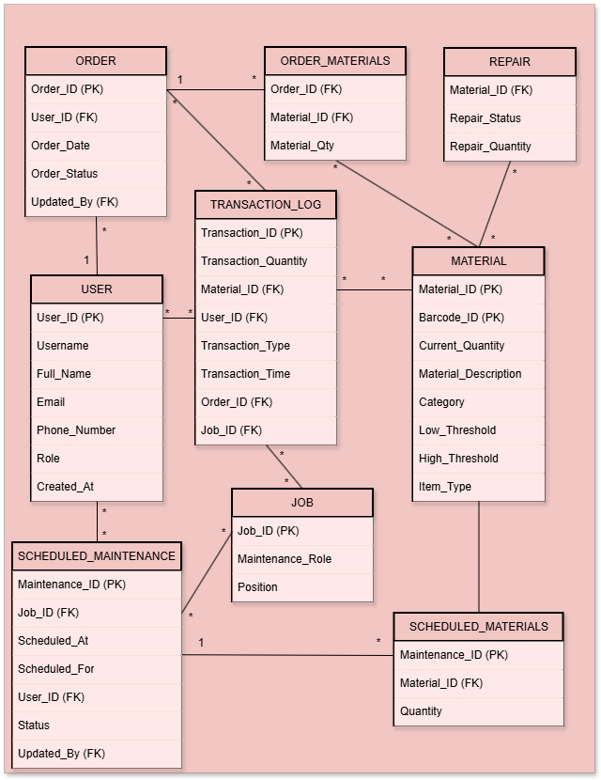
~ Entity Relationship Diagram ~
Category includes Mechanical, Electrical and Instrumentation
Role includes Storekeeper, Maintenance Engineer and Inventory Manager.
Maintenance_Role includes Maintenance, Electrical or Instrumentation.
Position includes Technician Grade 5, Technician Grade 6, Technician Grade 7 and Maintenance Supervisor.

Slide 19
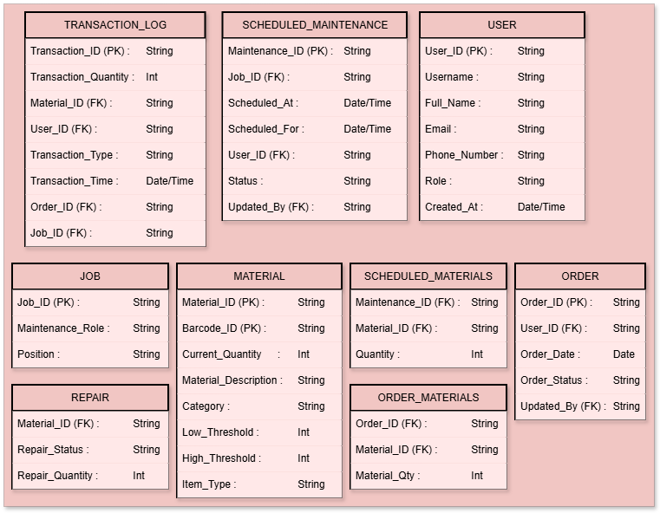
~ Database Design~

Slide 20
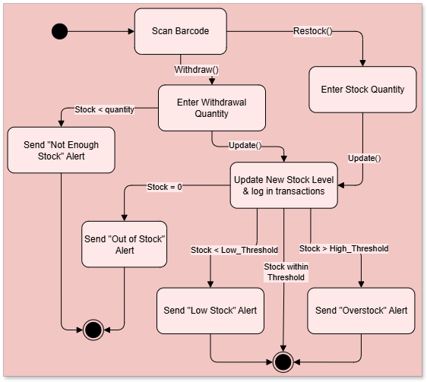
~ Design Diagram – State Diagram ~

Slide 21
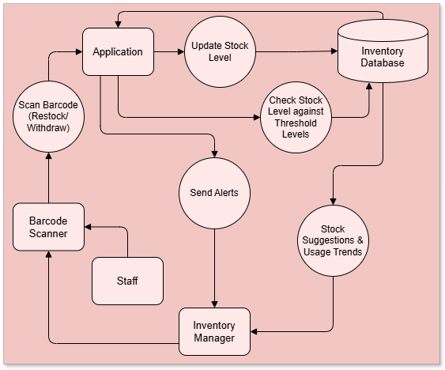
~ Design Diagram – Data Flow Diagram ~

Slide 22
Thank you

