Slide 1
Smart Inventory Tracking
Arab Open University – Bahrain
Faculty of Computer Studies
Inventory Management for Satellite Store at AlBa
Student ID: 6220354
Name: Maheen Muhammad Zafeer
Supervisor: Dr. Mohammad Riyaz Belgaum
Smart Inventory Tracking
Satellite Store
AlBa

Slide 2
~ Introduction ~
Industrial maintenance stores manage thousands of inventory items daily
Many still rely on spreadsheets or handwritten logs
Manual methods are slow and error-prone
Lack of real-time visibility causes shortages and overstocking
Aim:
Develop a Smart Inventory Tracking System to automate inventory tracking and improve stock visibility in real time
Monitor material movement and stock levels
Improve accuracy, efficiency and visibility of store inventory
Support better planning and cost reduction

Slide 3
~ Suggested Solution ~
Smart Inventory Tracking System Mobile Application with barcode scanning
Central SQL database for accurate transaction logging
Real-time stock updates for withdrawals and restocking
Automated alerts for low or overstock situations
Dashboard with usage trends
Simple, user-friendly interface with minimal IT dependency
Requirements Gathering:
Meeting & emails with AlBa Supervisor
Observation of current Excel-based System
Review of similar inventory systems

Slide 4
~ Aims ~
The main aim of this project is to develop a Smart Inventory Tracking System that automates tracking, provides real-time stock visibility and improves planning and availability of essential materials.
Specific Objectives:
Maintain accurate inventory levels through real-time stock withdrawal and restocking updates.
Generate low-stock alerts for items below low-threshold and overstock alerts for items being restocked over the high threshold, preventing shortages or overstocking.
Provide an analytical dashboard that displays key performance indicators and usage trends for better planning.
Maintain an auditable history of inventory transactions for accountability and reporting.

Slide 5
~ Requirements ~
Functional Requirements
Barcode-based stock withdrawal and restocking
Central SQL database for all records
Transaction logging
Real-time update of inventory levels
Dashboard and reports for usage trends
Low & high stock alerts
Add, edit and manage item categories
Search by item name or category
Order management, scheduled maintenance reservations and repair tracking
Non-Functional Requirements
Usability: Simple interface for non-technical staff
Performance: Real-time updates and fast processing
Reliability: Accurate stock synchronisation
Auditability: All actions fully traceable
Security: Protected role-based access
Scalability: Future multi-store expansion
Maintainability: Easy to update and extend

Slide 6
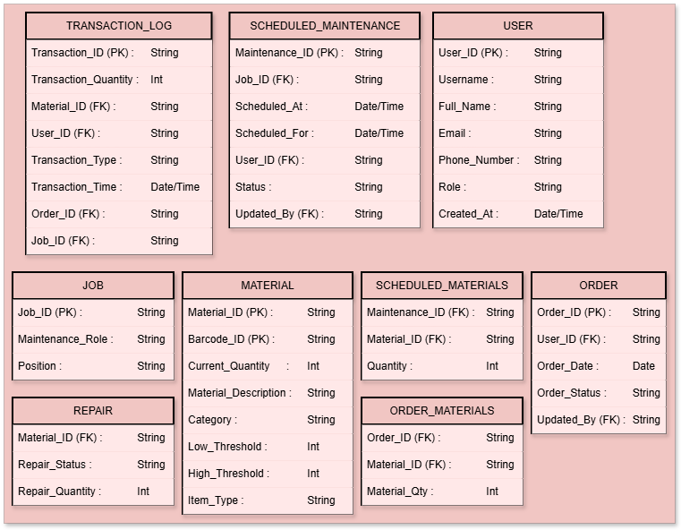
~ Database Design~

Slide 7
~ Implementation & Testing ~
Tools
Framework: Flutter / Dart
Database: Supabase PostgreSQL
Barcode Scanner: Mobile Scanner Library
Analytics: fl_chart
IDE: Visual Studio Code
Secure user authentication using Supabase – login and signup pages with input validation.
The testing methods used are functional testing and user acceptance testing.
Functional testing verifies that the software performs specified functions correctly and ensures it meets requirements.
User acceptance testing checks whether the software meets user needs and confirms it is ready for real-world use.

Slide 8
~ Results & Discussions ~
Results
Barcode scanning improved speed and accuracy
Real-time updates improved stock visibility
Validation checks improved data reliability
Reports enabled better stock planning
Role-based access improved security and usability
Goals Achieved
Successfully automated stock tracking
Implemented alerts and warnings
Built dashboard and analytics reports
Maintained full transaction audit history
PDF export

Slide 9
~ Results & Discussions ~
Future Improvements
Push notifications / Email alerts
Offline functionality
Advanced predictive analytics
An admin dashboard to approve orders before placing them
Calendar view for maintenance schedules
Supplier integration
Multi-store support
Web/Desktop version

Slide 10
~ Conclusion ~
The Smart Inventory Tracking System successfully replaces manual and spreadsheet-based inventory tracking with a mobile-based digital solution.
It improves accuracy, efficiency and real-time visibility of stock movement in a maintenance store environment.
Core objectives were achieved including real-time stock updates, barcode scanning, automated alerts and transaction logging.
Role-based access control and validation checks improved system security and reliability.
Dashboards and reports provide useful insights for better decision making and planning.
The system reduces human error and simplifies complex inventory workflows.
Although features like offline mode, notifications and supplier integration were not implemented, the system provides a strong foundation for future expansion.
The project also strengthened practical skills in Flutter development, database design, system integration and problem solving.

Slide 11
Thank you

