Slide 1




ELABORATOR _Baseline data
Analysis of results
Questionnaire on bike lanes safety
Trikala. 2024

Slide 2
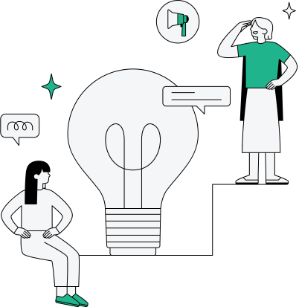
Intervention background
This survey was dedicated to evaluate the existing situation on the bike lanes of the city in terms of quality and safety.
The suggested intervention will be redesigning cycling lanes and fostering data collection
60 Sensors to record the use of bikes and software for monitoring the bikes’ fleet (including biometrics)
Implementation of 10 sensors to record illegal parking illegal parking on bike lanes and provide real time information to the municipal police.
The data collected from the sensors will provide information to re-design safer bike lanes

Slide 3

Overview of the evaluation methodology
we created short questionnaire which was distributed via the following channels:
e-trikala social media
the Municipalities official site
The survey was open for 3 weeks and gathered 311 answers

Slide 4
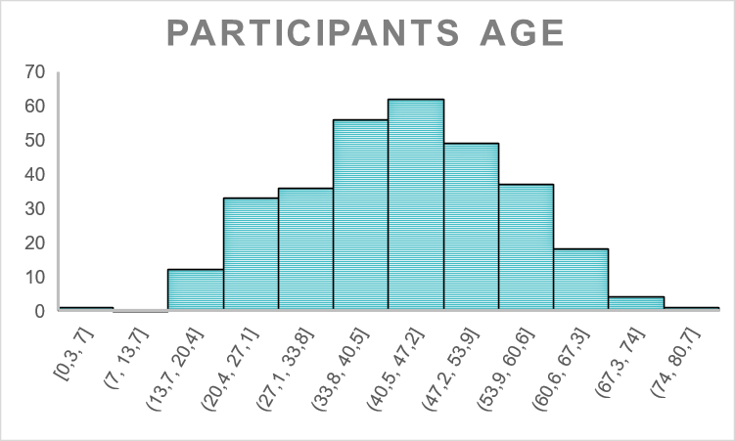
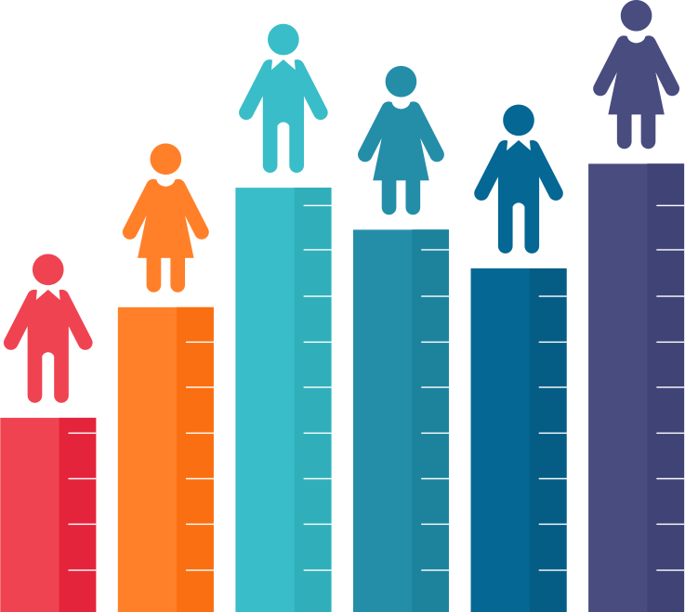
Evaluation Results
The first 3 questions were demographic ones
01.
The majority of the participants were from 40 to 65 years old

Slide 5
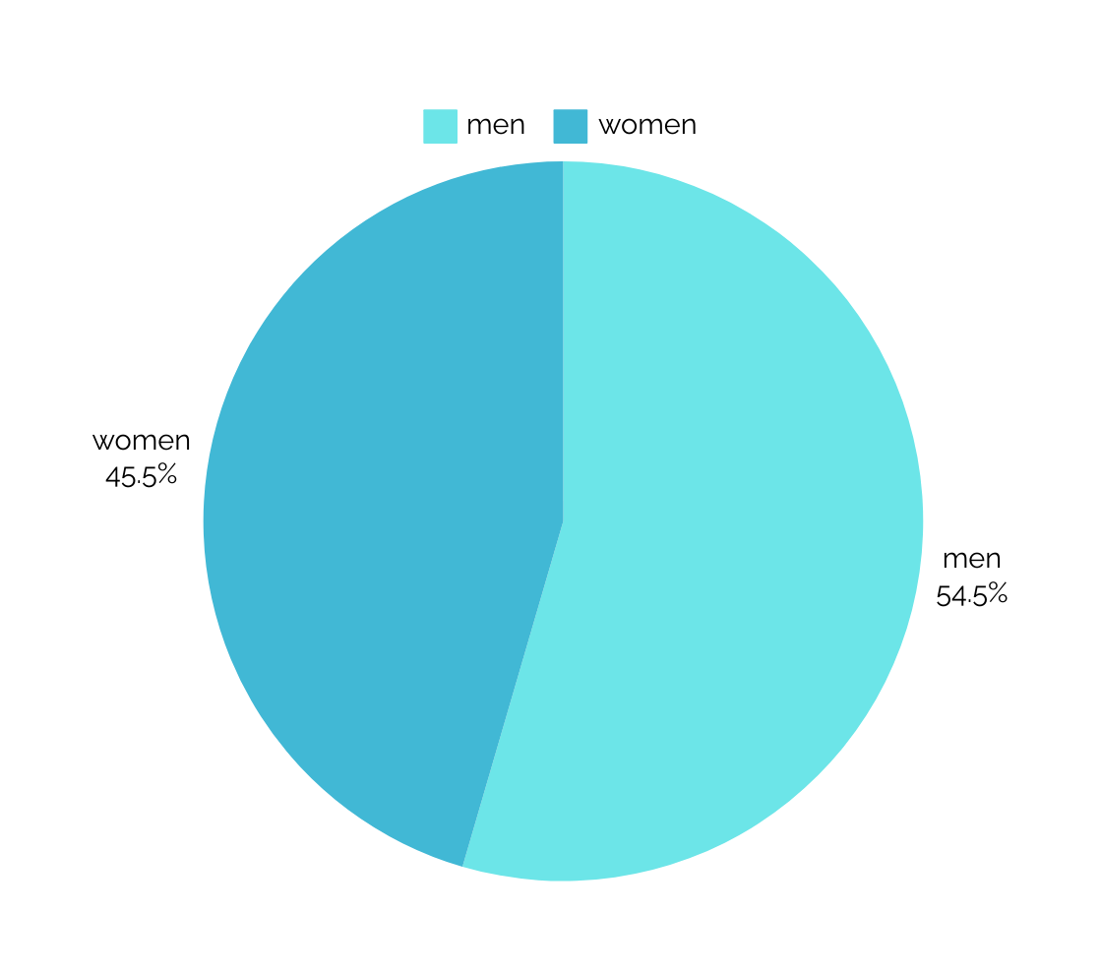

Evaluation Results
The first 3 questions were demographic ones
02.
In relation to the sex of the participants, the majority of the participants were men

Slide 6
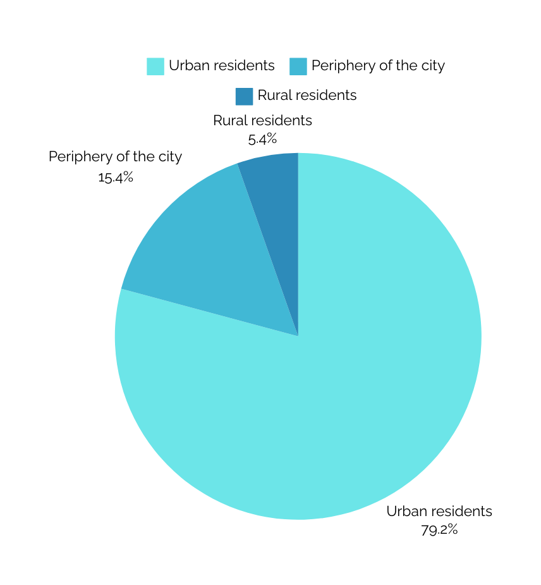

Evaluation Results
The first 3 questions were demographic ones
03.
The participants were asked to identify their place of residence

Slide 7
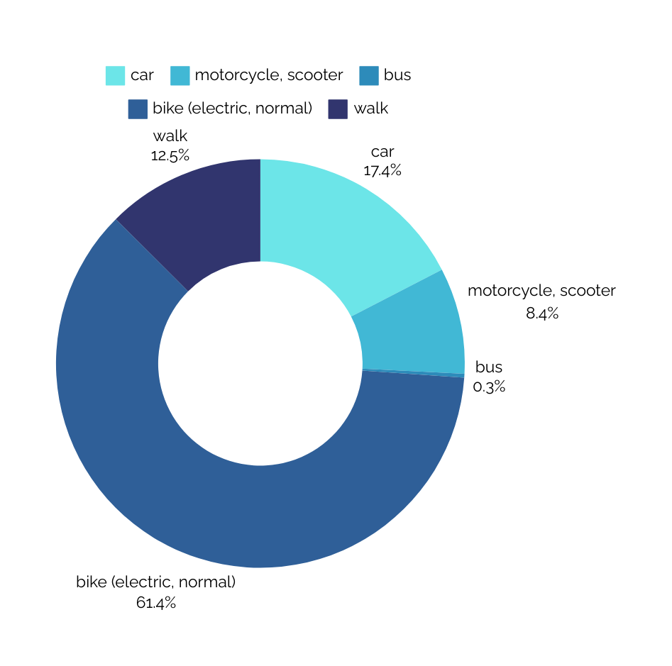

Evaluation Results
The next 14 questions evaluate the participants relation with cycling and safety of bike lanes
04.
What means of transportation do you use most often in your daily life?

Slide 8
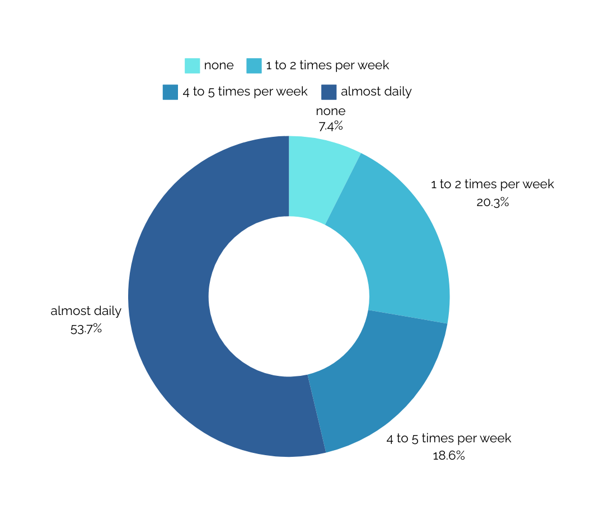
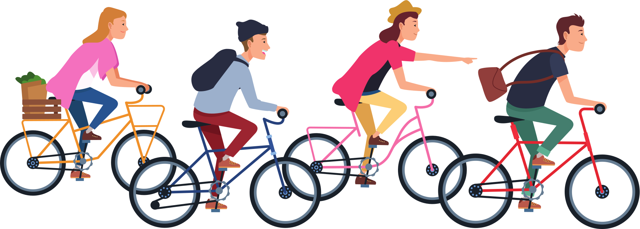
Evaluation Results
The next 14 questions evaluate the participants relation with cycling and safety of bike lanes
05.
How often do you use a bicycle during the week?

Slide 9
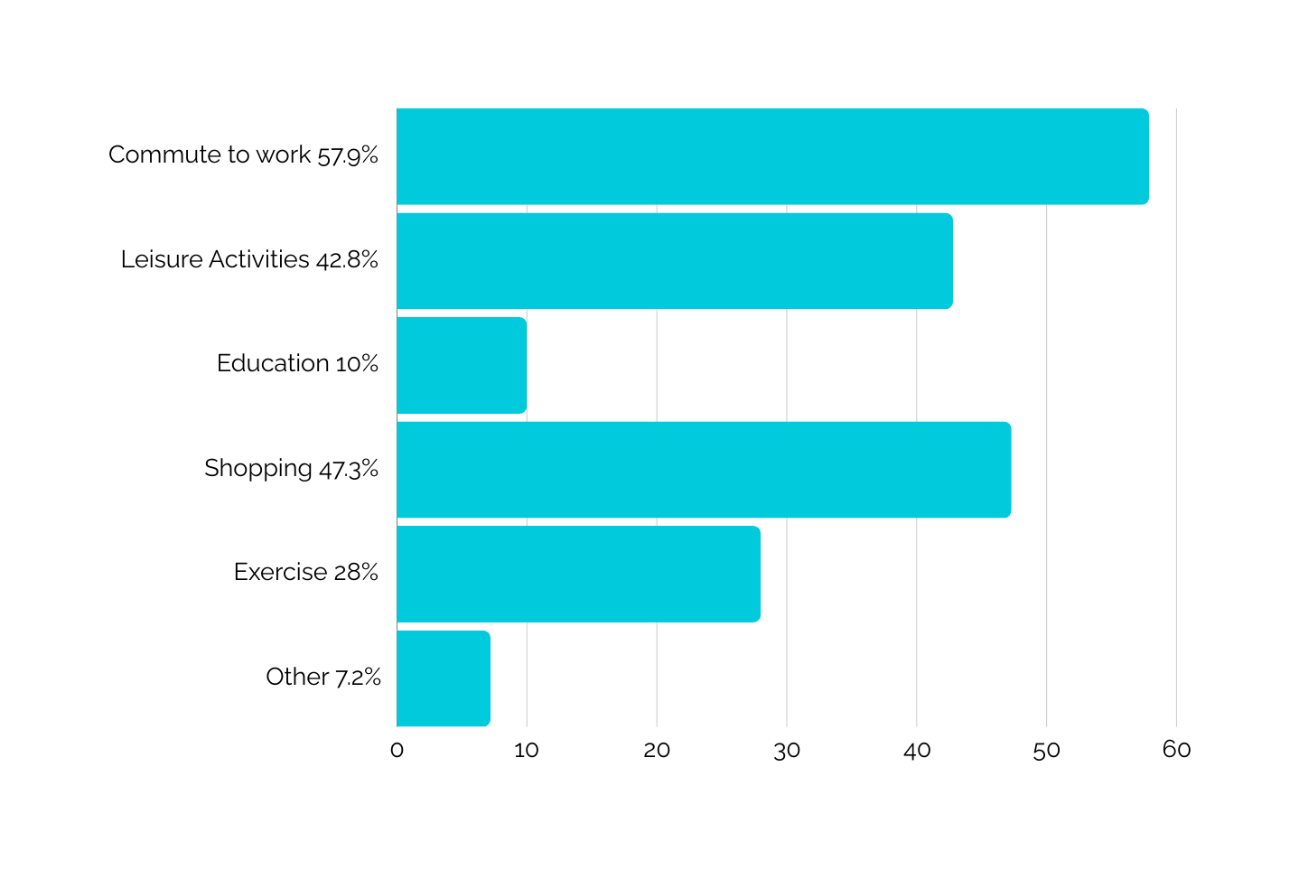
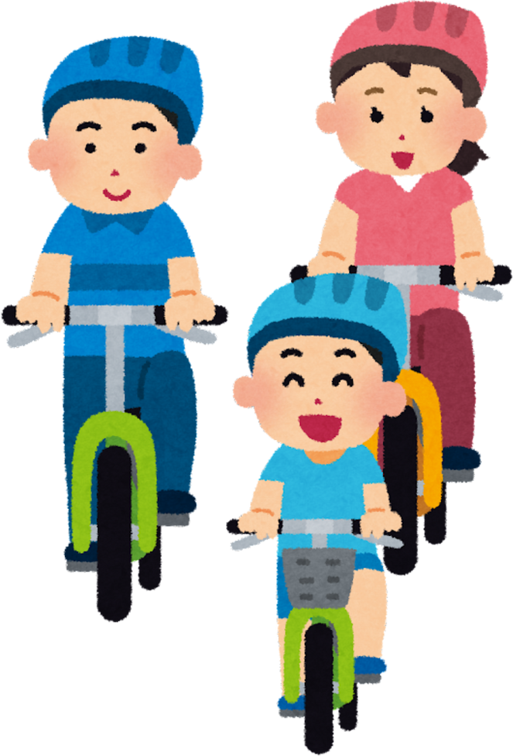
Evaluation Results
The next 14 questions evaluate the participants relation with cycling and safety of bike lanes
06.
What is the main use of your bike? You can choose more than one answer.

Slide 10
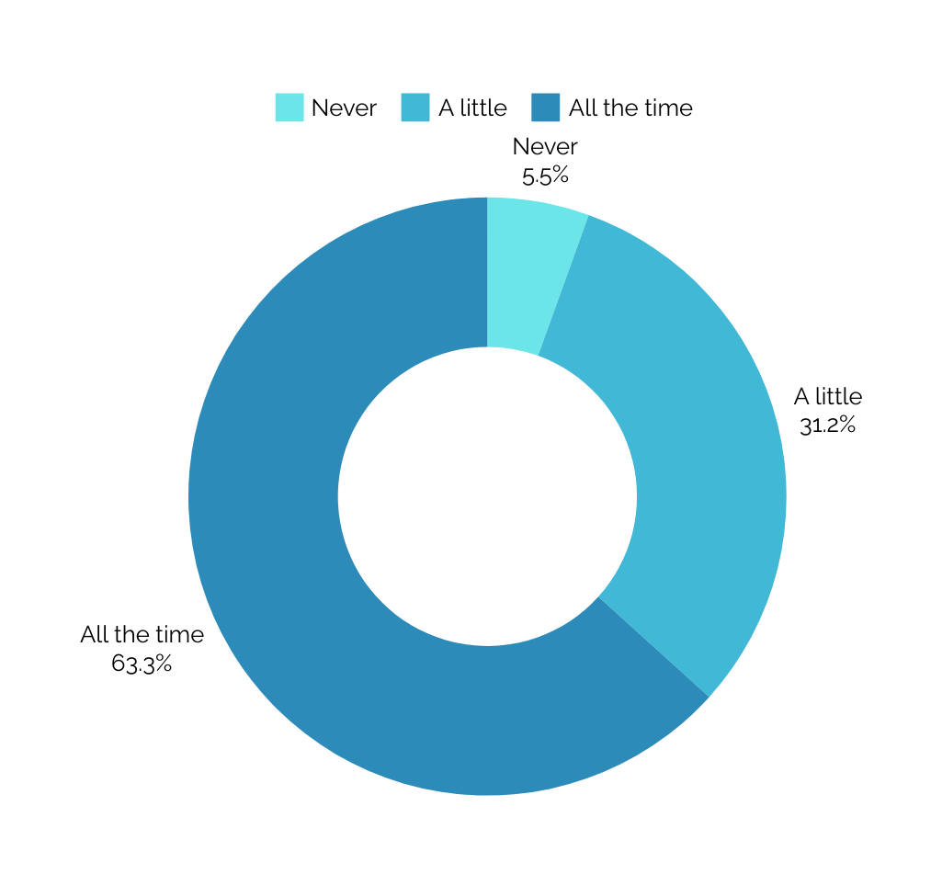
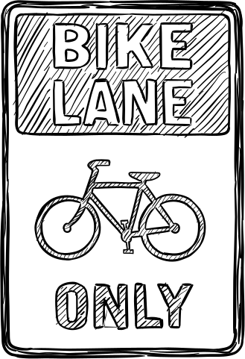
Evaluation Results
The next 14 questions evaluate the participants relation with cycling and safety of bike lanes
07.
When you're on your bike, how often do you use the bike lane?

Slide 11
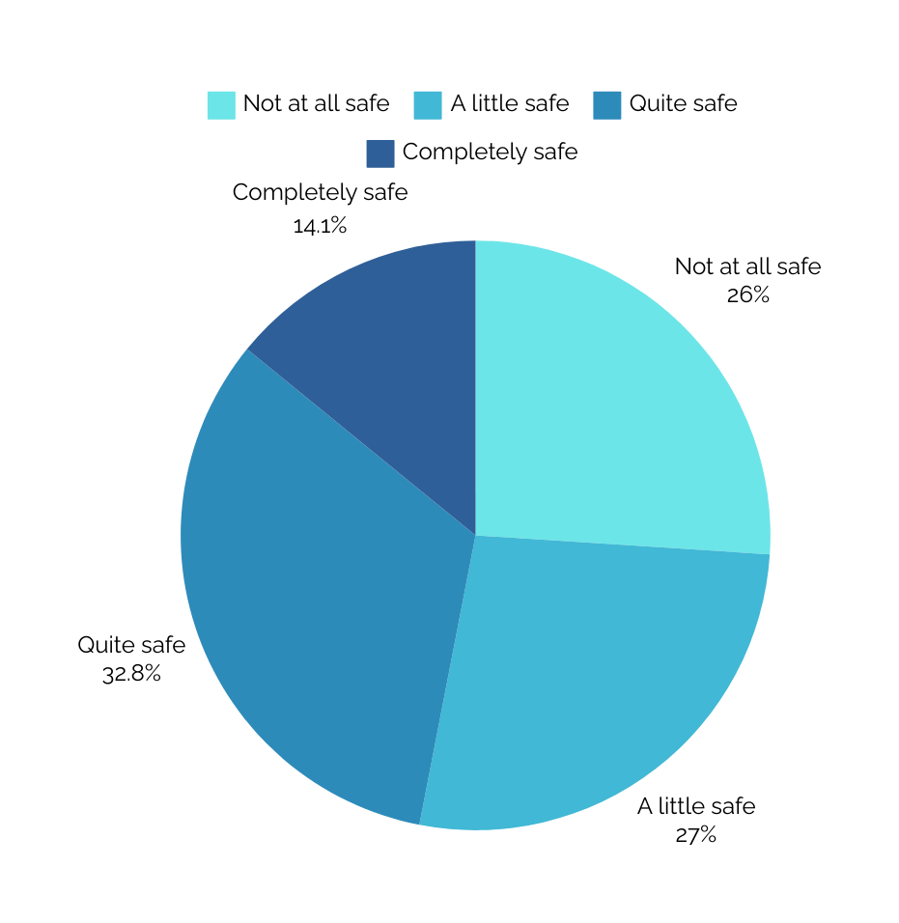
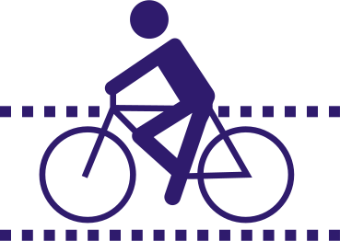
Evaluation Results
The next 14 questions evaluate the participants relation with cycling and safety of bike lanes
08.
How safe do you feel when using the cycle path?

Slide 12
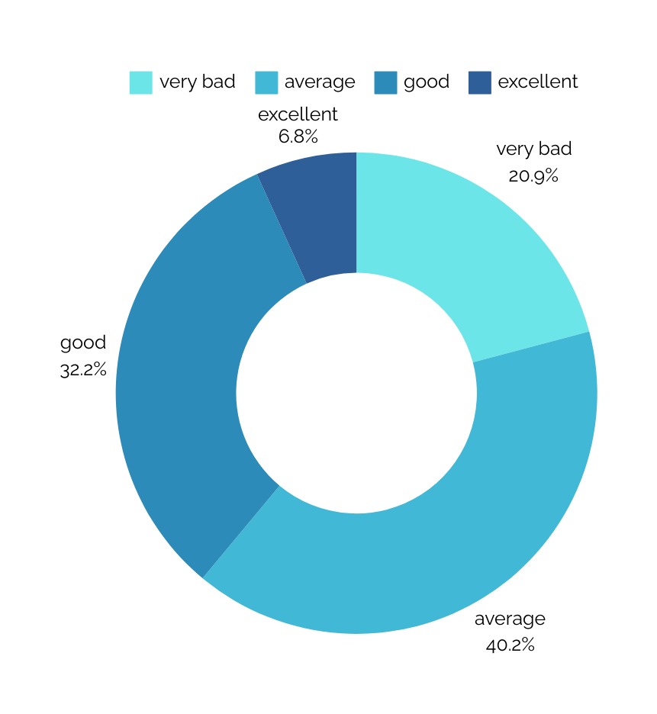
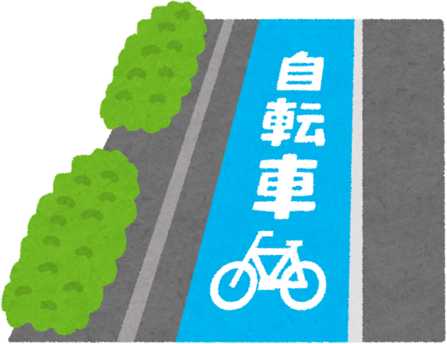
Evaluation Results
The next 14 questions evaluate the participants relation with cycling and safety of bike lanes
09.
How would you rate the condition of the bike lanes in your city?

Slide 13
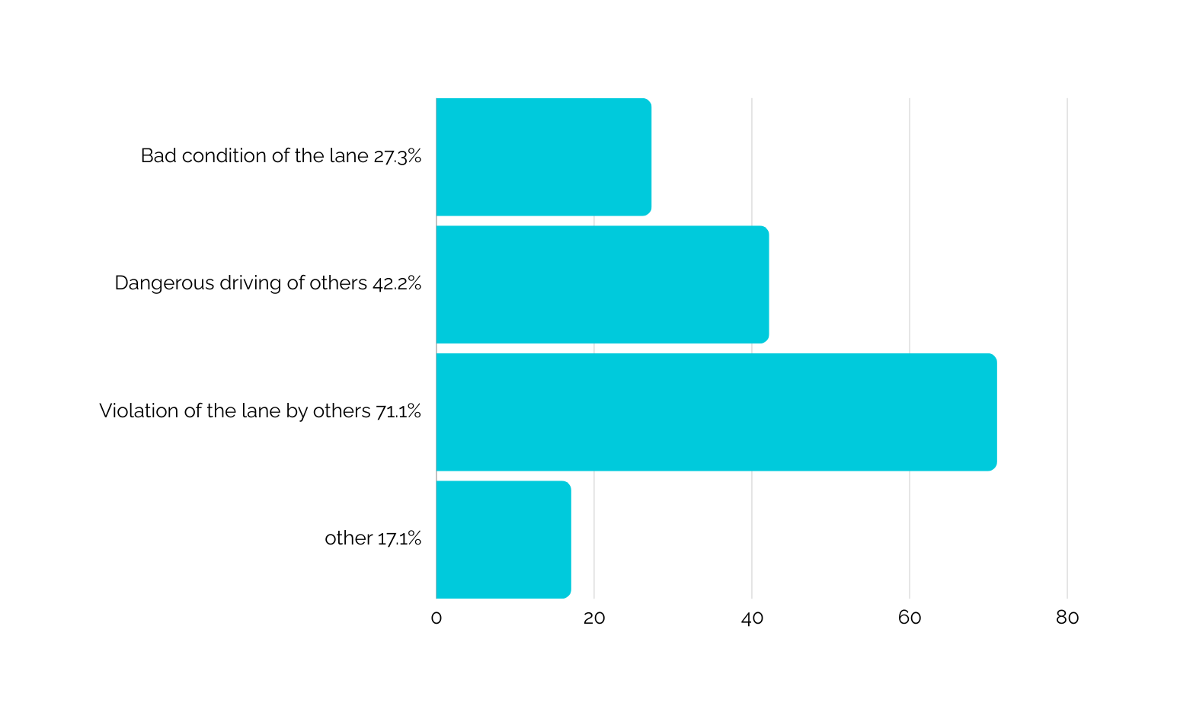

Evaluation Results
The next 14 questions evaluate the participants relation with cycling and safety of bike lanes
10.
What factors make you feel unsafe on the cycle path? You can choose more than one answer

Slide 14
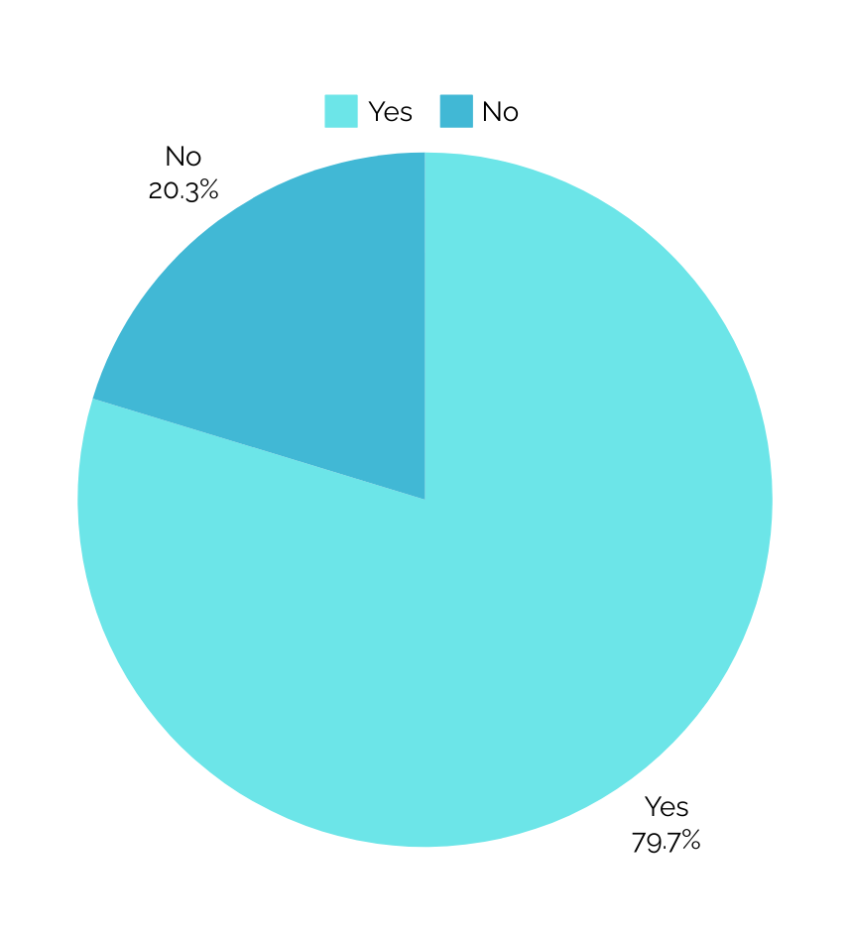

Evaluation Results
The next 14 questions evaluate the participants relation with cycling and safety of bike lanes
11.
Have you ever encountered dangerous situations on the cycle lane? (e.g. accidents, dangerous driving by others)

Slide 15
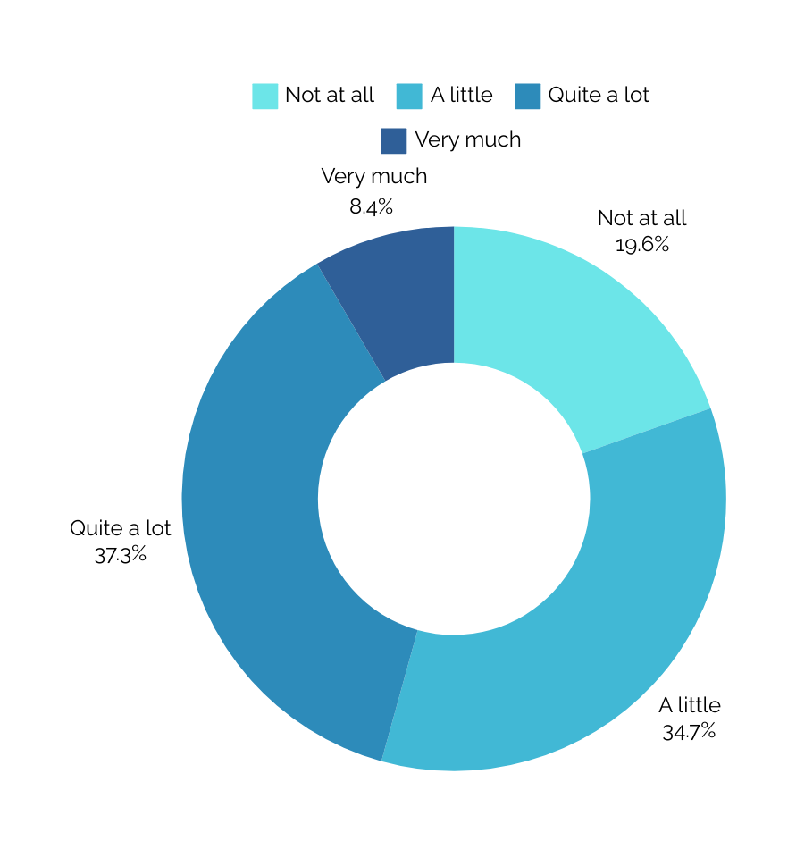

Evaluation Results
The next 14 questions evaluate the participants relation with cycling and safety of bike lanes
12.
How safe do you generally feel when commuting by bike?

Slide 16
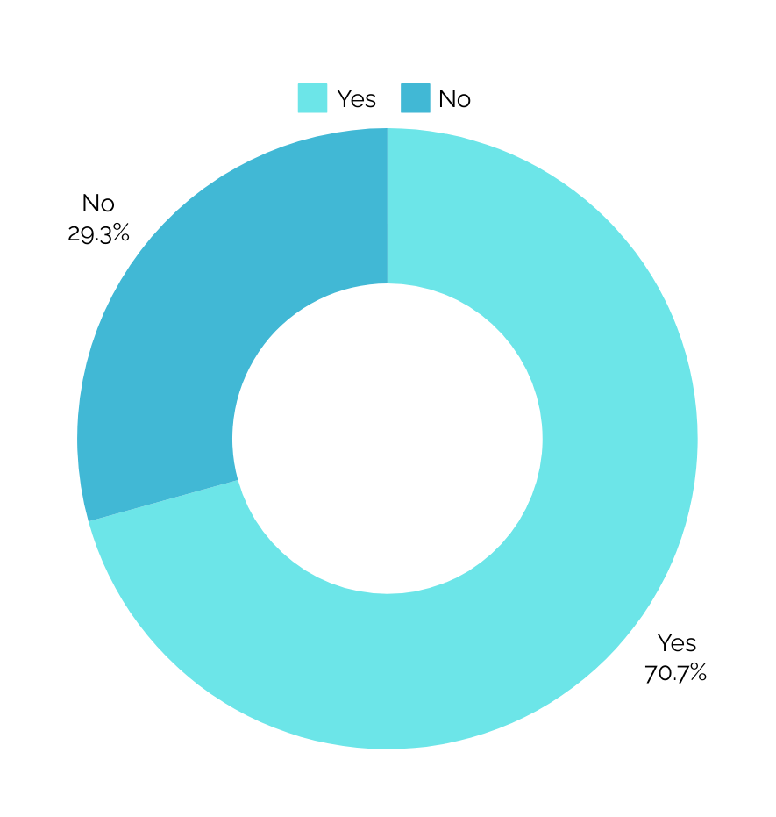

Evaluation Results
The next 14 questions evaluate the participants relation with cycling and safety of bike lanes
13.
Are there specific safety issues that arise when cycling around town?

Slide 17
Evaluation Results
The next 14 questions evaluate the participants relation with cycling and safety of bike lanes
14.
If yes, give as some examples
The cycle path is not complete and at night there are places that are dark and dangerous for cyclists
Car, truck and motorcycle drivers do not respect the cycle path
Lack of traffic education by pedestrians and drivers
Illegal use of the road network both by electric scooters and other types of motor vehicles, as well as by pedestrians.
Problem when crossing traffic lights and crossing cycle paths where they are perpendicular to roads where cars are moving. Also no lighting on the cycle path at night.
They do not comfortably fit two bicycles
The lack of cycle paths through the center in my area (Agios Kon/nos), use of delivery cars, electric vehicles, , poor construction of some cycle paths
There is no bicycle path from the neighbourhood of Pyrgos to Kalambakas to connect with the central bicycle path of Kalambakas.
Cyclists think that all roads, sidewalks, bike paths belong to them. They move arbitrarily and against the flow of the streets.
Proximity of a bicycle path to a road without a protective barrier
Parking of cars on the cycle path movement of motorcycles on the cycle path and movement of bicycles in the opposite direction on it
Bicycle routes are interrupted very often, there is no care for the safe circulation of bicycles, especially at crossings and at traffic lights, there is absolute anarchy in the parking of vehicles, no respect for pedestrians and cyclists.
The city has constructions everywhere, resulting in daily problems. It also has infinite potholes on the road which makes driving dangerous.
The bicycle path is together with a pedestrian path and table seats
The cycle paths are dangerous, there are holes covered with sheet metal
You are constantly forced to go out on roads as there is no complete cycle path anywhere
Absolute driving anarchy. No respect for other drivers. Bicycles, being the "smallest" vehicles, are most at risk. I drive both a car and a motorcycle and a bicycle and I also travel on foot, so I have a more general view on the subject.
Bad traffic behaviour of car and bicycle drivers. Illegal parking on the bike lane. Use of this by pedestrians.
Lack of bike lanes on bridges. Very dangerous spot without a traffic light for bicycles at the traffic lights of the Tsitsani Museum and at the Korai bridge with Kanouta. (frequent accidents with bicycles)

Slide 18
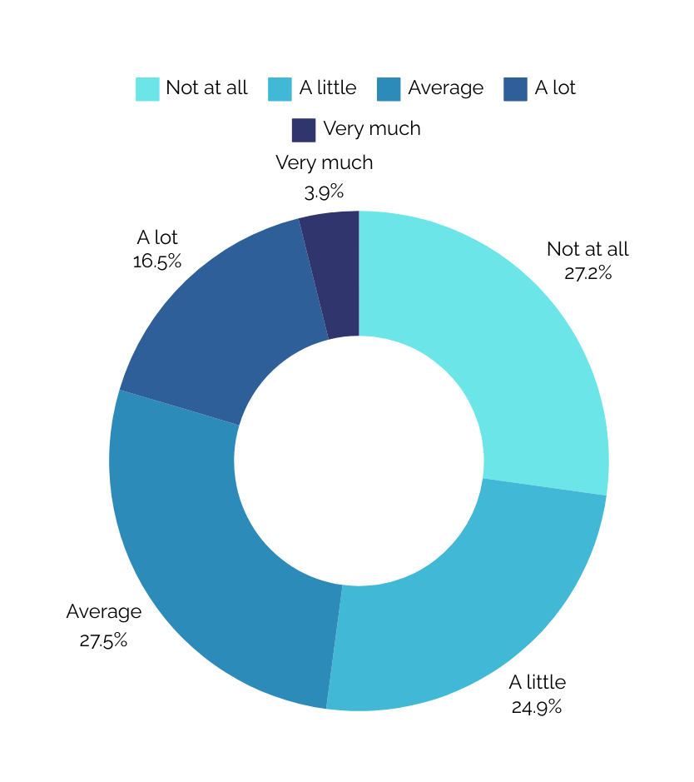
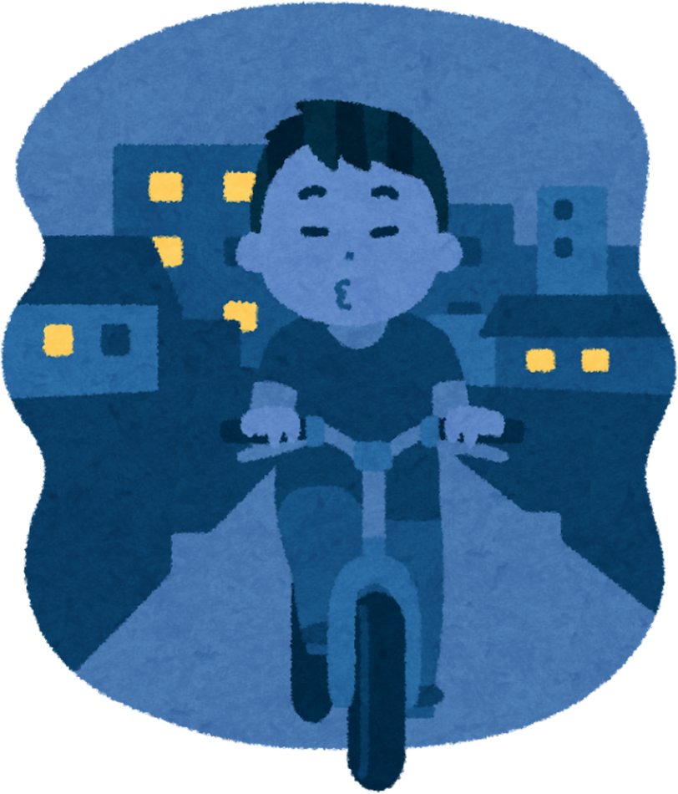
Evaluation Results
The next 14 questions evaluate the participants relation with cycling and safety of bike lanes
15.
How safe do you feel when cycling at night?

Slide 19
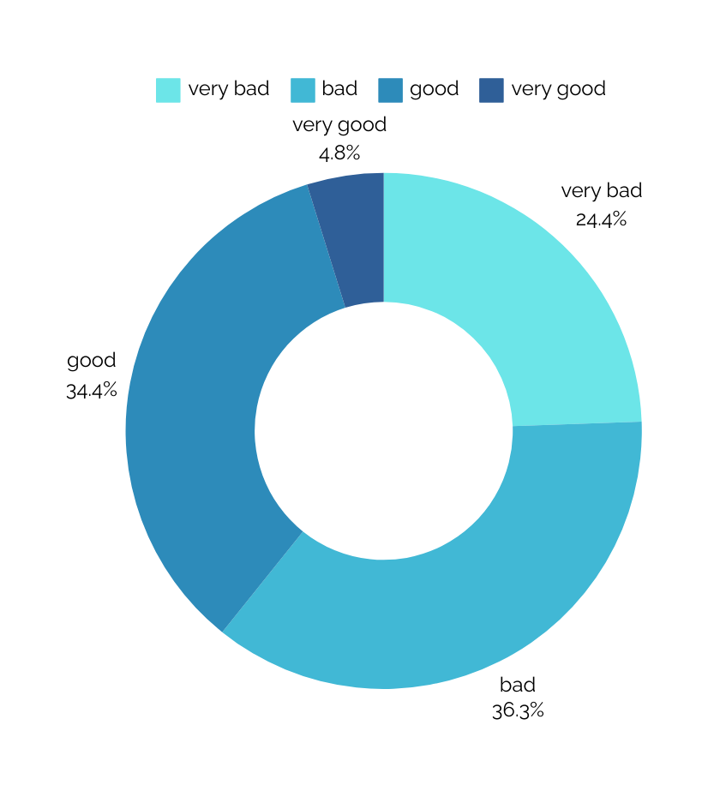

Evaluation Results
The next 14 questions evaluate the participants relation with cycling and safety of bike lanes
16.
How would you describe the level of noise and traffic congestion in the city?

Slide 20
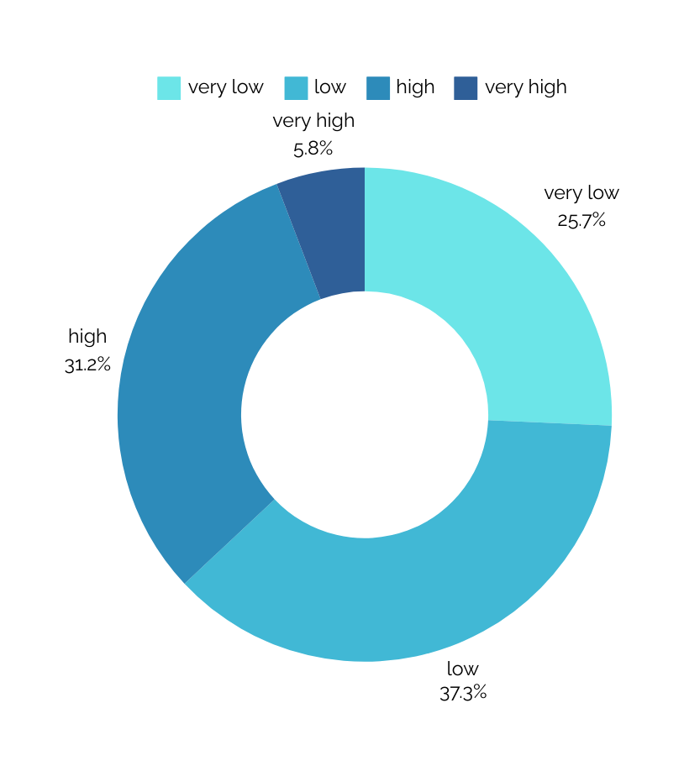

Evaluation Results
The next 14 questions evaluate the participants relation with cycling and safety of bike lanes
17.
In general, how would you describe the level of accessibility in the city?

Slide 21
Evaluation Results
The next 14 questions evaluate the participants relation with cycling and safety of bike lanes
18.
Do you have any suggestions on what needs to be done to feel safer as a cyclist?
Single cycle path that will not be violated by cars, motorbikes and pedestrians
Ramps at each intersection in each direction with adequate width and smooth transition between roadway and sidewalk/walkway
Roads need improvement in general
Initially, the ideal would be for everyone to have the necessary education.
There should be no table seats, as is the case now and pedestrians are forced to walk on the bike path.
Fines for those who park at the bike lane and especially when they are professional drivers..
Create more bike lanes and impose more penalties on offenders who "block" the bike lane
Education of all (pedestrians, drivers of two-wheelers and cars) in driving education
Two-way lanes with clear markings, more traffic lights for bicycles and pedestrians, better connection of intersections with the bicycle path (eg Despotikou bridge) and better lighting in the neighbourhoods beyond the center.
Bicycle lights, good lighting and training car drivers to prioritize bicycles
There should be fines for those who use the bike lanes illegally, the construction problems of some should be corrected, citizens should be informed about the correct use of bicycles as well as cars, and there should be proper, real policing to facilitate bicycle traffic in a city that needs to become cyclist friendly.
Proper signalling so the cyclist knows which way to go and for drivers also to control traffic properly and not run into bikes. Strict fines to those who park on the cycle path and to those who cause an accident on the cycle path and to those who destroy the plastic barriers
Construction of a proper cycle path with a dividing line and exclusive light marking as in Paris, Copenhagen, etc.
Barriers to prevent other vehicles from entering the bike lanes, policing (finally!)
Signalling and delineation for correct direction and movement by cyclists and policing of the cycle path
Implementation of ways to prevent cars from parking on cycle paths. Light marking and movement priority at traffic lights. Road behaviour as a basic subject in schools. Cyclists do NOT go backwards on the one-way streets!!
I suggest that the cycle paths are elevated in relation to the road surface and that there are iron pillars (as is the case in Karditsa).
Brave decisions should be made and car parking spaces should be abolished so that the bike path has the right dimensions to be safe.
To build a serious bicycle network, with smart routes that connect the whole city, so that violations such as parked motorbikes and cars on bicycle paths do not go unpunished

Slide 22
Evaluation Results
The next 14 questions evaluate the participants relation with cycling and safety of bike lanes
18.
Do you have any suggestions on what needs to be done to feel safer as a cyclist?
Mandatory lights on bicycles (mainly the rear) when riding at night
Better cycle paths and their extension from the entrance of Karditsis street to the center
To properly implement the projects with the right materials. Bike lanes with painted cement are dangerous
Organized cycle paths with continuity in both directions and police
Bollards should definitely be placed along the entire length, so that it is not possible for pedestrians and cars to violate it. And more ramps should be made so that the cyclist can exit the cycle path, because it is a reason that many of the cyclists do not prefer it and choose the normal road, resulting in more danger.
Our city is made up of elderly people and unfortunately the way the bike path is, they don't know that they shouldn't walk there.
Improvement of the cycle path network. Non-use of sidewalk by shops so that there are no pedestrians on the bike path. Penalty for vehicles parked illegally on the bike path. Traffic behaviour training of citizens
Traffic cameras and checks and fines for dangerous motorists
Creation of ramps instead of sidewalks (e.g. across from Kotsovolo at the turn of Garivaldi, in Kondili at the height of Filippou), creation of new cycle paths so that there is continuity at least in a large part of the center, creation of a separation from the road (e.g. on Str. Sarafi).
The cycle path should be only a cycle path, as it is in other countries, offering convenience and safety to those who use the bicycle for their needs.
A network of cycle paths adapted to the needs for safe driving, with good road surface, lighting, signalling and information/training of new and current drivers for a harmonious coexistence of all users of the road network.
more bike lanes on the streets and outside the center
Strict Policing and fines for offenders.
Repair of cycle paths, pedestrian paths
Correct paving.
The fabric of the city does not fit cars parked on both sides, a two-way street and a bike lane...something needs to be removed...the transportation experts need to sit down and do some serious studies

