Slide 1




ELABORATOR _Baseline data
Analysis of results
Questionnaire on road cross safety
Trikala. 2024

Slide 2

Intervention back ground
This survey was dedicated to evaluate the existing situation of a specific area of the city in terms of pedestrian and cyclists safety.
The suggested intervention will be the installation of one smart crossing in the specific area to raise awareness to the drivers that there is a school nearby and integrate smart infrastructure and road safety measures.
The area of intervention is located near, a stadium, a primary school and a Military School

Slide 3

Overview of the evaluation methodology
we created short questionnaire which was distributed via the following channels:
e-trikala social media
the Municipalities official site
the Military School Secretary site
we created QR posters that were distributed in the area
The survey was open for 2 weeks and gathered 143 answers

Slide 4
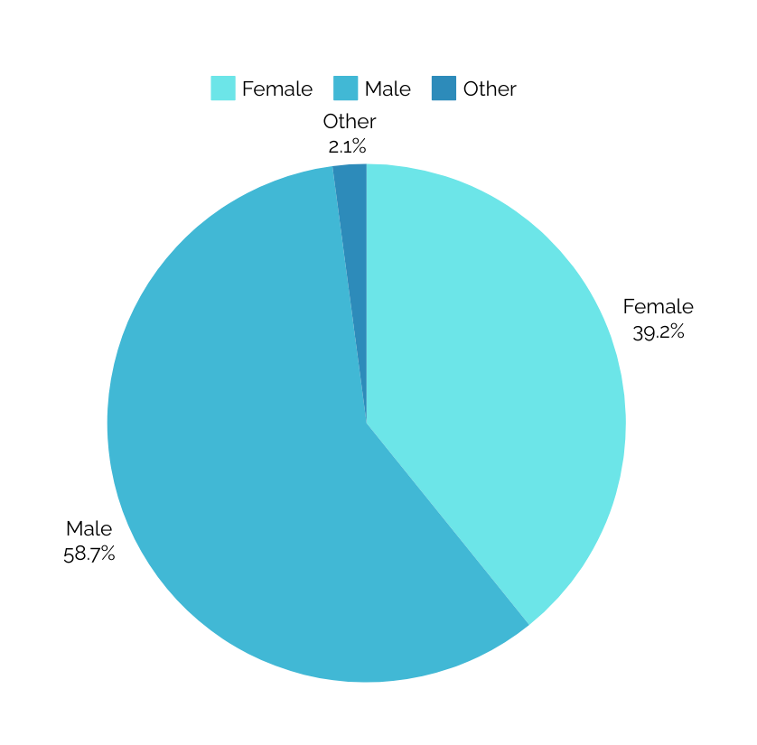

Evaluation Results
The first 3 questions were demographic ones
01.
As expected the majority of the participants were 20-21 years old and there was a range of ages from 12-64 years old
02.
In relation to the sex of the participants, the majority of the participants were men

Slide 5
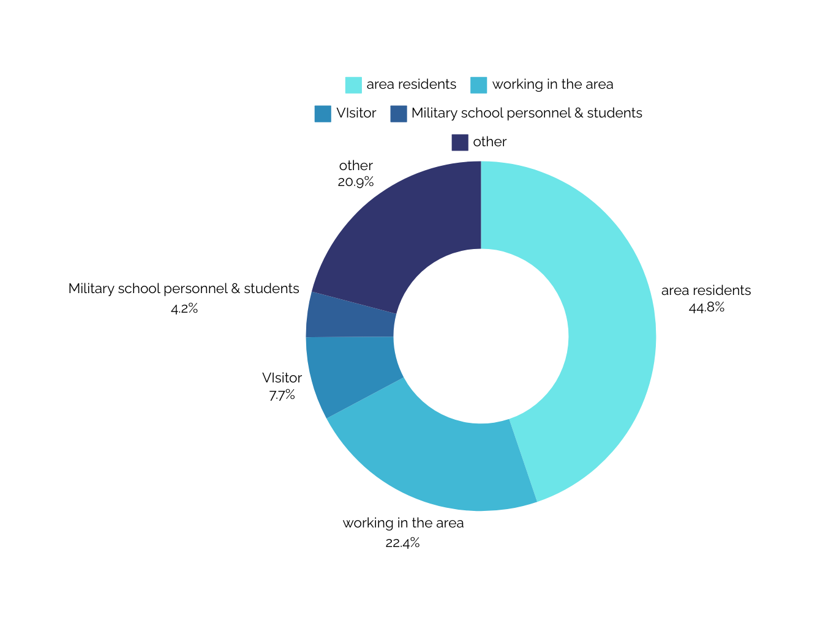

Evaluation Results
The first 3 questions were demographic ones
03.
The participants were asked to choose from a list in order to identify their role in the area.

Slide 6
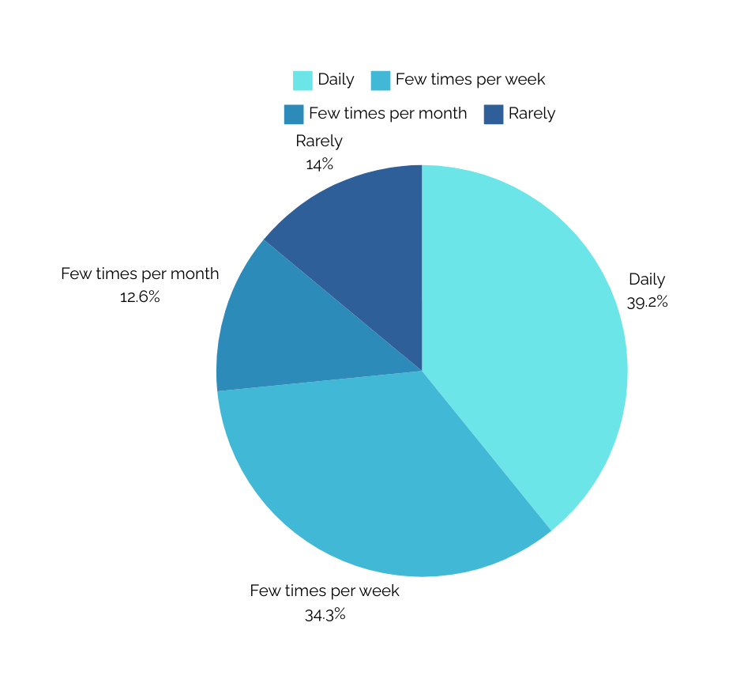
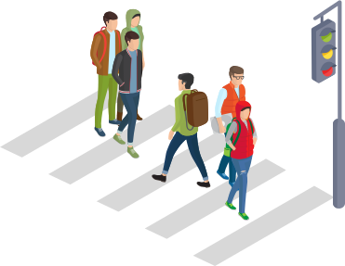
Evaluation Results
The next 11 questions evaluated the current status of the road crossing and the area in general
04.
How often do you use the specific smart crossing outside the Military School?

Slide 7
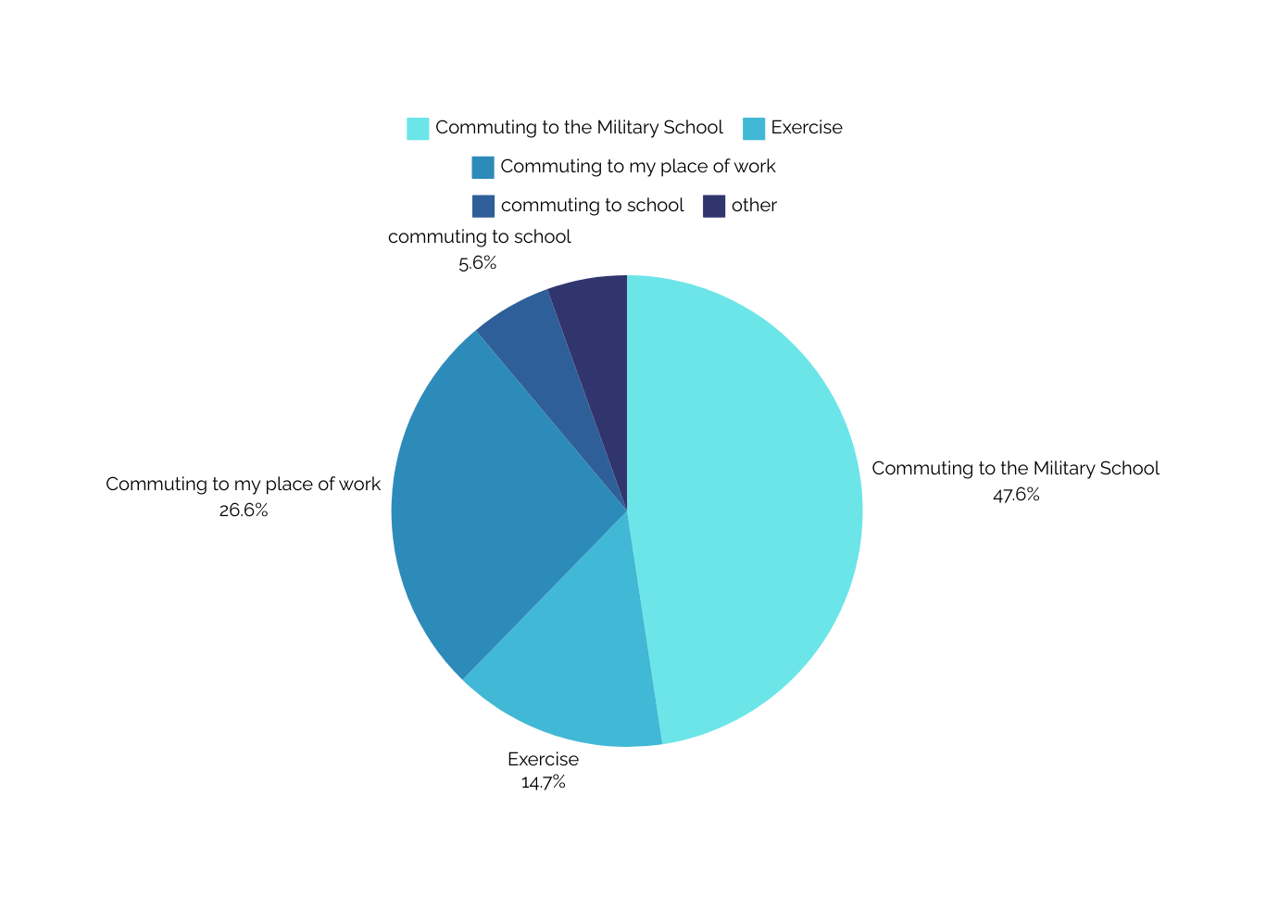
Evaluation Results
The next 11 questions evaluated the current status of the road crossing anf the area in general
05.
What is the main reason you are using the smart crossing outside the Military School?

Slide 8
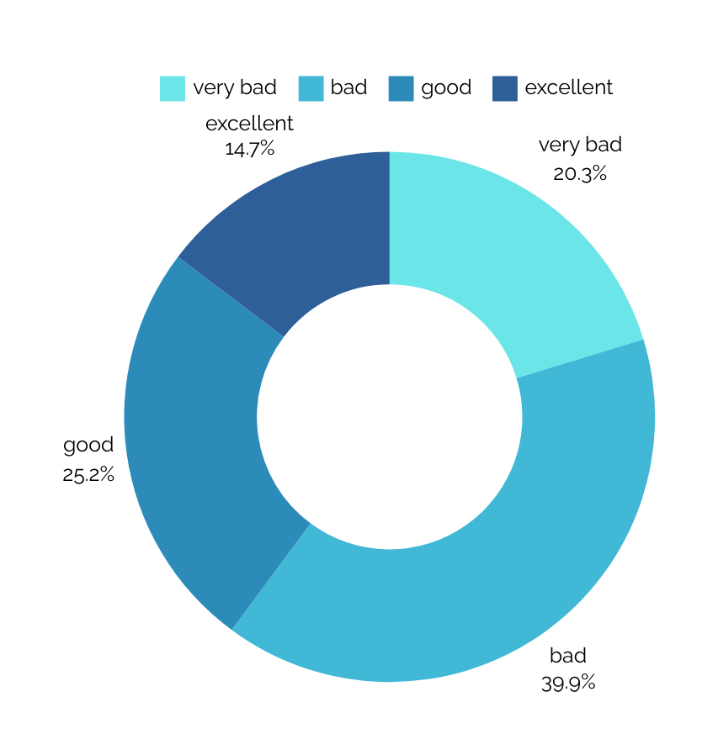
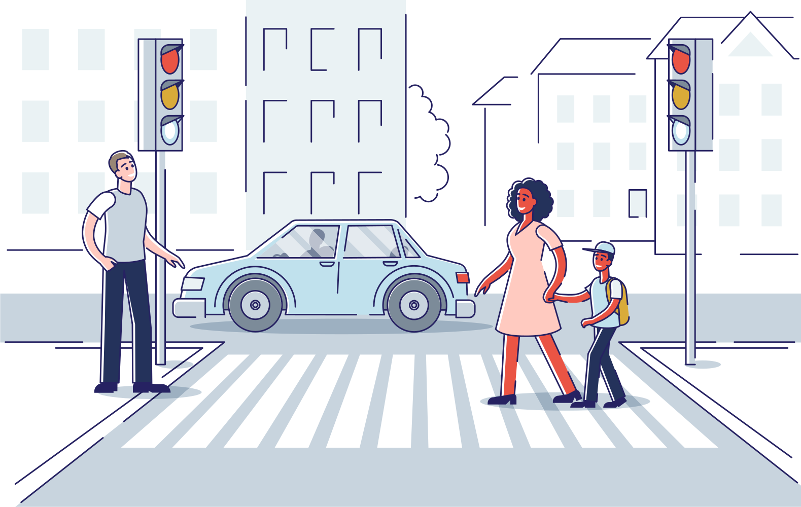
Evaluation Results
The next 11 questions evaluated the current status of the road crossing anf the area in general
06.
How would you characterise the current status of the specific smart crossing outside the Military school ?

Slide 9
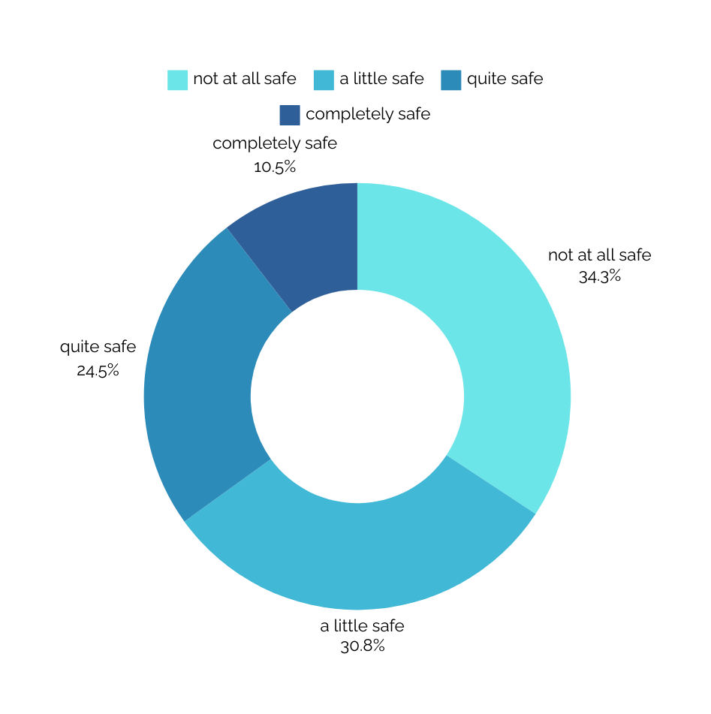

Evaluation Results
The next 11 questions evaluated the current status of the road crossing anf the area in general
07.
How safe to you feel every time you use the specific smart crossing outside the Military school ?

Slide 10
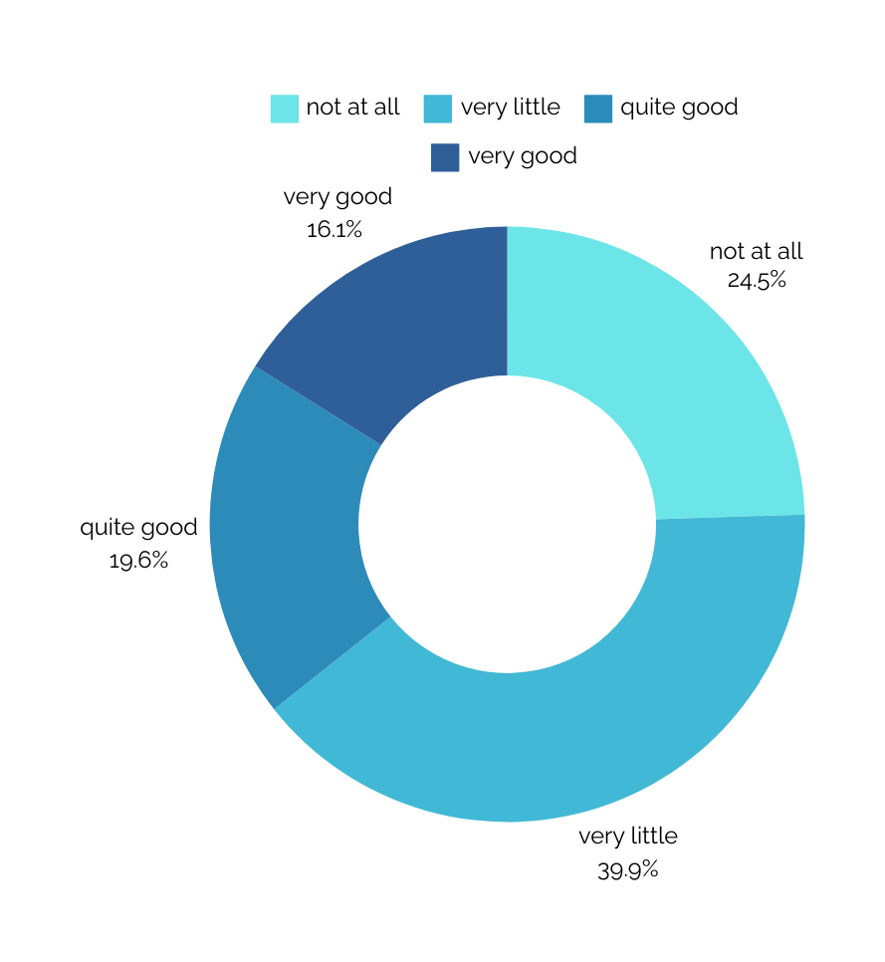
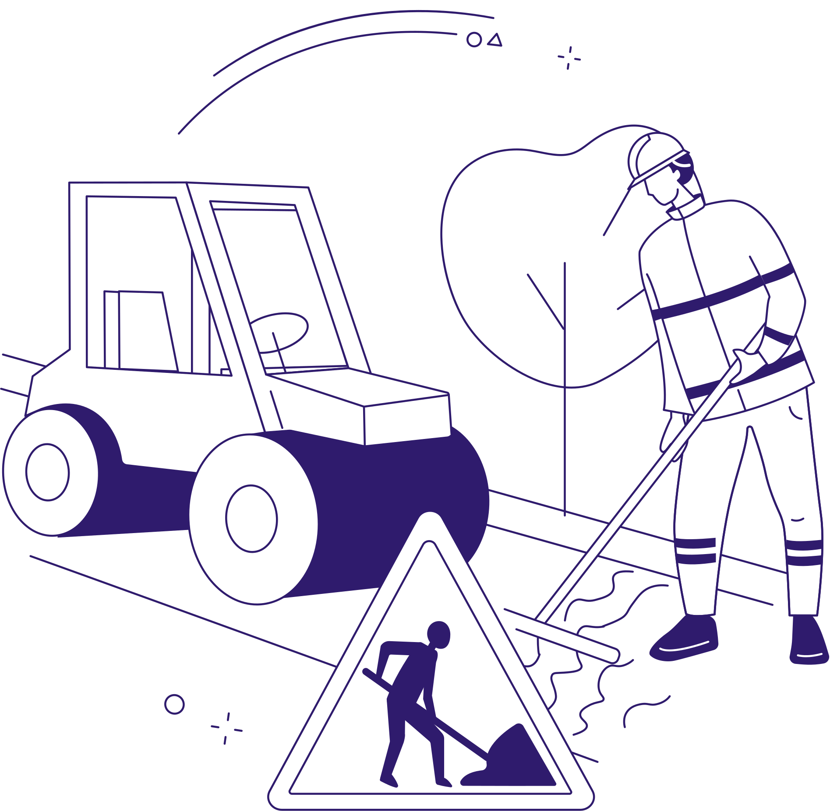
Evaluation Results
The next 11 questions evaluated the current status of the road crossing anf the area in general
08.
To your opinion how well maintained is the specific smart crossing outside the Military school ?

Slide 11
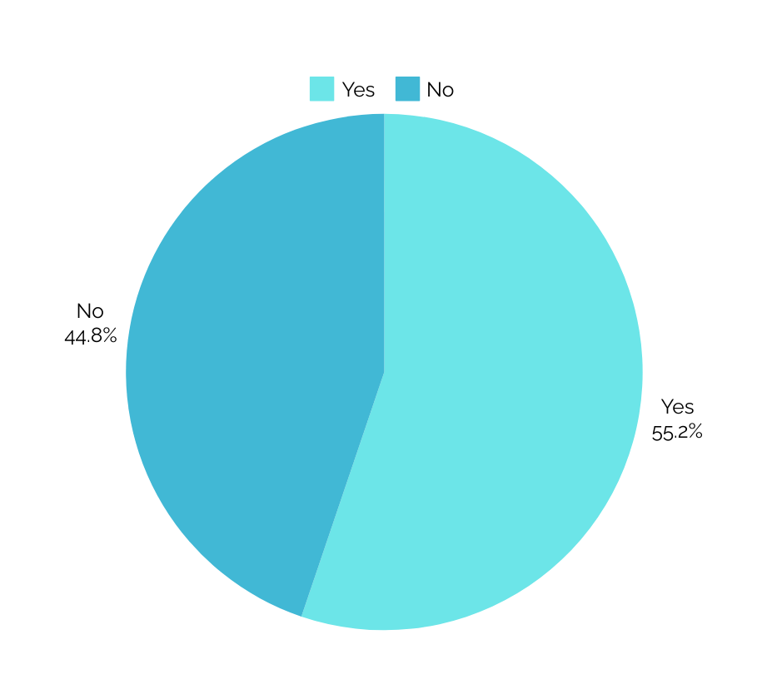

Evaluation Results
The next 11 questions evaluated the current status of the road crossing anf the area in general
09.
From your personal experience, have you personally encountered or know someone who has encountered a dangerous situation at the crossing (e.g. accidents, dangerous driving by others, etc.)

Slide 12
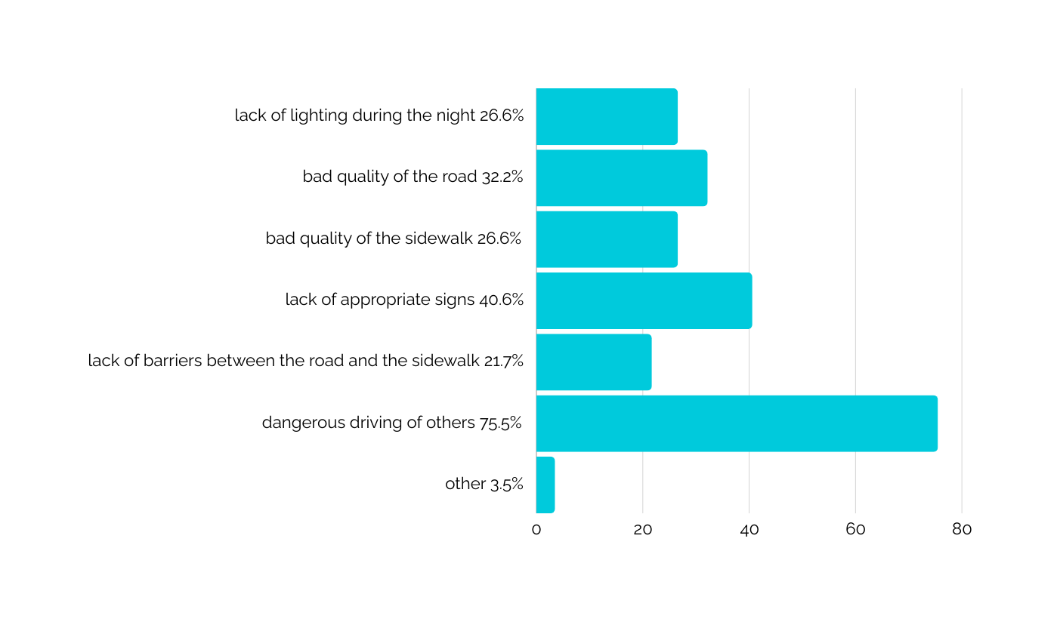

Evaluation Results
The next 11 questions evaluated the current status of the road crossing anf the area in general
10.
What factors make you feel unsafe when using this particular crossing? (you can choose more than one item)

Slide 13
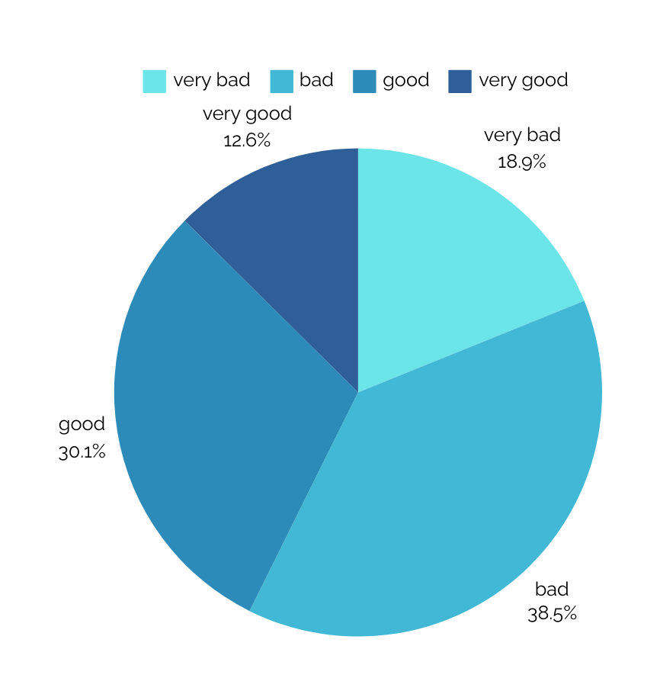

Evaluation Results
The next 11 questions evaluated the current status of the road crossing anf the area in general
11.
What is your overall impression of the area near the crossing in terms of accessibility? Are there obstacles, e.g. limited access to benches, ramps, crossings, etc.

Slide 14
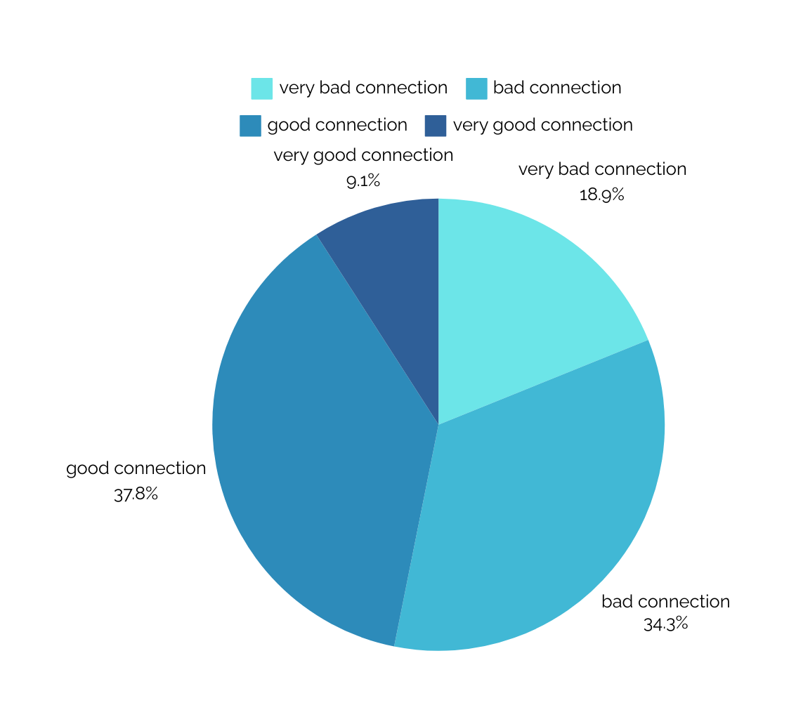
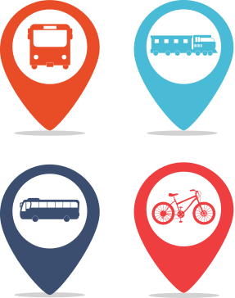
Evaluation Results
The next 11 questions evaluated the current status of the road crossing anf the area in general
12.
How is the area connected to other areas of the city? Is there a good connection to public transport?

Slide 15
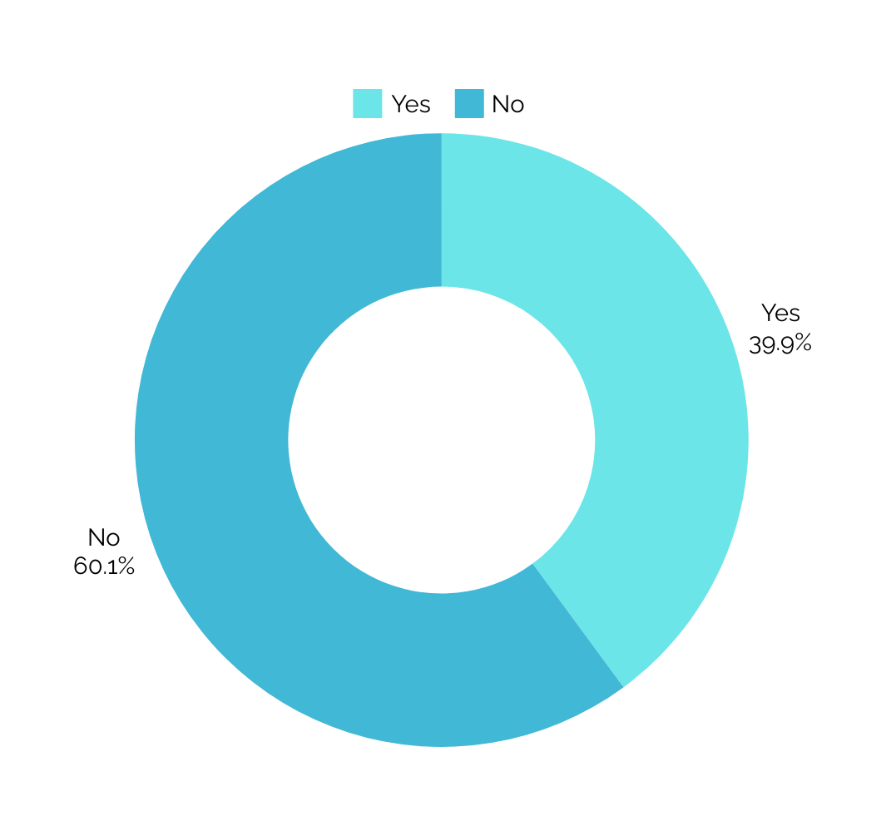

Evaluation Results
The next 11 questions evaluated the current status of the road crossing anf the area in general
13.
Are there adequate bike lanes nearby?

Slide 16
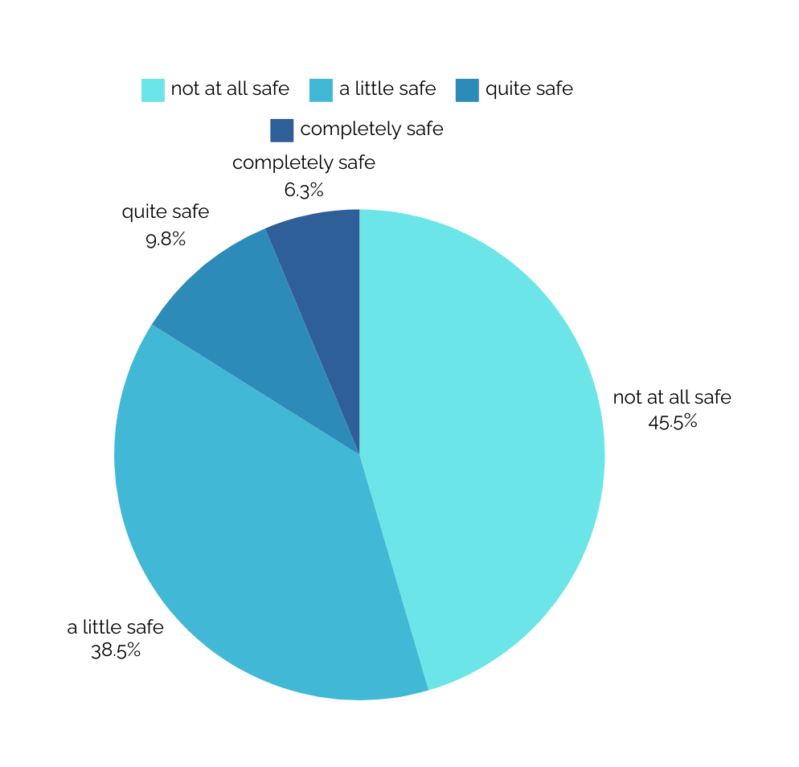

Evaluation Results
The next 11 questions evaluated the current status of the road crossing anf the area in general
14.
How safe is the road in the area for a biker?

Slide 17
Evaluation Results
The last 2 questions are open and encouraging the participants to suggest solutions. We are presenting the most popular ones
15.
How can the region be made more accessible and sustainable for all? (e.g. greenery, benches, meeting areas, ramps, better lighting, etc
Create a bicycle path
At one end of the crossing there is no ramp, it is very difficult to go up with a wheelchair. Also, cars don't stop at this crossing because they think it's only for SMY students.
Cycle path, lighting, road hubs
A pedestrian bridge should be built and the road should be shortened.
benches and space for people to meet
Since the point in question is the pedestrian crossing, I believe that such spaces cannot be constructed, except for the placement of flower beds with greenery for the sole purpose of upgrading it from an aesthetic point of view, since it is located at the entrance of the city and with a fairly large traffic flow, in particular during the mornings
Special marking and lighting
Reconstruction of the sidewalk with ramps and bike path as well as an aesthetic upgrade"
Stronger signalling
Staff to maintain it
Ramps, benches, greenery and trees because there is no shade at all and in the summer months we who live in the area and have to cross it to walk to the center suffer
Better lighting and elevated walkways
Lighting ramps reducing driver speed
Construction of a bike path, better lighting, separation of the sidewalk from the road, better policing of drivers who do not stop at crossings with very severe fines.
The area where the school is located is a long straight where it is a residential area drivers develop high speeds there is no other crossing nearby many accidents all the time with bicycles the pavement is in very good condition but not for bicycles they do not provide any safety.
More lighting. Placing a traffic light along the road so that low speeds are achieved.
More recreation areas combined with the existing space.
Better crossing (with lights)
Ramps and other means of protecting citizens

Slide 18
Evaluation Results
The last 2 questions are open and encouraging the participants to suggest solutions. We are presenting the most popular ones
16.
What are your suggestions for improving the crossing safety?
Signage placement as in the city center with flashing pavement markings
Only by signalling it, the pedestrians do not respect the drivers because they step on the crossing without checking, but neither do the drivers the pedestrians!
Recording of faults and immediate restoration
painting the passage- or stone or tile colored instead of painting
Placing small obstacles (samarakia) perpendicular to the road to reduce speed.
To be uneven (elevated), with reflectors and lights.
Creating means for proper security like dams before and after the crossing to reduce vehicle speed. and overground or underpass."
Roadblocks to reduce the speed of cars
There should be better and more visible markings for the crossing
Traffic lights, traffic cameras, traffic controls and punishment for violating the crossing.
A pedestrian bridge should be built and the road should be shortened so that cars do not run too fast
Correct signage and lighting
pavement reconstruction with cycle path and correct information
Use of light signals on the crossing like the one in front of the post office
The crossing is good, Tsitsani street from the point where SMY starts in Farmaki to the Larissa delta creates a problem for those who come out of the vertical streets by car because the traffic is high and for pedestrians there is absolutely nothing to rest or relieve the heat in the summer
Better lighting overpass or traffic lights
Make an underground passage
Overpass
Low speed limit on the whole road and lighting
Signaling
It must always be painted and visible
There should be traffic lights so that someone does not have to wait for hours to cross the street by car or on foot.
Ramps and crosswalks that glow or light up
Maintenance, marking
car speed limit
Finally road education and policing without tips and friendly pats on the back.
A beacon when someone needs to use it

