Slide 1
Software Engineering (CSC601) Lecture 14
Shilpa Ingoley
“There is nothing
permanent except
change.”

Slide 2
Module 5 Software Risk, Configuration management and Quality Assurance
5.1 Risk identification, Risk Assessment, Risk projection (estimation)
RMMM (Risk mitigation, monitoring, and management )
5.2 Software configuration management, SCM Repository, SCM Process

Slide 3
The “First Law”
No matter where you are in the system life cycle, the system will change, and the desire to change it will persist throughout the life cycle.
Bersoff, et al, 1980

Slide 4
What Are These Changes?
changes in
business requirements
changes in
technical requirements
changes in
user requirements
other
documents
software models
Project
Plan
data
Test
code

Slide 5
What is Change Management
Also called software configuration management (SCM)
It is an umbrella activity that is applied throughout the software process
It's goal is to maximize productivity by minimizing mistakes caused by confusion when coordinating software development
SCM identifies, organizes, and controls modifications to the software being built by a software development team
SCM activities are formulated to identify change, control change, ensure that change is being properly implemented, and report changes to others who may have an interest
5

Slide 6
(continued)
SCM is initiated when the project begins and terminates when the software is taken out of operation
View of SCM from various roles
Project manager -> an auditing mechanism
SCM manager -> a controlling, tracking, and policy making mechanism
Software engineer -> a changing, building, and access control mechanism
Customer -> a quality assurance and product identification mechanism
6

Slide 7
The Software Configuration
programs
documents
The pieces
data

Slide 8
Software Configuration
The Output from the software process makes up the software configuration
Computer programs (both source code files and executable files)
Work products that describe the computer programs (documents targeted at both technical practitioners and users)
Data (contained within the programs themselves or in external files)
8

Slide 9
Sources/Origins of Software Change
Errors detected in the software need to be corrected
New business or market conditions dictate changes in product requirements or business rules
New customer needs demand modifications of data produced by information systems, functionality delivered by products, or services delivered by a computer-based system
Reorganization or business growth/downsizing causes changes in project priorities or software engineering team structure
Budgetary or scheduling constraints cause a redefinition of the system or product
9

Slide 10
Elements of a Configuration Management System
Configuration elements
A set of tools coupled with a file management (e.g., database) system that enables access to and management of each software configuration item
Process elements
A collection of procedures and tasks that define an effective approach to change management for all participants
Construction elements
A set of tools that automate the construction of software by ensuring that the proper set of valid components (i.e., the correct version) is assembled
Human elements
A set of tools and process features used by a software team to implement effective SCM
10

Slide 11


Have you established a baseline yet?
11

Slide 12
Baseline
An SCM concept that helps practitioners to control change without seriously impeding justifiable change
IEEE Definition: A specification or product that has been formally reviewed and agreed upon, and that thereafter serves as the basis for further development, and that can be changed only through formal change control procedures
It is a milestone in the development of software and is marked by the delivery of one or more computer software configuration items (CSCIs) that have been approved as a consequence of a formal technical review
A CSCI may be such work products as a document (as listed in MIL-STD-498), a test suite, or a software component
12

Slide 13
Baselining Process
A series of software engineering tasks produces a CSCI
The CSCI is reviewed and possibly approved
The approved CSCI is given a new version number and placed in a project database (i.e., software repository)
A copy of the CSCI is taken from the project database and examined/modified by a software engineer
The baselining of the modified CSCI goes back to Step #2
13

Slide 14
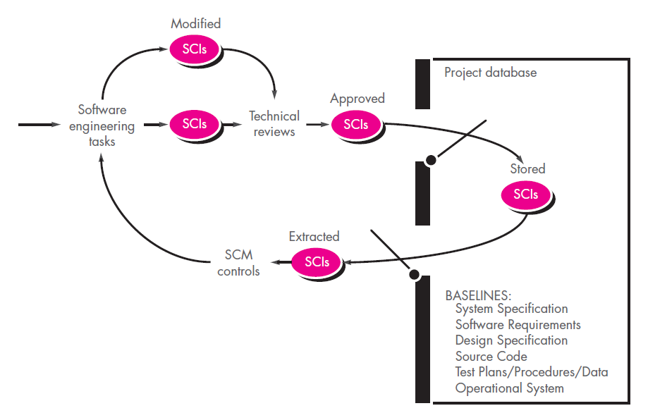
Baselined SCIs and the project database

Slide 15
Change Control
STOP

Slide 16
Change & SCM
Software Engineering
SCM
tools
• identification
• version control
methods
• change control
procedures
• auditing
a TQM foundation
• reporting
• construction

Slide 17
The SCM Repository

Slide 18
Paper-based vs. Automated Repositories
Problems with paper-based repositories (i.e., file cabinet containing folders)
Finding a configuration item when it was needed was often difficult
Determining which items were changed, when and by whom was often challenging
Constructing a new version of an existing program was time consuming and error prone
Describing detailed or complex relationships between configuration items was virtually impossible
Today's automated SCM repository
It is a set of mechanisms and data structures that allow a software team to manage change in an effective manner
It acts as the center for both accumulation and storage of software engineering information
Software engineers use tools integrated with the repository to interact with it
18

Slide 19
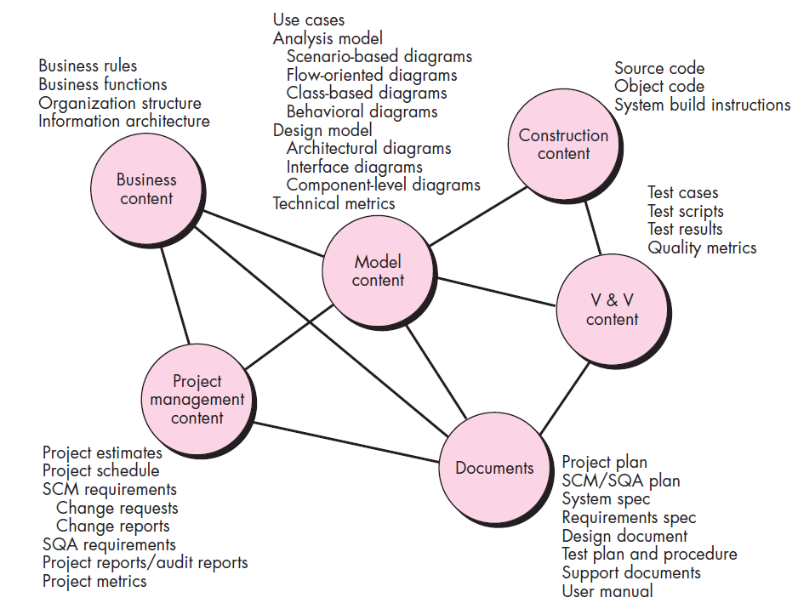
Content of the repository

Slide 20
Automated SCM Repository (Functions and Tools)
Versioning
Requirements
tracing
Functions
Data integrity
Information sharing
Tool integration
Data integration
Methodology enforcement
Document standardization
SCM Repository
Dependency
tracking
Configuration
management
Change
management
Audit
trails
(Explained on next two slides)
20

Slide 21
Functions of an SCM Repository
Data integrity
Validates entries, ensures consistency, cascades modifications
Information sharing
Shares information among developers and tools, manages and controls multi-user access
Tool integration
Establishes a data model that can be accessed by many software engineering tools, controls access to the data
Data integration
Allows various SCM tasks to be performed on one or more CSCIs
Methodology enforcement
Defines an entity-relationship model for the repository that implies a specific process model for software engineering
Document standardization
Defines objects in the repository to guarantee a standard approach for creation of software engineering documents
21

Slide 22
Toolset Used on a Repository
Versioning
Save and retrieve all repository objects based on version number
Dependency tracking and change management
Track and respond to the changes in the state and relationship of all objects in the repository
Requirements tracing
(Forward tracing) Track the design and construction components and deliverables that result from a specific requirements specification
(Backward tracing) Identify which requirement generated any given work product
Configuration management
Track a series of configurations representing specific project milestones or production releases
Audit trails
Establish information about when, why, and by whom changes are made in the repository
22

Slide 23
SCM Tools
SolarWinds Server Configuration Monitor
CFEngine Configuration Tool
Puppet Configuration Tool
CHEF Configuration Tool
Ansible Configuration Tool
SALTSTACK Configuration Tool
JUJU Configuration Tool
RUDDER
Bamboo Configuration Management
TeamCity Configuration Tool
Octopus Deploy
CFEngine, CHEF, Rudder and Bamboo configuration tools would be a good choice as they are open-source, highly scalable and robust and secure.
CFEngine, Ansible, CHEF enterprise version, Octopus, TeamCity, etc. These tools provide a reliable deployment process and support multiple OS platforms.
Source Code Management (SCM) DevOps Tools:
Team Foundation Server (TFS):
Kallithea:
Helix Core Version Control:
GitLab:
Bitbucket Server:
Subversion:
Mercurial:
GIT:
GitHub:
Gerrit:

Slide 24
The SCM Process

Slide 25
Primary Objectives of the SCM Process
Identify all items that collectively define the software configuration
Manage changes to one or more of these items
Facilitate construction of different versions of an application
Ensure the software quality is maintained as the configuration evolves over time
Provide information on changes that have occurred
(Compare this process to the five SCM tasks)
25

Slide 26
SCM Questions
How does a software team identify the discrete elements of a software configuration?
How does an organization manage the many existing versions of a program (and its documentation) in a manner that will enable change to be accommodated efficiently?
How does an organization control changes before and after software is released to a customer?
Who has responsibility for approving and ranking changes?
How can we ensure that changes have been made properly?
What mechanism is used to appraise others of changes that are made?
26

Slide 27
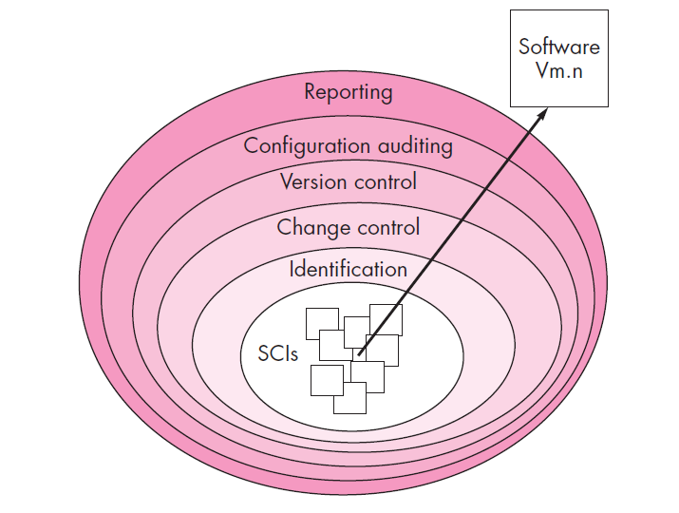
Layers/Tasks of the SCM process

Slide 28
SCM Tasks (continued)
Concentric layers (from inner to outer)
Identification
Change control
Version control
Configuration auditing
Status reporting
CSCIs flow outward through these layers during their life cycle
CSCIs ultimately become part of the configuration of one or more versions of a software application or system
28

Slide 29
Identification Task
Identification separately names each CSCI and then organizes it in the SCM repository using an object-oriented approach
Objects start out as basic objects and are then grouped into aggregate objects
Each object has a set of distinct features that identify it
A name that is unambiguous to all other objects
A description that contains the CSCI type, a project identifier, and change and/or version information
List of resources needed by the object
The object realization (i.e., the document, the file, the model, etc.)
29

Slide 30
Change Control Task
Change control is a procedural activity that ensures quality and consistency as changes are made to a configuration object
A change request is submitted to a configuration control authority(CCA), which is usually a change control board (CCB)
The request is evaluated for technical merit, potential side effects, overall impact on other configuration objects and system functions, and projected cost in terms of money, time, and resources
An engineering change order (ECO) is issued for each approved change request
Describes the change to be made, the constraints to follow, and the criteria for review and audit
The baselined CSCI is obtained from the SCM repository
Access control governs which software engineers have the authority to access and modify a particular configuration object
Synchronization control helps to ensure that parallel changes performed by two different people don't overwrite one another
30

Slide 31
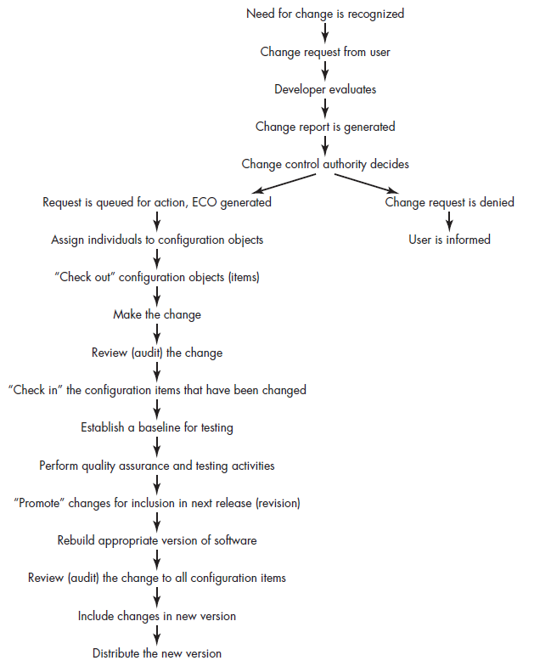
The change control process

Slide 32
Version Control Task
Version control is a set of procedures and tools for managing the creation and use of multiple occurrences of objects in the SCM repository
Required version control capabilities
An SCM repository that stores all relevant configuration objects
A version management capability that stores all versions of a configuration object (or enables any version to be constructed using differences from past versions)
A make facility that enables the software engineer to collect all relevant configuration objects and construct a specific version of the software
Issues tracking (bug tracking) capability that enables the team to record and track the status of all outstanding issues associated with each configuration object
The SCM repository maintains a change set
Serves as a collection of all changes made to a baseline configuration
Used to create a specific version of the software
Captures all changes to all files in the configuration along with the reason for changes and details of who made the changes and when
32

Slide 33
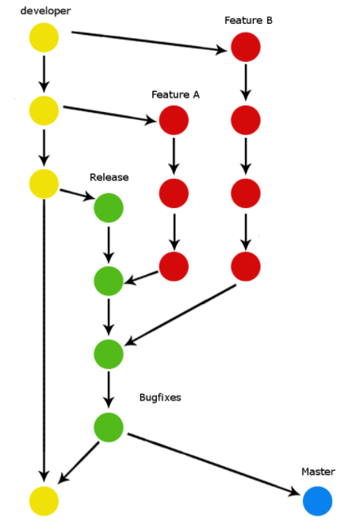
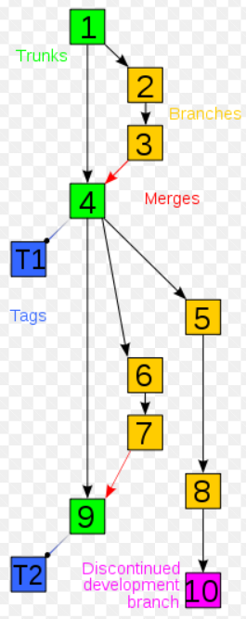

Slide 34
Configuration Auditing Task
Configuration auditing is an SQA activity that helps to ensure that quality is maintained as changes are made
It complements the formal technical review and is conducted by the SQA group
It addresses the following questions
Has the change specified in the ECO been made? Have any additional modifications been incorporated?
Has a formal technical review been conducted to assess technical correctness?
Has the software process been followed, and have software engineering standards been properly applied?
Has the change been "highlighted" and "documented" in the CSCI? Have the change data and change author been specified? Do the attributes of the configuration object reflect the change?
Have SCM procedures for noting the change, recording it, and reporting it been followed?
Have all related CSCIs been properly updated?
A configuration audit ensures that
The correct CSCIs (by version) have been incorporated into a specific build
That all documentation is up-to-date and consistent with the version that has been built
34

Slide 35
Status Accounting
Change
Reports
Change
Requests
ECOs
SCIs
Status Accounting
Reporting

Slide 36
Status Reporting Task
Configuration status reporting (CSR) is also called status accounting
Provides information about each change to those personnel in an organization with a need to know
Answers what happened, who did it, when did it happen, and what else will be affected?
Sources of entries for configuration status reporting
Each time a CSCI is assigned new or updated information
Each time a change is approved by the CCB and an ECO is issued
Each time a configuration audit is conducted
The configuration status report
Placed in an on-line database or on a website for software developers and maintainers to read
Given to management and practitioners to keep them appraised of important changes to the project CSCIs
36

Slide 37
Summary
Introduction
SCM Repository
SCM Process
Identification
Change control
Version control
Configuration auditing
Status reporting
37
☺

