Slide 1

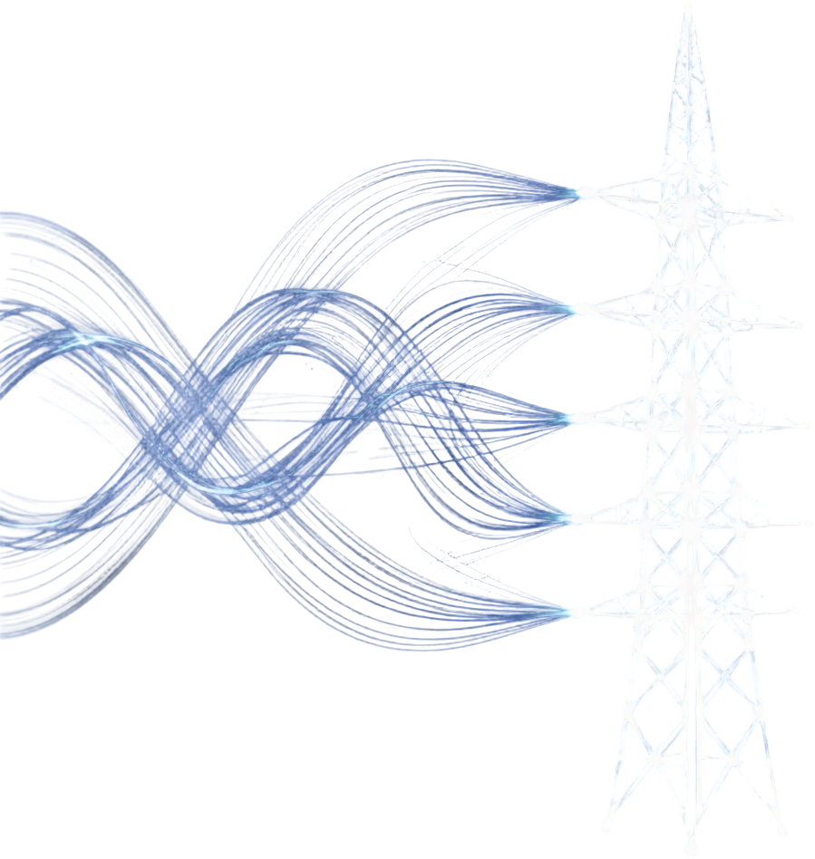
IBM Bob AI Hackathon 2026 · Track U1: Grid Reliability & Risk Intelligence
GridSentinel AI
Explainable composite risk intelligence for transformer fleets — from SCADA telemetry to Granite-generated work orders.
Track U1
Grid Reliability & Risk Intelligence
Presented by Team Mantra
GridSentinel AI
01

Slide 2
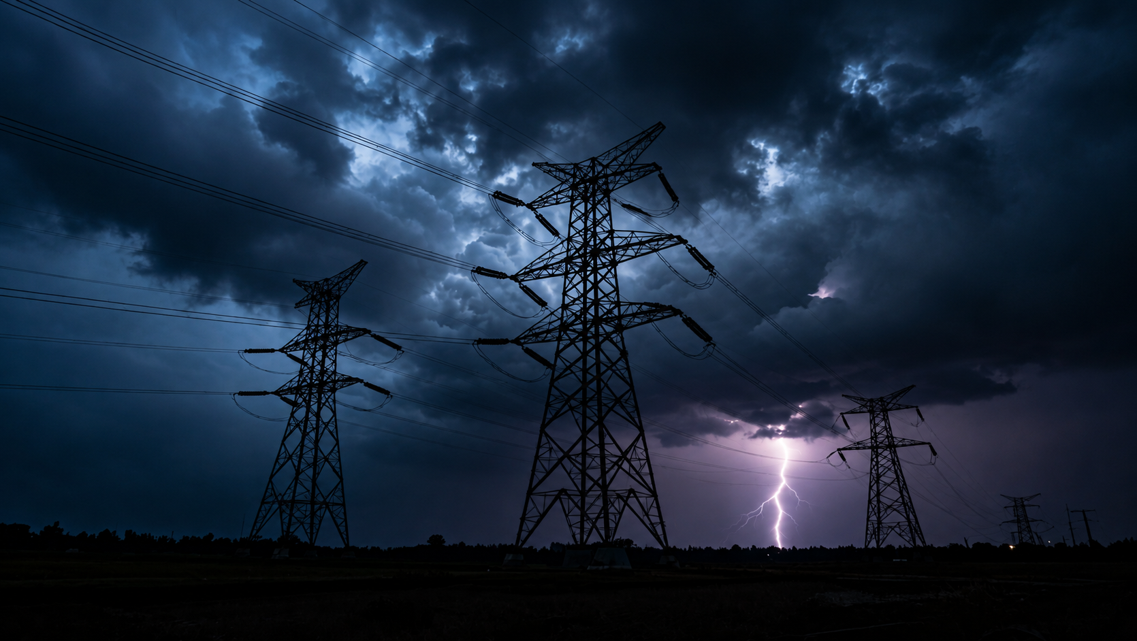
THE PROBLEM
Hidden faults silently degrade transformers — until weather stress and blind spots turn a latent risk into a grid outage.
1
2
3
Hidden Transformer Faults
Weather Compounding
Criticality Blind Spots
Dissolved gas anomalies and insulation degradation accumulate undetected inside transformers. SCADA telemetry alone cannot surface these latent faults — grid operators are flying blind until failure strikes.
Extreme heat, storms, and load surges accelerate fault progression. Without real-time weather-stress correlation, operators cannot anticipate when a marginal asset will cross the failure threshold.
Not all transformers carry equal consequence. Utilities, transmission operators, and grid reliability engineers lack a composite risk score that weighs physical health, environmental stress, and grid criticality together.
GridSentinel AI
02

Slide 3





OUR SOLUTION: END-TO-END PIPELINE
1
2
3
4
Ingest & Diagnose
Stress & Criticality
Composite Risk Score
Granite Work Order
SCADA/telemetry streams feed DGA physical health analytics — detecting dissolved gas anomalies and latent transformer faults in real time.
Weather stress overlays and grid criticality mapping identify which assets face compounding environmental and topological risk.
60/20/20 composite risk formula weights DGA health, weather stress, and grid criticality into a single explainable risk score per asset.
IBM Granite 3.0 synthesises a prioritised work order; a human operator countersigns before any field action — advisory only.
GridSentinel AI
03

Slide 4

HOW IT WORKS: EXPLAINABLE RISK SCORING
Layer 1
DGA
60%
DGA Physical Health Score — dominant weight; dissolved gas ratios, fault gas trends, and anomaly severity from SCADA telemetry
Physical health from dissolved gas analysis
Layer 2
Weather Stress Index — ambient temperature, humidity, and storm proximity amplifying thermal degradation risk
Weather
20%
Thermal & storm stress on transformer assets
Layer 3
20%
Grid Criticality Score — load centrality, downstream dependency, and consequence severity if asset fails
Criticality
GridSentineAI
04

Slide 5







PRODUCT EXPERIENCE
Command-Center UI
Asset health
Fleet Diagnostics
DGA Analysis
Fleet view flags high-risk transformers with composite score overlays
DGA diagnostics surface dissolved-gas trends and fault-type classification
Live weather stress layer shows heat, humidity and storm exposure per asset
Weather Context
Work-Order Workflow
Granite drafts prioritised work orders; engineer countersigns before dispatch
Risk explainability
GridSentinel AI
05

Slide 6

DECISION & SIMULATION: WHAT-IF PLANNING
Risk Explanation Engine
1
Breaks down every composite risk score into its 60/20/20 components — physical DGA health, weather stress, and grid criticality — with plain-language rationale for each flagged asset.
Fully explainable
Operational Contingency Simulator
2
Read-only / no SCADA writes
Models cascading failure scenarios and rerouting options in a sandbox environment. Operators explore "what if this transformer fails?" without touching live SCADA data or control systems.
Operational Load Transfer Planner
3
Suggests safe load-transfer sequences to isolate high-risk assets during planned maintenance or emergency response, ranked by consequence severity and grid stability impact.
Advisory-only output
GridSentinel AI
06

Slide 7




AI + RESPONSIBLE GOVERNANCE
GridSentinel AI is built on IBM Granite 3.0 with human-in-the-loop safeguards, offline resilience, and strict advisory-only boundaries.
Granite 3.0
Human-in-Loop
Governance
IBM Granite 3.0 powers risk narrative generation and work-order synthesis. Developed entirely within IBM Bob IDE. Offline fallback mode ensures continuous scoring even when LLM connectivity is unavailable.
Every AI-generated work order requires a human engineer countersign before dispatch. No automated action is taken on live SCADA. GridSentinel surfaces risk — operators make all final decisions.
GridSentinel operates in advisory-only mode with full audit trails. Risk scores are fully explainable via the 60/20/20 formula. No black-box outputs — every recommendation is traceable and contestable.
GridSentinelAI
07

Slide 8





IBM Bob AI Hackathon 2026 — Track U1: Grid Reliability & Risk Intelligence
"Earlier attention to high-risk assets. Faster work-order synthesis. Consequence-aware prioritization — building a resilient, explainable grid."
GRIDSENTINEL AI — POWERING RESILIENT GRID OPERATIONS
Team Mantra — GridSentinel AI
Mahek Dhebariya
Khushi Ka.Patel
Palak Donga
Yashvi Antala
Team Lead & Frontend Architect
Physics & Diagnostic Engine Lead
Data, Criticality & IBM Granite Lead
Quality Assurance & Testing Lead
React 18 + Vite dashboard animated gauges
FastAPI integration
UI/UX, presentation prep
Authored ‘src/dga_engine’s py’ per IEEE C57.104
gas ratio and thermal degradation algorithms
Built ‘criticality engine’’
‘weather engine’’
engineered IBM Granite
prompt pipeline
Led system verification
test suite execution
documentation compliance
GridSentinel AI
08
IBM Bob AI Hackathon 2026

