Slide 1
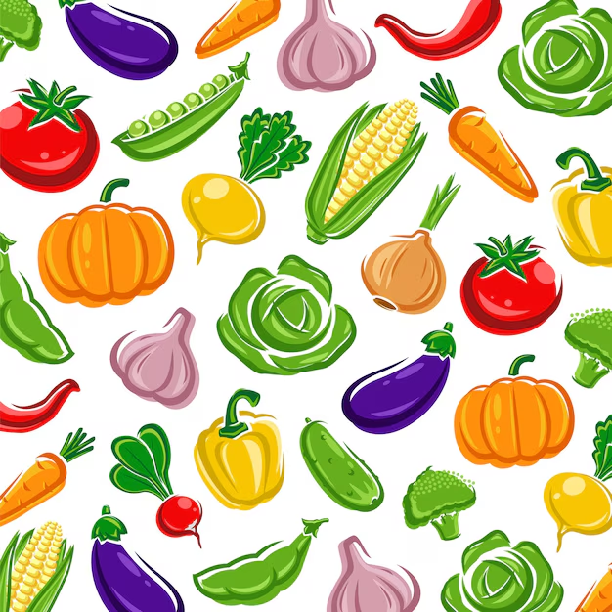
Vegetable Selling System
240160510034

Slide 2
Introduction
The Vegetable Delivery System is a web-based platform designed to simplify the process of buying and selling fresh vegetables. It connects local farmers directly with consumers, eliminating middlemen and ensuring fair pricing and fresh produce. The system offers convenient features like online ordering, cart management, and order tracking, benefiting both farmers and customers. This case study explores the design, functionality, and impact of such a system in promoting digital agriculture and improving daily life efficiency.

Slide 3
Problem
Local/small sellers struggle to get listed due to high commissions and strict rules.
Quick commerce solutions mainly serve urban areas.
Freshness and source transparency of vegetables are limited.

Slide 4
ER diagram

Slide 5
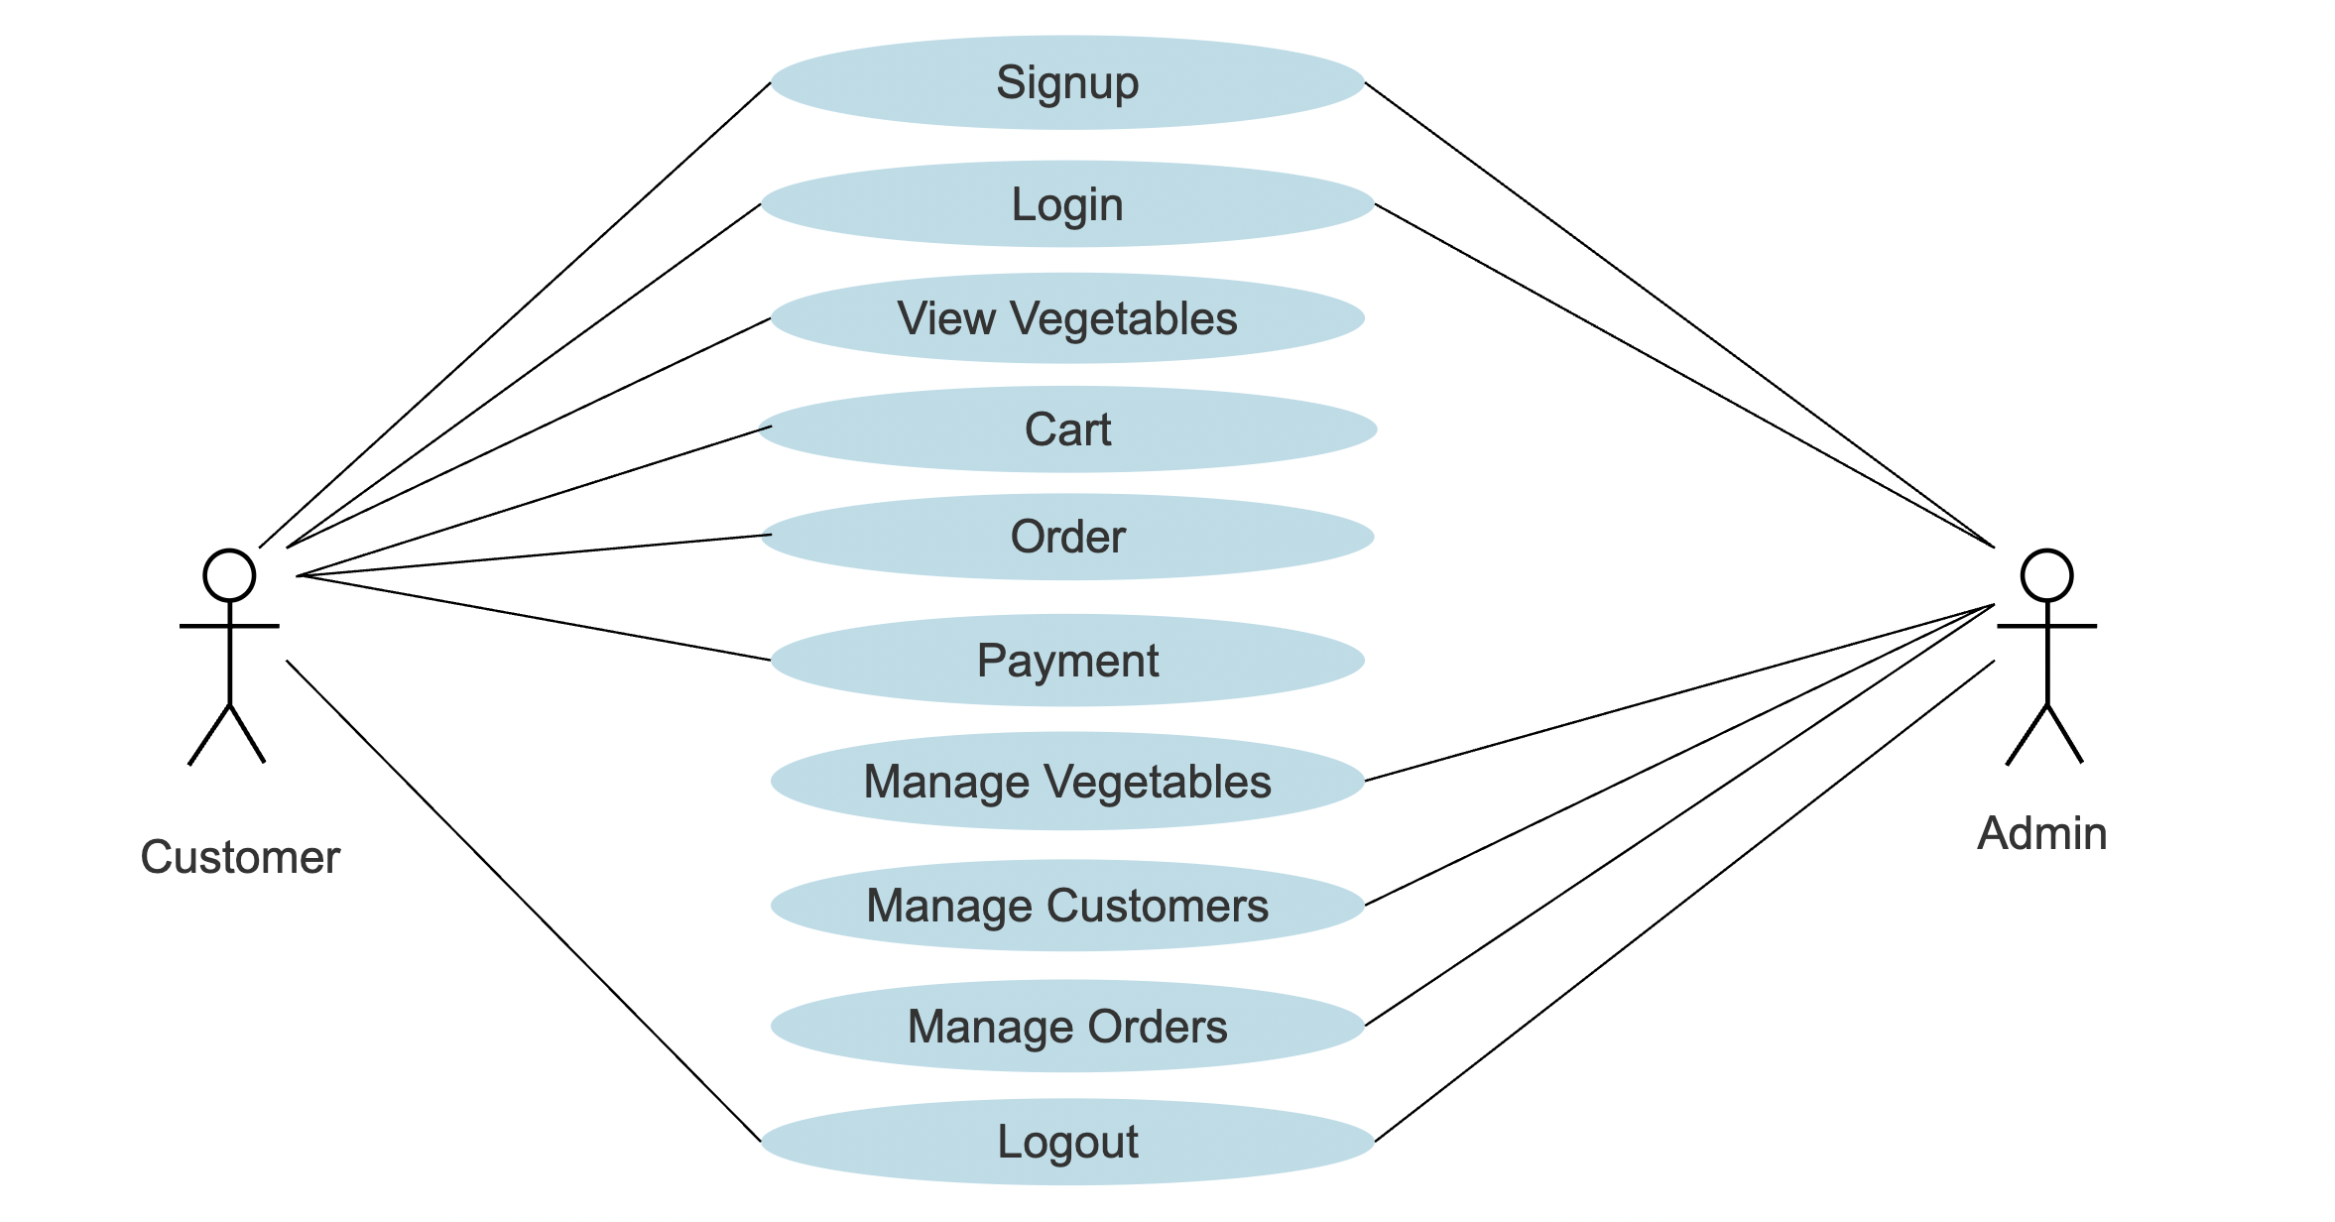
Use Case Diagram

Slide 6
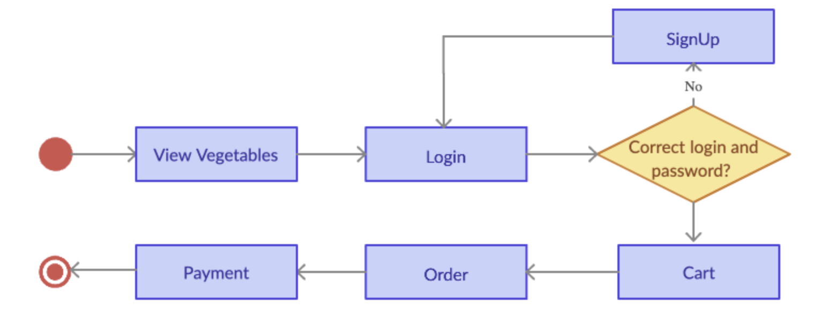
Activity Diagram

Slide 7
Tables Structure
Users: user_id, name, email, password, phone, address, created_at;
Admin: admin_id, name, email, password;
Vegetables: veg_id, name, price, qty, image, added_by, added_at;
Cart: cart_id, user_id, veg_id, qty;
Orders: order_id, user_id, total_amount, order_date, status;

Slide 8
References
www.creately.com
www.smartdraw.com
www.goole.com

Slide 9
Thank you

