Slide 1







STACK OVERFLOW DEVELOPER SURVEY-2019
Mahek Panchal
24 Oct 2024

Slide 2



OUTLINE
Executive Summary
Introduction
Methodology
Results
Visualization – Charts
Dashboard
Discussion
Findings & Implications
Conclusion
Appendix

Slide 3

EXECUTIVE SUMMARY
Data Wrangling and Cleaning
Identifying and removing duplicate rows
Handling missing values for all columns
Normalizing data using two columns
Data Analysis
Plotting distribution curves and histograms
Calculating median, identifying outliers, and computing the Inter Quartile Range (IQR)
Determining upper and lower bounds, and finding correlations between numerical columns
Data Visualization
Creating histograms, scatter plots, bubble charts, and boxplots
Generating pie charts, bar charts, and stacked charts for medians and counts
Dashboard Creation
Designing and building a dashboard using IBM Cognos Analytics.

Slide 4

INTRODUCTION
About the Dataset
The dataset is based on a survey conducted by Stack Overflow, an online developer platform, which collected responses from software professionals globally.
The original dataset contains approximately 90,000 responses.
Aim of the Assignment
This assignment will let you explore, analyze, and visualize the subset of the actual dataset to present key insights.
Key Information
The data set includes responses to various survey questions, covering topics like employment status, coding habits, education, and compensation.
The trends of developer’s preferences are also predicted using different charts.

Slide 5

METHODOLOGY
Collect Survey data
Use web scraping to collect data from an API
Data Wrangling
Find and Remove Duplicates
Find and Impute Missing Values
Normalize the Data
Exploratory Data Analysis
Find how data is distributed
Find outliers
Find correlation
Data Visualization
Visualize data using different types of charts
Generate Dashboard

Slide 6
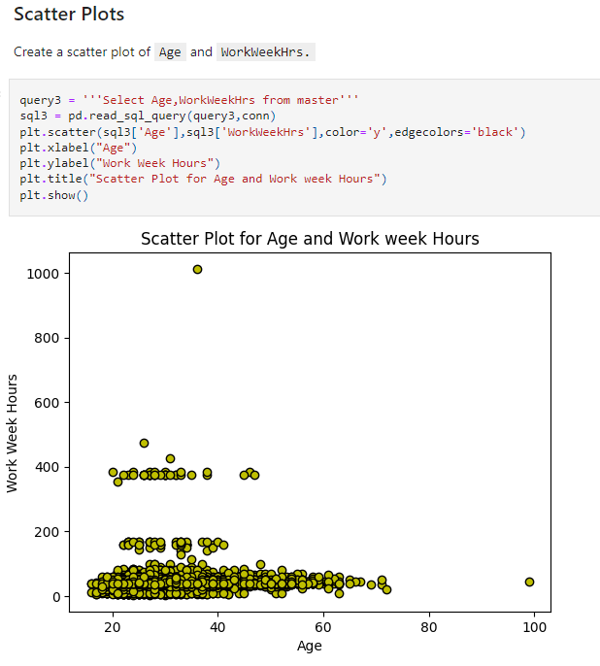
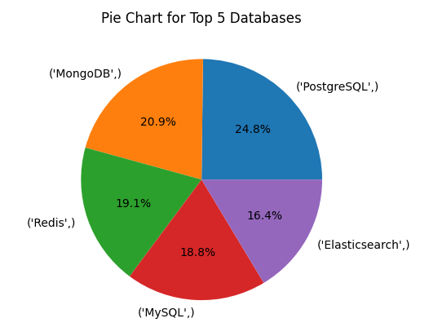
RESULTS

Slide 7
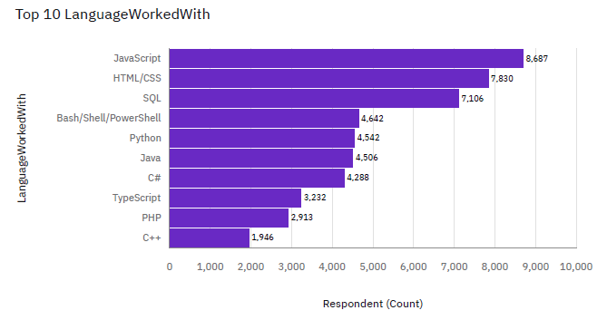
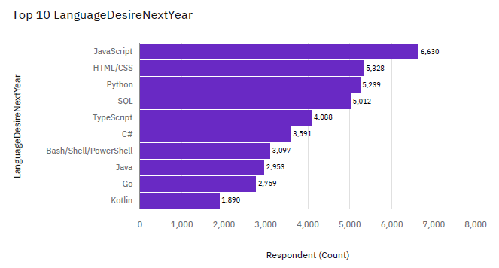
PROGRAMMING LANGUAGE TRENDS

Slide 8
PROGRAMMING LANGUAGE TRENDS - FINDINGS & IMPLICATIONS
Findings:
Over 8,000 respondents reported using JavaScript in their work, indicating its strong prevalence in the programming landscape.
Approximately 2,000 respondents indicated that they use C++, showcasing its relevance among developers, though it ranks lower than other languages.
A significant increase in the desire to learn Python was reported among respondents, ranking it third after JavaScript and HTML/CSS, indicating its growing importance in the programming landscape.
Implications:
JavaScript's popularity signals strong demand for developers. Training programs should focus on JavaScript to meet market needs.
C++ is important for game development and systems programming. Companies in these areas should seek skilled C++ developers.
The rising interest in Python suggests a shift in market demand for developers proficient in this language.

Slide 9
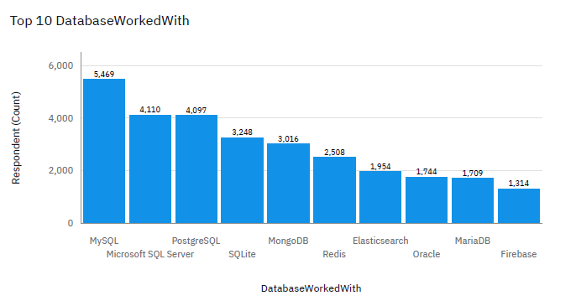
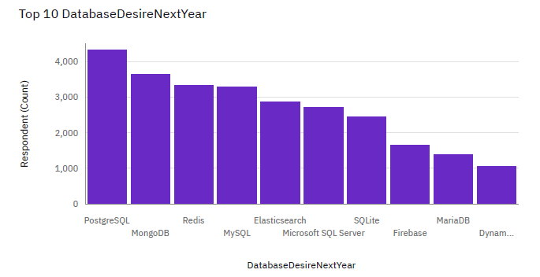
DATABASE TRENDS

Slide 10
DATABASE TRENDS - FINDINGS & IMPLICATIONS
Findings:
Out of all respondents, 5,469 reported working with MySQL, indicating its strong presence in the database landscape.
Microsoft SQL Server has 4,110 users, while PostgreSQL has 4,097 users, showcasing close competition between these database technologies.
There is a notable shift in preference towards PostgreSQL, with its user base expected to surpass 4,000 next year, positioning it as the first choice over MySQL and reflecting a growing interest in PostgreSQL and MongoDB.
Implications:
Given the significant number of MySQL users, a robust demand remains for MySQL expertise in the job market.
The close user counts for Microsoft SQL Server and PostgreSQL indicate a competitive environment.
The rising trend in PostgreSQL's popularity suggests a shift in developer preferences. Companies should invest in training and resources for PostgreSQL and MongoDB to align with this trend and meet future data management needs.

Slide 11

DASHBOARD
You can look at my IBM Cognos Analytics Dashboard over here: https://github.com/mahekP07/CourseraProjects/blob/master/LABS/M5-DashboardLab/Current%20Technology%20Usage.pdf

Slide 12
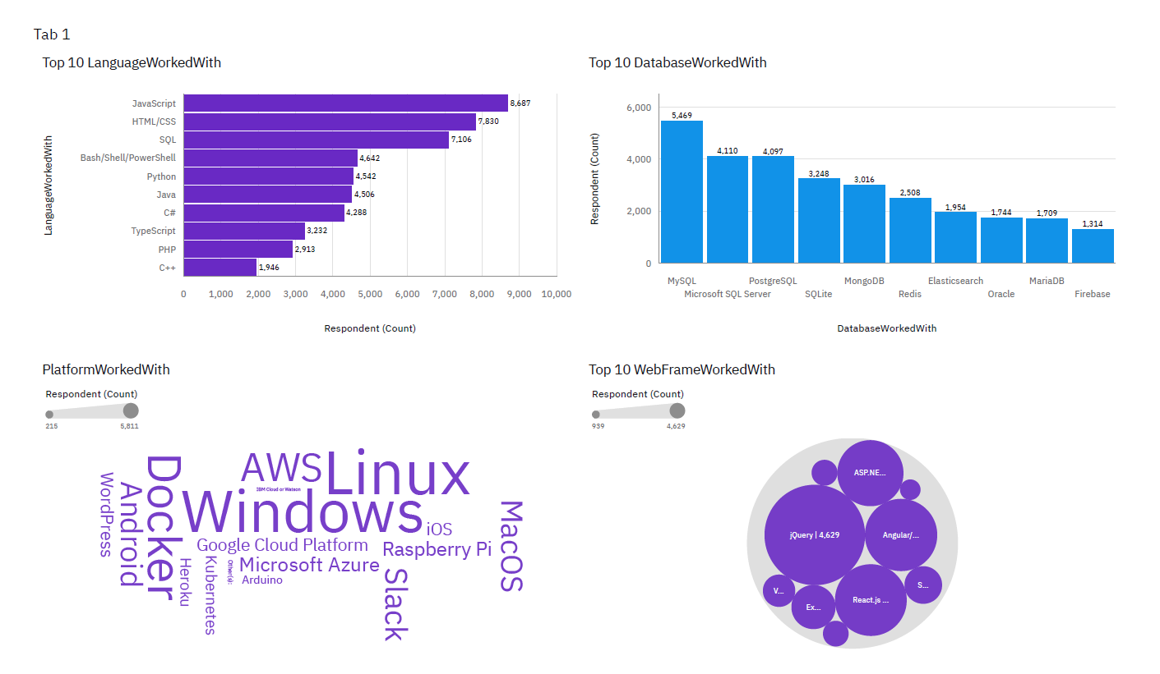
CURRENT TECHNOLOGY TRENDS

Slide 13
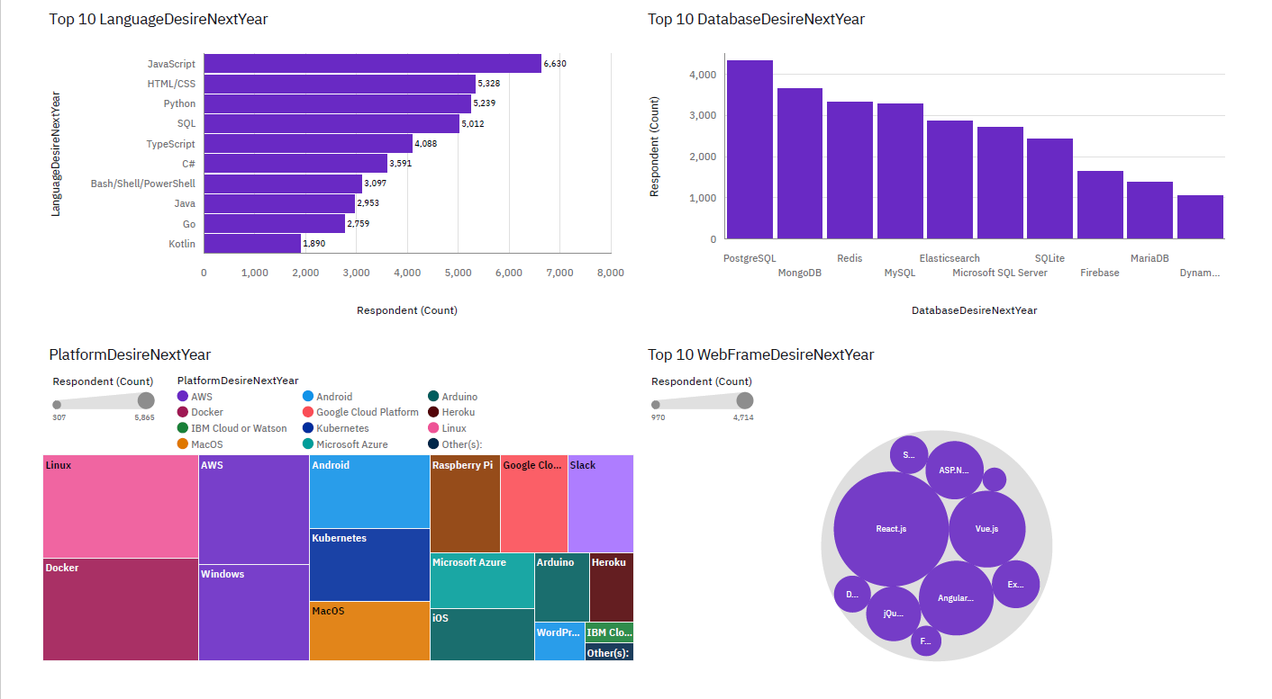
FUTURE TECHNOLOGY TRENDS

Slide 14
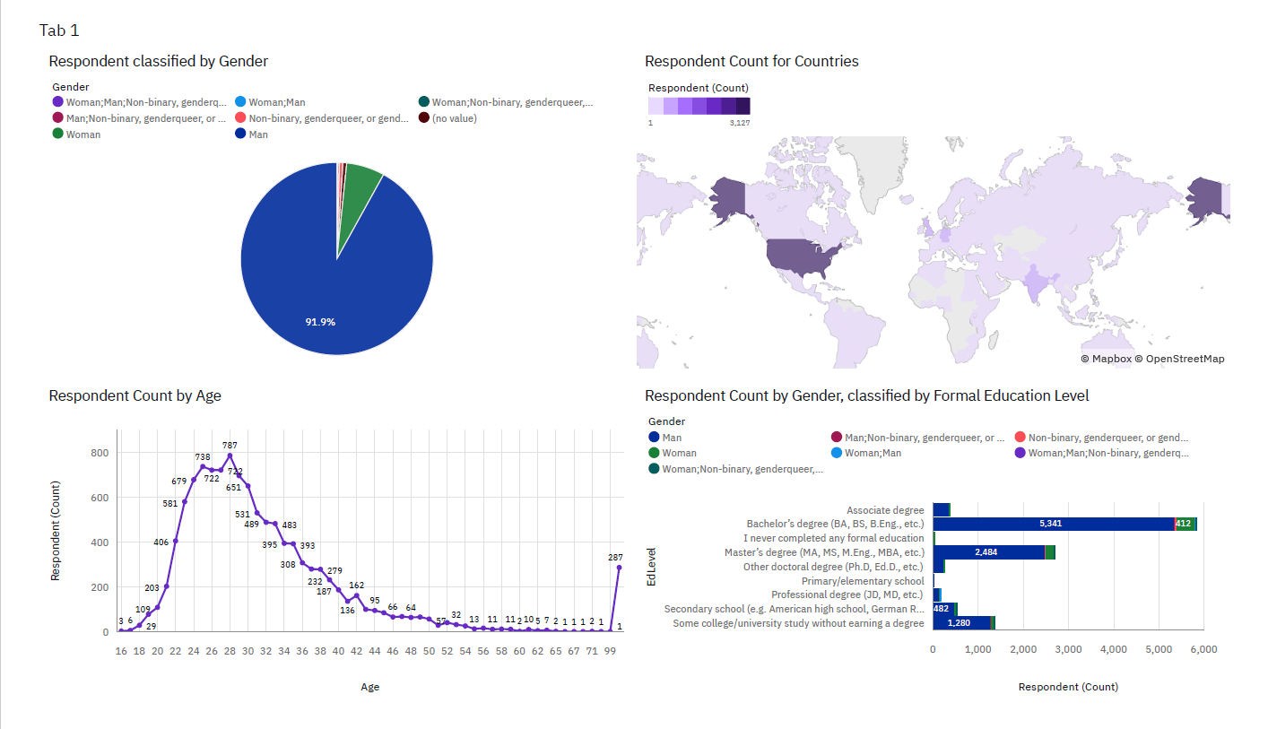
DEMOGRAPHICS

Slide 15
DISCUSSION
Based on the analysis, individuals and companies can identify the most in-demand skill sets, allowing job seekers to focus on gaining proficiency in those areas.

Slide 16
OVERALL FINDINGS & IMPLICATIONS
Findings:
JavaScript is widely used, and Python is becoming popular.
Over 90% of respondents are young male developers.
Developers are mostly located in developed countries.
Implications:
With JavaScript being widely used and Python gaining popularity, job seekers should prioritize building expertise in these languages to increase their employability. Companies should offer training to stay competitive.
The predominance of young male developers highlights a gender imbalance.
Since developers are primarily located in developed countries, expanding recruitment efforts globally could provide access to a broader, more diverse pool of developers.

Slide 17

CONCLUSION
The increasing popularity of Python and the shift toward PostgreSQL and MongoDB reflect changing developer preferences. Both individuals and companies should stay agile by adapting to these trends to remain competitive in the tech landscape.
With JavaScript and HTML/CSS being highly used, the demand for skilled web developers continues to rise.
The dominance of young male developers in the industry highlights a significant gender gap. Focused efforts on diversity, equity, and inclusion are essential for creating a more diverse and innovative tech workforce.
As most developers are concentrated in developed countries, there is an opportunity to explore talent from underrepresented regions. Expanding recruitment to emerging markets can help companies access new, diverse talent and drive global growth.

Slide 18

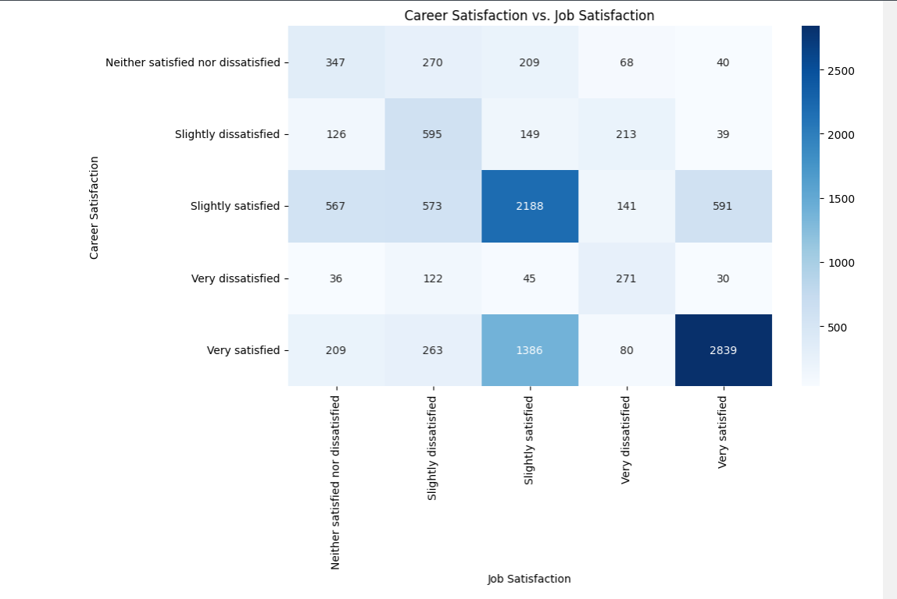
APPENDIX

Slide 19
JOB POSTINGS (Module-1)

Slide 20
POPULAR LANGUAGES (Module-1)

