Slide 1

GLOBAL SALES & PERFORMANCE ANALYSIS
Presented by:
Mahek Sham Bagai

Slide 2
About me
Academic Background: M.Sc. Physics (Pursuing)
Current Focus: Data Science & Analytics
Experience: Fresher
Project Experience: Machine Learning & Data Analytics Projects
Career Interest: Data Analytics, Machine Learning & AI
Github Profile – https://github.com/mahekbagai-1704
LinkedIn Profile URL – https://www.linkedin.com/in/mahek-bagai-080576398

Slide 3
Agenda
Business Problem & Objective
Dataset & Data Preparation
Data Cleaning & Transformation
Data Model & Relationships
Dashboard & Analysis
Key Insights
Business Recommendations
Conclusion

Slide 4
BUSINESS PROBLEM
OBJECTIVE
Build an interactive Power BI dashboard
Analyze sales and profitability
Identify regional, product and customer trends
Analyze returns and shipping performance
Support data-driven business decisions
Large volume of sales and operational data
Difficult to track overall business performance
Need to understand sales, profit, returns and regional performance
Raw data alone does not provide clear business insights

Slide 5
BUSINESS REQUIREMENTS &
KEY ANALYSIS QUESTIONS
01 — Overall Performance
How are overall sales and profitability performing?
02 — Sales Performance
Which regions, markets, categories and products generate the highest sales?
03 — Profitability
Which regions, categories and segments contribute most to profit?
04 — Discount Impact
How does discounting affect profitability?
05 — Returns
Where are returns concentrated, and which regions have higher return rates?
06 — Shipping & Regional Performance
How do shipping costs and regional performance vary across the business?

Slide 6
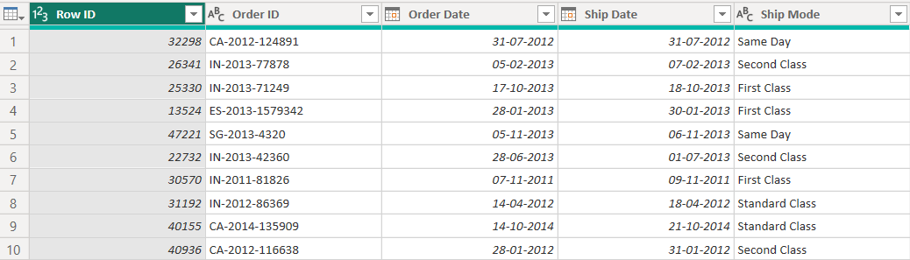
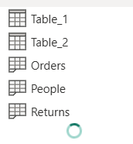
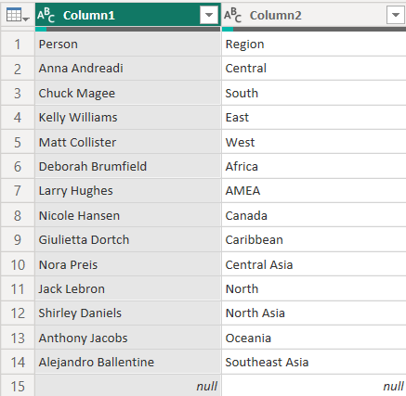
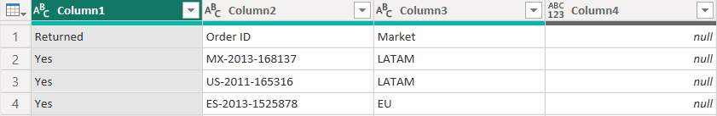
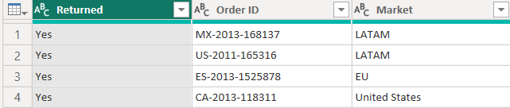
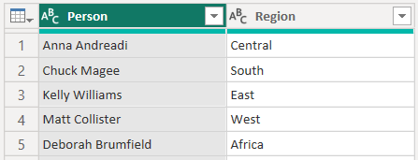
RAW DATASET
Orders - Raw Structure
RAW DATASET – INITIAL TABLE STRUCTURE
People - Raw Structure
Orders - Main transaction data
Returns - Returned order information
People - Regional manager information
Table_1 - Duplicate of Returns
Table_2 - Duplicate of People
Returns - Raw Structure
Table_1 - Duplicate Data
Table_2 - Duplicate Data

Slide 7
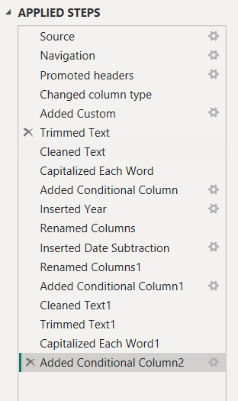
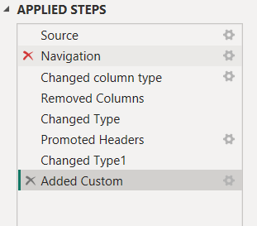
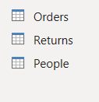
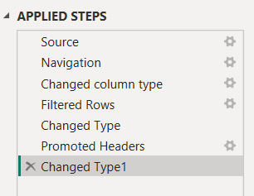
DATA CLEANING & TRANSFORMATION
KEY DATA PREPARATION STEPS
• Removed duplicate tables
• Corrected column names & data types
• Handled missing values
• Cleaned and transformed date fields
• Split/extracted required columns
• Prepared tables for relationships
RAW DATA → CLEANING → TRANSFORMATION → ANALYSIS-READY DATA

Slide 8
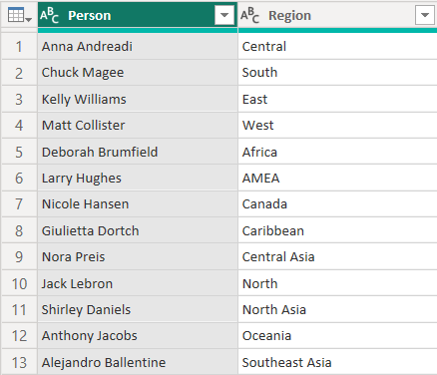
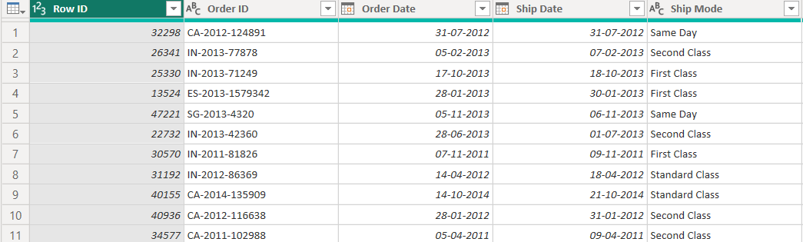
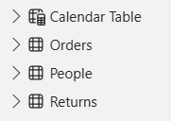
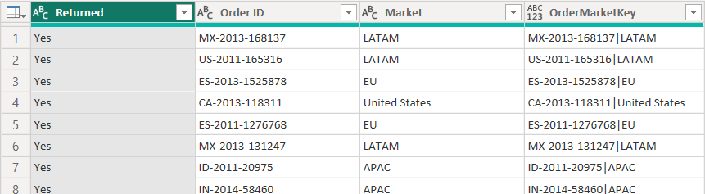
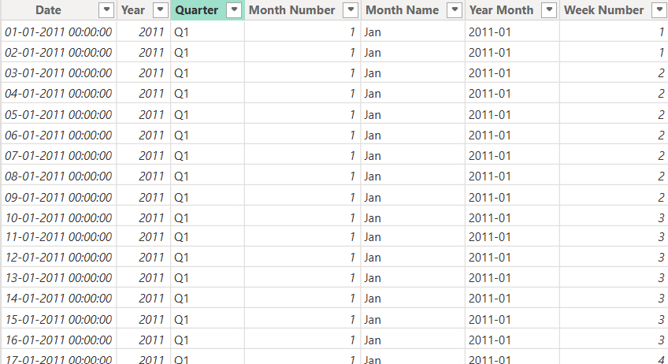
FINAL DATASET OVERVIEW
ORDERS
Main transaction & sales data
RETURNS
Returned order information
PEOPLE
Regional manager & region mapping
CALENDAR TABLE
Date dimension for time-based analysis
Table | No. of Rows | No. of Columns
Orders | 51,290 | 31
Returns | 1,173 | 5
People | 13 | 3
Calendar Table | 1,461 | 8
Cleaned tables prepared for data modeling and dashboard analysis

Slide 9
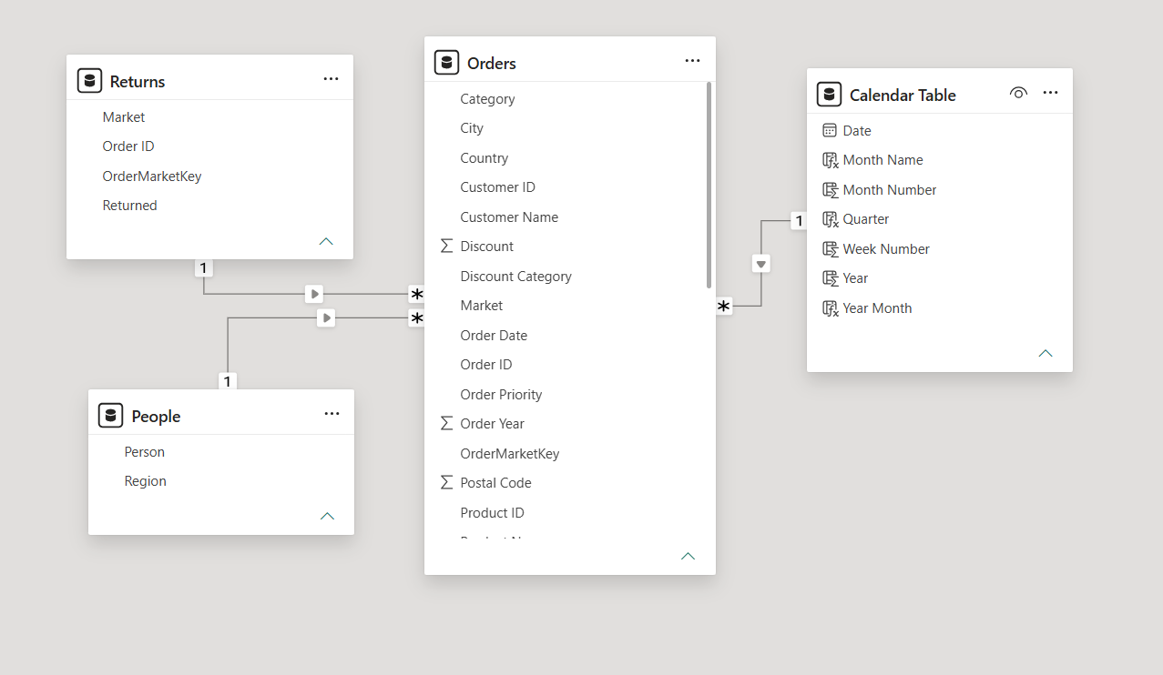
DATA MODEL & RELATIONSHIPS
ORDERS
Central transaction table
CALENDAR TABLE
Time-based analysis
PEOPLE
Region & manager mapping
RETURNS
Returned order information
MODEL TYPE
Star-schema-style structure

Slide 10
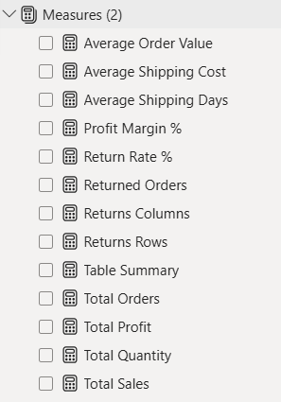
DAX MEASURES
KEY DAX MEASURES
Sales & Orders
  Total Sales
  Total Orders
  Total Quantity
  Average Order Value
Profitability
  Total Profit
  Profit Margin %
Returns
  Returned Orders
  Return Rate %
Shipping
  Average Shipping Cost
  Average Shipping Days
Measures created using DAX for dynamic KPI and business analysis

Slide 11
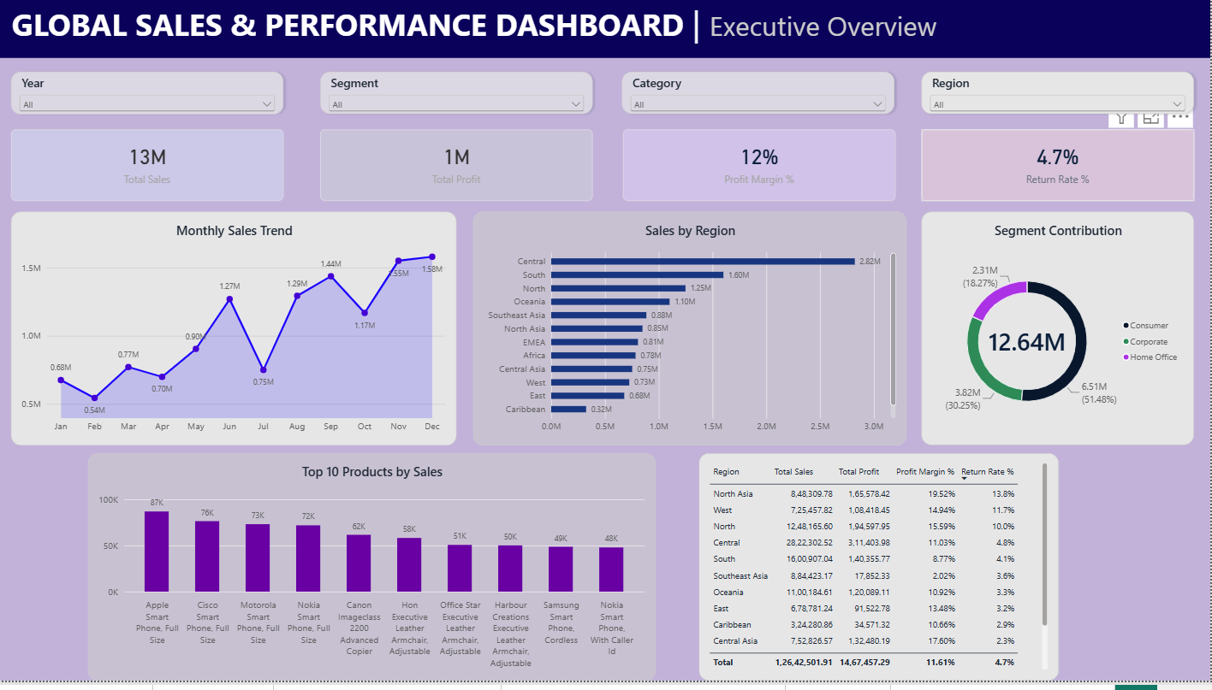
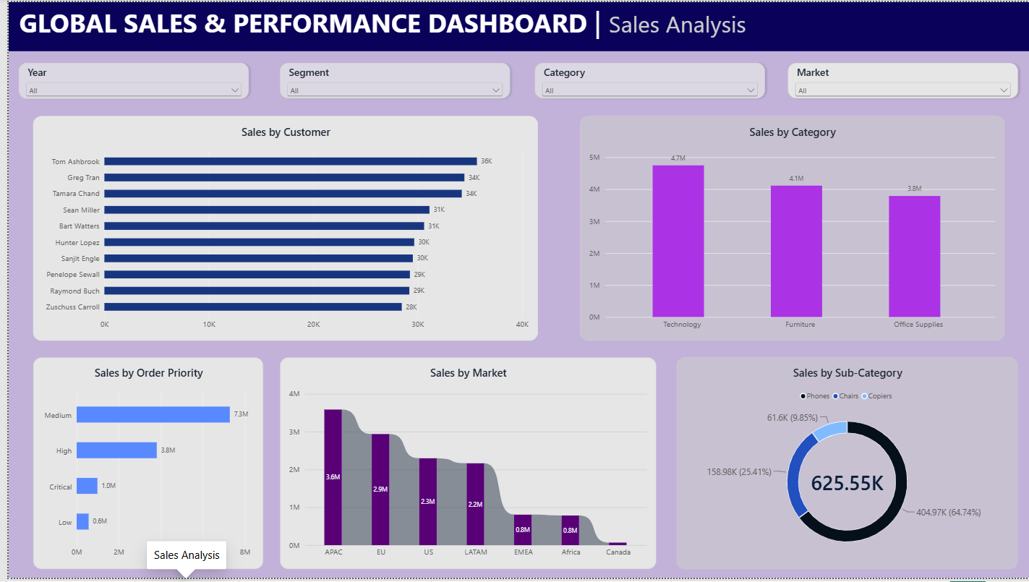
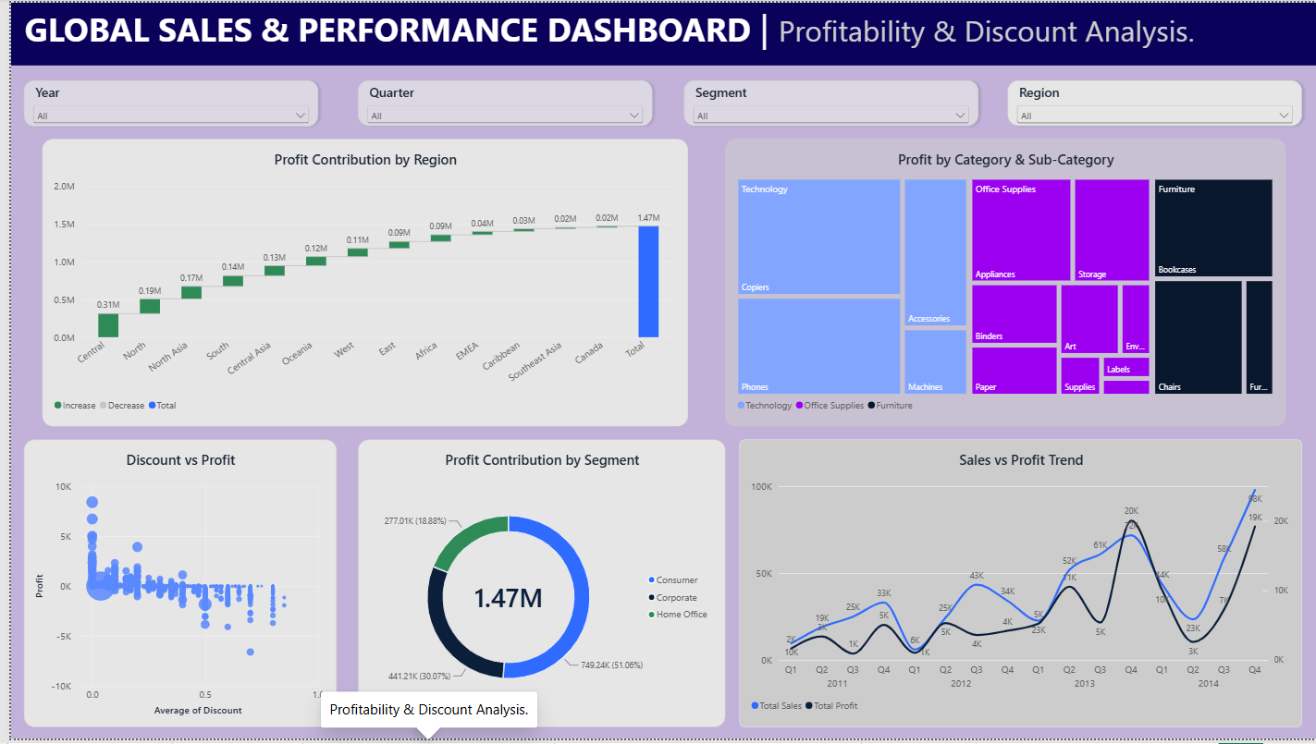
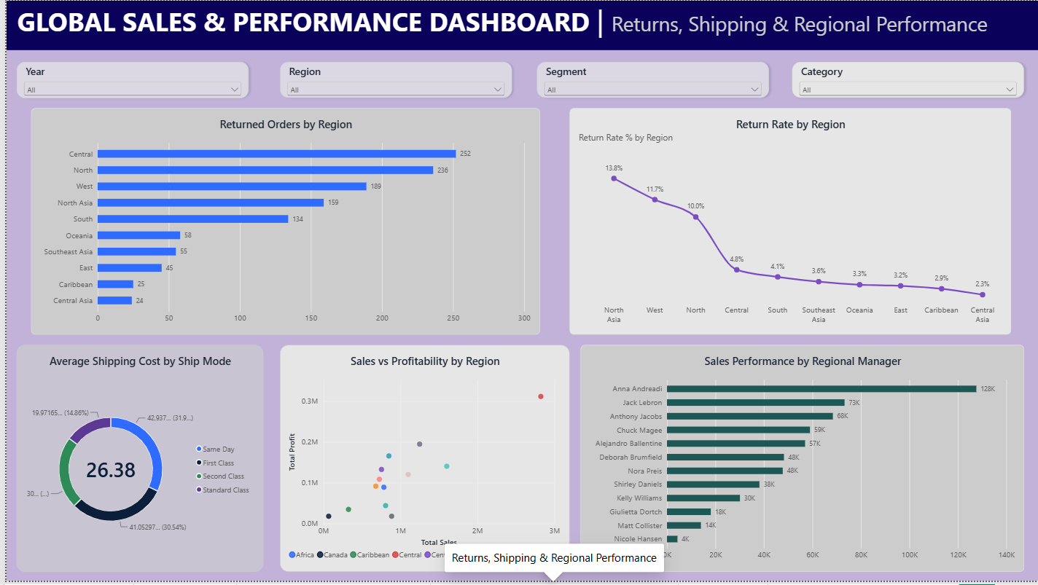
Dashboard Design & Visualizations
Interactive Power BI dashboard for sales, profitability, returns and regional performance analysis

Slide 12
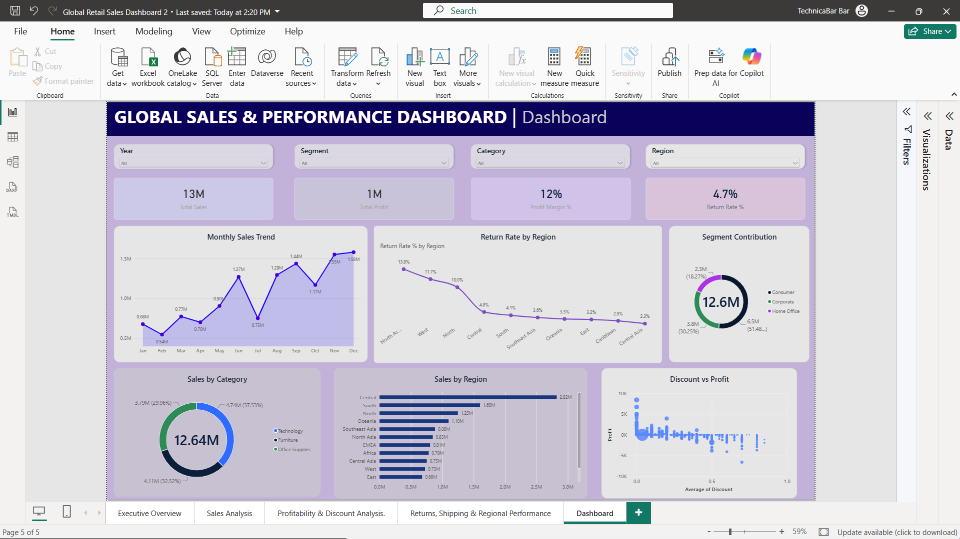
FINAL DASHBOARD

Slide 13
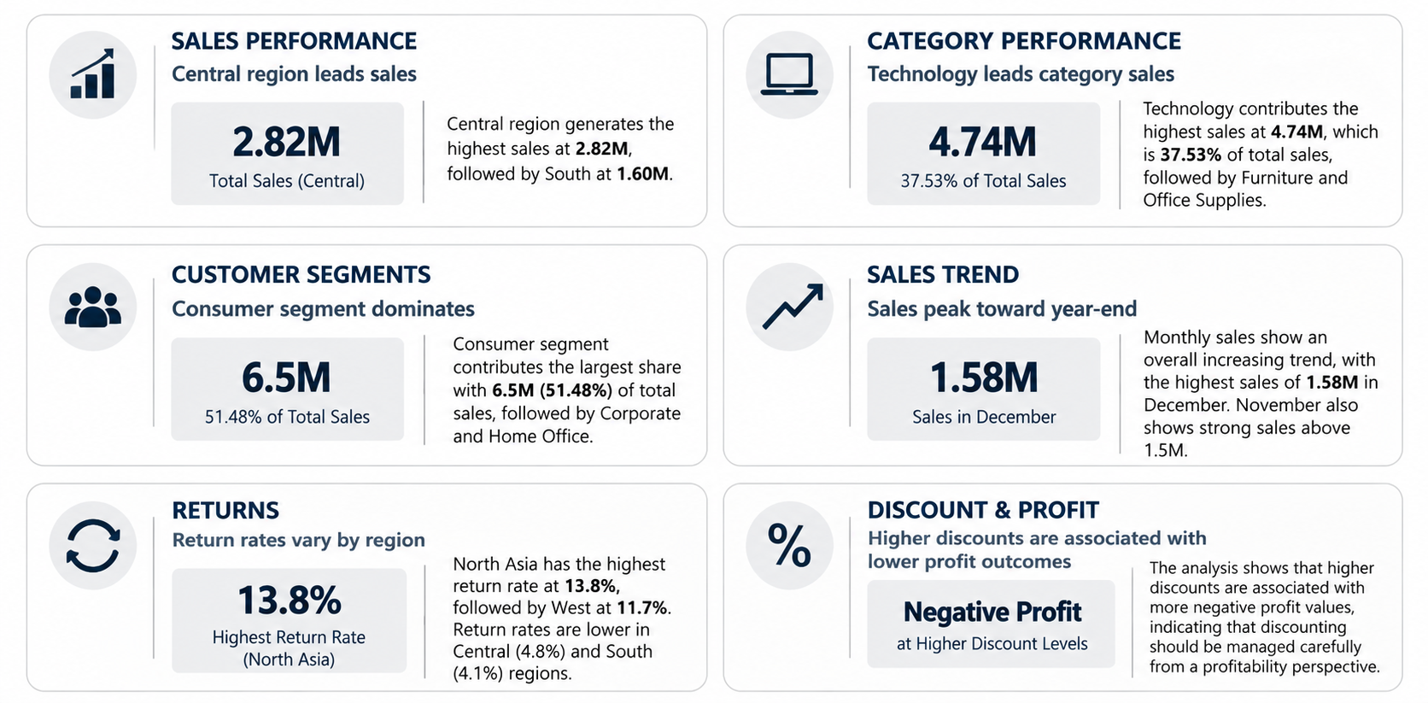
KEY BUSINESS INSIGHTS & FINDINGS

Slide 14
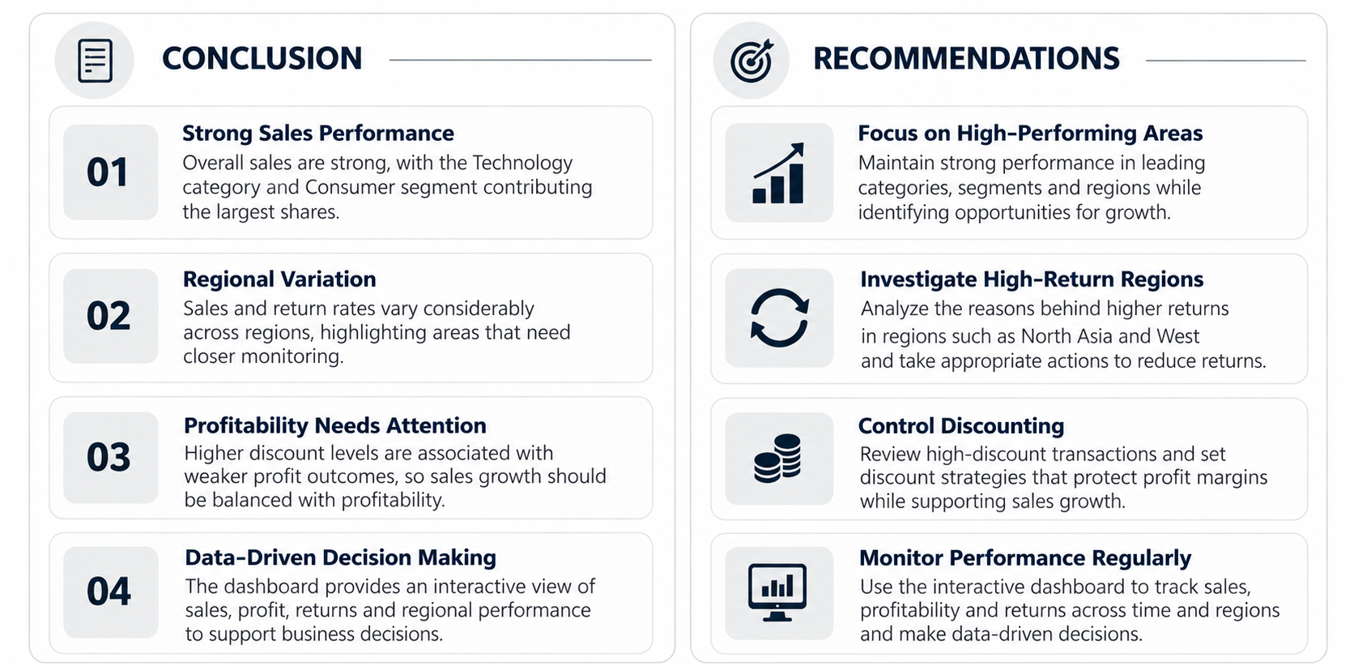
CONCLUSION & RECOMMENDATIONS

Slide 15
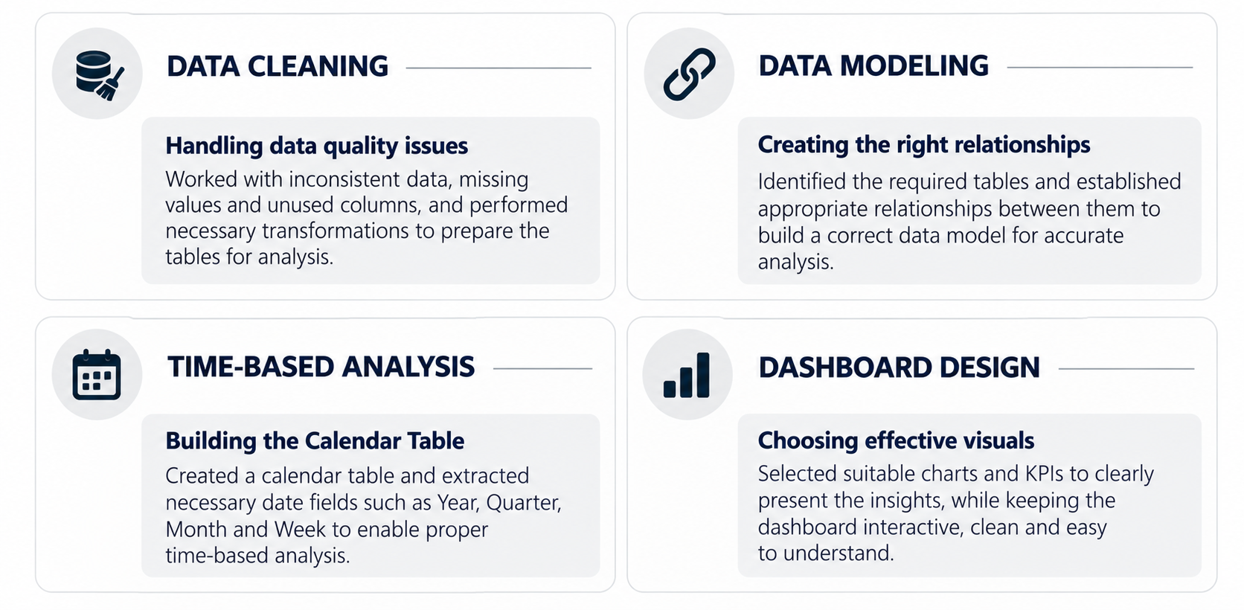
CHALLENGES FACED DURING THE PROJECT

Slide 16
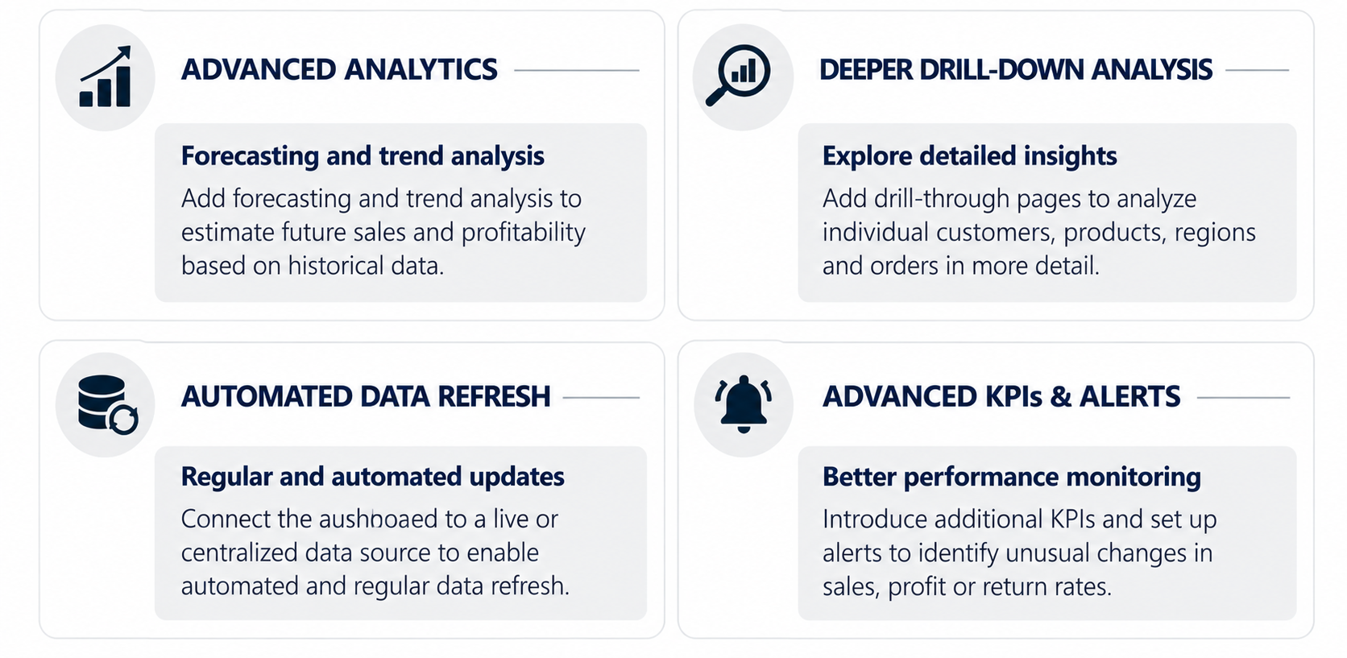
FUTURE IMPROVEMENTS

Slide 17


Slide 18

THANK YOU

