Slide 1




AI Readiness &
Risk Assessment
Proposal | October 2026
Adaptive
Collaborative
Innovative

Slide 2

AGENDA
1
Why AI Readiness Matters Now
2
Approach & Methodology
3
Engagement Plan & Deliverables

Slide 3


The Shift Has Already Happened
AI has moved from experiment to infrastructure. The competitive question in 2026 isn't whether your peers are using it - it's how far ahead they already are.
78-88%
$407B
$15.7T
Enterprise AI adoption
Worldwide AI spending
Global economic impact
of organisations report using AI in at least one business function
34.8% annual growth
potential contribution of AI by 2030
Source: McKinsey State of AI 2025 Survey; IDC Worldwide AI and Generative AI Spending Guide 2025 - as presented in GT Bahrain 'Introduction to Artificial Intelligence' (2026).
9
© 2026 Grant Thornton Bahrain. All rights reserved

Slide 4
What AI Unlocks
AI delivers measurable outcomes across the organisation - when it is adopted with the right foundations.
Automate
Analyze
Generate
Predict
Assist
-27%
-31%
+26-60%
22%
<2 min
operational costs
downtime
developer productivity
efficiency gains
resolution time; +$40M profit impact
JPM Coin turns deposits into on-chain, programmable, always-on digital money.
Shell scales AI-fuelled predictive maintenance to 10,000 assets.
AI coding assistants accelerate software delivery.
UPS ORION optimises delivery routes with advanced analytics.
Klarna's AI assistant handled two-thirds of customer-service chats in its first month.
The same capabilities create new risks - to data, decisions, customers and compliance - unless governance keeps pace.
Source: McKinsey State of AI 2025 Survey; IDC Worldwide AI and Generative AI Spending Guide 2025 - as presented in GT Bahrain 'Introduction to Artificial Intelligence' (2026).
9
© 2026 Grant Thornton Bahrain. All rights reserved

Slide 5
The AI Adoption Maturity Curve
Organisations move from awareness to governed, enterprise-wide AI. Example: JPMorgan Chase - LLM Suite adoption journey (2023-2025).
Governance maturity
Enterprise enablement
Controlled adoption
2025 onward
Use-case discovery
Late 2025
Oversight & controls embedded
Awareness
Late 2024
Multi-model, firm-wide use (250,000+ employees globally)
Early-mid 2024
Opt-in scaling (140,000-200,000 employees in 8 months), proving ROI
Late 2022-2023
Initial rollout (60,000 employees), tracked usage
Pilots & hackathons
Where are you on the curve? The GT AI Readiness & Risk Assessment places the organisation on this journey, measures readiness across five domains and shows what must be in place - governance, risk management, skills, strategy and data - to move up safely.
Source: GT Bahrain 'Introduction to Artificial Intelligence' (2026), based on public JPMorgan Chase disclosures.
9
© 2026 Grant Thornton Bahrain. All rights reserved

Slide 6
Why Organisations Are Moving Fast
The commercial pressure for AI adoption is becoming difficult to ignore - but adoption is moving faster than governance.
Faster decision cycles
But adoption is moving faster than governance.
Example: Morgan Stanley deployed Microsoft 365 Copilot and AI assistants to thousands of financial advisors. Advisors spent less time searching internal documents and more time serving clients - enabling faster responses and better service.
Competitive pressure
Productivity pressure
AI adoption
Data volume growth
Cost optimisation
“Bahrain's National AI Strategy promotes embedding AI in finance and operations while requiring governance to support economic diversification and regulatory compliance.”
Information & eGovernment Authority (iGA), Bahrain AI Report, 2025
Customer expectations
As adoption scales across operations, finance, risk, HR, customer service and cybersecurity, organisations need stronger governance, controls and audit readiness.
9
© 2026 Grant Thornton Bahrain. All rights reserved

Slide 7
Why Assess AI Readiness and Risk Now
AI is already in the organisation - in staff tools, in software and in suppliers' services. Boards and regulators now expect it to be governed.
Regulation is arriving
Shadow AI and embedded AI
Agentic AI raises the stakes
EU AI Act obligations phase in to 2026-27 (AI literacy since Feb 2025); Bahrain PDPL applies to AI processing personal data; iGA AI Policy (2025); CBB expectations for licensees; draft Bahrain AI law.
Staff use public GenAI tools; vendors switch on AI features in existing software. Without an inventory, risk is invisible.
AI that takes actions through tools and APIs introduces prompt injection, excessive agency and new fraud paths (ISACA, 2026).
AI-enabled threats
Boards are asking
Investment needs a baseline
Deepfake payment fraud, AI-crafted phishing and automated attacks target every organisation - whether or not it uses AI itself.
Who owns AI? What is our risk appetite? Which AI do we use, with what data, and who checks it?
A measured starting point focuses budgets on the gaps that matter and shows progress over time.
9
© 2026 Grant Thornton Bahrain. All rights reserved

Slide 8
What the Assessment Answers
Four answers in one report - in about 45 minutes of the client's time, delivered within 5 working days.
1
How ready are we?
Readiness score and maturity (Partial / Informed / Repeatable / Adaptive) overall and for each of five domains.
2
How risky is our AI?
Inherent AI risk tier (Low to Very high) from how AI is used, the decisions it influences, the data it touches and the oversight in place - based on the NSW AI Assessment Framework.
3
Is our readiness enough for our risk?
Overall AI risk exposure and a recommended pathway: proceed, proceed with conditions, remediate before scaling, or pause.
4
What should we do first?
Findings per question, top-5 priority actions, a phased roadmap, regulatory considerations (PDPL, CBB, EU AI Act, ISO/IEC 42001) and next steps.
9
© 2026 Grant Thornton Bahrain. All rights reserved

Slide 9



Approach &
Methodology
© 2026 Grant Thornton Bahrain. All rights reserved

Slide 10
Our Approach - Report Within 5 Working Days
Light-touch for the client, rigorous behind the scenes. The scoring engine stays with GT - the client receives a clear, independent report.
Day 1 Kick-off
Day 1-2 Questionnaire
Day 3-4 GT analysis
Day 5 Report
Day 5 Debrief
• 30-minute call with the sponsor
• Confirm scope (whole organisation, unit or AI system) and respondents
• Questionnaire link sent the same day
• Secure Microsoft Forms questionnaire
• 34 questions: profile (14), AI use profile (4), readiness (16)
• Plain-language answer options; about 45 minutes
• Responses processed in GT's proprietary assessment engine
• Inherent risk tier, domain maturity, exposure, findings and roadmap generated
• Reviewed by a GT AI GRC professional
• Confidential PDF report (7-9 pages)
• Emailed to the sponsor with headline results
• 60-90 minute debrief with leadership (same day or agreed date)
• Agree priorities and owners
• Options: governance build, RCM review, ISO/IEC 42001 readiness
Timeline assumes the questionnaire is completed by Day 2; the report is issued within 3 working days of receiving complete responses.
9
© 2026 Grant Thornton Bahrain. All rights reserved

Slide 11
Five Assessment Domains
16 readiness questions across five equally weighted domains, aligned to GT AI Ready7, ISO/IEC 42001, NIST AI RMF and the NSW AI Assessment Framework.
AI Governance
AI Risk & Security
Training & Awareness
Strategy & Value
Data & Technology
4 questions
6 questions
1 question
2 questions
3 questions
• AI governance structure & accountability
• AI policy, acceptable use & regulatory compliance
• Responsible-AI guardrails & human oversight
• AI incidents, monitoring & assurance
• AI risk management framework
• AI risk appetite, KRIs & reporting
• AI inventory & risk / impact assessment
• Third-party & AI supply-chain risk
• Securing AI systems
• Defending against AI-enabled threats
• AI training, literacy & awareness
• AI strategy & executive ownership
• Use-case portfolio & value realisation
• Data governance, quality & privacy for AI
• AI architecture, integration & monitoring
• Model risk management & validation
AI Risk & Security combines Protect AI Systems and Protection from AI Threats with the new AI risk-management questions (framework, appetite & KRIs, third-party risk).
9
© 2026 Grant Thornton Bahrain. All rights reserved

Slide 12
Inherent AI Risk Profile (NSW AIAF-based)
Four questions establish how much risk the organisation's AI use carries - before considering its controls.
AI use profile
Which statement best describes how AI is used in your organisation today (including AI embedded in software and tools used by staff)?
Inherent risk tier
Low
Decision impact
What is the most significant type of decision or outcome your AI systems influence?
Medium
High
Data sensitivity
What is the most sensitive data processed by your AI systems (including data staff enter into AI tools)?
Very high
Overrides apply - for example, AI that makes or materially influences decisions about individuals' rights or access to services cannot be rated Low.
Oversight & reversibility
How much human oversight applies to AI outputs, and how reversible are the outcomes?
Exposure = inherent risk tier x readiness maturity. A mature organisation with high-risk AI can be at moderate exposure; an immature organisation with the same AI is at critical exposure. The pathway follows from the exposure.
Basis: NSW AI Assessment Framework; EU AI Act risk categories; ISO/IEC 23894 and ISO/IEC 42005.
9
© 2026 Grant Thornton Bahrain. All rights reserved

Slide 13
How Results Are Expressed
Clients see clear, comparable results; the detailed scoring rules remain GT's proprietary methodology.
Five-level answer scale for every readiness question
Level 0 - Not in place
Level 1 - Initial / ad hoc
Level 2 - Defined
Level 3 - Implemented
Level 4 - Optimised
Maturity bands (GT AI Ready7)
Partial (< 50%)
Foundational capabilities are missing or ad hoc; AI risk is largely unmanaged.
Informed (50 - 70%)
Awareness and some defined practices exist, but they are not consistently implemented.
Repeatable (70 - 90%)
Practices are defined and consistently applied across most of the organisation.
Adaptive (90%+)
Practices are optimised, measured and continuously improved.
Pathways
Low exposure
PROCEED - SELF-MANAGED
Moderate exposure
PROCEED WITH CONDITIONS
High exposure
REMEDIATE BEFORE SCALING
Critical exposure
PAUSE HIGH-IMPACT AI & ESCALATE
Domains are equally weighted. Mapping of answers to findings, risks, controls (GT AI RCM v2.1) and recommendations is applied in the GT engine and reviewed by a GT professional.
9
© 2026 Grant Thornton Bahrain. All rights reserved

Slide 14
How Answers Are Collected - and Why the Engine Stays with GT
The client never handles spreadsheets or formulas. Responses flow securely from a form to a reviewed PDF report.
Client
GT secure tenant
GT assessment engine
GT reviewer
Client
Completes the secure Microsoft Forms questionnaire (one respondent or a coordinated team response)
Responses exported from Forms in GT's Microsoft 365 environment
Proprietary scoring, findings and roadmap logic - not shared
AI GRC professional reviews results and context
Receives the PDF report by email; debrief session
Why we do not send the Excel engine
How we protect the client's answers
• Protects GT methodology, weightings and content
• Avoids answers being 'tuned' to the score
• Consistent, quality-reviewed results across clients
• No macros, formulas or printing issues on client devices
• Stored only in GT's Microsoft 365 tenant; access limited to the engagement team
• No personal data beyond contact details; Bahrain PDPL-compliant handling
• Never entered into public AI tools
• Retained per engagement terms; deleted on request
• Report marked confidential; shared only with the named sponsor
9
© 2026 Grant Thornton Bahrain. All rights reserved

Slide 15
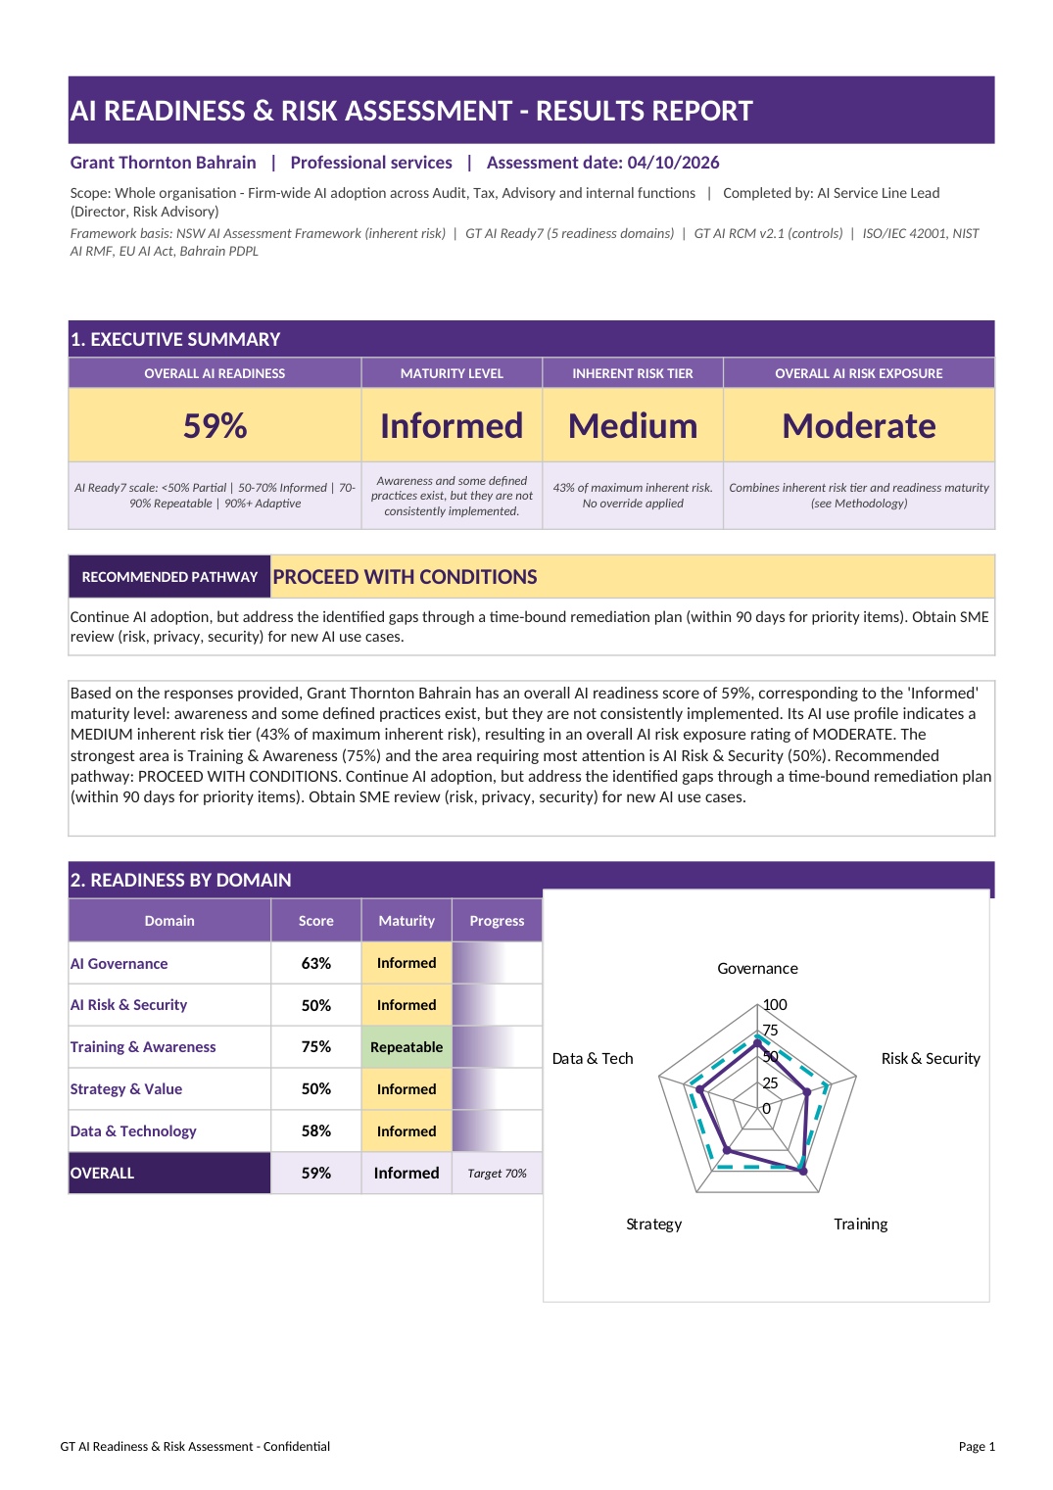
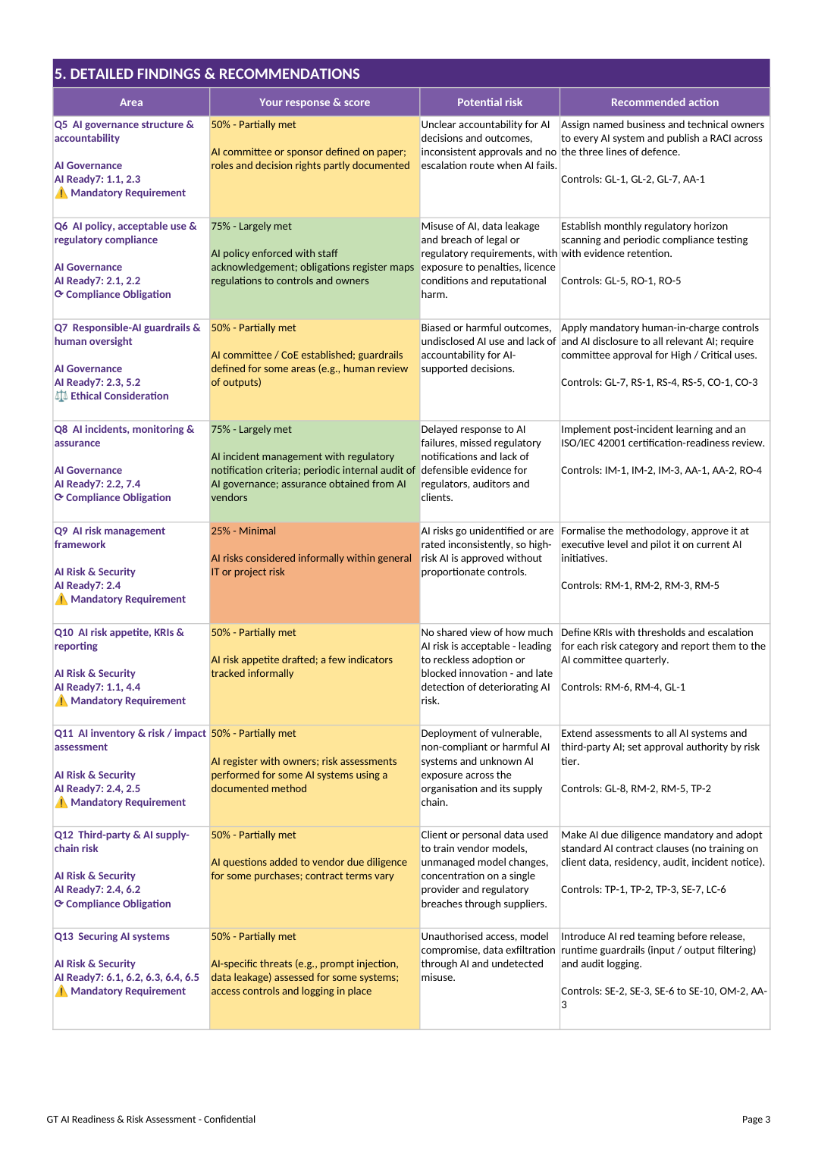
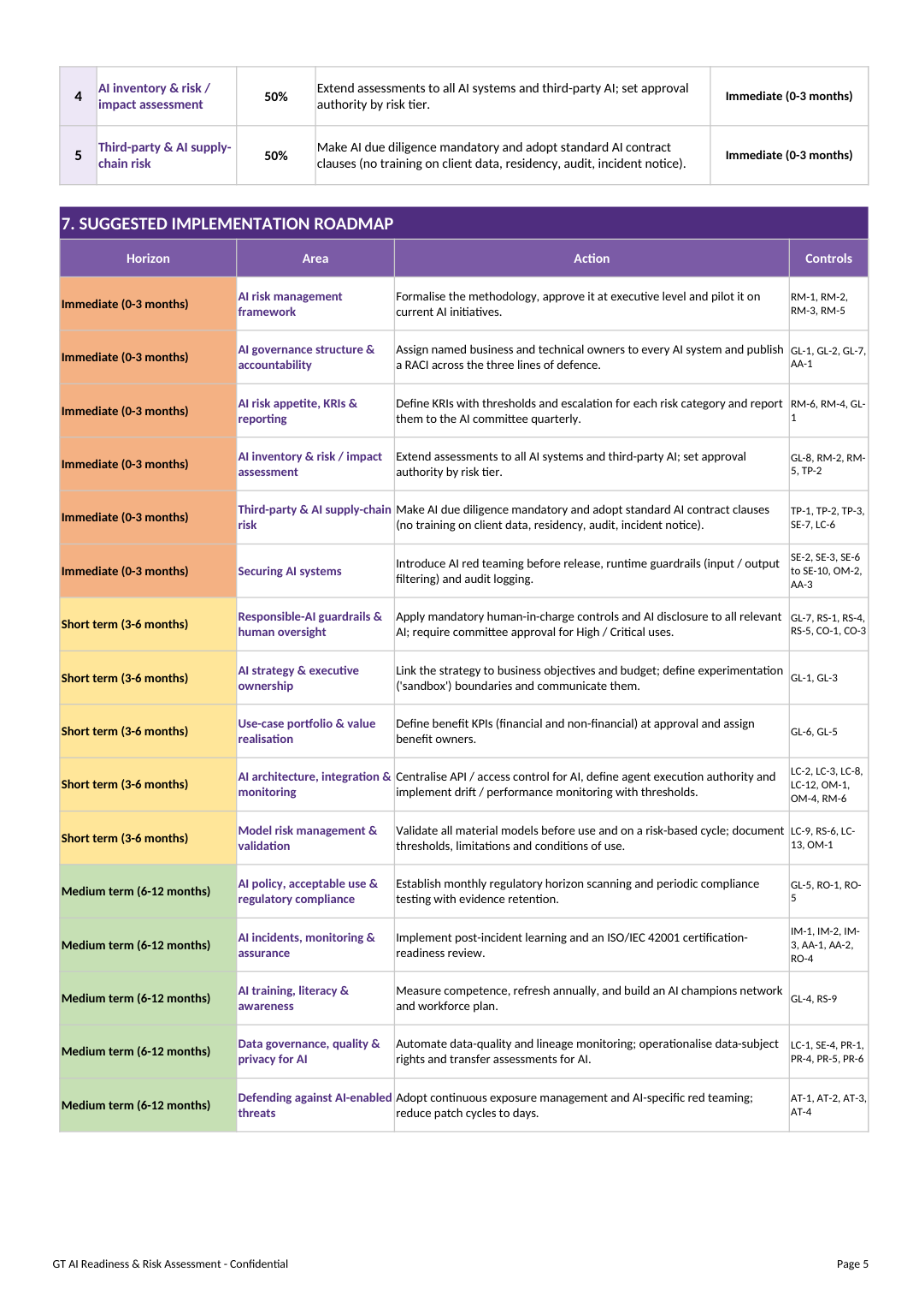
The Report - What the Client Receives
Pages from an illustrative sample report (sample answers). The full report runs to 7-9 pages.
Report sections
Executive summary & pathway
Readiness by domain (radar)
AI use & inherent risk profile
Responsible-AI principle coverage
Detailed findings & recommendations
Top-5 priority actions
Suggested roadmap
Regulatory & standards considerations
How GT can help; next steps & sign-off
Executive summary & domains
Findings & recommendations
Roadmap
9
© 2026 Grant Thornton Bahrain. All rights reserved

Slide 16
Our Own Starting Point - GT Bahrain AI Ready7 (Sept 2026)
We assessed ourselves first. GT Bahrain's AI Ready7 results by pillar, and consolidated into the five assessment domains.
Assessment domain | Ready7 pillars | Score
AI Governance | Governance & Ethics | 60%
AI Risk & Security | Protect AI Systems + Protection from AI Threats | 63%
Training & Awareness | Training & Development | 69%
Strategy & Value | Business Alignment | 50%
Data & Technology | Architecture & Technology + Data & Quality | 63%
Overall | Readiness status: Informed | 61.4%
Our priorities: Strategy & Value (50%) and AI Governance (60%) - including lifecycle AI risk assessment (Ready7 2.4) and data classification for AI (5.1), both 'Not Met'. The AI Readiness & Risk Assessment adds deeper governance and risk-management questions to measure exactly these areas.
Source: GT Bahrain AI Ready7 Result Report (Sept 2026). Domain = average of its Ready7 pillars. Coral = below 60%.
9
© 2026 Grant Thornton Bahrain. All rights reserved

Slide 17
Engagement Plan &
Deliverables
© 2026 Grant Thornton Bahrain. All rights reserved

Slide 18
Engagement Options - Report Within 5 Working Days
ESSENTIAL report by Day 5
STANDARD report by Day 5
PLUS report by Day 5
• Kick-off call
• Online questionnaire
• GT analysis and quality review
• Confidential PDF report
• 30-minute results call
• Everything in Essential
• Multi-respondent input (risk, IT, business)
• Review of key evidence provided with the questionnaire
• Leadership debrief workshop (90 min)
• Agreed 90-day action plan
• Everything in Standard
• AI inventory risk-tiering of up to 10 AI systems (GT AI Risk Assessment Framework)
• Board-ready summary
• Follow-on options (scoped separately): RCM v2.1 control review, ISO/IEC 42001 gap assessment, AI security & agent audit
Timeline (all options)
Day 1
Kick-off; questionnaire sent
Day 1-2
Client completes questionnaire
Day 3-4
GT analysis & quality review
Day 5
Report issued
Day 5
Debrief & action plan
Fees are proposed per option once scope (entities, AI systems, respondents) is confirmed. Re-assessment after 6-12 months shows progress on the same scale.
9
© 2026 Grant Thornton Bahrain. All rights reserved

Slide 19
Deliverables, Client Inputs and Standards
DELIVERABLES
FROM THE CLIENT
STANDARDS & FRAMEWORKS
• Confidential AI Readiness & Risk Assessment report (PDF) by Day 5
• Readiness by domain and overall maturity
• Inherent AI risk tier, exposure and pathway
• Findings, top-5 priorities and roadmap
• Regulatory considerations
• Debrief presentation (Standard / Plus)
• An executive sponsor and a coordinator
• Completed questionnaire by Day 2 (about 45 minutes)
• Optional evidence: AI policy, AI inventory, risk register, vendor contracts
• Availability for the debrief
• GT AI Ready7 maturity model
• NSW AI Assessment Framework
• ISO/IEC 42001, ISO/IEC 23894, ISO/IEC 42005
• NIST AI RMF 1.0
• EU AI Act; Bahrain PDPL; CBB; iGA AI Policy
• ISACA Securing AI Agents (2026); OWASP LLM Top 10
Natural next step: the GT AI Strategy & Roadmap service uses the Opportunity Discovery Toolkit to show WHERE AI fits - the readiness assessment shows HOW READY the organisation is to adopt it safely. Both can run together within the same 5 working days.
9
© 2026 Grant Thornton Bahrain. All rights reserved

Slide 20

Thank You !
© 2026 Grant Thornton Bahrain. All rights reserved

