Slide 1




AI Strategy &
Roadmap
Proposal | October 2026
Adaptive
Collaborative
Innovative

Slide 2

AGENDA
1
Context & Our Starting Point
2
Approach & Methodology
3
Engagement Plan & Deliverables

Slide 3

The Questions Every Leadership Team Is Asking
An AI strategy is only useful if it says precisely where AI creates value in this organisation - and where it does not.
Where exactly does AI fit?
Do we have the data?
Is automation enough?
Which processes, functions and decisions would genuinely benefit - beyond generic 'use ChatGPT' advice?
Is our data digital, joined-up, reliable and deep enough for AI - or do we need foundations first?
For many organisations - especially smaller ones - workflow automation, RPA and dashboards deliver most of the value at lower cost and risk.
Build, buy or partner?
What are the risks?
What do we do first?
What can we realistically run with our scale, budget and technology team?
Which uses affect customers, employees or regulators (PDPL, CBB, NHRA, TRA, EU AI Act) and what controls are required?
A prioritised roadmap with quick wins, measurable KPIs and clear ownership.
Our approach answers these with evidence: an AI position screen, a 240-entry AI use-case library, a process-by-process AI fit diagnostic and a risk-tiered roadmap - delivered within 5 working days.
3
© 2026 Grant Thornton Bahrain. All rights reserved

Slide 4
Where the Value Is - Sector Focus
AI and automation potential is highest where volumes, data and regulation meet: financial services, healthcare and telecom lead - and our library goes deepest there.
Sector | Value at stake by 2030 | Potential | Where the value is | Library entries
Banking & payments | $2.1T | 10.0% | Very high | Onboarding & KYC, financial-crime alert triage, fraud, credit, customer service, regulatory reporting | 23
Insurance | $2.1T | 10.0% (financial services) | Very high | Claims intake & settlement, claims fraud, underwriting intake, policy servicing | 17
Capital markets & wealth | $2.1T | 10.0% (financial services) | High | Reconciliations, surveillance, research, client reporting | 8
Healthcare | $5.1T | 20.7% | Very high | Revenue cycle, scheduling, documentation, coding, imaging and early warning (regulated) | 20
Telecommunications | $305B | 12.4% (technology, communications & entertainment) | Very high | Network operations (AIOps), churn, care automation, fraud, revenue assurance | 17
Government & public sector | Not sized separately | High | Citizen services, application processing, translation, records, inspections | 15
Retail & e-commerce | $2.0T | 14.8% | High | Demand forecasting, pricing, personalisation, content, service | 11
Hospitality & tourism | $2.0T | 14.8% (retail & consumer) | High | Revenue management, guest messaging, reputation, F&B waste | 10
Manufacturing & industrial | $4.0T | 11.9% | High | Predictive maintenance, quality inspection, scheduling, energy | 11
Oil, gas, energy & utilities | $1.7T | 12.0% | High | Asset integrity, inspection, load forecasting, leak detection, ESG reporting | 10
Logistics, aviation & transport | $569B | 10.3% | High | Routing, warehouse optimisation, customs documents, fleet maintenance | 9
Real estate & construction | Not sized separately | Medium | Lease abstraction, tenant service, rent collection, progress monitoring | 7
Education | Not sized separately | Medium | Student service, content, timetabling - assessment and admissions are high-risk | 7
Professional services | Not sized separately | High | Audit analytics, drafting, tax research, DD review, practice operations | 15
Plus 60 cross-industry entries (finance, HR, customer service, procurement, risk, IT ...). Source (value at stake, GDP uplift by 2030): QuantumBlack & PwC analysis (Predictions for 2030); insurance and capital markets share the financial-services figure.
4
© 2026 Grant Thornton Bahrain. All rights reserved

Slide 5
Our Starting Point - GT Bahrain AI Ready7 Position
GT Bahrain's AI Ready7 results (Sept 2026), consolidated into the five GT readiness domains, against our proposed end-2027 targets.
Domain | Ready7 | Target | Gap
AI Governance | 60% | 80% | +20
AI Risk & Security | 63% | 78% | +15
Training & Awareness | 69% | 80% | +11
Strategy & Value | 50% | 75% | +25
Data & Technology | 63% | 78% | +15
Overall readiness | 61.4% | >= 75%
What it means: GT Bahrain is 'Informed' (61.4%) - strongest in Training & Awareness (69%), weakest in Strategy & Value (50%). Knowing where AI fits and governing it is our own priority too.
Readiness vs fit: Ready7 tells us HOW READY an organisation is; the Opportunity Discovery method tells us WHERE AI FITS. A complete strategy needs both.
Source: GT Bahrain AI Ready7 Result Report (Sept 2026). Domain = average of its Ready7 pillars: Data & Technology = Architecture & Technology + Data & Quality; AI Risk & Security = Protect AI Systems + Protection from AI Threats. Maturity: <50% Partial | 50-70% Informed | 70-90% Repeatable | 90%+ Adaptive.
5
© 2026 Grant Thornton Bahrain. All rights reserved

Slide 6



Approach &
Methodology
© 2026 Grant Thornton Bahrain. All rights reserved

Slide 7
Our Methodology at a Glance
Five phases, report within 5 working days. Phase 3 - AI Opportunity Discovery - is what makes the strategy specific to the organisation.
1 Mobilise
2 Situational analysis
3 AI opportunity discovery
4 Strategy formulation
5 Roadmap & report
• Scope, sponsor, stakeholders
• Pre-work: sector, process list and documents
• Kick-off
• External scan (regulation, market, sector, technology)
• Internal scan: strategy, systems, data, current AI use
• Leadership interviews
• SWOT -> strategic options
• AI position screen (data x scale)
• Function workshops with the use-case library
• AI fit diagnostic per process
• Value, feasibility & risk scoring
• AI vision & ambition
• Objectives & KPIs
• Priority portfolio
• Build / buy / partner
• Risk appetite & guardrails
• Operating model
• H1 / H2 / H3 roadmap
• Enablers: data, platforms, people, governance
• Use-case canvases
• Report & presentation
Day 0-1
Day 1
Day 1-3
Day 3-4
Day 4-5
7
© 2026 Grant Thornton Bahrain. All rights reserved

Slide 8
Principles Behind Our Approach
What makes a GT AI strategy different from a technology wish-list.
1
Problem first, not technology first
2
Automation before AI - where it is enough
We start from processes, pain points and decisions - then choose the technology.
If rules, workflow or a dashboard solve it, we say so. AI is recommended only where it adds value that automation cannot.
3
Data decides
4
Right-sized to the organisation
Every AI recommendation passes a data gate: is the data digital, available, reliable and (for prediction) labelled?
A solution ceiling based on scale, budget and technology capacity: an SME and a bank get different answers.
5
Proportionate risk
6
Standards-based and vendor-agnostic
Each opportunity is risk-tiered (NSW AIAF, EU AI Act Annex III, PDPL, sector regulators) and carries minimum controls before go-live.
ISO/IEC 42001, 22989, 5259, 42005, NIST AI RMF, OECD, APQC - and no vendor commissions.
8
© 2026 Grant Thornton Bahrain. All rights reserved

Slide 9
Phases 1-2: Mobilise and Situational Analysis
Understand the organisation, its sector and its starting point before discussing solutions.
ACTIVITIES
PRE-WORK & TOOLS
OUTPUTS
• Kick-off with sponsor; confirm scope, objectives and success criteria
• Review strategy, IT landscape, data assets and current AI use (incl. shadow AI)
• Leadership interviews (strategy, operations, IT, risk)
• External scan: Bahrain Vision 2030, iGA AI Policy, PDPL, sector regulator (CBB, NHRA, TRA ...), EU AI Act reach, peer AI use
• SWOT -> strategic options
• Client pre-work before Day 1: sector, organisation chart, top processes and pain points, key documents
• Sector profile and value-at-stake data
• PESTLE and SWOT / TOWS templates
• AI use inventory template (incl. embedded AI in SaaS)
• Optional baseline: GT AI Readiness & Risk Assessment (20 questions, 5 domains)
• Situational analysis and SWOT
• Strategic options
• Current AI use inventory
• Readiness baseline (if selected)
9
© 2026 Grant Thornton Bahrain. All rights reserved

Slide 10
Phase 3: The GT AI Opportunity Discovery Toolkit
A structured, facilitated method that answers 'where exactly does AI fit?' - process by process - and tells the organisation where automation is enough.
1 Position
2 Discover
3 Diagnose
4 Prioritise
5 Plan
Is the organisation positioned for AI? 12 questions on DATA (digitisation, history, quality, documents, integration, outcomes) and SCALE & CAPACITY (size, volumes, IT, budget, digital channels, change capacity).
Function-by-function workshops using the GT AI Use-Case Library: 240 entries - 60 cross-industry plus 180 for 14 sectors, filtered to the client's sector.
For every process: task nature -> solution family (10 families, 5 levels), data gate, organisational fit and risk tier - plus the library's GT recommendation.
Value (volume, effort, importance, customer impact) x feasibility (data, standardisation, simplicity, fit), risk-adjusted.
Opportunity report, H1 / H2 / H3 roadmap lanes with the enabling foundations, and a one-page canvas per priority use case.
Archetype + solution ceiling
Process & pain-point inventory
Verdict + recommendation
Ranked opportunities
Report, roadmap, canvases
Not a readiness test: the toolkit locates opportunities and the right type of solution. Governance maturity is measured separately by the GT AI Readiness & Risk Assessment.
10
© 2026 Grant Thornton Bahrain. All rights reserved

Slide 11
Step 1: Organisational AI Position - Is Automation Enough?
Two scores place the organisation in one of four archetypes. Each archetype sets a ceiling on the complexity of solution it can realistically adopt today.
12 position questions
C. Buy and configure AI
Good data, limited scale / capacity: adopt and configure proven AI products rather than build.
Ceiling: level 4 - Configured AI on own data
D. Build and scale AI
Data and scale support custom AI: build a portfolio, including advanced analytics and governed agentic AI.
Ceiling: level 5 - Custom AI / agentic AI
Data position: how processes run (paper -> integrated systems); depth of digital history; data quality & ownership; where documents live; integration; recorded outcomes ('labels').
Scale & capacity: employees; transaction volumes; in-house technology skills; budget; digital interactions; capacity for change.
DATA
HIGH
A. Automation is enough - for now
Digitise and automate first; use AI that is already built into everyday tools.
Ceiling: level 3 - Off-the-shelf / embedded AI
B. Data foundations first
Scale is there but the data is not: fix data foundations while automating and adopting off-the-shelf AI.
Ceiling: level 3 - Off-the-shelf / embedded AI
DATA
LOW
Solution levels
1. Digitise / redesign
2. Automate (no AI)
3. Off-the-shelf / embedded AI
4. Configured AI on own data
5. Custom AI / agentic AI
SCALE & CAPACITY LOW
SCALE & CAPACITY HIGH
Basis: OECD Framework for the Classification of AI Systems (Economic Context; Data & Input), ISO/IEC 42001 cl. 4.1-4.2, NIST AI RMF MAP 1.3-1.6.
11
© 2026 Grant Thornton Bahrain. All rights reserved

Slide 12
Step 2: The GT AI Use-Case Library - 240 Entries
Recommendations come from a curated, standards-based library - not from a blank page. Deepest coverage where automation potential is highest.
Every entry carries
Sector & function: APQC Process Classification Framework level-1 functions
Process & typical pain point
Task nature -> solution family: ISO/IEC 22989 / OECD-based, 10 families
GT recommendation: what to implement and how - specific to the use case
Data needed & KPIs: what the data gate checks; how value is measured
Regulatory & risk notes: CBB, NHRA, TRA, NBR, PDPL, EU AI Act, model-risk, sector standards
Minimum risk tier: EU AI Act Annex III high-risk uses (credit, life & health insurance, employment, education, public assistance, emergency triage) floored at High
Example entry BNK-05 | Banking & payments | Retail credit decisioning
Recommendation: Explainable scorecard / ML credit model with policy rules, reason codes and human review of declines; bias and stability testing.
Data: Application data, bureau data, repayment history
KPIs: Decision time; default rate; approval rate by segment
Notes: HIGH-RISK: EU AI Act Annex III 5(b) creditworthiness of natural persons; CBB credit-risk rules; fair-lending; model validation.
Minimum risk tier: High
12
© 2026 Grant Thornton Bahrain. All rights reserved

Slide 13
Step 3: Diagnose - From Task to Solution
The nature of the work - not the hype - determines the solution. Each process gets one of five verdicts and the library's recommendation.
Nature of the task | Solution family | Level | AI? | Min. data
Move or re-key data between systems following fixed rules | Workflow automation / RPA | 2 | No | Partial
Check or approve items against fixed criteria (rules, thresholds, checklists) | Rules engine / workflow automation | 2 | No | Partial
Produce reports, dashboards or reconciliations from existing data | BI, dashboards & reconciliation automation | 2 | No | Digital history
Extract information from documents, forms or emails | Intelligent document processing (IDP) | 3 | Light | Partial
Draft, summarise, translate or review text | Generative AI assistant (off-the-shelf) | 3 | Yes | None
Answer questions from internal knowledge, policies or past work | GenAI knowledge assistant (RAG on own content) | 4 | Yes | Partial
Converse with customers, citizens or staff (chat, voice, WhatsApp) | Conversational AI / virtual agent | 4 | Yes | Partial
Recognise or inspect images, video or speech | Computer vision / speech AI | 4 | Yes | Partial
Forecast, score, classify or detect anomalies from historical data | Predictive analytics / machine learning | 5 | Yes | Digital history
Coordinate multi-step work across systems that needs judgement | Agentic AI (supervised agents) | 5 | Yes | Digital history
Verdict logic (in order)
Process varies by person?
Redesign / standardise first
Family needs no AI?
Automate - AI not needed
Data below the family's minimum?
AI later - close data gap first
Level above the organisation's ceiling?
Stretch - partner or later stage
Otherwise
AI fit now
Inputs per process: volume, effort (hours / month), standardisation, data availability, strategic importance, customer / quality impact, effect on individuals' rights, personal data, intended autonomy. Basis: ISO/IEC 22989, 23053, OECD AI classification, ISO/IEC 5259, ISO/IEC 42001 Annex A.7.
13
© 2026 Grant Thornton Bahrain. All rights reserved

Slide 14
Step 4: Prioritise - Value, Feasibility and Risk
Transparent scoring that leadership can challenge - and that separates quick wins from strategic bets.
VALUE (1-5)
FEASIBILITY (1-5)
INHERENT RISK TIER
30% Volume of the process
25% Effort today (staff hours / month)
25% Strategic importance
20% Customer / quality impact
30% Data fit (vs. family minimum)
25% Process standardisation
25% Solution simplicity (level 1-5)
20% Organisational fit (vs. ceiling)
+2 Affects individuals' rights or access
+1 Personal or confidential data
+0-2 Autonomy (assist / approve / automated)
+1-2 Impact of errors
Never below the library minimum tier
Strategic bets
High value, harder
Quick wins
High value, feasible
Priority = value x feasibility, reduced for High risk (-15%) and where redesign is needed first (-20%).
Horizons: H1 (0-6 months) quick wins and automation; H2 (6-12 months) strategic bets, stretch items, redesigned processes and every High-risk or agentic use case (after impact assessment and controls); H3 (12-24 months) items waiting on data foundations.
Minimum controls by tier (GT AI Risk Assessment Framework, ISO/IEC 42005, PDPL) on every canvas.
Deprioritise
Low value, harder
Fill-ins
Low value, feasible
Basis: NIST AI RMF MAP 3.1-3.2, ISO/IEC 42001 cl. 6.2, NSW AI Assessment Framework, EU AI Act Annex III, ISACA Securing AI Agents (2026).
14
© 2026 Grant Thornton Bahrain. All rights reserved

Slide 15
Illustrative Output - Bahrain Retail Bank
Worked example included with the toolkit (illustrative inputs): 25 processes selected from the banking and cross-industry library entries.
Build & scale AI
76%
8%
16%
AI position (archetype D)
Data 61% | Scale & capacity 78%
of processes: AI fit now
(IDP, ML alert triage, virtual agents)
automation is enough
(payment repairs, CBB returns)
need data or process
foundations first
# | Process / use case | Solution family | Verdict | Risk | Horizon
1 | Payment exceptions & repairs | Rules engine / workflow | Automate - AI not needed | Low | H1
2 | Sanctions & PEP screening alert review | Predictive ML | AI fit now | Medium | H2
3 | Retail customer onboarding (eKYC) | Intelligent document processing | AI fit now | High | H2
4 | Banking virtual assistant | Conversational AI | AI fit now | Medium | H1
5 | Retail credit decisioning | Predictive ML | AI fit now | High | H2
6 | Trade-finance document checking (LCs) | Intelligent document processing | AI fit now | Medium | H1
7 | IT service desk | Conversational AI | AI fit now | Low | H1
8 | Card & payment fraud detection | Predictive ML | AI fit now | High | H2
What the client learns
Highest-ranked item needs no AI at all - rules-based payment repair.
Credit decisioning and eKYC fit, but are High-risk (EU AI Act Annex III / biometrics): scheduled for H2 after impact assessment and controls.
Collections, card disputes and IFRS 9 staging fail the data gate: capture outcomes first.
Complaints handling varies by team: standardise before automating.
15
© 2026 Grant Thornton Bahrain. All rights reserved

Slide 16
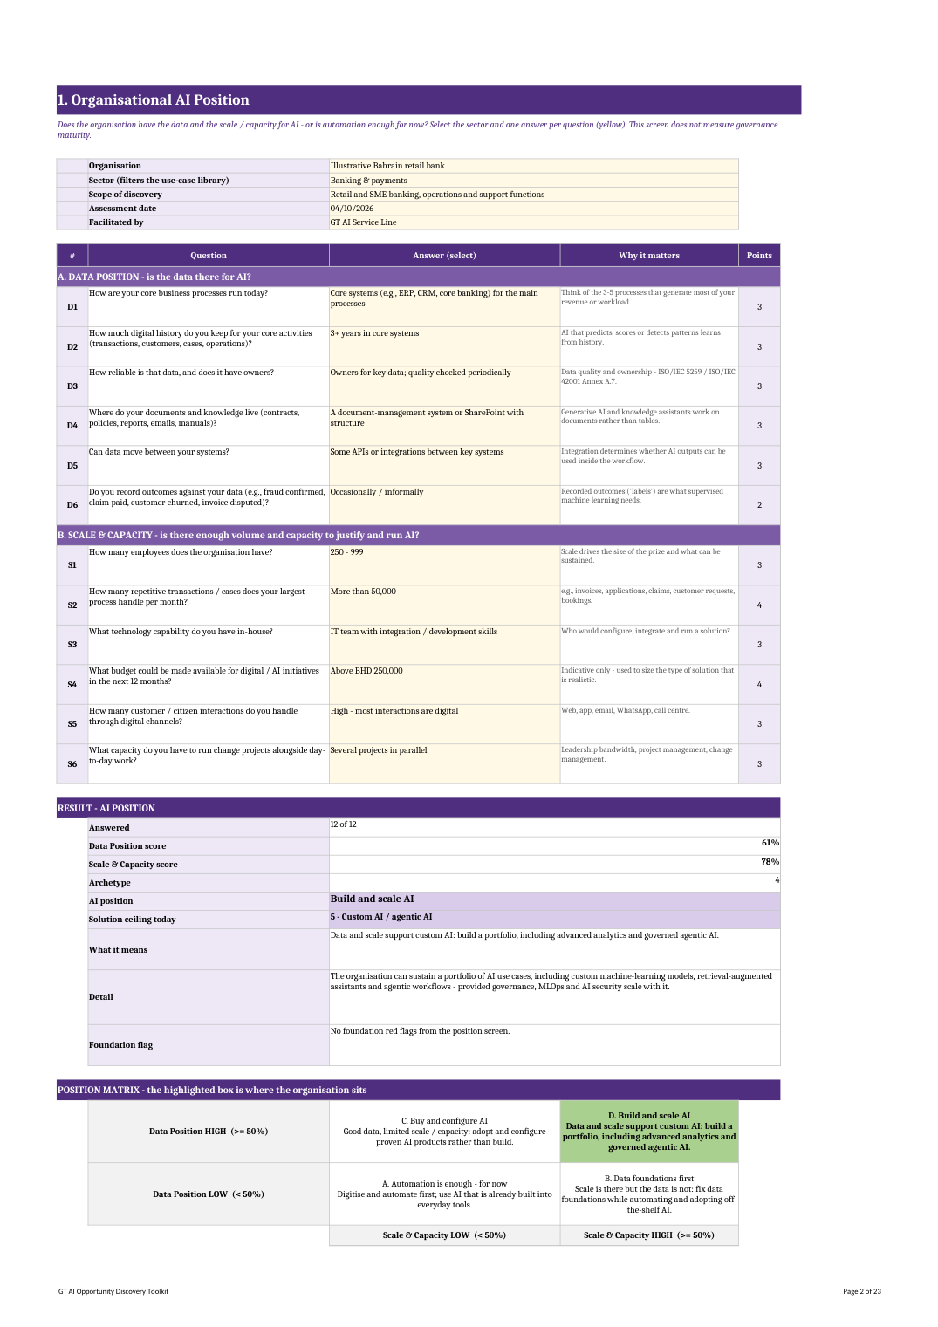
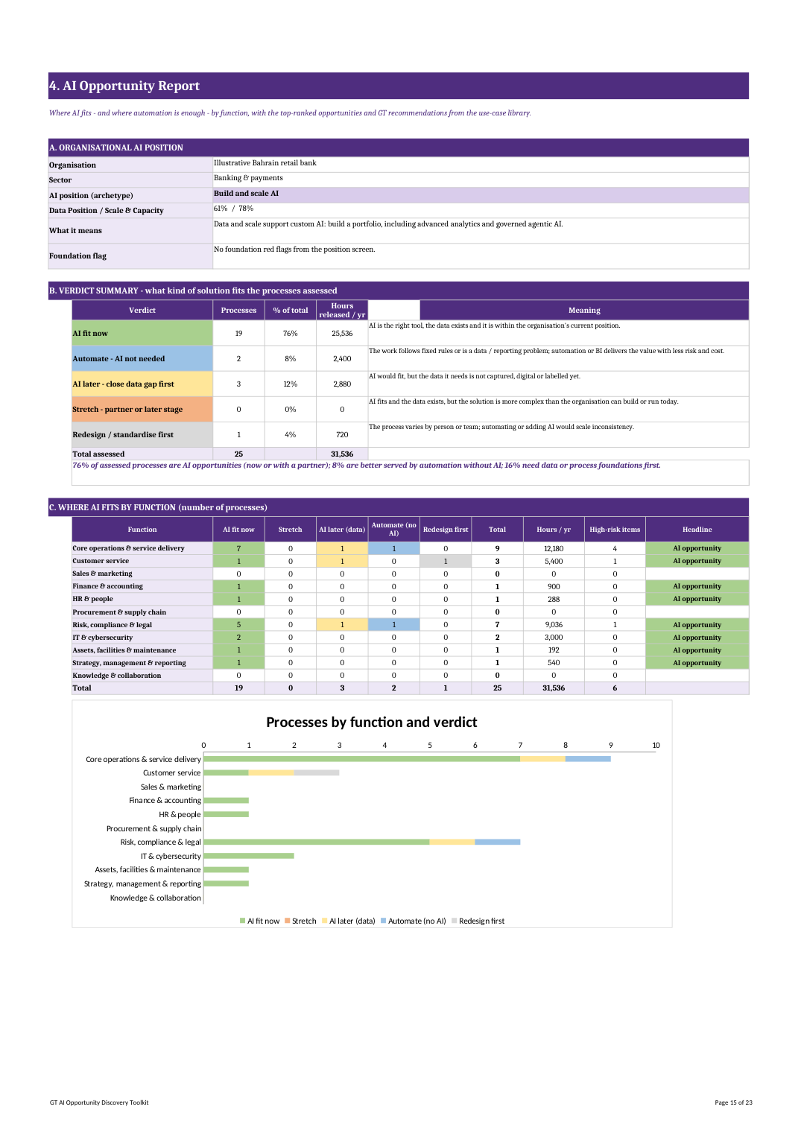
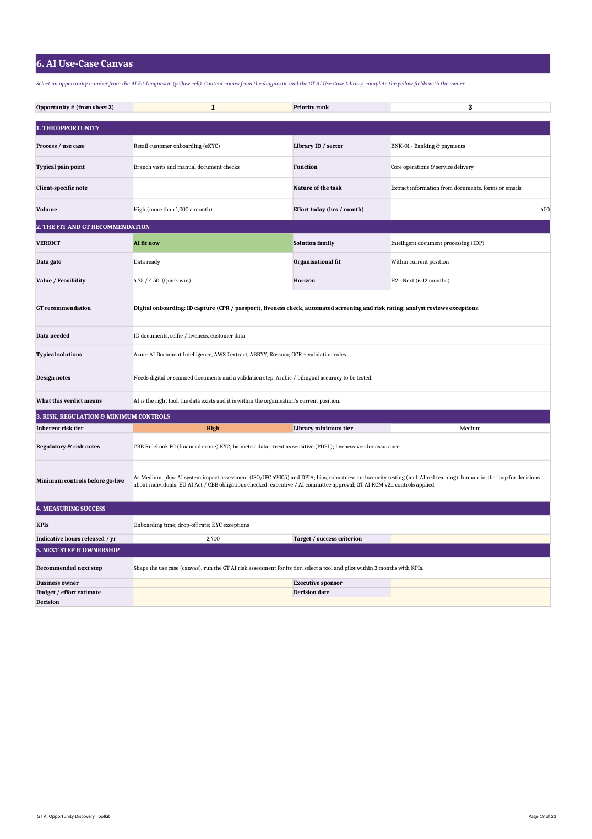
What the Client Receives from Phase 3
Illustrative pages from the retail-bank worked example.
Also delivered:
Top-10 opportunities with GT recommendations
Full AI fit diagnostic (up to 50 processes)
Roadmap lanes with enabling foundations
Sector lens and regulators
Standards appendix
Organisational AI position
AI opportunity report
Use-case canvas (one per priority)
16
© 2026 Grant Thornton Bahrain. All rights reserved

Slide 17
Phase 4: AI Strategy Formulation
The opportunity evidence becomes a strategy leadership can approve, fund and govern.
Vision & ambition
Objectives & KPIs
Priority portfolio
Build / buy / partner
Where AI will - and will not - be used; ambition consistent with the AI position archetype.
3-5 measurable objectives (ISO/IEC 42001 cl. 6.2) using the library KPIs: hours released, cycle time, quality, customer outcomes.
The ranked opportunities grouped into themes; automation programme and AI programme distinguished.
Decided per family against the solution ceiling; vendor-selection criteria (security, data residency, no training on client data).
Risk appetite & guardrails
Operating model
People & change
Data & platforms
AI risk appetite statement, acceptable-use policy, approval by risk tier, human oversight.
Executive sponsor, AI owner / CoE, decision rights, intake and stage-gates; links to existing risk and IT governance.
AI literacy for all users, role-based skills, change and communications plan.
Data foundations required by H2 / H3 opportunities; platform choices (automation, GenAI, data).
17
© 2026 Grant Thornton Bahrain. All rights reserved

Slide 18
Phase 5: Roadmap and Report
A sequenced plan the organisation can execute - with the foundations each opportunity depends on.
H1 Now (0-6 months)
Quick wins and fill-ins: automation programme, off-the-shelf GenAI under policy, first configured AI pilots.
H2 Next (6-12 months)
Strategic bets, stretch items with partners, redesigned processes, High-risk and agentic use cases once controls are in place.
H3 Later (12-24 months)
AI use cases unlocked by data foundations; scaling of proven pilots.
ENABLERS ACROSS ALL HORIZONS
Governance
AI policy, AI register, tier-based risk assessment and controls (GT AI Risk Assessment Framework)
Data
owners, quality, integration, capture of outcomes
Platforms
one automation platform; enterprise GenAI; data platform as needed
People
AI literacy, champions, change management
Value tracking
KPI dashboard, benefits realisation, quarterly portfolio review
Report delivered on Day 5: AI strategy and roadmap report, opportunity report, top-10 use-case canvases and a leadership presentation.
18
© 2026 Grant Thornton Bahrain. All rights reserved

Slide 19
Standards and Frameworks Behind the Method
Every step is traceable to recognised international guidance - giving boards and regulators confidence in the result.
Step | Standard or framework | How it is used
1 Position | OECD Framework for the Classification of AI Systems (2022) | Economic Context and Data & Input dimensions shape the position screen: scale, sector, data provenance, structure and availability.
1 Position | ISO/IEC 42001:2023 cl. 4.1 - 4.2 | Understanding the organisation, its context and interested parties before deciding where AI is used.
1 Position | NIST AI RMF 1.0 - MAP 1.3, 1.4, 1.6 | Organisational mission, business value and system requirements established before AI is selected.
2 Discover | APQC Process Classification Framework (cross-industry) | Function taxonomy of the 240-entry GT AI Use-Case Library (11 functions mapped to APQC level-1 categories).
2 Discover | Sector regulation (CBB Rulebook, NHRA, TRA, iGA AI Policy, PDPL) | Sector entries of the library carry the relevant Bahrain regulator and rule references and a minimum risk tier.
2 Discover | NIST AI RMF 1.0 - MAP 1.1 | Intended purpose, context of use and users documented for each candidate process.
3 Diagnose | ISO/IEC 22989:2022 and ISO/IEC 23053:2022 | AI concepts, tasks and ML system components - basis for the task-nature to solution-family mapping.
3 Diagnose | OECD AI classification - AI Model and Task & Output dimensions | Distinguishes recognition, detection, forecasting, personalisation, goal-driven optimisation and generation tasks.
3 Diagnose | ISO/IEC 5259 series (2024-2025) and ISO/IEC 8183:2023 | Data quality and data life cycle for analytics and ML - basis for the per-process data gate.
3 Diagnose | ISO/IEC 42001:2023 Annex A.7 (Data for AI systems) | Data acquisition, quality, provenance and preparation expected before AI is deployed.
3 Diagnose | NSW AI Assessment Framework (AIAF) | Inherent-risk questions (impact on people, autonomy, data sensitivity) behind the risk tier.
3 Diagnose | EU AI Act (Reg. 2024/1689) Art. 5, 6, 50 and Annex III | Library minimum risk tiers: high-risk uses (credit scoring, life & health insurance pricing, employment, education, public assistance, emergency triage) are floored at High; prohibited practices and transparency duties noted.
3 Diagnose | Bahrain PDPL (Law No. 30 of 2018) | Personal and sensitive data flag; lawful basis and DPIA expectations for higher-risk processing.
3 Diagnose | ISACA - Cybersecurity Recommendations for Securing AI Agents (2026); OWASP Top 10 for LLM Applications (2025) | Autonomy rating and agentic guardrails: least agency, human approval for high-impact actions, excessive-agency risk.
4 Prioritise | NIST AI RMF 1.0 - MAP 3.1, 3.2 | Expected benefits and costs (incl. of errors) weighed per use case.
4 Prioritise | ISO/IEC 42001:2023 cl. 6.2 | AI objectives that are measurable - feed the KPIs on each canvas.
5 Plan | ISO/IEC 42005:2025 and ISO/IEC 23894:2023 | AI system impact assessment and risk management for Medium / High-tier use cases before go-live.
5 Plan | ISO/IEC 5338:2023 and ISO/IEC 42001 Annex A.6 | AI system life cycle from design to retirement for each roadmap item.
5 Plan | GT AI Risk Assessment Framework | Tier-based minimum controls on each use-case canvas; control testing once in production.
Complementary | GT AI Ready7 / GT AI Readiness & Risk Assessment | Measures governance and capability maturity. Not repeated here - this toolkit asks WHERE AI fits, not HOW READY the organisation is.
19
© 2026 Grant Thornton Bahrain. All rights reserved

Slide 20
Engagement Plan &
Deliverables
© 2026 Grant Thornton Bahrain. All rights reserved

Slide 21
Engagement Plan - Report Within 5 Working Days
A focused, workshop-based engagement. Client pre-work before Day 1 keeps the timeline to five days.
Day 0
Day 1
Day 2
Day 3
Day 4
Day 5
Pre-work
Position & context
Discovery
Diagnose & prioritise
Strategy & roadmap
Report & presentation
• Kick-off call (30 min)
• Client shares sector, top processes, pain points and key documents
• Workshop invitations
• Leadership kick-off
• AI position screen (30-45 min)
• Situational scan & interviews
• First function workshops
• Function workshops with the use-case library (2-3 h each)
• Process inventory completed
• AI fit diagnostic
• Value / feasibility / risk scoring
• Validation call with sponsor
• Strategy formulation
• Roadmap lanes & enablers
• Use-case canvases
• GT quality review
• Strategy & roadmap report issued
• Leadership presentation
• Agree next steps
Client time: sponsor 30 min / day; one 2-3 hour workshop per function in scope; position screen with leadership, IT and finance; Day-5 presentation. Scope: standard scope covers up to 6 functions and 50 processes; larger groups run additional workshop days in parallel.
21
© 2026 Grant Thornton Bahrain. All rights reserved

Slide 22
Deliverables and Engagement Options
Deliverable | Format
AI strategy & roadmap report (situational analysis, strategy, roadmap) | Report (PDF) + leadership deck
Organisational AI position and opportunity report | Toolkit output (PDF)
AI fit diagnostic of in-scope processes with GT recommendations | Excel (GT AI Opportunity Discovery Toolkit)
Use-case canvases for the top 10 opportunities | One-page canvases (PDF)
Roadmap lanes, enablers and KPIs | Report section + Excel
AUTOMATION & AI SCAN report in 3 working days - SMEs
Position screen, one discovery workshop, diagnostic of up to 15 processes, opportunity report and roadmap lanes. Answers: is automation enough?
AI STRATEGY & ROADMAP report in 5 working days - standard
All five phases, up to 6 functions / 50 processes, strategy, roadmap and top-10 canvases.
STRATEGY + READINESS both reports in 5 working days
Fees are proposed per option once scope (entities, functions, locations) is confirmed. Implementation support is scoped separately.
Standard scope plus the GT AI Readiness & Risk Assessment (questionnaire completed as pre-work) - where AI fits AND how ready the organisation is.
22
© 2026 Grant Thornton Bahrain. All rights reserved

Slide 23
Why Grant Thornton Bahrain
Strategy, governance, risk, cyber and assurance under one roof - with proprietary tools and the GT global network.
Practise what we advise
GT Bahrain assessed its own AI readiness with AI Ready7 (Sept 2026) and uses the results to set its own priorities.
GT AI tools and apps
Tool / app | Status
GT AI Opportunity Discovery Toolkit (240-entry library) | Available
GT AI Readiness & Risk Assessment (20 questions, 5 domains) | Available
GT AI Security & Agent Audit Checklist | Available
GT AI Risk Assessment Framework & Toolkit | Available
AI-powered BCP tool | In preparation
AI-powered Financial Statements tool | In preparation
Client AI self-assessment portal | Planned
Trusted and regulation-ready
Audit, GRC and cyber heritage; Bahrain PDPL, CBB, iGA AI Policy and EU AI Act mapped into the GT AI Risk Assessment Framework.
Honest about automation
We recommend AI only where it beats automation - protecting budgets and reducing risk.
Sector depth
A 240-entry use-case library with the deepest coverage in banking, insurance, healthcare and telecom.
End-to-end AI service lines
AI Strategy & Roadmap | AI Governance, Risk & Compliance | AI-Driven Automation & Apps | Training & Awareness.
The AI-powered BCP tool and AI-powered Financial Statements tool are in preparation and are not yet available to clients.
23
© 2026 Grant Thornton Bahrain. All rights reserved

Slide 24

Thank You !
© 2026 Grant Thornton Bahrain. All rights reserved

