Slide 1
Amazon Sales Performance
& Data Analytics Project
Created By: Mahek Khan
Domain: E-Commerce Analytics | Data Analysis | Business Intelligence

Slide 2
INTRODUCTION
- Amazon generates a massive volume of sales data through daily online transactions.
- Analyzing this data helps businesses understand customer buying behavior, revenue trends, and product demand.
- This project demonstrates data cleaning, preprocessing, and visualization using real e-commerce data.
- Insights derived from this project can assist in improving sales strategy, operational efficiency, and customer satisfaction.

Slide 3
Objectives
- To understand sales performance using real transaction data
- To identify top-performing states, cities, and product categories
- To analyze revenue trends and order distribution
- To compare Amazon-fulfilled and Merchant-fulfilled orders
- To detect missing values and perform proper data cleaning
- To derive key business insights through Exploratory Data Analysis (EDA)

Slide 4
Skills & Tools Used
1. Python
2. Pandas
3. NumPy
4. Matplotlib
5. Seaborn
6. Data Cleaning
7. Exploratory Data Analysis (EDA)
8. Data Visualization

Slide 5
Dataset Description
- Dataset Name: Amazon Sales Report Dataset
- Records: 128,975
- Features (Columns): 24
- Target Variable / Key Metric: Amount (Order Value in INR)
Description:
- The dataset used in this project is the Amazon Sales Report dataset.
- It contains multiple transaction records with details such as Order ID, Order Status, Sales Amount, Shipping Details, Fulfillment Method, etc.

Slide 6
Key Attributes
- Order Details: Order ID, Date, Status
- Fulfillment & Sales: Fulfilment type (Amazon/Merchant), Sales Channel, Amount, Currency
- Shipping Info: Ship-city, Ship-state, Ship-postal-code, Ship-country, Ship service level
- Product Info: Style, SKU, Category, Promotion IDs
- Customer & Business: B2B or Retail, Fulfilled by
- Miscellaneous: Unwanted column

Slide 7
Total Revenue Generated
ANALYSIS:
- The total revenue gives an overview of the overall performance of Amazon sales.
- A high total revenue indicates strong demand across multiple product categories and regions.
- Helps businesses understand the scale of operations and total monetary inflow from customer orders.
CONCLUSION:
- Amazon generates substantial revenue from its online platform.
- This metric can help identify overall business growth and assess the effectiveness of sales strategies.
- Key for management decisions on marketing, inventory, and fulfillment planning.

Slide 8
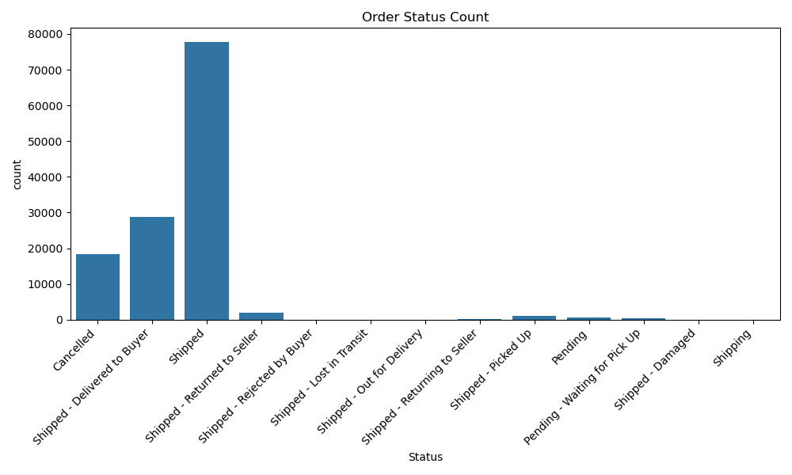
Order Status Distribution
ANALYSIS:
- Counted orders under each status and plotted a bar chart.
- Helps identify proportion of delivered, cancelled, or returned orders.
CONCLUSION:
- Most orders are successfully delivered/shipped.
- Cancelled and returned orders are minimal, indicating good fulfillment performance.

Slide 9
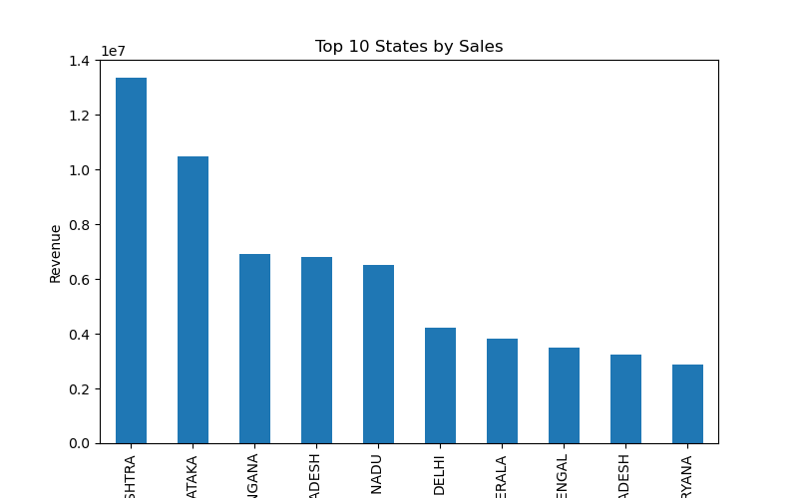
Top 10 States by Sales
ANALYSIS:
- Summed sales Amount for each state and sorted top 10.
- Reveals which regions contribute most to revenue.
Conclusion:
- Few major states contribute the highest revenue.
- Useful for targeted marketing and inventory planning.

Slide 10
Top 10 Cities by Revenue
ANALYSIS:
- Aggregated total sales per city and identified top 10.
- Highlights urban areas driving maximum revenue.
CONCLUSION:
- Metro cities generate the most revenue.
- Helps prioritize logistics, marketing, and resource allocation.

Slide 11
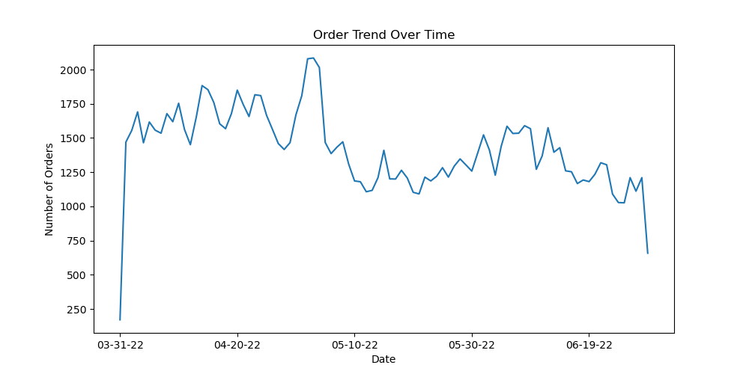
Order Trend Over Time
ANALYSIS:
- Grouped orders by Date and counted number of orders daily.
- Plotted line chart to visualize trends.
Conclusion:
- Orders fluctuate daily with some peak and low days.
- Indicates seasonal or campaign-driven trends.

Slide 12
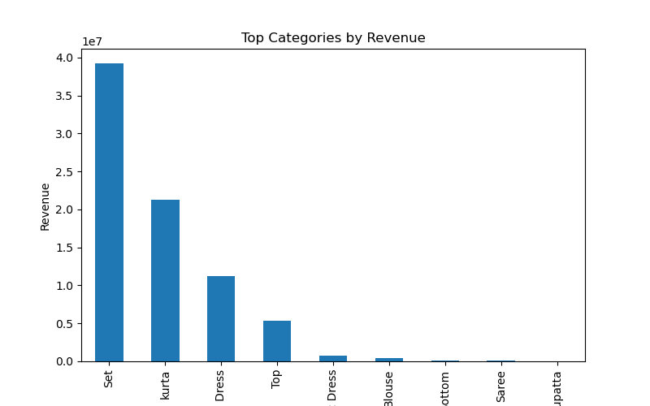
Top Product Categories by Sales
ANALYSIS:
- Summed sales for each product category and plotted top performers.
- Identifies high-demand product categories.
CONCLUSION:
- Few product categories perform much better than others.
- Useful for inventory and promotional focus.

Slide 13
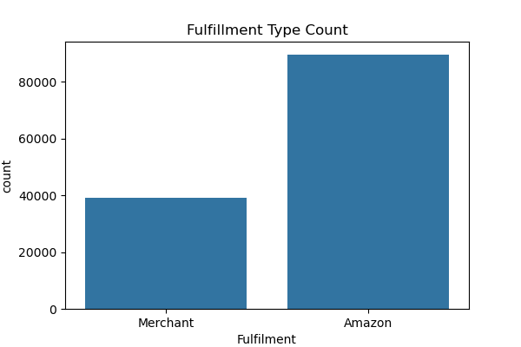
Fulfillment Type Count & Revenue
ANALYSIS:
- Compared Amazon-fulfilled and Merchant-fulfilled orders in terms of count and revenue.
CONCLUSION:
- Amazon-fulfilled orders generally perform better overall.
- Important for choosing fulfillment strategies.

Slide 14
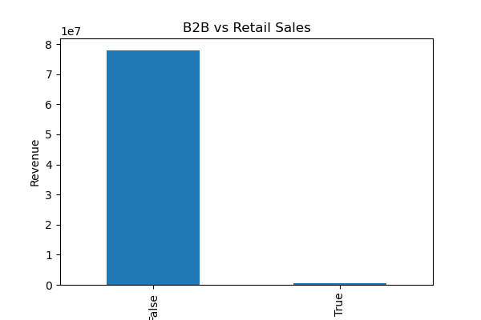
B2B vs Retail Sales
ANALYSIS:
- Separated B2B and retail orders and compared sales revenue.
CONCLUSION:
- Retail (B2C) orders dominate over B2B.Useful for prioritizing B2C strategies and offers.

Slide 15
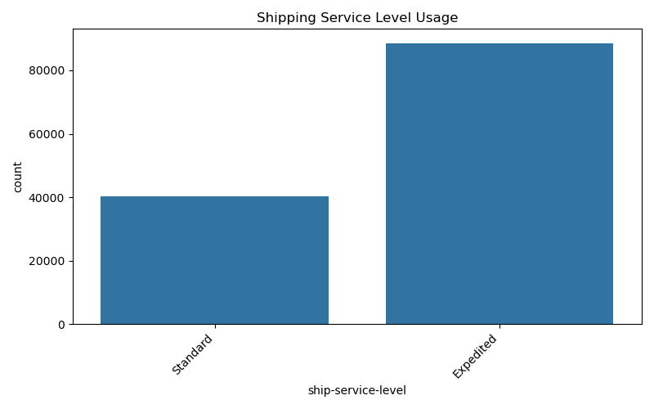
Most Used Shipping Service Level
ANALYSIS:
- Counted frequency of each shipping service level.
- Visualized to understand shipping preferences.
CONCLUSION:
- Standard shipping is most frequently used.
- Helps plan logistics and delivery timelines efficiently.

Slide 16
Highest Order Amount
Analysis:
- The highest order amount represents the largest single transaction in the dataset.
- Shows which transactions have unusually high value, potentially for premium or bulk purchases.
- Important for spotting high-value customers or special deals that contribute significantly to revenue.
Conclusion:
- While most orders are in the small to medium price range, high-value transactions can have a significant impact on overall revenue.
-This insight helps in tailoring premium offers or loyalty programs for high-value customers.

Slide 17
Final Conclusion
- This project cleaned and structured the Amazon sales dataset, applied data visualization, and extracted actionable business insights.
- The analysis helps e-commerce businesses improve sales strategy, fulfillment efficiency, and customer targeting. It also demonstrates valuable Data Analytics skills using Python, Pandas, and visualization tools.

