Slide 1

DisasterLens
AI-Assisted Multimodal Triage for Disaster Relief
Mahek Nagdev & Pratyusha Jaitly
CS6140, Machine Learning | Final Project Presentation
Notes:
TITLE CARD. Do not narrate this slide. Start talking the instant recording begins, over this card, with the opening line of the Introduction (next slide's notes). Jump straight into content, no 'today I will present...' framing.

Slide 2


INTRODUCTION
When disaster strikes, minutes matter
Relief teams are flooded with hundreds of photos and text reports from the field and social media, all at once. Responders have minutes, not hours, to tell a collapsed building with people trapped apart from routine news commentary.
+
Today, this triage is still done by hand.
DisasterLens reads an image and a text report together, estimates severity and specific resource needs (food, water, shelter, medical) and plots it on a map, so responders can prioritize where to send help first.
Priority triage
in seconds
2 / 11
Notes:
When a major earthquake or flood hits, relief teams are flooded with hundreds of photos and text reports from the field and social media, all at once. Aid workers have minutes, not hours, to figure out which reports describe collapsed buildings and trapped people, and which are routine commentary. Today, that triage is still done by hand. DisasterLens is a multimodal system that reads an image and a text report together, estimates severity and specific resource needs like food, water, shelter, and medical care, and plots it on a map, so responders can prioritize where to send help first.

Slide 3

RELATED WORK
Two ideas we build directly on
AIDER
CrisisMMD
Kyrkou & Theocharides, 2019
Alam, Ofli & Imran, 2018
Showed a lightweight CNN can classify aerial disaster imagery into damage categories in real time for drone-based response, proof that vision alone can carry a useful severity signal.
Established that tweets posted during disasters carry independently useful image and text signals, the basis for treating vision and language as separate, comparable channels instead of one blended input.
3 / 11
Notes:
Our approach builds on two lines of work: AIDER, which showed that a lightweight CNN can classify aerial disaster imagery into damage categories in real time for drone-based response, and CrisisMMD, which established that tweets posted during disasters carry independently useful image and text signals. We combine both ideas: image-based severity and text-based resource extraction, fused into one decision.

Slide 4
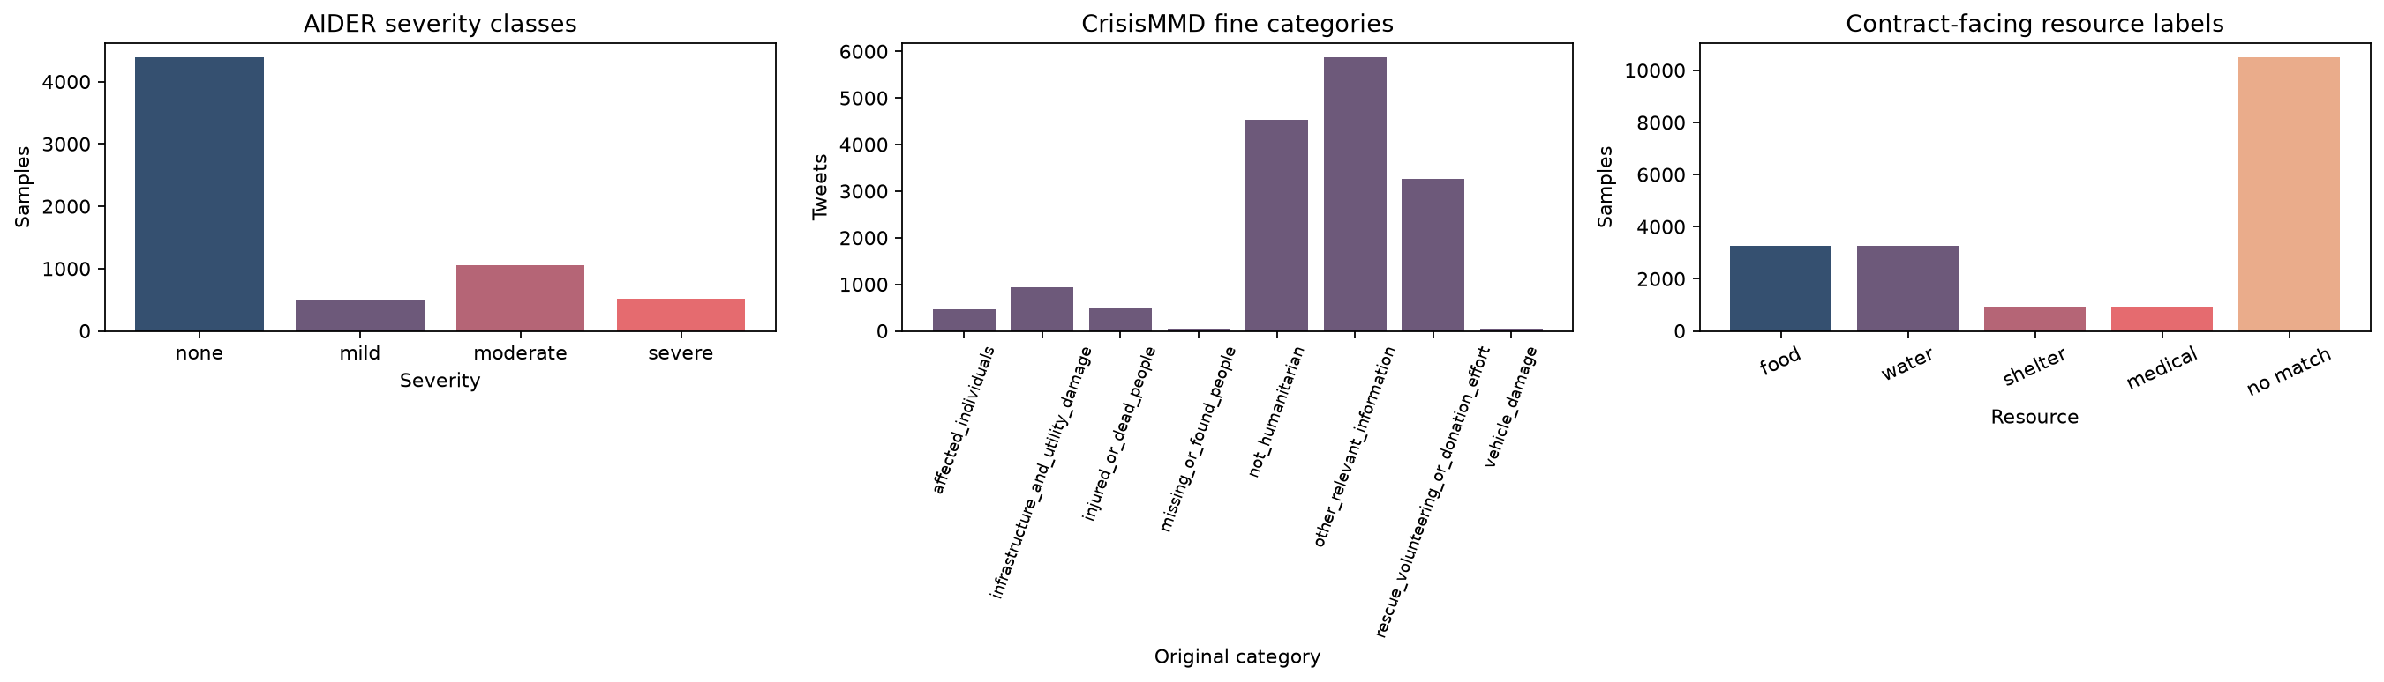
DATA & FEATURES
Two datasets, two heavily imbalanced label spaces
6,433
AIDER aerial images
16,058
unique CrisisMMD tweets
500
row image-text conflict fixture
Dataset | Train | Val | Test
AIDER (severity) | 5,144 | 642 | 647
CrisisMMD (resources) | 12,506 | 1,561 | 1,570
4 / 11
Notes:
We used two public datasets. AIDER contributes 6,433 aerial images, remapped from damage categories into four severity levels: none, mild, moderate, and severe. CrisisMMD contributes over sixteen thousand tweets across seven disasters, labeled into eight humanitarian categories, which we map onto four resource needs. Both datasets are heavily imbalanced, so we used macro-averaged metrics and class-weighted loss rather than trusting raw accuracy. Each dataset was split into deterministic 80/10/10 train, validation, and test partitions, shown here, and we built a five-hundred-row conflict fixture with real cases where the image and text disagree, to test how fusion behaves when signals don't match.

Slide 5


METHODS: VISION
Linear probing on a frozen CLIP encoder
Aerial
image
Frozen CLIP
encoder
Trainable
linear head
Severity
(4 classes)
The pretrained backbone stays frozen: only a small 512→128→4 classification head is trained. This keeps training cheap and appropriate for AIDER's comparatively small size, while still leveraging CLIP's broad visual pretraining instead of learning image features from scratch.
5 / 11
Notes:
For vision, we froze a pretrained CLIP image encoder and trained only a small linear classification head on top, mapping its 512-dimensional embedding to our four severity classes. Freezing the backbone kept training cheap and appropriate for AIDER's comparatively small size, while still leveraging CLIP's broad visual pretraining rather than learning image features from scratch.

Slide 6




METHODS: TEXT & FUSION
Two text signals, fused with an explicit policy
RoBERTa
LLM Extractor
Vision
fine-tuned, class-weighted
Gemini structured output
CLIP severity
Conflict policy: when signals disagree, favor whichever indicates greater urgency.
Fusion
layer
Final severity + resource vector + summary
6 / 11
Notes:
For text, we run two signals side by side: a RoBERTa classifier fine-tuned with class-weighted loss on CrisisMMD's eight categories, and a general-purpose LLM that extracts population estimates, resource needs, and locations directly from free text. A fusion layer combines the vision severity with both text signals into a final severity, a resource-need vector, and a plain-language summary. When signals disagree, say a moderate image paired with an urgent report, the policy explicitly favors whichever signal indicates greater urgency, rather than averaging them away.

Slide 7
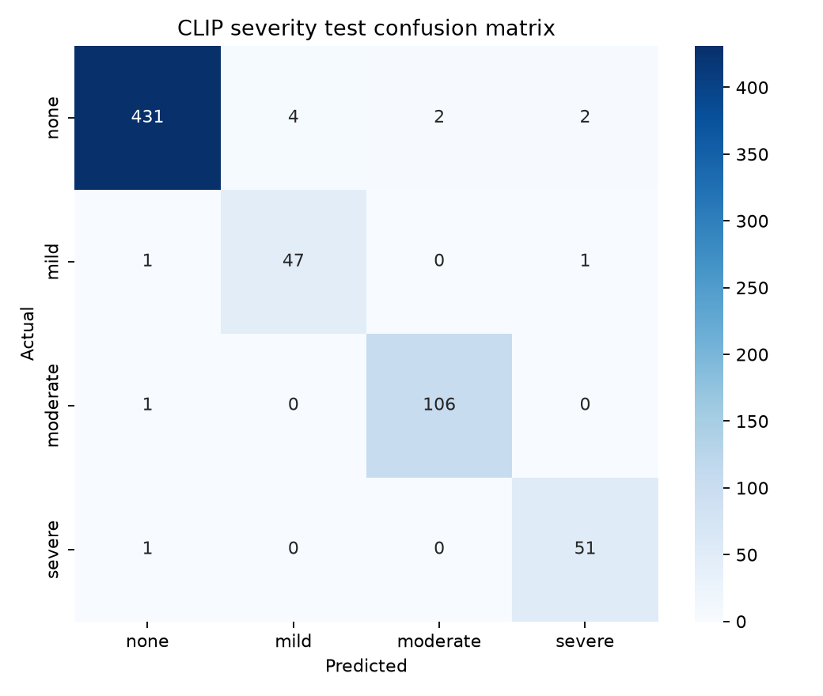
RESULTS: VISION
The severity classifier is highly reliable
98.15%
0.969
test accuracy, 647 held-out images
macro-F1 across 4 severity classes
Severity | Precision | Recall | F1
None | 0.993 | 0.982 | 0.987
Mild | 0.922 | 0.959 | 0.940
Moderate | 0.982 | 0.991 | 0.986
Severe | 0.944 | 0.981 | 0.962
Almost every confusion falls to a neighboring severity level, not a random error: the model's mistakes are the kind a human would also plausibly make.
7 / 11
Notes:
On the vision side, the CLIP classifier reached 98.15% accuracy and a 0.97 macro-F1 on 647 held-out AIDER images, with almost every confusion limited to neighboring severity levels rather than random errors.

Slide 8
RESULTS: TEXT
An honest negative result, and why we kept two signals
52.74%
0.275
Why it's not fatal
RoBERTa test accuracy
macro-F1, 8 categories
CrisisMMD's category labels don't map cleanly onto our four resource needs, a genuine taxonomy mismatch, not a bug.
On a report explicitly asking for food, RoBERTa missed it entirely, while our LLM-based extractor caught it correctly. That's exactly why the pipeline keeps a second, independent text signal instead of relying on RoBERTa alone.
Resource | F1 | Note
Food | 0.587 | shares source category with water
Water | 0.587 | shares source category with food
Medical | 0.414
Shelter | 0.021 | P = 1.00, R = 0.01: almost never predicted
8 / 11
Notes:
Text told a more honest story. RoBERTa reached only 52.74% accuracy and a macro-F1 of just 0.275 on the rarest categories, because CrisisMMD's labels don't map cleanly onto our four resource needs. That's exactly why we kept a second, LLM-based text signal: on a report explicitly asking for food, RoBERTa missed it entirely, while the LLM extractor caught it correctly.

Slide 9


RESULTS: HUMAN AGREEMENT
Urgency isn't labeled, so we measured it directly
Human – human (39-tweet sample, blind, independent)
Humans agree strongly on what “urgency” means for a given tweet.
The deterministic category-level rubric is a useful, honest approximation of that shared judgment, not a replacement for it.
92.31%
κ = 0.881
exact agreement
linear-weighted kappa
Deterministic proxy rubric vs. each human rater
58.97%
56.41%
vs. rater 1 (exact match)
vs. rater 2 (exact match)
9 / 11
Notes:
We also had to evaluate urgency itself, which isn't directly labeled in either dataset. So we built a deterministic proxy rubric, then had both of us independently rate the same 39-tweet sample. We agreed with each other on over 92% of examples, a Cohen's kappa of 0.88, confirming we share a consistent sense of urgency. But the deterministic rubric only matched each of us around 58% of the time, showing it's a useful approximation, not a ground truth.

Slide 10
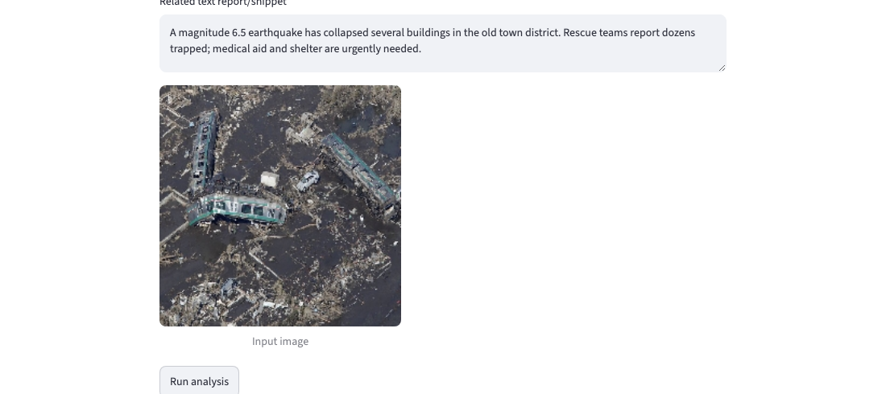
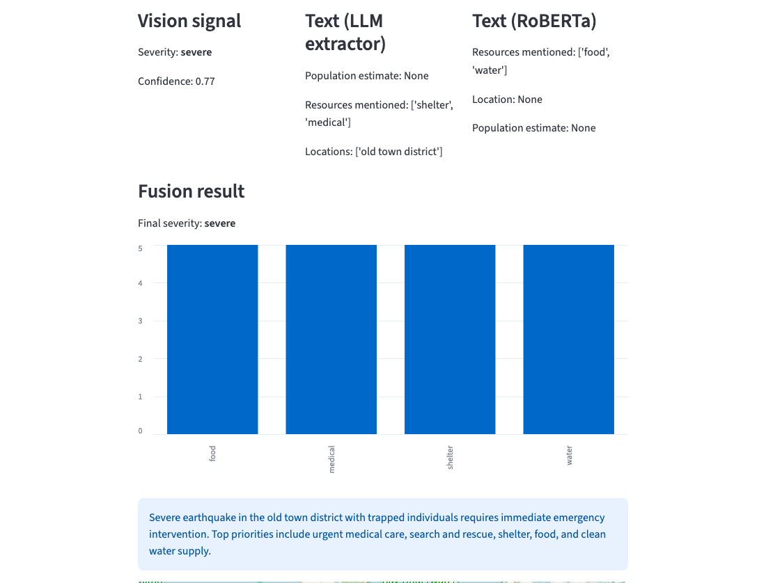

DEMO
DisasterLens, end to end
Input: aerial image + text report
A geocoded map marker shows responders exactly where to go.
Vision + two text signals → fused severity & resource priorities
10 / 11
Notes:
SWITCH TO LIVE SCREEN RECORDING OF THE RUNNING STREAMLIT APP HERE if possible. This slide is the fallback visual. Narration: Here's DisasterLens running end to end. We feed in an aerial image of a collapsed building alongside a text report describing trapped residents. Vision flags severe. The LLM extractor picks up the medical and shelter mentions and the affected location. RoBERTa independently flags food and water. The fusion layer combines all three into a final severe rating, a resource chart prioritizing medical care first, a plain-language summary, and a geocoded map marker showing responders exactly where to go.

Slide 11

Small, independently-trained parts. One clear fusion policy.
A fine-tuned vision classifier and a fine-tuned text classifier, each trained cheaply on its own dataset.
A general-purpose LLM orchestrating extraction and fusion, with an explicit conflict policy instead of a black box.
A human-verified urgency rubric, honest about where it's a strong approximation, not ground truth.
Thank you
github.com/maheknagdev/disasterlens
Notes:
DisasterLens shows that a fast, working relief-triage pipeline doesn't require training one giant multimodal model. It can be assembled from a small fine-tuned vision classifier, a fine-tuned text classifier, and a general-purpose LLM, fused with an explicit, defensible policy for when those signals disagree. Thank you.

