Slide 1
GANs
Mahek Vora

Slide 2
Generative Adversarial Network
Made of 2 neural nets : Discriminator (D) and Generator (G)
Discriminator (D) :
The net that has to undergo training.
It is the classifier that will do the heavy lifting during the normal operation once the training is complete.
Generator (G):
It is tasked to generate random samples that resemble real samples with a twist rendering them as fake samples.

Slide 3
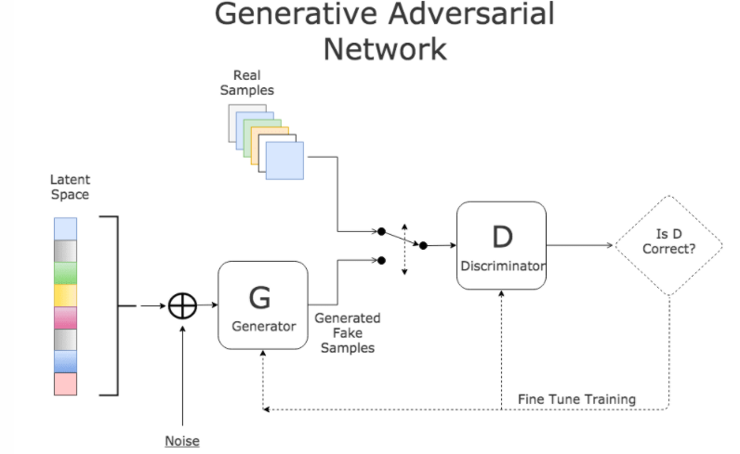
Structure

Slide 4
Training
D is presented with a random mix of legitimate images from training data as well as fake images generated by G.
D’s task is to identify correct and fake inputs.
Based on the outcome, both machines try to fine-tune their parameters and become better in what they do.

Slide 5
[If D makes the right prediction, G updates its parameters in order to generate better fake samples to fool D.
If D’s prediction is incorrect, it tries to learn from its mistake to avoid similar mistakes in the future.]
The reward for net D is the number of right predictions and the reward for G is the number D’s errors.
This process continues until an equilibrium is established and D’s training is optimized.

Slide 6
About the model:
Research paper:
https://arxiv.org/pdf/1406.2661v1.pdf
Code:
https://github.com/goodfeli/adversarial
Trained on MNIST, the Toronto Face Database (TFD), and CIFAR-10

