Slide 1
Resnet
Mahek Vora 23-01-22
A residual network to tackle vanishing gradients

Slide 2
Points covered
Shortcomings of Traditional CNN models
Residual blocks-The solution
Resnet Architecture
Origin/source of Resnet architecture

Slide 3
Traditional CNN models
It has been found that there is a maximum threshold for depth with the traditional Convolutional neural network model
This is attributed to the vanishing gradients problem
Vanishing gradients problem:As more layers using certain activation functions are added to neural networks, the gradients of the loss function approaches zero, making the network hard to train.
Encountered with gradient based learning methods & back propagation
Cause:Certain activation functions, like the sigmoid function, squishes a large input space into a small output space between 0 and 1. Therefore, a large change in the input of the sigmoid function will cause a small change in the output. Hence, the derivative becomes small.
image shows training under CNN for 20vs 56 layers
Remedy:Residual networks

Slide 4
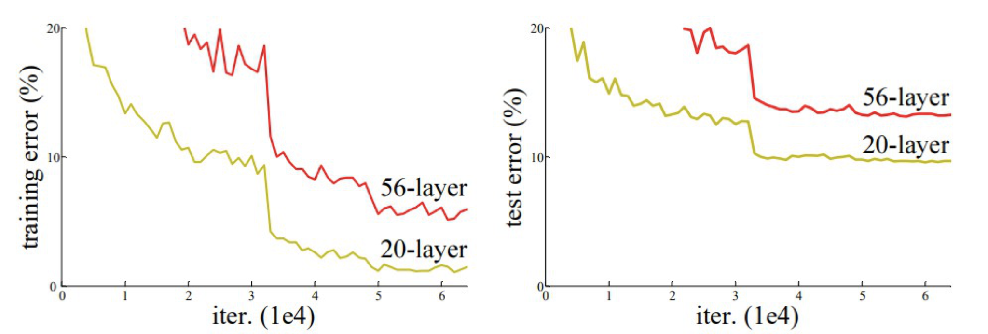

Slide 5
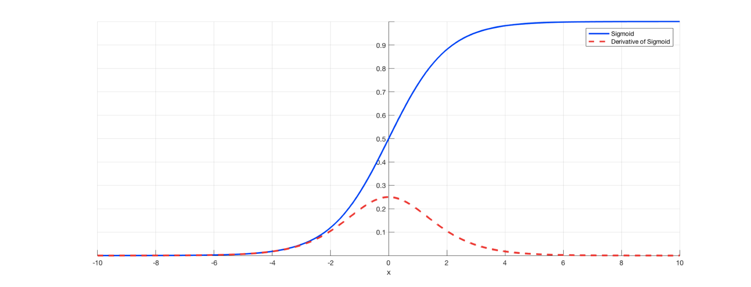
Sigmoid vs its derivative

Slide 6
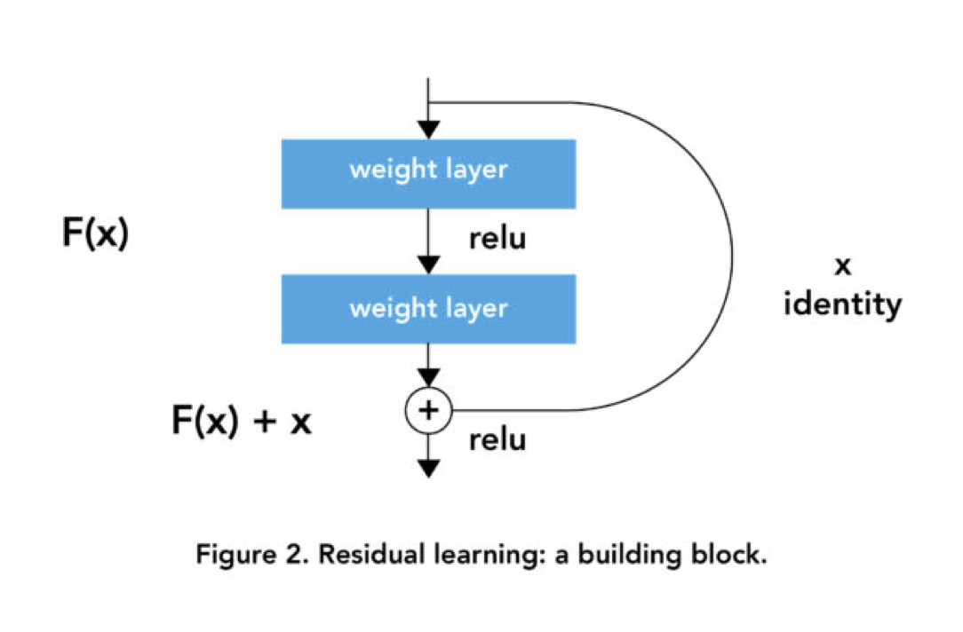
Residual blocks
Residual blocks have a skip connection,
Without them
H(x)=f(wx + b)
or H(x)=f(x)
With the introduction of skip connection, the output is changed to
H(x)=f(x)+x
The projection method is used to match the dimension which is done by adding 1×1 convolutional layers to input. In such a case, the output is:
H(x)=f(x)+w1.x

Slide 7
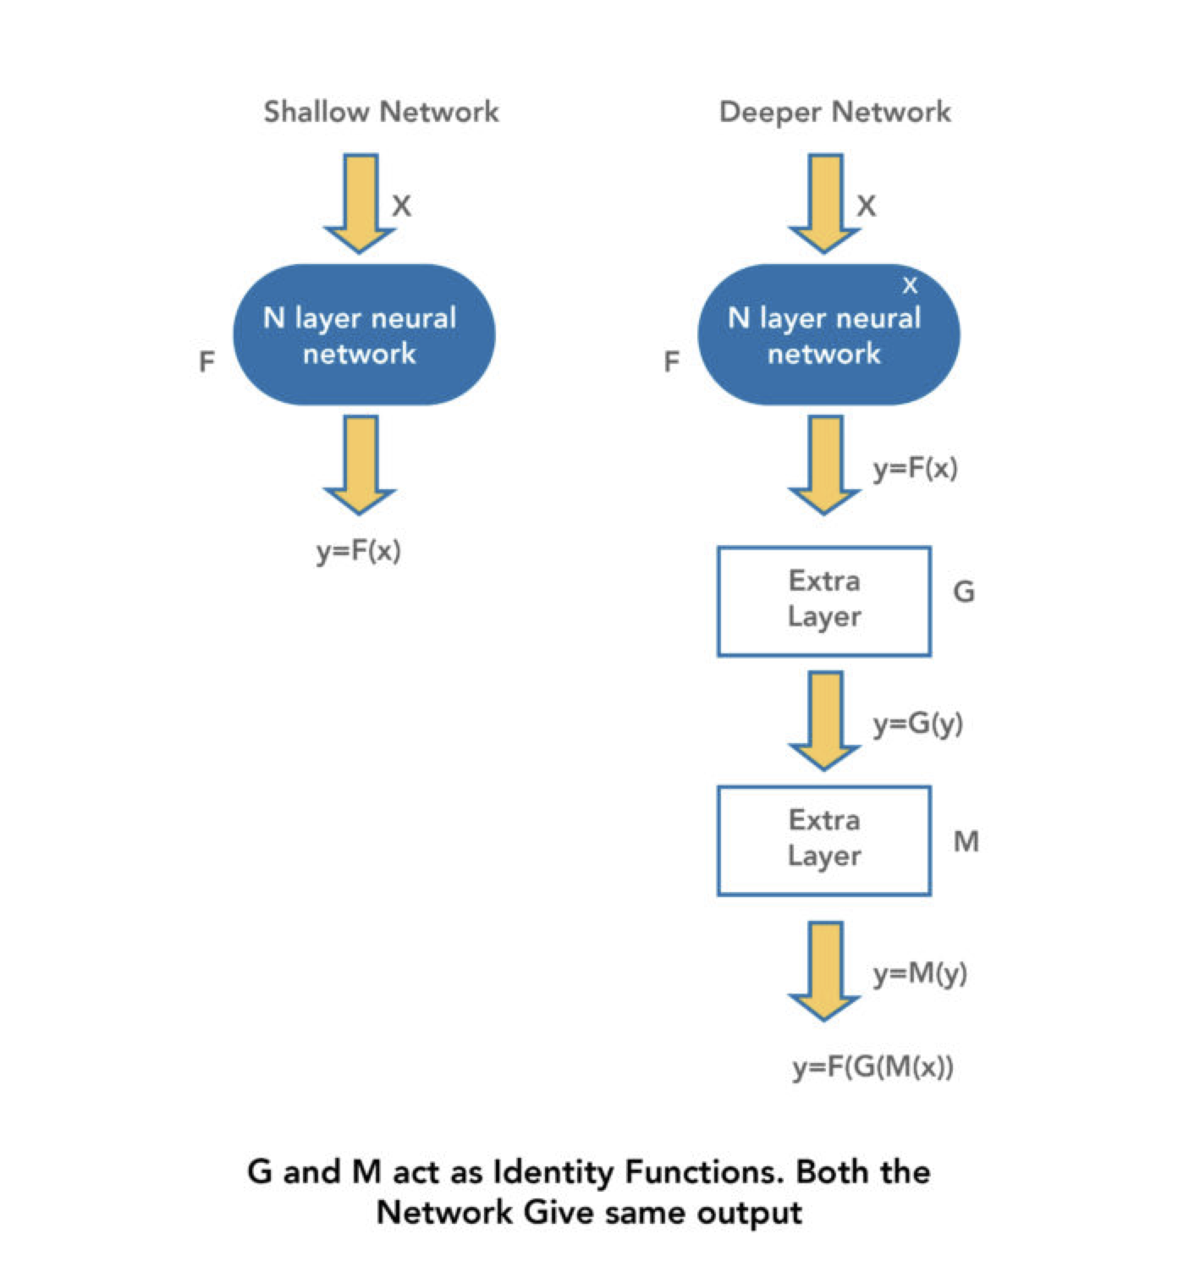
How does the skip connection help?
The skip connections in ResNet solve the problem of vanishing gradient in deep neural networks by allowing this alternate shortcut path for the gradient to flow through
It also allows the model to learn the identity functions which ensures that the higher layer will perform at least as good as the lower layer, and not worse (when f(x)=0, H is identity)

Slide 8
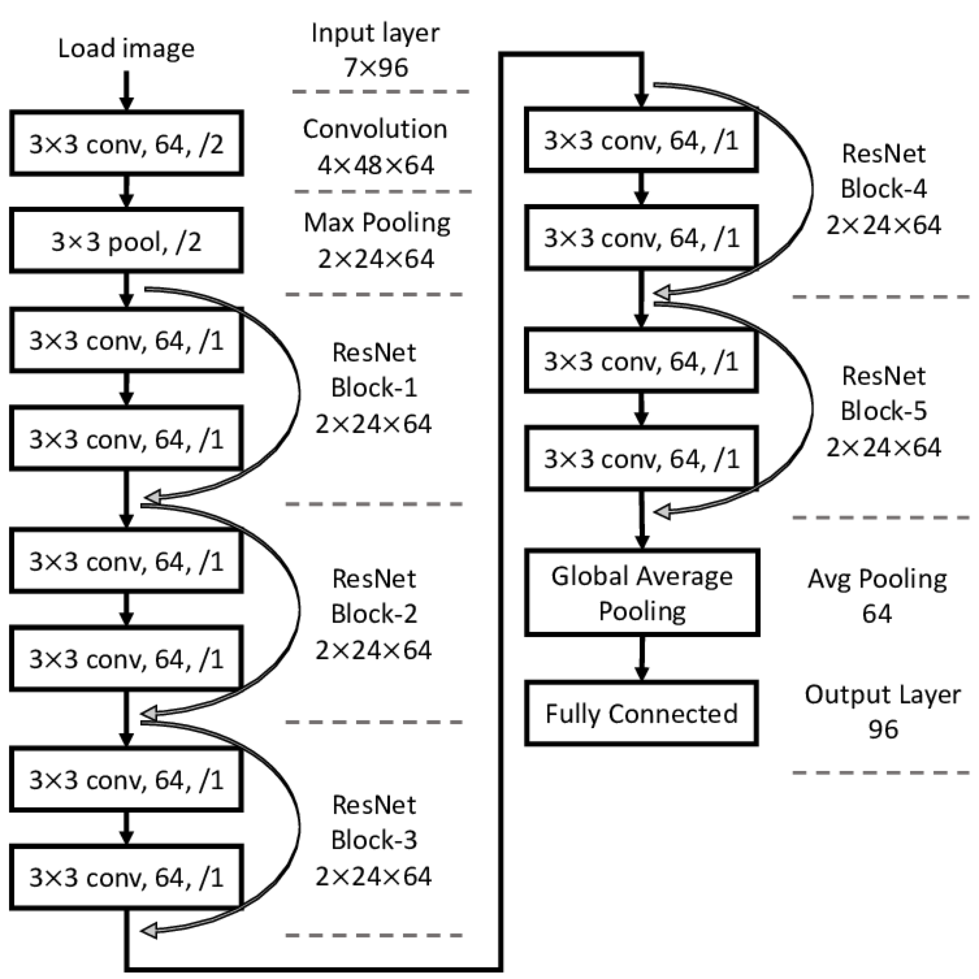
Architecture
Shown along with the residual blocks

Slide 9
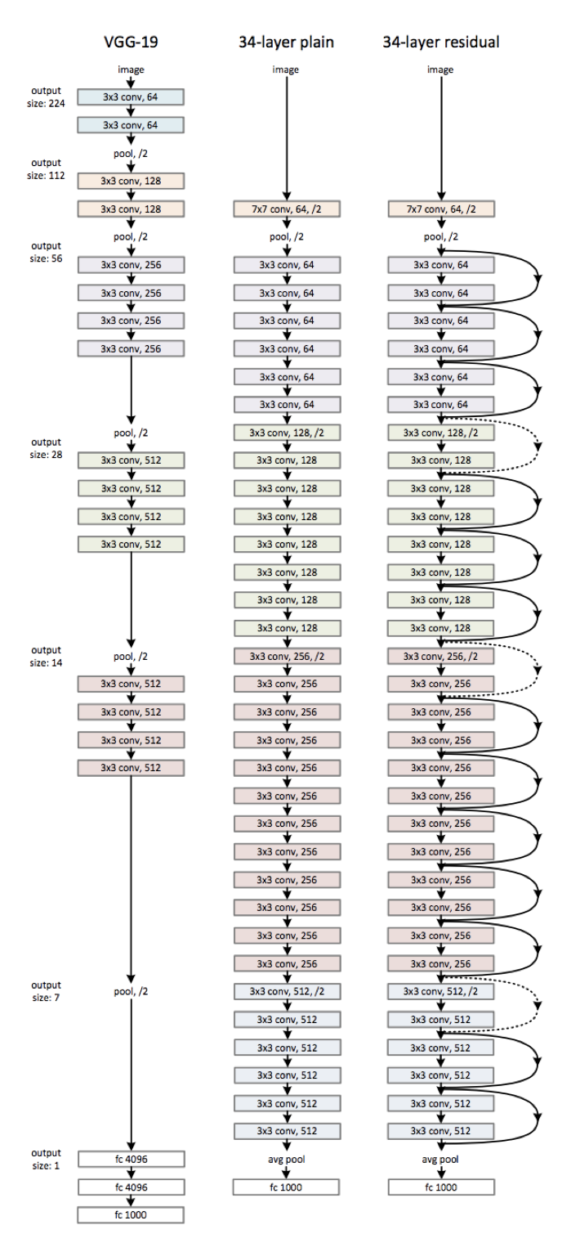
Origin/source of its architecture
VGG-19->34 layer plain->Resnet
The traditional ones do not have skip connections
The models used are 34-layer plain NN and a VGG-19 model (More on them in the next slide)
Resnet uses 34-layer plain architecture which is inspired by VGG-19+skip connections
These connections convert the architecture to a residual network

Slide 10
VGG=Visual Geometry Group
VGG=Visual Geometry Group
A standard CNN architecture with many layers
16 conv, 3 fc, 5 maxpool, 1softmax
Used for classification
A standard CNN architecture with many layers
34 layers

Slide 11
Thank you

