Slide 1
Segmentation Models
Mahek vora

Slide 2
Contents
Data loaders
Transforms
Model-Unet
Loss
Optimizer
Dice,IoU callbacks

Slide 3
Dataloaders

Slide 4
Data loaders
Given the dataset, compute masks for each image
Decode original image from its path
Obtain augmented data (tensor form) using defined transforms on image and all 4 masks
Concatenate masks with a combined mask of all 4

Slide 5
Transforms

Slide 6
Transforms
Using ablumentations
Returns image as a tensor
Transforms used for segmentation:
Train:
Horizontal, vertical flip
Cutout
Random crop scale
Test:
Horizontal, vertical flip
Cutout

Slide 7
Transforms explanation
1. Horizontal flip, vertical flip→ flip the images about axis
2. Cutout→the process of darkening square regions of an image
3. Size and number of holes used for cutout:
4. Random crop→ using a part of the image, here 95%
 | Number of holes | Size of holes in pixels
Train | 10 | 25
Test | log(256) | 25

Slide 8
Model

Slide 9
Model
Segmentation model with a pretrained encoder
architecture: 'Unet'
encoder: 'resnet18'
Pretrained on : 'imagenet'

Slide 10
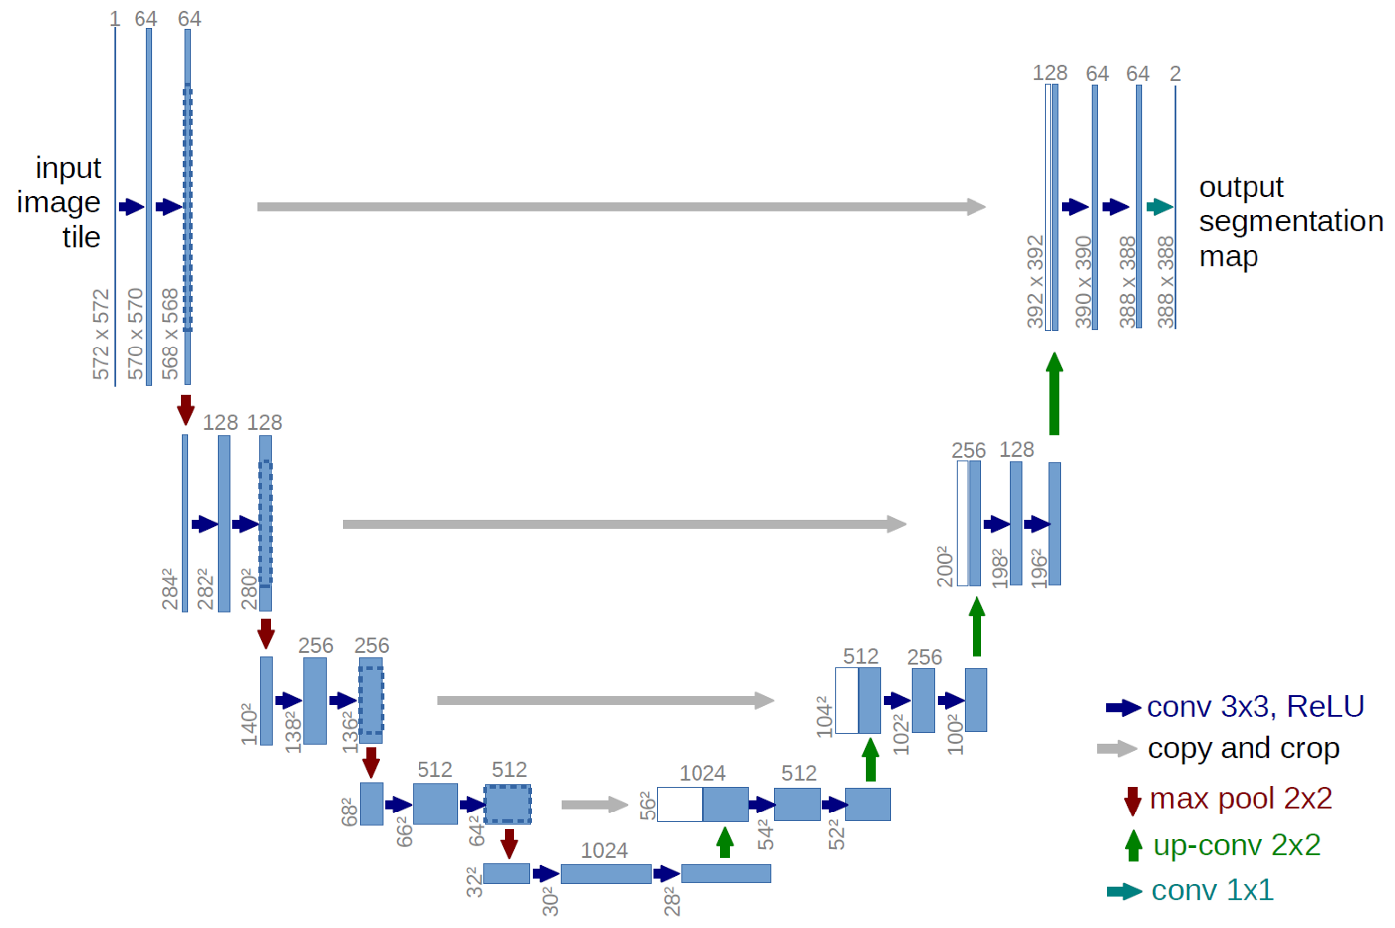
Unet -
An improvement over the existing FCN — “Fully convolutional networks for semantic segmentation” developed by Jonathan Long et al. in (2014)

Slide 11
Unet architecture
UNET is a U-shaped encoder-decoder network architecture, which consists of four encoder blocks and four decoder blocks that are connected via a bridge.
Encoder network(contracting path)
Halves the spatial dimensions
Doubles the number of filters (feature channels)
at each encoder block.
Decoder network
Doubles the spatial dimensions
Halves the number of filters (feature channels)

Slide 12
Encoder network
Learns an abstract representation of the input image through a sequence of the encoder blocks.
Encoder block :
2 3x3 convolutions, each convolution is followed by a ReLU activation function.
ReLU introduces non-linearity into the network → helps in the better generalization of the training data.
Output of the ReLU acts as a skip connection(shortcut connection that helps the indirect flow of gradients to the earlier layers without any degradation) for the corresponding decoder block.
2x2 max-pooling.
the spatial dimensions (height and width) of the feature maps are reduced by half.
Reduces the computational cost by decreasing the number of trainable parameters.

Slide 13
Bridge
Connects the encoder and the decoder network
Completes the flow of information.
Consists of:
2 3x3 convolutions
each convolution is followed by a ReLU activation functions

Slide 14
Decoder network
Abstract representation → a semantic segmentation mask.
The decoder block;
A 2x2 transpose convolution,
concatenated with the corresponding skip connection feature map from the encoder block.
These skip connections provide features from earlier layers that are sometimes lost due to the depth of the network.
2 3x3 convolutions are used, where each convolution is followed by a ReLU activation function.
The output of the last decoder passes through a 1x1 convolution with sigmoid activation.
The sigmoid activation function gives the segmentation mask representing the pixel-wise classification.

Slide 15
Loss

Slide 16
Loss
BCEDice=Bce+dice loss
BCEWithLogitsLoss from pytorch:
Combines a Sigmoid layer + BCELoss in one single class.
More numerically stable than a plain Sigmoid followed by a BCELoss
By combining the operations into one layer, we take advantage of the log-sum-exp trick for numerical stability.
ℓ(x,y)=L={l1,…,lN​}⊤,ln​=−wn​[yn⋅logσ(xn)+(1−yn​)⋅log(1−σ(xn​))],

Slide 17
optimizer

Slide 18
Optimizer
Rectified Adam, or RAdam,
A variant of the Adam stochastic optimizer
Introduces a term to rectify the variance of the adaptive learning rate.
It seeks to tackle the bad convergence problem suffered by Adam
(Adam is shown not being able to converge to the optimal solution in certain cases.)

Slide 19
Callbacks

Slide 20
Dice Callback
Input specifies y_true
Output is useful for dice calculations, specifies y_pred

Slide 21
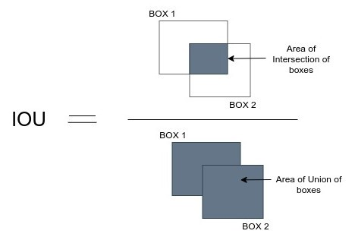
IoU callback
IoU=(Area of Intersection)/(Area of union)
A term used to describe the extent of overlap of two boxes.
we train a model to output a box that fits perfectly around an object.
The aim of this model would be to keep improving its prediction, until the IOU between the two boxes becomes equal to 1.

