Slide 1
VGG

Slide 2
ABOUT VGG
VGG stands for Visual Geometry Group; it is a standard deep Convolutional Neural Network (CNN) architecture with multiple layers. The “deep” refers to the number of layers with VGG-16 or VGG-19 consisting of 16 and 19 convolutional layers.
The VGG architecture is the basis of ground-breaking object recognition models. Developed as a deep neural network, the VGGNet also surpasses baselines on many tasks and datasets beyond ImageNet. Moreover, it is now still one of the most popular image recognition architectures.

Slide 3
ILSVRC challenge 2014-vgg team secured 2nd place
Won the localisation challenge of ILSVRC-2014 (Russakovsky et al., 2014). Results were considerably better than those of the ILSVRC-2013 winner Overfeat (Sermanet et al., 2014)
Indicated the performance advancement brought by their very deep ConvNets
They got better results with a simpler localisation method, but a more powerful representation.

Slide 4
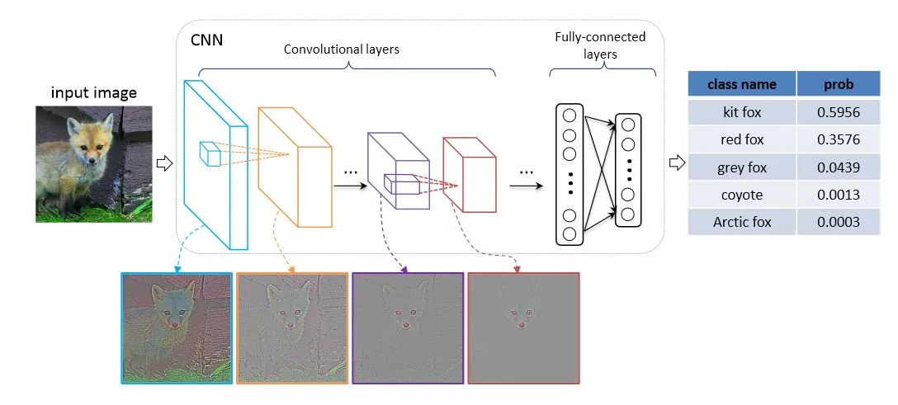
ARCHITECTURE

Slide 5
ARCHITECTURE
The VGG network is constructed with very small convolutional filters. The VGG-16 consists of 13 convolutional layers and three fully connected layers
Input: The VGGNet takes in an image input size of 224×224. For the ImageNet competition, the creators of the model cropped out the center 224×224 patch in each image to keep the input size of the image consistent.
Convolutional Layers: VGG’s convolutional layers leverage a minimal receptive field, i.e., 3×3, the smallest possible size that still captures up/down and left/right. Moreover, there are also 1×1 convolution filters acting as a linear transformation of the input. This is followed by a ReLU unit,
The convolution stride is fixed at 1 pixel to keep the spatial resolution preserved after convolution (stride is the number of pixel shifts over the input matrix).
Hidden Layers: All the hidden layers in the VGG network use ReLU. VGG does not usually leverage Local Response Normalization (LRN) as it increases memory consumption and training time. Moreover, it makes no improvements to overall accuracy.
Fully-Connected Layers: The VGGNet has three fully connected layers. Out of the three layers, the first two have 4096 channels each, and the third has 1000 channels, 1 for each class

Slide 6
