Slide 1


Simplify the service-stack
Matthew Hill
2018-11-15

Slide 2
What is Swoole?
Event-driven,
Asynchronous Programming
for PHP 7

Slide 3
yeah but, What is Swoole?
Event-driven framework for PHP
- async I/O (File,UnixSocket,TCP/UDP,Websocket)
- async HTTP/HTTP2 (yes, it supports SSL/TLS)
- async MySQL
- async Redis
- async DNS
- message queue, system locks, improved serializer

Slide 4
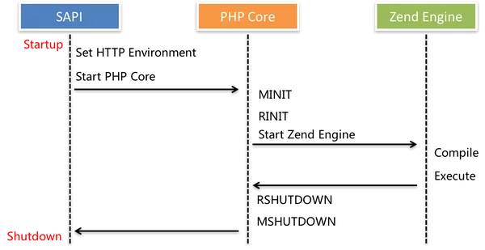
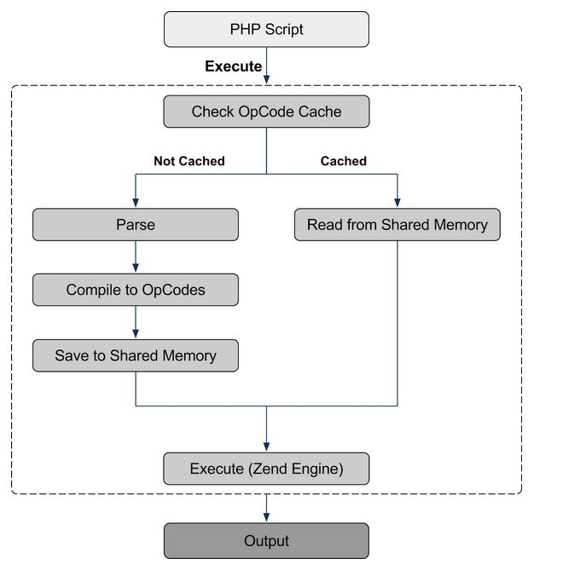
I’ll do you one better,
How is Swoole?

Slide 5
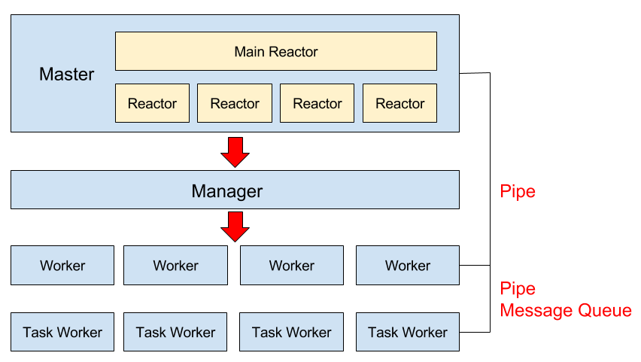
I’ll do you one better,
How is Swoole?

Slide 6
I’ll do you one better,
Why is Swoole?
https://mwop.net/blog/2018-10-16-swoole.html
“Remember when PHP 7 came out, and it was like doubling the performance of your application?
“What if you could do that again?
“In our initial benchmarks of Expressive applications, we found that they performed 4x better under Swoole than under a traditional nginx+php-fpm pair. More interesting: when benchmarking with a high number of concurrent requests, we also found that Swoole had fewer failed requests. This means you get both better performance and better resilience!”
- Matthew Weier O’Phinney - Async Expressive with Swoole

Slide 7
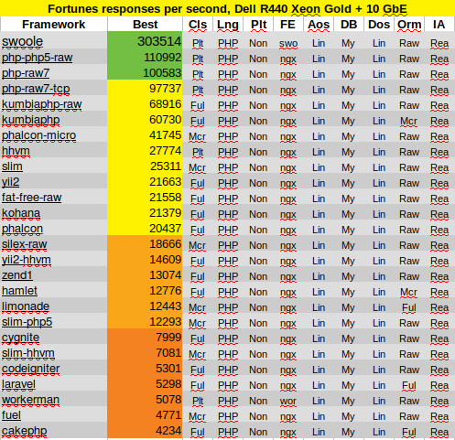
He’s not a dude, you’re a dude.
https://www.techempower.com/benchmarks/#section=data-r17&hw=ph&test=fortune

Slide 8
Caveats
- No global variables, mis-match between workers (you never use globals, right?)
- No set_error_handler(), leaks memory like a fish tank with a bullet hole
- No set_exception_handler(), see above
- Do not exit/die, corrupts the Worker pool
- Do not sleep(), causes the entire process to block
- You must catch thrown Exceptions within the same Worker
- No 3rd party code, it won’t play well with async and will probably kill gc
- No PDO and no mysqli, get used to Swoole\Mysql
- No Xdebug
- Do not include and require; include_once and require_once share across Workers

Slide 9

sucks ?

Slide 10

And what about the Gunslinger?
https://software-gunslinger.tumblr.com/post/47131406821/php-is-meant-to-die
PHP is meant to die
“If your project will rely on continually-running processes to function, avoid PHP.”
“if you want to keep the processes running forever they will crash, and will do it really fast under load”
“PHP is meant to die. The basic implementation, the core feature of the language, is to be suicidal, no matter what”
“Is there any hope for PHP and continually-running processes? No, right now, there isn’t.”

Slide 11

And what about the Gunslinger?
https://software-gunslinger.tumblr.com/post/47131406821/php-is-meant-to-die
PHP is meant to die =
- PHP does a terrible job of managing memory
- PHP is single-threaded

Slide 12
What has changed?
It’s not 2013 anymore

Slide 13
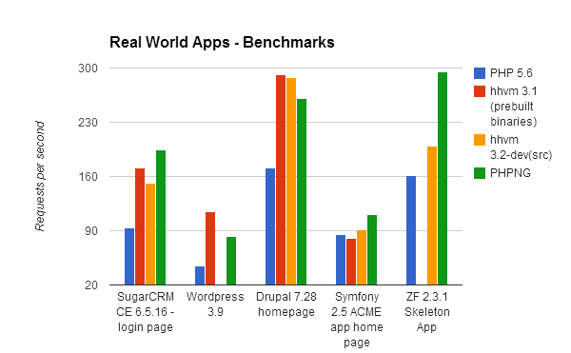
We’ve come a long way baby
http://zsuraski.blogspot.com/2014/07/benchmarking-phpng.html
gc is enabled by default
opcache has been thoroughly improved
hhvm → phpng

Slide 14

typical “scalable”
https://mwop.net/blog/2018-10-16-swoole.html

Slide 15

then isolate for security
https://mwop.net/blog/2018-10-16-swoole.html

Slide 16
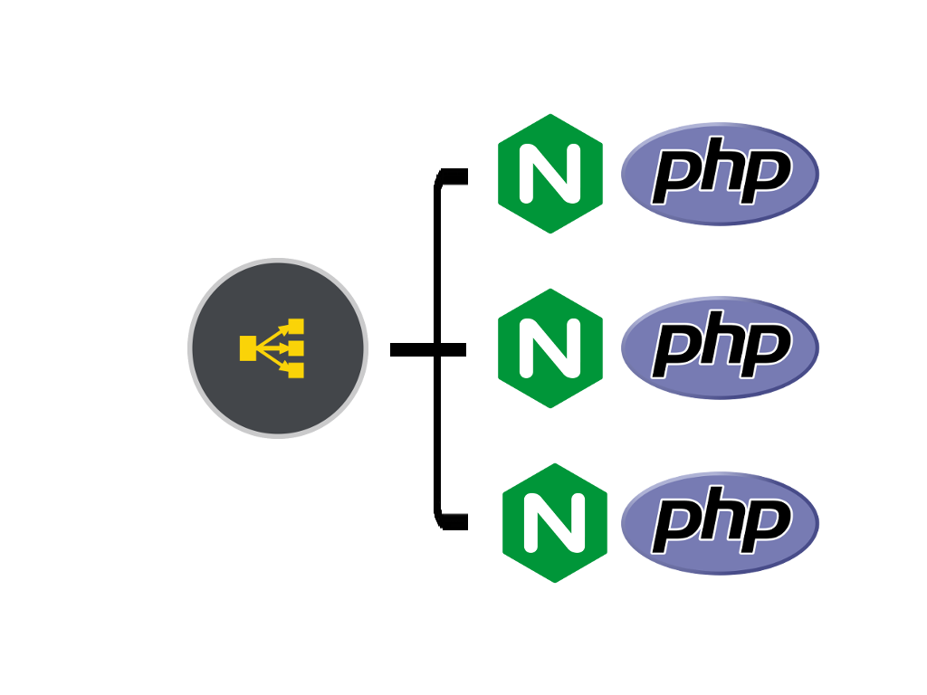
new “scalability”
https://mwop.net/blog/2018-10-16-swoole.html

Slide 17
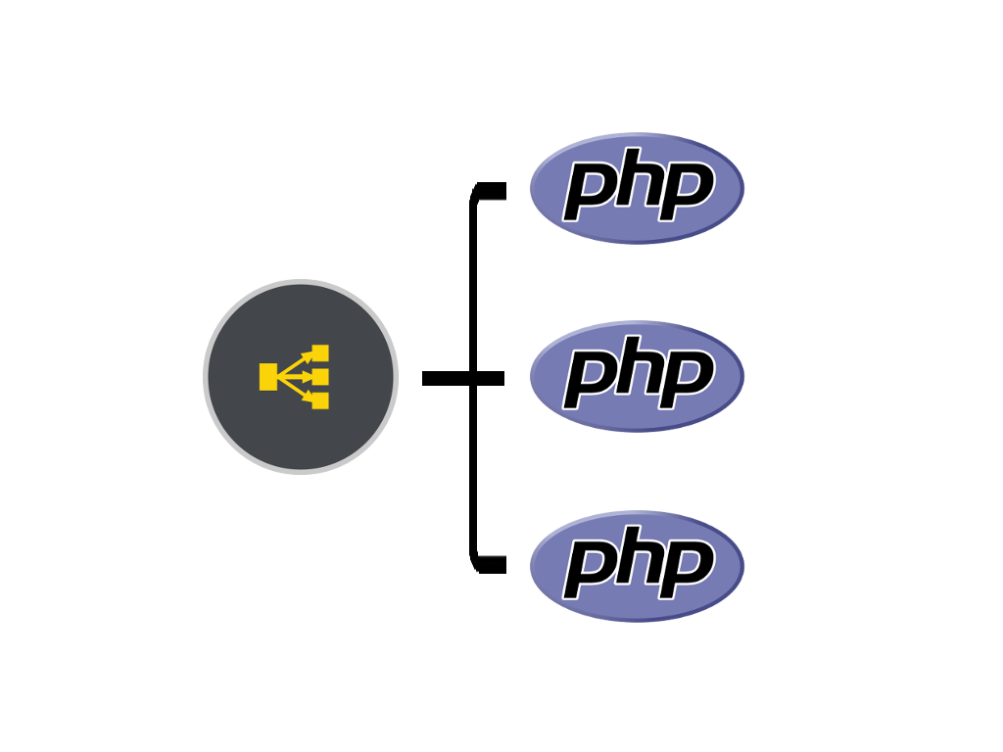
swoole scalability!
https://mwop.net/blog/2018-10-16-swoole.html

Slide 18
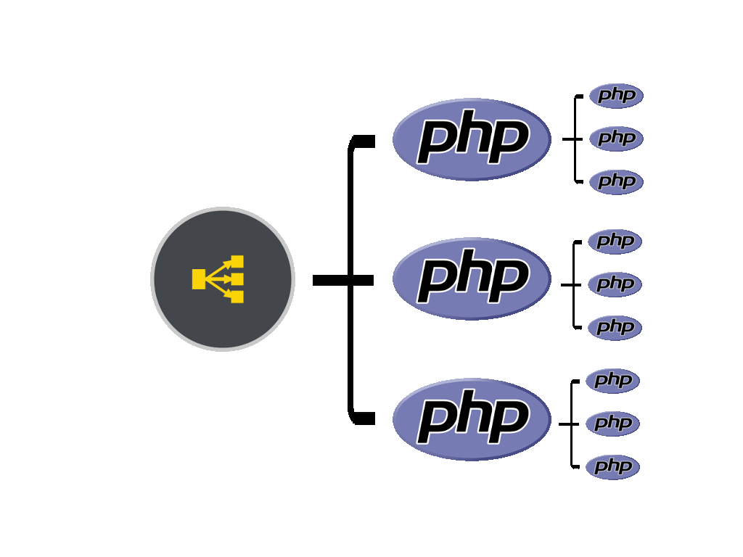
Slide title

Slide 19
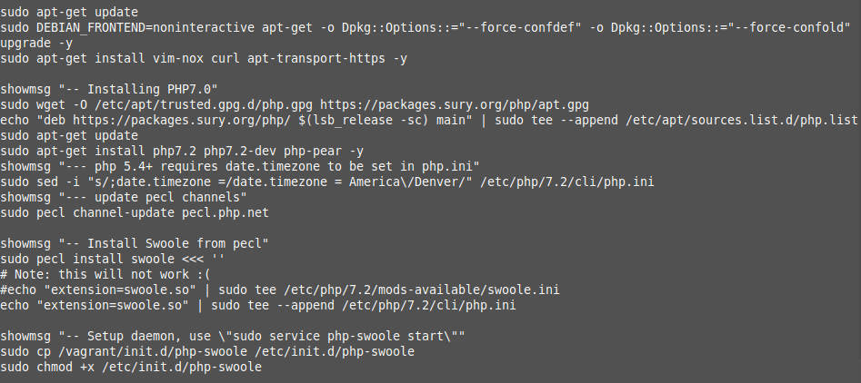
Ask me about my daemon

Slide 20
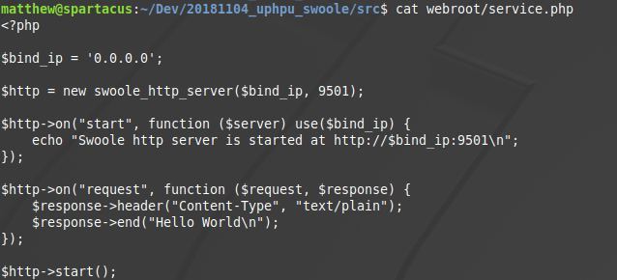
What is 9501? It is not 9000!

Slide 21

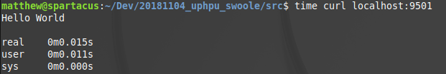
Hello World!

Slide 22
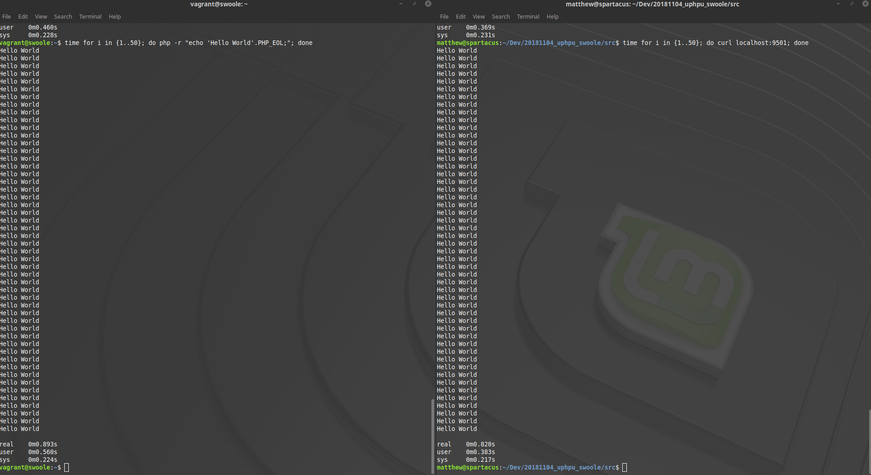
0.893s vs 0.820s

Slide 23
What you already love
https://github.com/swooletw/awesome-swoole
Laravel-Swoole : https://github.com/swooletw/laravel-swoole
Lumen-Swoole : https://github.com/breeze2/slumen
Expressive-Swoole : https://github.com/zendframework/zend-expressive-swoole
Phalcon-Swoole : https://github.com/phwoolcon/phwoolcon
Yii2-Swoole : https://github.com/liufee/yii2-swoole

Slide 24


And new friends to meet
Blink: https://github.com/bixuehujin/blink
Igni: https://github.com/igniphp/framework

Slide 25
Demo

Slide 26

I have been your speaker
Matthew Hill
mahelious@gmail.com
@mahelious on utos.slack.com

