Slide 1
Evaluating and Stabilizing Retrieval Augmented LLMs
TA: Jesse Zhang
Query Craft
Sriram Gurazada
Kavya Sree Polavarapu
Mahema Reddy Nelaturi
Saisrinath Narra
Abstract:
Focus: Enhancing consistency, relevance, debiasing in Retrieval-Augmented LLMs.
Techniques: debiasing for unbiased outputs, dynamic chunking, and advanced hybrid similarity searches
Validation: Metrics like BLEU, ROUGE-L, and WEAT ensure robust performance.

Slide 2
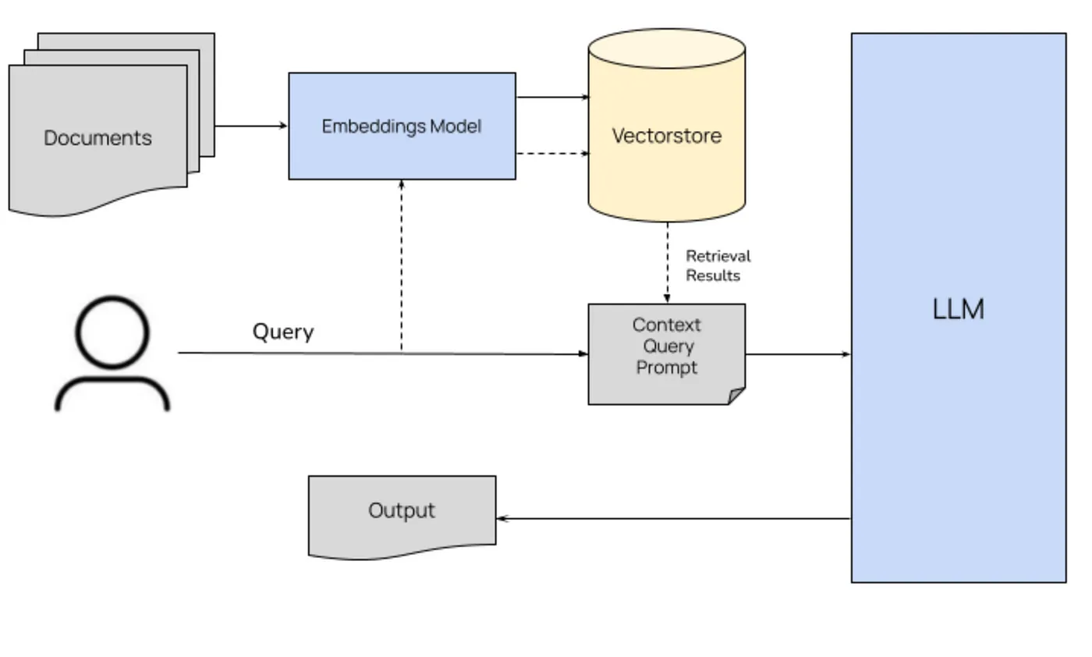
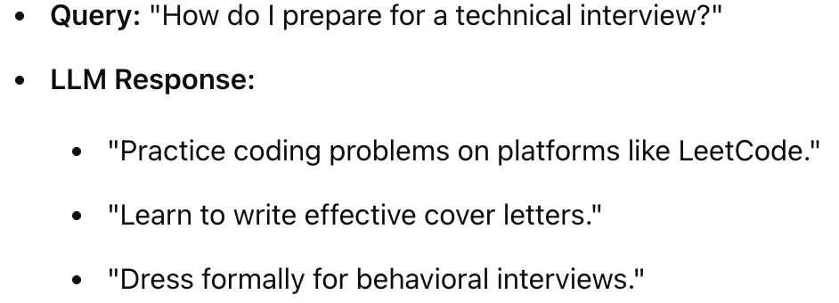
Challenges and Objectives
RAG
Bias
Inconsistent and irrelevant
Inefficiency and accuracy
HE is a Nurse
SHE is a Nurse
HE is muscular
SHE is muscular
“mitochondria is the power”
“House of the cell”

Slide 3
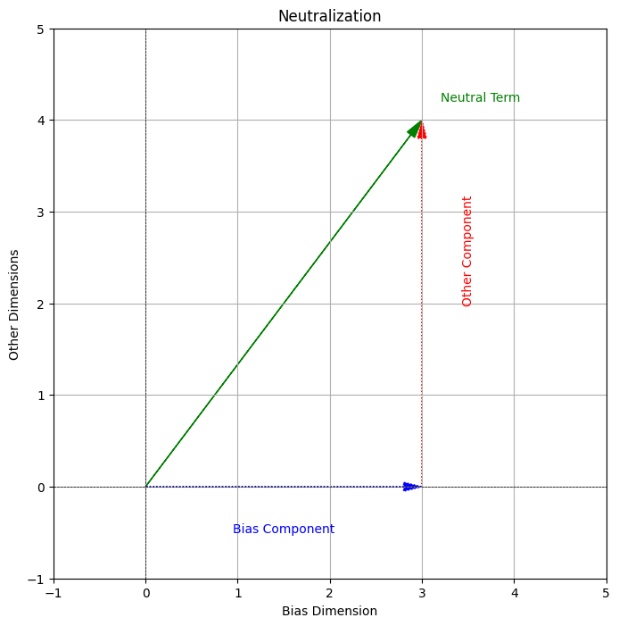
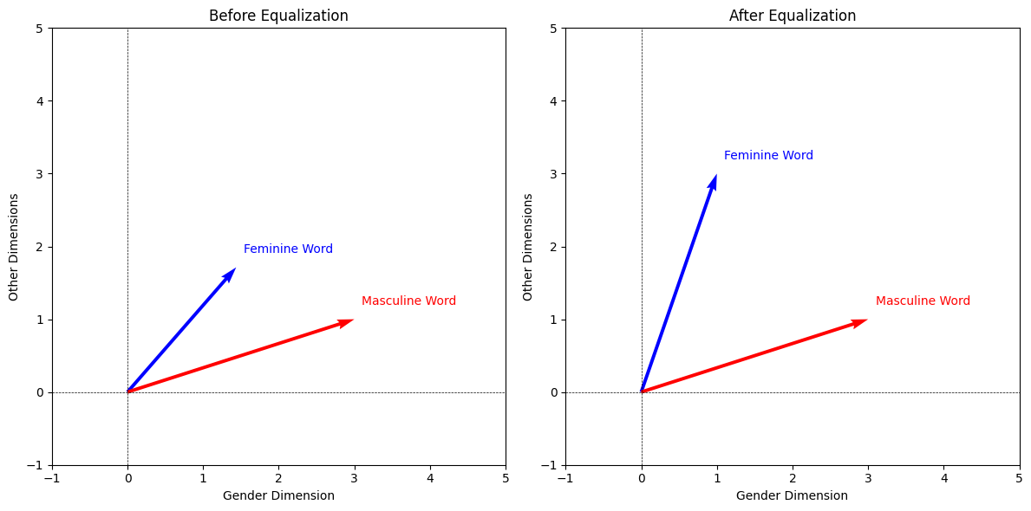
Methodology
Approach:
Context Retrieval:
Hybrid Similarity Searches using BM25, Cosine, FAISS, ANN
Dynamic Chunking, Semantic Chunking
Bias Mitigation:
Neutralization of neutral embeddings
Equalization of vector embeddings.

Slide 4
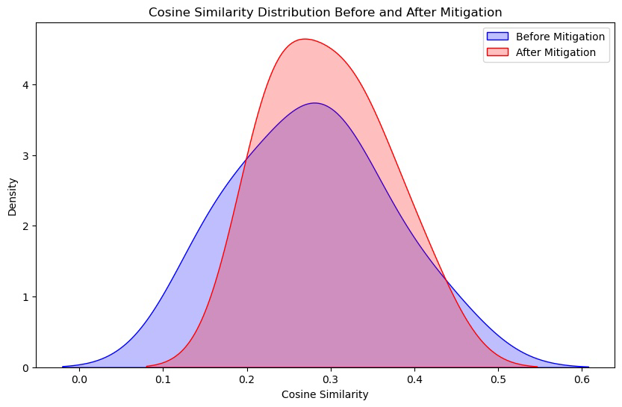
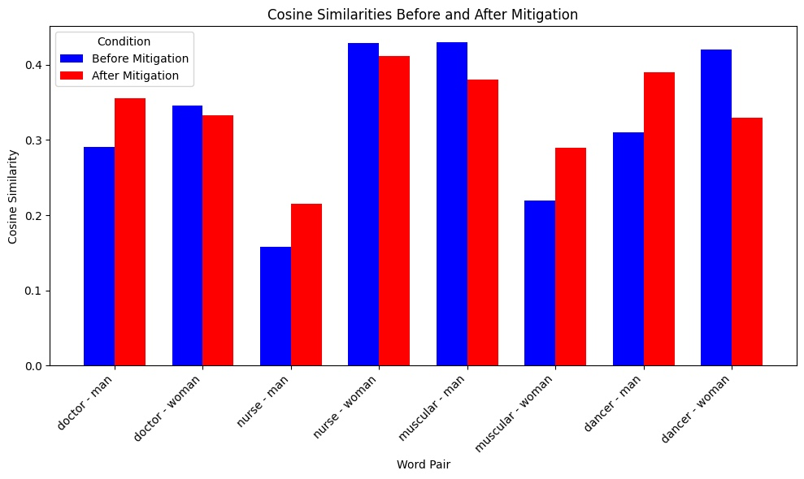
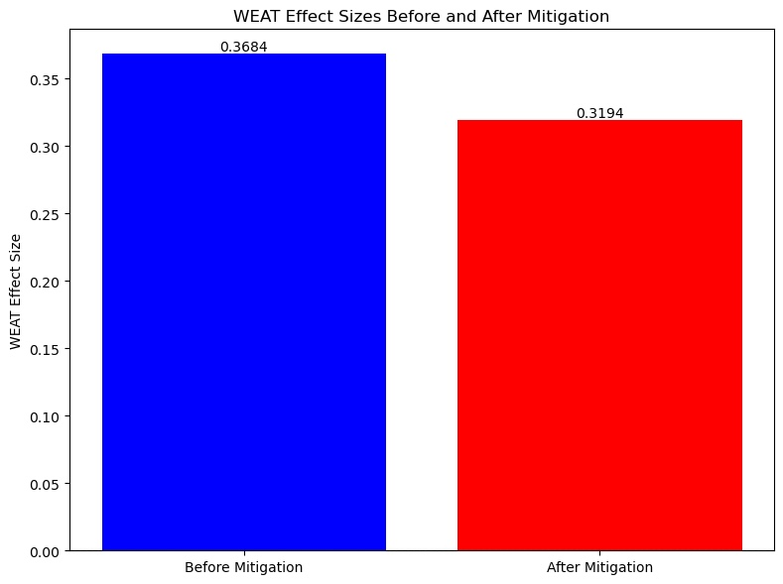
Experiments and Results
Key Findings:
Gender Bias Mitigation:
Improved association neutrality for neutral terms and decreased WEAT effect size.

Slide 5
Experiments and Results
What We Have Done:
FAISS + Flat Index:
Performs exact nearest neighbor search in dense embedding space.
Combined Methods:
FAISS + BM25 + Cosine Similarity:
Sparse keyword retrieval (BM25) + semantic similarity (FAISS).
Cosine similarity re-ranks combined results.
FAISS + Inverted Index + ANN:
Inverted index for efficient candidate filtering.
FAISS ANN for dense vector semantic search.
Method | Accuracy(Recall@K), Bleu, Cosine, Rogue | Best Use Case
BM25 + Cosine + FAISS (keywords and semantics) | Best | Hybrid queries with both keywords and semantics.
FAISS + ANN (handles metaphors) | High | Large-scale semantic search with high-quality embeddings.
FAISS Flat (exact semantic matches) | Very High | Small datasets where exact match is essential.

Slide 6
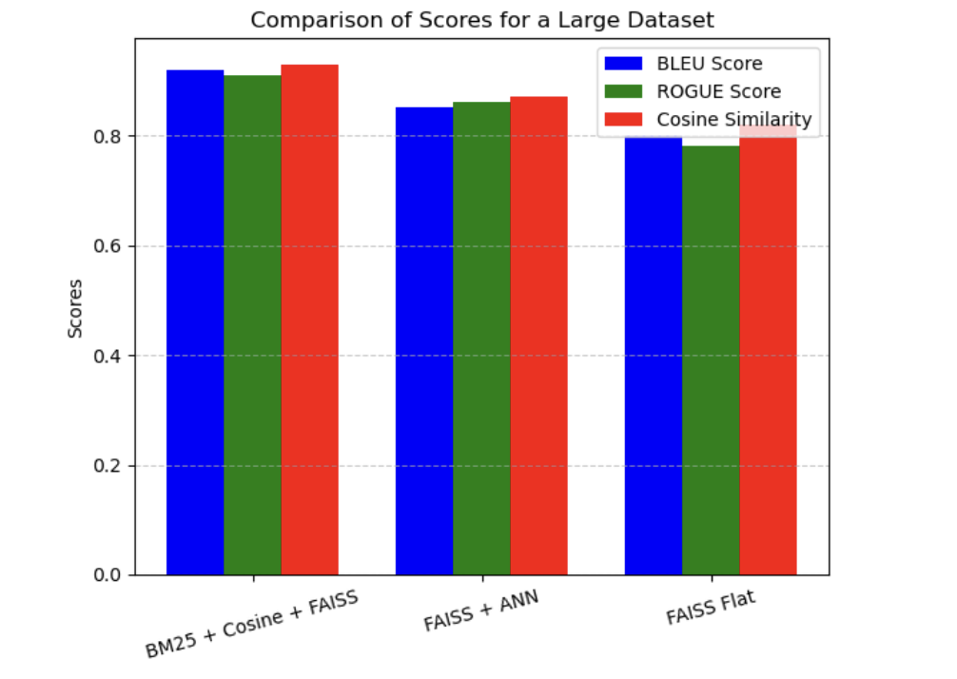
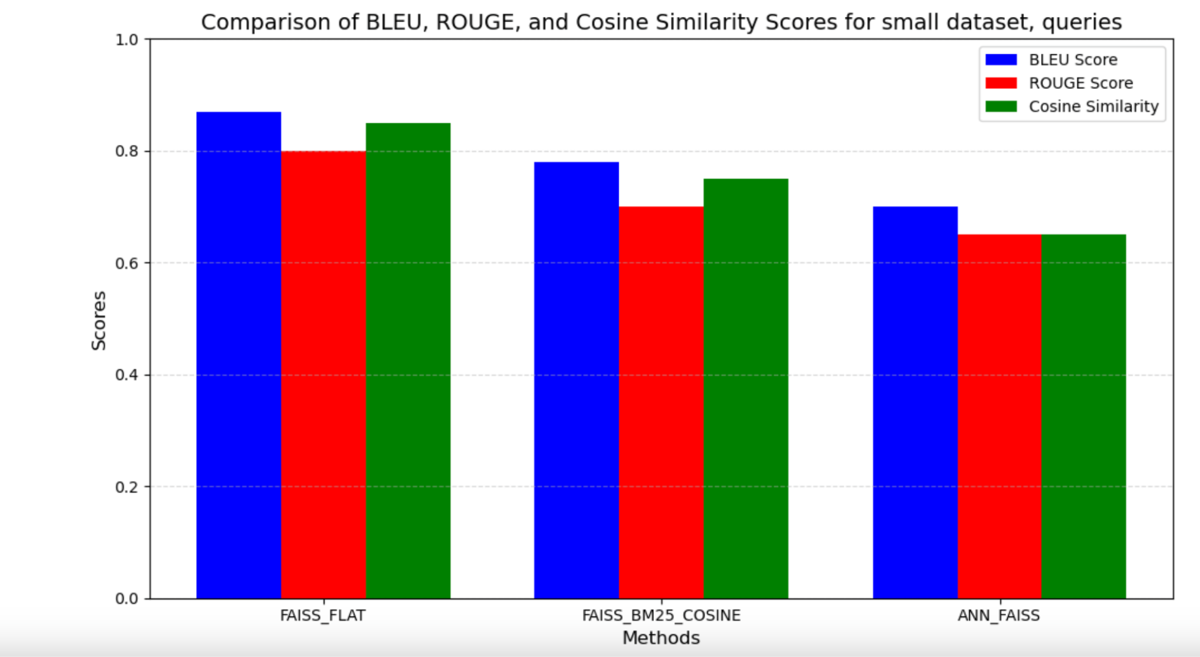
Metrics Overview:
Cosine Similarity:
Higher cosine similarity means embeddings align closely with the context of the query.
BLEU Score:
Compares text similarity at word/phrase level.
ROUGE Score:
Overlap of unigrams, bigrams, Longest Common Subsequence (LCS).

Slide 7
Future Scope
Enhancements and Next Steps:
Knowledge Graphs Integration:
Knowledge graphs help connect related concepts in a structured way, this reduces confusion and ensures more accurate, reliable answers.
Implement Similarity Ranking:
Develop advanced ranking algorithms for retrieved contexts based on relevance and quality.
Generalization to Other Biases:
Expand debiasing techniques to address racial and occupational biases, validated through additional WEAT tests.

