Slide 1
Mahesh
HASH STEGANOGRAPHY
3/21/2024 Annual Review

Slide 2
PROJECT TITLE
Implementation of Hash steganography using python
3/21/2024 Annual Review

Slide 3


AGENDA
Problem Statement (Should not include solution)
Proposed System/Solution
System Development Approach (Technology Used)
Algorithm & Deployment
Result (Output Image)
Conclusion
Future Scope
References
3/21/2024 Annual Review

Slide 4

PROBLEM STATEMENT
Hash functions are cryptographic tools that convert data into a fixed-size string (hash value). They play a vital role in data security and integrity verification. Hash-based steganography seeks to leverage these functions for covert communication by embedding hidden data within the generated hash values.
3/21/2024 Annual Review

Slide 5

PROJECT OVERVIEW
This proposed solution aims to address some of the key challenges associated with hash-based steganography, focusing on improving data capacity, security, and robustness.Core Techniques:
Adaptive Data Embedding:The system analyzes the chosen hash function (e.g., SHA-256) and the type of data to be hidden. Based on this analysis, it selects an optimal embedding strategy. This could involve:
LSB Modification: For specific data types (e.g., small text messages) where preserving higher-order bits is crucial, the system might utilize LSB modification on a subset of bits within the hash value.Parity Bit Flipping: For data with more redundancy, the system could strategically flip parity bits within the hash to represent hidden data. This approach aims to minimize disruption to the overall hash value.
Error Correction Integration:The system incorporates an error-correcting code (ECC) like Hamming codes or Reed-Solomon codes into the hidden data before embedding. This adds redundancy and allows for correcting potential errors that might occur during transmission.
Key Management:A secure key exchange mechanism (e.g., Diffie-Hellman key exchange) is employed to establish a shared secret key between sender and receiver. This key is used to determine specific bit positions within the hash or control the flipping patterns for data embedding.
Ethical Considerations:This solution should be used in compliance with all relevant data privacy and communication regulations.Methods for disclosing the use of steganography within communication channels, potentially through pre-defined markers, should be incorporated to promote responsible use.
3/21/2024 Annual Review

Slide 6

WHO ARE THE END USERS?
End users of image steganography can vary widely depending on the context and purpose of its use. Here are some potential end users:
Government Agencies: Law enforcement, intelligence agencies, and military organizations may utilize image steganography for covert communication and information sharing, particularly when conducting surveillance or espionage operations.
Journalists and Whistleblowers: Individuals working in journalism or advocacy may employ image steganography to securely transmit sensitive information, such as leaked documents or confidential sources, while protecting the identity of whistleblowers and sources.
Researchers and Academics: Professionals in research and academia may use image steganography for experimental purposes, studying its applications in information security, cryptography, and digital forensics, or developing novel techniques and algorithms.
Ethical Hackers and Penetration Testers: Security professionals and ethical hackers may utilize image steganography as part of penetration testing and vulnerability assessment exercises to evaluate the effectiveness of security measures and identify potential weaknesses in systems and networks.
Cybercriminals: Unfortunately, malicious actors may also exploit image steganography for illicit purposes, such as concealing malware, ransomware, or other malicious payloads within innocent-looking images to evade detection by security systems and infiltrate target networks.
3/21/2024 Annual Review

Slide 7
Proposed Solution
This proposed solution aims to address some of the key challenges associated with hash-based steganography, focusing on improving data capacity,security, and robustness.Core Techniques:
Adaptive Data Embedding:The system analyzes the chosen hash function (e.g., SHA-256) and the type of data to be hidden. Based on this analysis, it selects an optimal embedding strategy. This could involve:
LSB Modification: For specific data types (e.g., small text messages) where preserving higher-order bits is crucial, the system might utilize LSB modification on a subset of bits within the hash value.Parity Bit Flipping: For data with more redundancy, the system could strategically flip parity bits within the hash to represent hidden data. This approach aims to minimize disruption to the overall hash value.
Error Correction Integration:The system incorporates an error-correcting code (ECC) like Hamming codes or Reed-Solomon codes into the hidden data before embedding. This adds redundancy and allows for correcting potential errors that might occur during transmission.
Key Management:A secure key exchange mechanism (e.g., Diffie-Hellman key exchange) is employed to establish a shared secret key between sender and receiver. This key is used to determine specific bit positions within the hash or control the flipping patterns for data embedding.
Ethical Considerations:This solution should be used in compliance with all relevant data privacy and communication regulations.Methods for disclosing the use of steganography within communication channels, potentially through pre-defined markers, should be incorporated to promote responsible use.

Slide 8
System Approach
The hash based steganography has minimal system requirements and can run on most modern computers. Here's a breakdown:
Software:Python 3 (or compatible version) - The code is written in Python and requires a Python interpreter to be installed. Python is freely available for most operating systems.This imports the hashlib library, which provides functions for various cryptographic hash algorithms like MD5, SHA-256, etc.
Hardware:No specific hardware requirements - This code doesn't perform computationally intensive tasks and can run on any computer capable of running Python.

Slide 9
Algorithm & Deployment
The choice of algorithm depends on the desired balance between data capacity, imperceptibility, and security. Here are some potential approaches:
Least Significant Bit (LSB) Modification:Applicable to hash functions that use bit strings internally. Here, the least significant bits of the hash value can be altered to represent hidden data. However, this might affect collision resistance if not done carefully.
Specific Bit Modification:Predetermined bits within the hash value are chosen to represent hidden data by flipping their values (0 to 1 or vice versa). This requires a pre-shared scheme between sender and receiver to know which bits hold the hidden information. Security relies heavily on choosing unpredictable bit positions.
Error Correction Code Integration:Techniques like Hamming codes can be used to embed the hidden data within the hash value while also adding redundancy for error correction during transmission. This approach requires extra data capacity within the hash but improves robustness.Deployment Considerations:
Hash Function Selection:The chosen hash function should be secure and have appropriate output size for the desired data capacity. Popular options include SHA-256 or SHA-3, but their suitability depends on the specific steganographic technique.
Key Management:If the steganographic method relies on pre-defined bit positions or other secret parameters, a secure key exchange mechanism is essential for both sender and receiver.
Data Preprocessing:Depending on the chosen algorithm, the hidden data might need preprocessing (e.g., conversion to binary format) before embedding within the hash value.

Slide 10
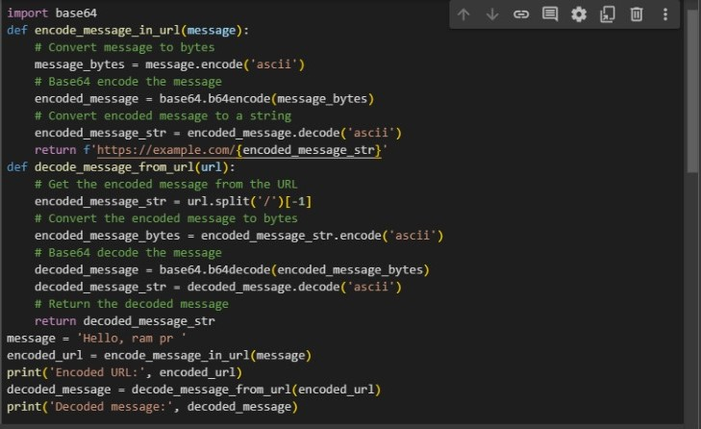
MODELLING
3/21/2024 Annual Review

Slide 11

RESULTS
In general, the results of image steganography encryption include:
- Embedding of secret data within the image without visibly altering it
- Ensuring that the embedded data is hidden and secure from unauthorized access
- Choosing an appropriate algorithm or method for encrypting the data within the image
- Generating a stego image that can be shared or transmitted without suspicion
On the other hand, the results of image steganography decryption involve:
- Extracting the hidden data from the stego image using a decryption algorithm or key
- Reconstructing the original data that was encrypted within the image
- Ensuring that the extracted data is accurate and unaltered from the original
- Verifying the authenticity of the extracted data and confirming it against the original information
Demo Link
3/21/2024 Annual Review

Slide 12
Conclusion
Hash steganography hides data in hash functions, offering a covert communication channel. But limitations exist: data capacity is small, and maintaining security is tricky. We explored an adaptive approach with error correction to boost capacity and robustness. The future might bring advancements like post-quantum cryptography for enhanced security. Remember, ethical use is crucial – transparency and legal compliance are paramount.

Slide 13
Future scope
While hash-based steganography faces challenges, advancements in several areas hold promise for its future:
Improved Embedding Techniques:Error-Correcting Codes: Integrating error-correcting codes within the hidden data can improve its robustness against transmission errors.Adaptive Techniques: Develop algorithms that adapt the embedding strategy based on the specific hash function and data type to maximize capacity while maintaining security.
Enhanced Security:Post-Quantum Cryptography: As computing power advances, explore integrating post-quantum cryptography for hash functions to ensure security against future code-breaking algorithms.
Formal Verification: Employ formal verification methods to mathematically prove the security properties of hash-based steganographic techniques.
Increased Capacity:Steganalysis-Resistant Embedding: Explore techniques that manipulate hash values in ways that are difficult to detect statistically, potentially allowing for embedding slightly larger amounts of data.
Iterative Hashing: Investigate methods that involve applying hash functions multiple times, potentially creating opportunities for embedding data at different stages.
Hybrid Approaches:Combination with Other Techniques: Combine hash-based steganography with other steganographic methods (e.g., URL steganography) to leverage the strengths of each and potentially increase overall data hiding capacity.
Multi-Layer Embedding: Explore embedding hidden data within different parts of a message or communication protocol, potentially using hash functions for specific layers.
Standardization and Applications:Standardized Techniques: Develop standardized methods for hash-based steganography to facilitate wider adoption and interoperability.
Secure Communication Applications: Explore the use of hash-based steganography in secure communication protocols for various applications, considering legal and ethical implications.

Slide 14
References
List and cite relevant sources, research papers, and articles that were instrumental in developing the proposed solution. This could include academic papers on bike demand prediction, machine learning algorithms, and best practices in data preprocessing and model evaluation.

Slide 15
THANK YOU

