Slide 1


Atliq Hardware
Consumer goods
Ad_Hoc Insights

Slide 2
Introduction - Atliq Hardwares is one of the leading computer hardware producers in India and well expanded in other countries too.
Background - Atliq Hardware's Management wants to get the insights to expand their business to make data driven decisions.
Task-
To run the SQL query to find out insights for the 10 ad-hoc requests .
Present the insights to top level management to take data driven decisions.

Slide 3
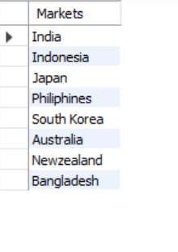
Atliq's exclusive markets in the APAC region
Query-
Provide the list of markets in which customer "Atliq Exclusive" operates its business in the APAC region.
Output-

Slide 4
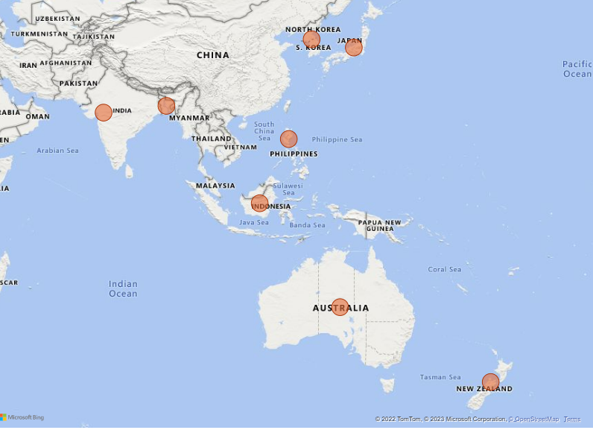
Insights
Atliq exclusive Operates in 8 Countries in APAC regions.
Atliq can build common ware-house for a pair eg: India,Bangalesh --reduce the logistics cost.

Slide 5

Annual product report
Query-
What is the percentage of unique product increase
in 2021 vs. 2020.
Output-

Slide 6
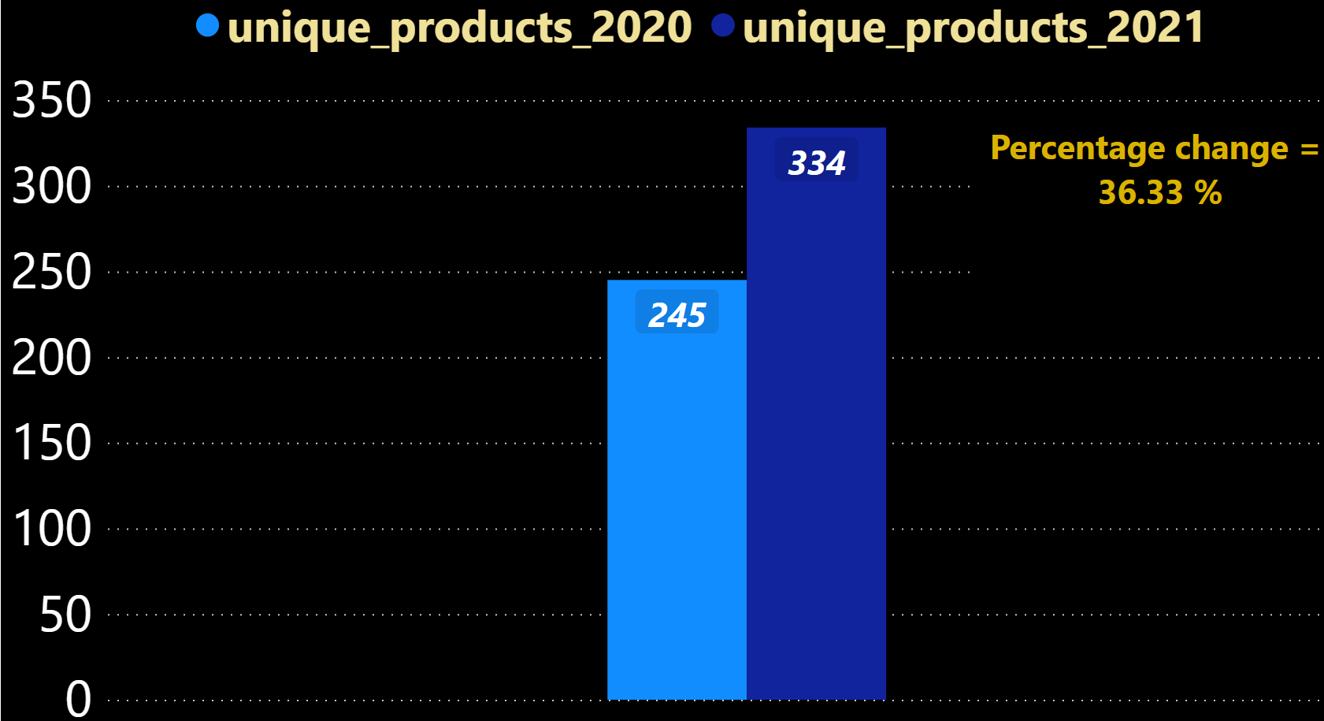
Insights
Unique product count increased by 36.33%.
Indicates the growth of the Atliq and expansion of its product into new categories.

Slide 7
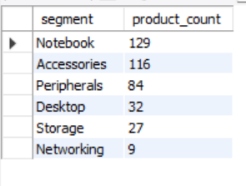
unique products within the segment
Query-
Provide a report with all the unique product counts for each segment and sort them in descending order of product counts.
Output-

Slide 8
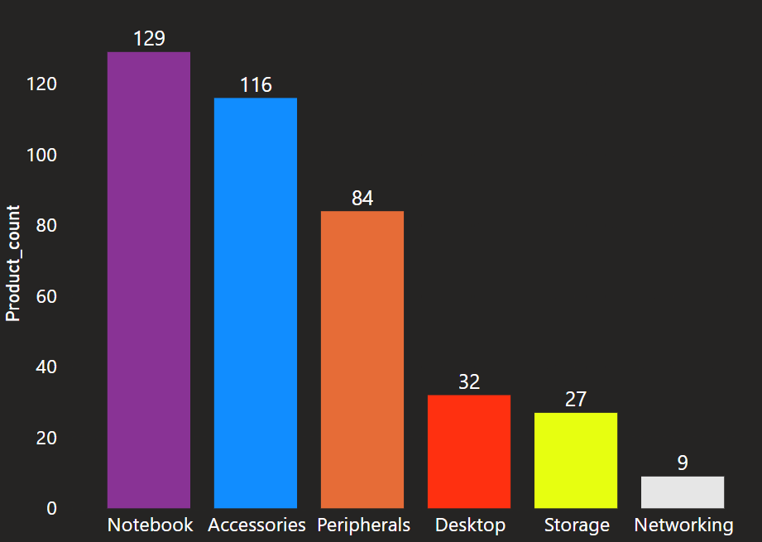
Insights
Notebook ,Accessories, Peripherals are the segments With high products count.

Slide 9
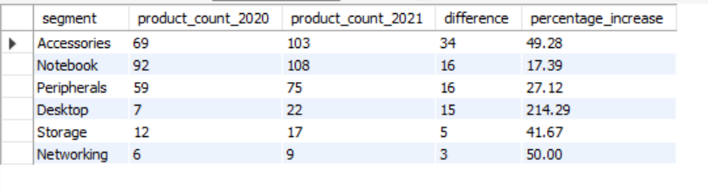
Analysis of product growth
Query-
Which segment had the most increase in unique products
in 2021 vs 2020.
Output-

Slide 10
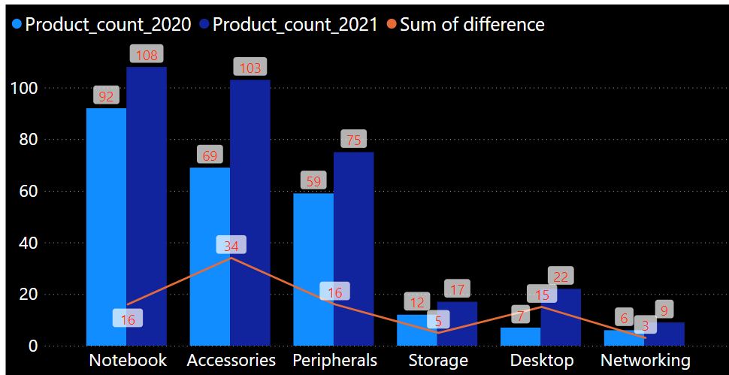
Insights
Atliq added more unique product in peripherals , accessories, notebook.
The company increased their products in Accessories by 34.

Slide 11
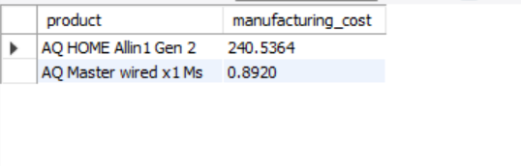
Products with high or low manufacturing costs
Query-
Get the products that have the highest and lowest
manufacturing costs.
Output-

Slide 12
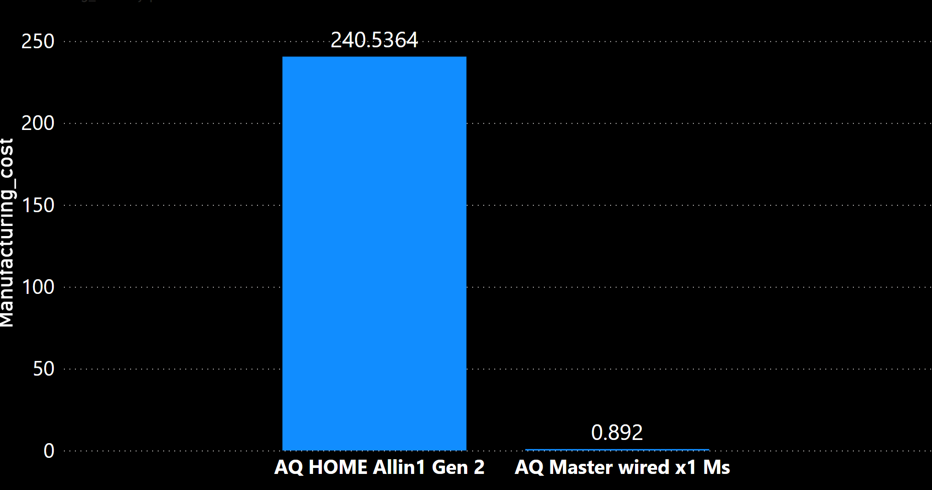
Insights
This shows the Atliq presence in each price range.
This helps in trust building of the company.

Slide 13
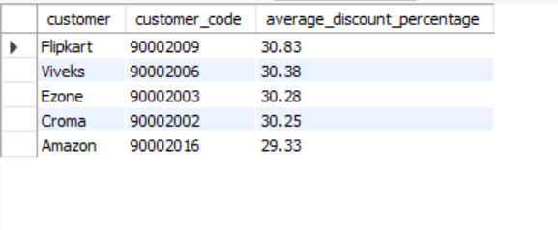
Discount received by customers
Query-
Generate a report which contains the top 5 customers who received an average high pre_invoice_discount_pct for the fiscal year 2021 and
in the Indian market.
Output-

Slide 14
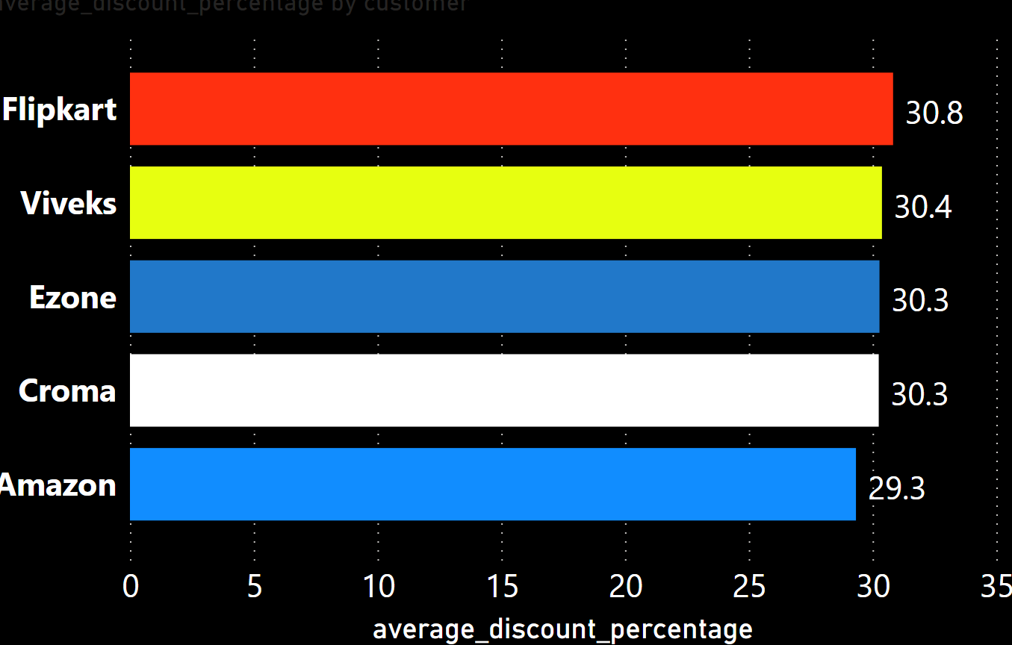
Insights
This shows the Atliq offers approx. same discount to all top 5 customer.
Flipkart customer avails max discount of 30.8%

Slide 15
Yearly report of sales
Query-
Get the complete report of the Gross sales
amount for the customer “Atliq Exclusive”
for each month.
Year | Month | Gross sales amount
2019 | 12 | 9755795.06
2019 | 11 | 15231894.97
2019 | 10 | 10378637.6
2019 | 9 | 9092670.34
2020 | 12 | 20409063.18
2020 | 11 | 32247289.79
2020 | 10 | 21016218.21
2020 | 9 | 19530271.3
2020 | 8 | 5638281.83
2020 | 7 | 5151815.4
2020 | 6 | 3429736.57
2020 | 5 | 1586964.48
2020 | 4 | 800071.95
2020 | 3 | 766976.45
2020 | 2 | 8083995.55
2020 | 1 | 9584951.94
2021 | 8 | 11324548.34
2021 | 7 | 19044968.82
2021 | 6 | 15457579.66
2021 | 5 | 19204309.41
2021 | 4 | 11483530.3
2021 | 3 | 19149624.92
2021 | 2 | 15986603.89
2021 | 1 | 19570701.71
Output-

Slide 16
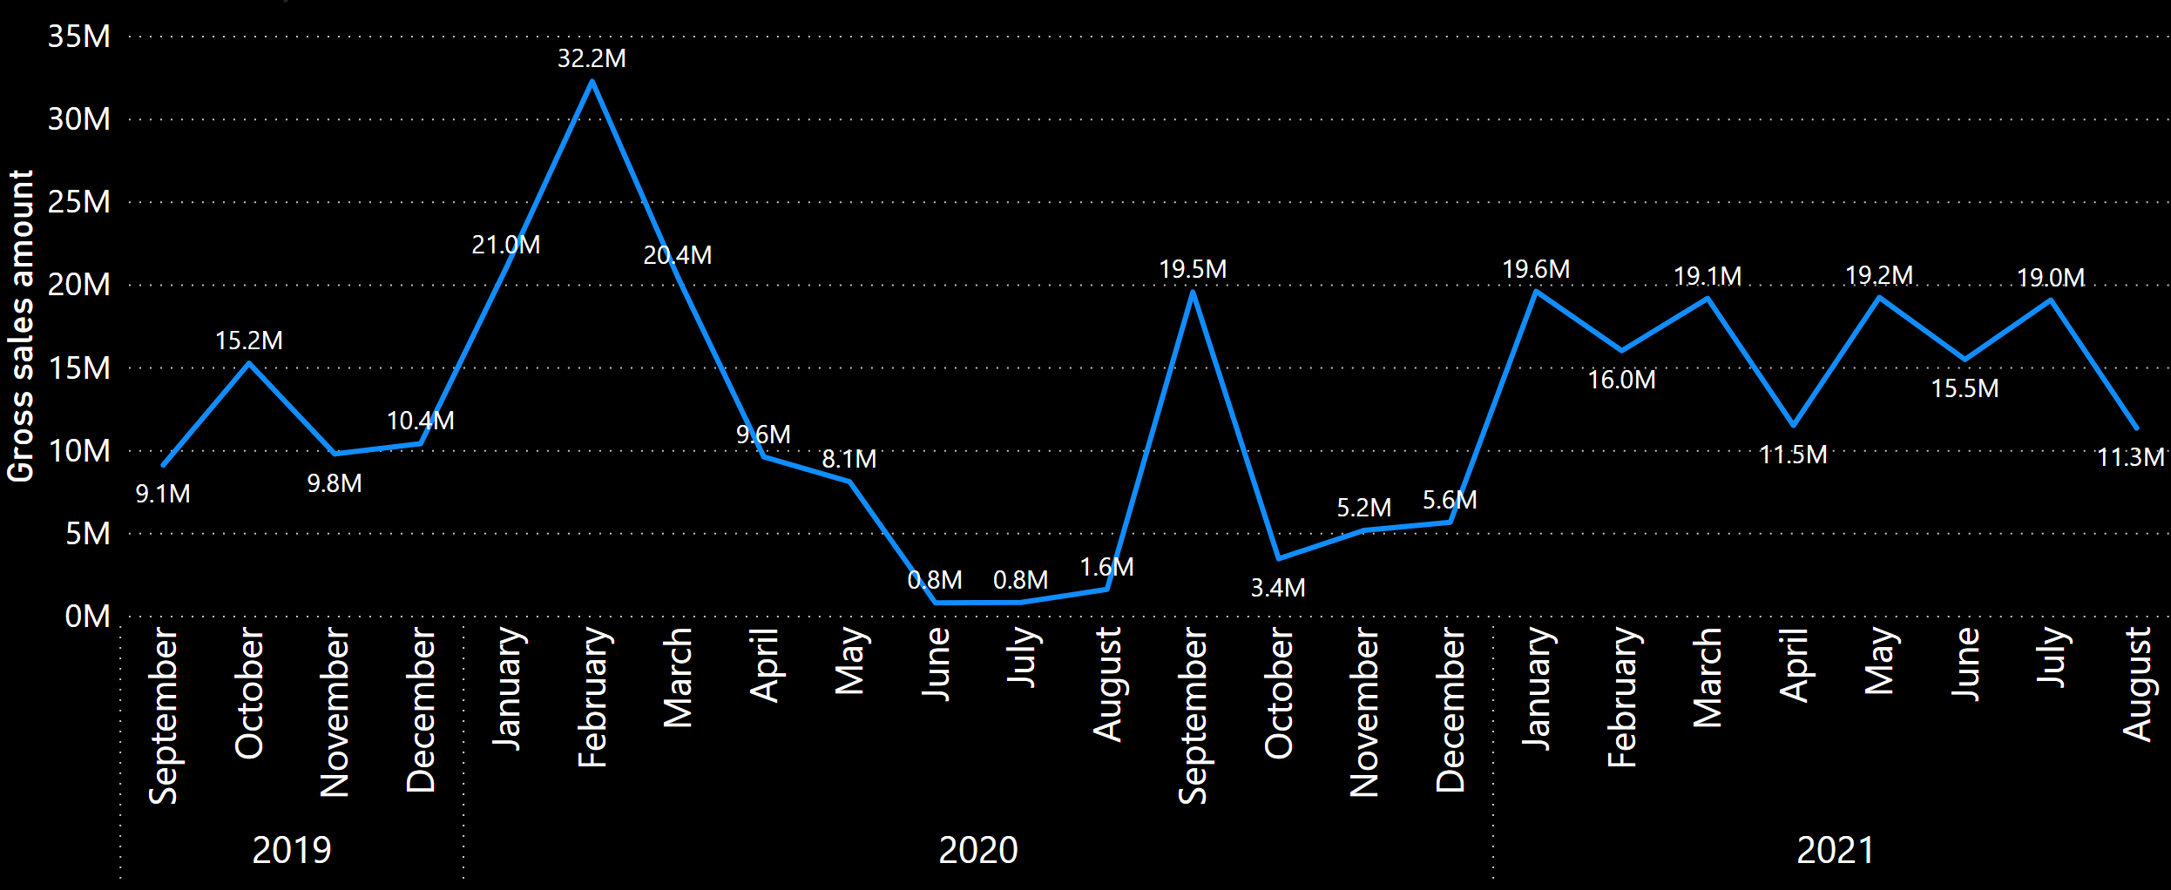
Insights
The company avg. sales in 2019 ̴ 12M
Sales increased in 2020 but due to corona drastic drop is observed.
Sales increased in 2021 due to presence of company in more product categories.

Slide 17
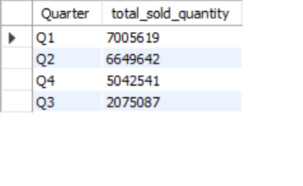
Sales quarterly analysis
Query-
In which quarter of 2020, got the maximum total_sold_quantity.
Output-

Slide 18
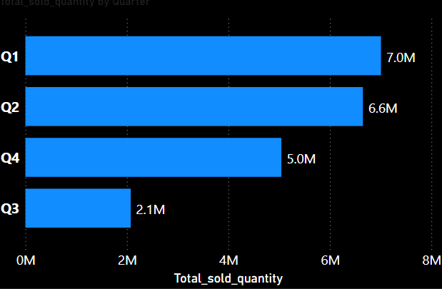
Insights
Q1(9th-11th month of 2020)
achieved highest sold products.

Slide 19
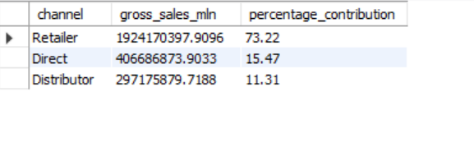
Sales contribution of Channel’s
Query-
Which channel helped to bring more gross sales in the fiscal year 2021 and the percentage of contribution.
Output-

Slide 20
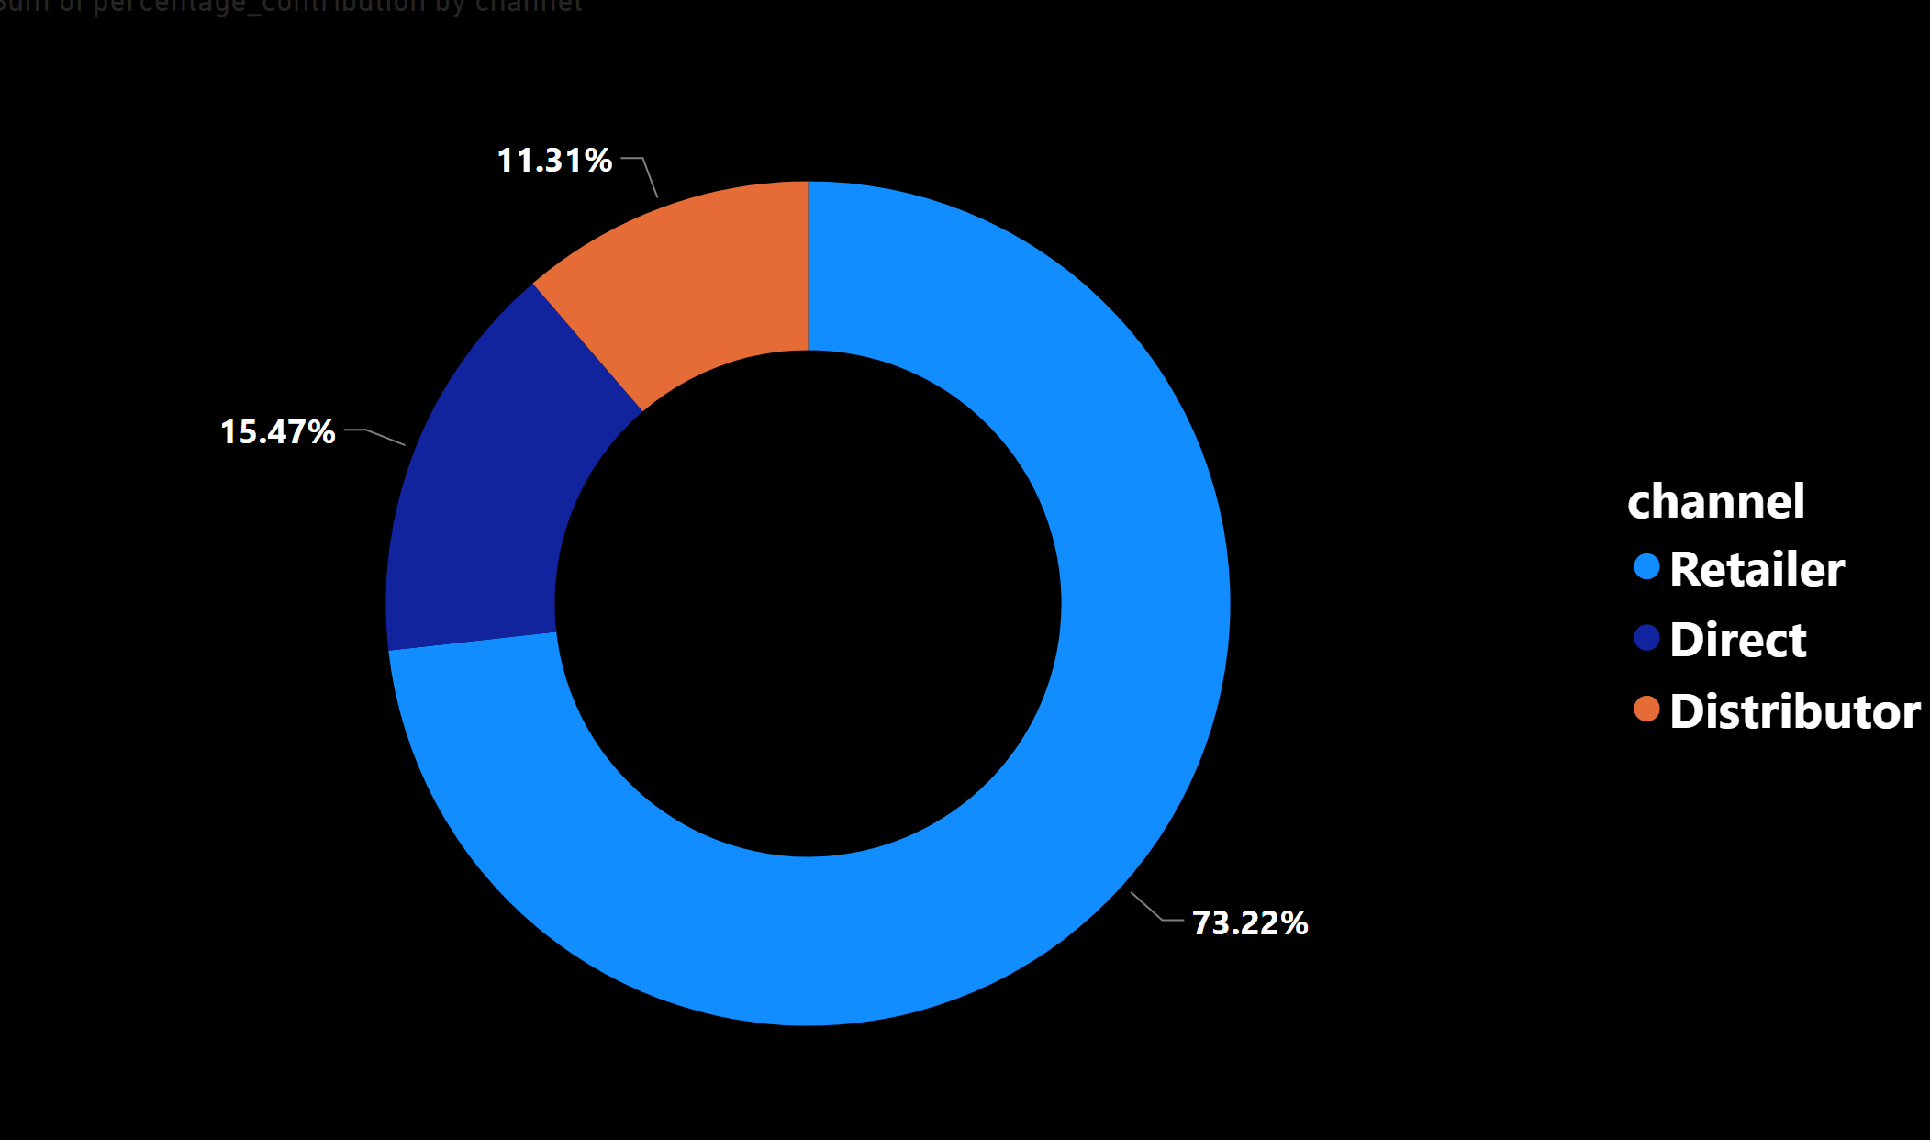
Insights
This shows the Atliq major contribution is through retailer.
The Atliq can plan strategies to encourage Direct channel to avail more profits .

Slide 21
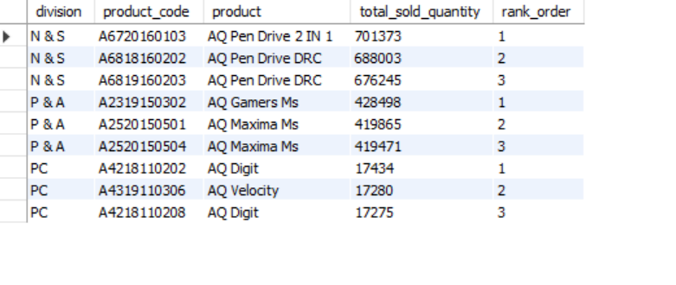
Top products in each division
Query-
Get the Top 3 products in each division that have a high
total_sold_quantity in the fiscal_year 2021.
Output-

Slide 22
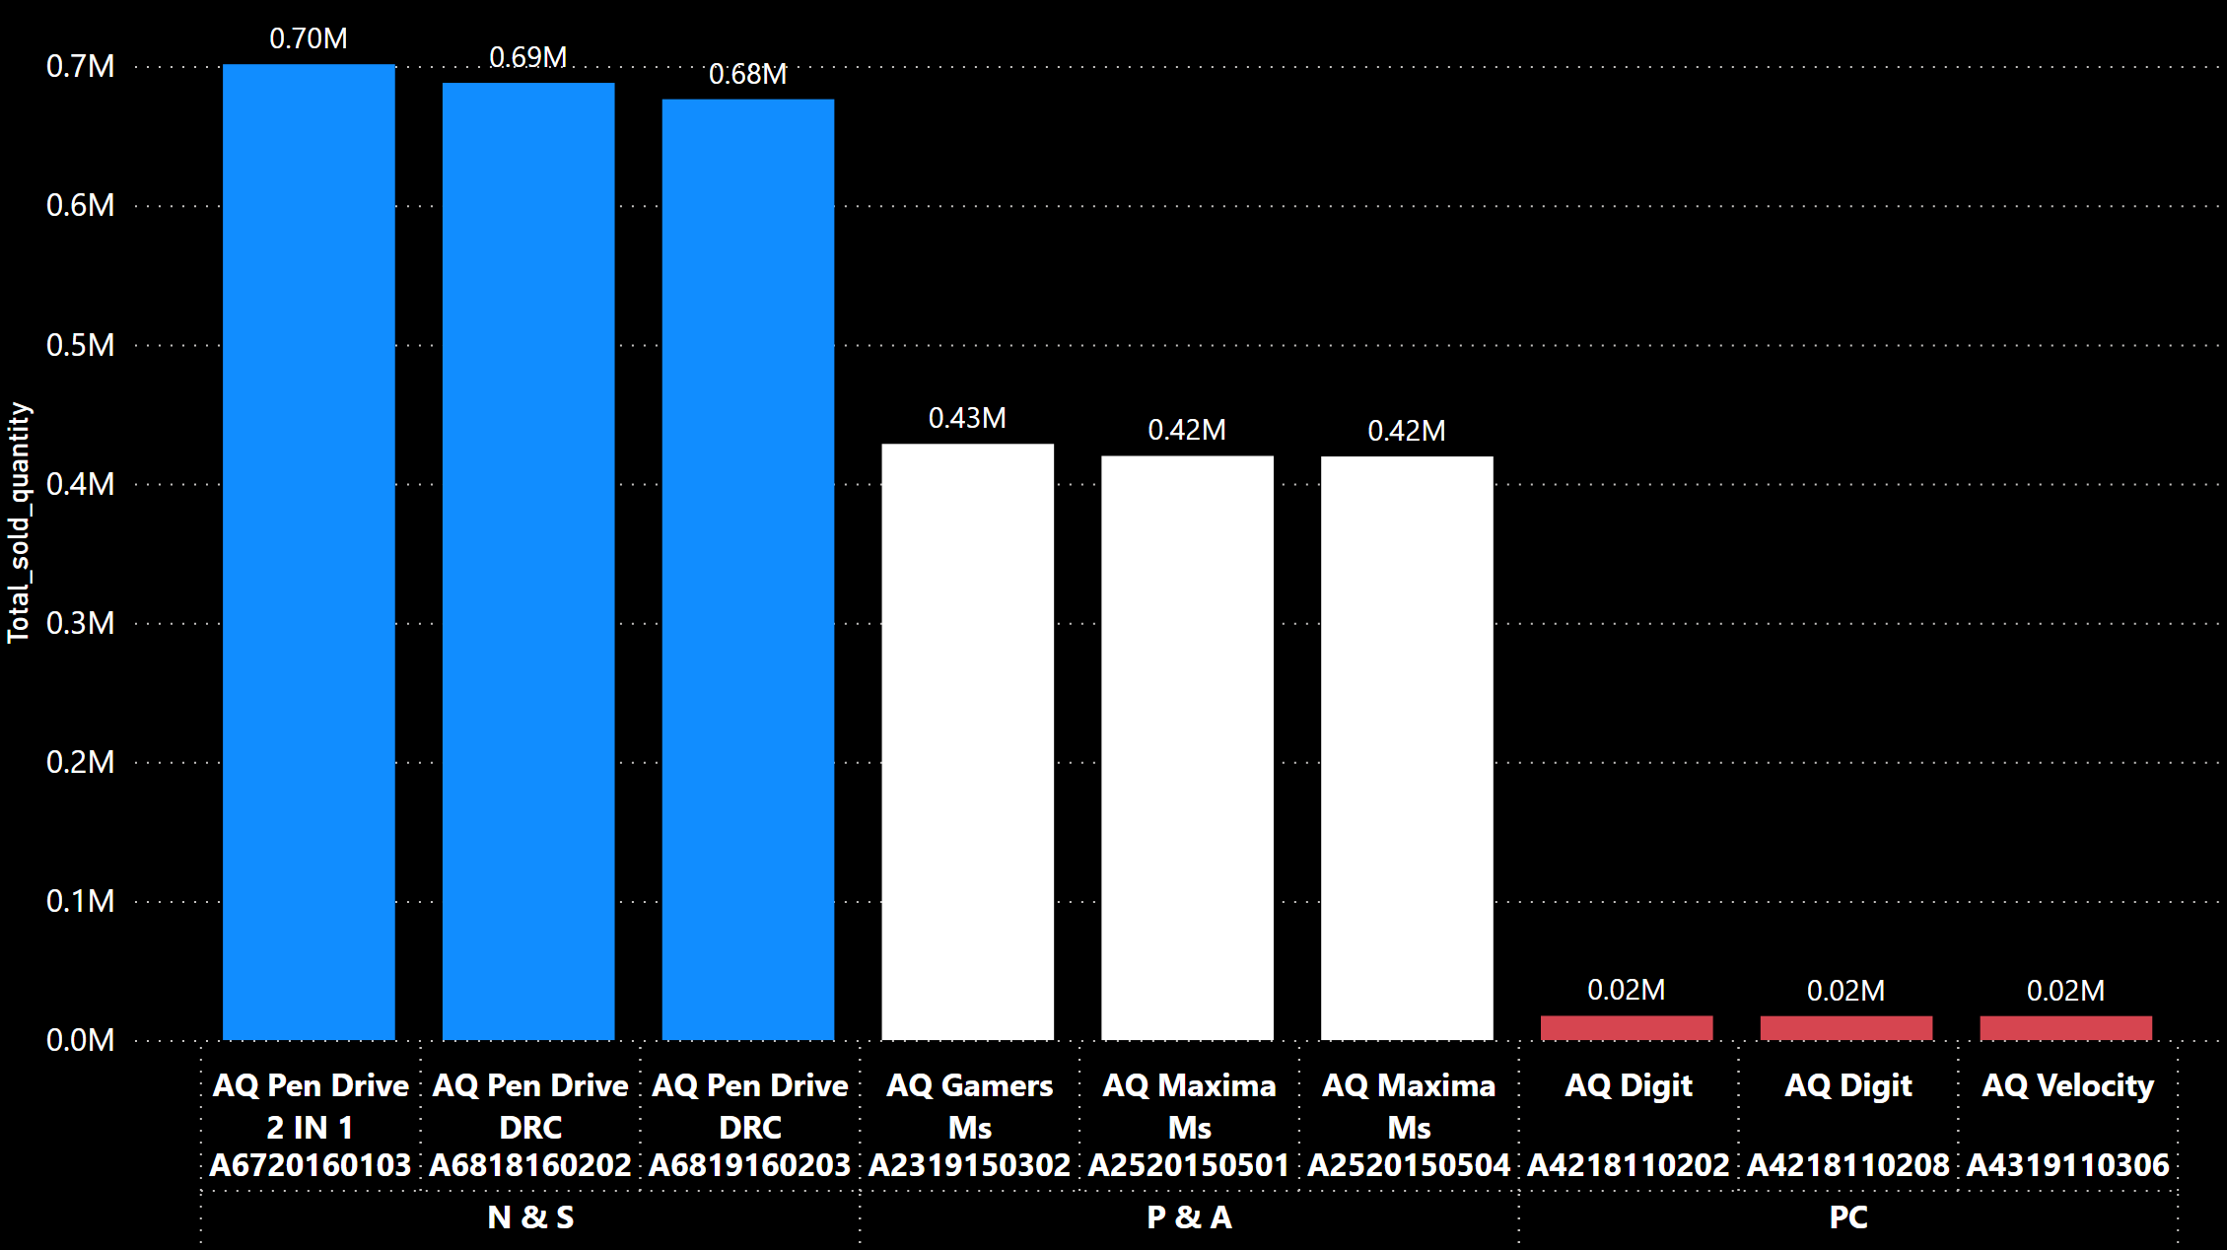
Insights
N&S products being low cost sold out in large quantity.
1:7(PC to P&A) customers are more towards updating existing systems.

Slide 23
Thank You

