Slide 1
Reliance Stock Market Prediction
Group 5:-
Ms. Naga Sai Hari Deepika Rampalli
Baira Mahendhar
SAMANVAI GOVIKAR
Mrs. Rohini Mahajan.
Yeshwanth Chalamarla
RANJEET KUMAR
Shubham Kumar Jha

Slide 2
Introduction
This project involves predicting stock prices of Reliance using multiple machine learning models.
It uses times series models for forecasting the future data.

Slide 3
Data Preparation
With the help of the Y finance module, we retrieve and collect the company's financial information (such as financial ratios, etc.)
We collected data from 1-Jan-2015 to 31-March-2023.
There are no null values and duplicated values in the data.

Slide 4
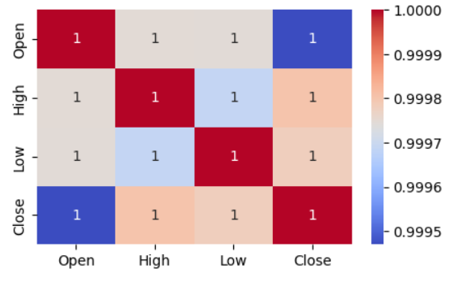
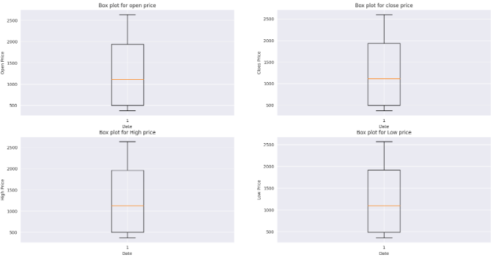
Data visualization
The attributes “Open”, “High”, “Low”, “Close” are highly correlated.
From the box plots, it was observed that there are no outliers.

Slide 5
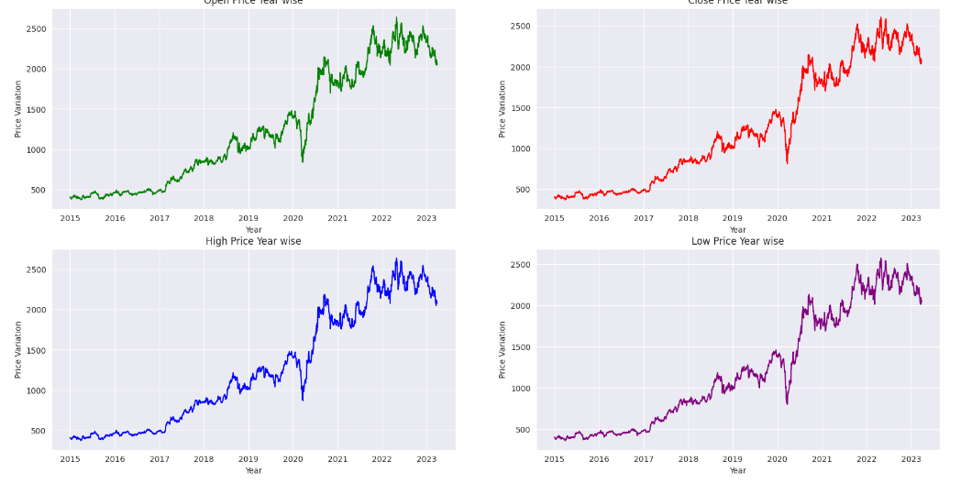
It was observed from the line plots that stock price got down rapidly in 2020 due to Corona.
It rises rapidly after lockdown.
The stock rate falls from 1500 to 800(46%) during peak Covid and then after recovered from 800 to 2100 (162%) at year end.

Slide 6
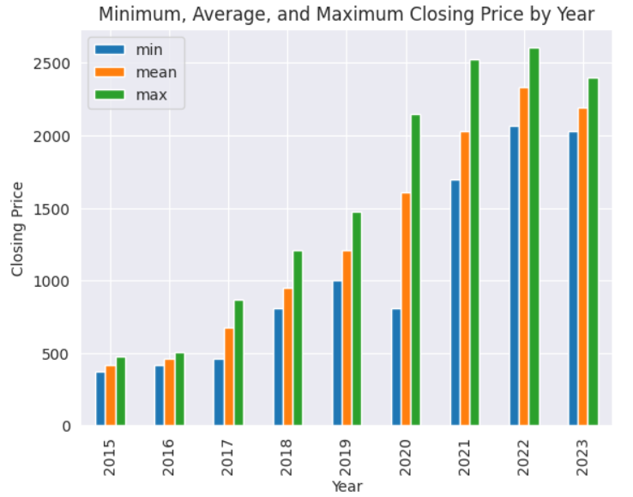
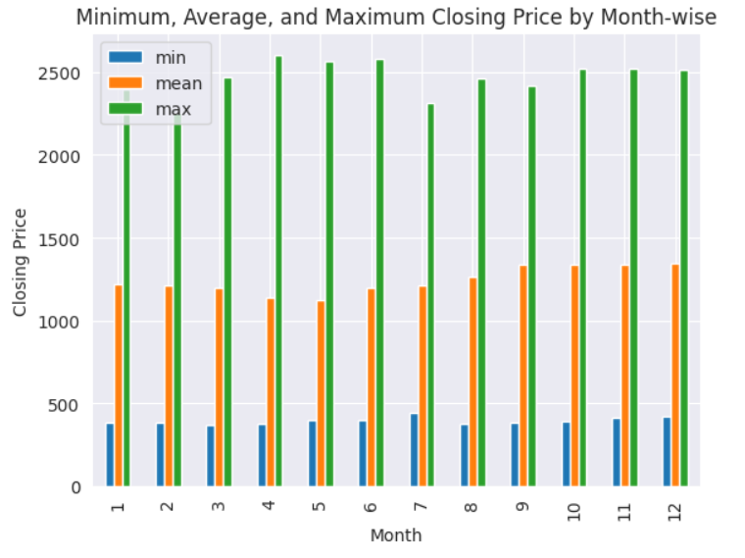
The min, max , average values of stock prices was analysed, which shows that there is a dip from 2022 to 2023.
There was a chance of fall from July to September.

Slide 7
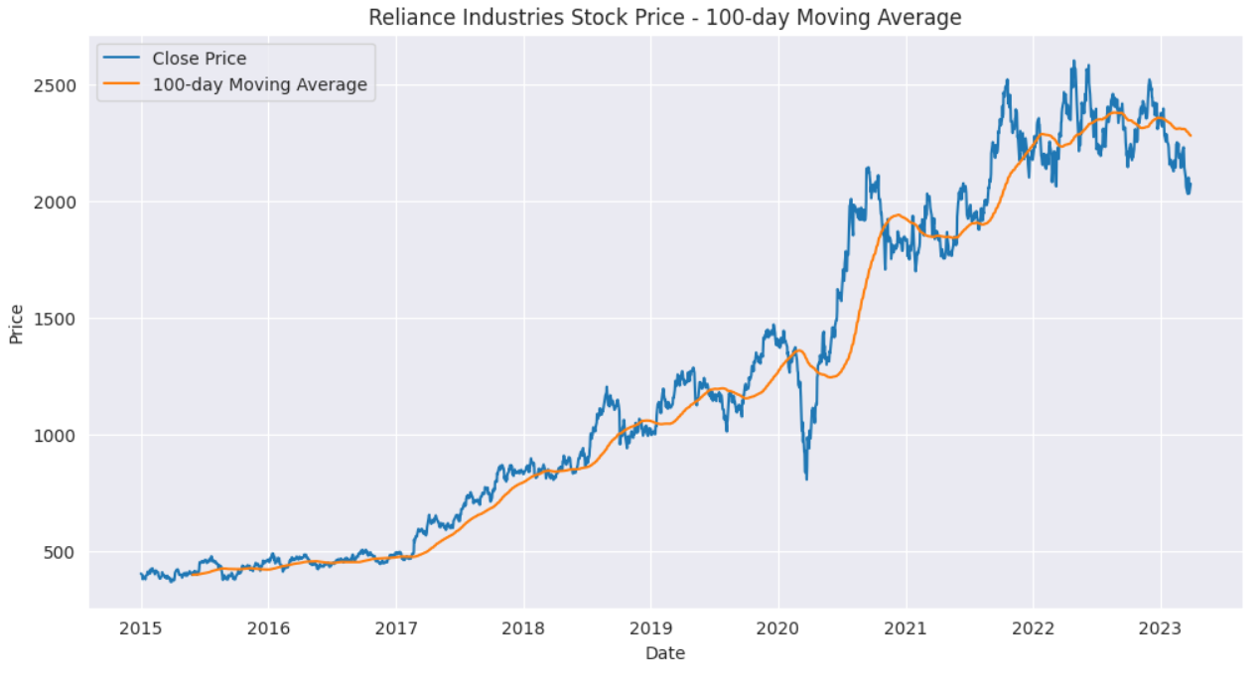
Between 2020 and 2021 , total no of shares sold/bought (buying/selling/ activity ) was high.
It was observed from moving average , that there is down trend during corona.

Slide 8
Feature engineering
The “close” column was taken for further analysis.
The “date” column was split into respective month, day and year.
Dummy columns for “month” column was created followed by logarithmic value of stock price was also created.
Other necessary columns for model building are created.

Slide 9
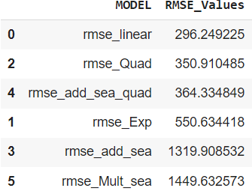
Model building
Linear , Exponential , Quadratic ,Additive seasonality, Additive seasonality quadratic and Multiplicative seasonality models are performed and RMSE values are compared.
Linear model was selected as the least RMSE value was obtained for this model.

Slide 10
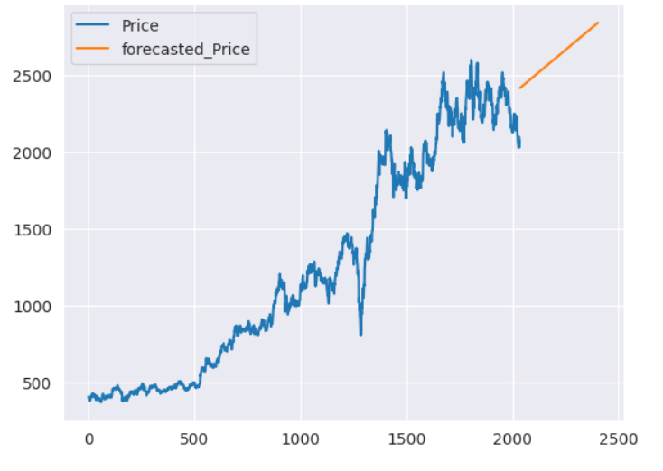
Evaluation
The linear model was fit to test data and predictions was made for next 365 days.

Slide 11
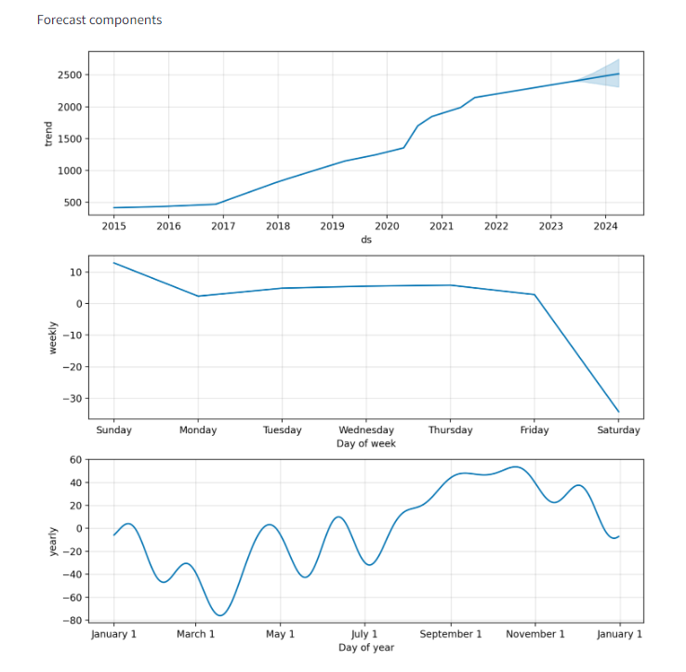
Deployment
Stream lit application was used for deployment.

Slide 12
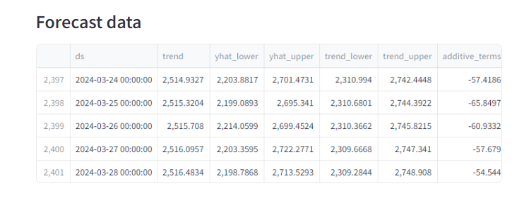
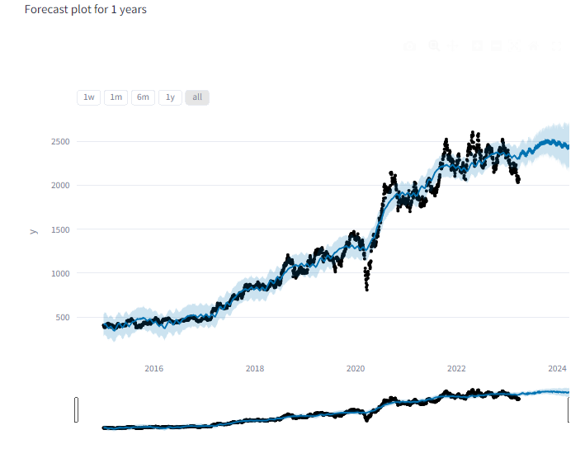

Slide 13
Thank You

