Slide 1

Retail Store Forecasting
MAHENDHAR BAIRA
mahendharbaira@gmail.com

Slide 2
What is Forecasting..?
Forecasting refers to the practice of predicting what will happen in the future by taking into consideration events in the past and present
Basically, it is decision-making tool that helps business cope with impact of the future’s uncertainty by examining historical data and trends.
Some business forecasting examples are.., Estimating future stock price, measuring the possibility of creating demand for a product,.. etc.
In this Case, we are going to predict future sales of an ONLINE RETAIL SOTRE and grabbing some insights by using various Machine Learning Algorithms.

Slide 3
About Dataset..
Invoice No: Invoice number. A 6-digit integral number uniquely assigned to each transaction. If this code starts with the letter 'c', it indicates a cancellation.
Stock Code: Product (item) code. A 5-digit integral number uniquely assigned to each distinct product.
Description: Product (item) name.
Quantity: The quantities of each product (item) per transaction.
Invoice Date: Invoice date and time. The day and time when a transaction was generated.
Unit Price: Unit price. Product price per unit in sterling (Â£).
Customer ID: Customer number. A 5-digit integral number uniquely assigned to each customer.
Country: Country name. The name of the country where a customer resides.

Slide 4
Data Analysis and Insights
- Insights from the Data

Slide 5
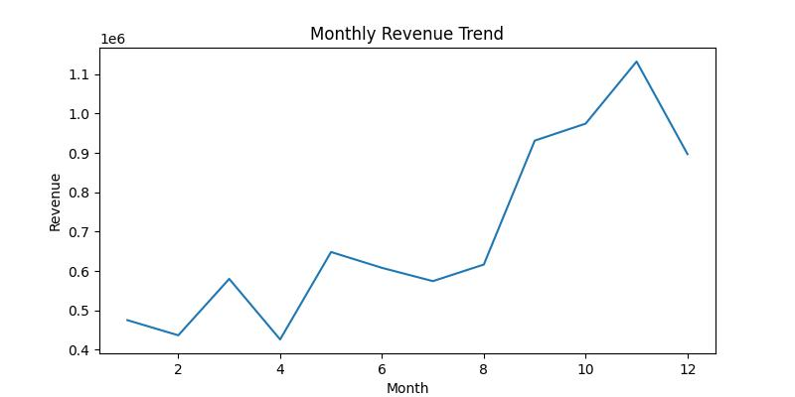
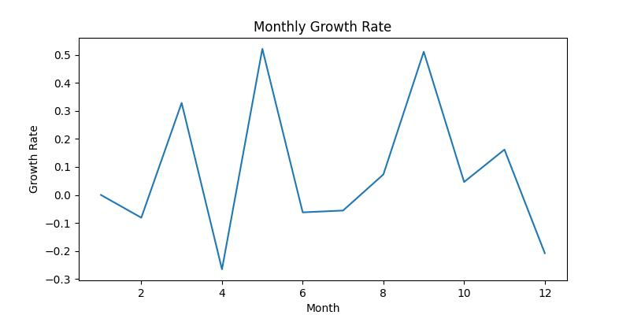
Monthly Analysis
If We closely observe the fig -1, Sales during last quarter(Q-4) increased than first three quarters
During April month., sales got down. After April., Sales raised suddenly almost 52% growth. It can be observed fig-2
So sales for even months got downed and for odd months sales increased.
Fig-1
Fig-2

Slide 6
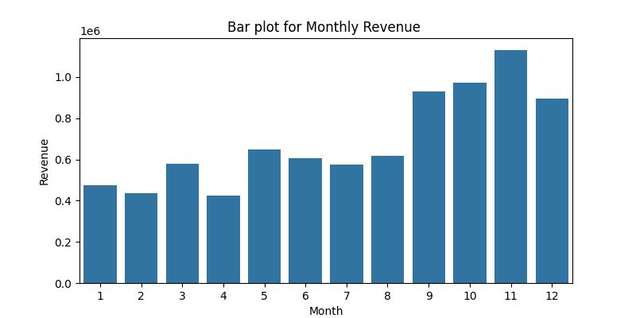
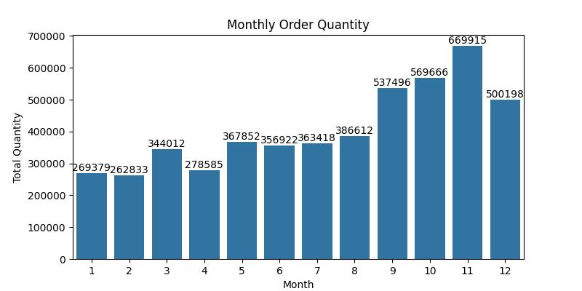
Sales and Revenue
During September, October, November, December ., sales revenue increases as Customers are more interested in buying Items.
In November , sales revenue got touched all-time high of 1million
From fig-4 we can observe the Monthly order quantity
Fig-3
Fig-4

Slide 7
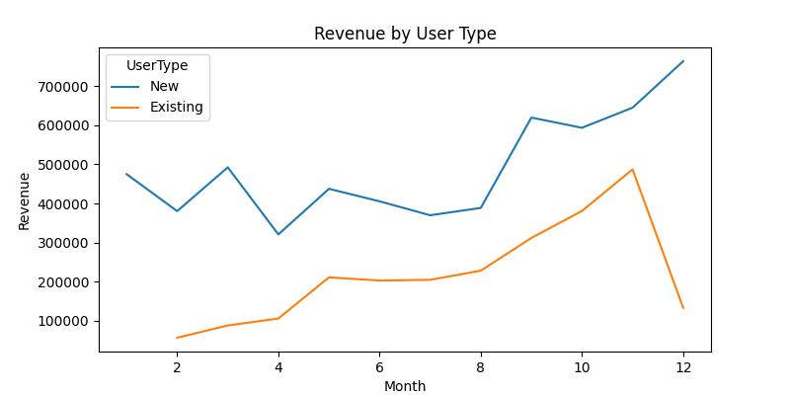
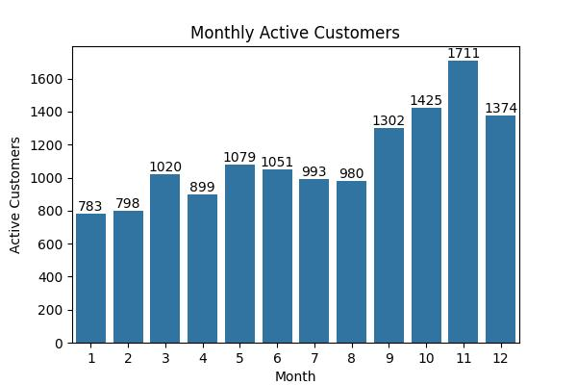
Customers
If we closely observe the fig-5, Existing Customers revenue is below the New customers. That means existing customers are not regularly visiting the store.
So we should retain the existing customers to increase our sales. Because with out them there would be no business.
From fig-6 , for the first 8 months customers attention is very less in purchasing. We must attract the customers by making some offers in purchasing.
Fig-5
Fig-6

Slide 8
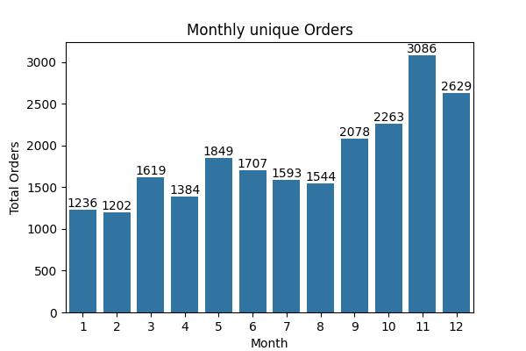
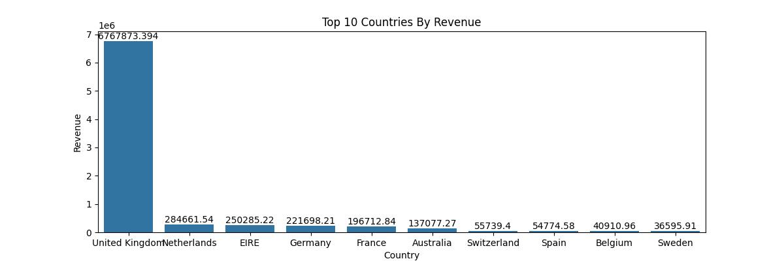
Orders and Revenue
From fig-7 we can clearly see that, people are less interested in purchasing new items compared to last quarter
From fig-8, as the retail store is in Europe., revenue from UK is more followed by Netherlands, EIRE, Germany
We should encourage the customers from neighbor countries also
Fig-7
Fig-8

Slide 9
Model Building
- By using different ML forecasting algorithms, we built models for future sales forecasting

Slide 10
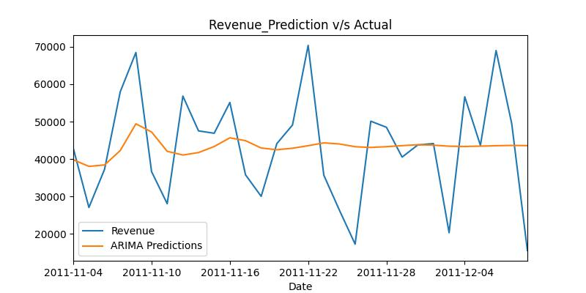
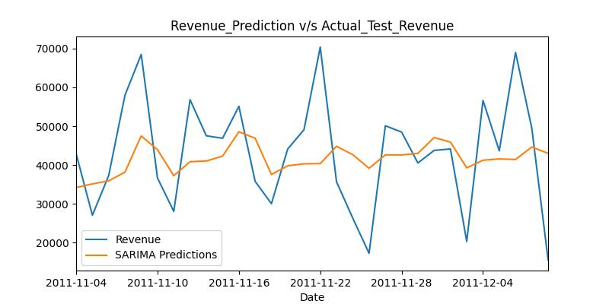
ARIMA & SARIMA
ARIMA takes into account the past values (autoregressive, moving average) and predicts future values based on that.
SARIMA similarly uses past values but also takes into account any seasonality patterns.
Fig-9 gives ARIMA predictions v/s test data
Fig -10 gives SARIMA predictions v/s test data
Fig-9
Fig-10

Slide 11
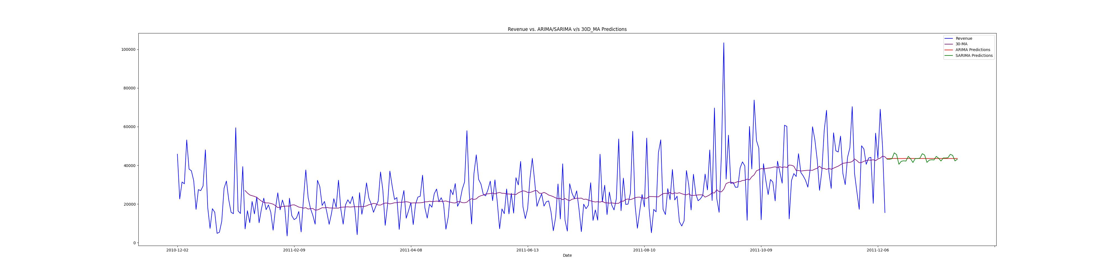
Final Line plot with ARIMA SARIMA and 30-day MA

Slide 12
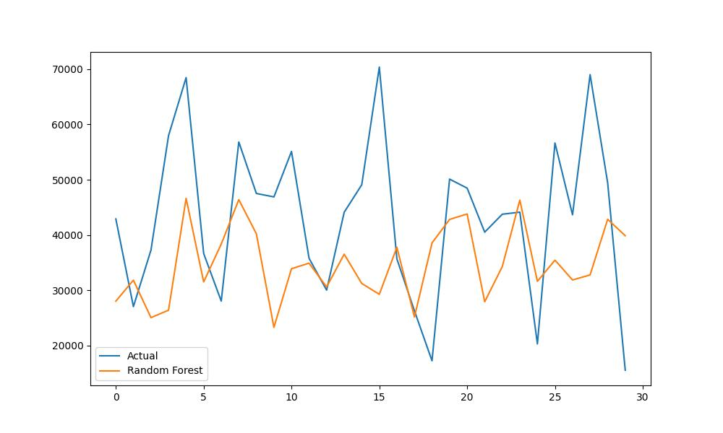
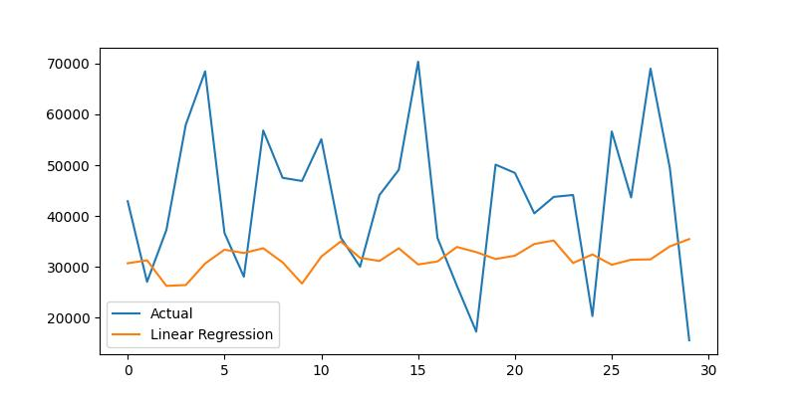
Supervised Machine Learning Model
We can use supervised learnings for forecasting
Here, shifting the data by (7,14,21) as 1st week, 2nd week, and 3rd week. Taking them as independent variables, I have built the models
Fig-11 shows, Random Forest model prediction with Test data
Fig-12 shows, Linear regression model prediction with Test data
Fig-11
Fig-12

Slide 13
Model Deployment
I have Developed a deployment code with stream lit. In that I have used Prophet algorithm for Forecasting
Run the code with stream lit run filename.py
By adjusting the slider. We can forecast monthly sales.

Slide 14

Thank you

