Slide 1
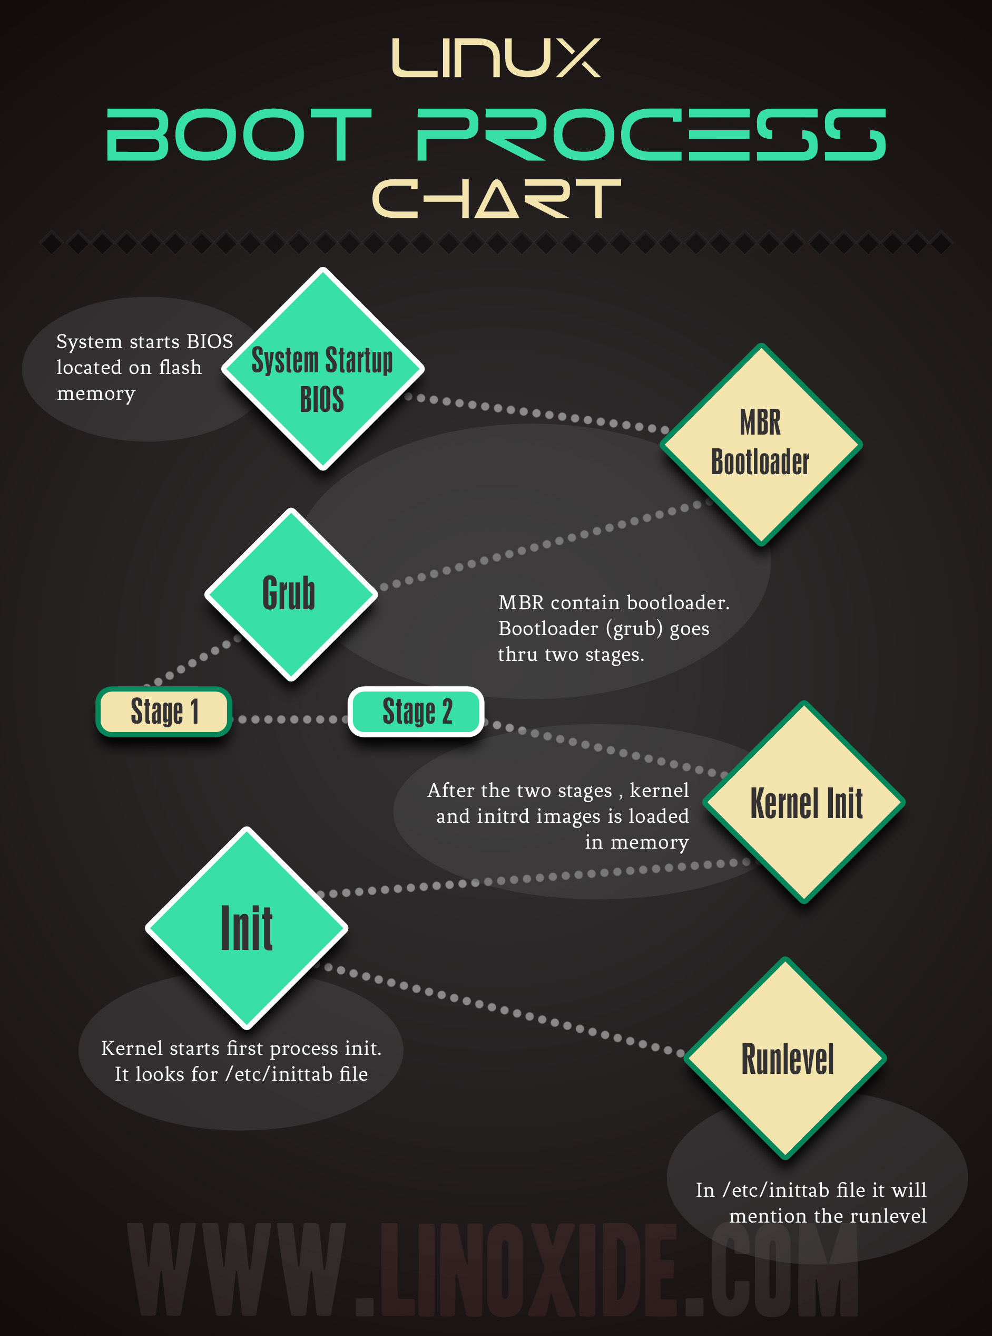

Slide 2
Basic Input Output System(BIOS)
BIOS is a firmware program that performs a very basic level of interaction with the hardware.
This is the first program that takes control when the computer is switched on.
The BIOS performs a test on all the hardware components and peripherals called POST or the “Power On Self Test”.
It initializes the required hardware for booting.
The BIOS checks for the boot sector on the bootable device.
Boot sector is the first physical sector on the storage device,
and contains the code required for booting the machine.

Slide 3
Master Boot Record (MBR)
In case of hard disks and many other mass storage media, the boot sector is MBR.
MBR consists of 512 bytes at the first sector of the hard disk.
It is important to note that MBR is not located inside any partition.
MBR precedes the first partition.
The layout of MBR is as follows:
  First 446 bytes contain bootable code.
  Next 64 bytes contain partition information for 4 partitions (16x4).
  The last 2 bytes are for MBR signature, also called magic number.
MBR contains the bootloader.

Slide 4
GRand Unified Bootloder (GRUB)
According to gnu.org, "a bootloader is the first software program that runs when a computer starts".
GRand Unified Bootloader is the bootloading program for Linux like operating systems.
There are two main versions of Grub that are available (Grub version 1 and 2).
One main feature of grub is that it can be installed using Linux image and there is no need for running the operating system.
Grub is a multi-stage bootloader (Stage1, Stage 1.5 and
Stage 2).

Slide 5
Kernel Initialization
After Stage 2 of GRUB loads the selected kernel into memory and turns control of the computer over to the kernel.
All of the kernels are in a self-extracting, compressed format to save space.
The kernels are located in the /boot directory, along with an initial RAM disk image, and device maps of the hard drives.
It serves as a temporary root file system and helps kernel to boot properly without mounting any root file system.
Now that all the drivers are loaded into memory, and kernel has booted, kernel mounts the root filesystem in read only mode, and starts the first process.

Slide 6
Init Process
The ‘init’ is the first process started by kernel (initialization process).
It is the parent of all processes.
The PID (Process ID) of init process is always 1.
This process persists till the computer halts.
It is responsible for the whole state of system.

Slide 7
Run Levels
Runlevel is the state in which a system boots.
It can boot in a single user mode, multi-user mode, with networking, and with graphics etc.
The following are the default runlevels defined by Linux:
  0: Halt or shutdown the system
  1: Single user mode
  2: Multi-user mode, without networking
  3: Full multi user mode, with NFS (typical for servers)
  4: Officially not defined; Unused
  5: Full multi user with NFS and graphics (typical for desktops)
  6: Reboot

