Slide 1
Function pointers
- Repaka srinivas

Slide 2
Sub Topics
Function pointers
  What is function ?
  What is function pointer ?
  What is the use of typedef in function pointer?
  Different ways of returning a function pointer from function ?
  When we need function pointers ?
  Advantages using function pointers ?
  Site for understanding complex function pointer declarations ( https://cdecl.org/)

Slide 3
Function :- A function is a group of statements that together perform a task
Function consisting of : -
    Function declaration
    Function call
    Function definition
Function itself is not a variable , but it is possible to define pointers to functions, which can be placed in arrays, passed to functions, returned by functions ,and so on.

Slide 4
Function pointer is also called a subroutine pointer or procedure pointer, is a pointer that points to a function.
As opposed to referencing to a data value, a function pointer points to a executable code within memory.
Deferenecing the function pointer yeilds the referenced function, which can be invoked and passed arguments just as in a function call.such accessing is called indirect access.

Slide 5
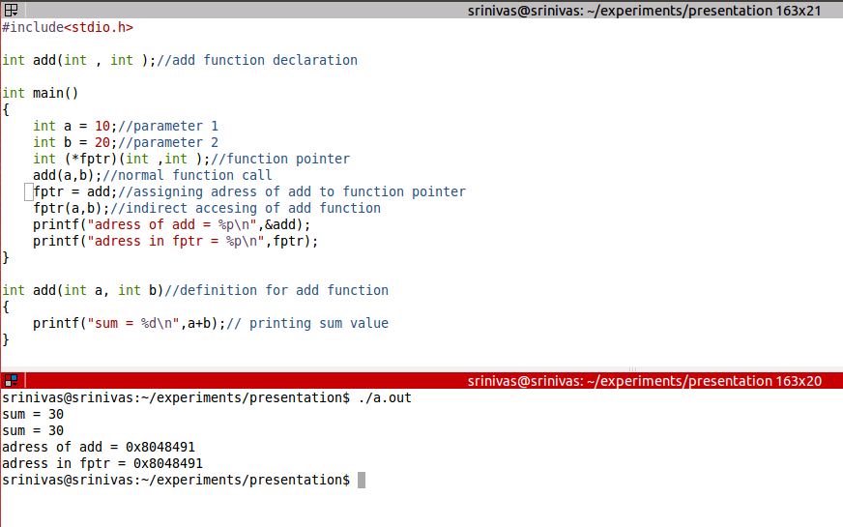

Slide 6
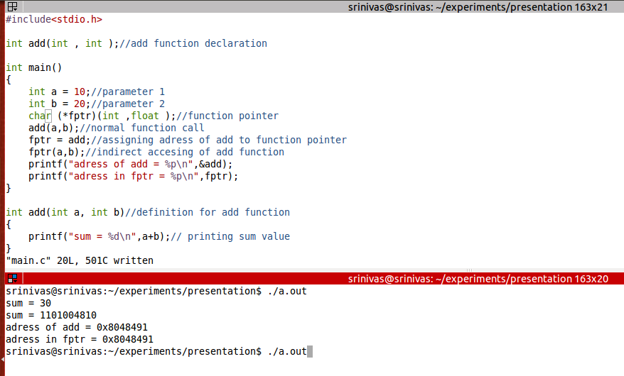

Slide 7
Typedef is a keyword used in c language to assign alternative names to existing datatypes.
Typedef interpretation is performed by the compiler.
Typedef gives an aliasing name for function pointer so that complexity of using function pointer decreases.
Using typedef we can easily understand the function pointers rather than using the function pointers full notation.

Slide 8
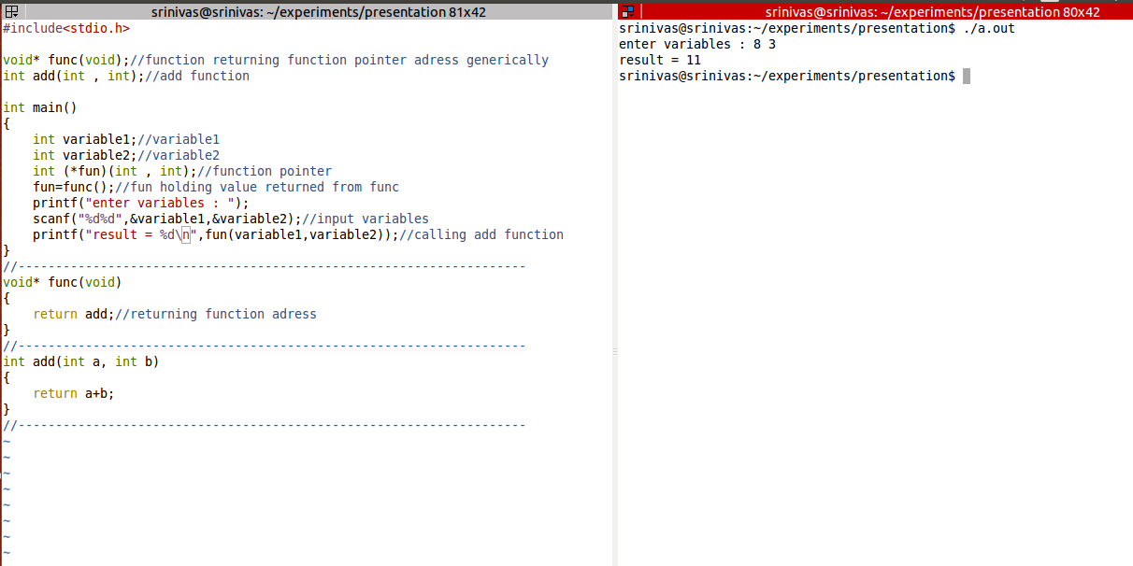

Slide 9
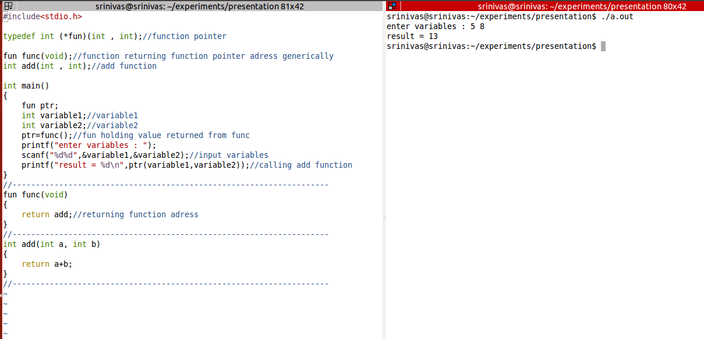

Slide 10
Function pointers can be useful when you want to create callback mechanism, and need to pass address of an function to another function.
Function pointers can be useful when you want to store an array of functions ,to call dynamically.
A function pointer is used when you have to switch between various versions of some implementation depending on what the user chooses for the particular session.

Slide 11
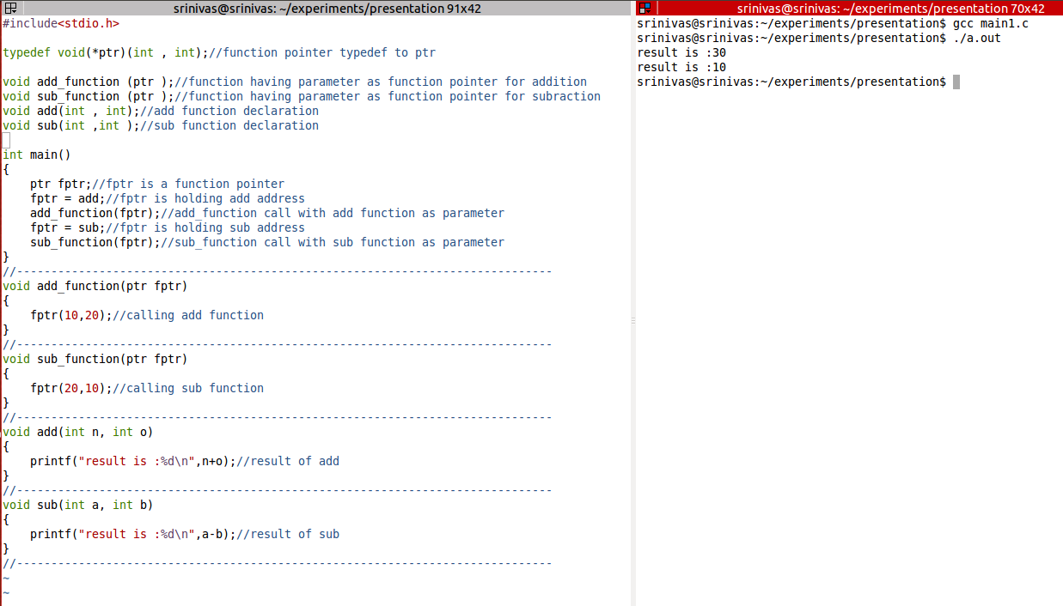

Slide 12
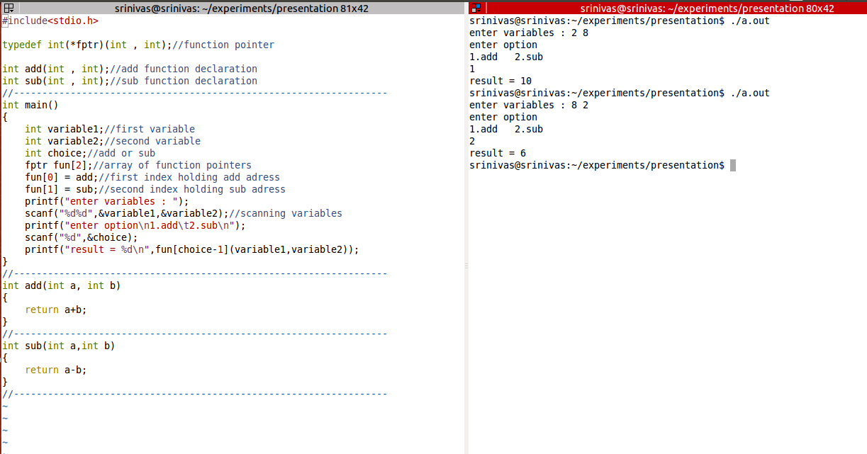

Slide 13
When we need functions to be called in a structure, we cannot call directly that fuctions in c language
But with using function pointers we can call function inside a structure

Slide 14
