Slide 1
Data Types In The Kernel
LDD_Team2C

Slide 2
Contents
Introduction
Use of Standard C Types
Assigning an Explicit Size to Data Items
Interface Specific Types
Portability Issues
Linked Lists

Slide 3
Introduction
What are data types?
Why kernel datatypes?
Three types of kernel data types
standard C types – basic types,
explicitly sized types – types with explicit size,
types used for specific kernel objects – special kernel data
types.

Slide 4
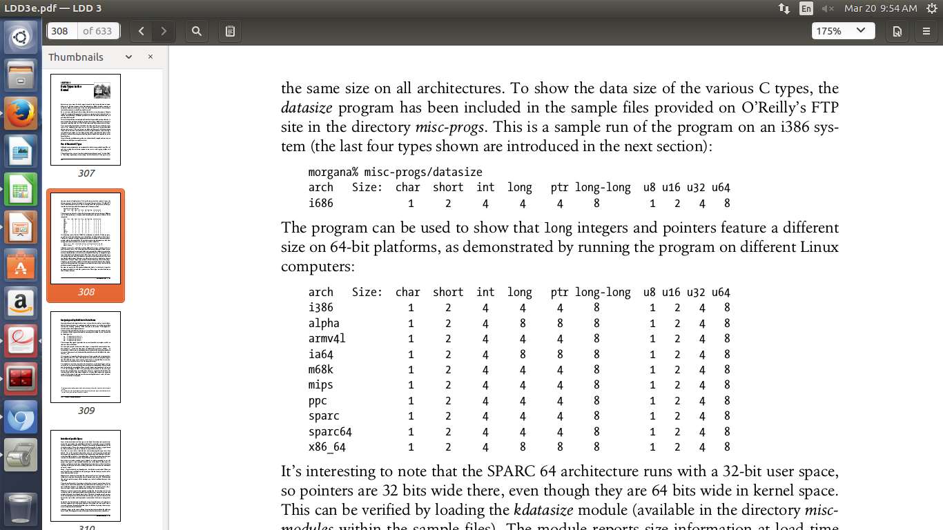
Use Of Standard C Types
Basic data types
Example int, char, long ... etc.
Size varies for different architecture

Slide 5
Use Of Standard C Types
  interesting example:
SPARC 64 uses (used:)) 32-bit user space,
pointers 32 bit,
in kernel pointers are 64 bit

Slide 6
Assigning An Explicit Size To Data Items
To know the size of data
  u8; /* unsigned byte (8 bits) */
  u16; /* unsigned word (16 bits) */
  u32; /* unsigned 32-bit value */
  u64; /* unsigned 64-bit value */
If a user-space program needs to use these types, use __ prefix (e.g., __u8)
Kernel also uses conventional types, such as unsigned int
Usually done for backward compatibility

Slide 7
Interface Specific Types
Defined by a library to provide an interface to specific data structure (e.g., pid_t).
Many _t types are defined in <linux/types.h>
Problematic in printk statements
One solution is to cast the value to the biggest possible type (e.g., unsigned long)
Avoids warning messages
Will not lose data bits

Slide 8
Portability Issue
Time intervals
Page size
Byte order
Data alignment
Pointers and error values

Slide 9
Time Intervals
clock maintained by kernel is measured in terms of jiffies
Jiffies
informal term for unspecified short period of time
defined as time taken for light to travel in one second in vaccum
time taken between two ticks of system timer interrupt
defined with ’HZ’

Slide 10
Time Intervals(contd...)
HZ determines how many times in a second the timer interrupt occurs
initially HZ was set to 100, and later to 250, then 1000, now kernel configuration parameter (100, 250, 300 (for video), 1000).

Slide 11
Page Size
always not 4kb
varies depends on architecture from 4kb to 64kb
programmers should not hardcode page size as 4kb
macros used :
  PAGE_SIZE
  PAGE_SHIFT
user space function : getpagesize()
to get free pages : get_free_pages(GFP_KERNEL, getorder(n)), n should be multiples of 2

Slide 12
Byte Order
code should not be affected by byte ordering
depends on processor :
  __BIG_ENDIAN
  __LITTLE_ENDIAN
conditional compilation :
  #ifdef __LITTLE_ENDIAN
  #ifdef __BIG_ENDIAN
but macros are easy for conversion

Slide 13
Byte Order(contd...)
some macros are :
  cpu_to_be64
  be64_to_cpu
  cpu_to_le64p
  le64_to_cpup
  cpu_to_be32s
  be32_to_cpus

Slide 14
Data Alignment
when try to read 4bytes of data at address which is not a multiple of 4, what happens ?
can achieve this using :
  natural alignment
  filler fields
  defined in kernel version (asm/unaligned.h) :
    get_unaligned(ptr)
    put_unaligned(val, ptr)

Slide 15
Pointer and Error Values
most kernel functions return pointer to caller function
on failure, it returns NULL
but in some cases , error code should be generated & returned
this can be achieved by :
  void *ERR_PTR(long error)
  long IS_ERR(const void *ptr)
  long PTR_ERR(const void *ptr)

Slide 16
Linked Lists
Types of linked list
1) Singly Linked List
2) Doubly Linked List
3) Circular Linked List
The simplest and most common data structure in the Linux kernel.
The list functions perform no locking.

Slide 17
Linked Lists
To use the list mechanism, your driver must include the file <linux/list.h>
This file defines a simple structure of type list_head:
struct list_head {
struct list_head *next, *prev;
};

Slide 18
Linked Lists
Driver maintains a list of things to do. It's declaration would look something like this :
struct todo_struct {
struct list_head list;
int priority; /* driver specific */
/* ... add other driver-specific fields */
};

Slide 19
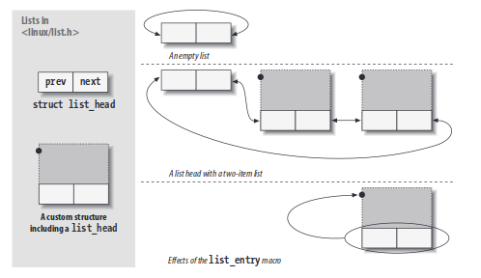
Linked Lists
The head of the list is usually a standalone list_head structure.
The simple struct list_head is used to maintain a list of data structures.

Slide 20
Linked Lists
List heads must be initialized prior to use with the INIT_LIST_HEAD macro. A “things to do” list head could be declared and initialized with:
struct list_head todo_list;
INIT_LIST_HEAD(&todo_list);
Alternatively, lists can be initialized at compile time:
LIST_HEAD(todo_list);

Slide 21
Linked Lists
The head of the list is usually a standalone list_head structure.
The simple struct list_head is used to maintain a list of data structures.

Slide 22
Linked Lists
A macro, list_entry, is provided that maps a list_head structure pointer back into a pointer to the structure that contains it.
It is invoked as follows:
list_entry(struct list_head *ptr, type_of_struct, field_name);
Using the provided macros helps avoid simple programming errors; the developers of these macros have also put some effort into ensuring that they perform well.

Slide 23
References
https://static.lwn.net/images/pdf/LDD3/ch11.pdf/
https://notes.shichao.io/lkd/ch6/

