Slide 1
Topic Name- Virtual memory,paging, swapping
Presented By : Vinay

Slide 2
Topics
Virtual memory
Structure of page table
Demand paging
Swapping

Slide 3
Virtual and Physical Address
Physical addresses are the locations that exists in memory unit
MMU computes physical address for corresponding logical
address.
Virtual addresses are provided by the OS to processes.
One virtual address space per process.
Programs use virtual addresses.

Slide 4
Virtual and Physical Address contd.
Logical address = page number + page offset
Physical address = frame number + page offset
Address translation: conversion of the virtual address to a
physical address.
Address translation is done by the MMU
MMU: it is the run time mapping from logical to physical address
space
It can be done with a relocation register

Slide 5
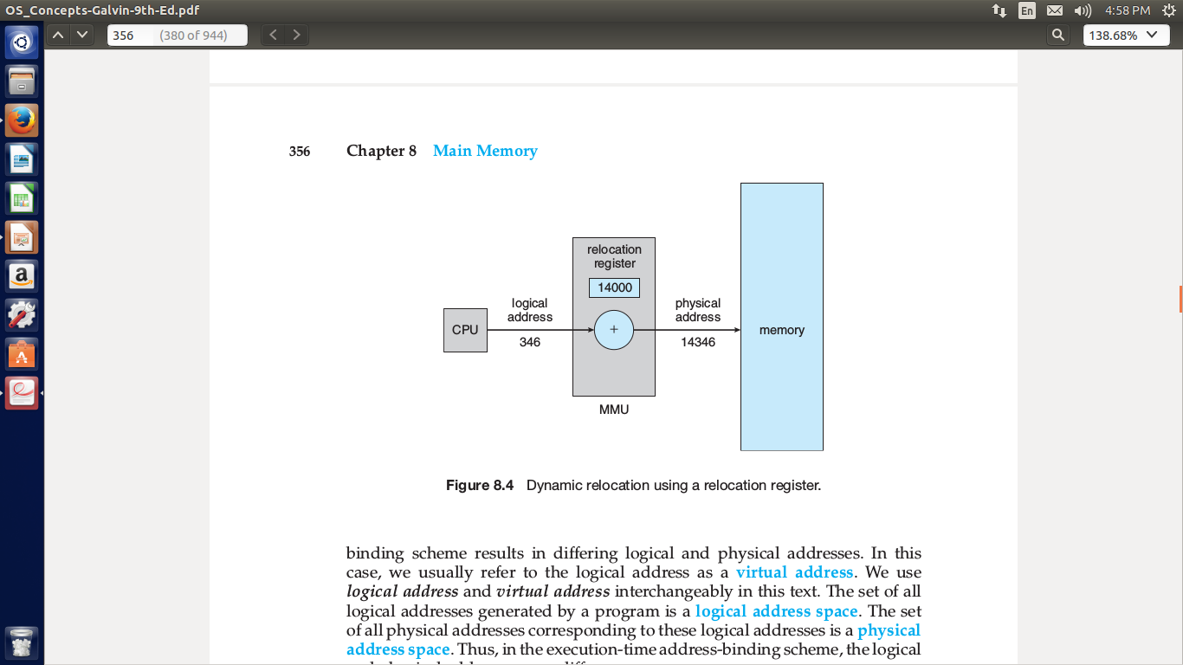
MMU

Slide 6
Virtual memory
The term virtual memory refers to something which appears to be present but actually it is not.
This technique allows users to use more memory for a program than the real memory of computer.
In this technique, we keep only a part of process in the memory
and other part on the disk(secondary storage)

Slide 7
Virtual memory contd.
Advantages
Only a part of program needs to be in the memory for execution
Logical address space is much larger than the physical address
space
Needs to allow pages to be swapped in and swapped out
Disadvantages
We need to maintain entire image of process in disk storage

Slide 8
Paging
Each virtual address space is divided into fixed-size chunks called pages.
Physical address space is divided into equal size frames.
Frame size matches page size.
MMU translates virtual addresses to physical using the page table of the running process.
Page size = Frame size
Advantages
we can make physical address as non contiguous

Slide 9
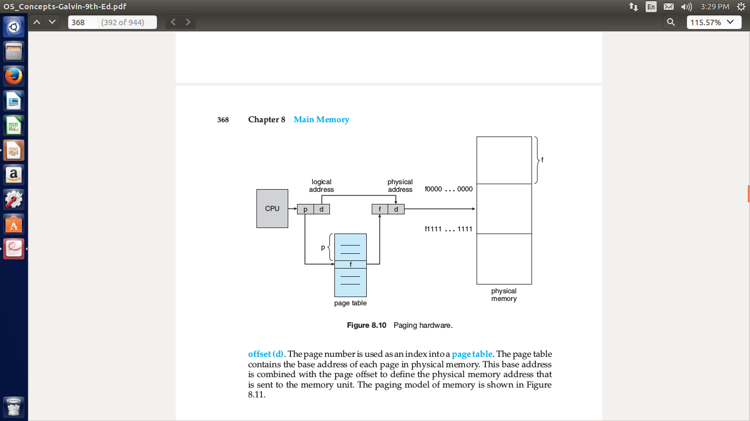
Paging contd.

Slide 10
Paging contd.
CPU generates logical address into two different parts
1)page number
2)offset
Page number is checked in the page table/page map table
Page map table maps which page number is stored at which
frames.
Page table contains the entry of page number and the
corresponding frame number from that we get the physical
address.

Slide 11
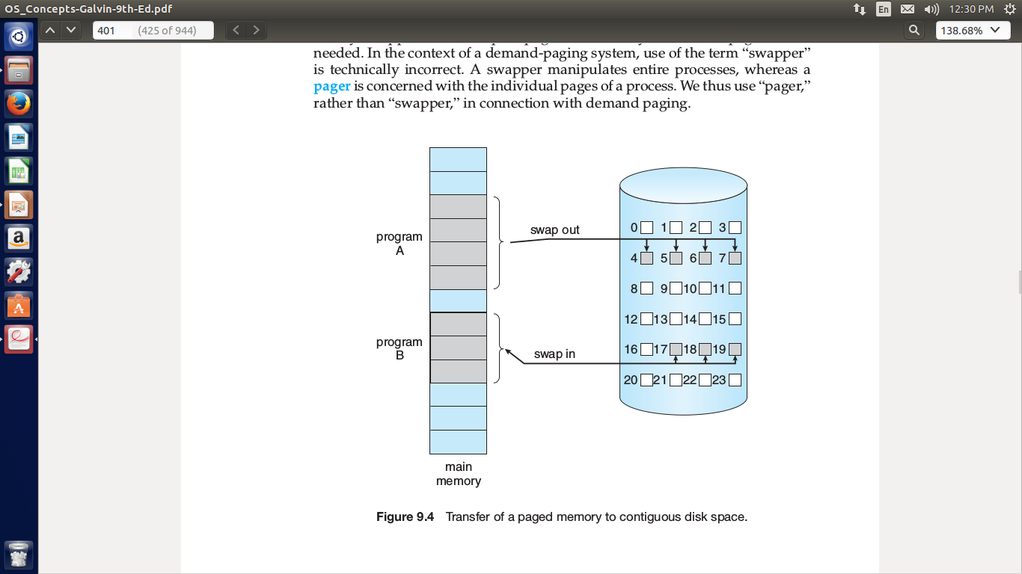
Demand paging
Implementation of VM is done
through demand paging.
A page is brought into memory
for it's execution only when it
is demanded.
It combines the paging and
swapping.

Slide 12
Demand paging contd.
Advantages
Reduces memory requirements
Swap time is reduced
It increases the degree of multi-programming
Disadvantages
Occurance of page fault

Slide 13
Demand paging contd.
Page fault
Whenever there is a requirement of any page and that page is not present in the main memory results in page fault.
Since the pages are not loaded from disk into the main memory
Page fault is used in the performance measurements.

Slide 14
Demand paging contd.
Effective access time(E) = [(P * page fault time) + (1-P) * ma]
Where
E = Effective access time
P = Probability of page fault
(1-P) = Probability of no page fault
ma = Memory access time

Slide 15
Translation Lookaside Table(TLB)
TLB: it is a hardware cache used to keep track of recently used transactions.
Each entry in the TLB contains a page number and frame number pairs.
It reduces the access time of the memory.
TLB
TLB hit (entry is found)
TLB miss (entry is not found)

Slide 16
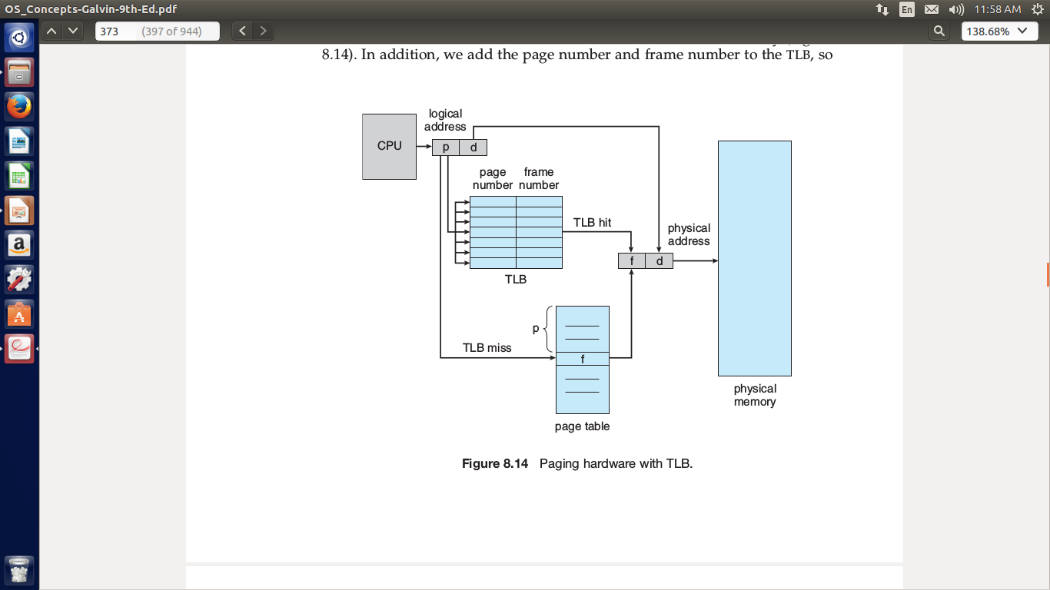
TLB condt.

Slide 17
Swapping
It is a mechanism in which a process can be swapped temporarily out of main memory to secondary storage.
So that memory is available to other processes.
It is the process of swap in and swap out of the processes or
jobs from disk to physical memory and vice versa.
Swap out process is the process that takes the job from physical memory to disk after completion of execution.
Swap in process is the process that takes the job from disk to the physical memory for execution purpose.

Slide 18
Swapping contd.
Variations of Swapping
Roll in and Roll out process:= used for the priority based scheduling algorithm.
If a higher priority process arrives and wants service of memory.
Then the memory manager will swap lower priority process to higher priority process.

Slide 19
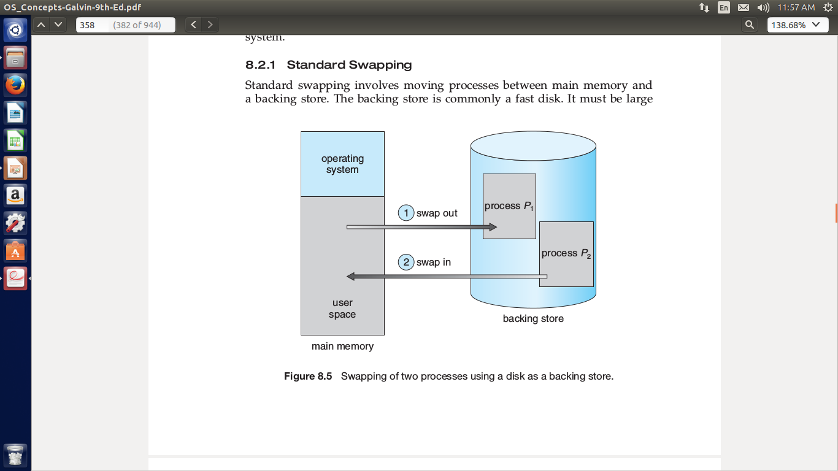
Swapping Contd.

Slide 20
Structure of page table
1)Hierarchial paging.
2)Hashed page tables.
3)inverted page tables.

Slide 21
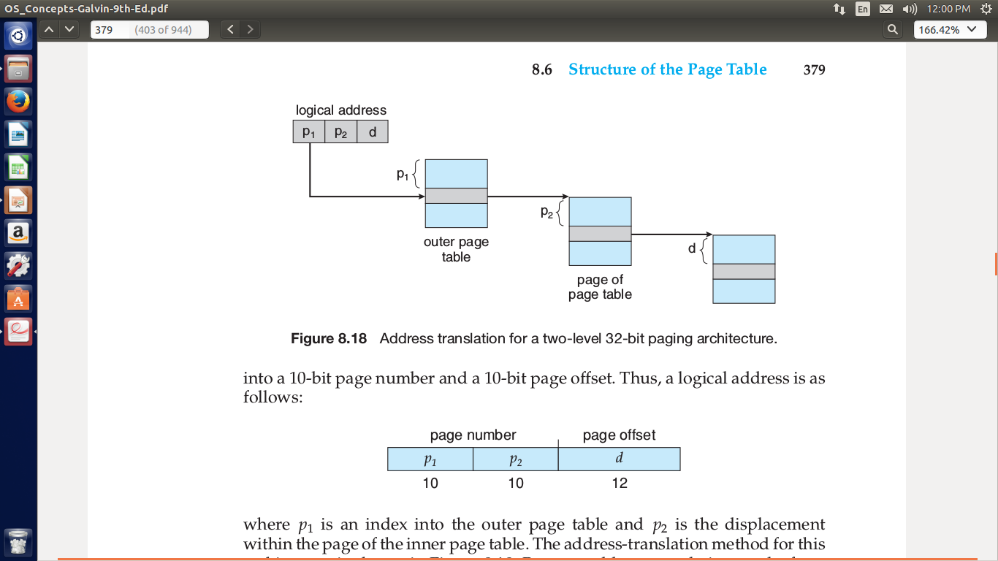
Hierarchical paging
It is two level paging
known as forward-mapped
page table
Break the logical address
space into multiple page tables

Slide 22
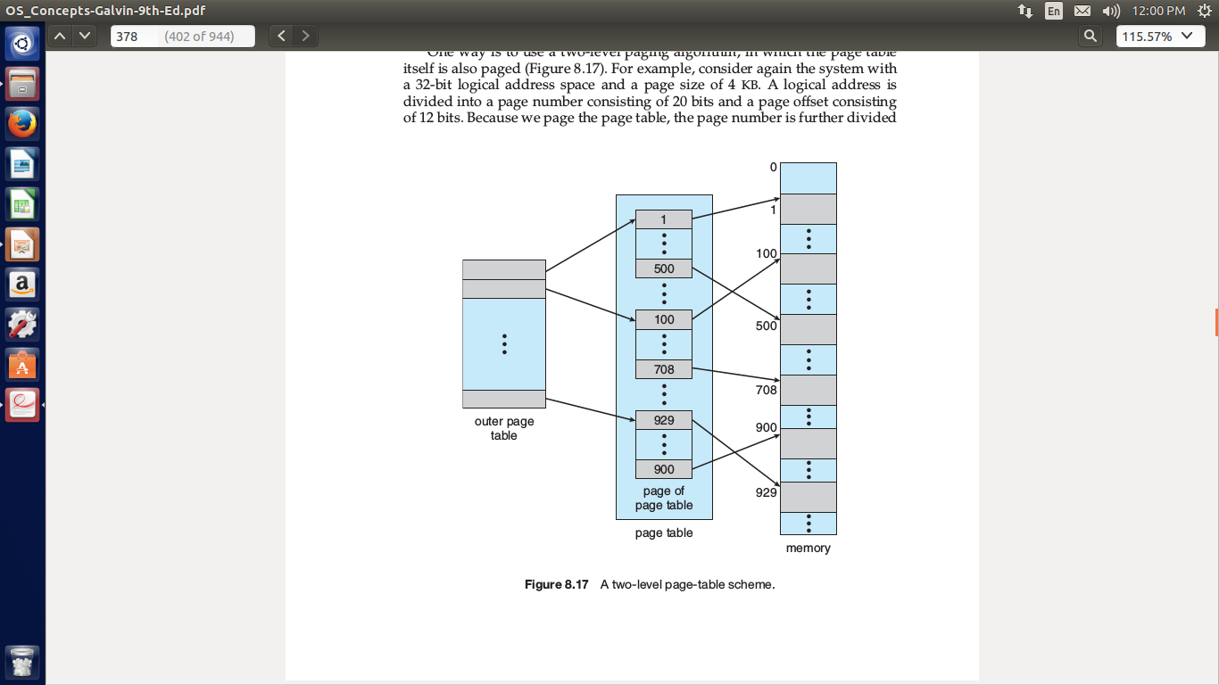
Two level paging

Slide 23
Hierarchical paging
Where
P1 = index into outer page table
P2 = displacement within the page of inner
page table.

Slide 24
Hashed paging
Address space > 32 bits
Virtual page number is hashed into page table
This page table contains a chain of elements hashing to the
same location.
Each element contains
1)virtual page number
2)value of the mapped page frame
3)pointer to the next element
Virtual page numbers are compared in this chain searching
for the match
If the match is found, the corresponding physical frame is
extracted.

Slide 25
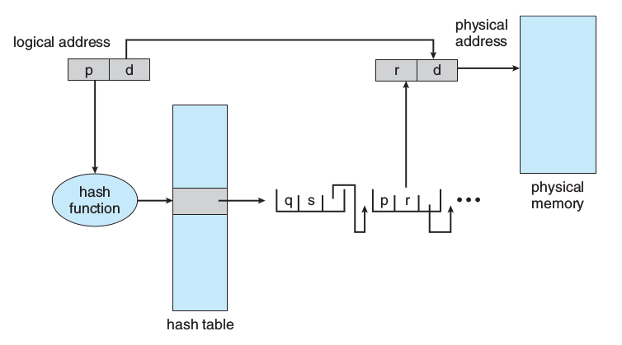
Hashed paging

Slide 26
Inverted page table
One entry for each real page of memory
Each consist of the virtual address of page stored in that real
memory location
Decreases memory needed to store page table
Increases the time needed to search the table when a page
reference occurs

Slide 27
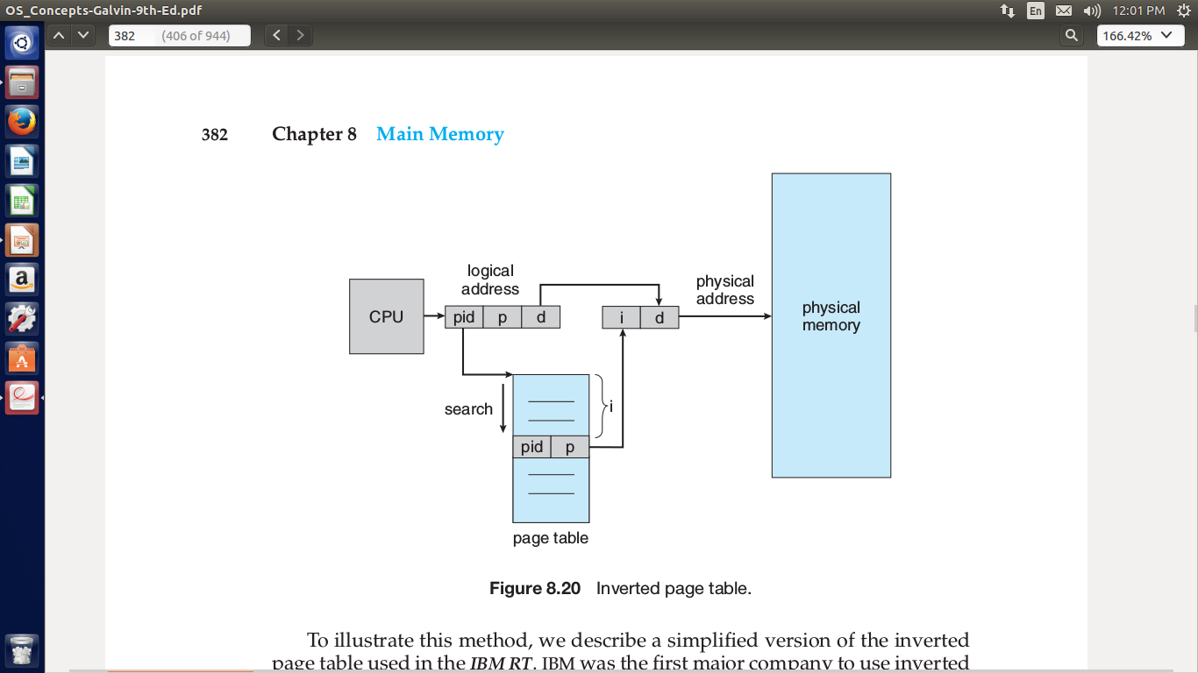
Inverted page table

Slide 28
Summary
Understood virtual memory
Understood paging, TLB
Understood demand paging
Understood structure of page table

Slide 29
References
Operating system concepts 9th Edition – Abraham Silberschatz,
peter Galvin, Greg Gagne.

