Slide 1
Self-referential Structure & Table Lookup
By
Sai kiran jv

Slide 2
Structure :-
    Strucure is a user defined data type , which is a collection one or more variables possibly of different types under a single name.
          Struct student {
                int id ;
                int class;
          }stu[10]

Slide 3
Self-referential Structure :-
    A structure pointing to a structure of same type.
          struct student {
                int id ;
                char name[20];
                struct student *next;
          }stu[10]
    Why can't we use a normal pointer ??
    Linked lists.

Slide 4
Lookup Table :-
    A lookup table is an array that replaces runtime computation with a simpler array indexing operation.
    Uses Hash technique.

Slide 5
Hash technique :-
    A hash table is a data structure used to implement an associative array, a structure that can map keys to values.
    A hash table uses a hash function to compute an index into an arrray of slots , from which the desired value can be found.
    Load factor = number of entries(n)/array size (m)
Key
Hash function
value

Slide 6
Hash Function:-
Division:
  h(k) = k mod m
  The size m of the hash table is usually chosen to be a prime
  Donot prefer 2 and 10.
Multiplication:
  h₂ (k) = [(ak ) mod 2pow(r)]>>(w-r).
  w is the max bit length of system you are working.
  a is a random number.
  m=2pow(r).

Slide 7
Mapping:-
U
(universe of keys)
0
h(k₁)
h(k₄)
K
(actual
keys)
k₁
k₄
h(k₂)
k₂
k₃
h(k₃)
m–1

Slide 8
d
U
(universe of keys)
0
h(k₁)
h(k₄)
K
(actual
keys)
k₁
k₄
k₂
collision
h(k₂)=h(k₅)
k₅
k₃
h(k₃)
m–1

Slide 9
Collision :-
Two words can hash to the same array index, resulting in collision.
Open Addressing: Search the array in some systematic way for an empty cell and insert the new item there if collision occurs.
Separate chaining: Create an array of linked list of words, so that the item can be inserted into the linked list if collision occurs.

Slide 10
Chaining:-
Keys: 0, 1, 4, 9, 16, 25, 36, 49, 64, 81
hash(key) = key % 10.
0
0
1
81
1
2
3
4
64
4
5
25
6
36
16
7
8
9
49
9

Slide 11
Open addressing:-
    All elements stored in hash table itself.
    When collisions occur, use a systematic (consistent) procedure to store elements in free slots of the table.

Slide 12
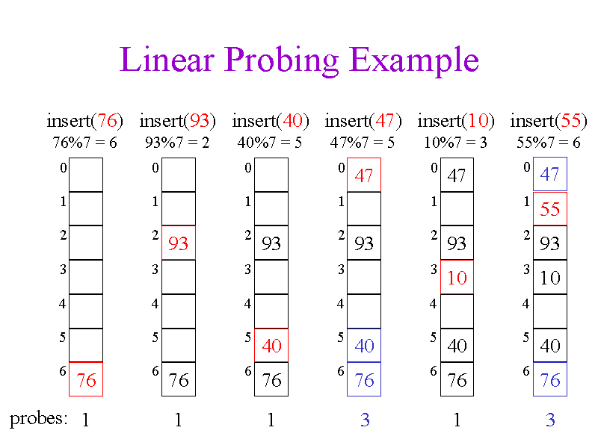
Linear probing :-
    h'(k)= [h(k)+f(i)]%m.
        f(i) = i
        where i = 0,1,2......
    Disadvantage is clustering.

Slide 13
Quadriatic probing :-
    h'(k)= [h(k)+f(i)]%m.
        f(i) = i pow (2). where i = 0,1,2......
    Easy for searching the element .

Slide 14
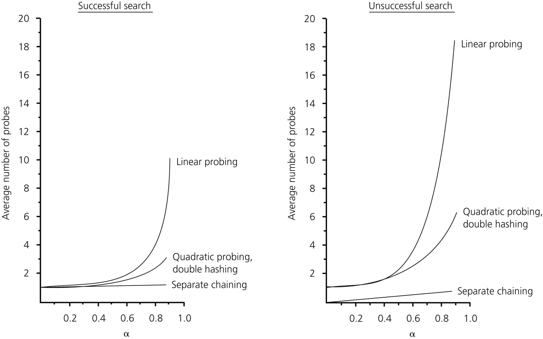
The relative efficiency of three collision-resolution methods
CENG 213 Data Structures

Slide 15
Thank you ...

