Slide 1
Signals
Abhijeet W

Slide 2


Contents
What is signal ?
  What is default action of signal ?
  Data structure associated with signal
  List of signals
Signal Disposition
  Signal system call & its drawback.
  How to send signals via keystroke, command, function , system call ?
  Sigaction system call & how to use it ?
Sigevent

Slide 3
Contents (cnt ...)
Some examples
Summary
Reference

Slide 4
What is signal ?
A signal is a notification to a process that an event has occurred.
Signals are two types
  Traditional Signals or Standard Signals (1 to 31)
  Real Time Signals

Slide 5
What is default action of signal ?
Default Action | Description
Term | Terminate process
Ing | Ignore signal
Core | Terminate process and dump core
Stop | Stop the process
Cont | Continue the process if process currently stopped

Slide 6
Data structure associated with signal
Basic data structure used to store the signal sent to a process is a sigset_t array of bits.
  typedef struct {
    unsigned long sig [2];
  }sigset_t;
Maximum number of signal that may be declared in linux is 64.

Slide 7
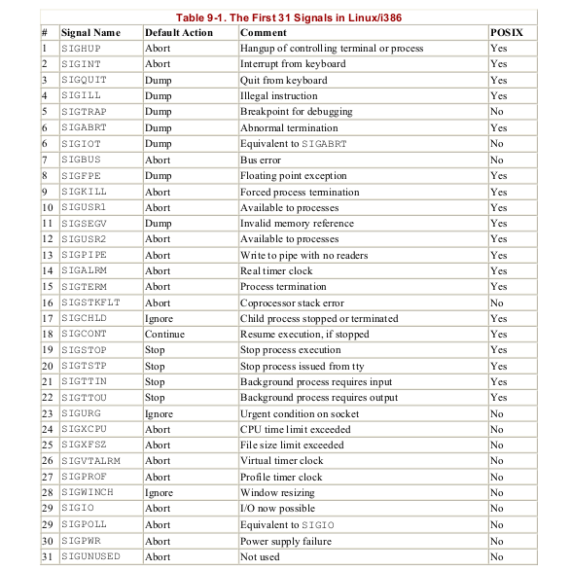
List of standard signals

Slide 8

Signal Dispositions
UNIX systems provide two ways of changing the disposition of a signal: signal() and sigaction().
Exception : A program can't handle signals of type SIGKILL, SIGSTOP.

Slide 9
Signal system call
Signal () :-
  ANSI C signal handling.
Synopsis :-
  #include <signal.h>
  typedef void (*sighandler_t )(int);
  sighandler_t signal(int signum, sighandler_t handler);
Return Value :-
  On success signal() returns previous value of signal handler.
  On error SIG_ERR or EINVAL invalid signum.

Slide 10
Drawback of signal system call
Signal function change the new action then return the previous value.
When SIGhandler is executing due to one signal but suddenly process get another signal comes kernel delivering another signal.
Using signal function not possible to inform kernel block other signal when SIGhandler is executing due to one signal.

Slide 11
Sending signal via keystroke
SIGINT : (ctrl-c)
  Signal number : 2
  Default action terminate the process.
SIGTSTP : (ctrl-z)
  Signal number : 20
  Default action terminate process.
SIGQUIT : (ctrl-\)
  Signal Number : 3
  Default action terminated the process and dump core.

Slide 12
Sending signal via commands
Kill :-
  Send a signal to process.
Synopsis :
  kill -[options] <pid> […]
Use -l or -L to list available signals. Particularly useful signals
include HUP, INT, KILL, STOP, CONT, and 0.
Example :
  kill -SIGINT 1234

Slide 13
Sending signal via function call
Function raise() :-
  raise – send signal to caller.
Synopsis :-
  #include <signal.h>
  int raise(int sig);
Return Value :-
  raise() returns zero on success and nonzero on failure.

Slide 14
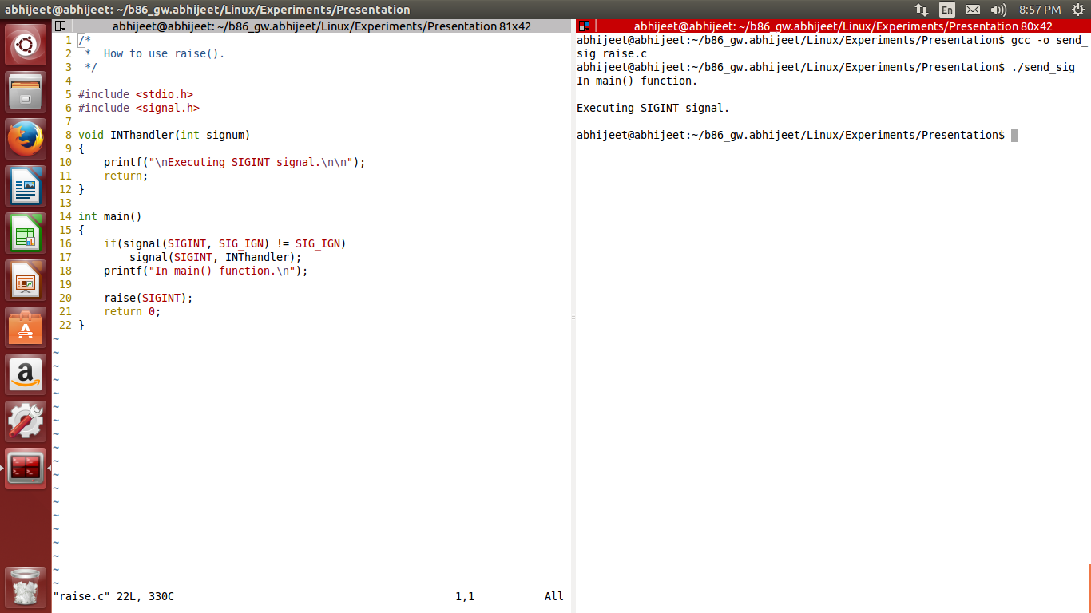
Sending signal via function call example

Slide 15
Sending signal via system call
System call kill() :-
  Send signal to process.
Synopsis :-
  #include <sys/types.h>
  #include <signal.h>
  int kill (pid_t pid, int sig);
Return Value :-
  On success (at list one signal was sent) return zero.
  On failure -1 returned , and errno is set appropriately.

Slide 16
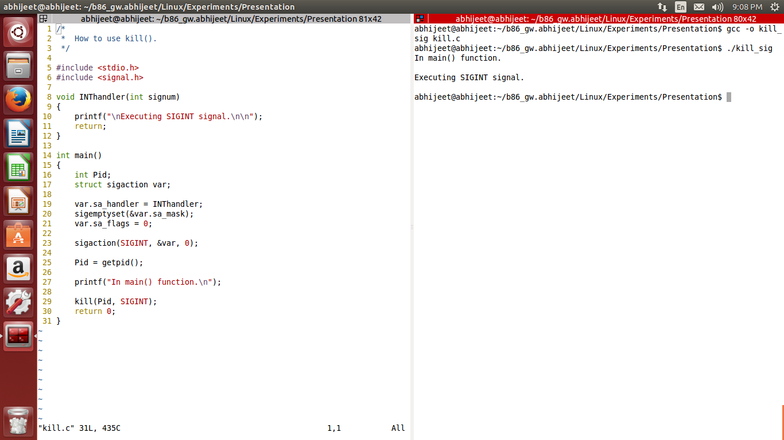
Sending signal via system call example

Slide 17
Sigaction system call
Sigaction() :-
  Examine and change a signal action.
Synopsis :-
  #include <signal.h>
  int sigaction(int signum, const struct sigaction *act, struct sigaction *oldact);
The sigaction() system call is used to change the action taken by a process, on receiving of specific signal.

Slide 18
Sigaction system call (cnt..)
Sigaction structure members :-
  struct sigaction {
    void (*sa_handler) (int);
    void (*sa_sigaction) (int, siginfo_t *, void*);
    sigset_t sa_mask;
    int sa_flags;
    void (*sa_restorer) (void);
    };
Return value :-
  sigaction() returns 0 on success ,on error returns -1.

Slide 19
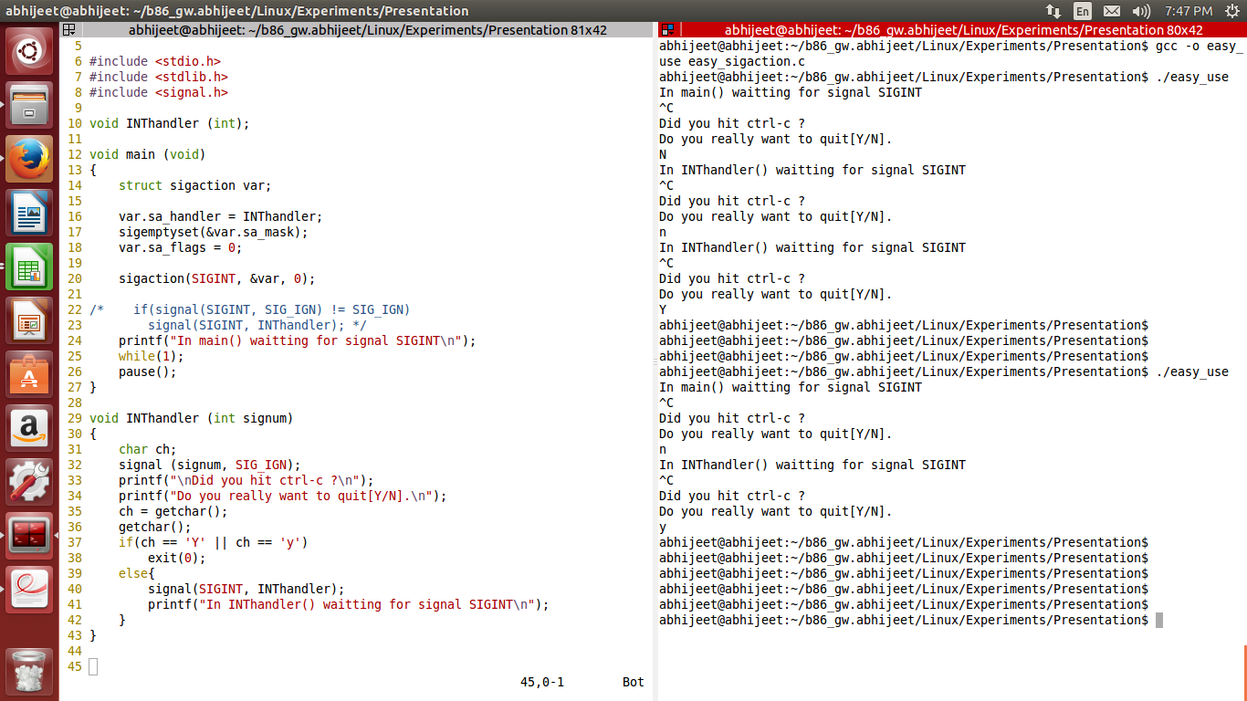
How to use sigaction()

Slide 20
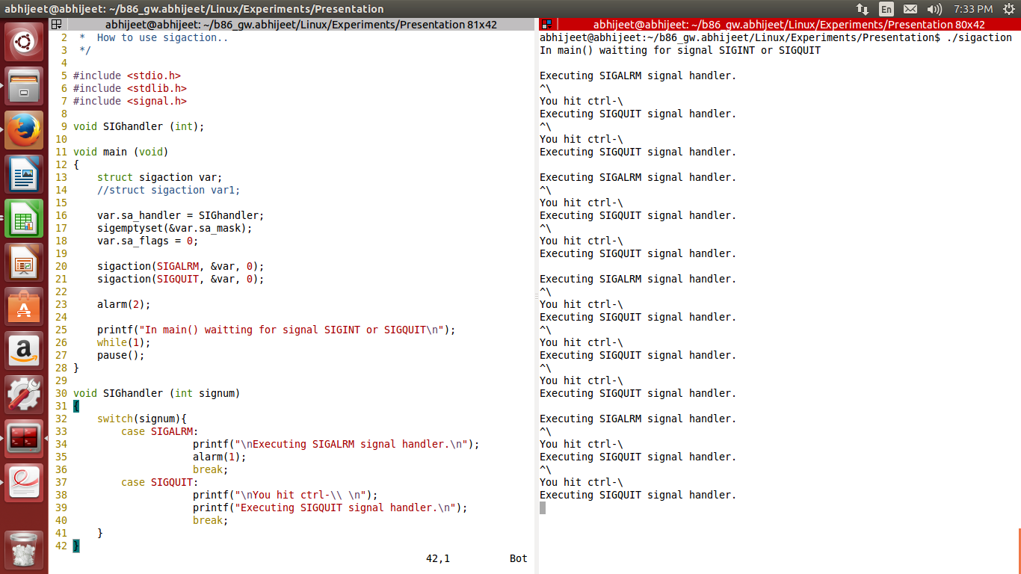
How to use sigaction() (cnt ...)

Slide 21
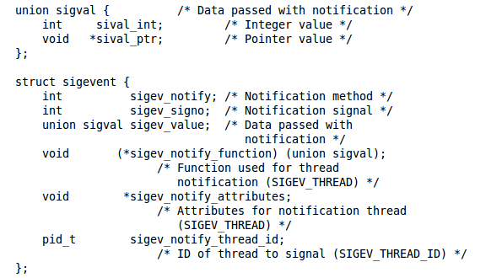
Sigevent
Sigevent :-
  Structure for notification from asynchronous routines.
Synopsis :-

Slide 22
Sigevent (cnt ...)
The sigevent structure is used by various APIs to describe the way a process is to be notified about an event. (e.g. Expiration of a timer, or the arrival of a message. )

Slide 23
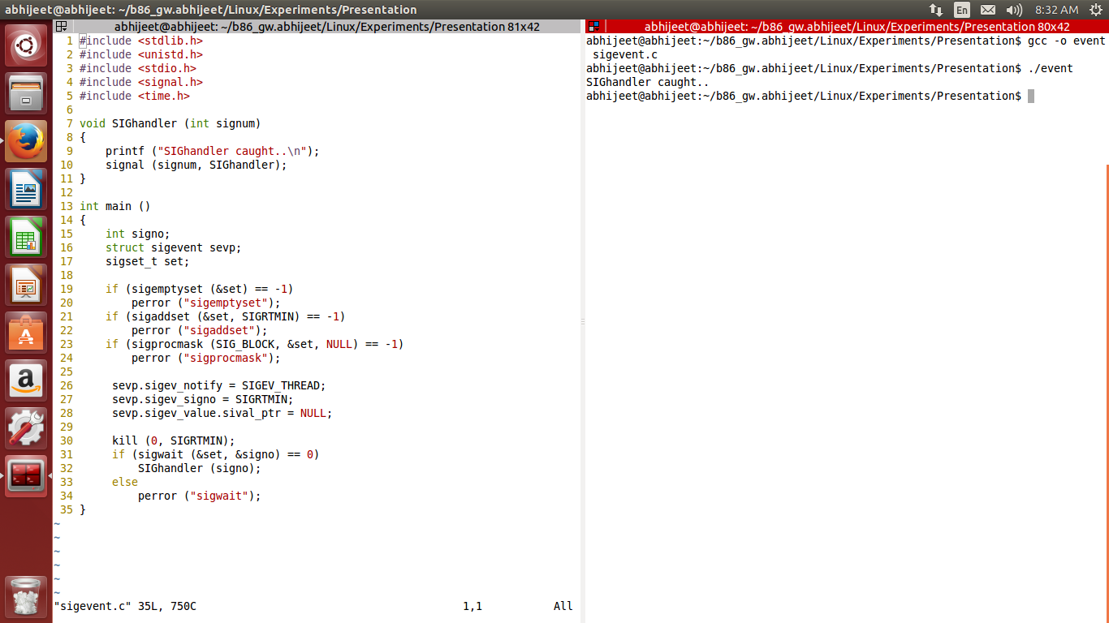
Sigevent Example

Slide 24
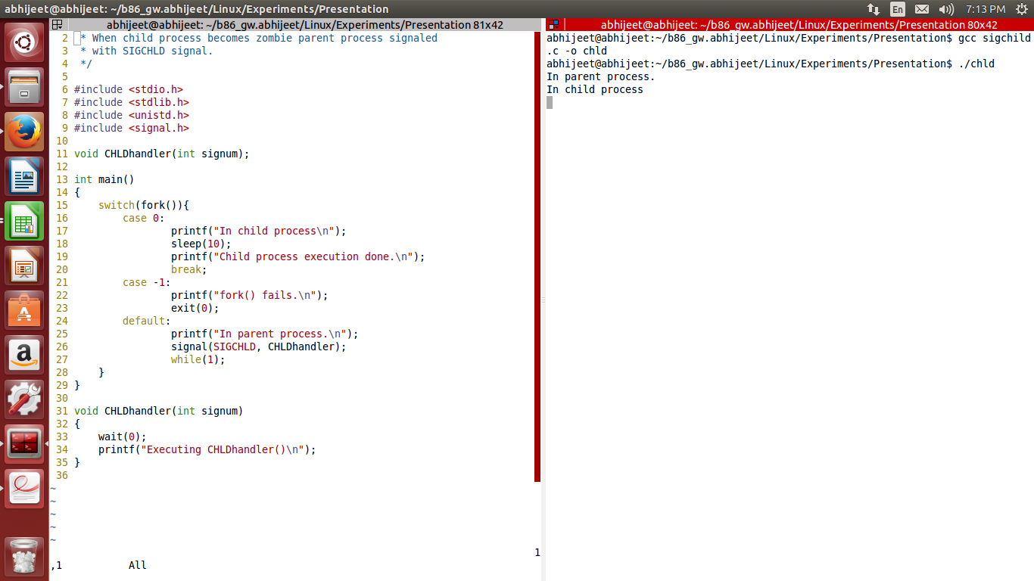
How to handle SIGCHLD signal

Slide 25
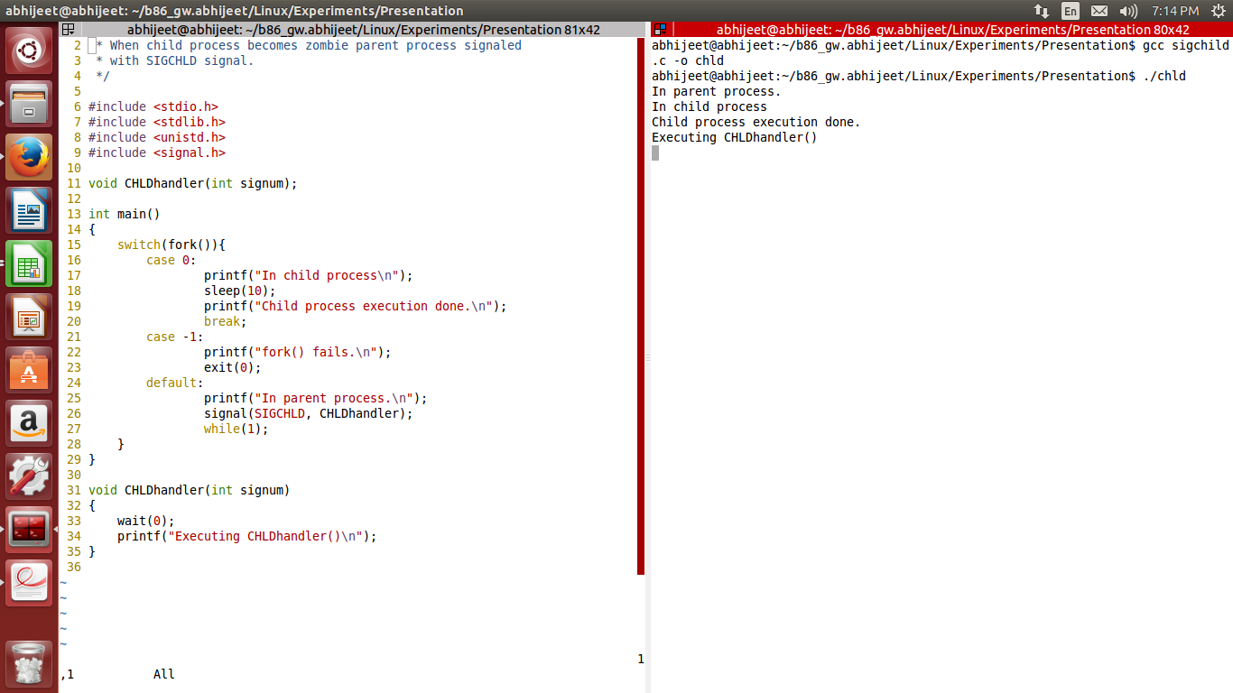
How to handle SIGCHLD signal (cnt...)

Slide 26
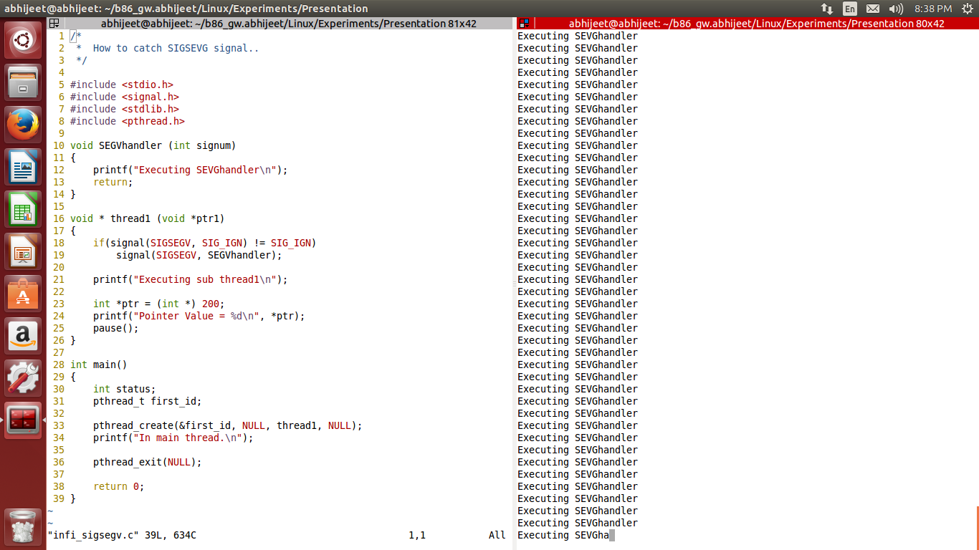
How to handle SIGSEGV signal.

Slide 27
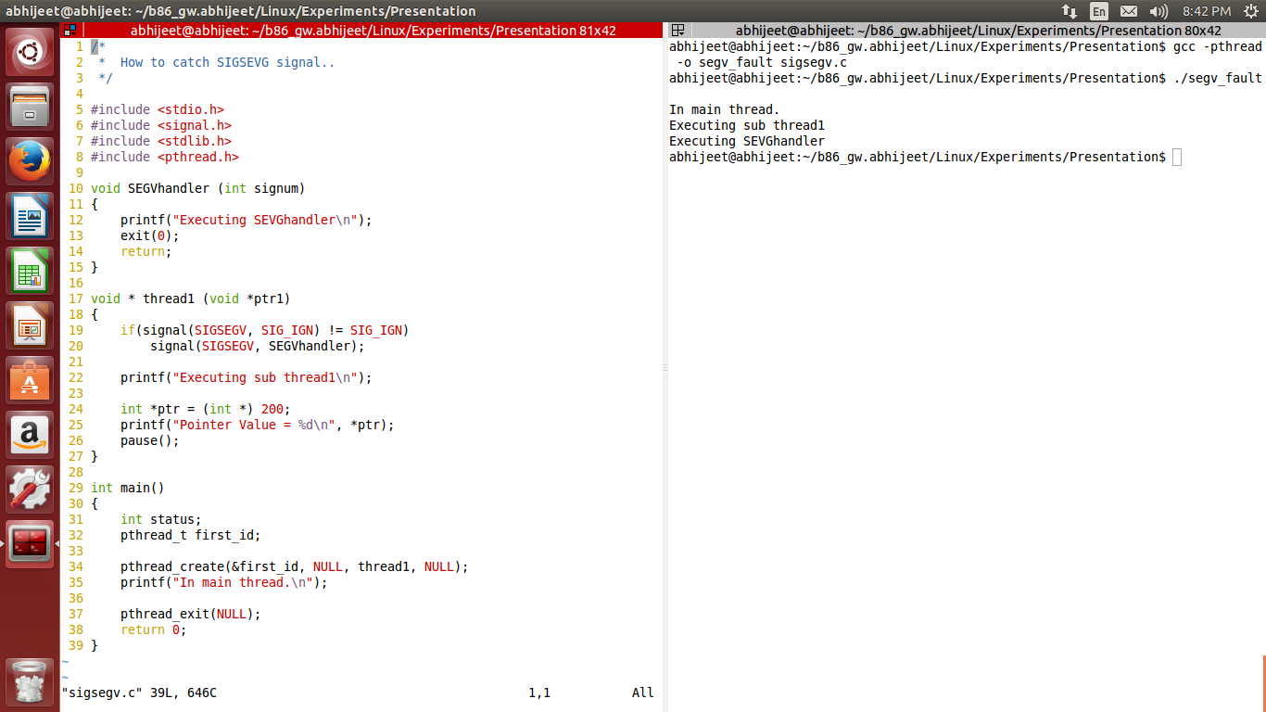
How to handle SIGSEGV (cnt...)

Slide 28
Summary
In this presentation we discuss about basics of signal.
What is signal , list of signals, default action of signals.
Signal handling using signal() and sigaction().
How create a event using sigevent.

Slide 29
References
The Linux Programming Interface.
      By Michael Kerrisk.
Understanding the Linux Kernel.
      By Daniel P. Bovet & Marco Cesati.

