Slide 1
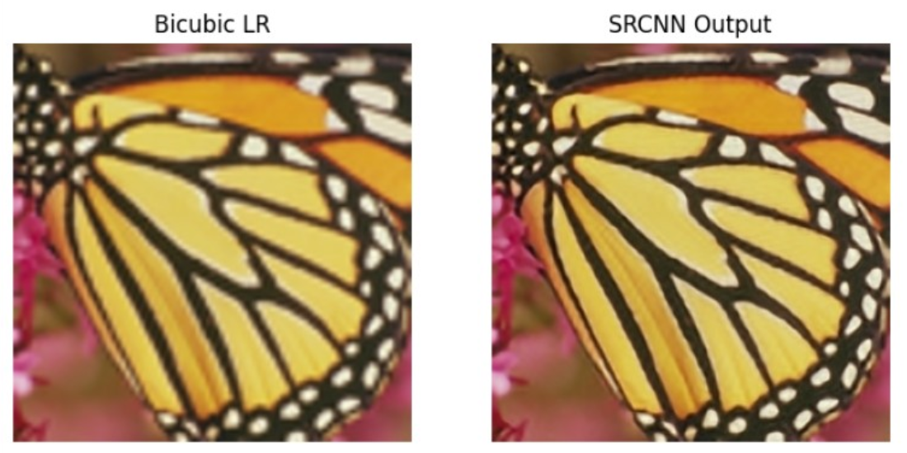
Image Super Resolution via Convolutional Neural Network
Mahendra Kausik Vankadara - PES1UG23AM163
Balasa Chenchu Purandar Puneet - PES1UG23AM906
AIML “C”

Slide 2
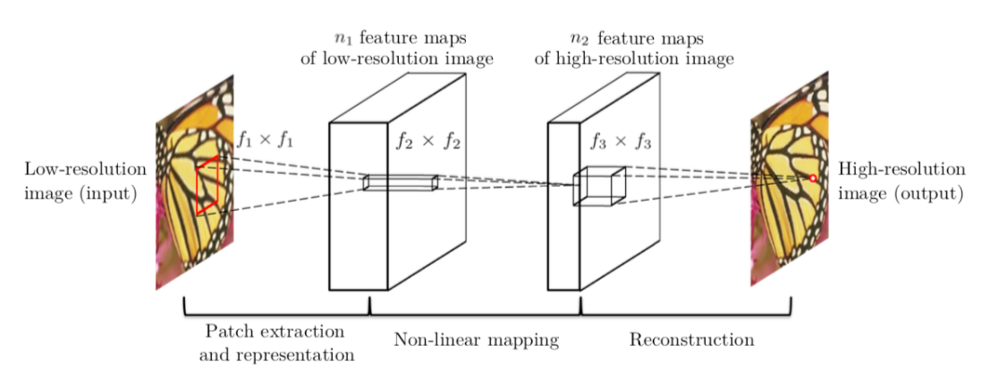
Introduction:
Low-resolution images often lack critical visual details, which can limit their utility in domains such as medical imaging, remote sensing, surveillance, and multimedia applications.
Employ the Super-Resolution Convolutional Neural Network (SRCNN) to reconstruct high-resolution images from low-resolution inputs, thereby enhancing image quality and preserving important features.

Slide 3
Dataset:
Training Dataset (91-image.h5): A collection of 91 high-quality images, preprocessed into smaller patches to train the SRCNN model for super-resolution tasks. It provides diverse textures and structures to improve model generalization.
Evaluation Dataset (Set5.h5): A benchmark dataset consisting of 5 widely used images to evaluate super-resolution performance. It allows quantitative assessment using metrics like PSNR and SSIM.

Slide 4
Model Architecture:
Input: Low Resolution Image
Layer 1(Feature Extraction):
  Convolution layer with 9×9 kernel, 1→64 channels
  Applies ReLU activation
  Extracts overlapping image patches and converts them into high-dimensional features.
Layer 2 (Non-linear Mapping):
  Convolution layer with 5×5 kernel, 64→32 channels
  Applies ReLU activation
  Learns complex non-linear relationships between low- and high-resolution representations.
Layer 3 (Reconstruction):
  Convolution layer with 5×5 kernel, 32→1 channels
  No activation function
  Reconstructs the final high-resolution image.
Output: Enhanced high-resolution image.

Slide 5
Training & Experiments:
Scale Factors and Learning Rates:
  Scale = 3 → Learning rates = 1e-3, 1e-4, 1e-5
  Scale = 2 → Learning rate = 1e-4
  Scale = 4 → Learning rate = 1e-4
Batch Size: 16
Epochs: 100
Loss Function: Mean Squared Error (MSE)
Evaluation Metric: Validation PSNR
These experiments investigate how different scales and learning rates influence the network’s validation performance.

Slide 6
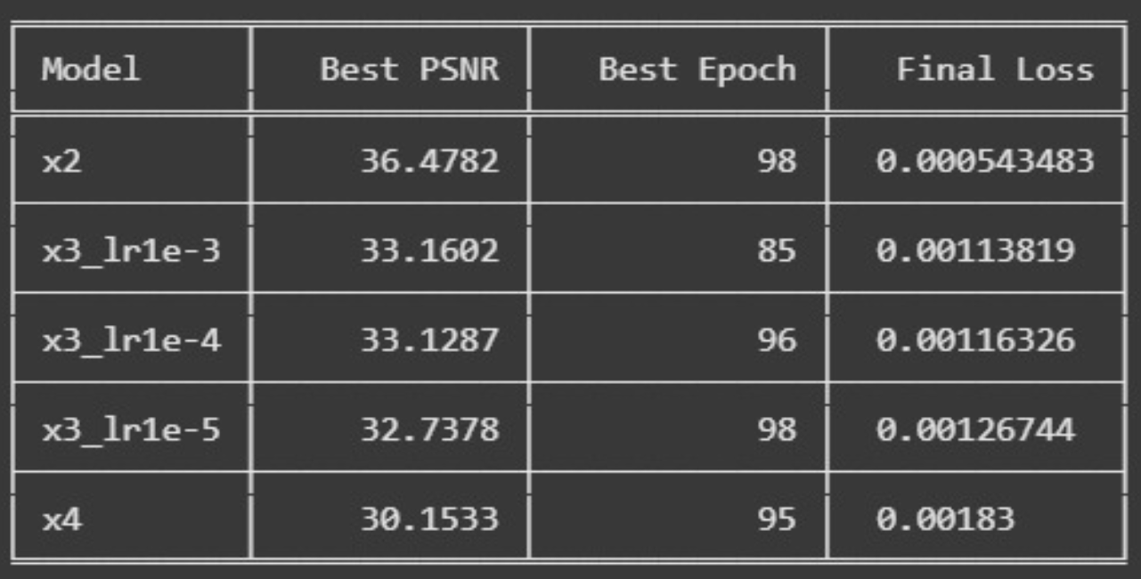
Quantitative Results:

Slide 7
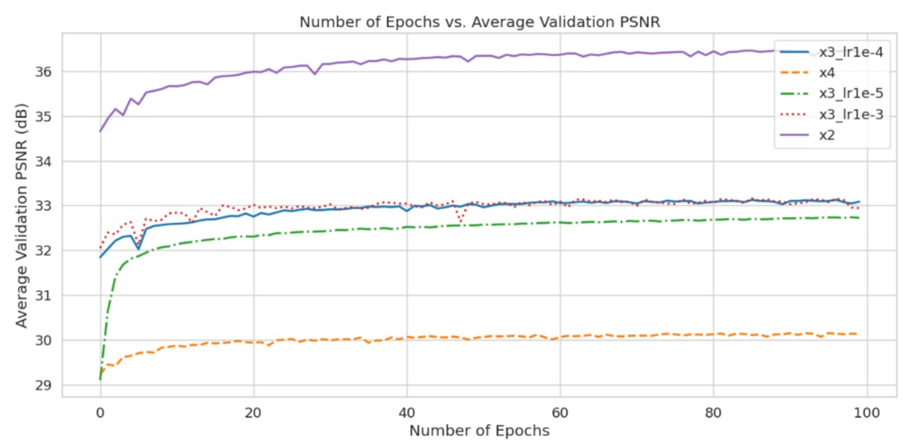
Validation PSNR vs Epochs:

Slide 8
Impact of the Upscaling Factor (Scale) is Significant:
This is the most dominant factor in the results. There is an inverse relationship between the upscaling factor and the final image quality (PSNR).
Observation: The x2 model achieves a much higher PSNR (36.48 dB) than the x3 models (~33.1 dB) and the x4 model (30.15 dB).
Reasoning: This is expected behavior. Super-resolution becomes a progressively harder task as the scale increases. An x4 model has to generate 16 pixels from a single input pixel, while an x2 model only needs to generate 4. This increased complexity naturally leads to lower reconstruction accuracy.
Evidence: The graph clearly shows three distinct performance tiers, with the purple line (x2) on top, the x3 models clustered in the middle, and the orange line (x4) at the bottom.

Slide 9
Choosing the Right Learning Rate is Crucial:
By comparing the three x3 models, we can see the effect of the learning rate.
Observation: A learning rate of 10⁻⁵ is too low. It learns significantly slower than the others (the green line on the graph rises more gradually) and converges to a lower overall PSNR (32.74 dB).
Observation: The learning rates of 10⁻³ and 10⁻⁴ produce very similar, near-optimal results. The 10⁻³ model achieves a slightly higher peak PSNR (33.16 dB vs 33.13 dB), but they are statistically very close.
Conclusion: For the x3 model, a learning rate of 10⁻⁴ appears to be a very good choice, offering a great balance of fast convergence and high performance. While 10⁻³ was marginally better here, a slightly lower rate like 10⁻⁴ is often considered "safer" and more stable.

Slide 10
Loss Correlates with PSNR:
Observation: The "Final Loss" values in the table align with the PSNR results. The model with the highest PSNR (x2) has the lowest loss (0.00054), while the model with the lowest PSNR (x4) has the highest loss (0.00183).
Reasoning: This confirms that the loss function was a good indicator of model performance, as minimizing the loss successfully maximized the image quality metric (PSNR).

Slide 11
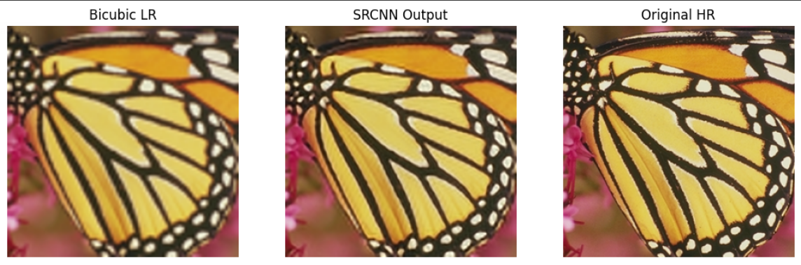
Results:

Slide 12

Results:

Slide 13
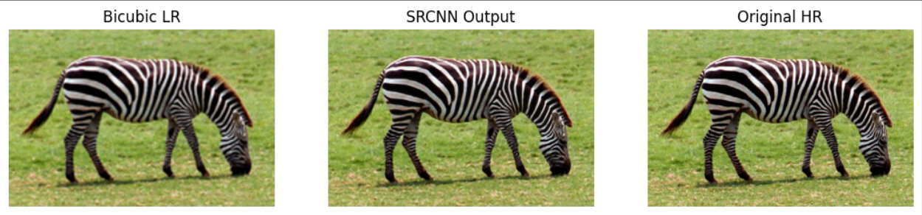
Results:

Slide 14
Thank You

