Slide 1
Taxi Trip Data Analytics
Prepared By
Mahendra Sahu

Slide 2
Requirement
Find the top 10 most frequent routes during the last 30 minutes.
A route is represented by a starting grid cell and an ending grid cell.

Slide 3




Solution
TaxiDataProducer (Testing)
TaxiDataStream
Demo

Slide 4
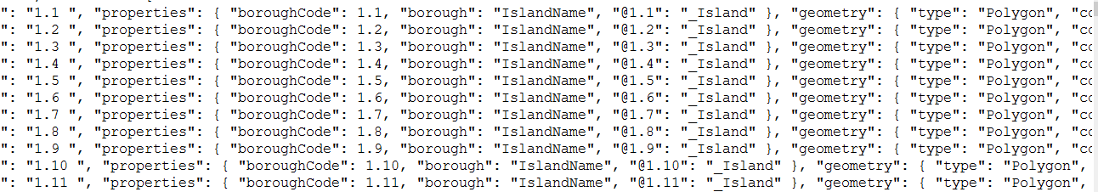
First step
Developed GeoJson config file which has Cell ID and coordinates mapping
Code location: TaxiDataStream\src\main\resources\ cell_grid.geojson

Slide 5
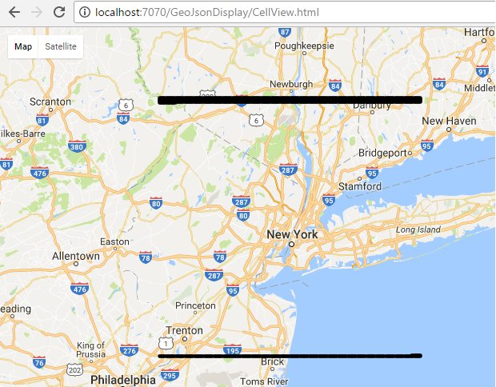
Second step
In order to validate the coordinate and Cell ID, first few rows and last row displayed on google map

Slide 6
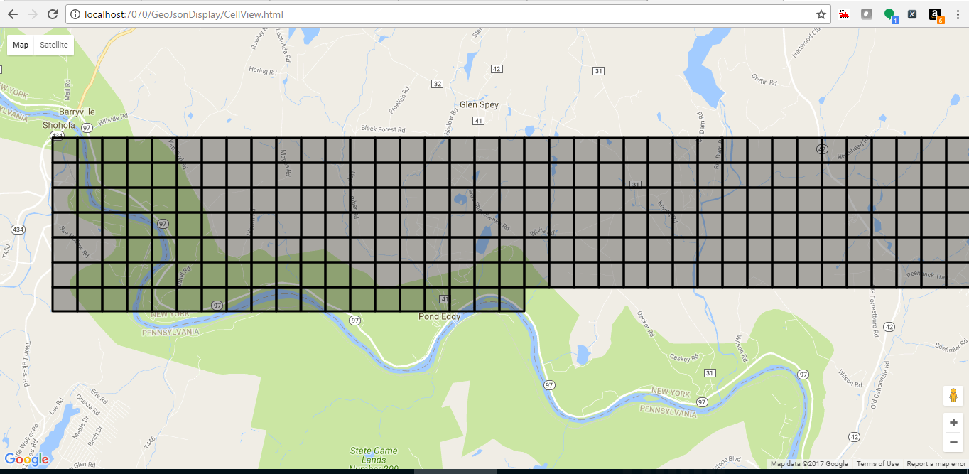
Second step
This is just example of 10 rows however geojson config file will have 300x300 Cell ID and respective coordinates

Slide 7
Third step
Configured Kafka and Written Kafka Producer
As of now Kafka Topic has only one partition
$BASE_DIR/TaxiDataProducer/bin

Slide 8
Fourth step
Written Spark Streaming Code
Using spark streaming Window function last 30 minute messages are being passed to SQL context
SQL context execute query and display the output on console
As well as store the output into Table
As part of final solution I need to write output result on D3js UI using socket.io and nodeJs.
$BASE_DIR/TaxiDataStream/bin

Slide 9
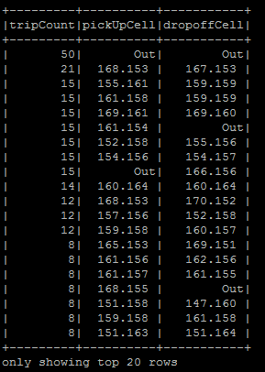
Fourth step
Sample output

Slide 10
D3JS Output (Live Update)

Slide 11
Application Installation Guide

